Slide 1
基于沙子本构的扰动流计算与相图讨论
Haoyu Lu
Nov. 24 ,2023

Slide 2
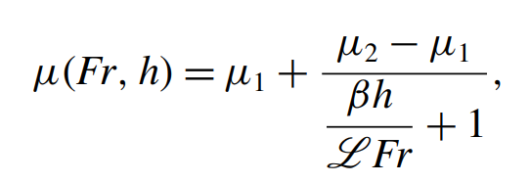


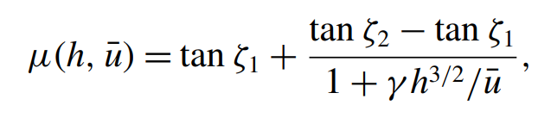
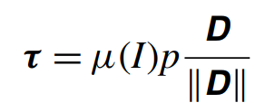
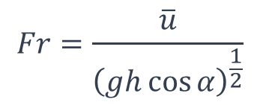
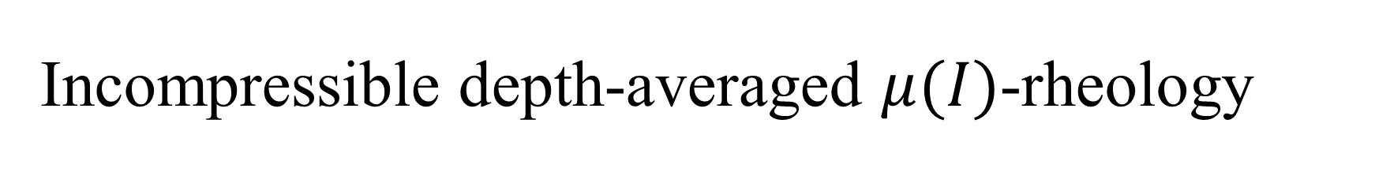
Incompressible depth-averaged $μ(I)$-rheology
$$Fr=\frac{\overline{u}}{{\left(gh\cos{α}\right)}^{\frac{1}{2}}}$$
代入governing eqns.
[1] Gray, J., & Edwards, A. (2014). A depth-averaged μ(I)-rheology for shallow granular free-surface flows. Journal of Fluid Mechanics, 755, 503-534. doi:10.1017/jfm.2014.450
[2] Barker T., Schaeffer D. G., Shearer M. and Gray J. M. N. T. 2017 Well-posed continuum equations for granular flow with compressibility and μ(I)-rheology Proc. R. Soc. http://doi.org/10.1098/rspa.2016.0846

Slide 3
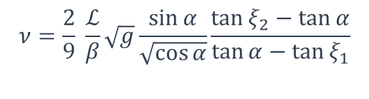
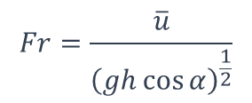
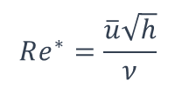
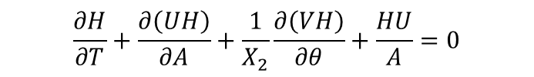
Non-dimensional depth-averaged governing eqns.
Pressure gradient
Shear stress
$$\frac{∂H}{∂T}+\frac{∂\left(UH\right)}{∂A}+\frac{1}{X_{2}}\frac{∂\left(VH\right)}{∂θ}+\frac{HU}{A}=0$$
Gravity
Bed shear stress
$$\frac{∂U}{∂T}+CU\frac{∂U}{∂A}+\frac{1}{X_{2}}U\frac{∂V}{∂θ}+\frac{1}{X_{2}}\left(U^{2}−V^{2}\right)\cos{α}=\frac{1}{Fr^{2}}\left(\tan{α}−μ_{u}\right)−\frac{1}{Fr^{2}}\frac{∂H}{∂A}+\frac{1}{Re^{∗}}\frac{1}{H}\left[\frac{∂}{∂A}\left(H^{\frac{3}{2}}\frac{∂U}{∂A}\right)+{\left(\frac{1}{X_{2}}\right)}^{2}\frac{∂}{∂θ}\left(H^{\frac{3}{2}}\frac{∂U}{∂θ}\right)\right]$$
$$\frac{∂V}{∂T}+U\frac{∂V}{∂A}+\frac{1}{X_{2}}CV\frac{∂V}{∂θ}=−\frac{1}{Fr^{2}}μ_{v}−\frac{1}{Fr^{2}}\frac{1}{X_{2}}\frac{∂H}{∂θ}+\frac{1}{Re^{∗}}\frac{1}{H}\left[\frac{∂}{∂A}\left(H^{\frac{3}{2}}\frac{∂V}{∂A}\right)+{\left(\frac{1}{X_{2}}\right)}^{2}\frac{∂}{∂θ}\left(H^{\frac{3}{2}}\frac{∂V}{∂θ}\right)\right]$$
$$Fr=\frac{\overline{u}}{{\left(gh\cos{α}\right)}^{\frac{1}{2}}}$$
$$Re^{∗}=\frac{\overline{u}\sqrt{h}}{ν}$$
$$ν=\frac{2}{9} \frac{ℒ}{β}\sqrt{g}\frac{\sin{α}}{\sqrt{\cos{α}}}\frac{\tan{ξ_{2}}−\tan{α}}{\tan{α}−\tan{ξ_{1}}}$$

Slide 4
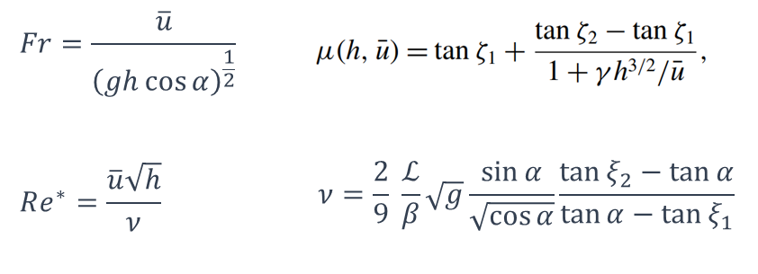
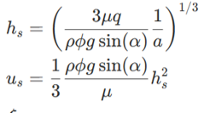
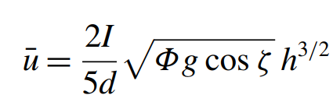
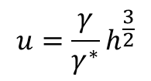
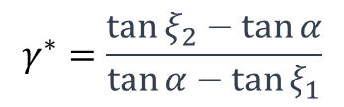

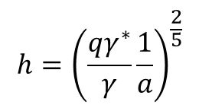


Non-dimensional depth-averaged governing eqns. --- Base flow
$$γ=\frac{β}{ℒ}\sqrt{g\cos{α}}$$
$$\frac{∂\left(UH\right)}{∂A}+\frac{HU}{A}=0$$
$$CU\frac{∂U}{∂A}+\frac{1}{X_{2}}\left(U^{2}\right)\cos{α}=\frac{1}{Fr^{2}}\left(\tan{α}−μ_{u}\right)−\frac{1}{Fr^{2}}\frac{∂H}{∂A}+\frac{1}{Re^{∗}}\frac{1}{H}\left[\frac{∂}{∂A}\left(H^{\frac{3}{2}}\frac{∂U}{∂A}\right)\right]$$
$$γ^{∗}=\frac{\tan{ξ_{2}}−\tan{α}}{\tan{α}−\tan{ξ_{1}}}$$
In water model
$$A→∞$$
$$h={\left(\frac{qγ^{∗}}{γ}\frac{1}{a}\right)}^{\frac{2}{5}}$$
Recall that
返回代入连续方程
$$u=\frac{γ}{γ^{∗}}h^{\frac{3}{2}}$$
Agree with Bagnold velocity result
[3] GDR MiDi. On dense granular flows. Eur. Phys. J. E 14, 341–365 (2004). https://doi.org/10.1140/epje/i2003-10153-0

Slide 5

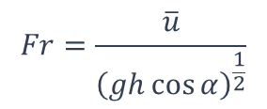
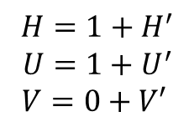
Non-dimensional depth-averaged governing eqns. --- Perturbation flow
Pressure gradient
Shear stress
$$\frac{∂H}{∂T}+\frac{∂\left(UH\right)}{∂A}+\frac{1}{X_{2}}\frac{∂\left(VH\right)}{∂θ}+\frac{HU}{A}=0$$
Gravity
Bed shear stress
$$\frac{∂U}{∂T}+CU\frac{∂U}{∂A}+\frac{1}{X_{2}}U\frac{∂V}{∂θ}+\frac{1}{X_{2}}\left(U^{2}−V^{2}\right)\cos{α}=\frac{1}{Fr^{2}}\left(\tan{α}−μ_{u}\right)−\frac{1}{Fr^{2}}\frac{∂H}{∂A}+\frac{1}{Re^{∗}}\frac{1}{H}\left[\frac{∂}{∂A}\left(H^{\frac{3}{2}}\frac{∂U}{∂A}\right)+{\left(\frac{1}{X_{2}}\right)}^{2}\frac{∂}{∂θ}\left(H^{\frac{3}{2}}\frac{∂U}{∂θ}\right)\right]$$
$$\frac{∂V}{∂T}+U\frac{∂V}{∂A}+\frac{1}{X_{2}}CV\frac{∂V}{∂θ}=−\frac{1}{Fr^{2}}μ_{v}−\frac{1}{Fr^{2}}\frac{1}{X_{2}}\frac{∂H}{∂θ}+\frac{1}{Re^{∗}}\frac{1}{H}\left[\frac{∂}{∂A}\left(H^{\frac{3}{2}}\frac{∂V}{∂A}\right)+{\left(\frac{1}{X_{2}}\right)}^{2}\frac{∂}{∂θ}\left(H^{\frac{3}{2}}\frac{∂V}{∂θ}\right)\right]$$
$$H=1+H^{′}$$
$$U=1+U^{′}$$
$$V=0+V′$$
$$Fr=\frac{\overline{u}}{{\left(gh\cos{α}\right)}^{\frac{1}{2}}}$$
$$Re^{∗}=\frac{\overline{u}\sqrt{h}}{ν}$$
$$ν=\frac{2}{9} \frac{ℒ}{β}\sqrt{g}\frac{\sin{α}}{\sqrt{\cos{α}}}\frac{\tan{ξ_{2}}−\tan{α}}{\tan{α}−\tan{ξ_{1}}}$$

Slide 6
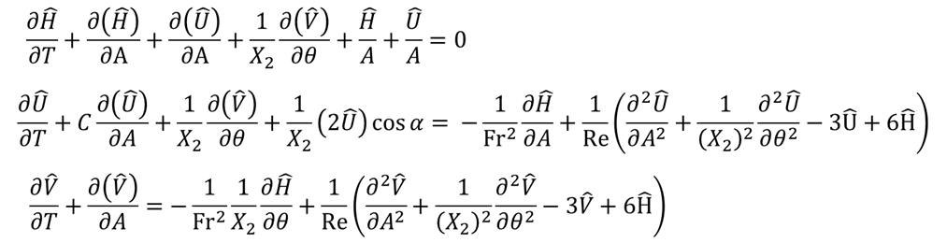
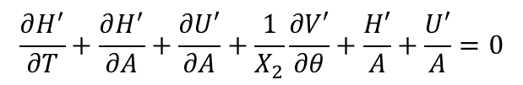

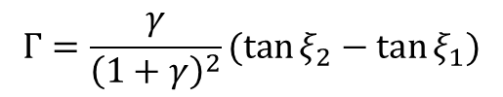
Non-dimensional depth-averaged governing eqns. --- Perturbation flow
$$H=1+H^{′}$$
$$U=1+U^{′}$$
$$V=0+V′$$
$$\frac{∂H^{′}}{∂T}+\frac{∂H^{′}}{∂A}+\frac{∂U′}{∂A}+\frac{1}{X_{2}}\frac{∂V′}{∂θ}+\frac{H′}{A}+\frac{U′}{A}=0$$
$$\frac{∂U′}{∂T}+C\frac{∂U′}{∂A}+\frac{1}{X_{2}}\frac{∂V′}{∂θ}+\frac{1}{X_{2}}2U^{′}\cos{α}=−\frac{1}{Fr^{2}}\frac{∂H^{′}}{∂A}+\frac{1}{Re^{∗}}\left[\frac{∂}{∂A}\left(\frac{∂U^{′}}{∂A}\right)+{\left(\frac{1}{X_{2}}\right)}^{2}\frac{∂}{∂θ}\left(\frac{∂U^{′}}{∂θ}\right)\right]+\frac{Γ}{Fr^{2}}\left(−U′+\frac{3}{2}H′\right)$$
$$\frac{∂V′}{∂T}+\frac{∂V′}{∂A}=−\frac{1}{Fr^{2}}\frac{1}{X_{2}}\frac{∂H′}{∂θ}+\frac{1}{Re^{∗}}\left[\frac{∂}{∂A}\left(\frac{∂V′}{∂A}\right)+{\left(\frac{1}{X_{2}}\right)}^{2}\frac{∂}{∂θ}\left(\frac{∂V′}{∂θ}\right)\right]+\frac{Γ}{Fr^{2}}\left(−V′+\frac{3}{2}H′\right)$$
In water model
$$Γ=\frac{γ}{{\left(1+γ\right)}^{2}}(\tan{ξ_{2}}−\tan{ξ_{1}})$$
Recall that
$$Fr=\frac{\overline{u}}{{\left(gh\cos{α}\right)}^{\frac{1}{2}}}$$
$$Re^{∗}=\frac{\overline{u}\sqrt{h}}{ν}$$
$$ν=\frac{2}{9} \frac{ℒ}{β}\sqrt{g}\frac{\sin{α}}{\sqrt{\cos{α}}}\frac{\tan{ξ_{2}}−\tan{α}}{\tan{α}−\tan{ξ_{1}}}$$

Slide 7
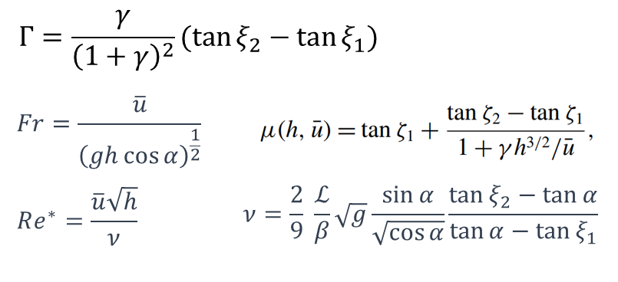
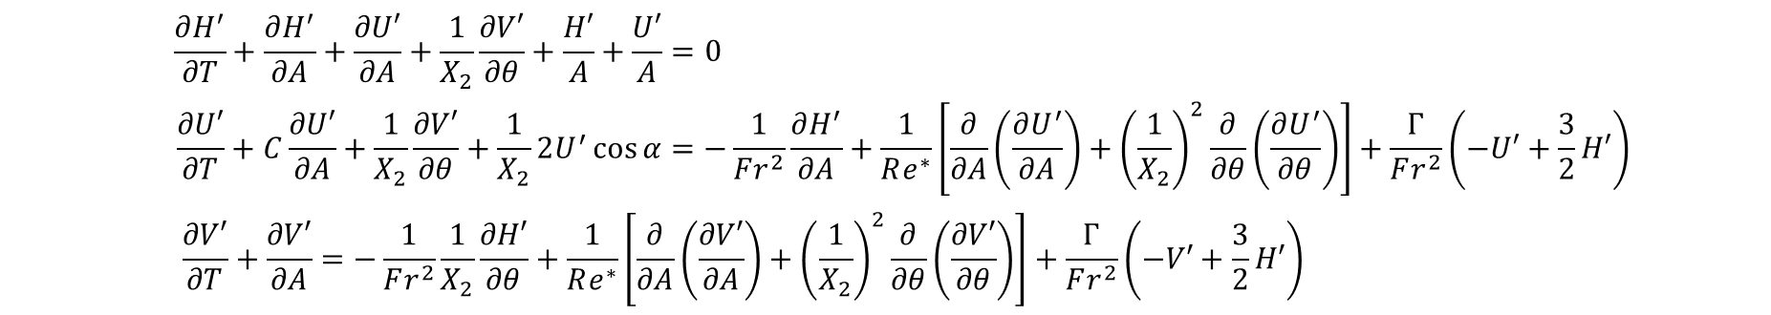
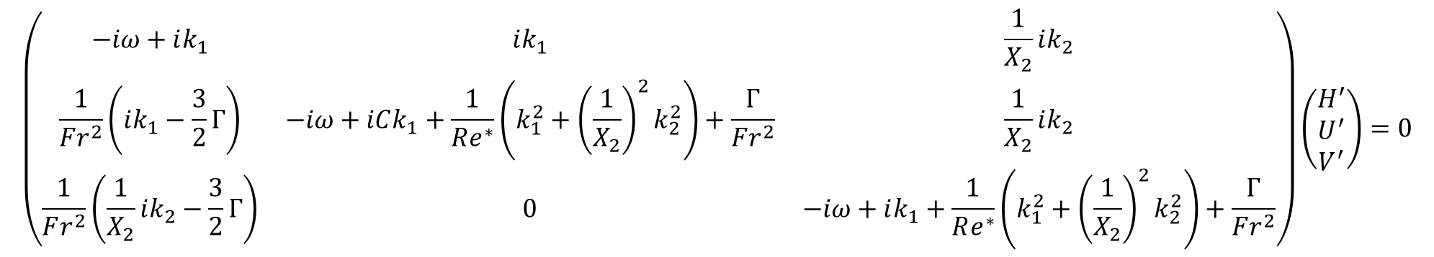




Non-dimensional depth-averaged governing eqns. --- Perturbation flow
$$H=1+H^{′}$$
$$U=1+U^{′}$$
$$V=0+V′$$
$$H^{′}=A_{H}e^{i(k_{1}A+k_{2}θ−ωT)}$$
$$U^{′}=A_{U}e^{i(k_{1}A+k_{2}θ−ωT)}$$
$$V^{′}=A_{V}e^{i(k_{1}A+k_{2}θ−ωT)}$$
$$\left(\begin{matrix}−iω+ik_{1} & ik_{1} & \frac{1}{X_{2}}ik_{2} \\ \frac{1}{Fr^{2}}\left(ik_{1}−\frac{3}{2}Γ\right) & −iω+iCk_{1}+\frac{1}{Re^{∗}}\left(k_{1}^{2}+{\left(\frac{1}{X_{2}}\right)}^{2}k_{2}^{2}\right)+\frac{Γ}{Fr^{2}} & \frac{1}{X_{2}}ik_{2} \\ \frac{1}{Fr^{2}}\left(\frac{1}{X_{2}}ik_{2}−\frac{3}{2}Γ\right) & 0 & −iω+ik_{1}+\frac{1}{Re^{∗}}\left(k_{1}^{2}+{\left(\frac{1}{X_{2}}\right)}^{2}k_{2}^{2}\right)+\frac{Γ}{Fr^{2}}\end{matrix}\right)\left(\begin{matrix}H^{′} \\ U^{′} \\ V^{′}\end{matrix}\right)=0$$

Slide 8
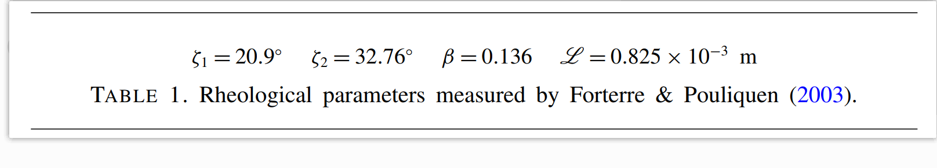
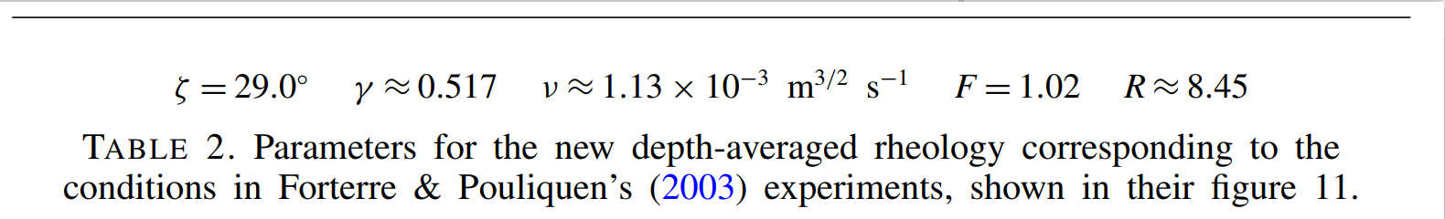
计算选用参数
[1] Gray, J., & Edwards, A. (2014). A depth-averaged μ(I)-rheology for shallow granular free-surface flows. Journal of Fluid Mechanics, 755, 503-534. doi:10.1017/jfm.2014.450

Slide 9
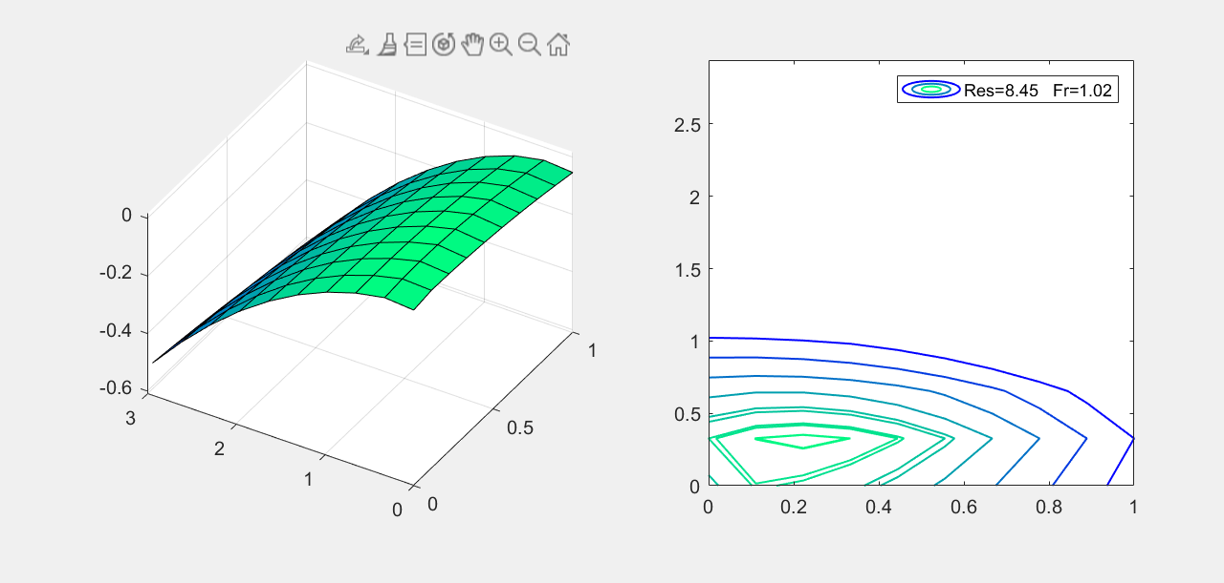
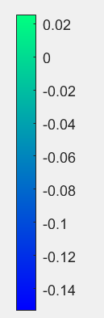
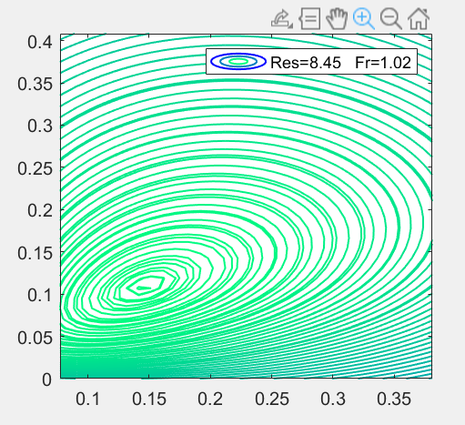
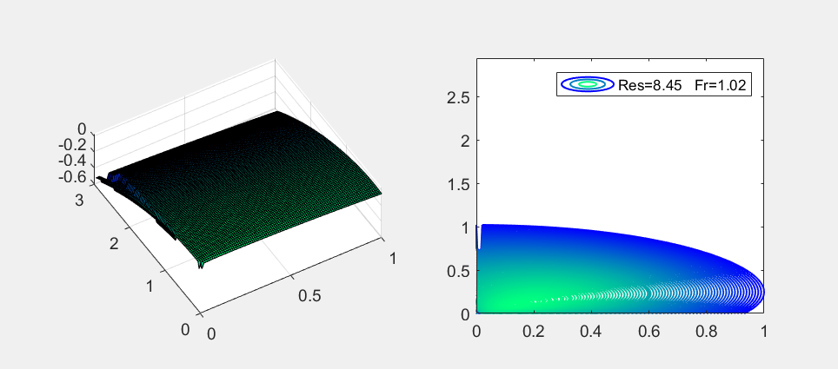












增长率最高处不再位于x轴！
$$ω_{I}$$
$$k_{2}$$
$$k_{1}$$
Zoom in
$$k_{2}$$
$$k_{1}$$
$$k_{2}$$
$$ω_{I}$$
$$k_{2}$$
$$k_{2}$$
$$k_{1}$$
$$k_{1}$$
$$k_{1}$$

Slide 10
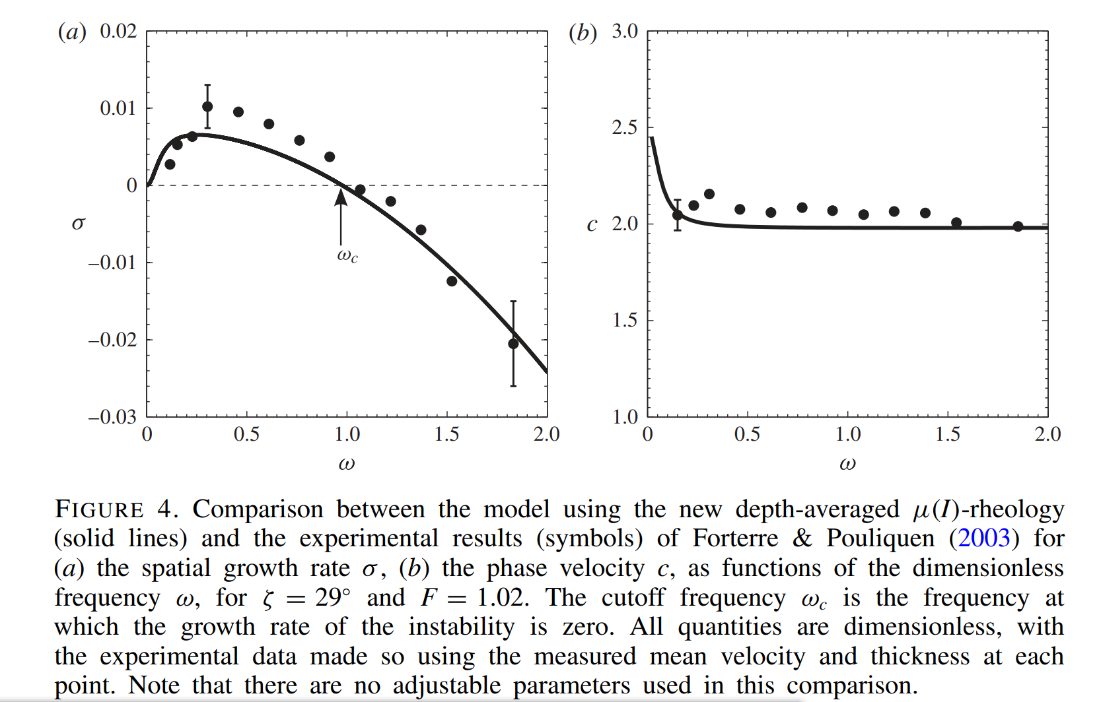
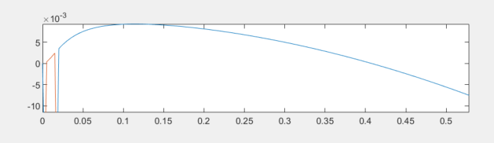
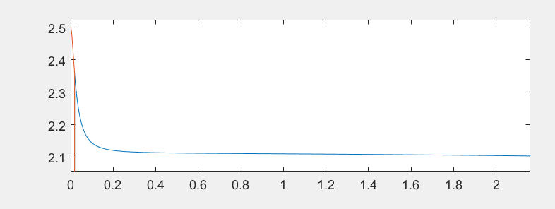
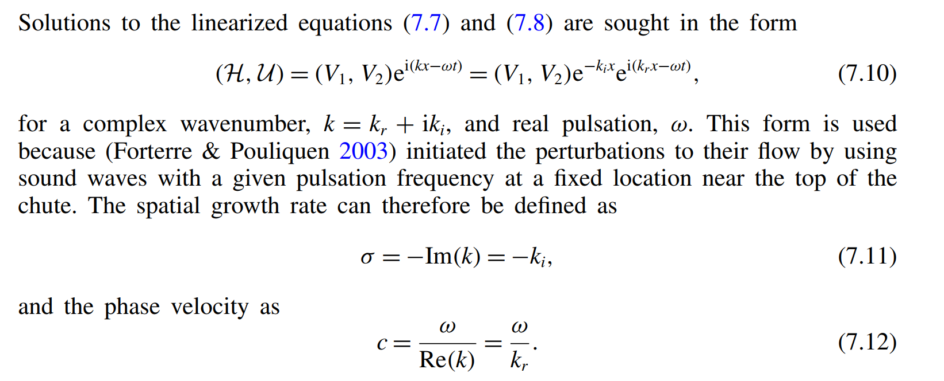
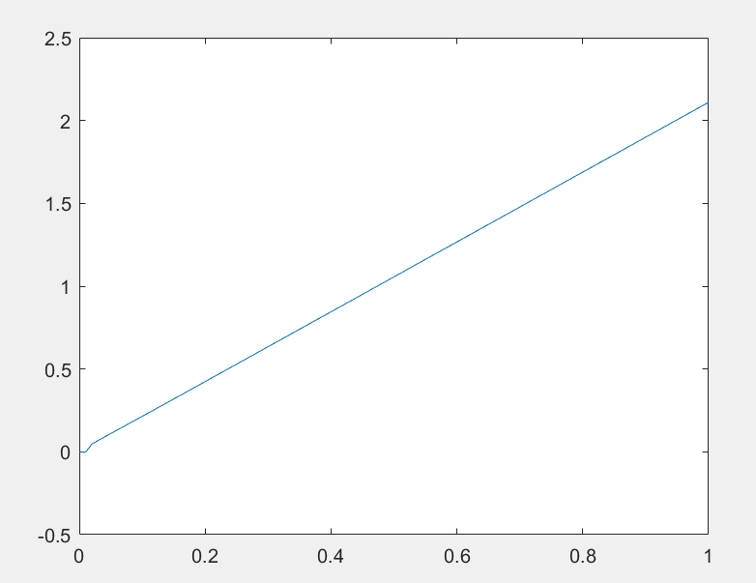







$$k_{2}=0$$
$$ω_{I}$$
$$k_{1}$$
$${\frac{ω_{R}}{k_{1}}≡C}_{R}$$
$$k_{1}$$
$$ω_{R}$$
$$k_{1}$$

Slide 11
备忘

