Slide 1
Background of Sandpile phenomenon
Haoyu Lu
2023.12.1

Slide 2
Ref
[1]Altshuler E, Ramos O, Martínez E, et al. Sandpile formation by revolving rivers[J]. Physical review letters, 2003, 91(1): 014501.
[2]Xiang-Zhao Kong , et al. Kinetic energy sandpile model for conical sandpile development by revolving rivers, Physics Letters A, Volume 348, Issues 3–6, 2006.
[3]Altshuler E, Toussaint R, Martínez E, et al. Revolving rivers in sandpiles: from continuous to intermittent flows[J]. Physical Review E, 2008, 77(3): 031305.
[4]Mandal, S., & Khakhar, D. (2019). Granular surface flow on an asymmetric conical heap. Journal of Fluid Mechanics, 865, 41-59. doi:10.1017/jfm.2019.26

Slide 3
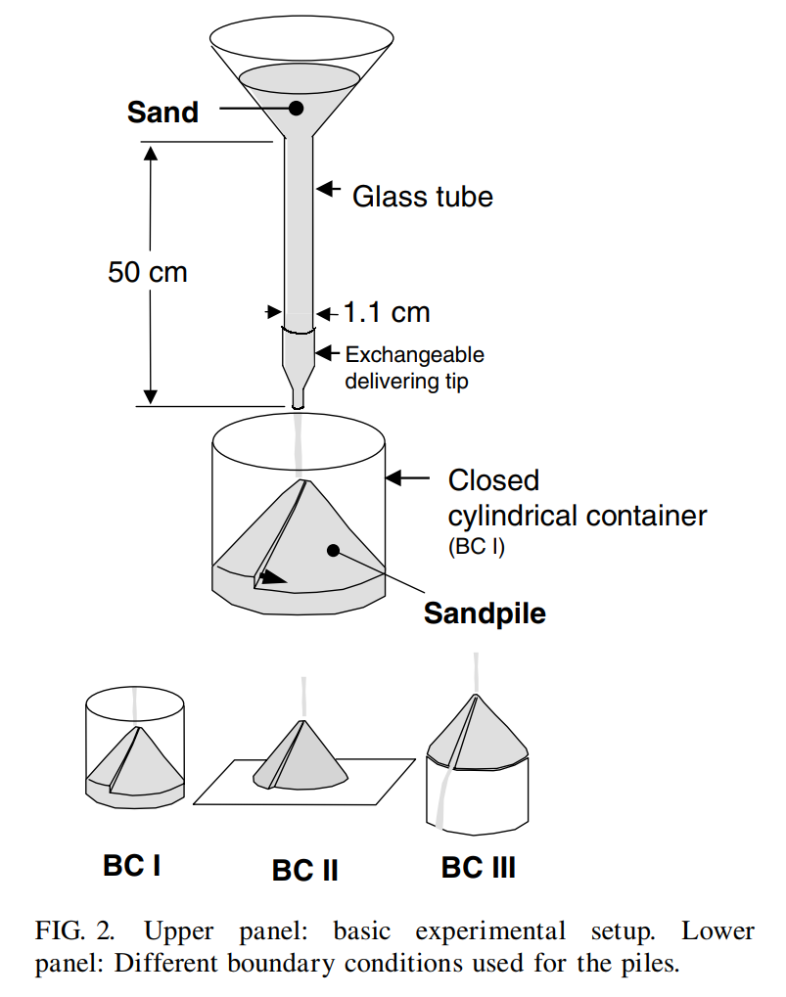



Altshuler2003: Sandpile formation
Experimental observation
Three different boundary conditions
BCI: cylinder container: Fixed radius $r_{I}$ of pile
BCII: Flat paper: Growing radius $r_{I}$ of pile
BCIII: Open boundary: Fixed radius $r_{I}$ of pile

Slide 4
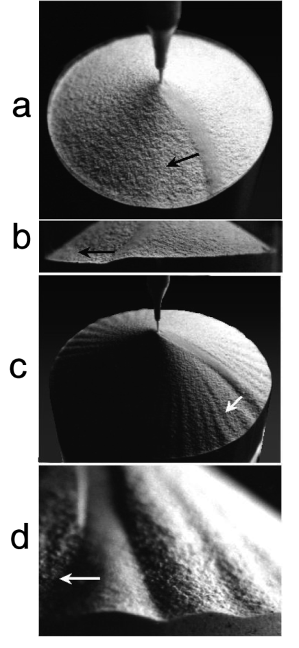
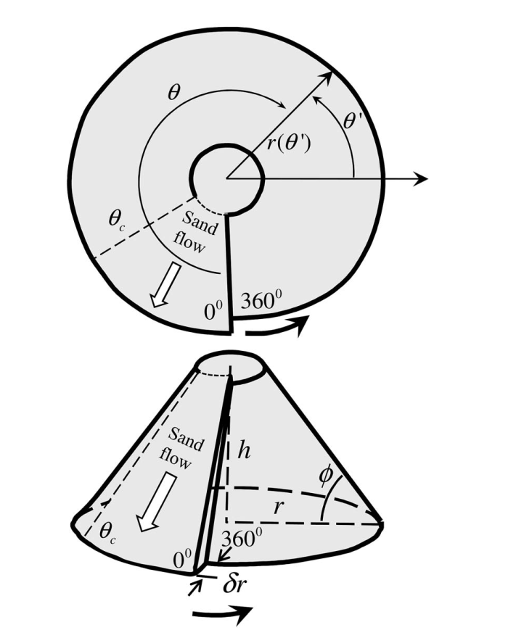




Altshuler2003: Sandpile formation
BCI: cylinder container: Fixed radius $r_{I}$ of pile
BCII: Flat paper: Growing radius $r_{I}$ of pile
Repose angle $θ_{c}\sim 33°$
$$r_{I}$$
3 cm
6 cm
No stable revolving rivers were observed
‘Continuous’ revolving rivers
‘Intermittent’ revolving rivers
a,b
c,d

Slide 5
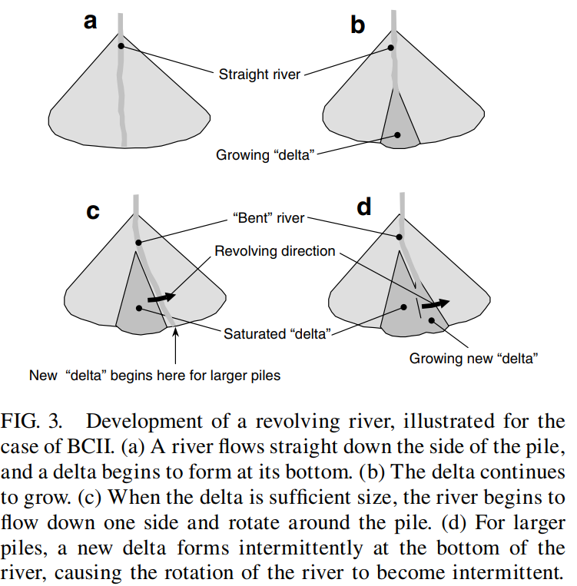

Altshuler2003: Sandpile formation
BCI: cylinder container: Fixed radius $r_{I}$ of pile
BCII: Flat paper: Growing radius $r_{I}$ of pile
Repose angle $θ_{c}\sim 33°$
$$r_{I}$$
3 cm
6 cm
No stable revolving rivers were observed
‘Continuous’ revolving rivers
‘Intermittent’ revolving rivers
BCIII: Open boundary: Fixed radius $r_{I}$ of pile
As soon as the pile grows to reach the radius of the base, the river stops revolving. The sand then drops off the pile when it reaches the edge.
In contrast to revolving rivers, the nonrevolving river is straight. For BCIII there is no possibility to built up a delta, so no bending of the river nor rotation takes place.

Slide 6
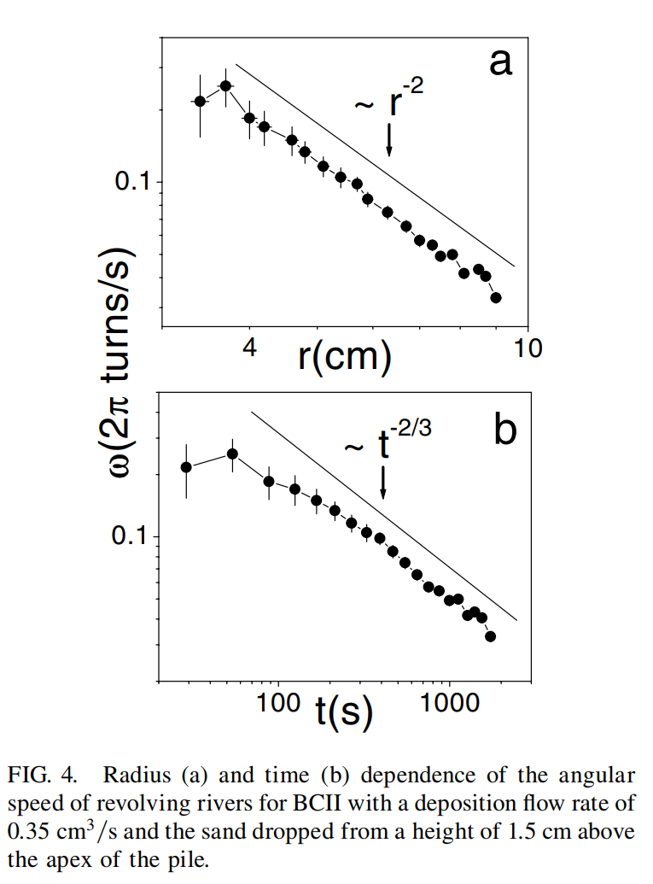
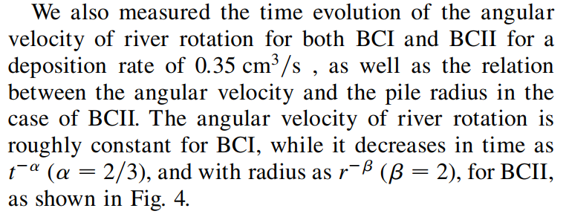




Altshuler2003: Sandpile formation
Repose angle $θ_{c}\sim 33°$
BCI: cylinder container: Fixed radius $r_{I}$ of pile
BCII: Flat paper: Growing radius $r_{I}$ of pile
$$r_{I}$$
3 cm
6 cm
No stable revolving rivers were observed
‘Continuous’ revolving rivers
‘Intermittent’ revolving rivers
Pile radius $r$
Angular velocity $ω$
Evolution time $t$

Slide 7
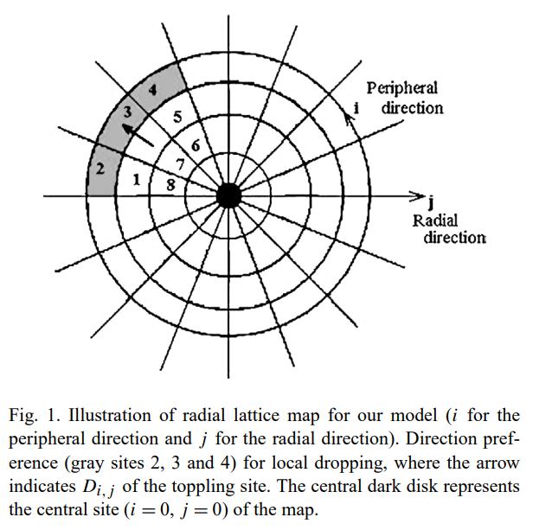
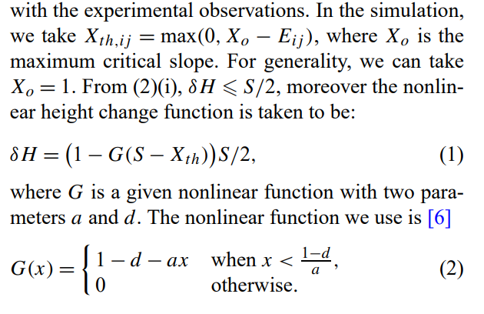
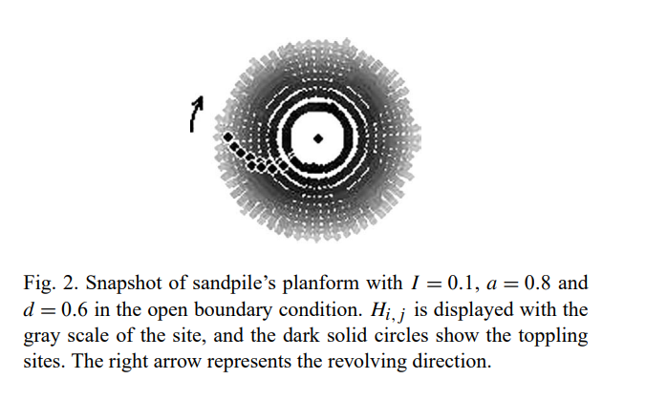
Altshuler2008: Mechanism
Improving the previous kinematic model to describe the mechanisms of river formation
Kong and co-workers [2] reported a detailed computational model for the revolving rivers which manages to reproduce many of their features in the continuous regime, but the intermittent regime was not accounted for

Slide 8
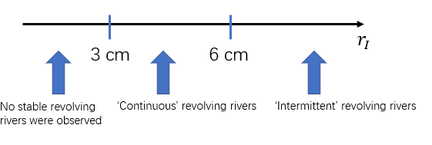
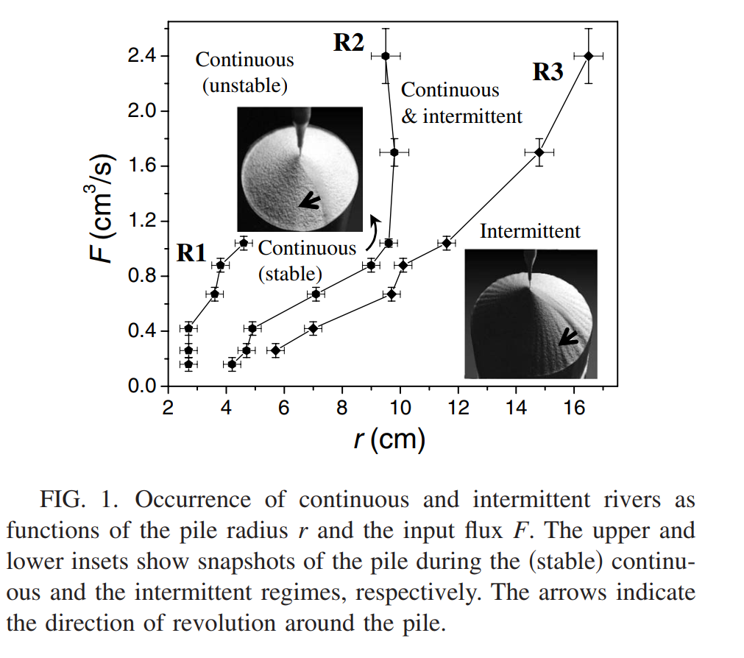
Altshuler2008: Mechanism
Established experimentally the “dynamical phase diagram” of the continuous and intermittent regimes for revolving rivers in sandpiles
Altshuler2003
The intermittent regime is the most robust dynamics in the system

Slide 9
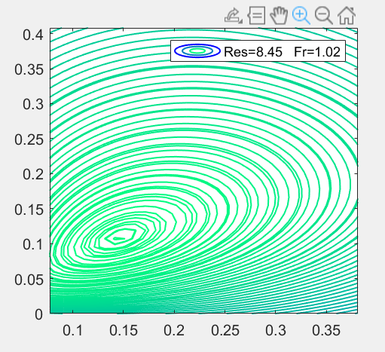
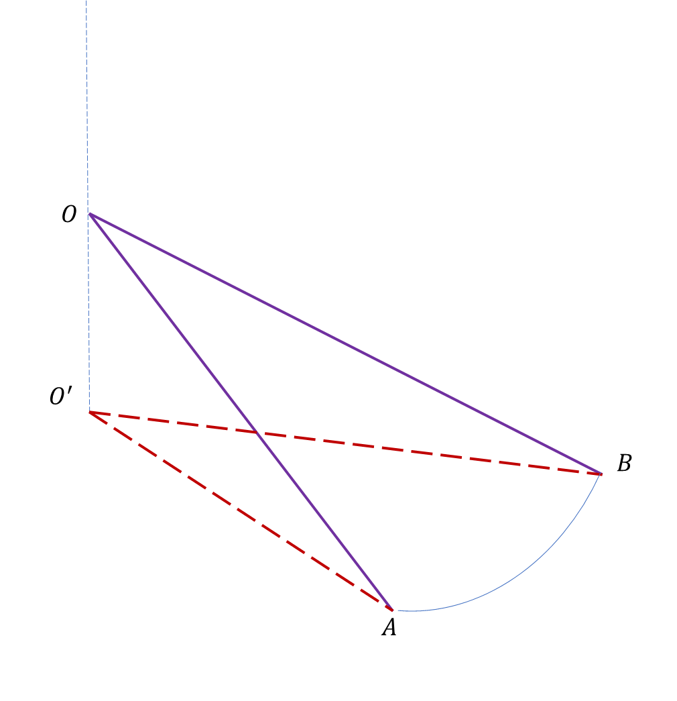
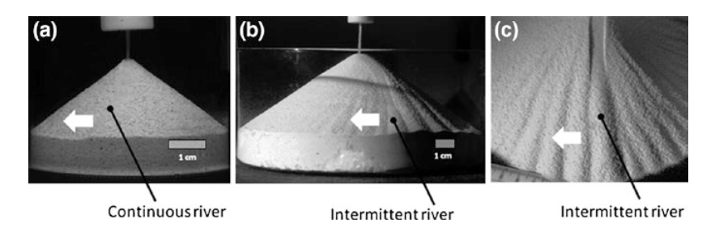








Our model – How the story goes on
$$r_{0}$$
Zoom in
Depth-averaged governing eqns.
$$b$$
Base flow
fix at ${a=a}_{0}$
Instability analysis:
Normal modes method
$$⊙θ$$
$$k_{2}$$
$$a$$
$μ(I)$ - rheology
$$k_{1}$$

Slide 11
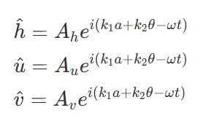





Criterion of instability
$$ω=ω_{R}+iω_{I}$$
$$r_{0}$$
Damping or Growing term
Thus when we consider exponential term of time, it will becomes
$$b$$
Base flow
fix at ${a=a}_{0}$
$$e^{−iωt}=e^{−{i(ω}_{R}+iω_{I})t}=e^{−iω_{R}t}e^{ω_{I}t}$$
$$⊙θ$$
$$a$$
When $ω_{I}>0$, it means when time goes up, these perturbations will diverge
When $ω_{I}<0$, it means when time goes up, these perturbations will damp
Thus the criterion is $ω_{I}=0$, and from the dispersion relation we can find
$$ω_{I}=ω_{I}(a_{0},Re,Fr,k_{1},k_{2})$$
At fixed $a_{0},Re,Fr$, the most likely observed wave phenomenon happens
$ω_{I}=\max{[ω_{I}]}$ in $ω_{I}>0$ ($k_{1},k_{2}$) region

Slide 12
