Slide 1
12.29讨论
Haoyu Lu

Slide 2
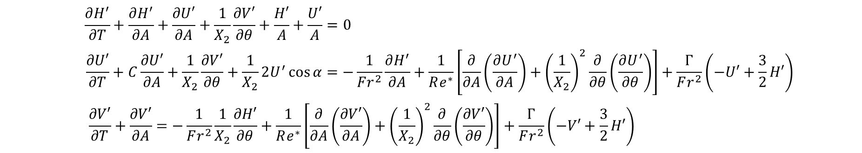
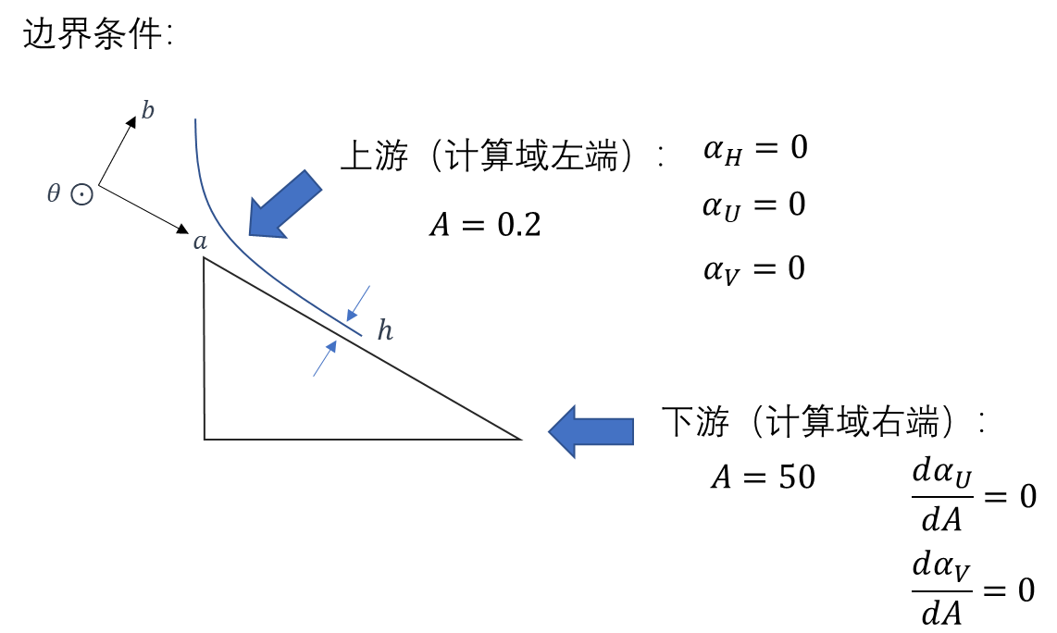
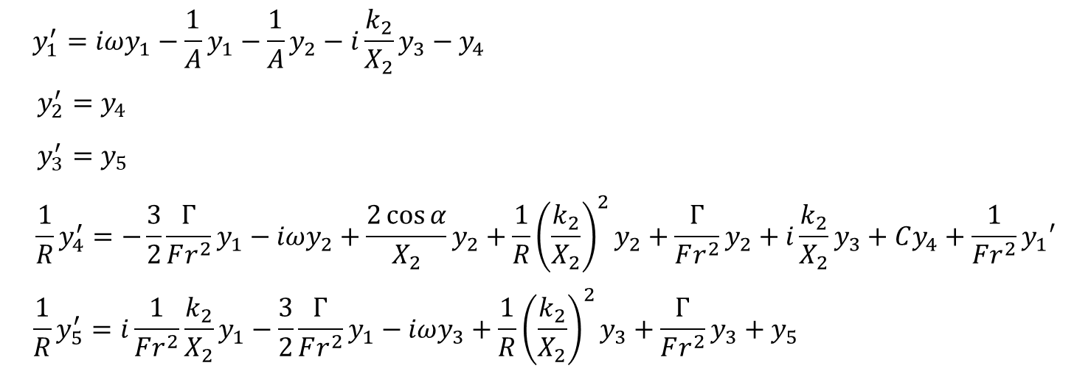




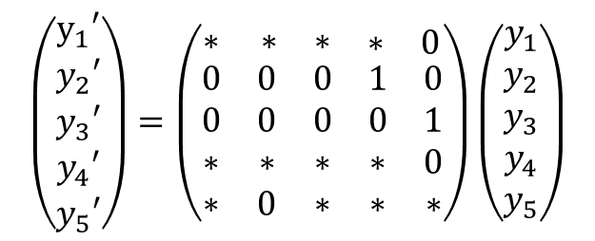


满足边界条件的解
$$1$$
$$H^{′}=α_{H}e^{i(k_{2}θ−ωT)}$$
$$U^{′}=α_{U}e^{i(k_{2}θ−ωT)}$$
$$α_{i}=α_{i}\left(A\right) ; i=H,U,V$$
$$V^{′}=α_{V}e^{i(k_{2}θ−ωT)}$$
$$\left(\begin{matrix}y_{1}′ \\ y_{2}′ \\ \begin{aligned}y_{3}′ \\ y_{4}′ \\ y_{5}′\end{aligned}\end{matrix}\right)=\left(\begin{matrix}∗ & \begin{matrix}∗ & \begin{matrix}∗ & \begin{matrix}∗ & 0\end{matrix}\end{matrix}\end{matrix} \\ \begin{aligned}0 \\ 0 \\ ∗ \\ ∗\end{aligned} & \begin{matrix}\begin{matrix}\begin{aligned}0 \\ 0 \\ ∗ \\ 0\end{aligned} & \begin{aligned}0 \\ 0 \\ ∗ \\ ∗\end{aligned}\end{matrix} & \begin{matrix}\begin{aligned}1 \\ 0 \\ ∗ \\ ∗\end{aligned} & \begin{aligned}0 \\ 1 \\ 0 \\ ∗\end{aligned}\end{matrix}\end{matrix}\end{matrix}\right)\left(\begin{aligned}y_{1} \\ y_{2} \\ y_{3} \\ y_{4} \\ y_{5}\end{aligned}\right)$$
$$Y^{′}=MY$$

Slide 3
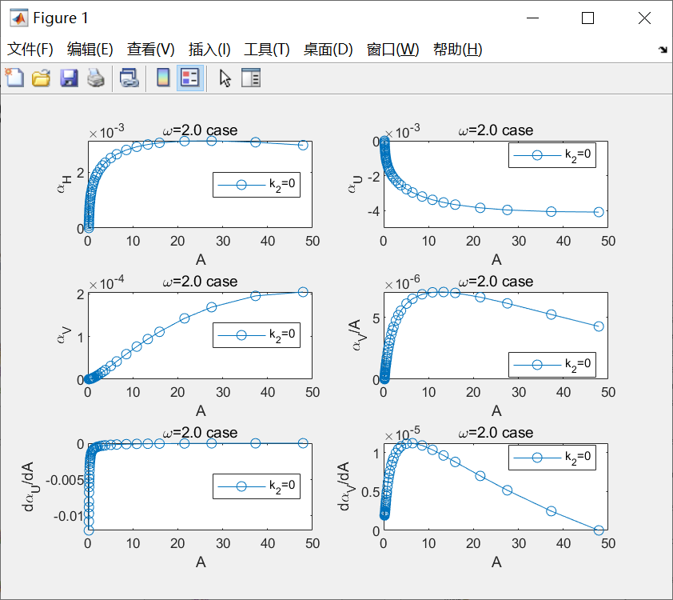
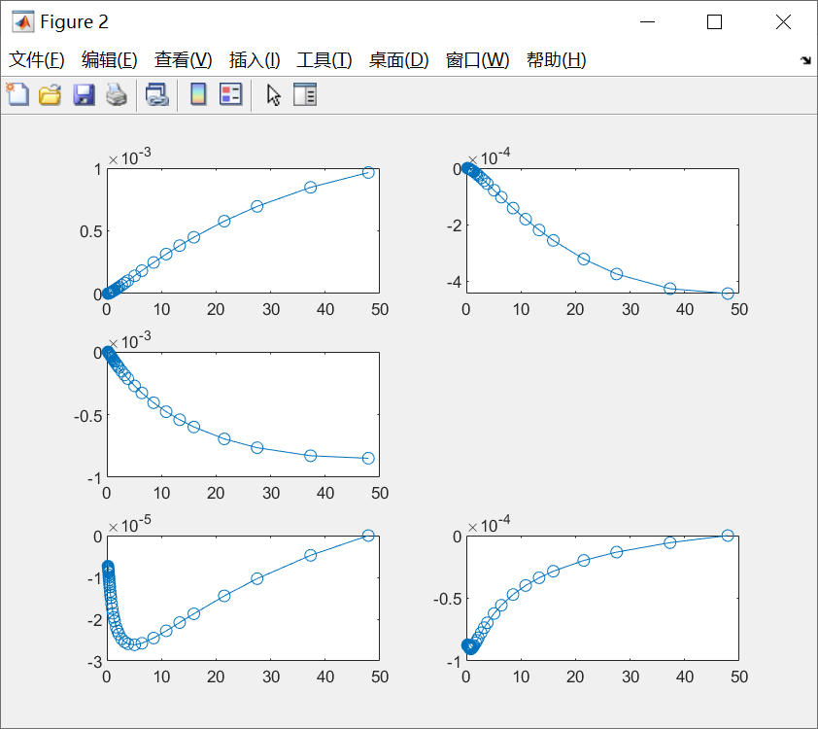
之前的解
无量纲化的差异
实部
虚部

Slide 4
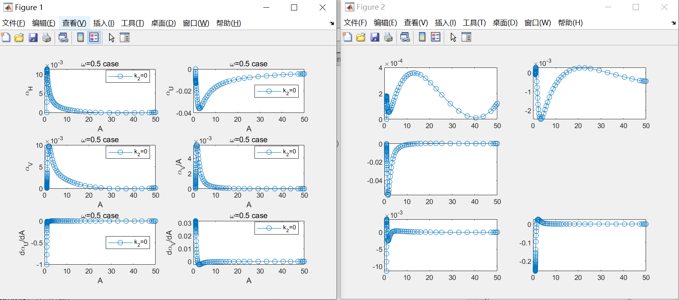





换无量纲的解
$$H^{′}=α_{H}e^{i(k_{2}θ−ωT)}$$
$$U^{′}=α_{U}e^{i(k_{2}θ−ωT)}$$
$$α_{i}=α_{i}\left(A\right) ; i=H,U,V$$
$$V^{′}=α_{V}e^{i(k_{2}θ−ωT)}$$
实部
$$e^{ik_{1}A}$$
虚部

Slide 5
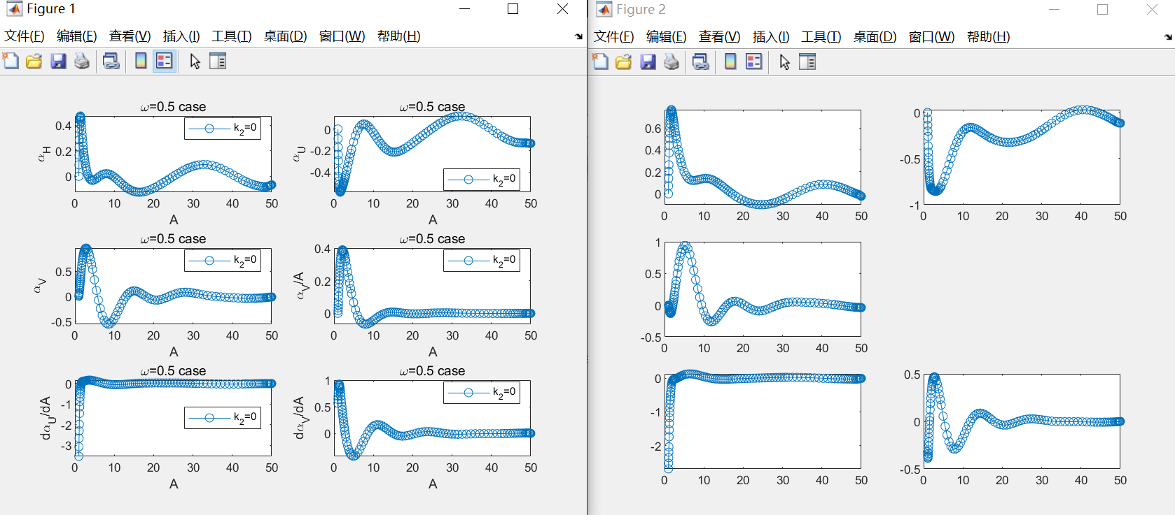
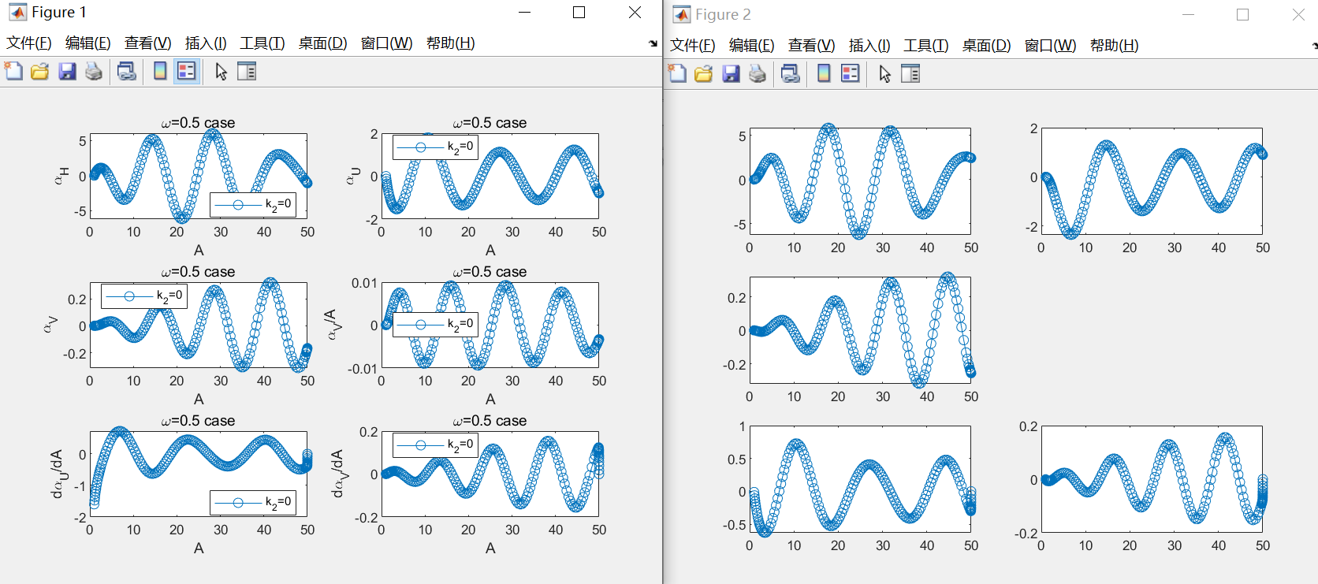









不同流量的解
$$H^{′}=α_{H}e^{i(k_{2}θ−ωT)}$$
$$U^{′}=α_{U}e^{i(k_{2}θ−ωT)}$$
$$α_{i}=α_{i}\left(A\right) ; i=H,U,V$$
$$V^{′}=α_{V}e^{i(k_{2}θ−ωT)}$$
$$q_{0}=3.5×{10}^{−8}m^{3}/s$$
$$q_{0}=3.5×{10}^{−7}$$
$$r_{0}=2.5×{10}^{−3}m$$
$$r_{0}=2.5×{10}^{−3}m$$
$$U_{0}=0.112m/s$$
$$U_{0}=1.12m/s$$
$$q_{0}=3.5×{10}^{−6}$$
$$r_{0}=2.5×{10}^{−3}m$$
$$U_{0}=11.2m/s$$

Slide 6

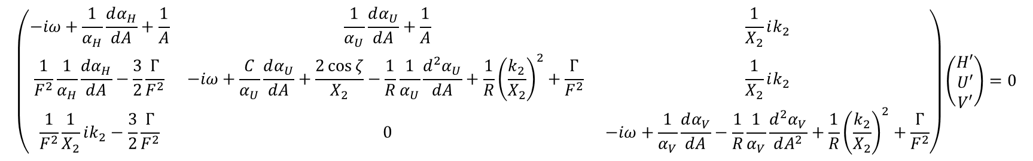



特征矩阵计算式
$$H^{′}=α_{H}e^{i(k_{2}θ−ωT)}$$
$$U^{′}=α_{U}e^{i(k_{2}θ−ωT)}$$
$$α_{i}=α_{i}\left(A\right) ; i=H,U,V$$
$$V^{′}=α_{V}e^{i(k_{2}θ−ωT)}$$
$$\left(\begin{matrix}−iω+\frac{1}{α_{H}}\frac{dα_{H}}{dA}+\frac{1}{A} & \frac{1}{α_{U}}\frac{dα_{U}}{dA}+\frac{1}{A} & \frac{1}{X_{2}}ik_{2} \\ \frac{1}{F^{2}}\frac{1}{α_{H}}\frac{dα_{H}}{dA}−\frac{3}{2}\frac{Γ}{F^{2}} & −iω+\frac{C}{α_{U}}\frac{dα_{U}}{dA}+\frac{2\cos{ζ}}{X_{2}}−\frac{1}{R}\frac{1}{α_{U}}\frac{d^{2}α_{U}}{dA}+\frac{1}{R}{\left(\frac{k_{2}}{X_{2}}\right)}^{2}+\frac{Γ}{F^{2}} & \frac{1}{X_{2}}ik_{2} \\ \frac{1}{F^{2}}\frac{1}{X_{2}}ik_{2}−\frac{3}{2}\frac{Γ}{F^{2}} & 0 & −iω+\frac{1}{α_{V}}\frac{dα_{V}}{dA}−\frac{1}{R}\frac{1}{α_{V}}\frac{d^{2}α_{V}}{dA^{2}}+\frac{1}{R}{\left(\frac{k_{2}}{X_{2}}\right)}^{2}+\frac{Γ}{F^{2}}\end{matrix}\right)\left(\begin{matrix}H′ \\ U′ \\ V′\end{matrix}\right)=0$$
困难1：矩阵元与A相关，特征矩阵det为零难以在各个A处都满足
困难2：三个振幅$α_{H},α_{U},α_{V}$形式未知，无法求解出色散关系

Slide 7
谢谢！

