Slide 1
整体稳定性计算讨论
2024.1.6

Slide 2






计算方法1：扰动量形式代入
$$\frac{∂H^{′}}{∂T}+U_{s}\frac{∂H^{′}}{∂A}+H_{s}\frac{∂U′}{∂A}+H_{s}\frac{1}{X_{2}}\frac{∂V′}{∂θ}+U_{s}\frac{H′}{A}+H_{s}\frac{U′}{A}=0$$
$$\frac{∂U′}{∂T}+CU_{s}\frac{∂U′}{∂A}+U_{s}\frac{1}{X_{2}}\frac{∂V′}{∂θ}+U_{s}\frac{1}{X_{2}}2U^{′}\cos{α}=−\frac{1}{Fr^{2}}\frac{∂H^{′}}{∂A}+H_{s}^{\frac{1}{2}}\frac{1}{Re^{∗}}\left[\frac{∂}{∂A}\left(\frac{∂U^{′}}{∂A}\right)+{\left(\frac{1}{X_{2}}\right)}^{2}\frac{∂}{∂θ}\left(\frac{∂U^{′}}{∂θ}\right)\right]+\frac{Γ}{Fr^{2}}\left(−\frac{U^{′}}{U_{s}}+\frac{3}{2}\frac{H^{′}}{H_{s}}\right)$$
$$\frac{∂V′}{∂T}+U_{s}\frac{∂V′}{∂A}=−\frac{1}{Fr^{2}}\frac{1}{X_{2}}\frac{∂H^{′}}{∂θ}+H_{s}^{\frac{1}{2}}\frac{1}{Re^{∗}}\left[\frac{∂}{∂A}\left(\frac{∂V^{′}}{∂A}\right)+{\left(\frac{1}{X_{2}}\right)}^{2}\frac{∂}{∂θ}\left(\frac{∂V^{′}}{∂θ}\right)\right]−\frac{η}{Fr^{2}}\frac{V^{′}}{U_{s}}$$
$$H^{′}=α_{H}e^{i(k_{2}θ−ωT)}$$
$$U^{′}=α_{U}e^{i(k_{2}θ−ωT)}$$
$$α_{i}=α_{i}\left(A\right) ; i=H,U,V$$
$$V^{′}=α_{V}e^{i(k_{2}θ−ωT)}$$
$$−iωα_{H}+U_{s}\frac{dα_{H}}{dA}+\frac{U_{s}}{A}α_{H}+H_{s}\frac{dα_{U}}{dA}+\frac{H_{s}}{A}α_{U}+i\frac{k_{2}}{\cos{ζ}}\frac{H_{s}}{A}α_{V}=0$$
$$−iωα_{U}+CU_{s}\frac{dα_{U}}{dA}+\frac{2U_{s}}{A}α_{U}+\frac{Γ}{F^{2}}\frac{1}{U_{s}}α_{U}−\frac{1}{R}H_{s}^{\frac{1}{2}}\frac{d^{2}α_{U}}{dA^{2}}+\frac{1}{R}H_{s}^{\frac{1}{2}}{\left(\frac{k_{2}}{\cos{ζ}}\right)}^{2}\frac{1}{A^{2}}α_{U}+\frac{1}{F^{2}}\frac{dα_{H}}{dA}−\frac{3}{2}\frac{Γ}{F^{2}}\frac{1}{H_{s}}α_{H}+i\frac{k_{2}}{\cos{ζ}}\frac{U_{s}}{A}α_{V}=0$$
$$−iωα_{V}+U_{s}\frac{dα_{V}}{dA}+\frac{η}{F^{2}}\frac{1}{U_{s}}α_{V}−\frac{1}{R}H_{s}^{\frac{1}{2}}\frac{d^{2}α_{V}}{dA^{2}}+\frac{1}{R}H_{s}^{\frac{1}{2}}{\left(\frac{k_{2}}{\cos{ζ}}\right)}^{2}\frac{1}{A^{2}}α_{V}+i\frac{1}{F^{2}}\frac{k_{2}}{\cos{ζ}}\frac{1}{A}α_{H}=0$$

Slide 3

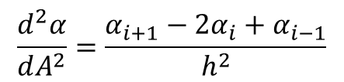
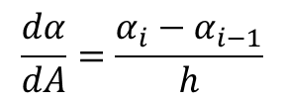
计算方法2：差分
$$−iωα_{H}+U_{s}\frac{dα_{H}}{dA}+\frac{U_{s}}{A}α_{H}+H_{s}\frac{dα_{U}}{dA}+\frac{H_{s}}{A}α_{U}+i\frac{k_{2}}{\cos{ζ}}\frac{H_{s}}{A}α_{V}=0$$
$$−iωα_{U}+CU_{s}\frac{dα_{U}}{dA}+\frac{2U_{s}}{A}α_{U}+\frac{Γ}{F^{2}}\frac{1}{U_{s}}α_{U}−\frac{1}{R}H_{s}^{\frac{1}{2}}\frac{d^{2}α_{U}}{dA^{2}}+\frac{1}{R}H_{s}^{\frac{1}{2}}{\left(\frac{k_{2}}{\cos{ζ}}\right)}^{2}\frac{1}{A^{2}}α_{U}+\frac{1}{F^{2}}\frac{dα_{H}}{dA}−\frac{3}{2}\frac{Γ}{F^{2}}\frac{1}{H_{s}}α_{H}+i\frac{k_{2}}{\cos{ζ}}\frac{U_{s}}{A}α_{V}=0$$
$$−iωα_{V}+U_{s}\frac{dα_{V}}{dA}+\frac{η}{F^{2}}\frac{1}{U_{s}}α_{V}−\frac{1}{R}H_{s}^{\frac{1}{2}}\frac{d^{2}α_{V}}{dA^{2}}+\frac{1}{R}H_{s}^{\frac{1}{2}}{\left(\frac{k_{2}}{\cos{ζ}}\right)}^{2}\frac{1}{A^{2}}α_{V}+i\frac{1}{F^{2}}\frac{k_{2}}{\cos{ζ}}\frac{1}{A}α_{H}=0$$
$$\frac{dα}{dA}=\frac{α_{i}−α_{i−1}}{h}$$
$$\frac{d^{2}α}{dA^{2}}=\frac{α_{i+1}−2α_{i}+α_{i−1}}{h^{2}}$$
$$h≡ΔA=A_{i}−A_{i−1}$$
$$\left(\frac{{U_{s}}_{i}}{h}+\frac{{U_{s}}_{i}}{A_{i}}\right){α_{H}}_{i}+\left(−\frac{{U_{s}}_{i}}{h}\right){α_{H}}_{i−1}+\left(\frac{{H_{s}}_{i}}{h}+\frac{{H_{s}}_{i}}{A_{i}}\right){α_{U}}_{i}+\left(−\frac{{H_{s}}_{i}}{h}\right){α_{U}}_{i−1}+\left(i\frac{k_{2}}{\cos{ζ}}\frac{{H_{s}}_{i}}{A_{i}}\right){α_{V}}_{i}=iω{α_{H}}_{i}$$
$$\left(\frac{1}{F^{2}h}−\frac{3}{2}\frac{Γ}{F^{2}}\frac{1}{{H_{s}}_{i}}\right){α_{H}}_{i}+\left(−\frac{1}{F^{2}h}\right){α_{H}}_{i−1}+\left(−\frac{1}{Rh^{2}}{H_{s}}_{i}^{\frac{1}{2}}\right){α_{U}}_{i+1}+\left(\frac{C}{h}{U_{s}}_{i}+\frac{2}{A_{i}}{U_{s}}_{i}+\frac{2}{Rh^{2}}{H_{s}}_{i}^{\frac{1}{2}}+\frac{1}{R}{\left(\frac{k_{2}}{\cos{ζ}}\right)}^{2}{\left(\frac{1}{A_{i}}\right)}^{2}{H_{s}}_{i}^{\frac{1}{2}}+\frac{Γ}{F^{2}}\frac{1}{{U_{s}}_{i}}\right){α_{U}}_{i}+\left(−\frac{C}{h}{U_{s}}_{i}−\frac{1}{Rh^{2}}{H_{s}}_{i}^{\frac{1}{2}}\right){α_{U}}_{i−1}+\left(i\frac{k_{2}}{\cos{ζ}}\frac{{U_{s}}_{i}}{A_{i}}\right){α_{V}}_{i}=iω{α_{U}}_{i}$$
$$\left(i\frac{1}{F^{2}}\frac{k_{2}}{\cos{ζ}}\frac{1}{A_{i}}\right){α_{H}}_{i}+\left(−\frac{1}{Rh^{2}}{H_{s}}_{i}^{\frac{1}{2}}\right){α_{V}}_{i+1}+\left(\frac{{U_{s}}_{i}}{h}+\frac{2}{Rh^{2}}{H_{s}}_{i}^{\frac{1}{2}}+\frac{1}{R}{\left(\frac{k_{2}}{\cos{ζ}}\right)}^{2}{\left(\frac{1}{A_{i}}\right)}^{2}{H_{s}}_{i}^{\frac{1}{2}}+\frac{η}{F^{2}}\frac{1}{{U_{s}}_{i}}\right){α_{V}}_{i}+\left(−\frac{{U_{s}}_{i}}{h}−\frac{1}{Rh^{2}}{H_{s}}_{i}^{\frac{1}{2}}\right){α_{V}}_{i−1}=iω{α_{V}}_{i}$$

Slide 4
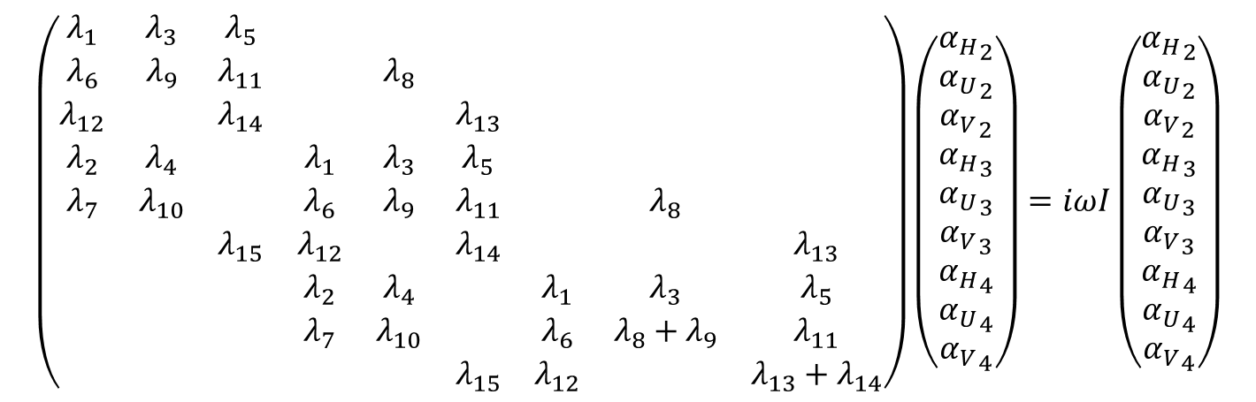
$$λ_{1}{α_{H}}_{i}+λ_{2}{α_{H}}_{i−1}+λ_{3}{α_{U}}_{i}+λ_{4}{α_{U}}_{i−1}+λ_{5}{α_{V}}_{i}=iω{α_{H}}_{i}$$
计算方法3：解广义特征值
$$λ_{6}{α_{H}}_{i}+λ_{7}{α_{H}}_{i−1}+λ_{8}{α_{U}}_{i+1}+λ_{9}{α_{U}}_{i}+λ_{10}{α_{U}}_{i−1}+λ_{11}{α_{V}}_{i}=iω{α_{U}}_{i}$$
$$\left(\frac{{U_{s}}_{i}}{h}+\frac{{U_{s}}_{i}}{A_{i}}\right){α_{H}}_{i}+\left(−\frac{{U_{s}}_{i}}{h}\right){α_{H}}_{i−1}+\left(\frac{{H_{s}}_{i}}{h}+\frac{{H_{s}}_{i}}{A_{i}}\right){α_{U}}_{i}+\left(−\frac{{H_{s}}_{i}}{h}\right){α_{U}}_{i−1}+\left(i\frac{k_{2}}{\cos{ζ}}\frac{{H_{s}}_{i}}{A_{i}}\right){α_{V}}_{i}=iω{α_{H}}_{i}$$
$$λ_{12}{α_{H}}_{i}+λ_{13}{α_{V}}_{i+1}+λ_{14}{α_{V}}_{i}+λ_{15}{α_{V}}_{i−1}=iω{α_{V}}_{i}$$
$$\left(\frac{1}{F^{2}h}−\frac{3}{2}\frac{Γ}{F^{2}}\frac{1}{{H_{s}}_{i}}\right){α_{H}}_{i}+\left(−\frac{1}{F^{2}h}\right){α_{H}}_{i−1}+\left(−\frac{1}{Rh^{2}}{H_{s}}_{i}^{\frac{1}{2}}\right){α_{U}}_{i+1}+\left(\frac{C}{h}{U_{s}}_{i}+\frac{2}{A_{i}}{U_{s}}_{i}+\frac{2}{Rh^{2}}{H_{s}}_{i}^{\frac{1}{2}}+\frac{1}{R}{\left(\frac{k_{2}}{\cos{ζ}}\right)}^{2}{\left(\frac{1}{A_{i}}\right)}^{2}{H_{s}}_{i}^{\frac{1}{2}}+\frac{Γ}{F^{2}}\frac{1}{{U_{s}}_{i}}\right){α_{U}}_{i}+\left(−\frac{C}{h}{U_{s}}_{i}−\frac{1}{Rh^{2}}{H_{s}}_{i}^{\frac{1}{2}}\right){α_{U}}_{i−1}+\left(i\frac{k_{2}}{\cos{ζ}}\frac{{U_{s}}_{i}}{A_{i}}\right){α_{V}}_{i}=iω{α_{U}}_{i}$$
$$\left(i\frac{1}{F^{2}}\frac{k_{2}}{\cos{ζ}}\frac{1}{A_{i}}\right){α_{H}}_{i}+\left(−\frac{1}{Rh^{2}}{H_{s}}_{i}^{\frac{1}{2}}\right){α_{V}}_{i+1}+\left(\frac{{U_{s}}_{i}}{h}+\frac{2}{Rh^{2}}{H_{s}}_{i}^{\frac{1}{2}}+\frac{1}{R}{\left(\frac{k_{2}}{\cos{ζ}}\right)}^{2}{\left(\frac{1}{A_{i}}\right)}^{2}{H_{s}}_{i}^{\frac{1}{2}}+\frac{η}{F^{2}}\frac{1}{{U_{s}}_{i}}\right){α_{V}}_{i}+\left(−\frac{{U_{s}}_{i}}{h}−\frac{1}{Rh^{2}}{H_{s}}_{i}^{\frac{1}{2}}\right){α_{V}}_{i−1}=iω{α_{V}}_{i}$$
特征矩阵：以5个点为例，沿对角线分布的带状矩阵
$$\left(\begin{matrix}λ_{1} & λ_{3} & λ_{5} & & & & & & \\ λ_{6} & λ_{9} & λ_{11} & & λ_{8} & & & & \\ λ_{12} & & λ_{14} & & & λ_{13} & & & \\ λ_{2} & λ_{4} & & λ_{1} & λ_{3} & λ_{5} & & & \\ λ_{7} & λ_{10} & & λ_{6} & λ_{9} & λ_{11} & & λ_{8} & \\ & & λ_{15} & λ_{12} & & λ_{14} & & & λ_{13} \\ & & & λ_{2} & λ_{4} & & λ_{1} & λ_{3} & λ_{5} \\ & & & λ_{7} & λ_{10} & & λ_{6} & λ_{8}+λ_{9} & λ_{11} \\ & & & & & λ_{15} & λ_{12} & & λ_{13}+λ_{14}\end{matrix}\right)\left(\begin{matrix}{α_{H}}_{2} \\ {α_{U}}_{2} \\ {α_{V}}_{2} \\ {α_{H}}_{3} \\ {α_{U}}_{3} \\ {α_{V}}_{3} \\ {α_{H}}_{4} \\ {α_{U}}_{4} \\ {α_{V}}_{4}\end{matrix}\right)=iωI\left(\begin{matrix}{α_{H}}_{2} \\ {α_{U}}_{2} \\ {α_{V}}_{2} \\ {α_{H}}_{3} \\ {α_{U}}_{3} \\ {α_{V}}_{3} \\ {α_{H}}_{4} \\ {α_{U}}_{4} \\ {α_{V}}_{4}\end{matrix}\right)$$

Slide 5
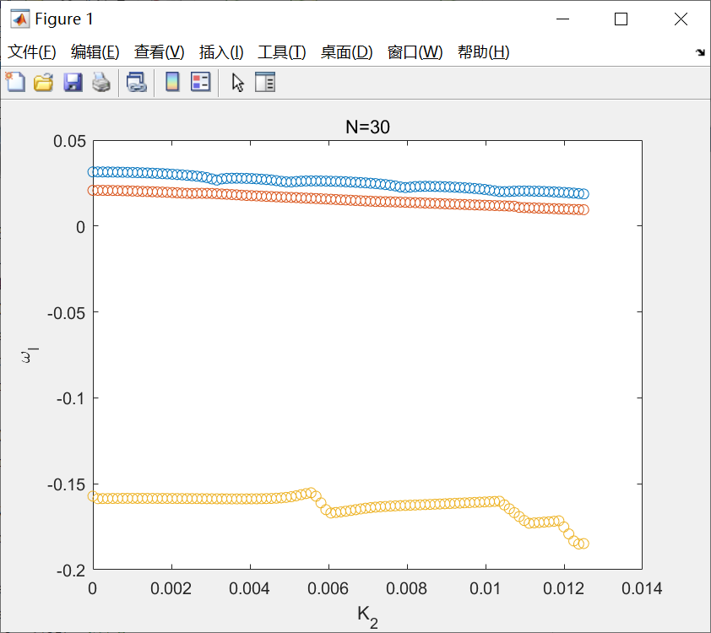
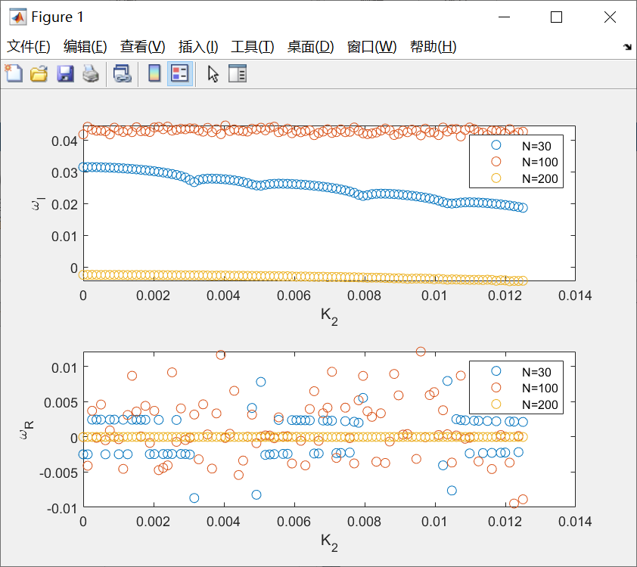
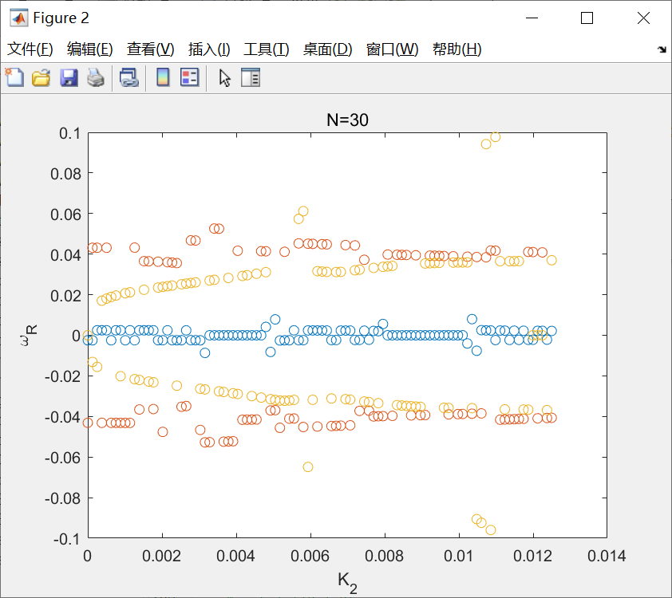



计算结果讨论
$$\left[V,D\right]=eig(P,Q)$$
$$PV=QVD$$
计算域：$A=[1,41]$
目前我按虚部的大小对解得的不同的重根进行排序

Slide 6
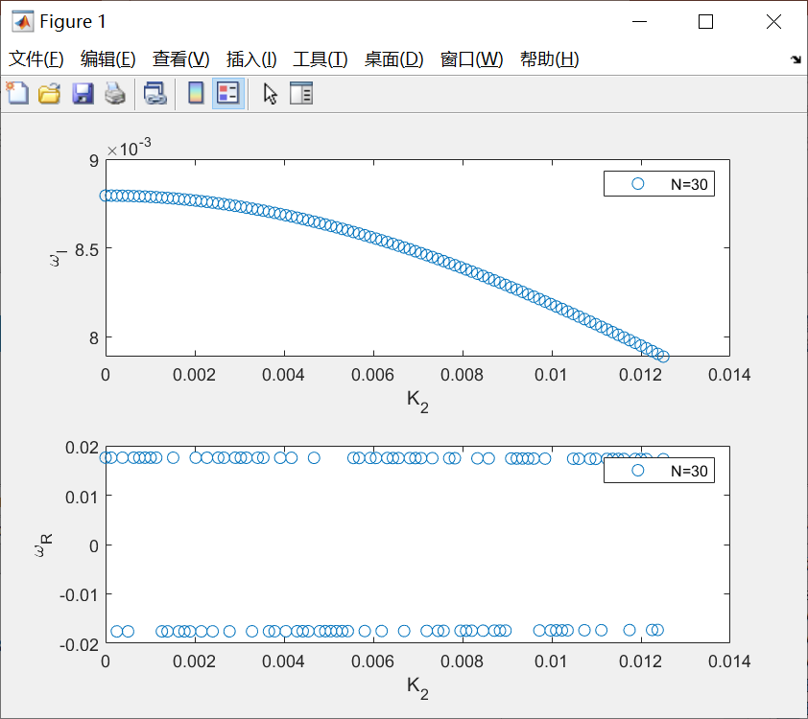
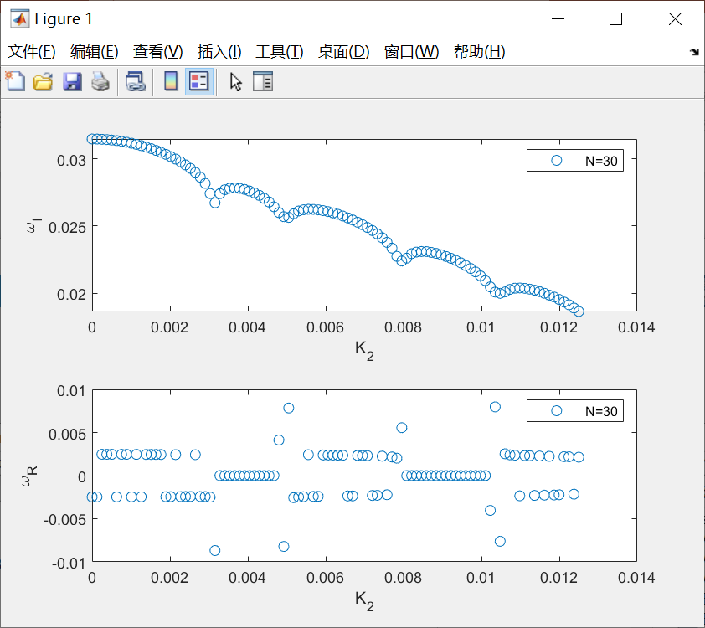
29
25

Slide 7









目前选用的参数值
本构参数
初始流量
圆锥底角
$$ζ_{1}=20.9$$
$$q_{0}=3.5×{10}^{−6} m^{3}/s$$
$$ζ=25$$
$$ζ_{2}=32.76$$
$$ℒ=0.825×{10}^{−3} m$$
$$u_{int}=1.12 m/s$$
$经验$参数
$$β=0.136$$
$$r_{int}=2.5×{10}^{−3} m$$

Slide 8
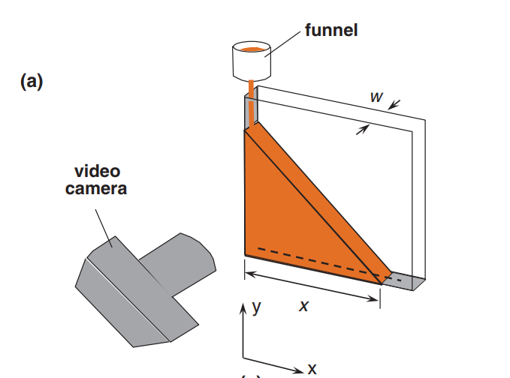
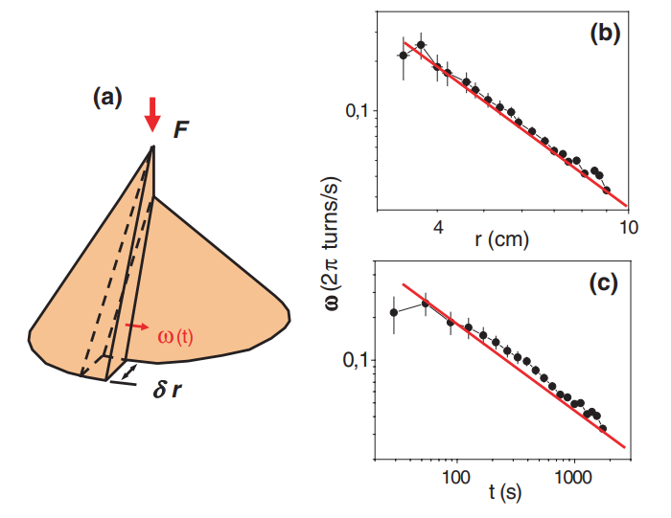
方法？
Hele-Shaw cell
周向的转动是累积效应？

Slide 9
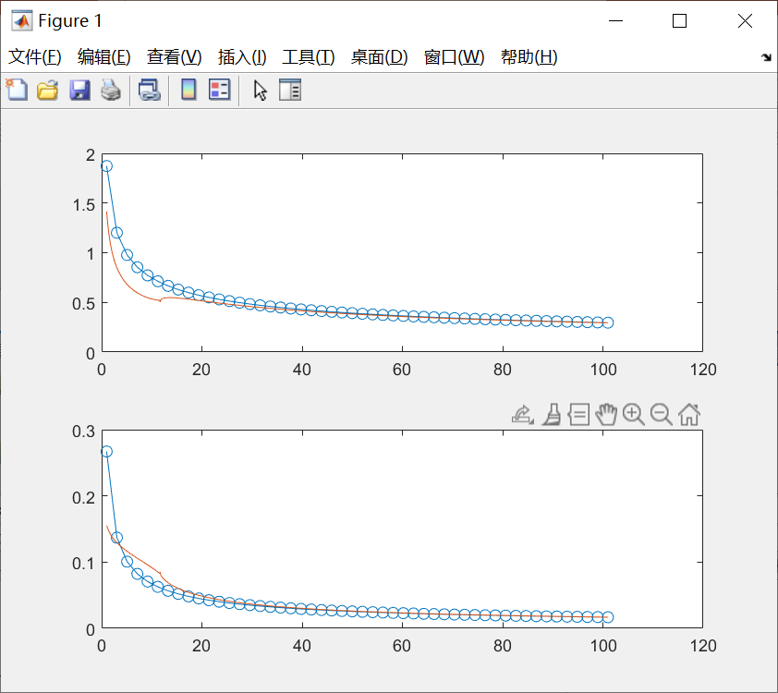
基本流

Slide 10
谢谢！

