Slide 1
0115 Discussion
Haoyu Lu

Slide 2


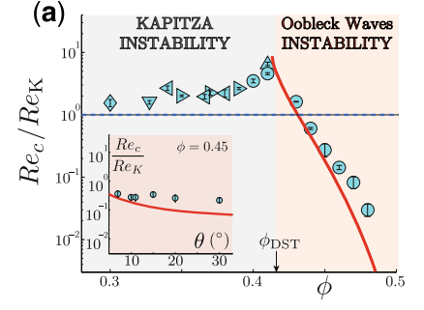

At large volume fraction ($φ>0.4$) surface wave can spontaneously emerge
Kapitza threshold $$Re_{K}=\frac{5}{6}\cot{ζ}$$
In long wave free surface instability down a incline:
When incline angle is small, the criterion Re becomes large, while :
Greater than 0.4 spontaneously emerge under low Re
discontinuous

Slide 3
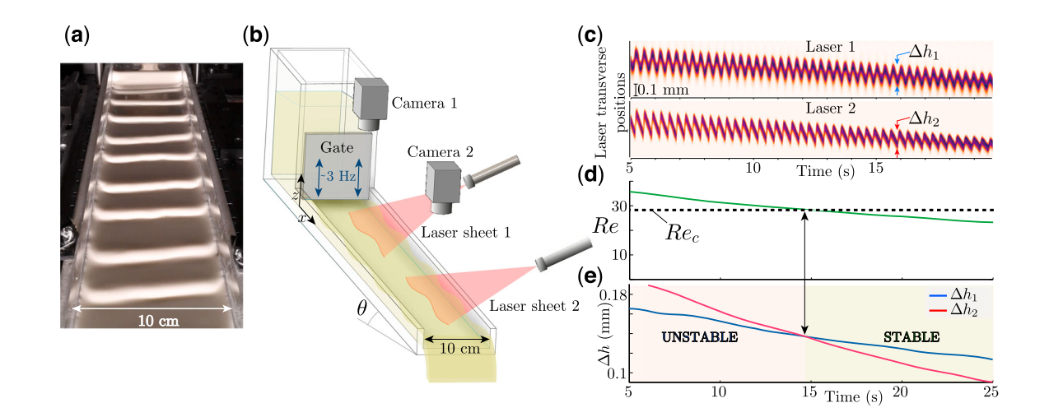





To find the contrast, the experiment is set up like:
Indicate vertical oscillations of free surface
$$L=1 m$$
$$W=0.1 m$$
$$θ = 2°$$
Kapitza threshold $$Re_{K}=\frac{5}{6}\cot{ζ}$$
Criterion: $Δh_{1}=Δh_{2}$ to find $Re_{c}$

Slide 4
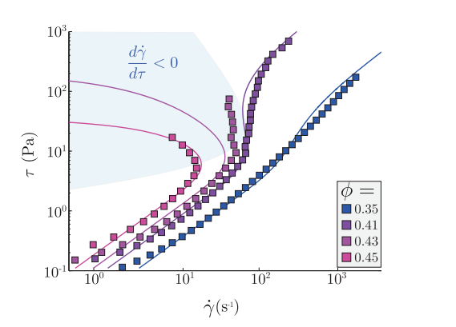
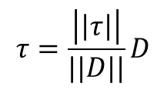




The reason of this kind of instability: S-shape rheological curve
$τ$: shear stress
$\dot{γ}$: shear rate
‘Linear like’ classical roll-wave rheological relation
$$τ=\frac{\left|\left|τ\right|\right|}{||D||}D$$
When $φ$ goes up, the curve is no longer linear
$\frac{d\dot{γ}}{dτ}<0$ leads to the spontaneous instability

Slide 5
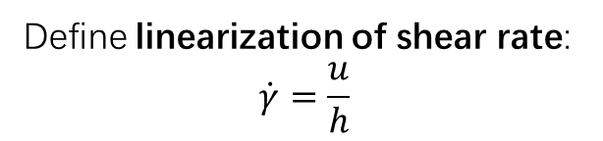

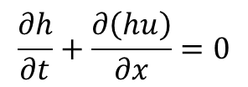
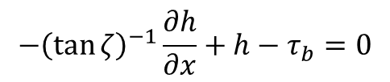
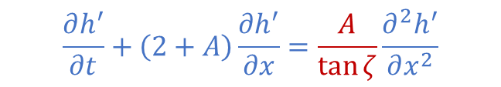

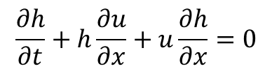
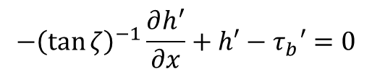
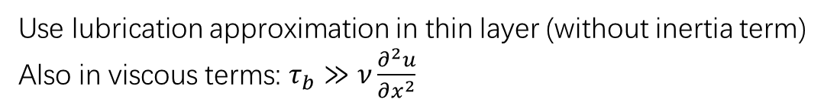
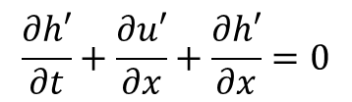
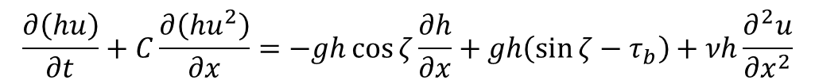
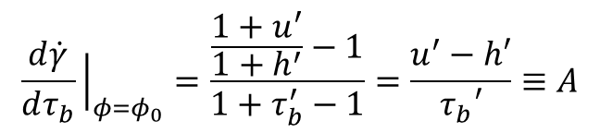
$\frac{d\dot{γ}}{dτ}<0$ leads to the spontaneous instability
Derivation
$$\frac{∂h}{∂t}+\frac{∂\left(hu\right)}{∂x}=0$$
Governing eqns. of flow down the incline
$$\frac{∂\left(hu\right)}{∂t}+C\frac{∂\left(hu^{2}\right)}{∂x}=−gh\cos{ζ}\frac{∂h}{∂x}+gh\left(\sin{ζ}−τ_{b}\right)+νh\frac{∂^{2}u}{∂x^{2}}$$
Define linearization of shear rate:
$$\dot{γ}=\frac{u}{h}$$
Use lubrication approximation in thin layer (without inertia term)
Also in viscous terms: $τ_{b}≫ν\frac{∂^{2}u}{∂x^{2}}$
Linearize the derivative
$$\frac{∂h}{∂t}+h\frac{∂u}{∂x}+u\frac{∂h}{∂x}=0$$
$$\frac{∂h′}{∂t}+\frac{∂u′}{∂x}+\frac{∂h′}{∂x}=0$$
$$\frac{d\dot{γ}}{dτ_{b}}{\left.​\right|}_{φ=φ_{0}}=\frac{\frac{1+u^{′}}{1+h^{′}}−1}{1+τ_{b}^{′}−1}=\frac{u^{′}−h′}{τ_{b}′}≡A$$
$$−{\left(\tan{ζ}\right)}^{−1}\frac{∂h^{′}}{∂x}+h′−τ_{b}′=0$$
$$−{\left(\tan{ζ}\right)}^{−1}\frac{∂h}{∂x}+h−τ_{b}=0$$
Simultaneous equation in blue boxes and obtain:
$$\frac{∂h^{′}}{∂t}+\left(2+A\right)\frac{∂h^{′}}{∂x}=\frac{A}{\tan{ζ}}\frac{∂^{2}h^{′}}{∂x^{2}}$$
$A<0$ leads to the amplification of instability
Wave speed
‘Diffusion like’ term

Slide 6










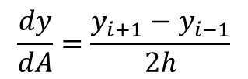
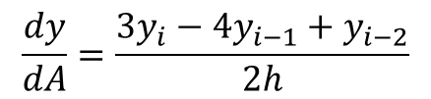


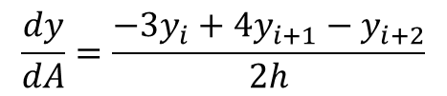
Differential method
$$−iωα_{H}+U_{s}\frac{dα_{H}}{dA}+\frac{U_{s}}{A}α_{H}+H_{s}\frac{dα_{U}}{dA}+\frac{H_{s}}{A}α_{U}+i\frac{k_{2}}{\cos{ζ}}\frac{H_{s}}{A}α_{V}=0$$
$$−iωα_{U}+CU_{s}\frac{dα_{U}}{dA}+\frac{2U_{s}}{A}α_{U}+\frac{Γ}{F^{2}}\frac{1}{U_{s}}α_{U}−\frac{1}{R}H_{s}^{\frac{1}{2}}\frac{d^{2}α_{U}}{dA^{2}}+\frac{1}{R}H_{s}^{\frac{1}{2}}{\left(\frac{k_{2}}{\cos{ζ}}\right)}^{2}\frac{1}{A^{2}}α_{U}+\frac{1}{F^{2}}\frac{dα_{H}}{dA}−\frac{3}{2}\frac{Γ}{F^{2}}\frac{1}{H_{s}}α_{H}+i\frac{k_{2}}{\cos{ζ}}\frac{U_{s}}{A}α_{V}=0$$
$$−iωα_{V}+U_{s}\frac{dα_{V}}{dA}+\frac{η}{F^{2}}\frac{1}{U_{s}}α_{V}−\frac{1}{R}H_{s}^{\frac{1}{2}}\frac{d^{2}α_{V}}{dA^{2}}+\frac{1}{R}H_{s}^{\frac{1}{2}}{\left(\frac{k_{2}}{\cos{ζ}}\right)}^{2}\frac{1}{A^{2}}α_{V}+i\frac{1}{F^{2}}\frac{k_{2}}{\cos{ζ}}\frac{1}{A}α_{H}=0$$
$$h≡ΔA=A_{i}−A_{i−1}$$
$$i=1…N$$
$$y_{I}=α_{H}$$
Use $o(ΔA^{2})$ method
$$y_{II}=α_{U}$$
$$\frac{dy}{dA}=\frac{y_{i+1}−y_{i−1}}{2h}$$
Centered dif
Interior points
$$i=2…N−1$$
$$y_{III}=α_{V}$$
$$y_{IV}=\frac{dα_{U}}{dA}$$
$$\frac{dy}{dA}=\frac{−3y_{i}+4y_{i+1}−y_{i+2}}{2h}$$
Forward dif
Left boundary point
$$i=1$$
$$y_{V}=\frac{dα_{V}}{dA}$$
$$\frac{dy}{dA}=\frac{3y_{i}−4y_{i−1}+y_{i−2}}{2h}$$
Backward dif
Right boundary point
$$i=N$$

Slide 7
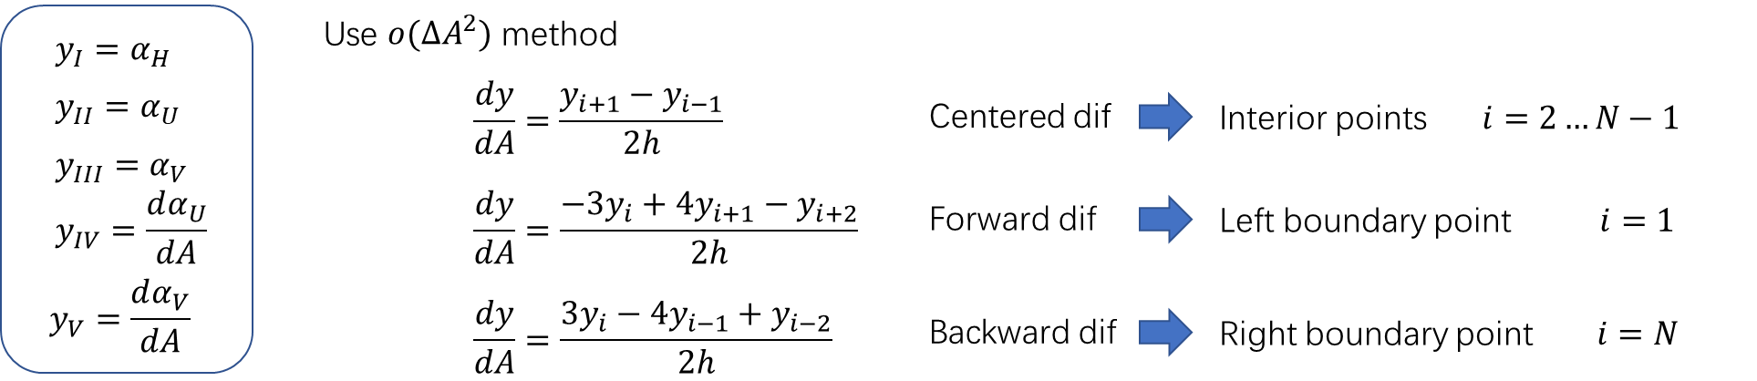
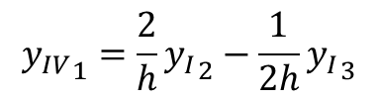
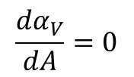



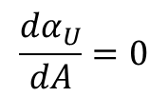


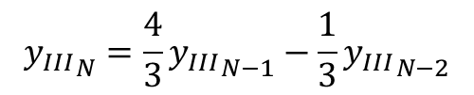

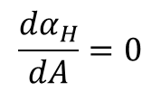

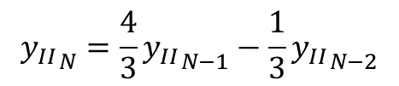
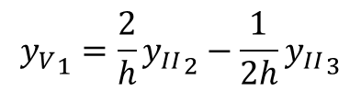

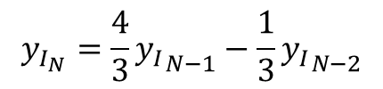
Boundary condition settings
Left B.C.s
Right B.C.s
$$α_{H}=0$$
$$y_{I_{1}}=0$$
$$\frac{{dα}_{H}}{dA}=0$$
$$y_{I_{N}}=\frac{4}{3}{y_{I}}_{N−1}−\frac{1}{3}{y_{I}}_{N−2}$$
$$α_{U}=0$$
$${y_{II}}_{1}=0$$
$${y_{II}}_{N}=\frac{4}{3}{y_{II}}_{N−1}−\frac{1}{3}{y_{II}}_{N−2}$$
$$\frac{{dα}_{U}}{dA}=0$$
$$α_{V}=0$$
$${y_{III}}_{1}=0$$
$${y_{III}}_{N}=\frac{4}{3}{y_{III}}_{N−1}−\frac{1}{3}{y_{III}}_{N−2}$$
$${y_{IV}}_{1}=\frac{2}{h}{y_{I}}_{2}−\frac{1}{2h}{y_{I}}_{3}$$
$$\frac{{dα}_{V}}{dA}=0$$
$${y_{V}}_{1}=\frac{2}{h}{y_{II}}_{2}−\frac{1}{2h}{y_{II}}_{3}$$
$${y_{IV}}_{N}=0$$
$${y_{V}}_{N}=0$$

Slide 8



























Governing equs. for interior points
$$L_{1}y_{I_{i−1}}+L_{2}{y_{I}}_{i}+L_{3}{y_{II}}_{i}+L_{4}{y_{III}}_{i}+L_{5}{y_{IV}}_{i}+L_{6}{y_{I}}_{i+1}=iω{y_{I}}_{i}$$
$$L_{7}{y_{I}}_{i−1}+L_{8}{y_{IV}}_{i−1}+L_{9}{y_{I}}_{i}+L_{10}{y_{II}}_{i}+L_{11}{y_{III}}_{i}+L_{12}{y_{IV}}_{i}+L_{13}{y_{I}}_{i+1}+L_{14}{y_{IV}}_{i+1}=iω{y_{II}}_{i}$$
$$L_{15}{y_{V}}_{i−1}+L_{16}{y_{I}}_{i}+L_{17}{y_{III}}_{i}+L_{18}{y_{V}}_{i}+L_{19}{y_{V}}_{i+1}=iω{y_{III}}_{i}$$
$$L_{20}{y_{II}}_{i−1}+L_{21}{y_{IV}}_{i}+L_{22}{y_{II}}_{i+1}=0$$
$$L_{23}{y_{III}}_{i−1}+L_{24}{y_{V}}_{i}+L_{25}{y_{III}}_{i+1}=0$$
$$L_{1}=−\frac{{U_{s}}_{i}}{2h}$$
$$L_{2}=\frac{{U_{s}}_{i}}{A_{i}}$$
$$L_{3}=\frac{{H_{s}}_{i}}{A_{i}}$$
$$L_{4}=i\frac{k_{2}}{\cos{ζ}}\frac{{H_{s}}_{i}}{A_{i}}$$
$$L_{5}={H_{s}}_{i}$$
$$L_{6}=\frac{{U_{s}}_{i}}{2h}$$
$$L_{7}=−\frac{1}{2F^{2}h}$$
$$L_{8}=\frac{1}{R}{H_{s}}_{i}^{\frac{1}{2}}\frac{1}{2h}$$
$$L_{9}=−\frac{3}{2}\frac{Γ}{F^{2}}\frac{1}{{H_{s}}_{i}}$$
$$L_{10}=\frac{2{U_{s}}_{i}}{A_{i}}+\frac{Γ}{F^{2}}\frac{1}{{U_{s}}_{i}}+\frac{1}{R}{H_{s}}_{i}^{\frac{1}{2}}{\left(\frac{k_{2}}{\cos{ζ}}\right)}^{2}\frac{1}{A_{i}^{2}}$$
$$L_{11}=i\frac{k_{2}}{\cos{ζ}}\frac{{U_{s}}_{i}}{A_{i}}$$
$$L_{12}=C⋅{U_{s}}_{i}$$
$$L_{13}=\frac{1}{2F^{2}h}$$
$$L_{14}=−\frac{1}{R}{H_{s}}_{i}^{\frac{1}{2}}\frac{1}{2h}$$
$$L_{15}=\frac{1}{R}{H_{s}}_{i}^{\frac{1}{2}}\frac{1}{2h}$$
$$L_{16}=i\frac{1}{F^{2}}\frac{k_{2}}{\cos{ζ}}\frac{1}{A_{i}}$$
$$L_{17}=\frac{η}{F^{2}}\frac{1}{{U_{s}}_{i}}+\frac{1}{R}{H_{s}}_{i}^{\frac{1}{2}}{\left(\frac{k_{2}}{\cos{ζ}}\right)}^{2}\frac{1}{A_{i}^{2}}$$
$$L_{18}={U_{s}}_{i}$$
$$L_{19}=−\frac{1}{R}{H_{s}}_{i}^{\frac{1}{2}}\frac{1}{2h}$$
$$L_{20}=−\frac{1}{2h}$$
$$L_{21}=−1$$
$$L_{22}=\frac{1}{2h}$$
$$L_{23}=−\frac{1}{2h}$$
$$L_{24}=−1$$
$$L_{25}=\frac{1}{2h}$$

Slide 9

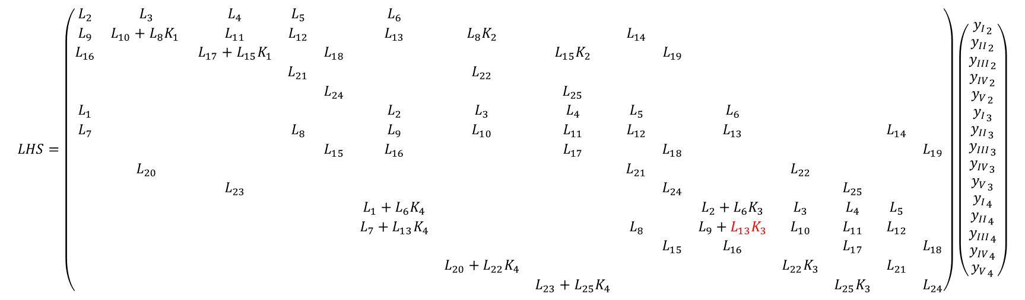
$$LHS=\left(\begin{matrix}L_{2} & L_{3} & L_{4} & L_{5} & & L_{6} & & & & & & & & & \\ L_{9} & L_{10}+L_{8}K_{1} & L_{11} & L_{12} & & L_{13} & L_{8}K_{2} & & L_{14} & & & & & & \\ L_{16} & & L_{17}+L_{15}K_{1} & & L_{18} & & & L_{15}K_{2} & & L_{19} & & & & & \\ & & & L_{21} & & & L_{22} & & & & & & & & \\ & & & & L_{24} & & & L_{25} & & & & & & & \\ L_{1} & & & & & L_{2} & L_{3} & L_{4} & L_{5} & & L_{6} & & & & \\ L_{7} & & & L_{8} & & L_{9} & L_{10} & L_{11} & L_{12} & & L_{13} & & & L_{14} & \\ & & & & L_{15} & L_{16} & & L_{17} & & L_{18} & & & & & L_{19} \\ & L_{20} & & & & & & & L_{21} & & & L_{22} & & & \\ & & L_{23} & & & & & & & L_{24} & & & L_{25} & & \\ & & & & & L_{1}+L_{6}K_{4} & & & & & L_{2}+L_{6}K_{3} & L_{3} & L_{4} & L_{5} & \\ & & & & & L_{7}+L_{13}K_{4} & & & L_{8} & & L_{9}+L_{13}K_{3} & L_{10} & L_{11} & L_{12} & \\ & & & & & & & & & L_{15} & L_{16} & & L_{17} & & L_{18} \\ & & & & & & L_{20}+L_{22}K_{4} & & & & & L_{22}K_{3} & & L_{21} & \\ & & & & & & & L_{23}+L_{25}K_{4} & & & & & L_{25}K_{3} & & L_{24}\end{matrix}\right)\left(\begin{aligned}{y_{I}}_{2} \\ {y_{II}}_{2} \\ {y_{III}}_{2} \\ {y_{IV}}_{2} \\ {y_{V}}_{2} \\ {y_{I}}_{3} \\ {y_{II}}_{3} \\ {y_{III}}_{3} \\ {y_{IV}}_{3} \\ {y_{V}}_{3} \\ {y_{I}}_{4} \\ {y_{II}}_{4} \\ {y_{III}}_{4} \\ {y_{IV}}_{4} \\ {y_{V}}_{4}\end{aligned}\right)$$
$$RHS=iω\left(\begin{matrix}1 & & & & & & & & & & & & & & \\ & 1 & & & & & & & & & & & & & \\ & & 1 & & & & & & & & & & & & \\ & & & 0 & & & & & & & & & & & \\ & & & & 0 & & & & & & & & & & \\ & & & & & 1 & & & & & & & & & \\ & & & & & & 1 & & & & & & & & \\ & & & & & & & 1 & & & & & & & \\ & & & & & & & & 0 & & & & & & \\ & & & & & & & & & 0 & & & & & \\ & & & & & & & & & & 1 & & & & \\ & & & & & & & & & & & 1 & & & \\ & & & & & & & & & & & & 1 & & \\ & & & & & & & & & & & & & 0 & \\ & & & & & & & & & & & & & & 0\end{matrix}\right)\left(\begin{aligned}{y_{I}}_{2} \\ {y_{II}}_{2} \\ {y_{III}}_{2} \\ {y_{IV}}_{2} \\ {y_{V}}_{2} \\ {y_{I}}_{3} \\ {y_{II}}_{3} \\ {y_{III}}_{3} \\ {y_{IV}}_{3} \\ {y_{V}}_{3} \\ {y_{I}}_{4} \\ {y_{II}}_{4} \\ {y_{III}}_{4} \\ {y_{IV}}_{4} \\ {y_{V}}_{4}\end{aligned}\right)$$

Slide 10
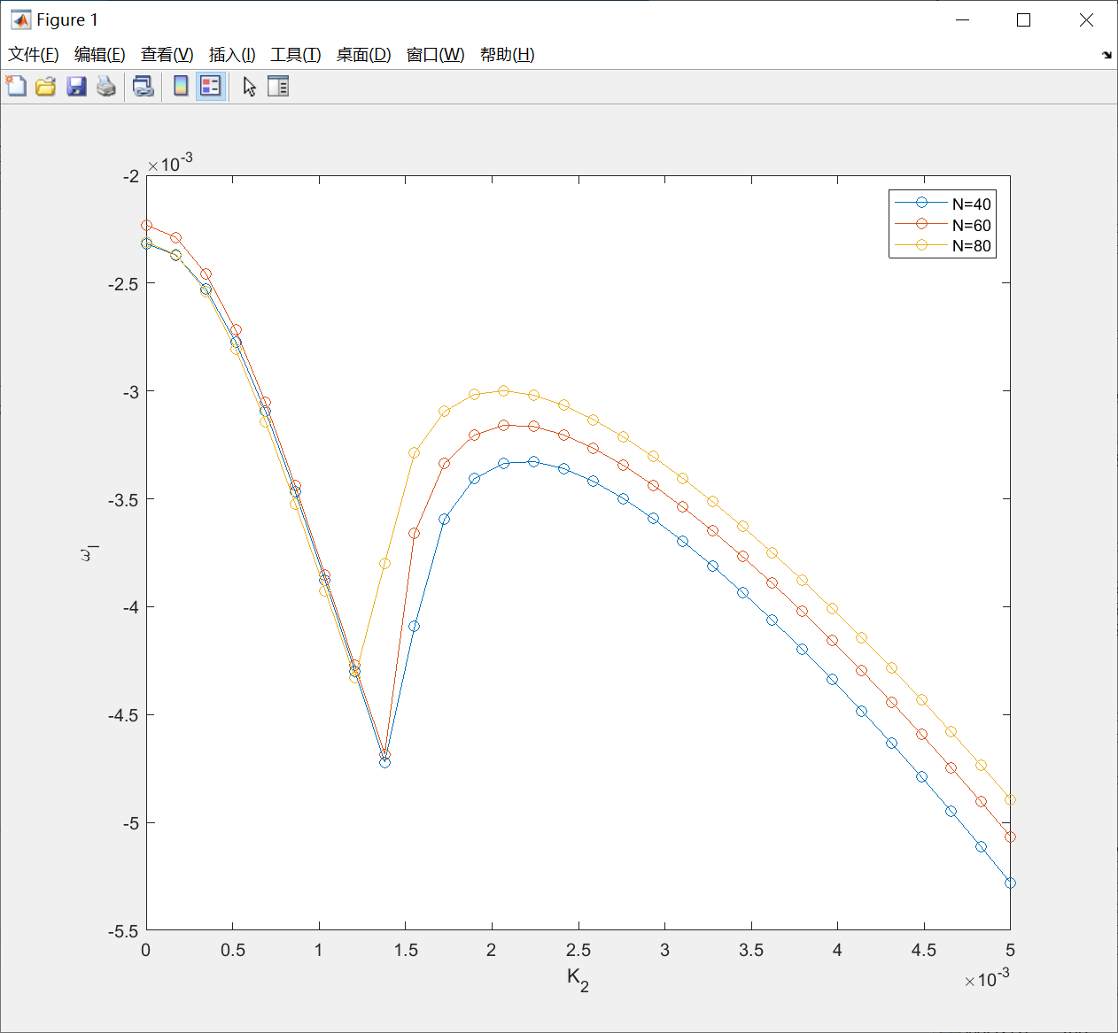
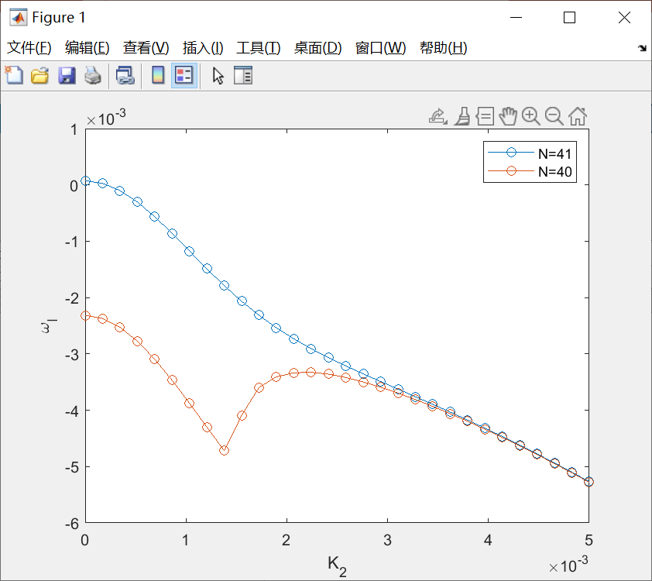
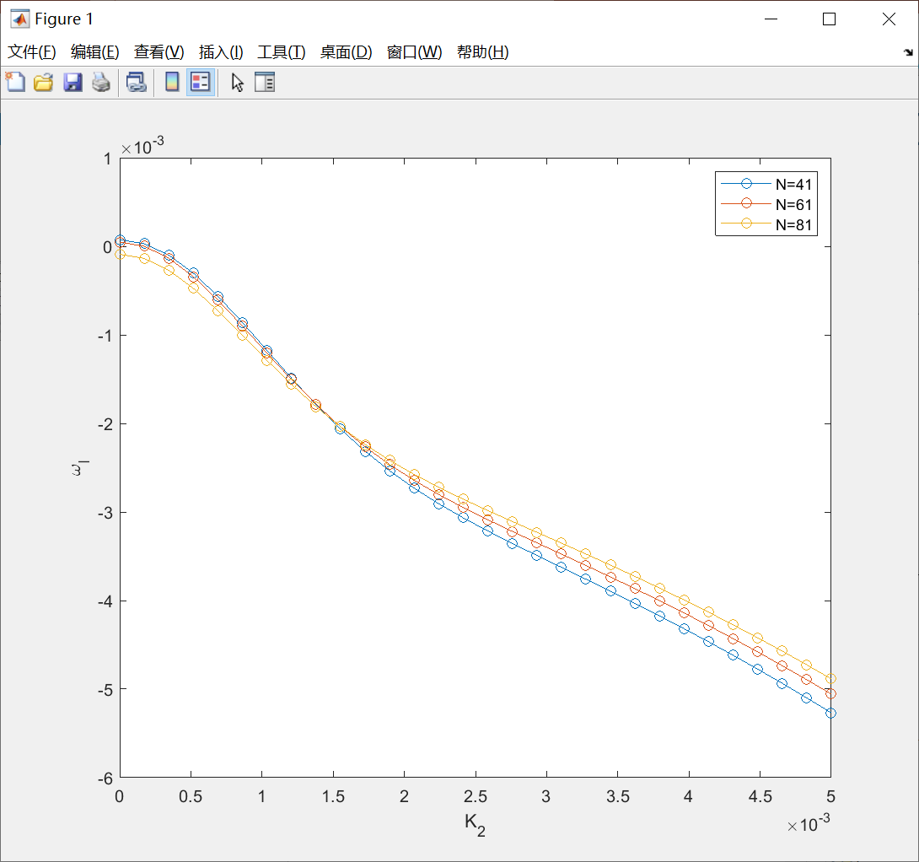
Results
A=linspace(Aint,Aend,N)
Odd
Even

Slide 11
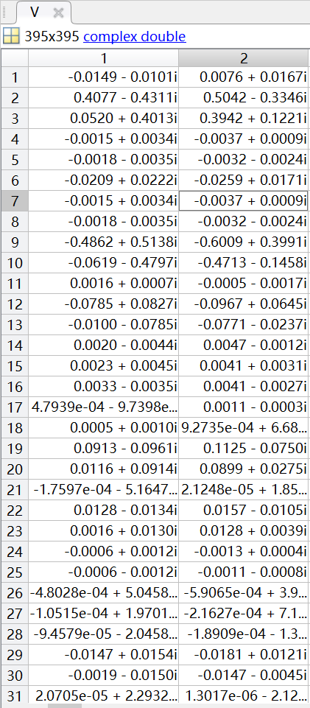






Notes
$D：$特征值构成的对角阵
$V$：各特征值对应的特征向量组成的矩阵
$$AV=BVD$$
$A：$左系数矩阵
$B$：右系数矩阵
$$\left[V,D\right]=eig(A,B)$$

