Slide 1
整体稳定性计算记录3
2024.1.19

Slide 2





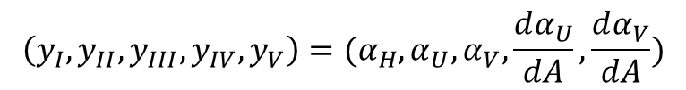





$$\left(y_{I},y_{II},y_{III},y_{IV},y_{V}\right)=(α_{H},α_{U},α_{V},\frac{dα_{U}}{dA},\frac{dα_{V}}{dA})$$
List eqns. at half points
$$L_{1}y_{I_{i+1}}+L_{2}{y_{I}}_{i}+L_{3}{y_{II}}_{i+1}+L_{4}{y_{II}}_{i}+L_{5}{y_{III}}_{i+1}+L_{6}{y_{III}}_{i}+L_{7}{y_{IV}}_{i+1}+L_{8}{y_{IV}}_{i}=R_{1}{y_{I}}_{i+1}+R_{2}{y_{I}}_{i}$$
$$L_{9}{y_{I}}_{i+1}+L_{10}{y_{I}}_{i}+L_{11}{y_{II}}_{i+1}+L_{12}{y_{II}}_{i}+L_{13}{y_{III}}_{i+1}+L_{14}{y_{III}}_{i}+L_{15}{y_{IV}}_{i+1}+L_{16}{y_{IV}}_{i}=R_{3}{y_{II}}_{i+1}+R_{4}{y_{II}}_{i}$$
$$L_{17}{y_{I}}_{i+1}+L_{18}{y_{I}}_{i}+L_{19}{y_{III}}_{i+1}+L_{20}{y_{III}}_{i}+L_{21}{y_{V}}_{i+1}+L_{22}{y_{V}}_{i}=R_{5}{y_{III}}_{i+1}+R_{6}{y_{III}}_{i}$$
$$L_{23}{y_{II}}_{i+1}+L_{24}{y_{II}}_{i}+L_{25}{y_{IV}}_{i+1}+L_{26}{y_{IV}}_{i}=0$$
$$L_{27}{y_{III}}_{i+1}+L_{28}{y_{III}}_{i}+L_{29}{y_{V}}_{i+1}+L_{30}{y_{V}}_{i}=0$$
Left BCs
Right BCs
$${y_{I}}_{1}=0$$
$$\frac{dy_{I}}{dA}{\left.​\right|}_{N}=\frac{3{y_{I}}_{N}−4{y_{I}}_{N−\frac{1}{2}}+{y_{I}}_{N−1}}{h}=\frac{3{y_{I}}_{N}−4\left(\frac{{{{y_{I}}_{N}+y}_{I}}_{N−1}}{2}\right)+{y_{I}}_{N−1}}{h}=\frac{{y_{I}}_{N}−{y_{I}}_{N−1}}{h}=0$$
$${y_{II}}_{1}=0$$
$${y_{III}}_{1}=0$$
$${y_{I}}_{N}={y_{I}}_{N−1}$$
$${y_{IV}}_{1}≡\frac{dy_{II}}{dA}{\left.​\right|}_{1}=\frac{4{y_{II}}_{1+\frac{1}{2}}−{y_{II}}_{2}−3{y_{II}}_{1}}{h}=\frac{4\left(\frac{{{{y_{II}}_{1}+y}_{II}}_{2}}{2}\right)−{y_{II}}_{2}−3{y_{II}}_{1}}{h}=\frac{{y_{II}}_{2}−{y_{II}}_{1}}{h}=\frac{{y_{Ii}}_{2}}{h}$$
$${y_{IV}}_{N}=0$$
$${y_{II}}_{N}={y_{II}}_{N−1}$$
$${y_{V}}_{1}=\frac{{y_{III}}_{2}}{h}$$
$${y_{V}}_{N}=0$$
$${y_{III}}_{N}={y_{III}}_{N−1}$$

Slide 3
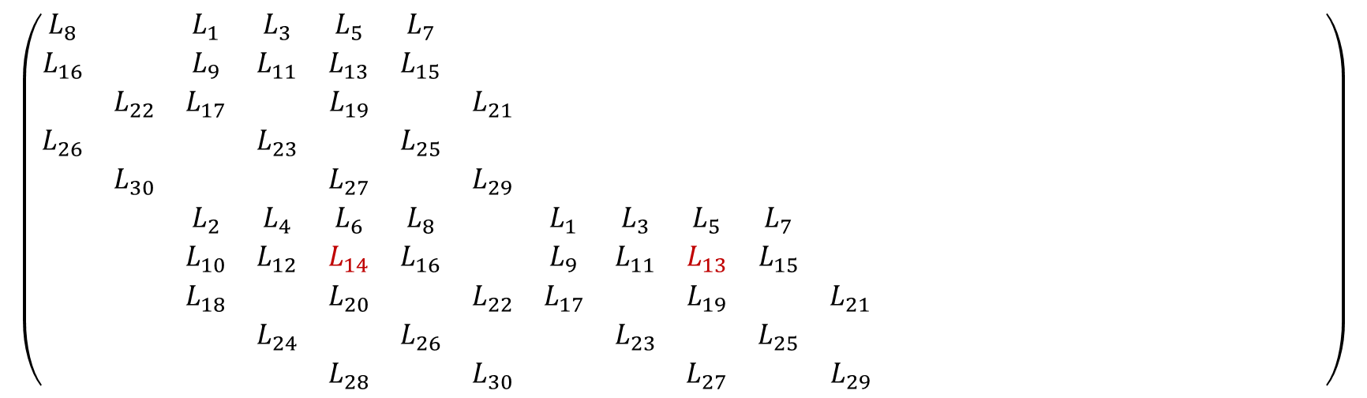
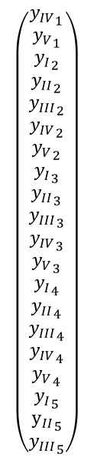
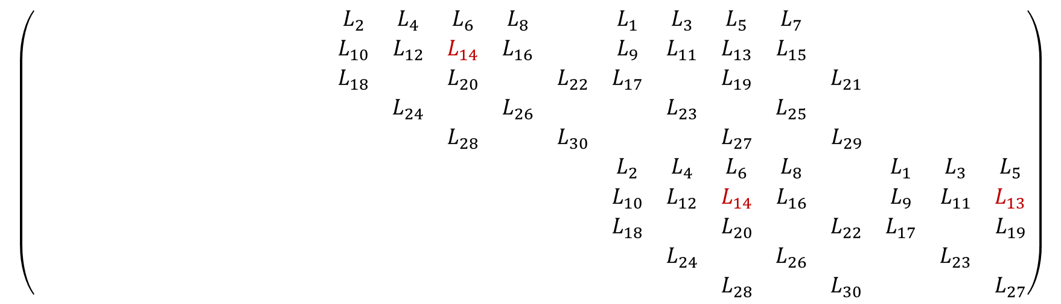
$$\left(\begin{matrix}L_{8} & & L_{1} & L_{3} & L_{5} & L_{7} & & & & & & & & & & & & & & \\ L_{16} & & L_{9} & L_{11} & L_{13} & L_{15} & & & & & & & & & & & & & & \\ & L_{22} & L_{17} & & L_{19} & & L_{21} & & & & & & & & & & & & & \\ L_{26} & & & L_{23} & & L_{25} & & & & & & & & & & & & & & \\ & L_{30} & & & L_{27} & & L_{29} & & & & & & & & & & & & & \\ & & L_{2} & L_{4} & L_{6} & L_{8} & & L_{1} & L_{3} & L_{5} & L_{7} & & & & & & & & & \\ & & L_{10} & L_{12} & L_{14} & L_{16} & & L_{9} & L_{11} & L_{13} & L_{15} & & & & & & & & & \\ & & L_{18} & & L_{20} & & L_{22} & L_{17} & & L_{19} & & L_{21} & & & & & & & & \\ & & & L_{24} & & L_{26} & & & L_{23} & & L_{25} & & & & & & & & & \\ & & & & L_{28} & & L_{30} & & & L_{27} & & L_{29} & & & & & & & & \end{matrix}\right)$$
$$\left(\begin{matrix}{y_{IV}}_{1} \\ {y_{V}}_{1} \\ {y_{I}}_{2} \\ {y_{II}}_{2} \\ {y_{III}}_{2} \\ {y_{IV}}_{2} \\ {y_{V}}_{2} \\ {y_{I}}_{3} \\ {y_{II}}_{3} \\ {y_{III}}_{3} \\ {y_{IV}}_{3} \\ {y_{V}}_{3} \\ {y_{I}}_{4} \\ {y_{II}}_{4} \\ {y_{III}}_{4} \\ {y_{IV}}_{4} \\ {y_{V}}_{4} \\ {y_{I}}_{5} \\ {y_{II}}_{5} \\ {y_{III}}_{5}\end{matrix}\right)$$
$$\left(\begin{matrix} & & & & & & & L_{2} & L_{4} & L_{6} & L_{8} & & L_{1} & L_{3} & L_{5} & L_{7} & & & & \\ & & & & & & & L_{10} & L_{12} & L_{14} & L_{16} & & L_{9} & L_{11} & L_{13} & L_{15} & & & & \\ & & & & & & & L_{18} & & L_{20} & & L_{22} & L_{17} & & L_{19} & & L_{21} & & & \\ & & & & & & & & L_{24} & & L_{26} & & & L_{23} & & L_{25} & & & & \\ & & & & & & & & & L_{28} & & L_{30} & & & L_{27} & & L_{29} & & & \\ & & & & & & & & & & & & L_{2} & L_{4} & L_{6} & L_{8} & & L_{1} & L_{3} & L_{5} \\ & & & & & & & & & & & & L_{10} & L_{12} & L_{14} & L_{16} & & L_{9} & L_{11} & L_{13} \\ & & & & & & & & & & & & L_{18} & & L_{20} & & L_{22} & L_{17} & & L_{19} \\ & & & & & & & & & & & & & L_{24} & & L_{26} & & & L_{23} & \\ & & & & & & & & & & & & & & L_{28} & & L_{30} & & & L_{27}\end{matrix}\right)$$

Slide 4
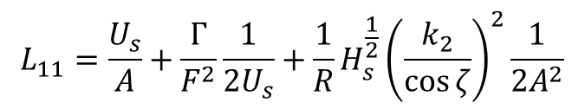
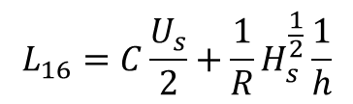
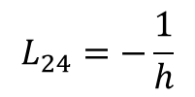

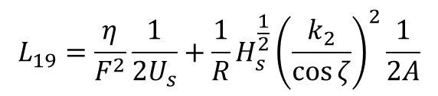
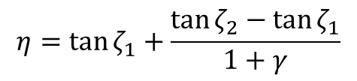
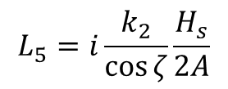
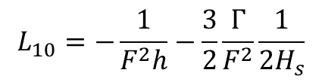
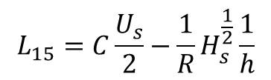
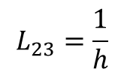
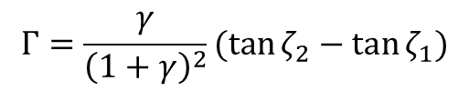
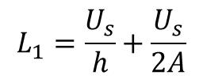
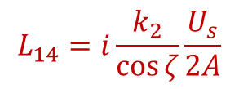
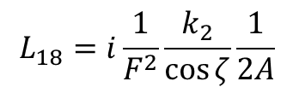
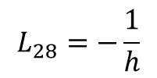
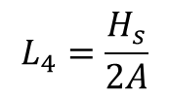
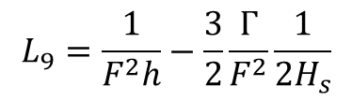
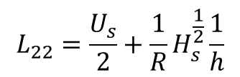
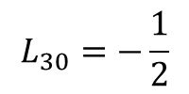
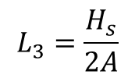
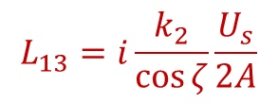
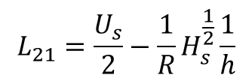
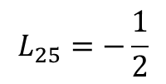
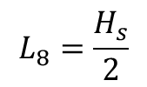
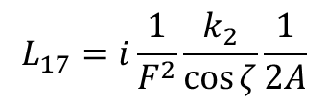
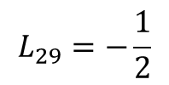
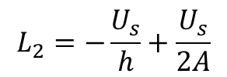

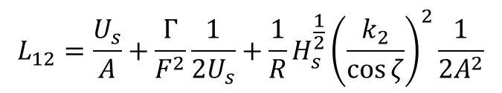
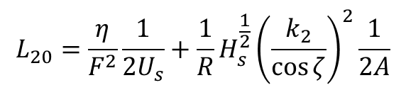
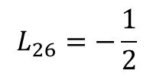
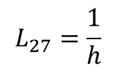
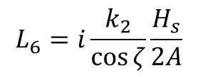
List coeffs. at half points $i+\frac{1}{2}$
$$Γ=\frac{γ}{{\left(1+γ\right)}^{2}}(\tan{ζ_{2}}−\tan{ζ_{1}})$$
$$η=\tan{ζ_{1}}+\frac{\tan{ζ_{2}−\tan{ζ_{1}}}}{1+γ}$$
$$L_{1}=\frac{U_{s}}{h}+\frac{U_{s}}{2A}$$
$$L_{9}=\frac{1}{F^{2}h}−\frac{3}{2}\frac{Γ}{F^{2}}\frac{1}{2H_{s}}$$
$$L_{17}=i\frac{1}{F^{2}}\frac{k_{2}}{\cos{ζ}}\frac{1}{2A}$$
$$L_{2}=−\frac{U_{s}}{h}+\frac{U_{s}}{2A}$$
$$L_{10}=−\frac{1}{F^{2}h}−\frac{3}{2}\frac{Γ}{F^{2}}\frac{1}{2H_{s}}$$
$$L_{18}=i\frac{1}{F^{2}}\frac{k_{2}}{\cos{ζ}}\frac{1}{2A}$$
$$L_{3}=\frac{H_{s}}{2A}$$
$$L_{19}=\frac{η}{F^{2}}\frac{1}{2U_{s}}+\frac{1}{R}H_{s}^{\frac{1}{2}}{\left(\frac{k_{2}}{\cos{ζ}}\right)}^{2}\frac{1}{2A}$$
$$L_{11}=\frac{U_{s}}{A}+\frac{Γ}{F^{2}}\frac{1}{2U_{s}}+\frac{1}{R}H_{s}^{\frac{1}{2}}{\left(\frac{k_{2}}{\cos{ζ}}\right)}^{2}\frac{1}{2A^{2}}$$
$$L_{4}=\frac{H_{s}}{2A}$$
$$L_{20}=\frac{η}{F^{2}}\frac{1}{2U_{s}}+\frac{1}{R}H_{s}^{\frac{1}{2}}{\left(\frac{k_{2}}{\cos{ζ}}\right)}^{2}\frac{1}{2A}$$
$$L_{5}=i\frac{k_{2}}{\cos{ζ}}\frac{H_{s}}{2A}$$
$$L_{12}=\frac{U_{s}}{A}+\frac{Γ}{F^{2}}\frac{1}{2U_{s}}+\frac{1}{R}H_{s}^{\frac{1}{2}}{\left(\frac{k_{2}}{\cos{ζ}}\right)}^{2}\frac{1}{2A^{2}}$$
$$L_{21}=\frac{U_{s}}{2}−\frac{1}{R}H_{s}^{\frac{1}{2}}\frac{1}{h}$$
$$L_{13}=i\frac{k_{2}}{\cos{ζ}}\frac{U_{s}}{2A}$$
$$L_{6}=i\frac{k_{2}}{\cos{ζ}}\frac{H_{s}}{2A}$$
$$L_{22}=\frac{U_{s}}{2}+\frac{1}{R}H_{s}^{\frac{1}{2}}\frac{1}{h}$$
$$L_{14}=i\frac{k_{2}}{\cos{ζ}}\frac{U_{s}}{2A}$$
$$L_{7}=\frac{H_{s}}{2}$$
$$L_{15}=C\frac{U_{s}}{2}−\frac{1}{R}H_{s}^{\frac{1}{2}}\frac{1}{h}$$
$$L_{23}=\frac{1}{h}$$
$$L_{24}=−\frac{1}{h}$$
$$L_{25}=−\frac{1}{2}$$
$$L_{26}=−\frac{1}{2}$$
$$L_{8}=\frac{H_{s}}{2}$$
$$L_{16}=C\frac{U_{s}}{2}+\frac{1}{R}H_{s}^{\frac{1}{2}}\frac{1}{h}$$
$$L_{27}=\frac{1}{h}$$
$$L_{28}=−\frac{1}{h}$$
$$L_{29}=−\frac{1}{2}$$
$$L_{30}=−\frac{1}{2}$$

Slide 5
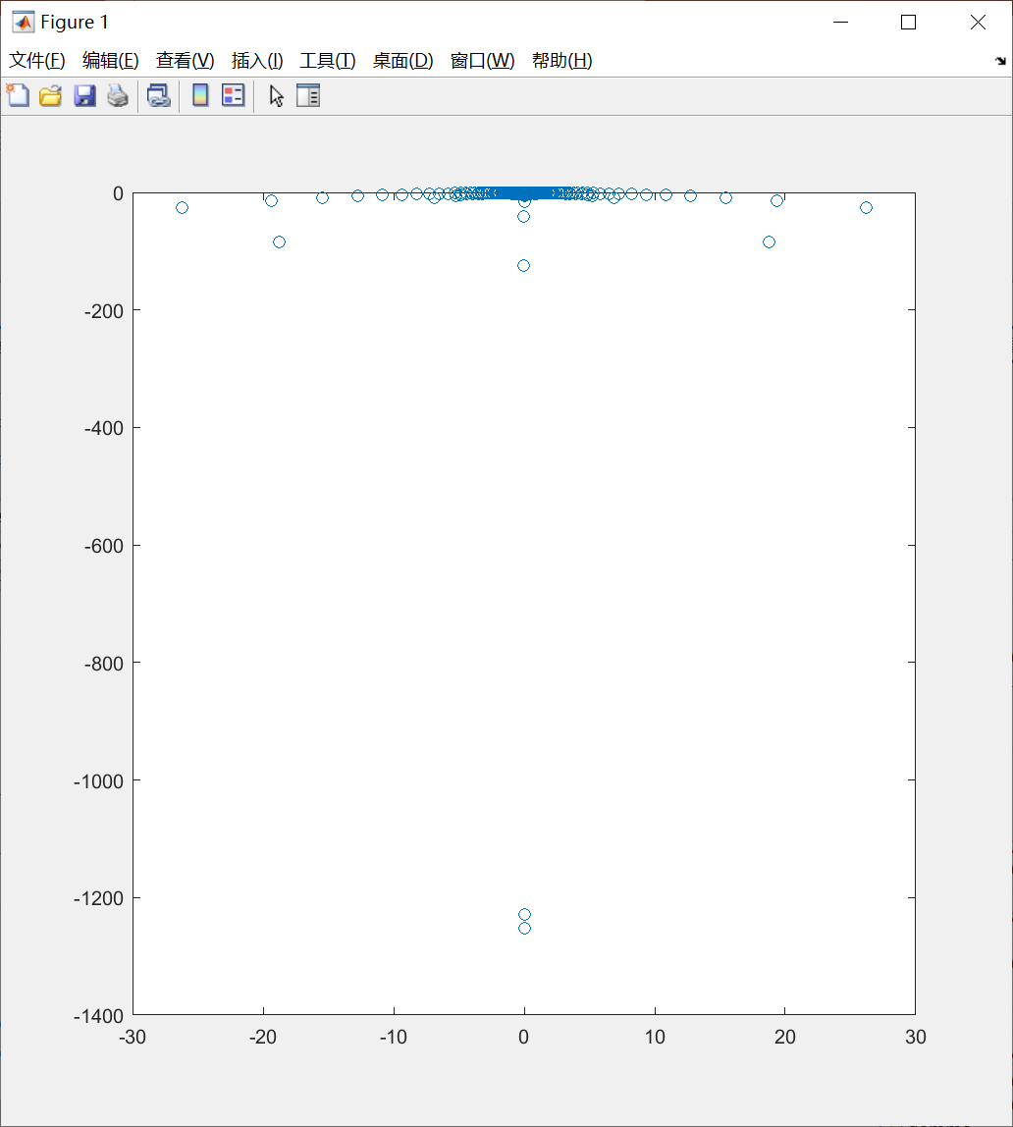
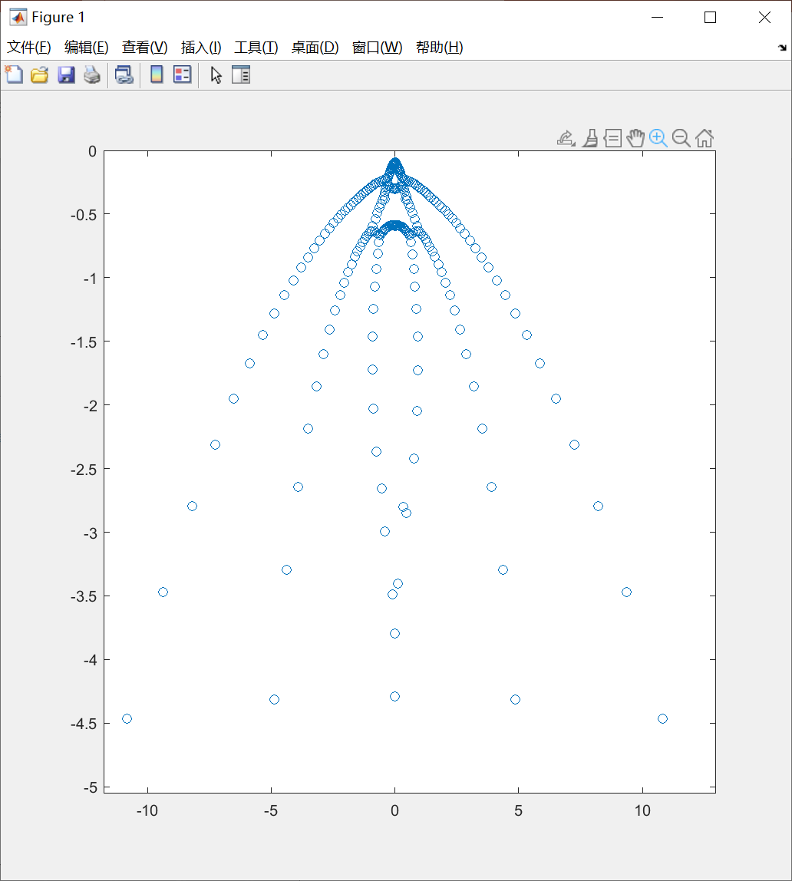

Slide 6
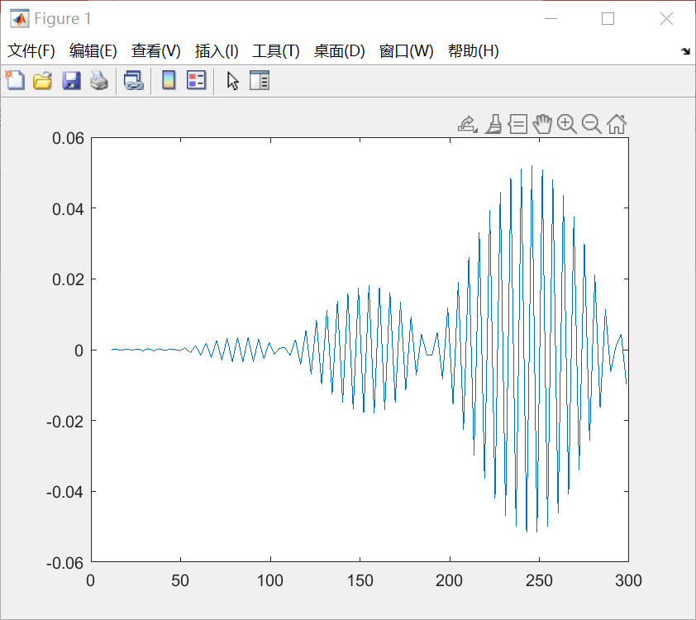
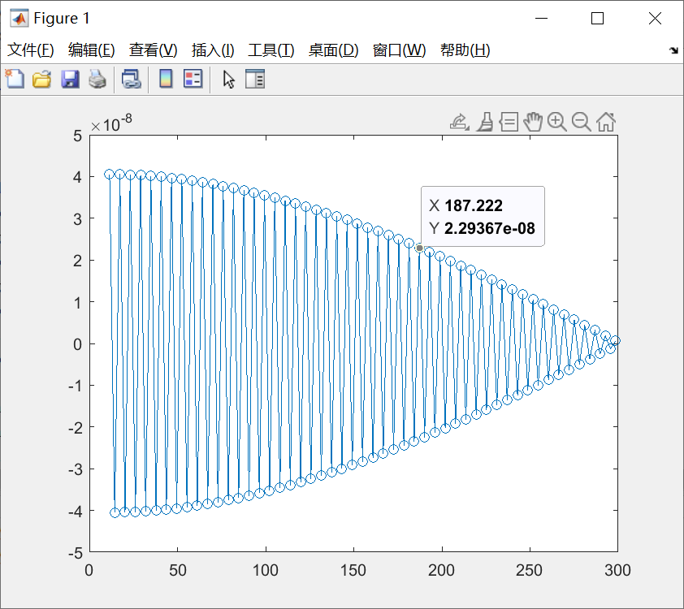
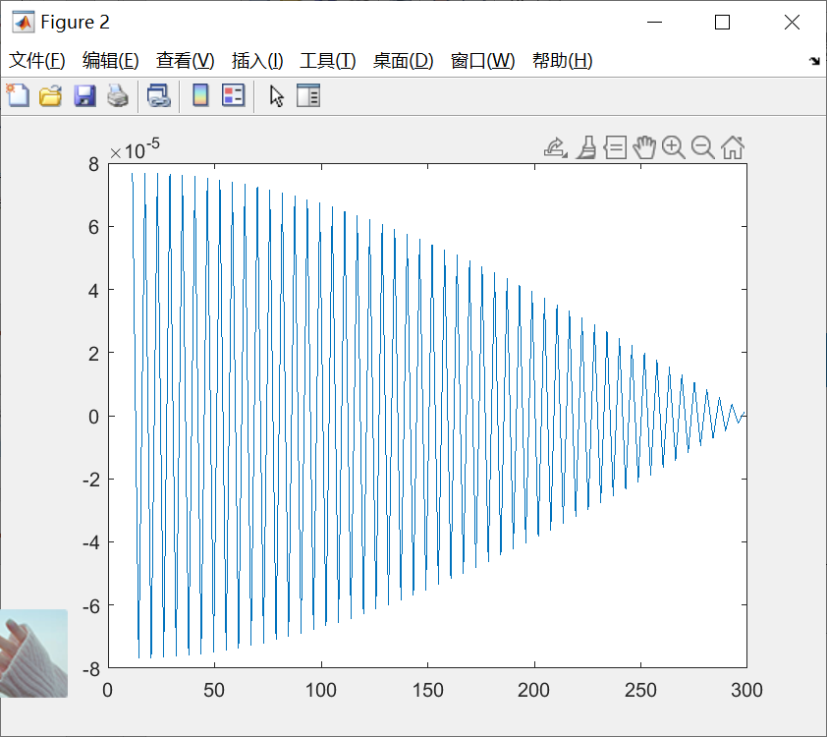

Slide 7
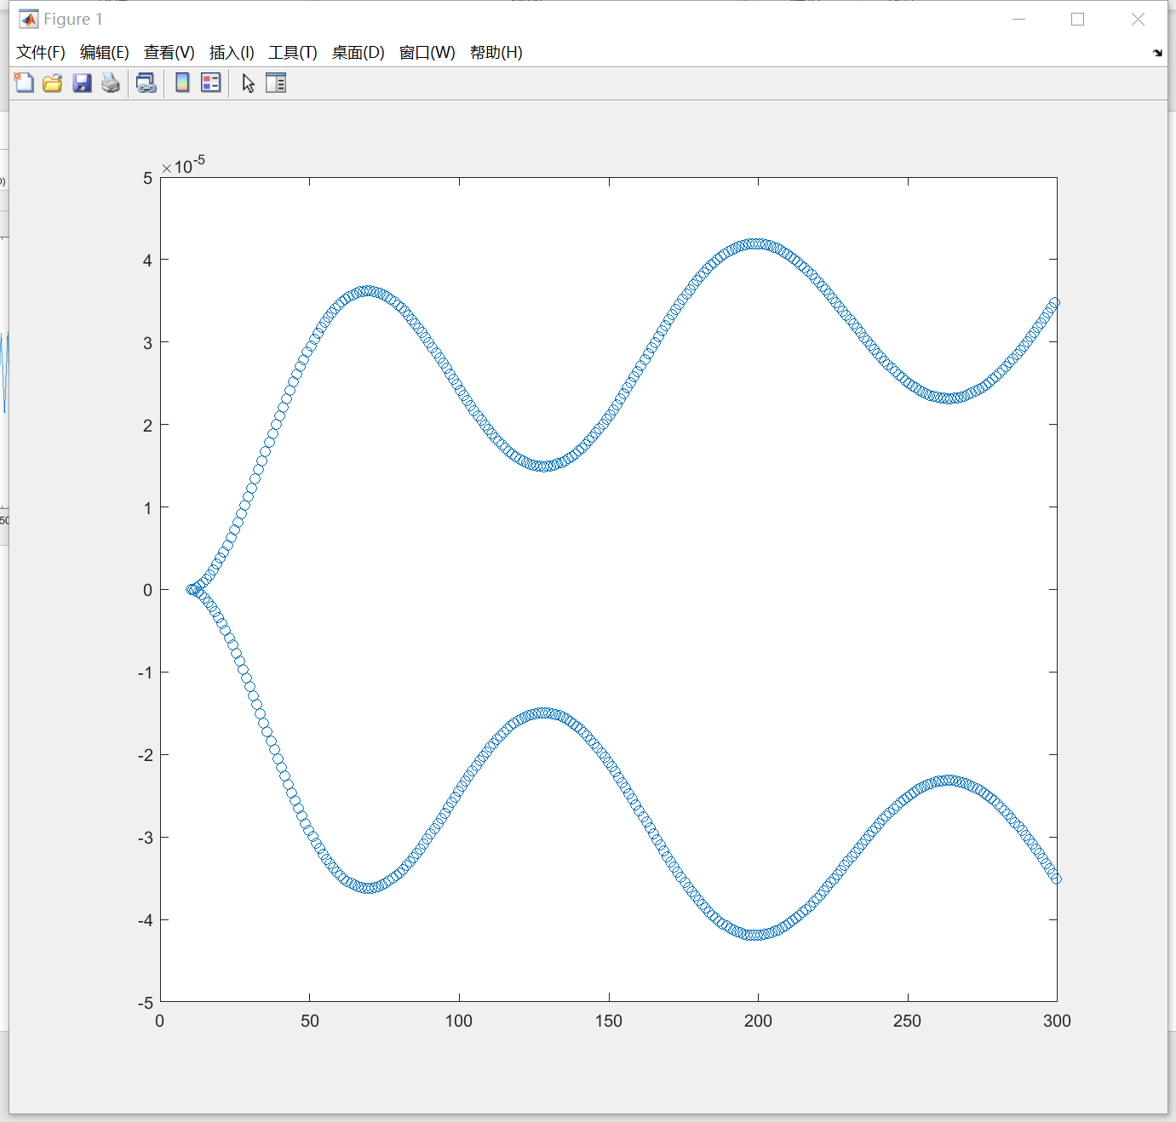
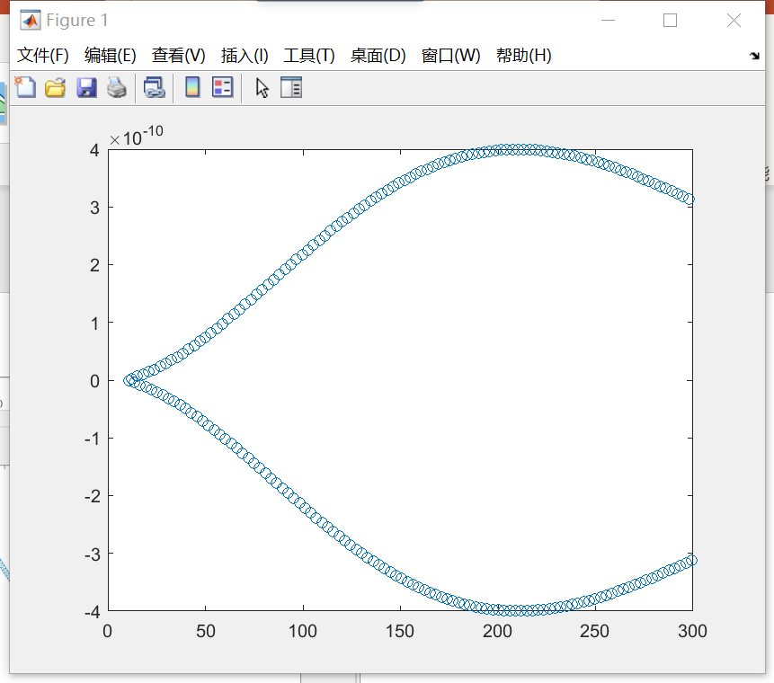
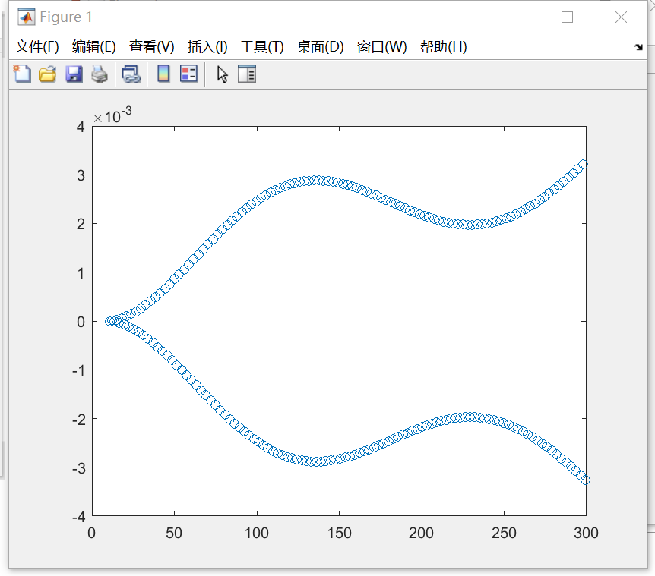

Slide 8
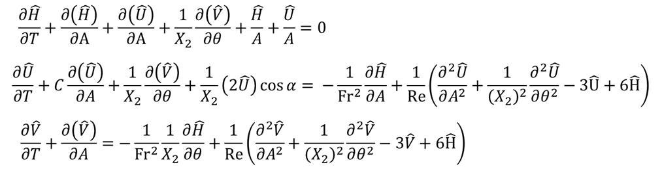
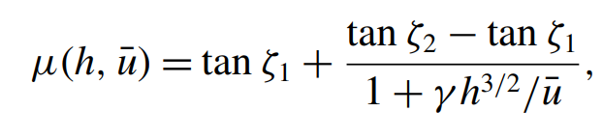
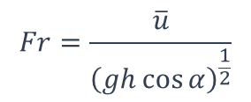
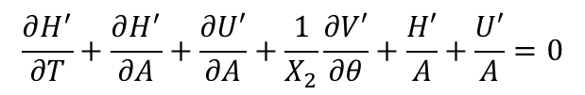

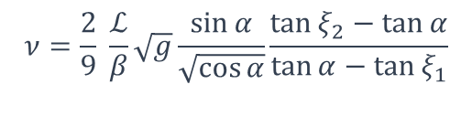
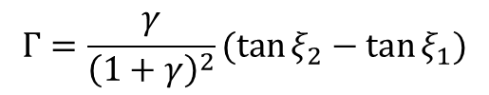

Non-dimensional depth-averaged governing eqns. --- Perturbation flow
$$H=1+H^{′}$$
$$U=1+U^{′}$$
$$V=0+V′$$
$$\frac{∂H^{′}}{∂T}+\frac{∂H^{′}}{∂A}+\frac{∂U′}{∂A}+\frac{1}{X_{2}}\frac{∂V′}{∂θ}+\frac{H′}{A}+\frac{U′}{A}=0$$
$$\frac{∂U′}{∂T}+C\frac{∂U′}{∂A}+\frac{1}{X_{2}}\frac{∂V′}{∂θ}+\frac{1}{X_{2}}2U^{′}\cos{α}=−\frac{1}{Fr^{2}}\frac{∂H^{′}}{∂A}+\frac{1}{Re^{∗}}\left[\frac{∂}{∂A}\left(\frac{∂U^{′}}{∂A}\right)+{\left(\frac{1}{X_{2}}\right)}^{2}\frac{∂}{∂θ}\left(\frac{∂U^{′}}{∂θ}\right)\right]+\frac{Γ}{Fr^{2}}\left(−U′+\frac{3}{2}H′\right)$$
$$\frac{∂V′}{∂T}+\frac{∂V′}{∂A}=−\frac{1}{Fr^{2}}\frac{1}{X_{2}}\frac{∂H′}{∂θ}+\frac{1}{Re^{∗}}\left[\frac{∂}{∂A}\left(\frac{∂V′}{∂A}\right)+{\left(\frac{1}{X_{2}}\right)}^{2}\frac{∂}{∂θ}\left(\frac{∂V′}{∂θ}\right)\right]+\frac{η}{Fr^{2}}\left(−V′+\frac{3}{2}H′\right)$$
In water model
$$Γ=\frac{γ}{{\left(1+γ\right)}^{2}}(\tan{ξ_{2}}−\tan{ξ_{1}})$$
Recall that
$$Fr=\frac{\overline{u}}{{\left(gh\cos{α}\right)}^{\frac{1}{2}}}$$
$$Re^{∗}=\frac{\overline{u}\sqrt{h}}{ν}$$
$$ν=\frac{2}{9} \frac{ℒ}{β}\sqrt{g}\frac{\sin{α}}{\sqrt{\cos{α}}}\frac{\tan{ξ_{2}}−\tan{α}}{\tan{α}−\tan{ξ_{1}}}$$

Slide 9



Slide 10




$$\left(\begin{matrix} & & 1 & & & & & & & & & & & & & & & & & \\ & & & 1 & & & & & & & & & & & & & & & & \\ & & & & 1 & & & & & & & & & & & & & & & \\ & & & & & & & & & & & & & & & & & & & \\ & & & & & & & & & & & & & & & & & & & \\ & & 1 & & & & & 1 & & & & & & & & & & & & \\ & & & 1 & & & & & 1 & & & & & & & & & & & \\ & & & & 1 & & & & & 1 & & & & & & & & & & \\ & & & & & & & & & & & & & & & & & & & \\ & & & & & & & & & & & & & & & & & & & \end{matrix}\right)$$
$$\left(\begin{matrix}{y_{IV}}_{1} \\ {y_{V}}_{1} \\ {y_{I}}_{2} \\ {y_{II}}_{2} \\ {y_{III}}_{2} \\ {y_{IV}}_{2} \\ {y_{V}}_{2} \\ {y_{I}}_{3} \\ {y_{II}}_{3} \\ {y_{III}}_{3} \\ {y_{IV}}_{3} \\ {y_{V}}_{3} \\ {y_{I}}_{4} \\ {y_{II}}_{4} \\ {y_{III}}_{4} \\ {y_{IV}}_{4} \\ {y_{V}}_{4} \\ {y_{I}}_{5} \\ {y_{II}}_{5} \\ {y_{III}}_{5}\end{matrix}\right)$$
$$\frac{iω}{2}$$
$$\left(\begin{matrix} & & & & & & & 1 & & & & & 1 & & & & & & & \\ & & & & & & & & 1 & & & & & 1 & & & & & & \\ & & & & & & & & & 1 & & & & & 1 & & & & & \\ & & & & & & & & & & & & & & & & & & & \\ & & & & & & & & & & & & & & & & & & & \\ & & & & & & & & & & & & 1 & & & & & 1 & & \\ & & & & & & & & & & & & & 1 & & & & & 1 & \\ & & & & & & & & & & & & & & 1 & & & & & 1 \\ & & & & & & & & & & & & & & & & & & & \\ & & & & & & & & & & & & & & & & & & & \end{matrix}\right)$$

Slide 11
Appendix

Slide 12




$$\left(\begin{matrix}L_{8} & & L_{1} & L_{3} & L_{5} & L_{7} & & & & & & \\ L_{16} & & L_{9} & L_{11} & L_{13} & L_{15} & & & & & & \\ & L_{22} & L_{17} & & L_{19} & & L_{21} & & & & & \\ L_{26} & & & L_{23} & & L_{25} & & & & & & \\ & L_{30} & & & L_{27} & & L_{29} & & & & & \\ & & L_{2} & L_{4} & L_{6} & L_{8} & & L_{1} & L_{3} & L_{5} & L_{7} & \\ & & L_{10} & L_{12} & L_{14} & L_{16} & & L_{9} & L_{11} & L_{13} & L_{15} & \\ & & L_{18} & & L_{20} & & L_{22} & L_{17} & & L_{19} & & L_{21} \\ & & & L_{24} & & L_{26} & & & L_{23} & & L_{25} & \\ & & & & L_{28} & & L_{30} & & & L_{27} & & L_{29}\end{matrix}\right)$$
$$\begin{matrix}{y_{IV}}_{1} \\ {y_{V}}_{1} \\ {y_{I}}_{2} \\ {y_{II}}_{2} \\ {y_{III}}_{2} \\ {y_{IV}}_{2} \\ {y_{V}}_{2} \\ {y_{I}}_{3} \\ {y_{II}}_{3} \\ {y_{III}}_{3} \\ {y_{IV}}_{3} \\ {y_{V}}_{3} \\ {y_{I}}_{4} \\ {y_{II}}_{4} \\ {y_{III}}_{4} \\ {y_{IV}}_{4} \\ {y_{V}}_{4} \\ {y_{I}}_{5} \\ {y_{II}}_{5} \\ {y_{III}}_{5}\end{matrix}$$
$$\left(\begin{matrix}L_{2} & L_{4} & L_{6} & L_{8} & & L_{1} & L_{3} & L_{5} & L_{7} & & & & \\ L_{10} & L_{12} & L_{14} & L_{16} & & L_{9} & L_{11} & L_{13} & L_{15} & & & & \\ L_{18} & & L_{20} & & L_{22} & L_{17} & & L_{19} & & L_{21} & & & \\ & L_{24} & & L_{26} & & & L_{23} & & L_{25} & & & & \\ & & L_{28} & & L_{30} & & & L_{27} & & L_{29} & & & \\ & & & & & L_{2} & L_{4} & L_{6} & L_{8} & & L_{1} & L_{3} & L_{5} \\ & & & & & L_{10} & L_{12} & L_{14} & L_{16} & & L_{9} & L_{11} & L_{13} \\ & & & & & L_{18} & & L_{20} & & L_{22} & L_{17} & & L_{19} \\ & & & & & & L_{24} & & L_{26} & & & L_{23} & \\ & & & & & & & L_{28} & & L_{30} & & & L_{27}\end{matrix}\right)$$

Slide 13



$$LHS_{1}=\left(\begin{matrix}L_{1} & L_{3}+\frac{L_{8}}{h} & L_{5} & L_{7} & & & & & & & & & & & \\ L_{9} & L_{11}+\frac{L_{16}}{h} & L_{13} & L_{15} & & & & & & & & & & & \\ L_{17} & & L_{19}+\frac{L_{22}}{h} & & L_{21} & & & & & & & & & & \\ & L_{23}+\frac{L_{26}}{h} & & L_{25} & & & & & & & & & & & \\ & & L_{27}+\frac{L_{30}}{h} & & L_{29} & & & & & & & & & & \\ L_{2} & L_{4} & L_{6} & L_{8} & & L_{1} & L_{3} & L_{5} & L_{7} & & & & & & \\ L_{10} & L_{12} & L_{14} & L_{16} & & L_{9} & L_{11} & L_{13} & L_{15} & & & & & & \\ L_{18} & & L_{20} & & L_{22} & L_{17} & & L_{19} & & L_{21} & & & & & \\ & L_{24} & & L_{26} & & & L_{23} & & L_{25} & & & & & & \\ & & L_{28} & & L_{30} & & & L_{27} & & L_{29} & & & & & \\ & & & & & & & & & & & & & & \\ & & & & & & & & & & & & & & \\ & & & & & & & & & & & & & & \\ & & & & & & & & & & & & & & \\ & & & & & & & & & & & & & & \end{matrix}\right)$$
$$\left(\begin{matrix}{y_{I}}_{1} \\ {y_{II}}_{1} \\ {y_{III}}_{1} \\ {y_{IV}}_{1} \\ {y_{V}}_{1} \\ {y_{I}}_{2} \\ {y_{Ii}}_{2} \\ {y_{Iii}}_{2} \\ {y_{IV}}_{2} \\ {y_{V}}_{2} \\ {y_{I}}_{3} \\ {y_{II}}_{3} \\ {y_{III}}_{3} \\ {y_{IV}}_{3} \\ {y_{V}}_{3} \\ {y_{I}}_{4} \\ {y_{II}}_{4} \\ {y_{III}}_{4} \\ {y_{IV}}_{4} \\ {y_{V}}_{4} \\ {y_{I}}_{5} \\ {y_{II}}_{5} \\ {y_{III}}_{5} \\ {y_{IV}}_{5} \\ {y_{V}}_{5}\end{matrix}\right)$$
$$LHS_{2}=\left(\begin{matrix}L_{1} & L_{3}+\frac{L_{8}}{h} & L_{5} & L_{7} & & & & & & & & & & & \\ L_{9} & L_{11}+\frac{L_{16}}{h} & L_{13} & L_{15} & & & & & & & & & & & \\ L_{17} & & L_{19}+\frac{L_{22}}{h} & & L_{21} & & & & & & & & & & \\ & L_{23}+\frac{L_{26}}{h} & & L_{25} & & & & & & & & & & & \\ & & L_{27}+\frac{L_{30}}{h} & & L_{29} & & & & & & & & & & \\ L_{2} & L_{4} & L_{6} & L_{8} & & L_{1} & L_{3} & L_{5} & L_{7} & & & & & & \\ L_{10} & L_{12} & L_{14} & L_{16} & & L_{9} & L_{11} & L_{13} & L_{15} & & & & & & \\ L_{18} & & L_{20} & & L_{22} & L_{17} & & L_{19} & & L_{21} & & & & & \\ & L_{24} & & L_{26} & & & L_{23} & & L_{25} & & & & & & \\ & & L_{28} & & L_{30} & & & L_{27} & & L_{29} & & & & & \\ & & & & & & & & & & & & & & \\ & & & & & & & & & & & & & & \\ & & & & & & & & & & & & & & \\ & & & & & & & & & & & & & & \\ & & & & & & & & & & & & & & \end{matrix}\right)$$

Slide 14

$$\left(\begin{matrix}{y_{I}}_{1} \\ {y_{II}}_{1} \\ {y_{III}}_{1} \\ {y_{IV}}_{1} \\ {y_{V}}_{1} \\ {y_{I}}_{2} \\ {y_{Ii}}_{2} \\ {y_{Iii}}_{2} \\ {y_{IV}}_{2} \\ {y_{V}}_{2} \\ {y_{I}}_{3} \\ {y_{II}}_{3} \\ {y_{III}}_{3} \\ {y_{IV}}_{3} \\ {y_{V}}_{3} \\ {y_{I}}_{4} \\ {y_{II}}_{4} \\ {y_{III}}_{4} \\ {y_{IV}}_{4} \\ {y_{V}}_{4} \\ {y_{I}}_{5} \\ {y_{II}}_{5} \\ {y_{III}}_{5} \\ {y_{IV}}_{5} \\ {y_{V}}_{5}\end{matrix}\right)$$

Slide 15

$$LHS=\left(\begin{matrix} & & & & & & & & & & & & & & \\ & & & & & & & & & & & & & & \\ & & & & & & & & & & & & & & \\ & & & & & & & & & & & & & & \\ & & & & & & & & & & & & & & \\ & & & & & & & & & & & & & & \\ & & & & & & & & & & & & & & \\ & & & & & & & & & & & & & & \\ & & & & & & & & & & & & & & \\ & & & & & & & & & & & & & & \\ & & & & & & & & & & & & & & \\ & & & & & & & & & & & & & & \\ & & & & & & & & & & & & & & \\ & & & & & & & & & & & & & & \\ & & & & & & & & & & & & & & \end{matrix}\right)\left(\begin{aligned}{y_{I}}_{2} \\ {y_{II}}_{2} \\ {y_{III}}_{2} \\ {y_{IV}}_{2} \\ {y_{V}}_{2} \\ {y_{I}}_{3} \\ {y_{II}}_{3} \\ {y_{III}}_{3} \\ {y_{IV}}_{3} \\ {y_{V}}_{3} \\ {y_{I}}_{4} \\ {y_{II}}_{4} \\ {y_{III}}_{4} \\ {y_{IV}}_{4} \\ {y_{V}}_{4}\end{aligned}\right)$$

Slide 16


Slide 17

$$LHS=\left(\begin{matrix}L_{1} & L_{3}+\frac{L_{8}}{h} & L_{5} & L_{7} & & & & & & & & & & & \\ L_{9} & L_{11}+\frac{L_{16}}{h} & L_{13} & L_{15} & & & & & & & & & & & \\ L_{17} & & L_{19}+\frac{L_{22}}{h} & & L_{21} & & & & & & & & & & \\ & L_{23}+\frac{L_{26}}{h} & & L_{25} & & & & & & & & & & & \\ & & L_{27}+\frac{L_{30}}{h} & & L_{29} & & & & & & & & & & \\ L_{2} & L_{4} & L_{6} & L_{8} & & L_{1} & L_{3} & L_{5} & L_{7} & & & & & & \\ L_{10} & L_{12} & L_{14} & L_{16} & & L_{9} & L_{11} & L_{13} & L_{15} & & & & & & \\ L_{18} & & L_{20} & & L_{22} & L_{17} & & L_{19} & & L_{21} & & & & & \\ & L_{24} & & L_{26} & & & L_{23} & & L_{25} & & & & & & \\ & & L_{28} & & L_{30} & & & L_{27} & & L_{29} & & & & & \\ & & & & & & & & & & & & & & \\ & & & & & & & & & & & & & & \\ & & & & & & & & & & & & & & \\ & & & & & & & & & & & & & & \\ & & & & & & & & & & & & & & \end{matrix}\right)\left(\begin{aligned}{y_{I}}_{2} \\ {y_{II}}_{2} \\ {y_{III}}_{2} \\ {y_{IV}}_{2} \\ {y_{V}}_{2} \\ {y_{I}}_{3} \\ {y_{II}}_{3} \\ {y_{III}}_{3} \\ {y_{IV}}_{3} \\ {y_{V}}_{3} \\ {y_{I}}_{4} \\ {y_{II}}_{4} \\ {y_{III}}_{4} \\ {y_{IV}}_{4} \\ {y_{V}}_{4}\end{aligned}\right)$$

