Slide 1

Mentorship & Teamwork
IART 2022
Luís Soares - up201406356

Slide 2
Specification
Project summary as described on Hash Code 2022: You are given a list of contributors, who have already mastered various skills, and a list of projects with different skill requirements. Each contributor has a name and one or more skills at a specific level (0,1,2,...). Not possessing a skill is equivalent to possessing a skill at level 0.
Contributors can improve their skills by completing projects if their skill level is equal to or 1 level below the skill requirement, and they can mentor each other to work in roles in which they couldn't succeed on their own. There are M projects, each project is described by its name, the duration of the project in days, the score awarded for completing the project, the "best before" time in days, and a list of roles for contributors to work.
Our task is to assign contributors to project roles that fit their qualifications and maximize the score for completed projects. The project score is penalised if it is not finished before the "best day".

Slide 3
Related Work
In this work, the aim is to implement a system to solve an optimization problem, using different algorithms or meta-heuristics, such as hill-climbing, simulated annealing, tabu search, and genetic algorithms.
We searched for information from different sources, though the class materials and the lectures were by far the ones that helped the most to understand how to solve the problem.
http://www.cplusplus.com/forum/general/213115/
https://www.geeksforgeeks.org/introduction-hill-climbing-artificial-intelligence/
https://www.sciencedirect.com/topics/engineering/simulated-annealing-algorithm
https://github.com/nathanrooy/simulated-annealing:
https://github.com/polatbilek/Tabu-search-on-Travelling-Salesman-Problem
https://www.intechopen.com/online-first/77046
https://github.com/andschwa/uidaho-cs472-project1
https://en.wikipedia.org/wiki/Genetic_algorithm

Slide 4
Problem Formulation
In order to solve this problem, we chose an initial state from which we will find the optimum solution or a genome (in the case of genetic algorithms).. In our case, since we are using metaheuristics for optimization/decision we started with a randomly generated solution for our initial state and improve from there. The initial state has different order of the project for different projects and has different contributors for each skill required and all the contributors have the skill required.
After the choice of the initial state, we are able to change either the order of the work or the people working on it.
We have an evaluation function that must have in attention the state's score, having in consideration the penalties and the fact that some solutions will not respect that the people working on a project are not qualified enough for it.

Slide 5
Implementation Work
The program was developed in C++ using Eclipse. The code implementation for the algorithms is fully ready, I was able to find most of the base code and pseudo-code for them in the researches. I had a problem, with tabu search, though it was working properly it started to crash and give so problems when compiling that couldn't be solved for this delivery, I couldn´t spot the problem, because it seemed like it would crash after I try to break from a loop, but the logic of the algorithm is presented in the code file and commented.

Slide 6
Implemented Algorithms
Hill Climbing: After the choice of an initial state we analyze either a predefined or a given number of neighbors and their fitness value. We stop when no neighbor is better than the current node.
Simulated Annealing:Pretty much the same approach though now we have either a predefined or given initial temperature, final temperature, cooling rate and iterations per cycle. We analyse the neighbors but we can accept worst neighbors depending on the temperature.
Tabu Search: We keep a tabu table with either a given or predefined tabu tenure that prevents from choosing neighbors with blocked moves. For some reason this was implemented but is not working properly.
Genetic Algorithms: Values like the number of iterations or the size of the genome can be given or used the predefined, the goal is from the highest valued solutions of the genome cross them in a random way such that we get a higher valued generation. It was taken in consideration that the solutions should have the same contributor for different skills of the same project and different projects cant have the same order. Also, there is a mutation factor that introduces some randomness.

Slide 7
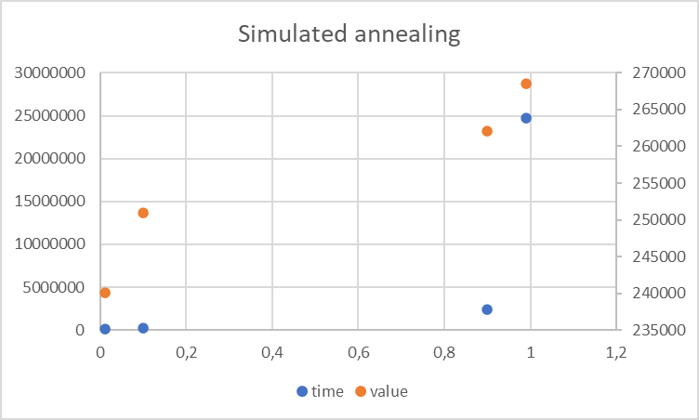
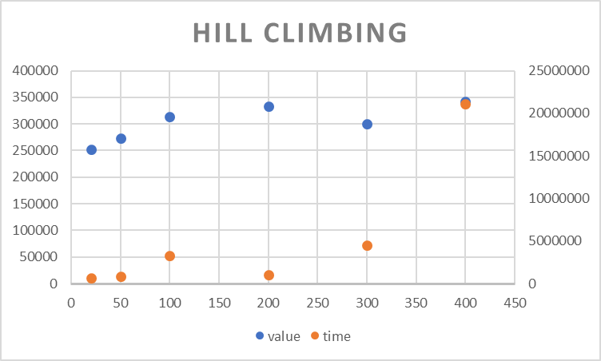
Experimental results

Slide 8
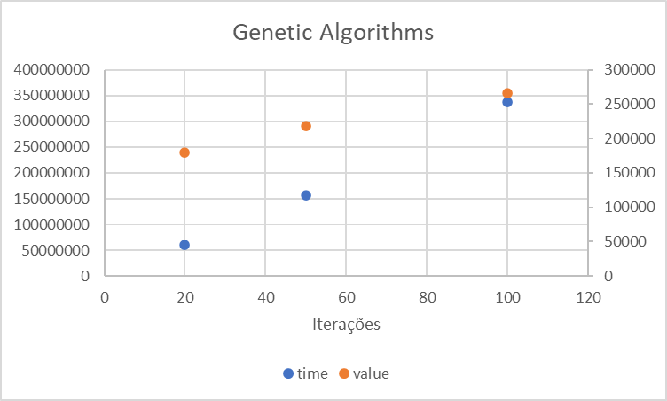
Experimental results

Slide 9
Conclusions
We can conclude that for hill climbing we will only get maximum local and the as much neighbors we check for iteration the higher the value we will get in average.
For simulated annealing, considering we chose good temperatures, we can escape local maximum and approach to global maximum, as higher we set the cooling rate as better the results will be.
For the genetic algorithms we will have higher values for the solution as we increase the genome or the iterations, though the time of computation increases a lot.

