Slide 1
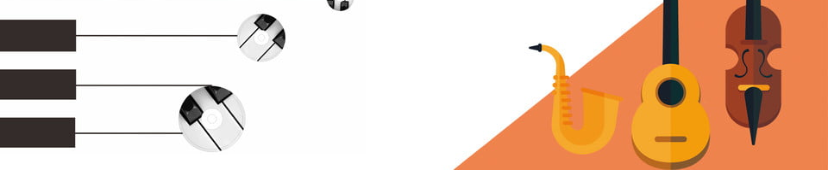

Slide 2
HOME
MSK
INFO
MSK
LESSON
MSK

Slide 3
NEWS
MSK
RESOURCE
MSK
ABOUT
MSK

Slide 4

JOIN
US

Slide 5

Learn
Piano

Slide 6
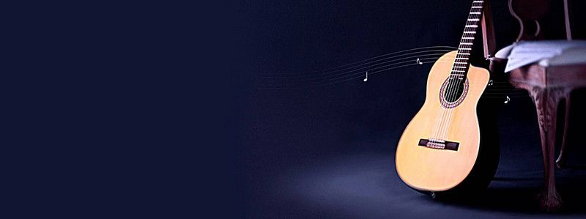
Learn Guitar

Slide 7

Learn Drum

Slide 8
