Slide 1
Autonomous Renewable-Powered Irrigation System
6th INTERNATIONAL EURASIAN CONFERENCE
ON SCIENCE ENGINEERING and TECHNOLOGY
Hakan Temiz | Muhammed Enes Kandemir | Eren Güler | Hüseyin Gürgün | Gökhan Yavuz
Artvin Coruh University - Department of Computer Engineering
25.06.2025

Slide 2



Introduction - Problem Definition
Irrigation of landscape areas requires intensive labor.
Manual control leads to time/resource waste.
Human errors cause environmental issues.

Slide 3



Existing Issues
IRRIGATION DURING RAINFALL.
OVER-IRRIGATION HARMS PLANTS AND SOIL.
TRACKING IRRIGATED ZONES IS ERROR-PRONE.

Slide 4
Proposed Solution
Autonomous/semi-autonomous system powered by solar energy
Operates independently of electrical grid.
Daytime energy storage,night-time irrigation.
Ability to perform special irrigation in two separate regions
Achieving water and energy savings
No human intervention needed
The system can operate in rural areas such as fields without the need for grid electricity.
Providing remote control and monitoring
Increases plant health and productivity.
Thanks to its modular structure, it can be easily adapted to different area sizes.
Provides time and resource management.
Since the software and hardware are developed according to open source principles, they are open to development.
Making irrigation decisions with real-time sensor data
Suitable for rural and urban areas.

Slide 5



Technical Components
Energy: Solar panels, batteries.
Communication: Wireless (Wi-Fi, LoRa, etc.).
Control: Local controllers and remote software.

Slide 6
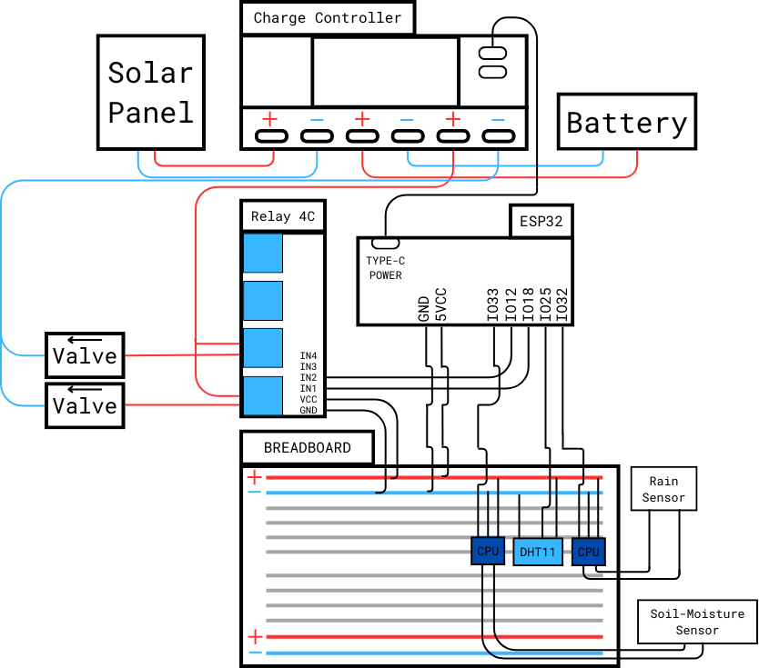
Sensors continuously measure environmental data (humidity, soil moisture, rainfall, etc.).
This data is transmitted wirelessly to the microcontroller.
The microcontroller determines the need for irrigation by analyzing sensor data.
If needed, the valve in the relevant area is automatically opened.
When the irrigation process is completed, the valve is closed.
The user can access the system through a simple interface, view the current status and change settings.

Slide 7
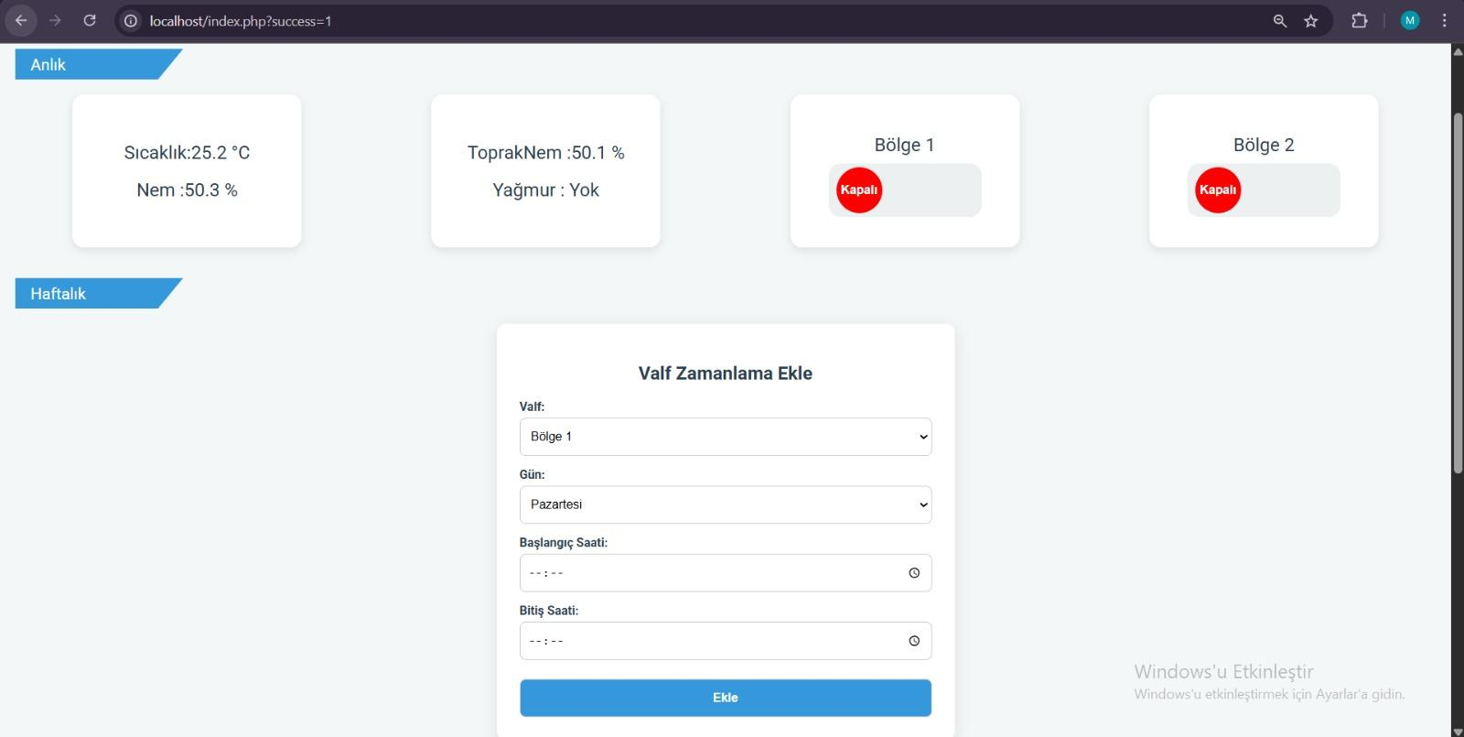
The system can also perform automatic irrigation at certain time intervals (timer feature).
At least two different irrigation zones can be managed independently of each other.

Slide 8
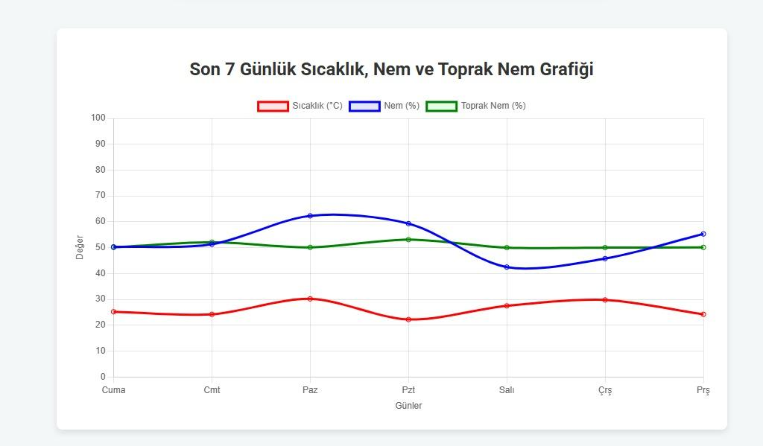
Data received from sensors are recorded regularly by the system.
Users can view daily and weekly sensor data graphically via the interface.Data received from sensors are recorded regularly by the system.

Slide 9
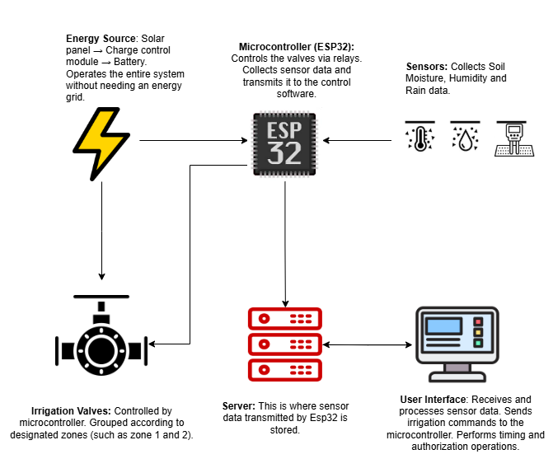
Flow Chart

Slide 10




Goals and Contributions
IMPROVE WATER USE EFFICIENCY.
REDUCE ENVIRONMENTAL IMPACT.
SUPPORT PLANT GROWTH.
PROMOTE SUSTAINABLE IRRIGATION.

Slide 11
Conclusion
An irrigation system that works with solar energy and is not dependent on the electricity grid has been developed.
The system is designed to automatically or semi-automatically irrigate at least two independent zones.
Environmental conditions are monitored in real time with soil moisture, rain and humidity sensors.
Irrigation decisions are made automatically based on sensor data or scheduling.
Remote control and monitoring can be achieved via wireless communication.
Weekly and instant sensor data are presented to the user; historical data can be analyzed.

Slide 12
Conclusion
Water savings were achieved by preventing unnecessary irrigation.
The need for physical labor has decreased, and all operations can be managed from a single center.
The system was developed in a modular structure that can be adapted to various areas such as fields, greenhouses and campuses.
The project is an example of smart agricultural practices and sustainable irrigation systems.

Slide 13
Thanks for your attention
Hakan Temiz | Muhammed Enes Kandemir | Eren Güler | Hüseyin Gürgün | Gökhan Yavuz

