Slide 1
NextRoom
Nicolò Palmiero
Luigi Sigillo
Supervisor: Joy Abi Rizk
Repository
https://github.com/LuigiSigillo/IotBigProject

Slide 2
Changes from 1° delivery
The main changes from the first delivery are:
We faced the problem of the COVID-19 and limited accesses to the museum in our system and redefined our solution taking into account this factor.
After some tests we decided to discard the option to implement the communication between each board and Azure IoT Hub using LoRaWAN. The test we have done to make this decision will be later described.
Since we have the possibility to test on a physical board we have changed our plans to evaluate our system. Indeed now we can do better evaluation tests, and discarded the possibility to use Fit IoT Lab mobile robots.

Slide 3
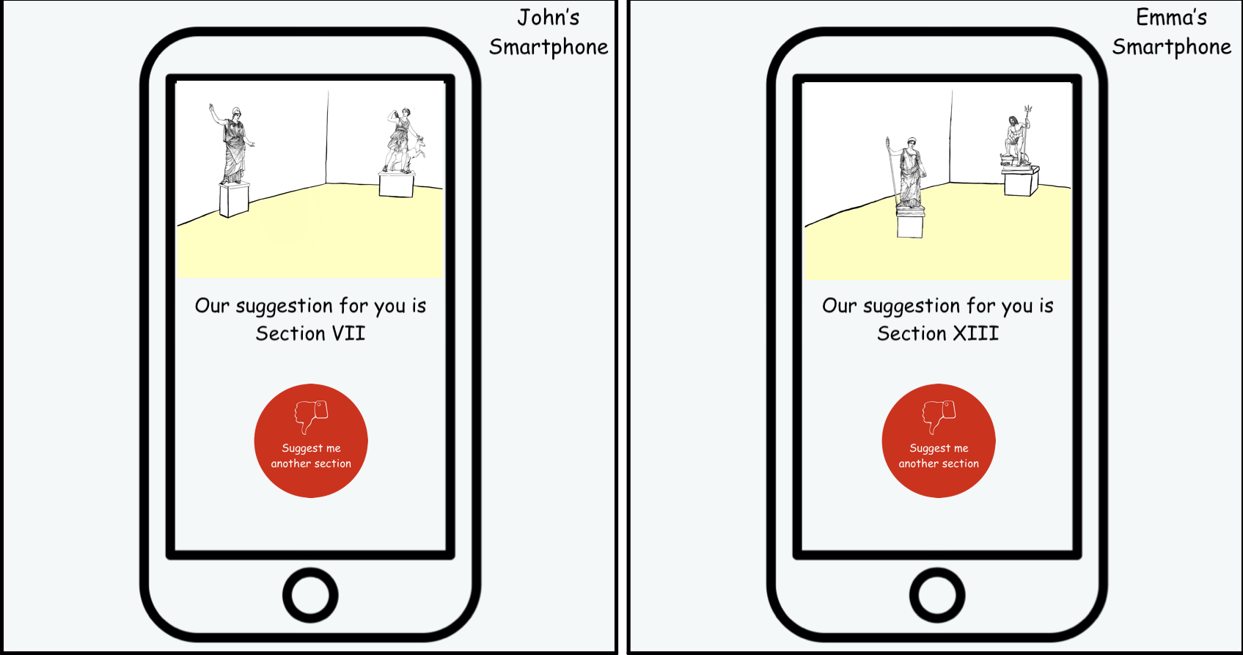
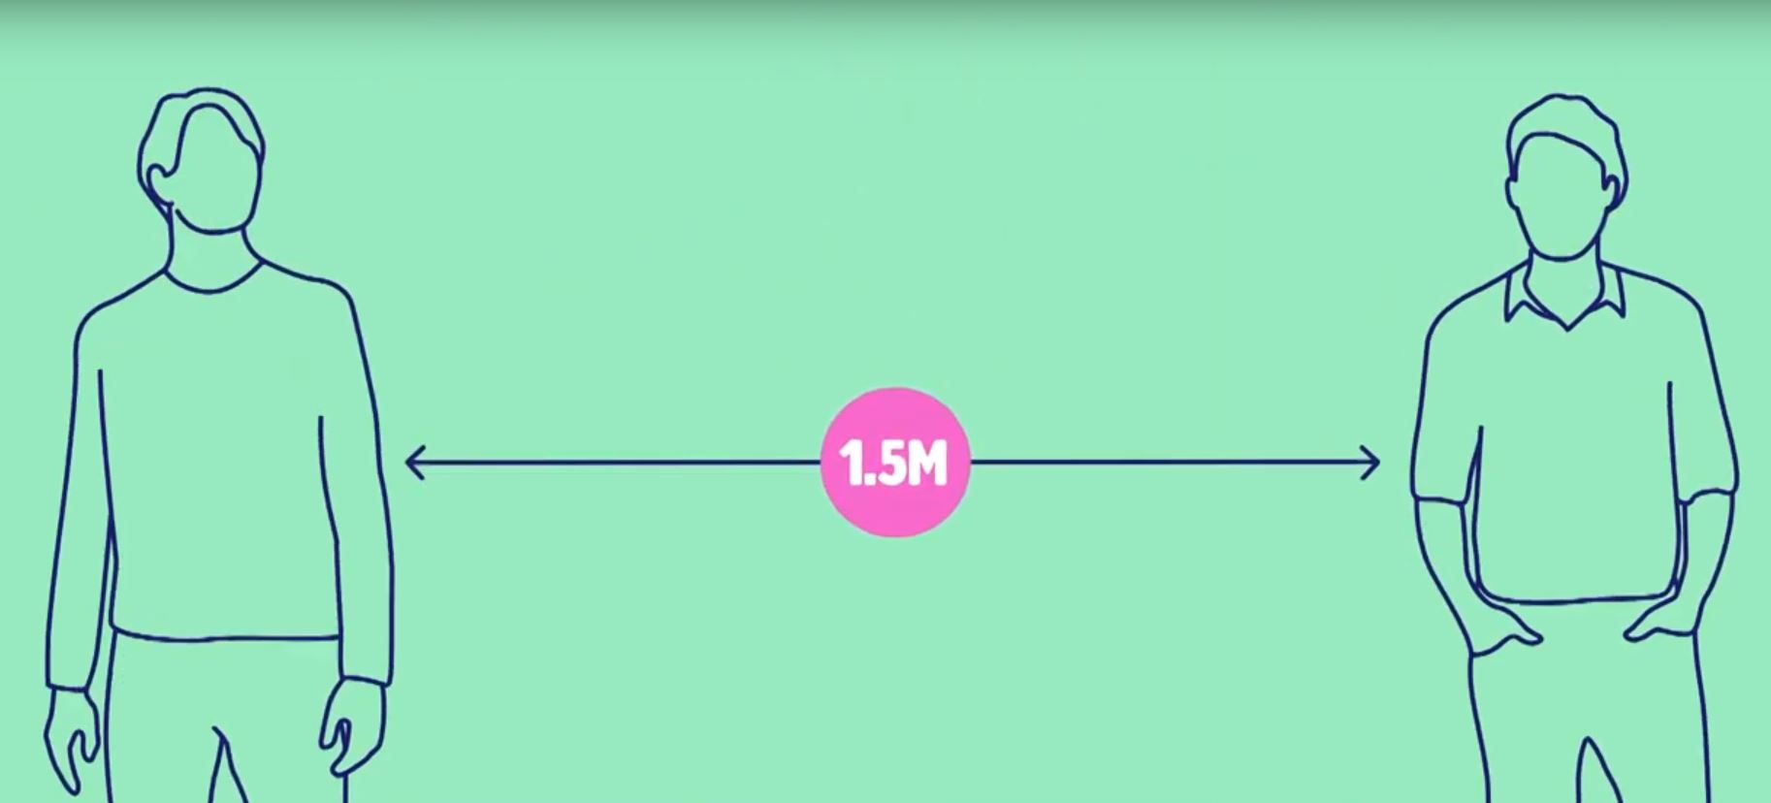
The problems
Personalized tours in the museum
Museum visits during the COVID-19 emergency

Slide 4
Our solution for personalized tours
Web application that runs on a smartphone
During a tour suggests the next section you could visit based on the time you have spent in the previous sections
The application will display a preview of the suggested section
The user could choose to follow it or to jump to another suggestion.
The suggestions are sent every time a user is leaving a section

Slide 5
Our solution to avoid gatherings
Solve the crowd problem of our personalized tour in these times in which sections cannot be overcrowded:
Dashboard for the curators of the museum to monitor the number of people in the different sections of the museum.
Added features to try to equalize the number of people in each section.
Suggest the most interesting section for the visitor and, at the same time, try to avoid the formation of gatherings

Slide 6
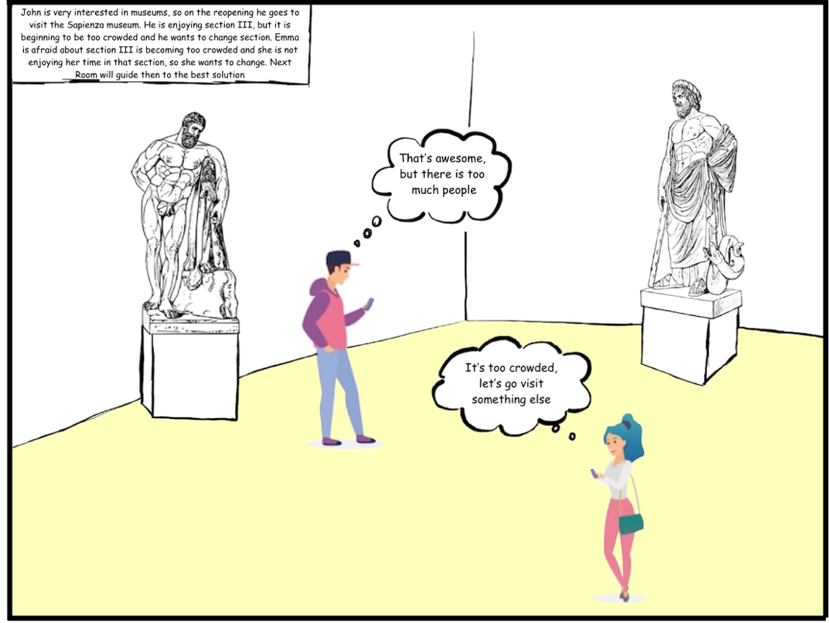
A Possible Scenario

Slide 7
A Possible Scenario

Slide 8
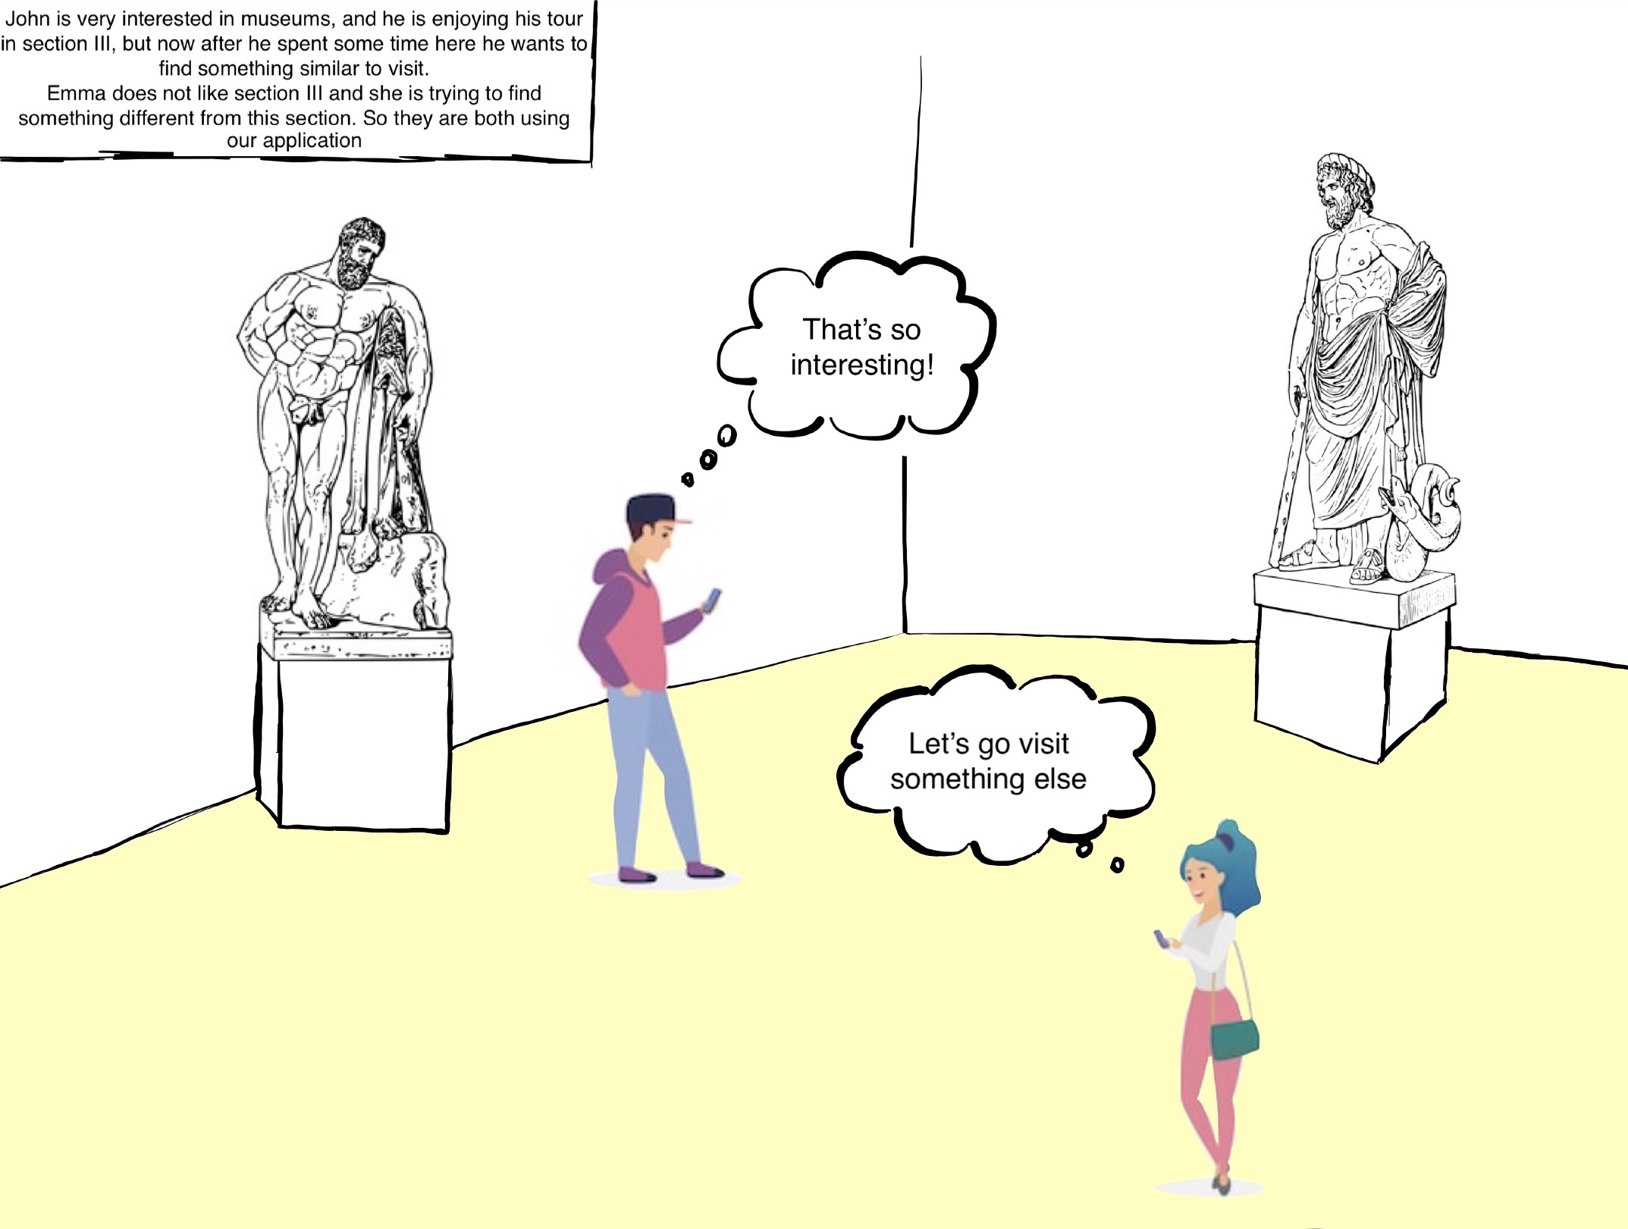
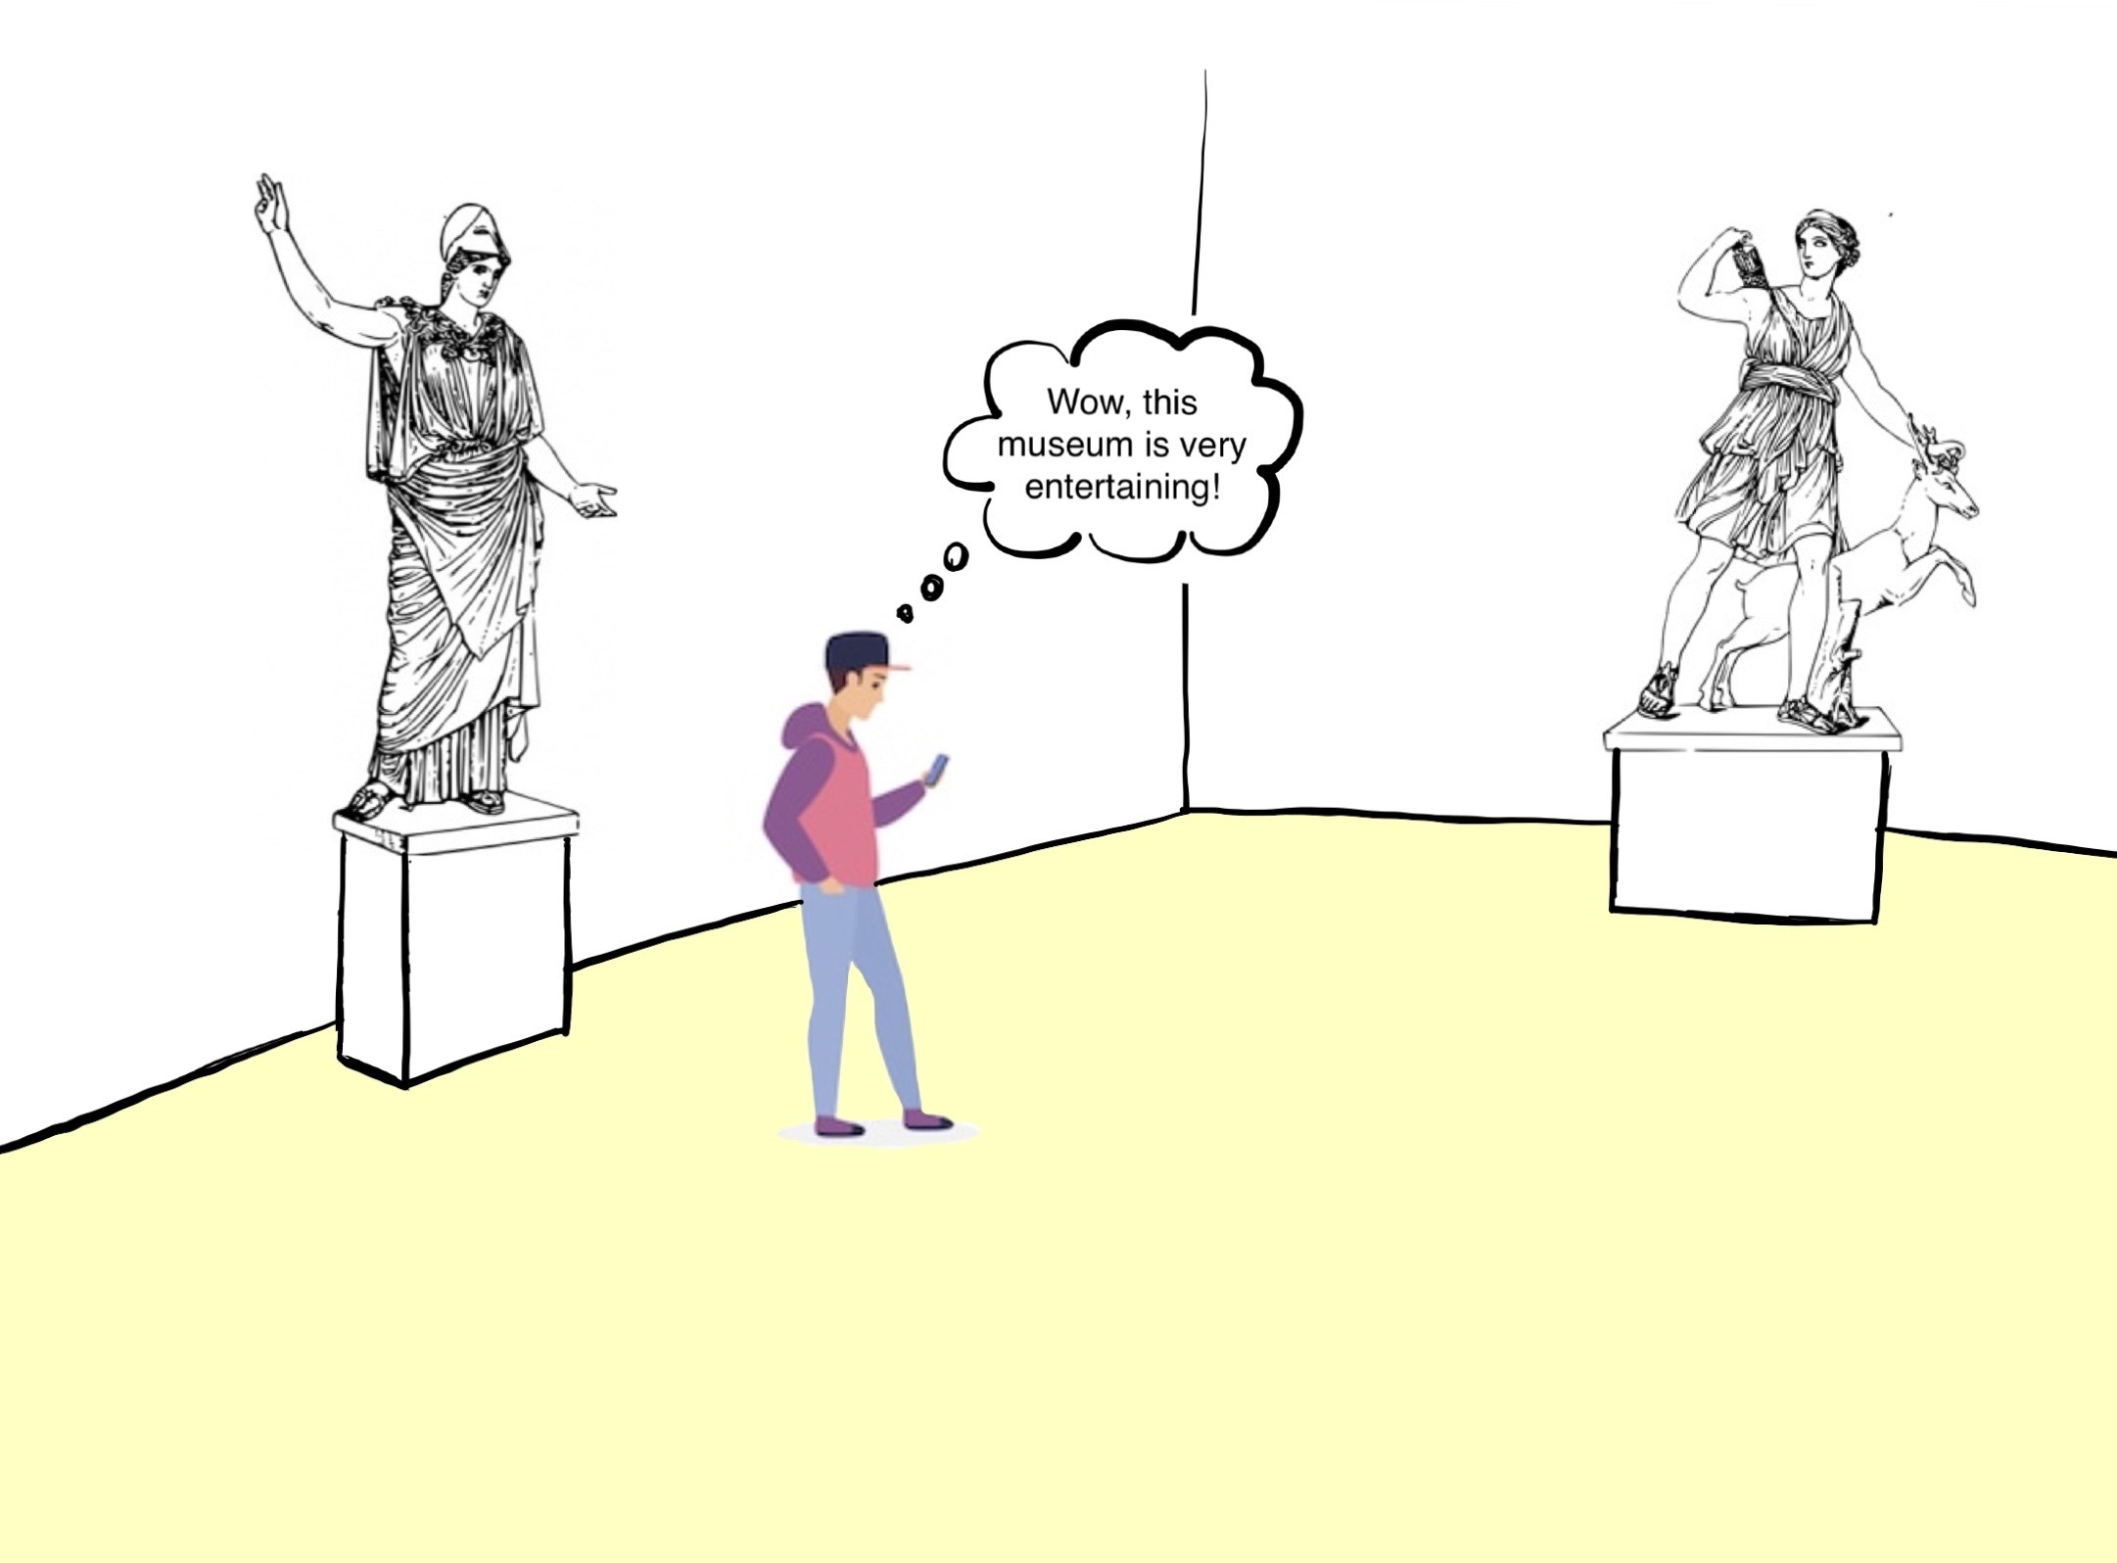
A Possible Scenario

Slide 9
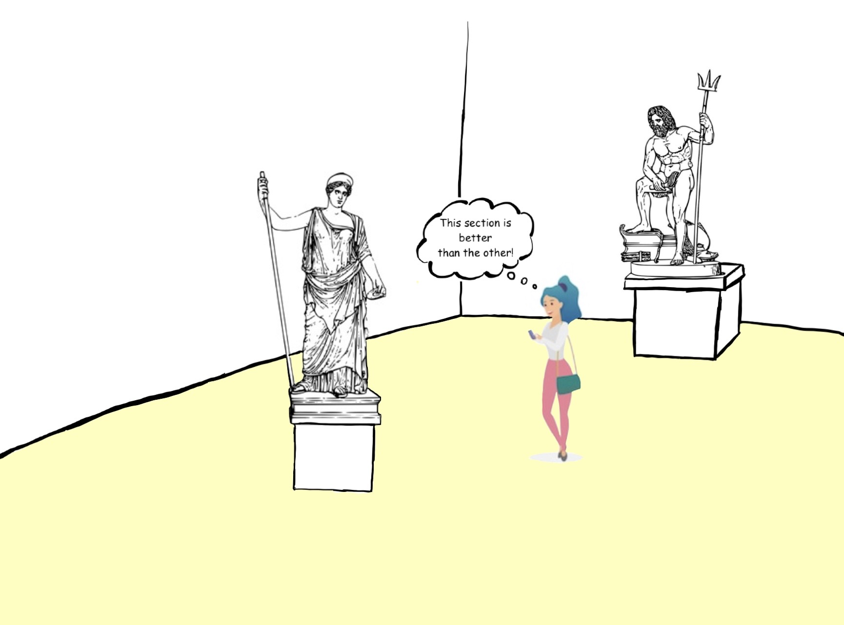
A Possible Scenario

Slide 10
Architecture

Slide 11
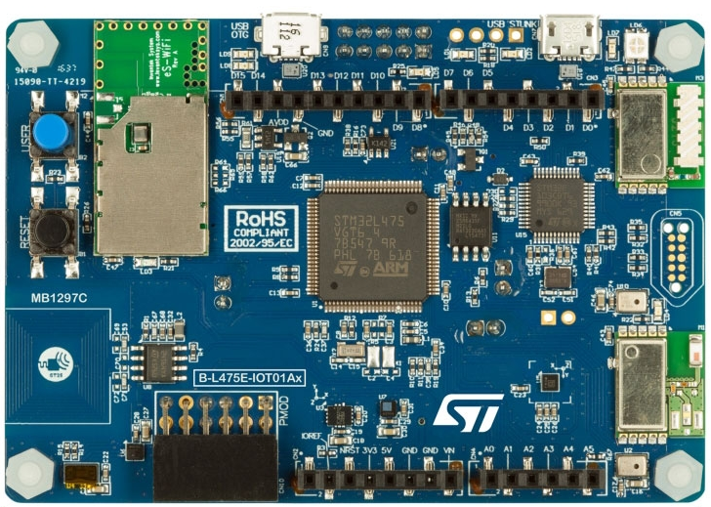

B-L475E-IOT01A Discovery kit
Ultra-low-power STM32L4 Series MCUs based on Arm® Cortex®-M4 core with 1 Mbyte of Flash memory and 128 Kbytes of SRAM
Bluetooth® V4.1 module (BLE technology)
802.11 b/g/n compliant Wi-Fi® module from Inventek

Slide 12
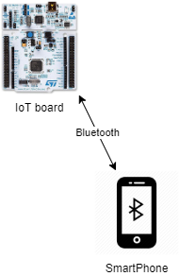
Typical scenario
BLE technology
Bluetooth beacon functionality

Slide 13
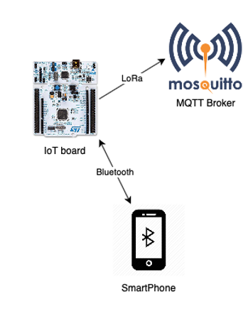
MQTT Protocol
MQTT protocol
Eclipse Mosquitto MQTT Broker

Slide 14
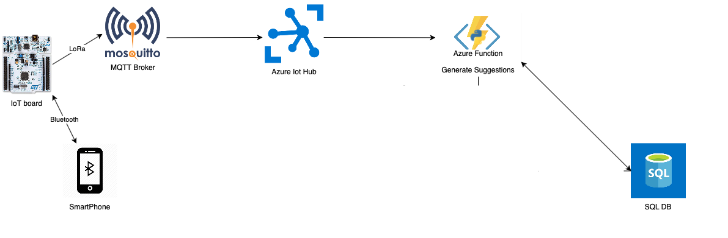
Cloud Services
Azure Cloud services
Azure Function
Azure IoT Hub
Azure SQL DB

Slide 15
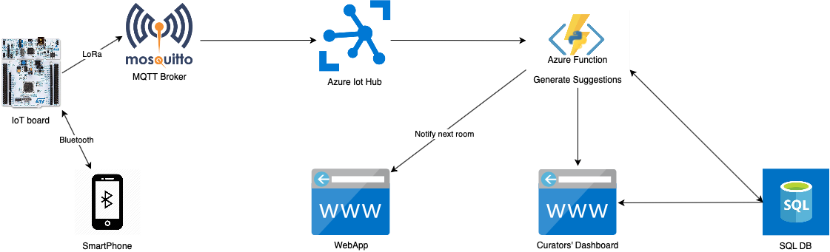
The complete flow
Azure App service will host the Web Application

Slide 16
Technical work done so far
Our work, from a technical point of view up to now is:
We have implemented the cloud infrastructure to make the system work:
An SQL database with all the necessary tables to maintain useful data to be processed by our system.
We implemented a scoring algorithm that takes into account the similarity between recent visits and the current visit, and the number of people that is currently in each section.
We have a starting version of the web application that gives suggestion about the next room to visit, taking into account the taste of the visitor and the crowding situation in each section.

Slide 17
Technical work for the last delivery
The boards in our future plans have to communicate to reach a consensus about the final list of devices in each section, moreover they have to send this list to the cloud.
We do not know if the board can handle this load. Otherwise the computation will be done using the computational power of the cloud as we do now.
The curators dashboard

Slide 18
Evaluation

Slide 19


Technical Evaluation
LoRaWAN and TTN not used anymore.
60% of message loss with TTN.
MQTT with Eclipse Mosquitto broker

Slide 20
Pricing Evaluation
Board Pricing
The board used is the B-L475E-IOT01A Discovery kit that has a retail price of about 50€
Considering at least two rooms per section, the estimated cost will be around 500€
Cloud Pricing
Azure Function: the first 400,000 GB/s of execution and 1,000,000 executions are free. Then you pay what you consume (serverless)
App service: The basic plan cost around 60€, for testing purpose we will use the free one.
Azure SQL Database: We choose to use the serverless option also in the DB, we use the maximum size of 15GB but it is possible to use more space.

Slide 21
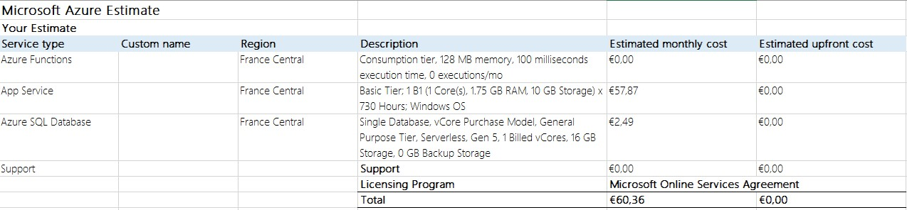
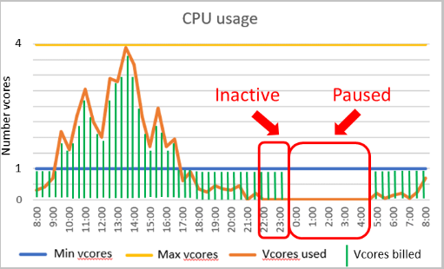
Pricing Evaluation

Slide 22
To be done

Slide 23
Evaluation for the last delivery
We have to test whether our cloud architecture is efficient enough for our purposes, our target remains to manage 20 devices per room.
So we will perform a simulation, through a Python script, sending data to the cloud and analyzing the behavior of our algorithm, taking into account that saving data to the DB, from what we have experienced so far, is an important bottleneck
Evaluation of MQTT (we have to repeat a similar experiment using MQTT)

Slide 24
Technical Evaluation
We will do a technical evaluation performing load tests on all parts of our system:
BLE IoT device-Smartphone interaction: how many smartphones a single device can handle?
Cloud IoT device-Cloud interaction: what is the message rate with which the device can send messages to Azure IoT hub?
Responsiveness Cloud-Smartphone interaction: how fast the smartphone receives the advice on where to go, does it depend from the number of connected devices?

Slide 25
User Experience Evaluation
We are planning evaluate the user experience using mockups, and after every demo of these prototypes we will collect people's opinions asking for feedbacks and publishing some google forms.
The questions will be mainly on:
User interface
Application services

Slide 26
Thank you for listening

