Slide 1

Scientific Data Curation
Luigia Cristiano, HMC Hub Matter
Helmholtz Institute Berlin

Slide 2
Agenda
Practices for data curation:
Data description and staging
Write a clear documentation for the data interpretation and reuse
Organize and name the files to improve the findability and reproducibility of the acquisition and analysis process
Use community standards for data and metadata when available
Use repositories for staging the data
Automatize the data processing and curation
Assign PIDs to datasets, software and cite them in your publication

Slide 3
Why this training
Familiarize end users with basics of scientific data curation
How to extract, format and standardize data description
How to stage the data locally and in institutional repository
Overall we want to show the benefits of the compliance to the FAIR data guidelines of your reseach data

Slide 4

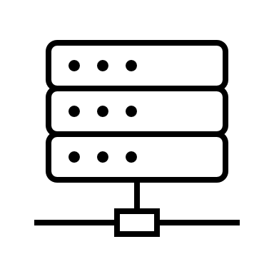


Why do we need scientific data curation
Evaluate the data quality, completeness
Provide full information for the data interpretation and data reuse
Enable the data discovery
Speed up the processes and test the robustness of the staging and processing solutions
Independently of data size and format
Independently of the data analysis method
Independently of the data storage solution
>PB, distributed
TB of database
<1GB, local

Slide 5
Why do we need scientific data curation
How can I control the effect of the analyis parameters on the model resolution ?
Where did I store that file ?
Which parameter did I use ?
How can I speed up the process ?
When and how did I generate this plot ?

Slide 6
Why do we need scientific data curation
How can I control the effect of the analyis parameters on the model resolution ?
Where did I store that file ?
Protocol of the analysis in the form of e-labbook, README, tags, parameter files
Data structures optmized for specific analysis processes
Which parameter did I use ?
How can I speed up the process ?
Data structures representing the procedures implemented
When and how did I generate this plot ?
Systematic file naming

Slide 7
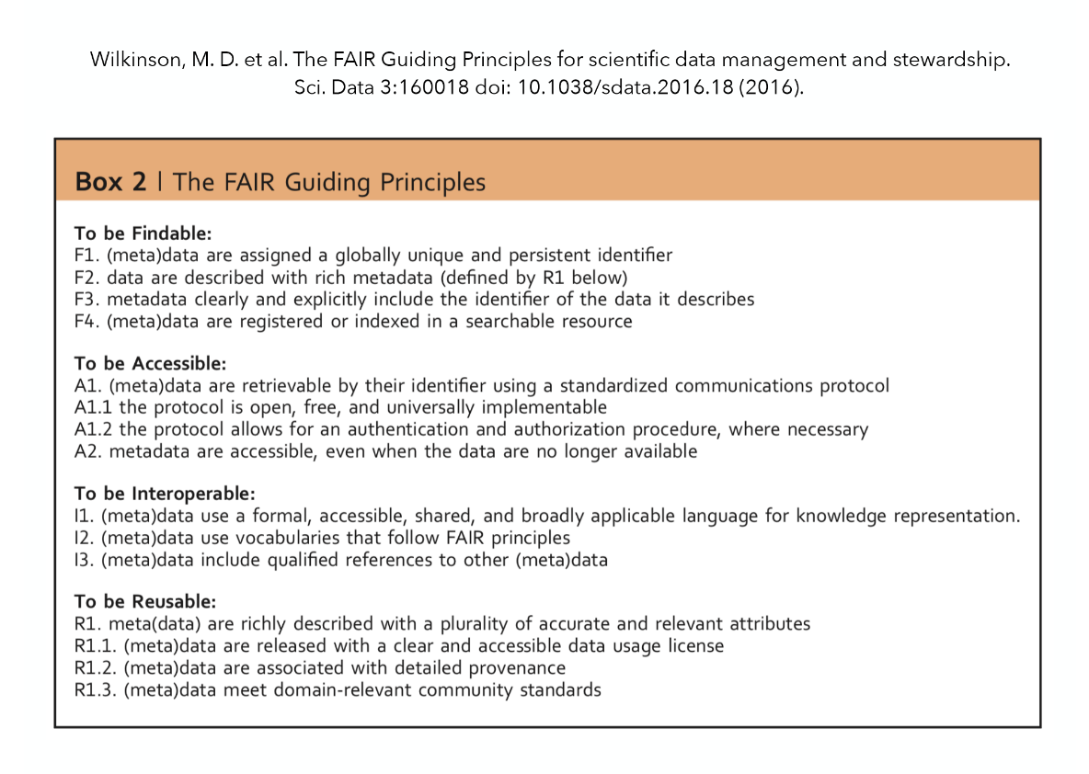
FAIR
FAIR is not Open Access
Different solutions and different paces of implementation are suggested for the different communities
Findable
Accessible
Interoperable
Reusable
Guidelines for promoting data visibility, reuse and ensure data quality

Slide 8
01 Scientific data documentation

Slide 9
Data life cycle and data curation
Who ?
What ?
When ?
Why ?
How ?
Where ?
Each phase of the life cycle is interested by data curation activity
At each phase it is essential to implement FAIR principles

Slide 10
Data life cycle and data curation
A Research Data Management Plan is available
A Research Data Management Plan is submitted
Short description of the experiment
PIs and co
Instruments reservation
Beam time/Lab reservation
Samples description
Start time and end time are indicated
Each phase of the life cycle is interested by data curation activity
At each phase it is essential to implement FAIR principles
Proposal
Acquisition
Reduction
Analysis
Publication

Slide 11
Research Data Management Plan
https://ec.europa.eu/futurium/sites/futurium/files/d6.1_693849_data_management_plan.pdf
EU Projects guidelines
e.g. Horizon 2020
RDMP as live document
Must be kept up to date
It represents a documentation of the pre-measurement phase
It contains information of the potential size of the database and the proposed staging solutions and conditions for the data access
It should be edited in collaboration with the RDM group at the institute

Slide 12
Data life cycle and data curation
Control software (author, license, version)
Instrument type and acquisition setting (possibly ID)
Parameter file
Sample preparation workflow
File naming convention
Data structure
Log file
Location
Creator
Lab-book
Each phase of the life cycle is interested by data curation activity
At each phase it is essential to implement FAIR principles
Proposal
Acquisition
Reduction
Analysis
Publication

Slide 13
Data life cycle and data curation
Software (author, license, version)
Parameter file
Log file (step by step procedure to ensure reproducibility)
Location
Creator
Connecting derivative and raw data
Each phase of the life cycle is interested by data curation activity
At each phase it is essential to implement FAIR principles
Proposal
Acquisition
Reduction
Analysis
Publication

Slide 14
Data life cycle and data curation
Software (author, license, version)
Parameter file
Log file (step by step procedure to ensure reproducibility)
Location
Creator
Connecting derivative and raw data
Connect the post analysis with pre analysis data set
File naming convention for the graphical output
Each phase of the life cycle is interested by data curation activity
At each phase it is essential to implement FAIR principles
Proposal
Acquisition
Reduction
Analysis
Publication

Slide 15
Data life cycle and data curation
Software (author, license, version)
Data workflow
Log file (step by step procedure to ensure reproducibility)
Location
Contributors and authors
Make data accessible in a standard-open format
Each phase of the life cycle is interested by data curation activity
At each phase it is essential to implement FAIR principles
Proposal
Acquisition
Reduction
Analysis
Publication

Slide 16
What are the key information to preserve
Who ?
What ?
When ?
Why ?
How ?
Where ?
1. How are the key parameters identified ?
2. How are these informations captured ?
Proposal
Acquisition
Reduction
Analysis
Publication

Slide 17
What are the key information to preserve
Sample characteristics
PIs
Instruments
Location
Contributors and authors
Experiment settings
Experiment begin and end time
File convention and total size
Abstract
Project description
1. How are the key parameters identified ?
Proposal
Acquisition
Reduction
Analysis
Publication

Slide 18
What are the key information to preserve
e.g. GATE system (https://www.helmholtz-berlin.de/pubbin/hzbgate )
Sample Formula and tracking system or sample ID (https://www.igsn.org/ )
Instruments ID (https://www.helmholtz-berlin.de/pubbin/igama_output?modus=einzel&sprache=en&gid=2127&typoid=75136)
Location
Institution and researcher ID (we will talk about this in the coming slides)
Community standard for File naming and data structure (we will talk about this in the coming slides)
2. How are these informations captured ?
Proposal
Acquisition
Reduction
Analysis
Publication

Slide 19
What are the key information to preserve
Software, scripts versions
Parameter file
File convention and total size
1. How are the key parameters identified ?
Proposal
Acquisition
Reduction
Analysis
Publication

Slide 20
What are the key information to preserve
Log files
Input parameter files
Output files with automatic naming
Output data structure
Workflow track system
Elog books
Elab books
File headers
codebooks
2. How are these informations captured ?
Proposal
Acquisition
Reduction
Analysis
Publication

Slide 21
Data description, tabular
Readme for the datafile
Title for the dataset
Name/institution/email/ORCID
Contributors and authors, contact person
Acquisition time
Geographic location
Language information
Keywords to describe the topic of the study
Information about funding program and agencies
Versioning
Link to related data collection
Information about data type, variables definition, unit of the measured quantities
Explanation on acquisition settings
Uncertainty associated, gaps
Short abstract
Preserve the authorship with PIDs and licencing the usage
Tools
Elab book
Parameter files
Activity reports
Files header
Data processing workflow and logfiles
Codebooks
Data acquisition software
Data management software
Automated generation of metadata by data staging workflows (from measurements to publication

Slide 22
How to preserve informations
From README to Metadata:
Proposal
Acquisition
Reduction
Analysis
Publication
Let’s create a README for a specific experiment workflow :

Slide 23
Hand on session: README file

Slide 24
Hand on session: Elab Book

Slide 25
How to capture informations with elab-books
From Hand notes to electronic lab-books:
icat
ElabFTW
Chemotion
Nomad-labbook
Let’s watch a demo!

Slide 26
Federated access to digital tools
AAI
Presentation by Andreas Tomiak
Let’s watch a demo!

Slide 27
How to preserve information in a standardized manner
Persistent Identifiers and Metadata:
Person
Institute
Sample
Instrument
Publication: software and datasets

Slide 28
02 Metadata

Slide 29
Data about data
How to ensure your data are understable and usable by others
Machine and human redable data documentation: structured information
Metadata organized in keys and values are descriptors to data discovery, interpretation and analysis
Metadata keep info on data provenance, copyrights and access restrictions
Metadata can be generic or discipline specific
Metadata: different levels of informations
General discovery: discipline, authors, institute
Cross domain keys
Domain specific keys
Metadata are remaining even when the data are gone
Minimum set of data should allow the discovery and citation- Mandatory
[1]

Slide 30
Metadata categories
Administrative
Authors ID, dataset id, time frame, embargo, versioning
Descriptive
Methodological and geog. Info, data quality metrics
Structural
Discipline dependent
Ancillary informations
Info on the preprocessing, or derived metrics
Lib.ua.edu
[2]

Slide 31
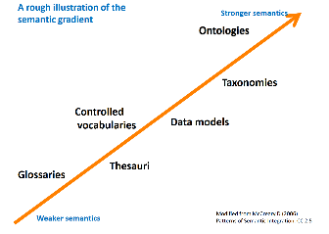
Metadata Structure
Metadata elements (categories/keys) and associated values
Defined by ontologies
Hierarchical structure supported by a taxonomy
Dictionary to extract the components
Ixml,json)
Thesaurus for the definition of categories
The metadata can be distributed attached to the data as „header“ or as separated file. Both options offer advantages and disadvantages
[3]

Slide 32
Metadata Structure
Metadata elements (categories/keys) and associated values
Defined by ontologies
Hierarchical structure supported by a taxonomy
Dictionary to extract the components
Ixml,json)
Thesaurus for the definition of categories
Let‘s see some examples!
The metadata can be distributed attached to the data as „header“ or as separated file. Both options offer advantages and disadvantages
[3]

Slide 33


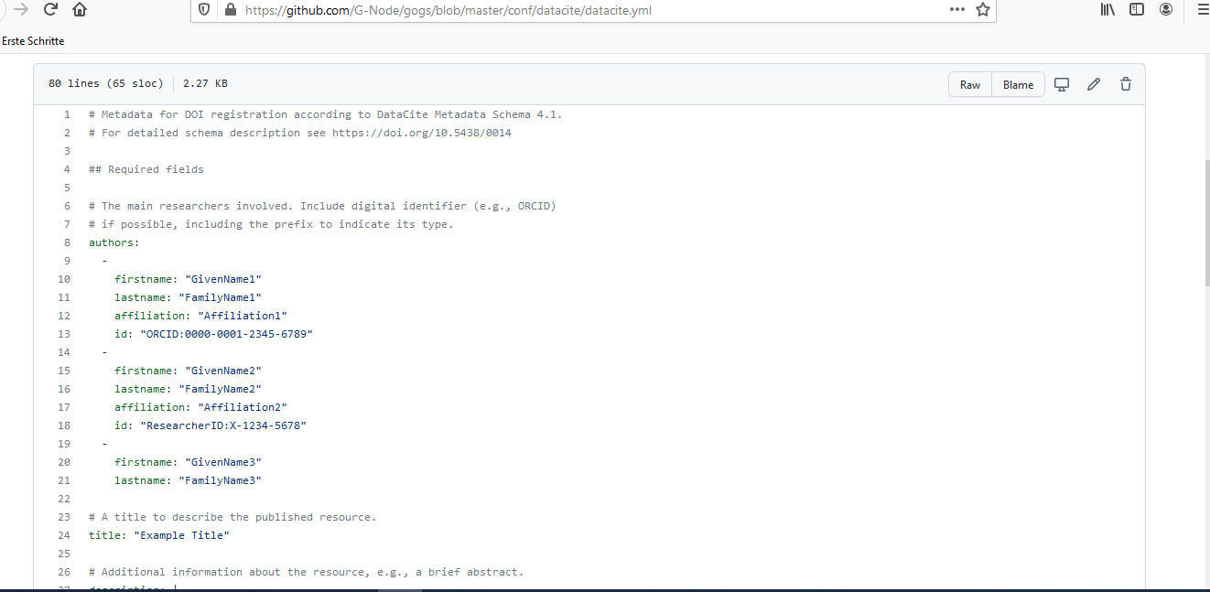

Formats converter
https://github.com/G-Node/gogs/blob/master/conf/datacite/datacite.yml
German Neuroinformatics Node, guidelines for DOI request
Several routines offer format conversions:
Good compromise between word/ASCII and json dictionary is the yaml format
It allows introducing a structure in free text environment.
Python functions/packages e.g.
[5]
Notes:
Csv can be painful for nested structure. It can be added a yaml frontmatter to csv to add the metadata. For this there is a format csvy that can be read by R, Excel Mac, Python
YAML files should end in .yaml whenever possible in Grav. YAML is case sensitive. YAML does not allow the use of tabs
YAML excels at working with mappings (hashes / dictionaries), sequences (arrays / lists), and scalars (strings / numbers). While it can be used with most programming languages, it works best with languages that are built around these data structure types. This includes: PHP, Python, Perl, JavaScript, and Ruby

Slide 34
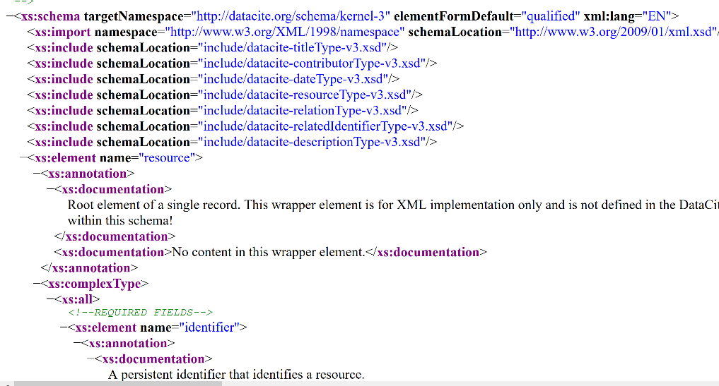
Metadata schema
The Simple Dublin Core Metadata
1. Title
2. Creator
3. Subject
4. Description
5. Publisher
6. Contributor
7. Date
8. Type
9. Format
10. Identifier
11. Source
12. Language
13. Relation
14. Coverage
15. Rights
Generic
DublinCore, DataCite,
Schema.org, EUDAT (comm. Dep)
https://www.eudat.eu/
Discipline dependent
Nxdl
https://github.com/nexusformat/definitions
https://github.com/nexusformat/definitions/blob/main/nxdl.xsd
Formats
Xml, csv, rdf, html, json
https://schema.datacite.org/meta/kernel-4.1/example/datacite-example-full-v4.1.xml
https://www.fdsn.org/xml/station/fdsn-station-1.1.xsd
[4]
Notes:
Xml for instruments when the instrument is a traditional industrial production.

Slide 35
Metadata schema
The Simple Dublin Core Metadata
1. Title
2. Creator
3. Subject
4. Description
5. Publisher
6. Contributor
7. Date
8. Type
9. Format
10. Identifier
11. Source
12. Language
13. Relation
14. Coverage
15. Rights
Generic
DublinCore, DataCite,
Schema.org, EUDAT (comm. Dep)
https://www.eudat.eu/
Discipline dependent
Nxdl
https://github.com/nexusformat/definitions
https://github.com/nexusformat/definitions/blob/main/nxdl.xsd
Formats
Xml, csv, rdf, html, json
Let‘s look at the schema features!
https://schema.datacite.org/meta/kernel-4.1/example/datacite-example-full-v4.1.xml
https://www.fdsn.org/xml/station/fdsn-station-1.1.xsd
[4]
Notes:
Xml for instruments when the instrument is a traditional industrial production.

Slide 36
Hands-on session: YAML, XML, JSON

Slide 37
03 Scientific data structures

Slide 38
Data formats and data structures
Formats
Prefer open
Community standards
Look at the repository recommendation
Machine readable (metadata)
Structures
Keep the versioning in the filenaming
File versioning system
Codes for format conversion
Associate readme, codebook, data dictionary and data list
[12]

Slide 39
Data documentation workflow
Attach-embed-link to the data all the information relative to the data production and data analysis.
Log and parameter files help the tracking of the analysis settings and facilitate the reproducibility of the data processing
Keep updated the documentation with an history of the data processing
Use of scripting to automatize the update and associate quality parameters to the data analysis
Use templates or define one. Use structured doc

Slide 40
Data organization
Optimize the data exploration and the data processing
Which structure is optimal for your data set depends on the analysis tools, the data type and the data processing you need to perfom
The access protocol and also the access terms to the data (raw or processed) plays also a key role on deciding which database structure is the most suitable for your research work
SQL versus noSQL databases
(training module on this topic is planned, register to our mailing list if interested)
Svn vs Git repository
(training module on this topic is planned, register to our mailing list if interested, Git training is offered by HIFIS https://events.hifis.net/category/4/ )

Slide 41

Data organization
General guidelines for the data organization:
Raw data---optimized for the access and back-up
Processed data:
- Clone of the raw data structure
Folder naming associated to the analysis method
- Versioning of the file, parameter and log files saved in the folder
Readme and vocabulary for abbreviations
Keep the syntax machine readable
Projectname_Date_time_instrument_analysis
Output_folder
V?_XSF_..._..._...
V1.log
Parameters.txt
Instrument_analysis_v1.txt
Defining a file name convention facilitates the data discovery
Scripts
A complete data description should be available in each folder

Slide 42
Hands-on session: file naming and data exploration

Slide 43
How prepare data to FAIRness
Identifier to the data, repository, metadata, licences
Standard or not proprietary formats
Keep data documented and versioned
Project or community repository
Cross references to related data

Slide 44
Data organization
From Files Collections to databases:
Proposal
Acquisition
Reduction
Analysis
Publication

Slide 45
03 Helmholtz Metadata Collaboration

Slide 46
HMC role
The FAIR principles will be guiding the development of data management services
HMC promotes planning on data curation and the implementation of standardized and automate procedure for the data staging.
Focus is the future reuse of the own data by developing tools from our consultancy with researchers.
We support researchers to understand what to share with data and which data are to be shared.
We offer solutions for the data FAIRification

Slide 47
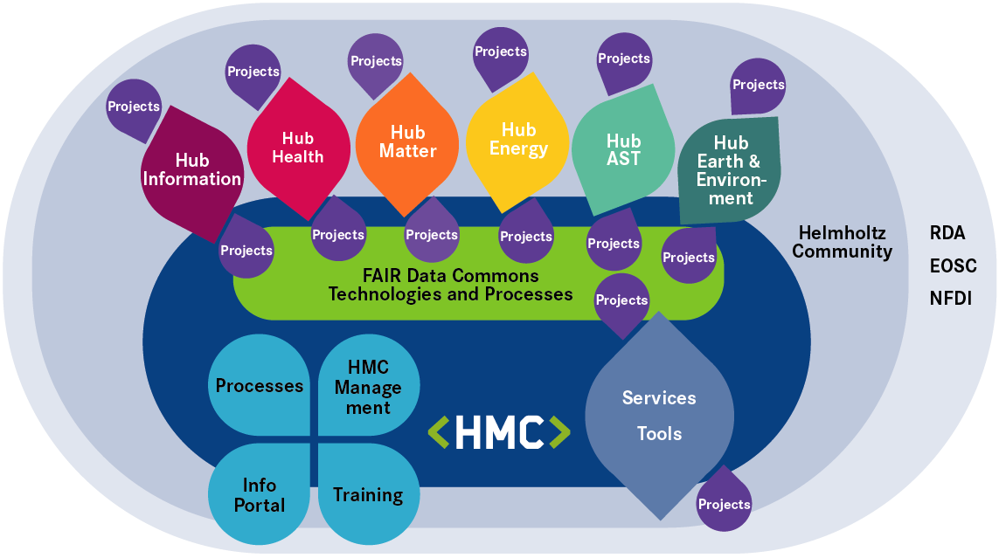
HMC role
The FAIR principles will be guiding the development of data management services
The mission of the Helmholtz Metadata Collaboration (HMC) is to facilitate the discovery, access, machine readability, and reuse of research data of the Helmholtz Association.
HMC promotes a coordination with the scientific community for the services development in order to establish widely accepted practices in the handling of research data.
Implementation of standards for the data description to favour the data interoperability and discovery are also goals of our initiative
[7]

Slide 48
HMC activities as FAIR initiatives
GO BUILD services for FAIR technology of data management
GO CHANGE promote the research management policies and incentives the FAIR implementation
GO TRAIN transfer of skills and FAIR awareness
Our training is promoting the compliance of good data management practices in different researchers communities for a Bottom-Up implementation of global FAIR research database

Slide 49
04 Community standards

Slide 50
NeXus Format

Slide 51
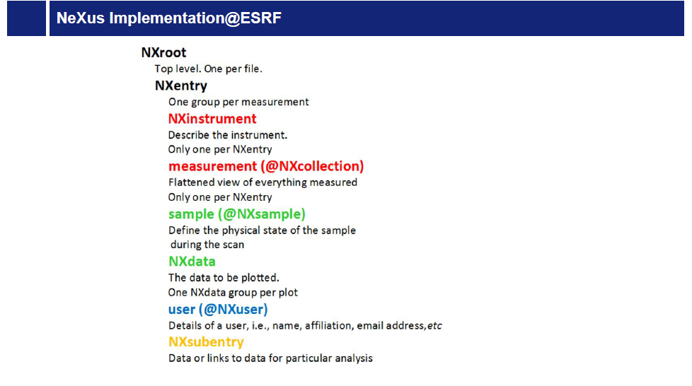
Metadata and data format: Nexus
Nexus for rich and easy to access metadata.
Why NeXus ? https://www.nexusformat.org/
HDF5/NeXus used as institutional standard at neutron, x-ray and muon facilities
Each facility diversify the dictionary limiting the immediate re-usability.
NeXus files may help to improve the situation.
HDF5 format and a tree structure for metadata representative of the complexity of PaN data
Built in Vocabulary for research community interoperability
Geometry of the beamline, sample stages, orientation and description of detectors, exposure time, beamline calibration info, scan description
To store multiple related data set create more entries
Hierarchy in Nexus
Classes (dictionary)
Groups
Levels
Attribute
MultiD array and scalars
NeXus structure allows links and pointing to data stored in other parts of the group
[7]

Slide 52
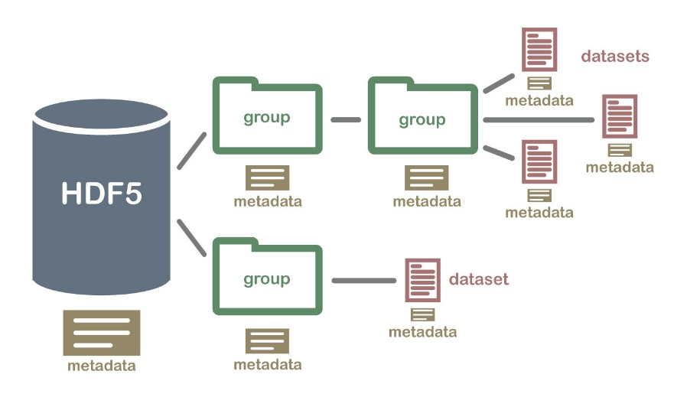
HDF5 Format
HDF5 format and a tree structure for metadata representative of the complexity of PaN data
Allows chunked storage and slices reading
Metadata can be attached
The I/O can be faster than contiguous data files
Compression
Can be prefixed or open database size
Heterogeneous database with links
Platform independent
Suitable for massive databases with a datatype and dataspace definition per dataset
HDF5 structure allows links and pointing to data stored in other parts of the group
[8]

Slide 53
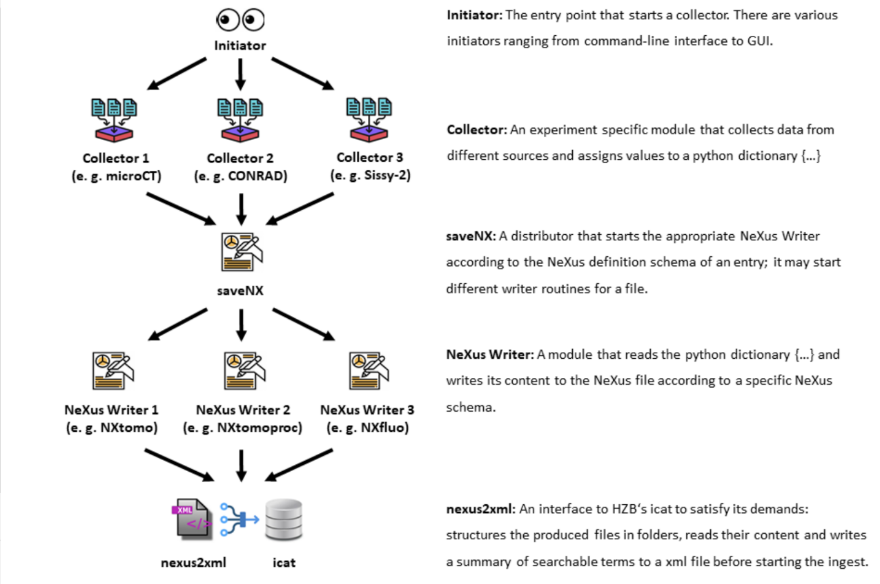
NeXus Writer and Icat data ingestion
Ingestion workflow
Access to the tools by virtual machine
1. data collection
2. identification of the instrument dictionary
3. sample data info collection
4. parameters attribution
5. local data saving
6. icat repository ingestion
Contact person: Gerrit Günther, HMC
https://gitlab.helmholtz-berlin.de/jaf/nexuswriter/-/blob/master/nexusCore/icatRepo/nexus2xml.py
Nexus application for describing XAS
https://github.com/nexusformat/definitions/blob/main/applications/NXxas.nxdl.xml

Slide 54
Data analysis with Nexus files
https://manual.nexusformat.org/utilities.html#data-analysis
A number of Python routines to process X-ray photons emission data in hdf5
XRF spectroscopy PyMCA
https://gitlab.elettra.eu/panosc/xrffitvis/
Xrayutilities for conversions spec hdf5
IGOR pro can upload HDF5 www.wavemetric.com
ORIGIN lab (+HDF5Browser App)
DAWN
Matlab
Spec2hdf5 available tools (silx.org)
Spec2nexus (https://spec2nexus.readthedocs.io)
PyMCA (http://pymca.sourceforge.net/)
NeXpy (http://nexpy.github.io/nexpy/)

Slide 55
NeXus structure and playground

Slide 56
05 Resource Identification PIDs

Slide 57
PID
Persisten identifiers are long lasting unique digital reference to an object, contributor and organization.
They act as pointers/entry points between the reference to the object and its actual location
They are character strings globally unique
Labeling a dataset i.e. with a PID support the data findability: independent on the data physical location
PID
PID
PID
V. Bunakov, R. Krahl, B. Matthews, N. Vizcaino, A. Vukolov(2022) Advanced infrastructure for PIDs in Photon and Neutron Ris. ExPaNDS Deliverable 2.5. https://doi.org/10.5281/zenodo.5905351
[19]
Notes:
Handle system is based on a global hierarchical system. Where tha global handle systems are on the highest level of the hierarchy

Slide 58
PID
It is managed and updated with new location in the registry
and resolvable
PID attribution (ARK, arXiv, DOI, ePIC, Handle, URN) to people and digital object.
Object for Instruments, Institutes, research products (workflows, labs procedures, software) and samples
Different protocols are used for the implementation of PID, a global handling system of the different services guarantee that a PID generated at national agencies is valide worldwide
[19]
Notes:
Handle system is based on a global hierarchical system. Where tha global handle systems are on the highest level of the hierarchy

Slide 59
ORCID
ORCID (Open Researcher and Contributor ID) registry for researchers. Provides an ID to associate publications, grants and employments to individuals and desambiguate.
It consist of a 16-digit alphanumerical code
It acts as record of professional activities. Journals requires that at least the corresponding authors has an ORCID
https://orcid.org/
[20]

Slide 60
DOI
DOI is built on the top of the Handle system and maintains a registry of metadata related to the object, It has local Registration agencies (DataCite for datasets, CrossRef for publications (chapters, proceedings, EIDR for audio objects). It is widely used in the publication registry and has specific metadata schemata, business model and assignment practices
Associate the ID number to the URL hosting the data
[20]

Slide 61
ROR & grant ID
ROR research organization Registry. It stores metadata about the organization hosting the project and the project framework of the research object.
GRID Global Research Identifier Database (www.grid.ac)
Crossref Funder Registry (crossref.org) enables the link between grants, projects and research products.
Funding agency identifier are in the form of a DOI and listed in the Funder Registry (e.g. 10.13039/501100001659 for DFG)
This tool facilitates the visualization of the projects results and the collections of products into “researchers portfolio” ready to be used e.g. when submitting new proposals to funding agencies.
Notes: corrections are needed in the PID slides from Expands
[20]

Slide 62
PID for Samples
IGSN research organization Registry.
It stores metadata about the organization
Guaranteed to be unique with Handle identifier (handle.net)
It has a sample metadata profile (alligned to datasite) at federated IGSN
IGSN has a landing page with sample descritpion accessible by QR code
Mandatory metadata are bibliographic but metadata structure include domain specific elements
It is possible to link samples to data and publication
~10 millions samples registered worldwide
Logs of all the operations (sample preparation ) on the sample embed the sample history.
This log file is preserved and attached to the metadata
Potential assignment of a PID ?
Considerations : sample charactr are changing while treated, measurements and sample creation can be really distinguished? What is the sample preservation after the measurements ?
[20]

Slide 63
Making research workflow FAIR: 03 Repositories and Licenses

Slide 64
How to publish database and software ? How to identify a suitable repository
Offer permanent archives and access to the data, provide persistent Identifiers (FAIR)
Look for an institutional repository, project repository
Generalist/ community/institutional repository: zenodo, figshare, eudat, dryad home/ CXIDB, EMPIAR, EMDataResource, NOMAD (https://nomad-lab.eu/services/repo-arch)
FAIRsharing registry of repositories https://fairsharing.org/ structured overview
RatSWD https://www.konsortswd.de/datenzentren/alle-datenzentren/
Collection of german data centers
Re3data.org international registry of research data repository
https://www.re3data.org/search?query=&subjects%5B%5D=30701%20Experimental%20Condensed%20Matter%20Physics
Measure of trustworthy of repository given (e.g. certificate, PIDs, metadata)

Slide 65
License
Open Data Commons group
3 standard licenses and additional community norms
PDDL: Public domain dedication
ODC-By: free user under the provision of referencing to the source
ODC-Odbl: any use of the database must refer to the source, any derivative product is to be distributed under same terms
https://creativecommons.org/licenses/
Creative Commons
CC-BY-SA attribution share alike and same licencing of related work
CC-BY- Attribution only
CC0 : Public domain dedication
PDM: Public Domain mark – free of know restrictions
Terms of use of your data
Data proper attribution
Data and databases for the licence
https://eu-datenschutz.org/
[23]
Notes:
2 Creative Commons is a non-profit organization that enables the sharing and use of creativity and knowledge through free legal tools. The free, easy-to-use copyright licenses provide a simple, standardized way to give the public permission to share and use your creative work — on conditions of your choice. CC licenses let you easily change your copyright terms from the default of ‘all rights reserved’ to ‘some rights reserved.’ CreativeCommons licenses are not an alternative to copyright. They work alongside copyright and enable you to modify your copyright terms to best suit your needs”. (source: creativecommons.org) Whenever possible, we recommend to assign the freest licence “CC BY” to your data (“use it, change it, redistribute it, but always name me as reference”), for some cases the “attribution share alike” licence CC BY-SA (same as above, but the data may only be redistributed under the same licence), or CC0. We recommend the 4.0 version. “The CC0 licence is a tool to deliberately dedicate copyright-protected works to the public domain. Thus, it is basically a waiver of rights. Once it is in effect, a work belongs to the public domain and can be used by anyone without any restrictions or obligations. CC0 is nothing but a standardised declaration of such a waiver which can be used by anyone who wishes to dedicate their work to the public domain.” (source: Open content – A practical guide to using Creative Commons licences)

Slide 66
Terms of use of your data
HZB data policy
https://www.helmholtz-berlin.de/pubbin/vademecumdatei?did=326
https://www.helmholtz-berlin.de/pubbin/vademecumdatei?did=131
Raw data :
The raw data is under embargo for 5 years and hosted for a least 10 ys at HZB
The embargo can be extended under request and can be shortened according to project needs
The raw data are licences with CC0
Results data are not affected
paN-data Europe common policy framework (february 2011) ---→ extended to FAIR by Pansoc
Open access to raw data and metadata
Curation of raw data supported by the facility
Data catalogue to make data accessible
Embargo on the raw data
[24]

Slide 67



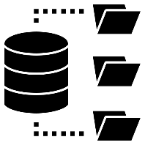

Data publication guidelines
Check the repository guidelines
Check the publication service guidelines
Check previous slides on data curation and metadata for publication
Data publication as supplement of peer reviews paper
Data publication on istitutional or generic repository
+
DOI to data , mentioned in the publication

Slide 68
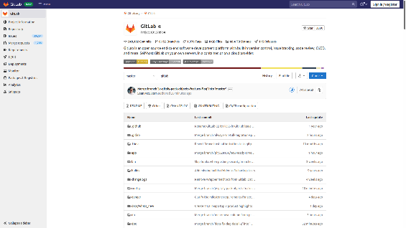


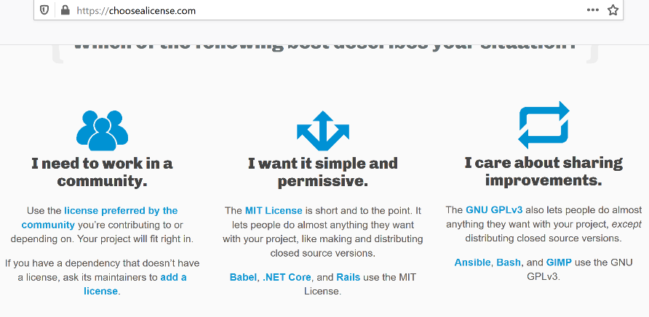
Software publication guidelines
Prepare a README file, usage description and dep.
Provide usage examples and test integration
Prepare a MAKE file or a setup.py file to prepare the repository clone or the installation with all dependencies included
Associate a usage licence
Enable the installation on OSs and give the compatibilities with the dependencies versions
Obtain a DOI for the software e.g. DataCite and a snapshot of the gitlab
Versioning the software
Offer help support and possibility to start the bug fixes
Use when possible the Gitlab /GIThub with institutional maintenance to guarantee the long term access to the software repository
https://github.com/
They both offer continuous integration and delivery and support the licences of your software
[26]

Slide 69
Software publication guidelines
No widely accepted FAIR principles as for research data (status 2019)
Software citation principles force11.org (https://doi.org/1025490/a97f-egyk
DataCite for software citation FORCE11.org principles mapped
https://github.com/
MIT Licence, Apache 2.0
A short and simple permissive license requiring preservation of copyright and license notices.
https://github.com/G-Node/gogs/blob/master/LICENSE
Indication of modification respect the original version
GNU General Public License v3.0 for free software www.gnu.org
They both offer continuous integration and delivery and support the licences of your software
[27]

Slide 70
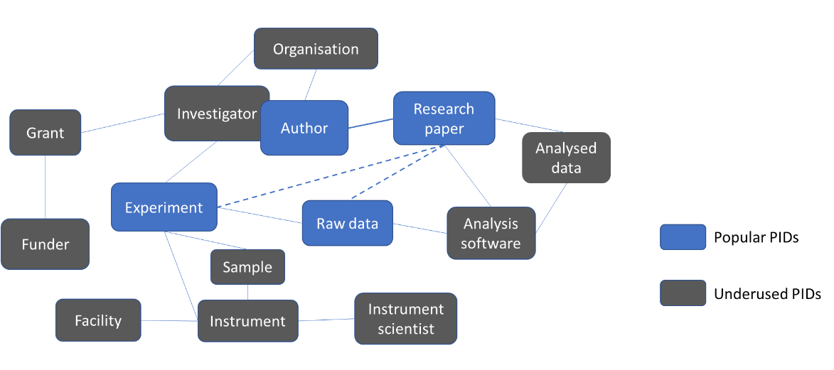
From expands report (2022)

Slide 71





Link the different resources: enables discovery and interoperability
Publications
Software catalogue
Data catalogue
Instrument
catalogue
Reconstruct the whole data life cycle
[28]

Slide 72
00 Recap: FAIR Principles and PaN data life cycle

Slide 73
Why FAIR
Guidelines for promoting data visibility, reuse and ensure data quality
FAIR is not Open Access
Different solutions and different paces of implementation are suggested for the different communities
Findable
Persistent ID
Metadata online
Online Repository
Accessible
Community or generic repository
Interoperable
Community or generic standards
Open file formats
Reusable
Rich, complete and clear documentation
Licenced

Slide 74
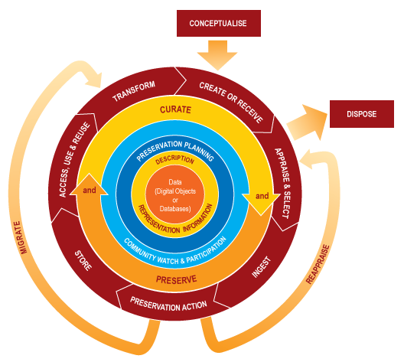
Research data life cycle
Proposal submission and scheduling
Proposal ID and measurement descriptions
Data creation
and processing
Design DMP, define derivative data, authoring
Data staging
Identify repository
Assign metadata and data format
Data publishing
Establish data access conditions
Associate PID and copyright and versioning
Data reuse
referencing to related publications and versions
Lib.ua.edu

Slide 75
Recap on How prepare data to FAIRness
Identifier to the data, repository, metadata, licences
Standard or not proprietary formats
Keep data documented and versioned
Project or community repository
Check the publication licences
Cross references to related data

Slide 76
Thanks.
luigia.cristiano@helmholtz-berlin.de
And the Hub Matter Team
HMC Hub Matter

