Slide 1
AMPs fagoma intestinal infantil
22.06.2022

Slide 2
Objetivos
Conocer cuáles AMPs están presentes en fagoma intestinal infantil
Determinar AMPs diferenciales entre grupos NW, O y OMS

Slide 3
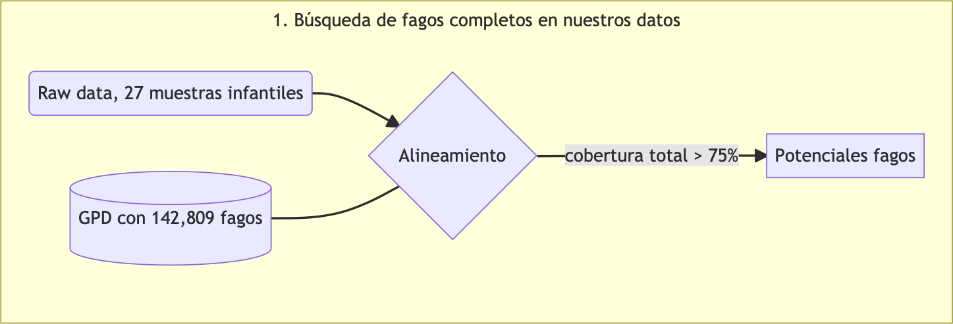
Pipeline
Se juntaron todas las muestras en un solo archivo (R1 y R2 por separado) y con este se realizó el alineamiento

Slide 4
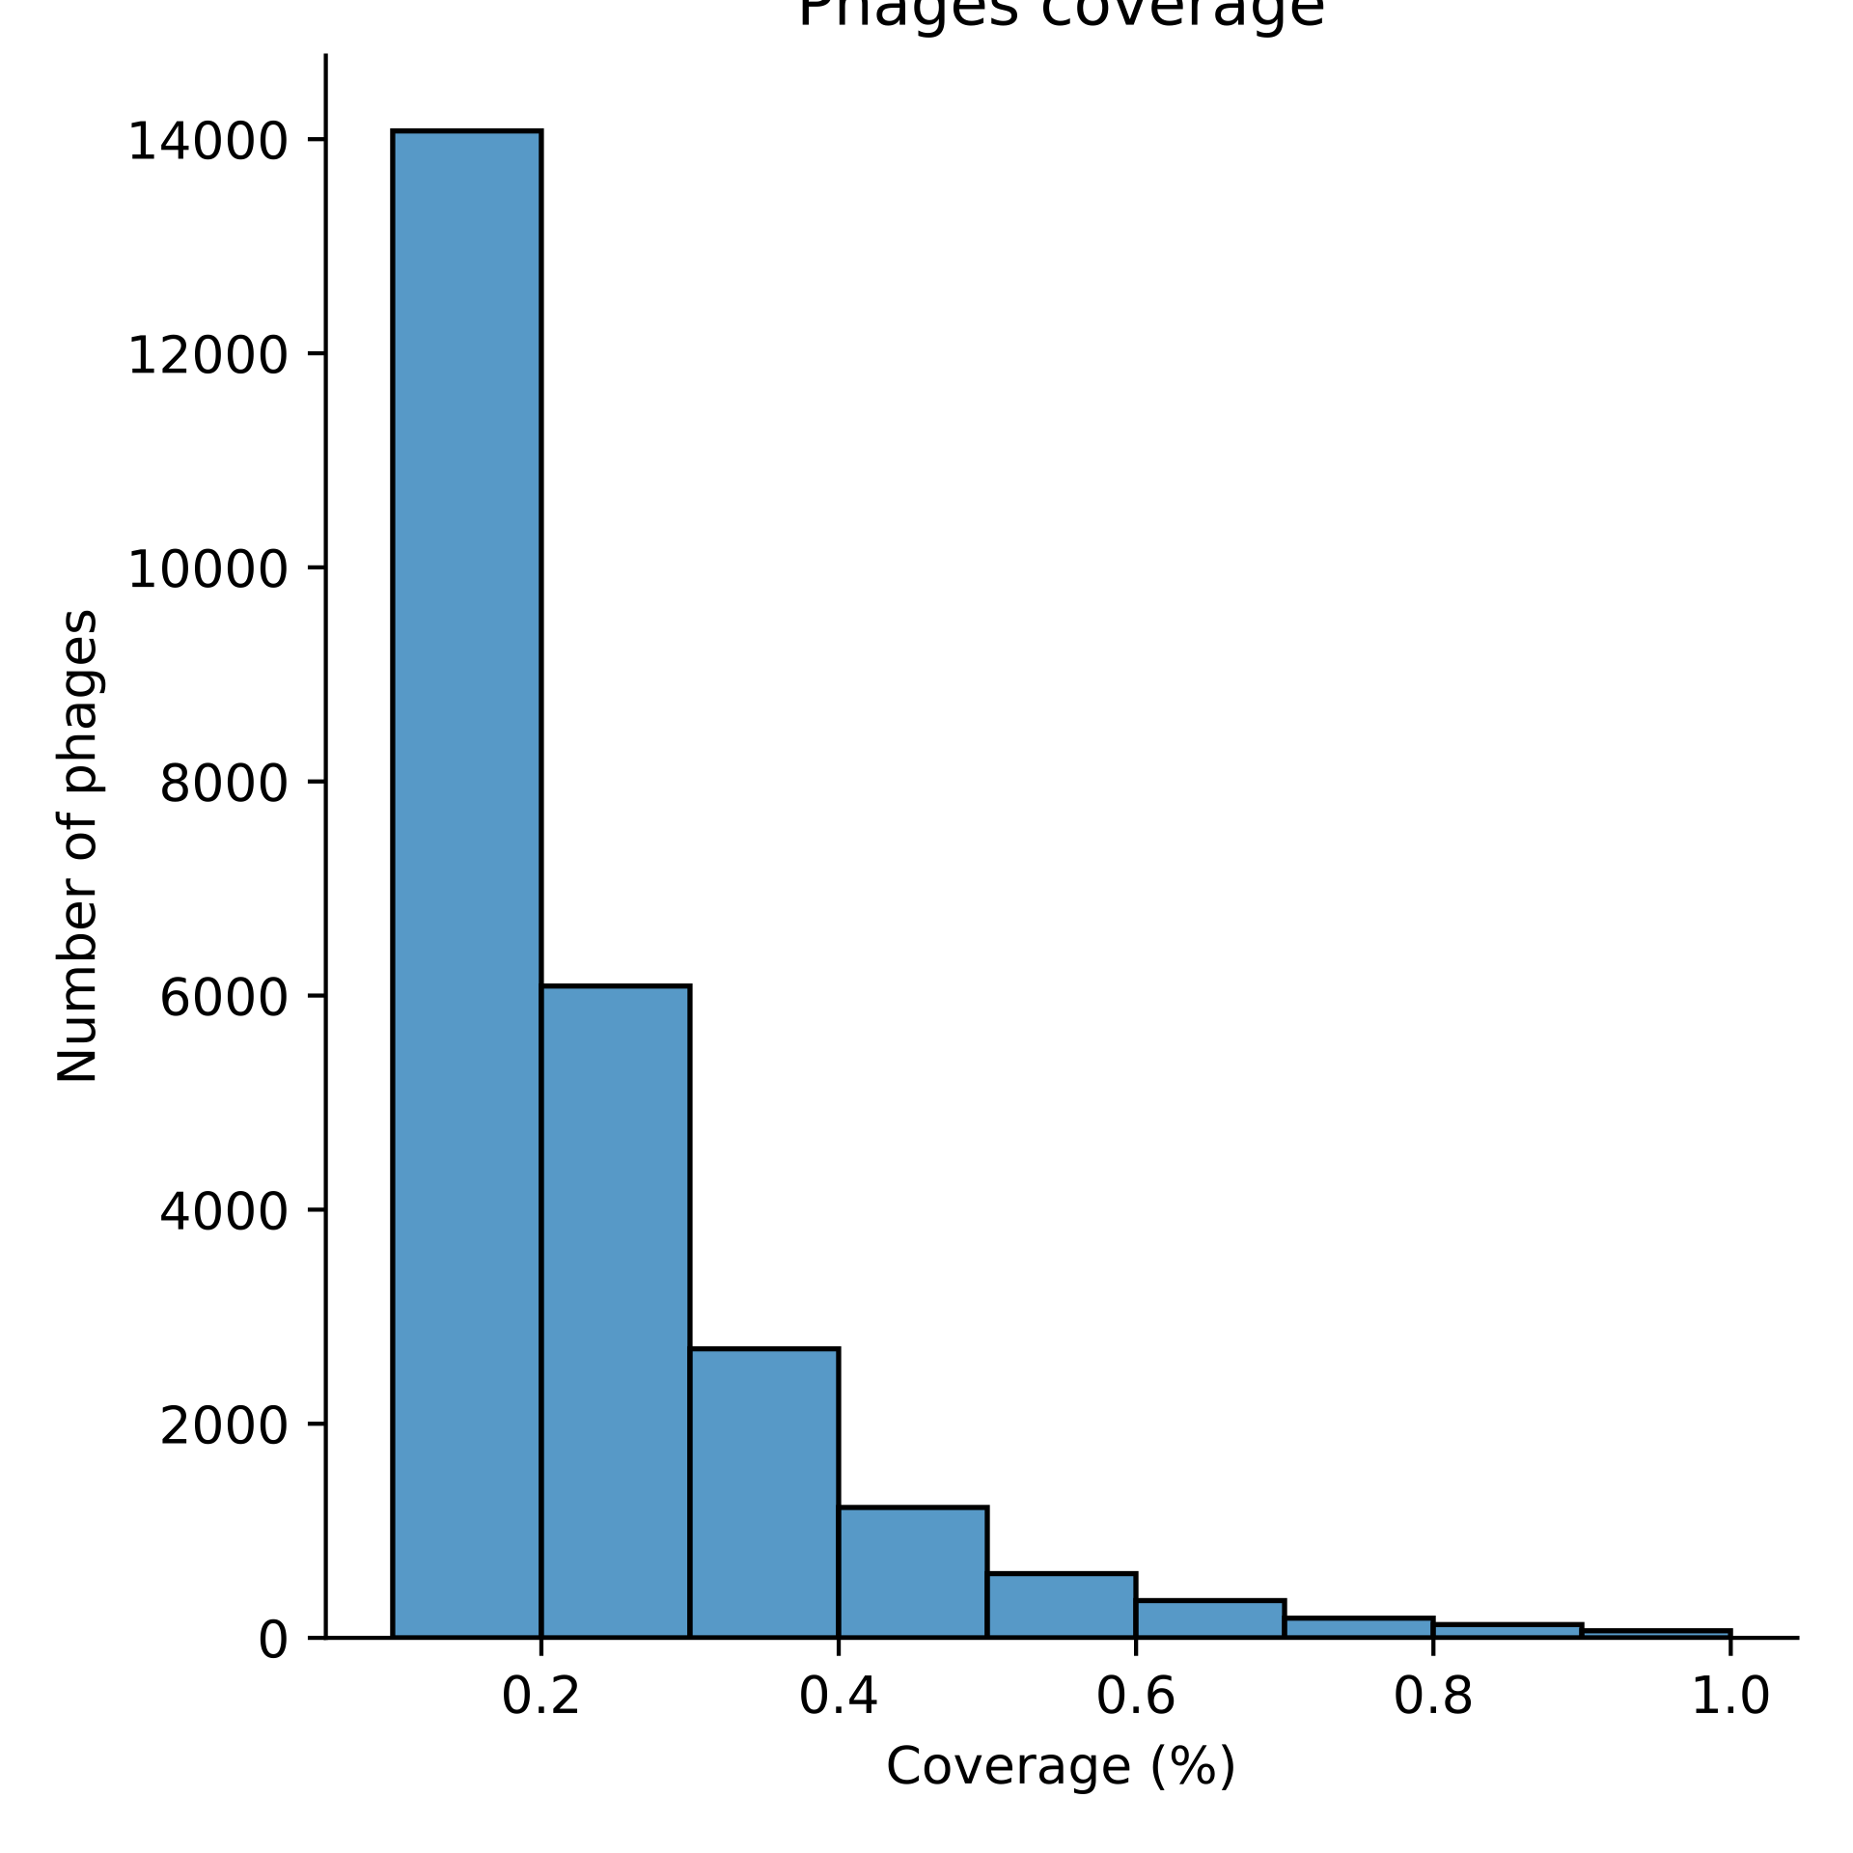
Cobertura de fagos
Coverage | Number of phages | Sum
(0.0991, 0.15] | 8762 | 25406
(0.15, 0.2] | 5315 | 16644
(0.2, 0.25] | 3549 | 11329
(0.25, 0.3] | 2540 | 7780
(0.3, 0.35] | 1665 | 5240
(0.35, 0.4] | 1035 | 3575
(0.4, 0.45] | 739 | 2540
(0.45, 0.5] | 479 | 1801
(0.5, 0.55] | 347 | 1322
(0.55, 0.6] | 253 | 975
(0.6, 0.65] | 222 | 722
(0.65, 0.7] | 126 | 500
(0.7, 0.75] | 98 | 410
(0.75, 0.8] | 86 | 290
(0.8, 0.85] | 74 | 190
(0.85, 0.9] | 50 | 116
(0.9, 0.95] | 38 | 66
(0.95, 1.0] | 28 | 28

Slide 5
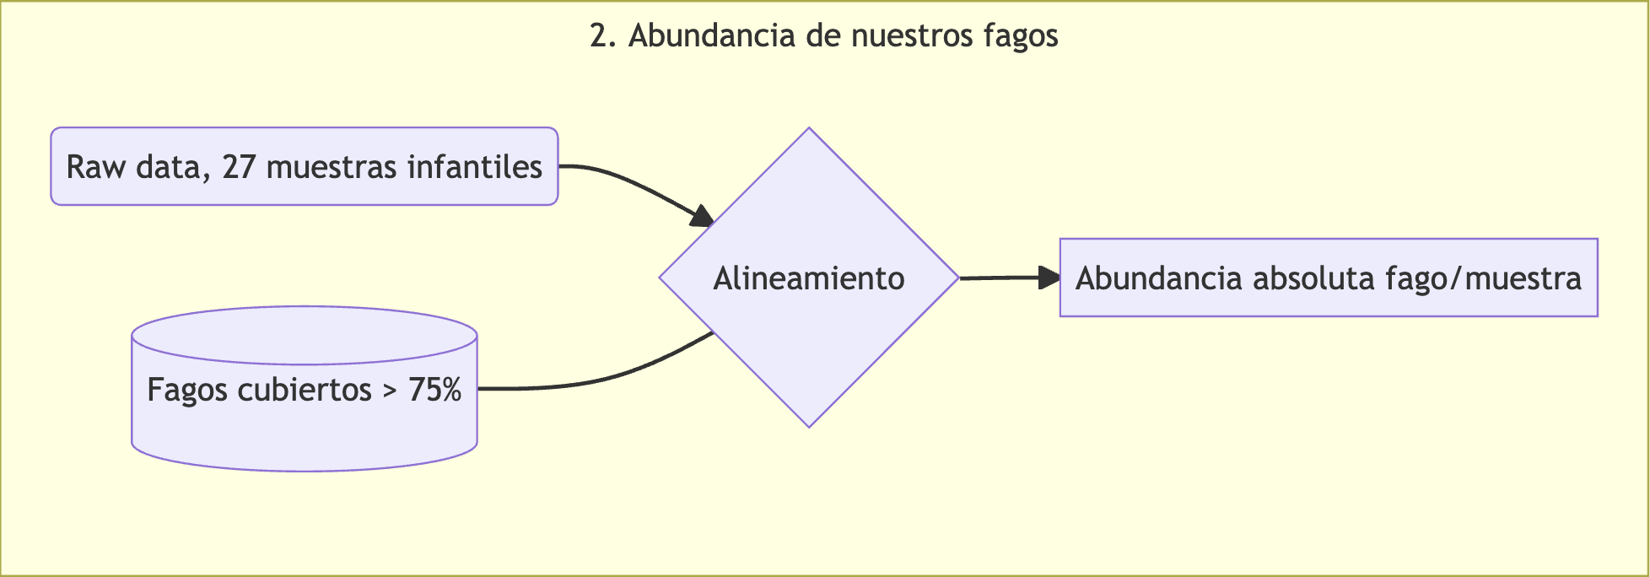
Realineamiento por muestra
Cambiar a 70% de cobertura para considerar un fago como completo?
LEfSe para contestar esa pregunta

Slide 6
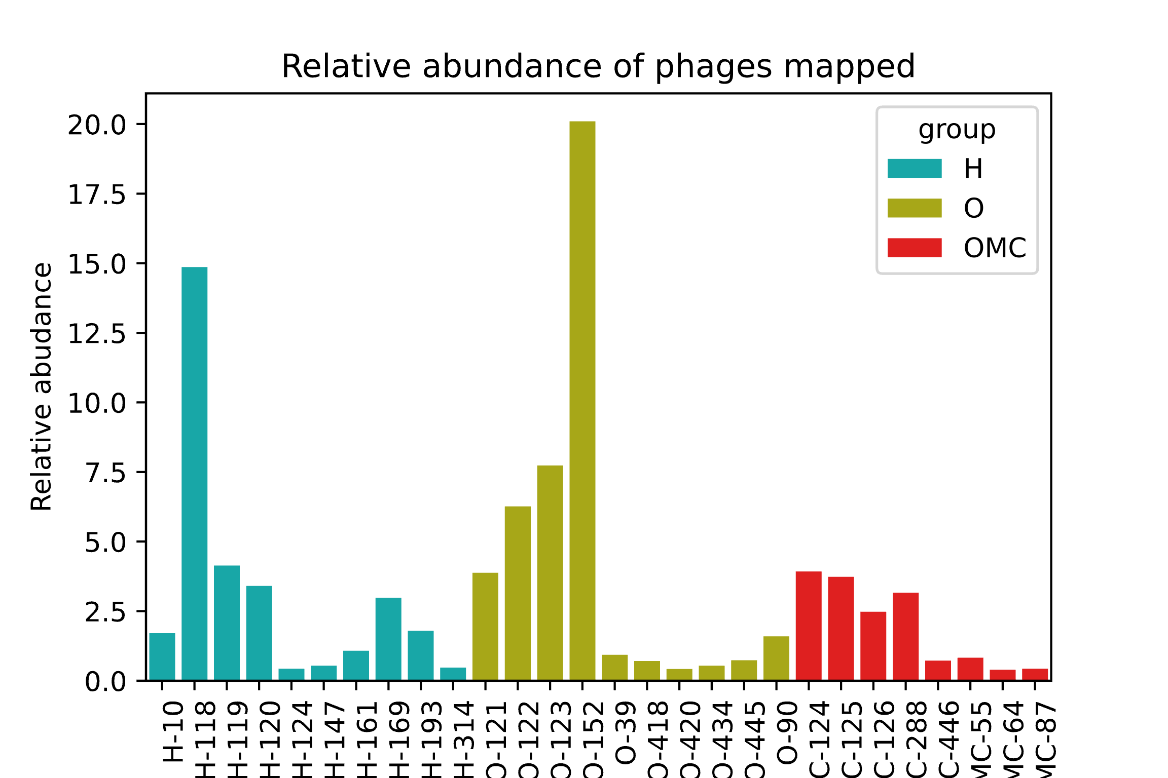
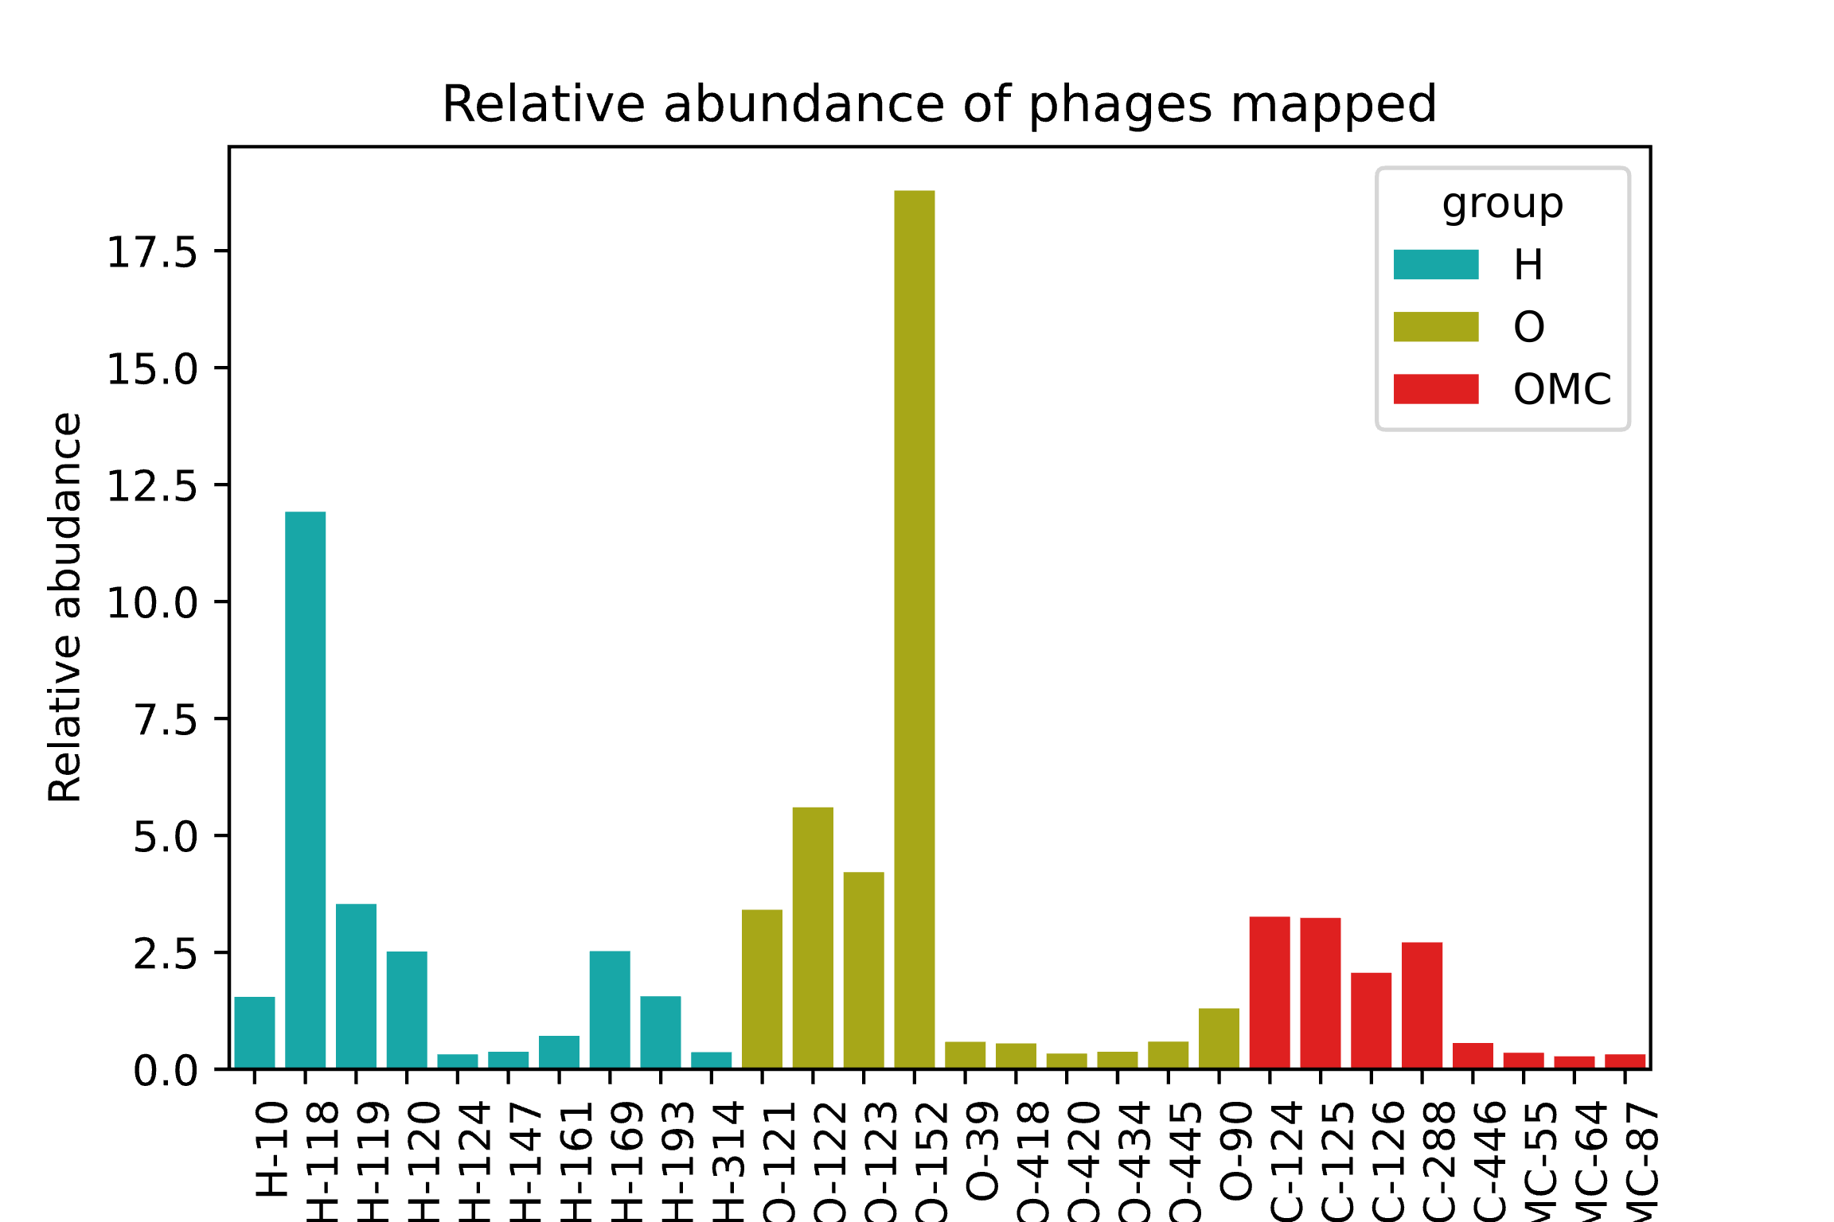
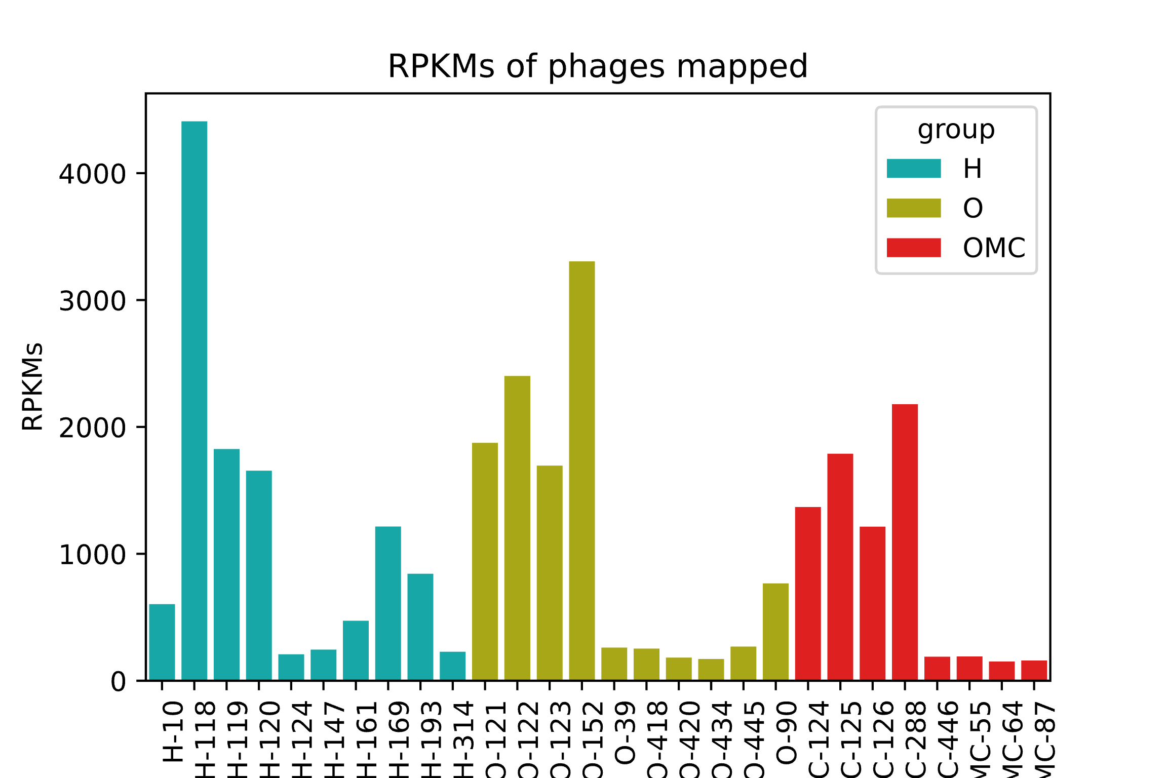
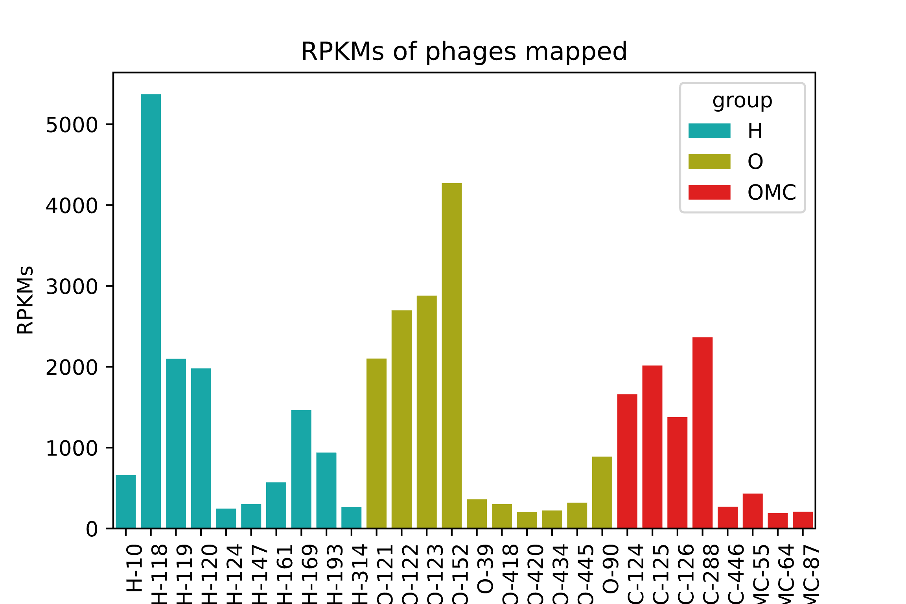
Realineamiento por muestra, abundancia relativa y RPKM

Slide 7
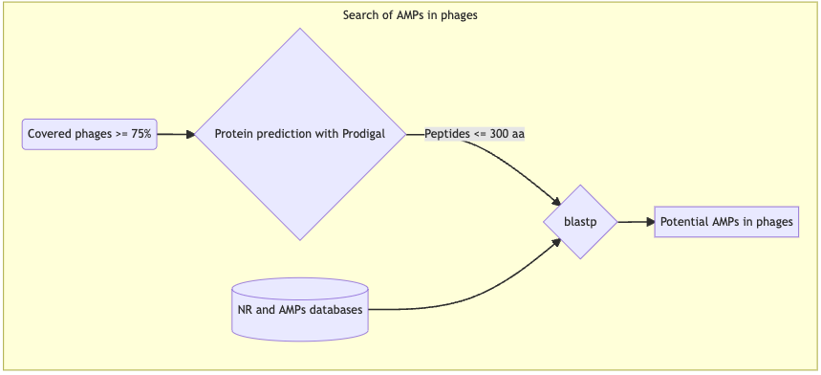
Anotacion de potenciales AMPs

Slide 8
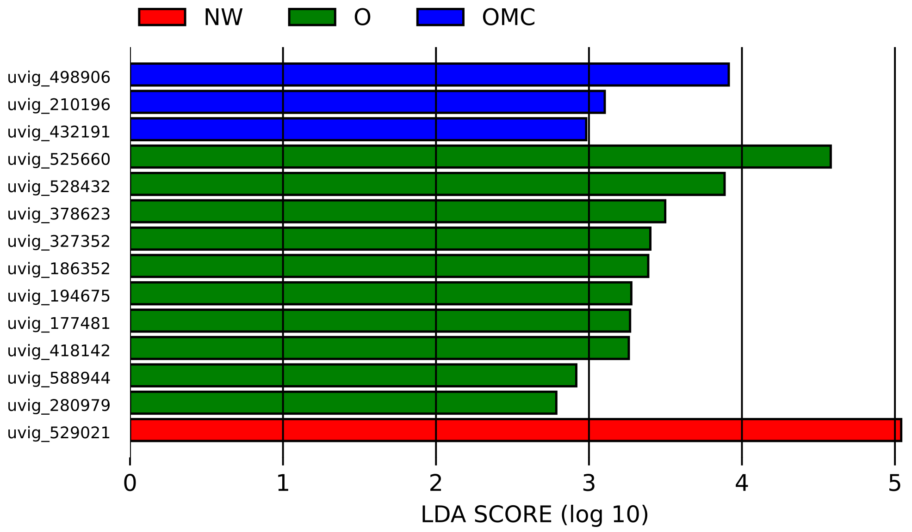
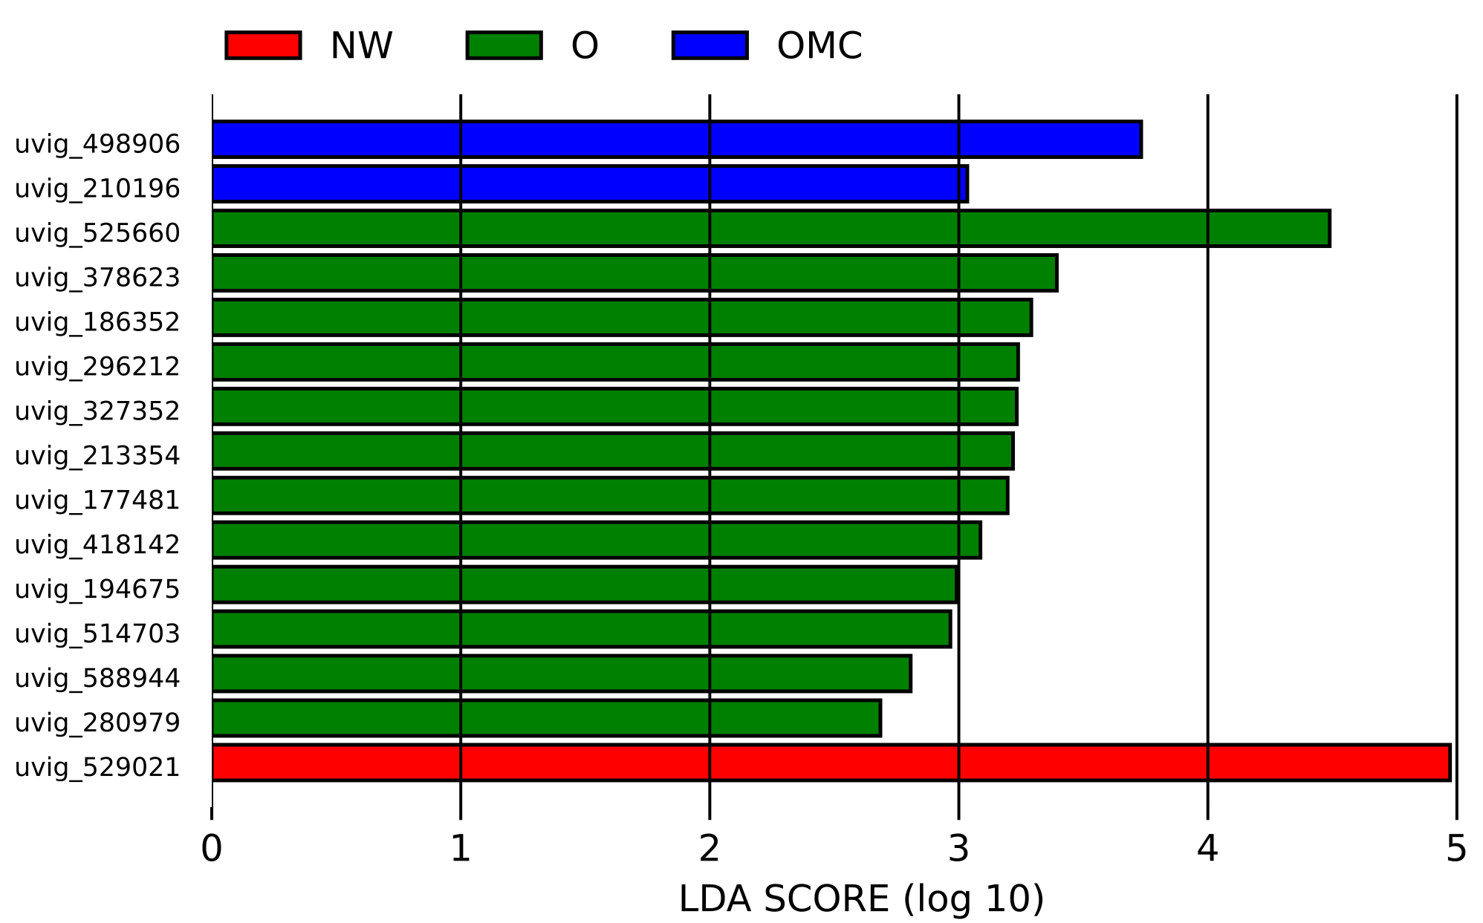
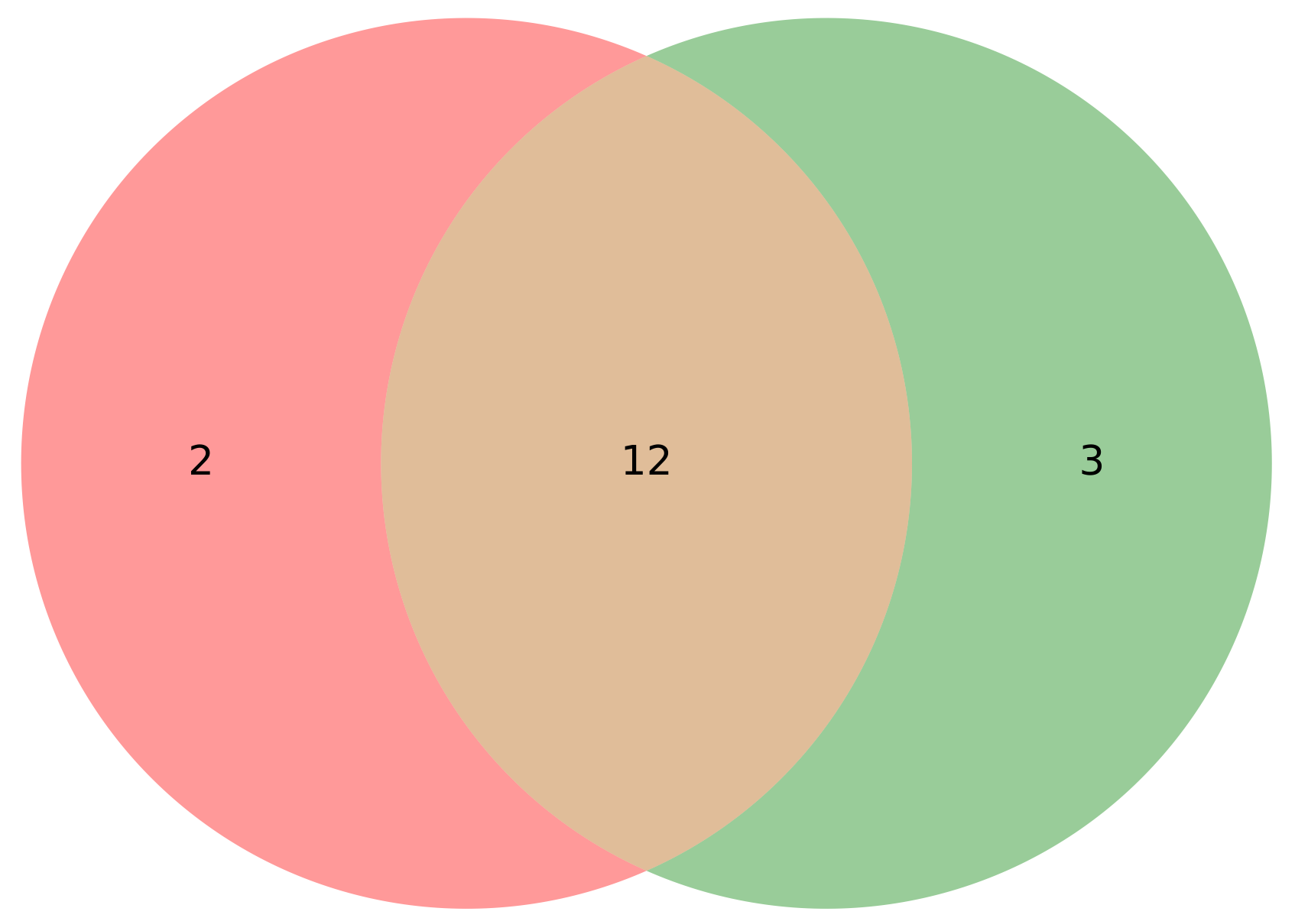
Abundancia diferencial entre grupos
75% de cobertura
70% de cobertura

Slide 9
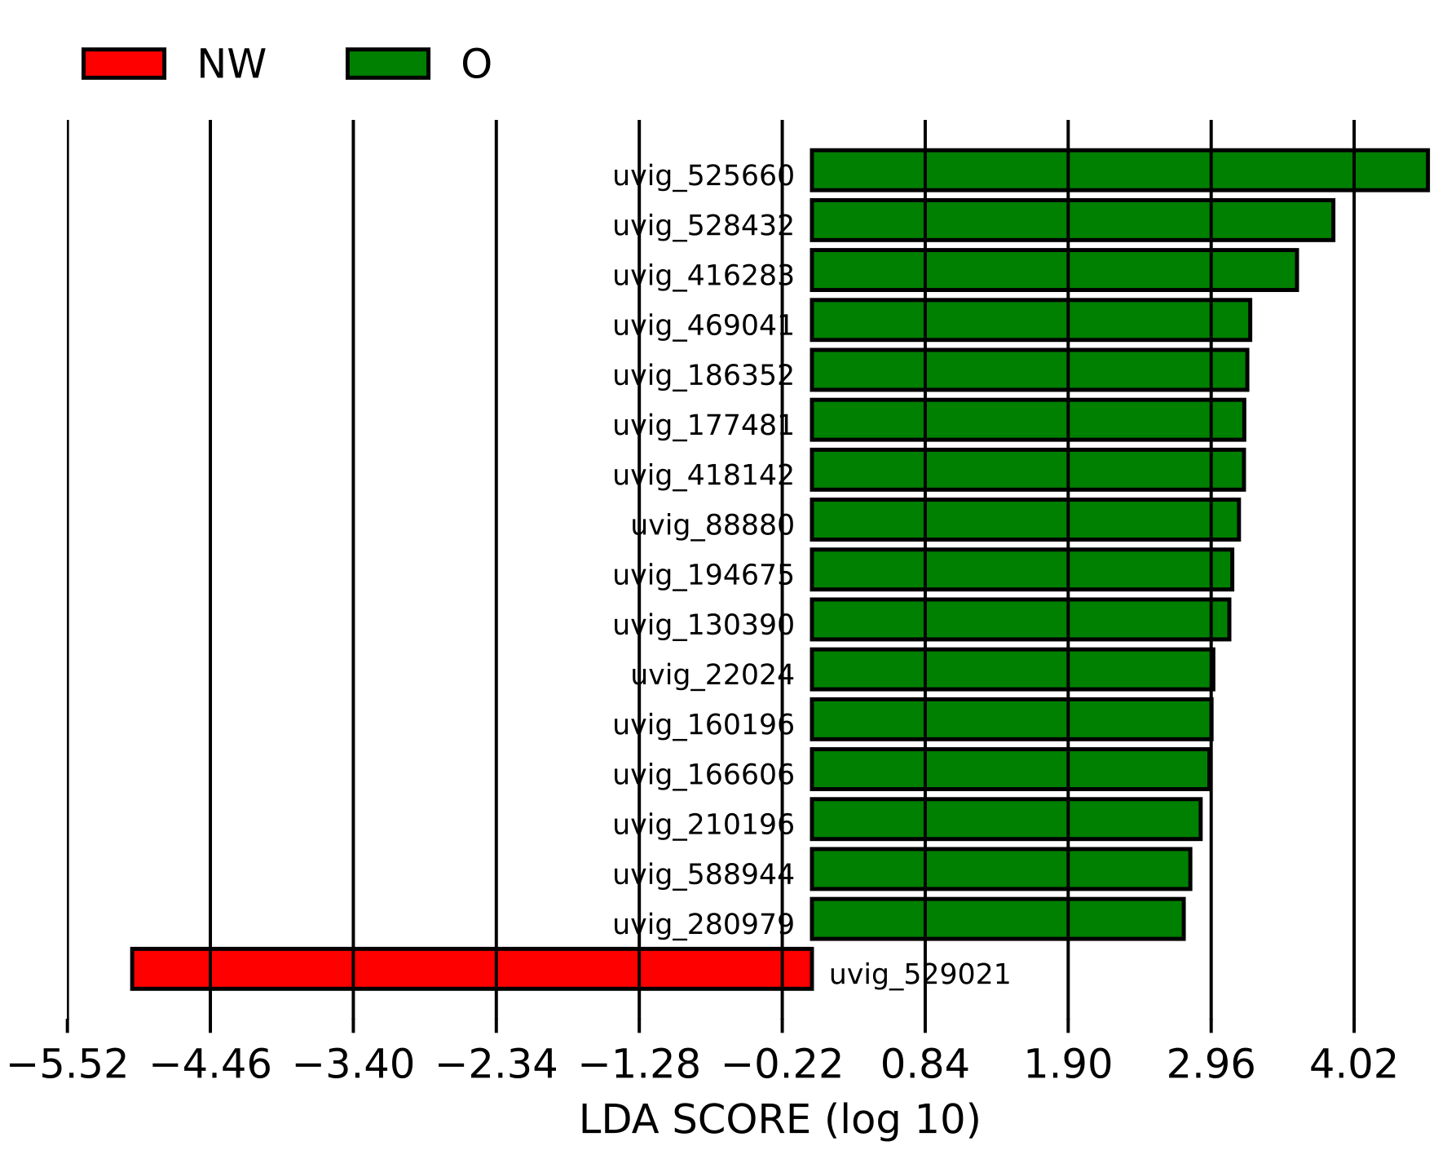
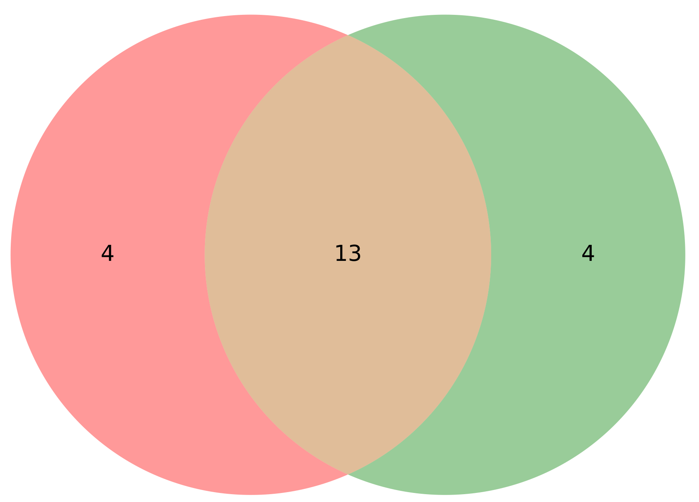
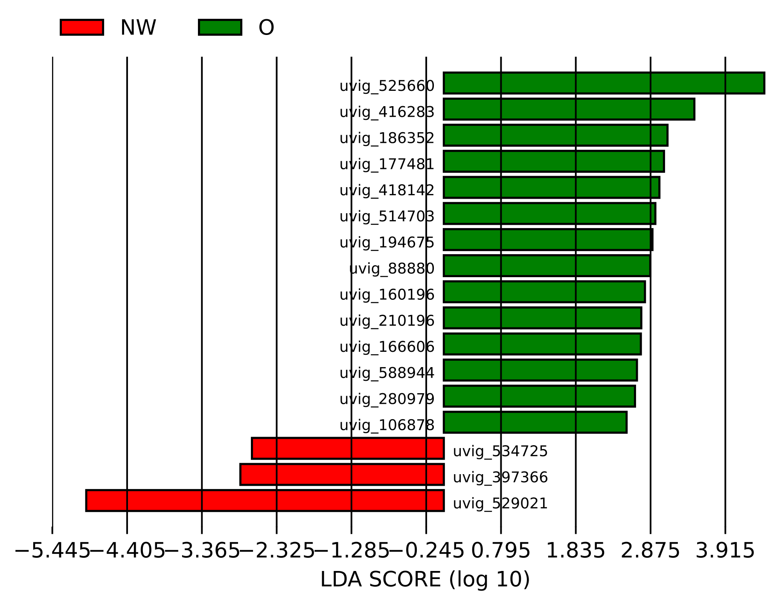
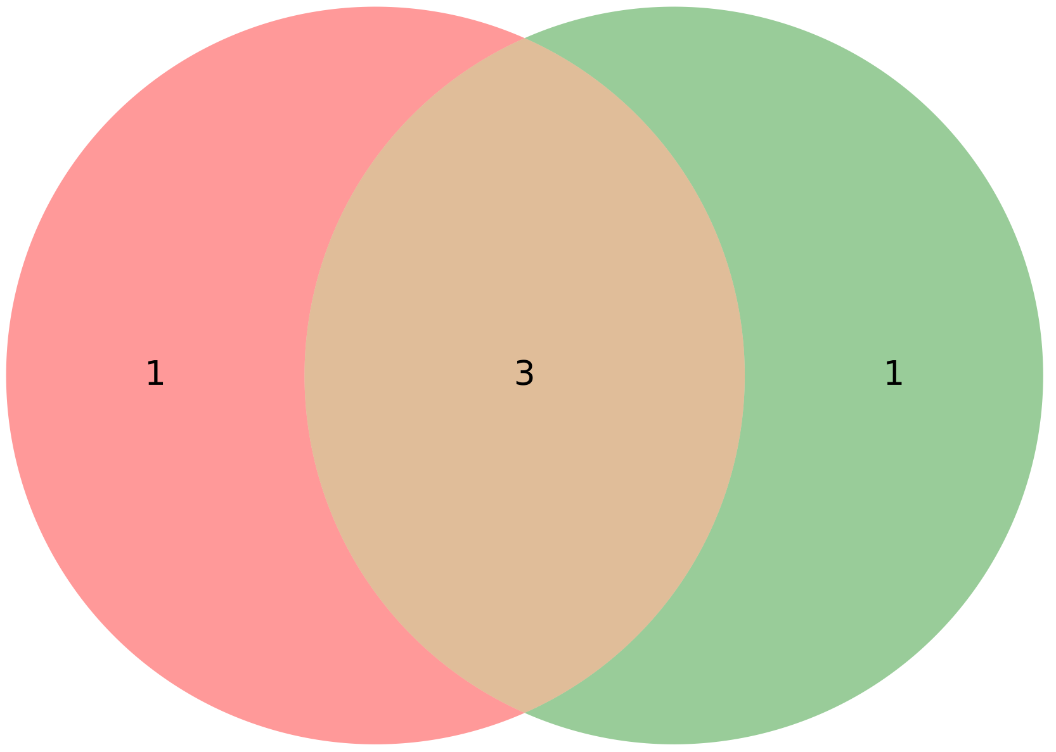
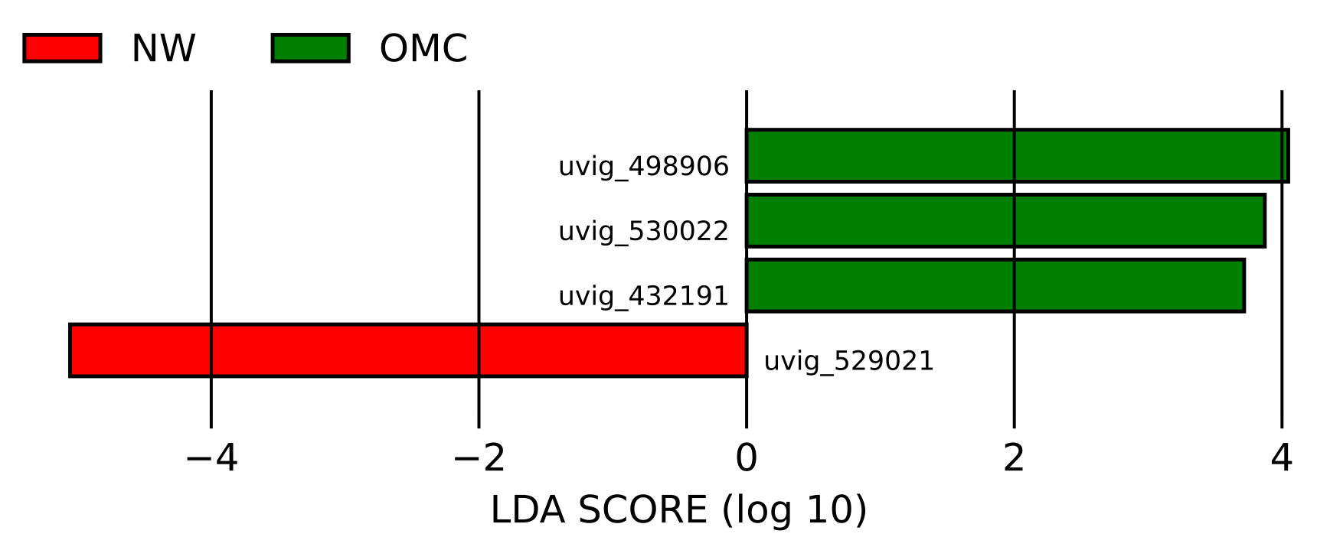
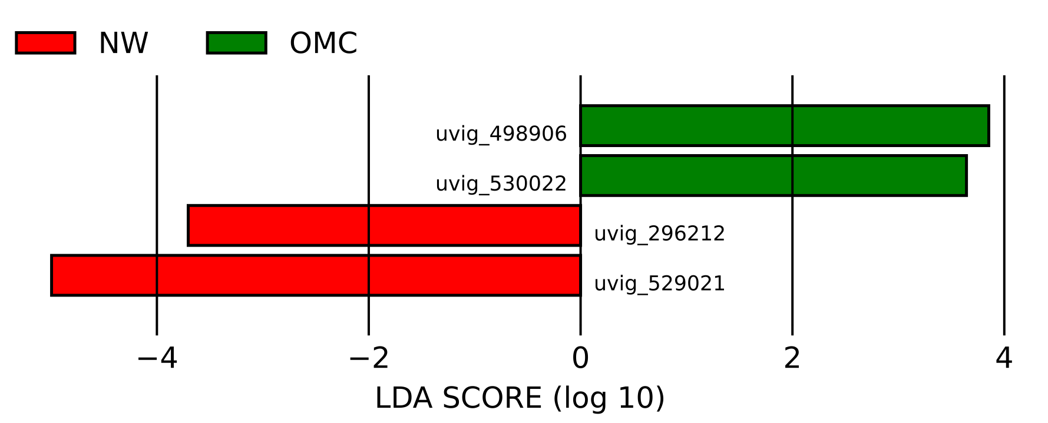
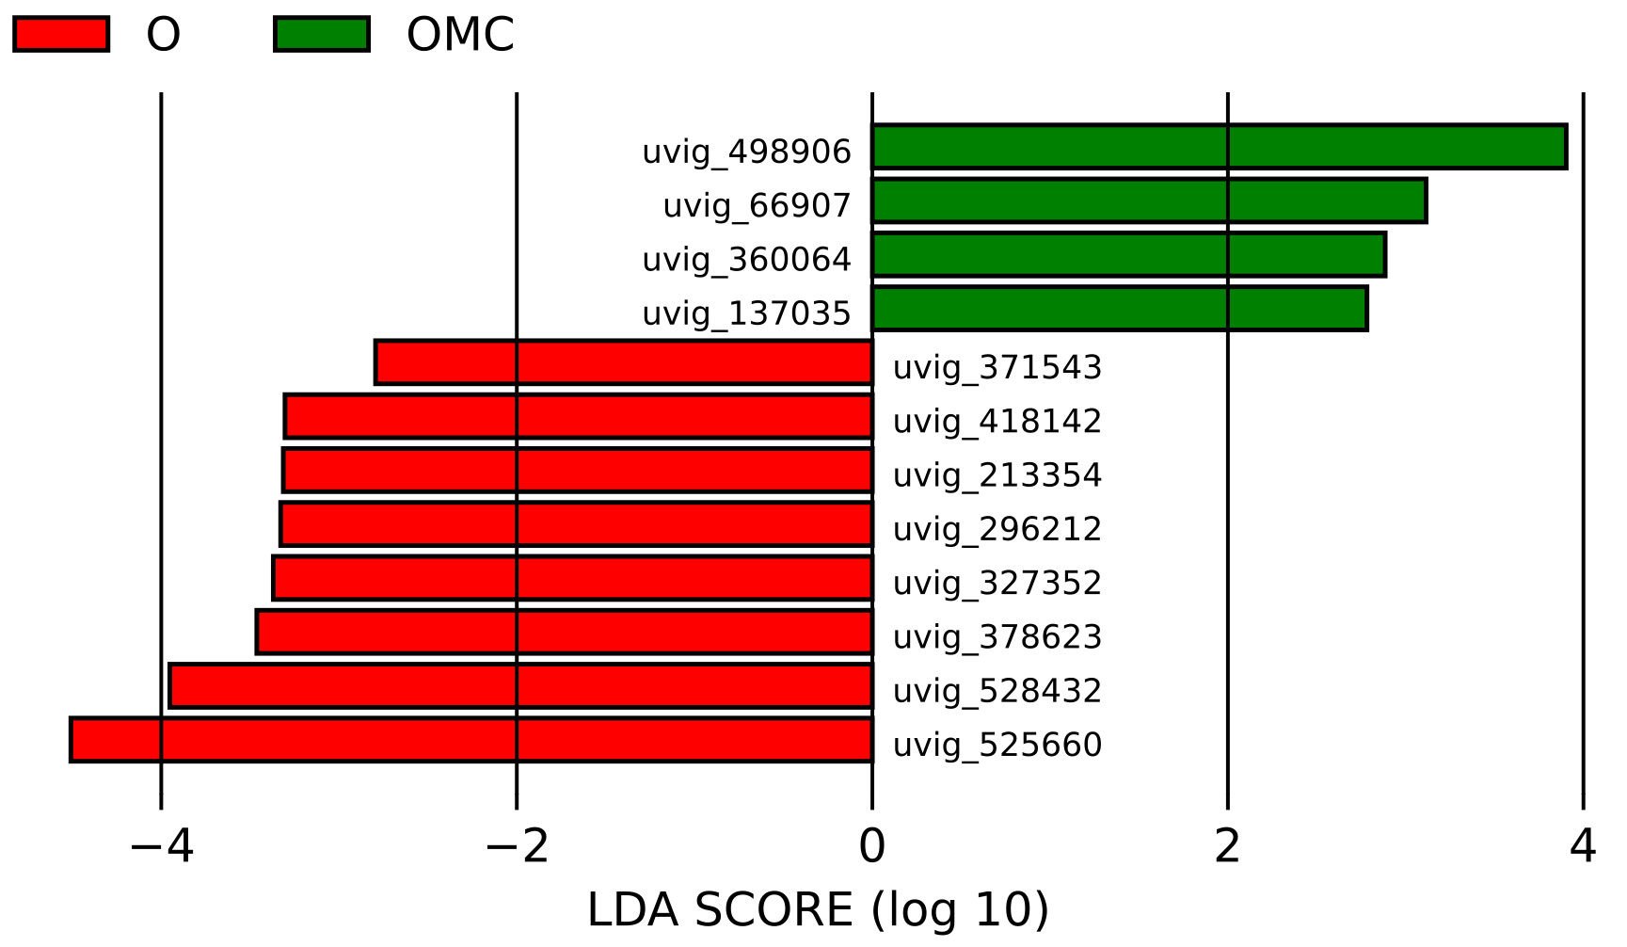
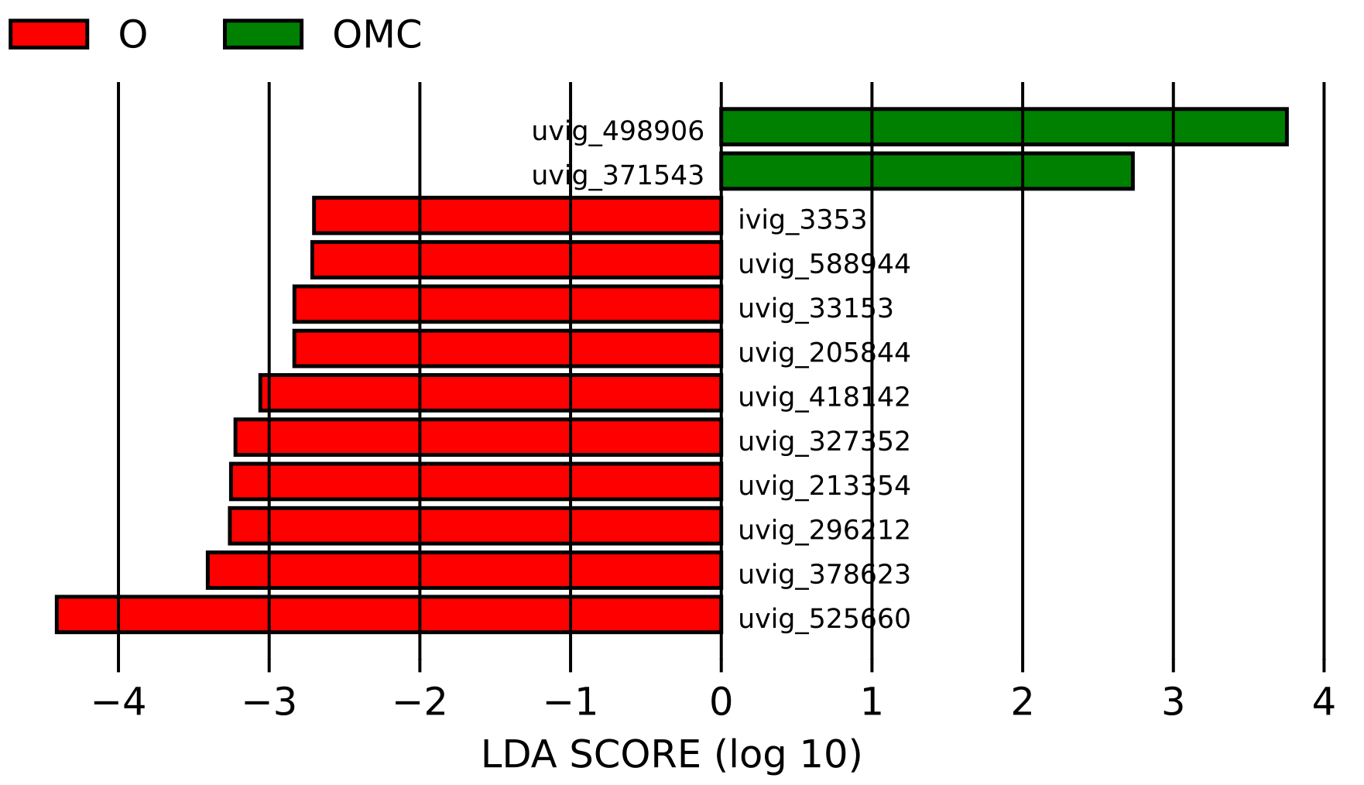
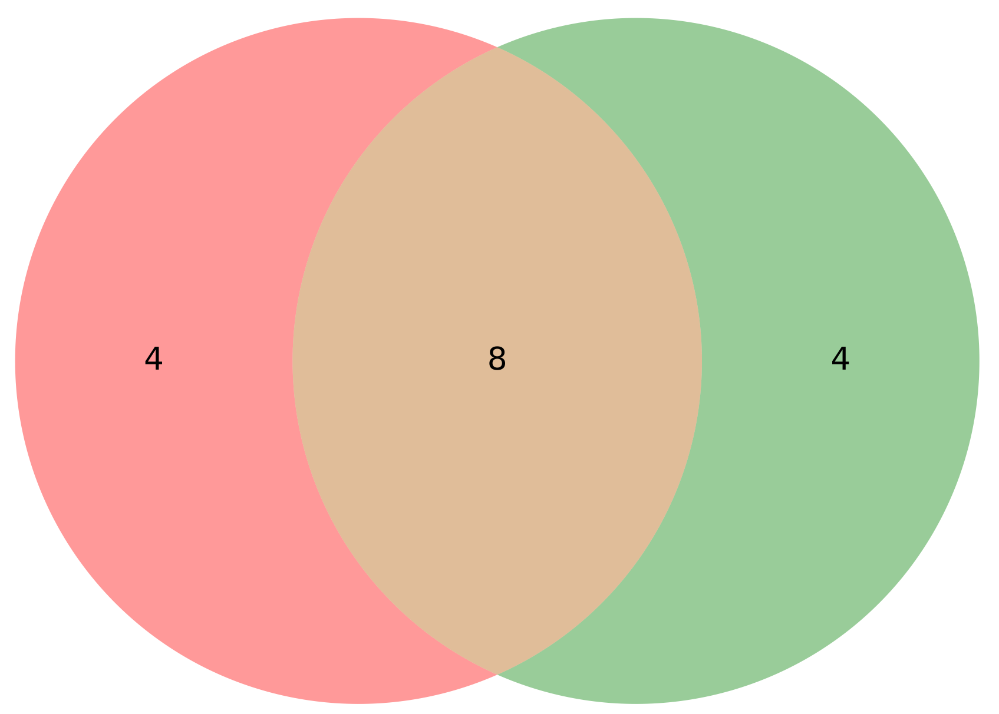
Abundancia diferencial entre grupos
75% de cobertura
70% de cobertura

Slide 10
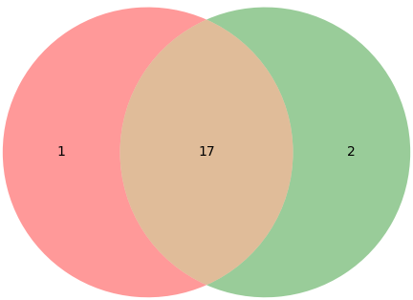
AMPs diferenciales entre grupos
75% de cobertura
70% de cobertura
phage holin [Clostridiales bacterium]
helix-turn-helix transcriptional regulator [Oscillibacter sp.]
TPA: helix-turn-helix domain-containing protein [Firmicutes bacterium]

Slide 11
AMPs diferenciales entre grupos
protein_id | blastp_classification | 75% | 70%
uvig_88880_10 | phage holin [Faecalibacterium sp. CAG:74_58_120] | 1 | 1
uvig_88880_28 | helix-turn-helix domain-containing protein [Faecalibacterium sp.] | 1 | 1
uvig_130390_1 | phage holin [Clostridiales bacterium] | 1 | 0
uvig_160196_27 | phage holin [Faecalibacterium sp. CAG:74_58_120] | 1 | 1
uvig_160196_45 | helix-turn-helix domain-containing protein [Faecalibacterium sp.] | 1 | 1
uvig_166606_2 | helix-turn-helix domain-containing protein [Faecalibacterium sp.] | 1 | 1
uvig_166606_20 | phage holin [Faecalibacterium sp. CAG:74_58_120] | 1 | 1
uvig_177481_16 | phage holin [Faecalibacterium sp. CAG:74_58_120] | 1 | 1
uvig_194675_1 | helix-turn-helix domain-containing protein [Faecalibacterium sp.] | 1 | 1
uvig_194675_18 | phage holin [Faecalibacterium sp. CAG:74_58_120] | 1 | 1
uvig_210196_15 | helix-turn-helix transcriptional regulator [Oscillospiraceae bacterium] | 1 | 1
uvig_213354_6 | TPA: MAG TPA: helix-turn-helix domain protein [Siphoviridae sp.] | 1 | 1
uvig_296212_61 | TPA: MAG TPA: helix-turn-helix domain protein [Siphoviridae sp.] | 1 | 1
uvig_416283_15 | helix-turn-helix domain-containing protein [Clostridiales bacterium] | 1 | 1
uvig_498906_12 | DNA-binding helix-turn-helix protein [Phocaeicola dorei 5_1_36/D4] | 1 | 1
uvig_529021_15 | TPA: MAG TPA: Repressor protein CI [Myoviridae sp.] | 1 | 1
uvig_530022_6 | helix-turn-helix domain-containing protein [Firmicutes] | 1 | 1
uvig_530022_21 | D-Ala-D-Ala carboxypeptidase family metallohydrolase [Faecalibacterium prausnitzii] | 1 | 1
uvig_33153_3 | helix-turn-helix transcriptional regulator [Oscillibacter sp.] | 0 | 1
uvig_33153_12 | TPA: helix-turn-helix domain-containing protein [Firmicutes bacterium] | 0 | 1

Slide 12
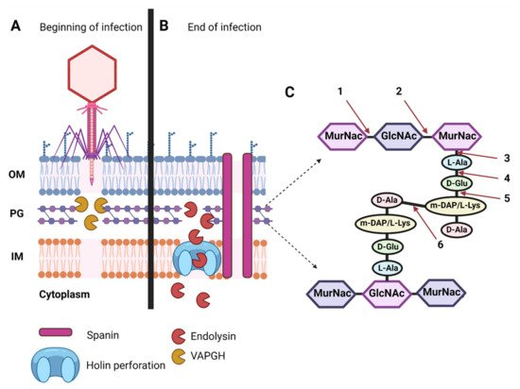
Holins

