Slide 1
Colaboración INMEGEN, metatranscriptoma NASH
22.06.2022

Slide 2
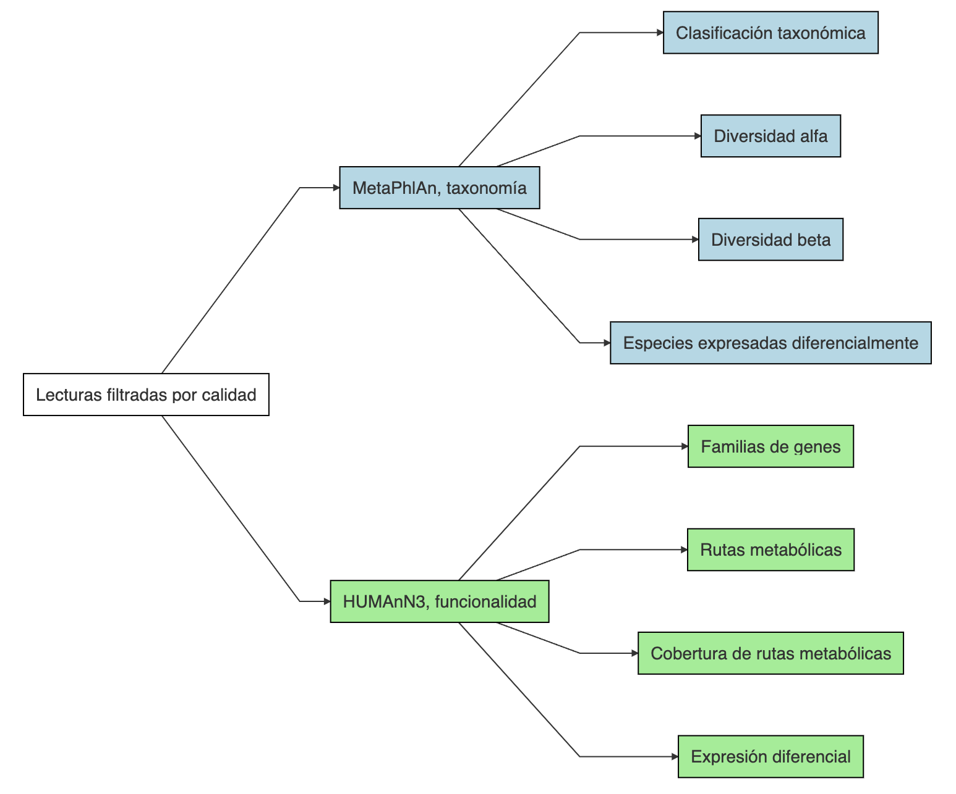
Pipeline

Slide 3
Metadata
sample | Sex | Status_1 | Status_2
RL509-mf | Female | NASH | NASH
RL511-mf | Female | NASH | NASH
RL514-mf | Female | Control | NAFL
RL516-mf | Female | Control | Control no-NAFL
RL518-mf | Male | NASH | NASH
RL528-mf | Female | NASH | NASH
RL568-mf | Female | NASH | NASH
RL569-mf | Female | Control | Control no-NAFL
RL573-mf | Female | Control | NAFL
RL585-mf | Male | Control | NAFL
RL587-mf | NA | NASH | NA
RL591-mf | Female | NASH | NASH
RL599-mf | NA | Control | NA
RL601-mf | Male | NASH | NASH
RL605-mf | Female | NASH | NASH
RL606-mf | Male | NASH | NASH
RL607-mf | Female | Control | Control no-NAFL
RL610-mf | NA | Control | NA
RL613-mf | Female | NASH | NASH
RL616-mf | Female | NASH | NASH
RL619-mf | NA | NASH | NA
RL621-mf | NA | NASH | NA
RL625-mf | NA | Control | NA
RL627-mf | Female | Control | Control no-NAFL
RL628-mf | Female | Control | Control no-NAFL
RL638-mf | NA | Control | NA
RL641-mf | Male | NASH | NASH
RL651-mf | Female | Control | NAFL
RL654-mf | Male | Control | NAFL
RL656-mf | Female | NASH | NASH
RL659-mf | Female | NASH | NASH
RL663-mf | Male | NASH | NASH
RL665-mf | Female | NASH | NASH
RL667-mf | Female | NASH | NASH
RL668-mf | Female | NASH | NASH
RL679-mf | Female | NASH | NASH
RL680-mf | Female | Control | NAFL
RL682-mf | Male | Control | NA
RL683-mf | Female | NASH | NASH
RL686-mf | Male | Control | Control no-NAFL
RL691-mf | Female | Control | NAFL
RL693-mf | Female | Control | NAFL
RL700-mf | Male | Control | NA
RL703-mf | Female | Control | Control no-NAFL
RL704-mf | Female | Control | NAFL
RL725-mf | Female | Control | NAFL

Slide 4
Comparaciones
NASH vs Control considerando todas las muestras
NASH vs Control estratificando por género (Male)
NASH vs Control estratificando por género (Female)

Slide 5
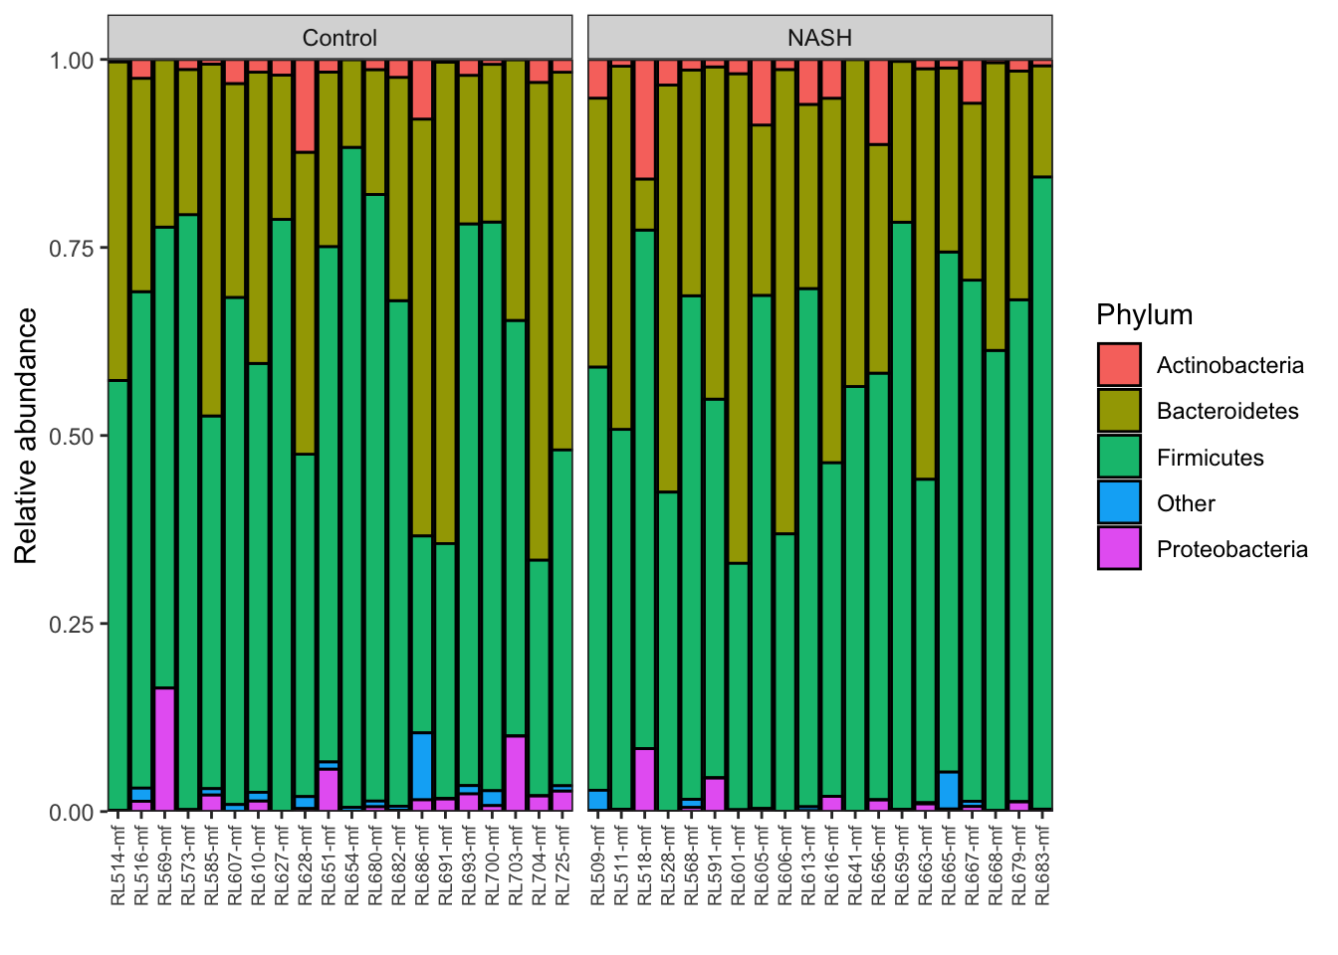
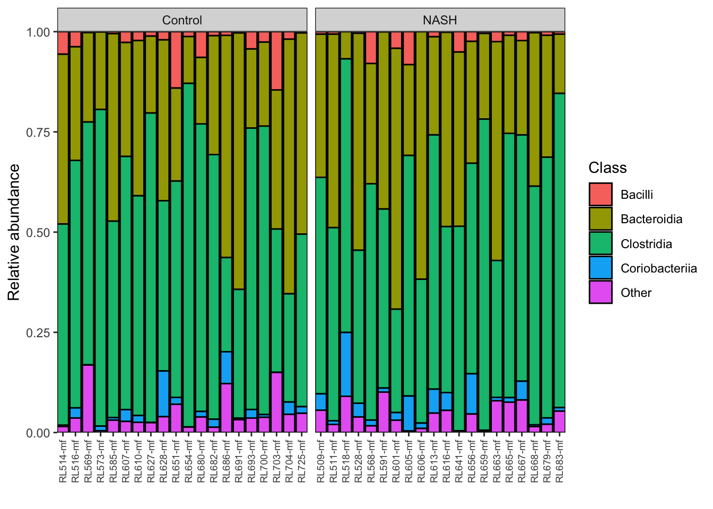
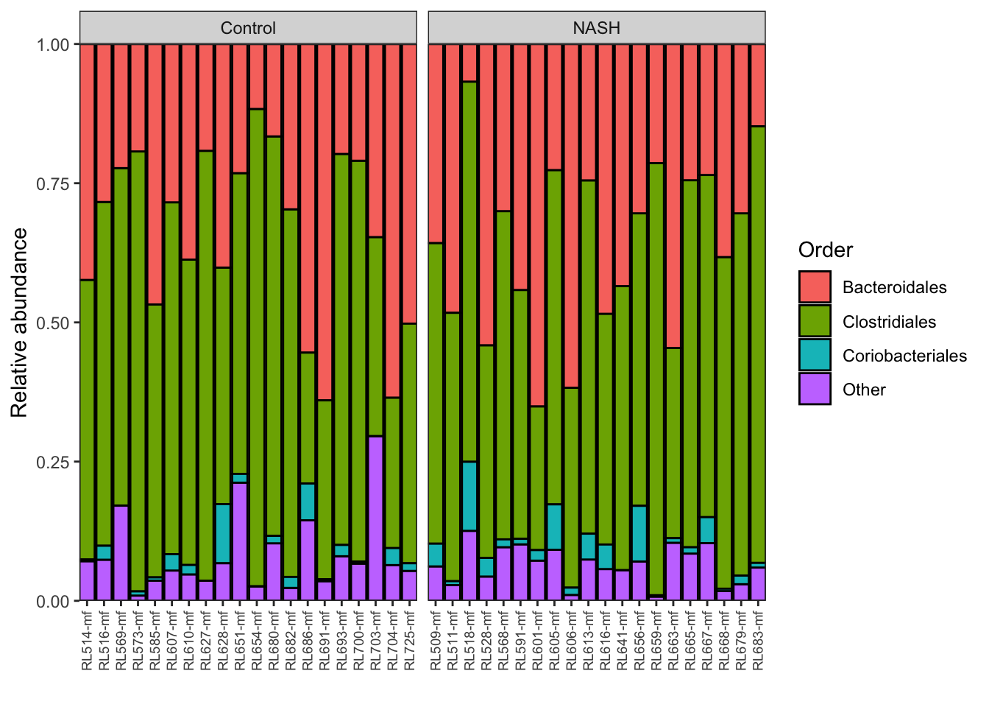
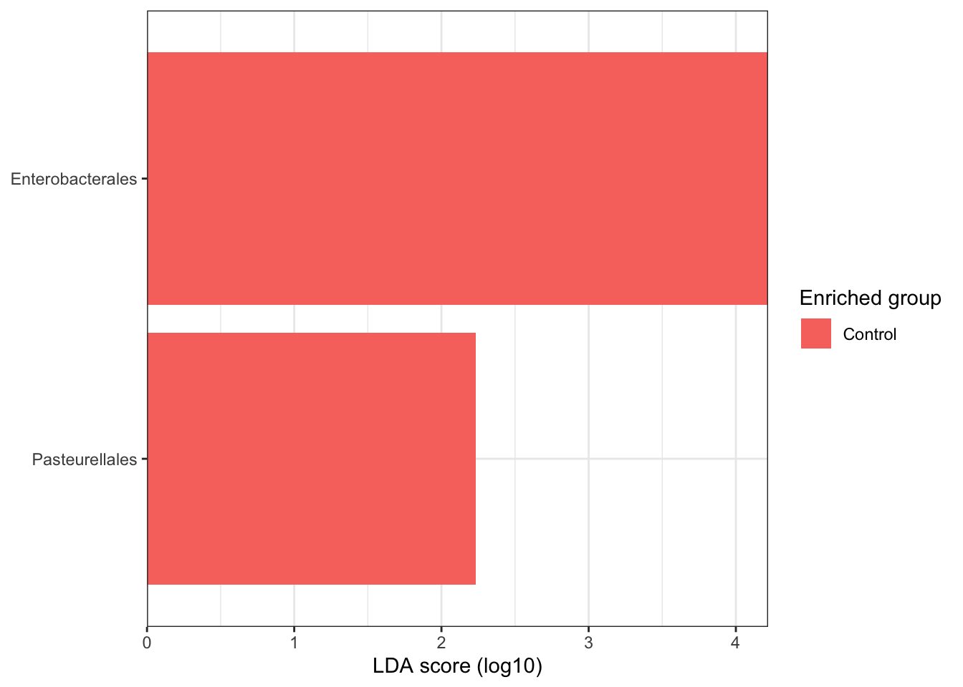
NASH vs Control considerando todas las muestras

Slide 6
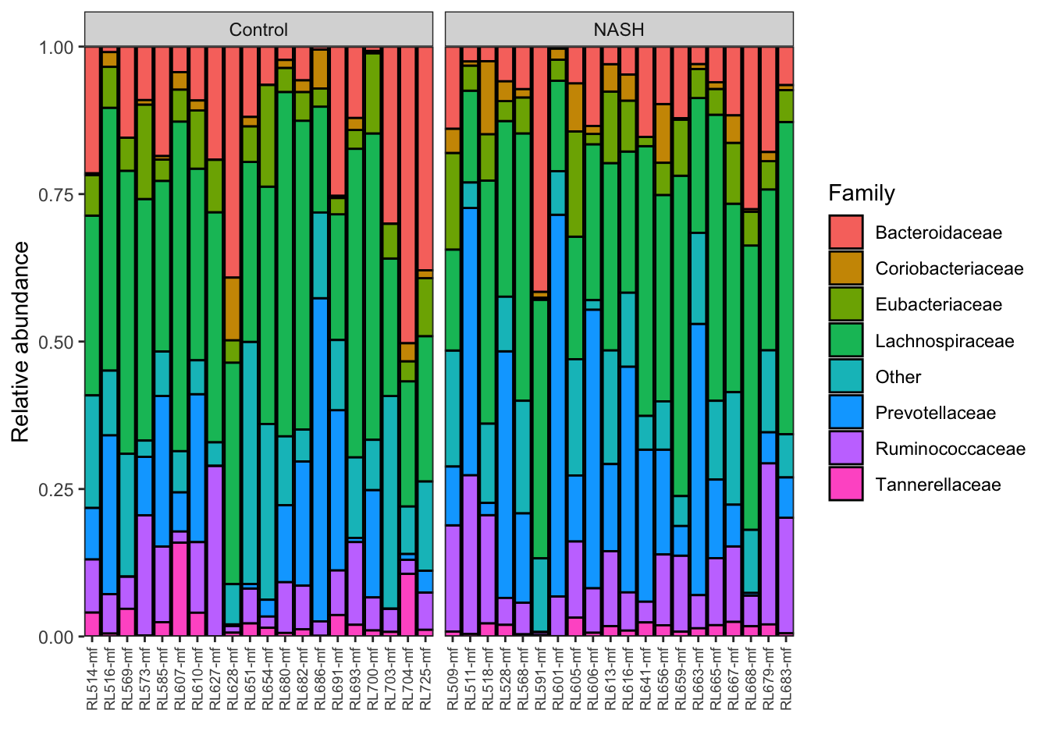
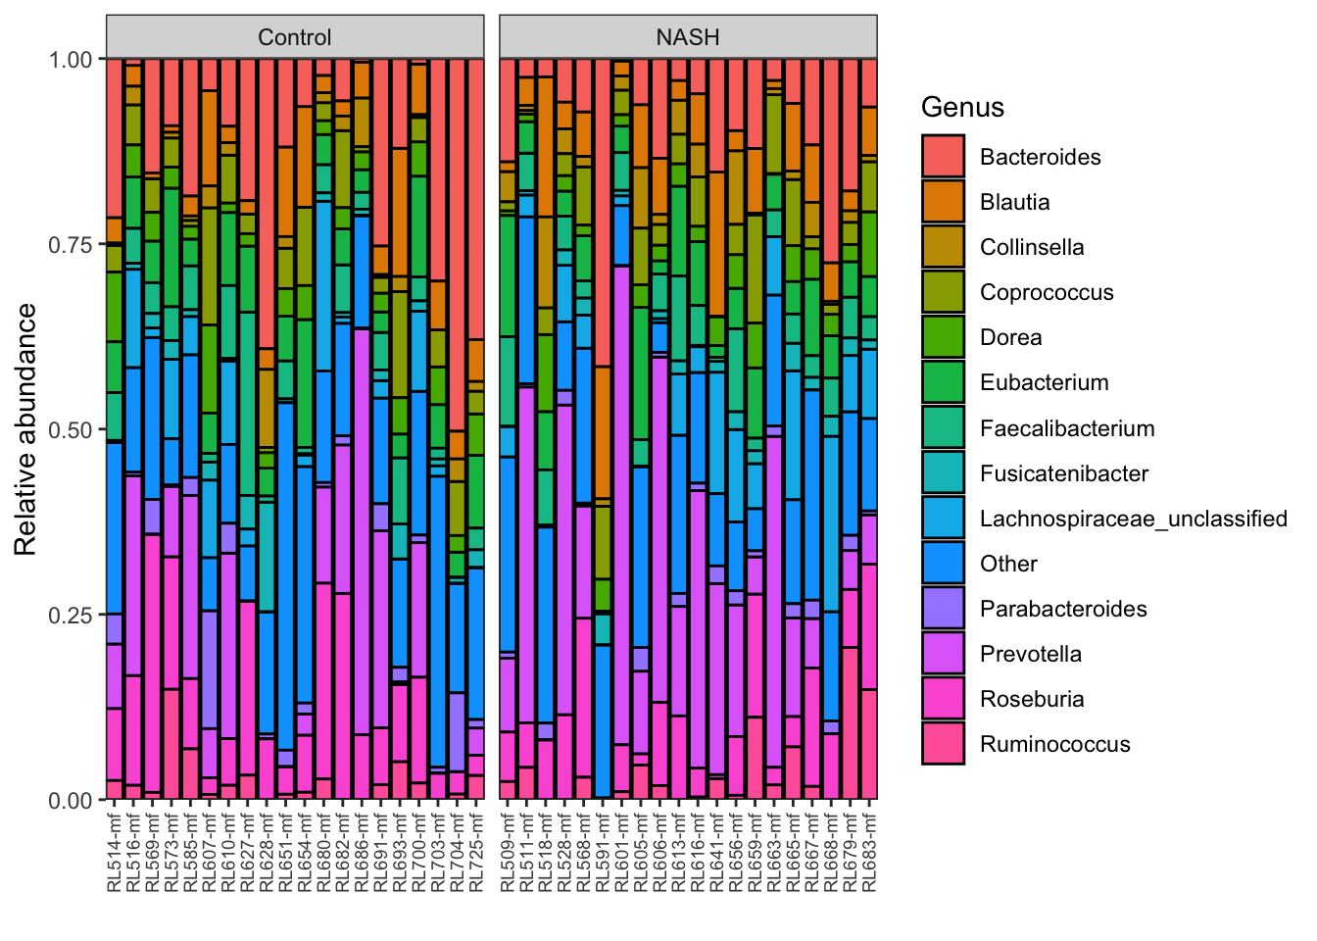
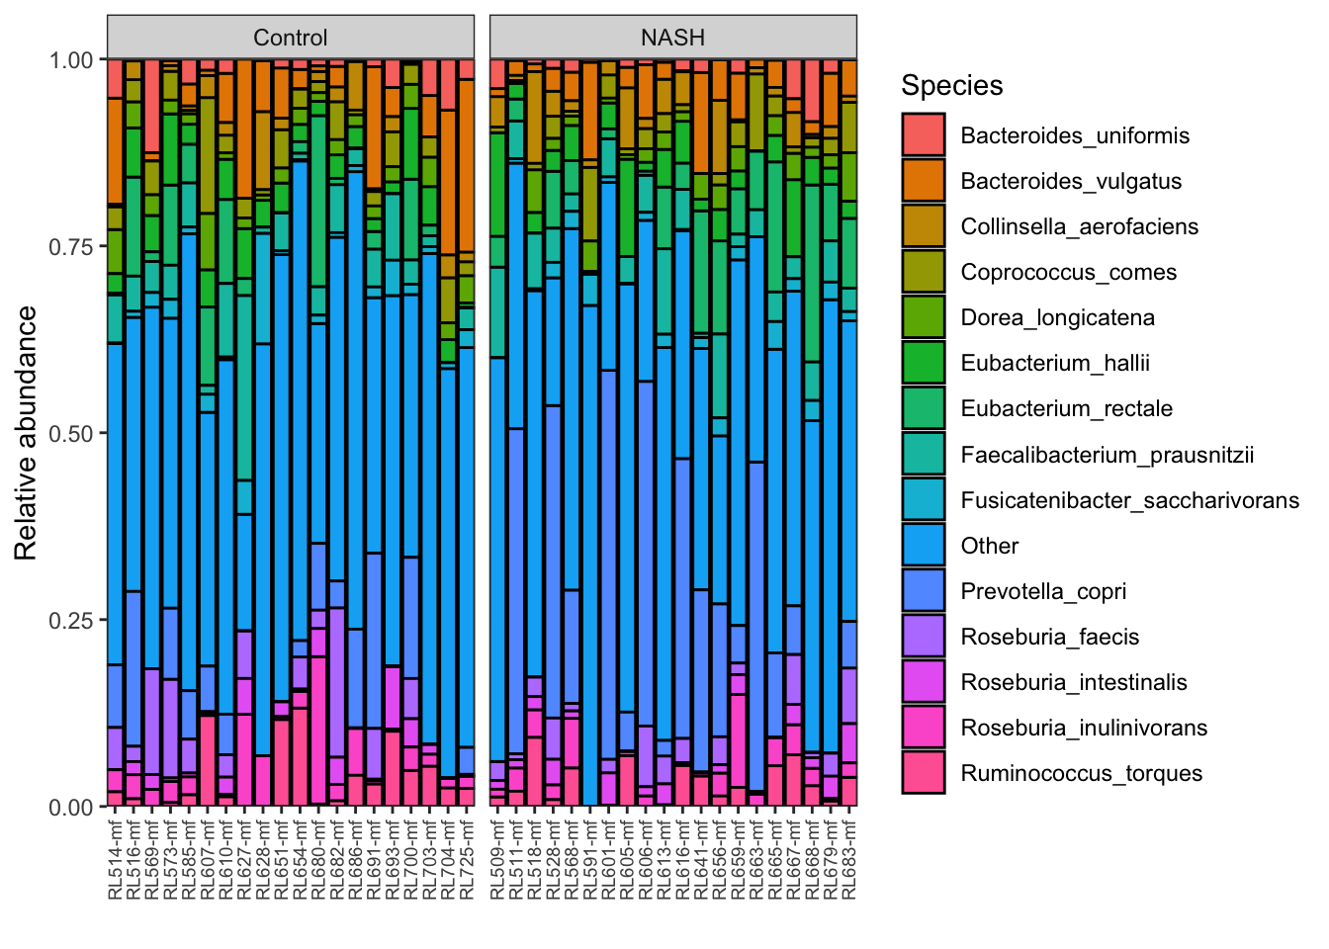
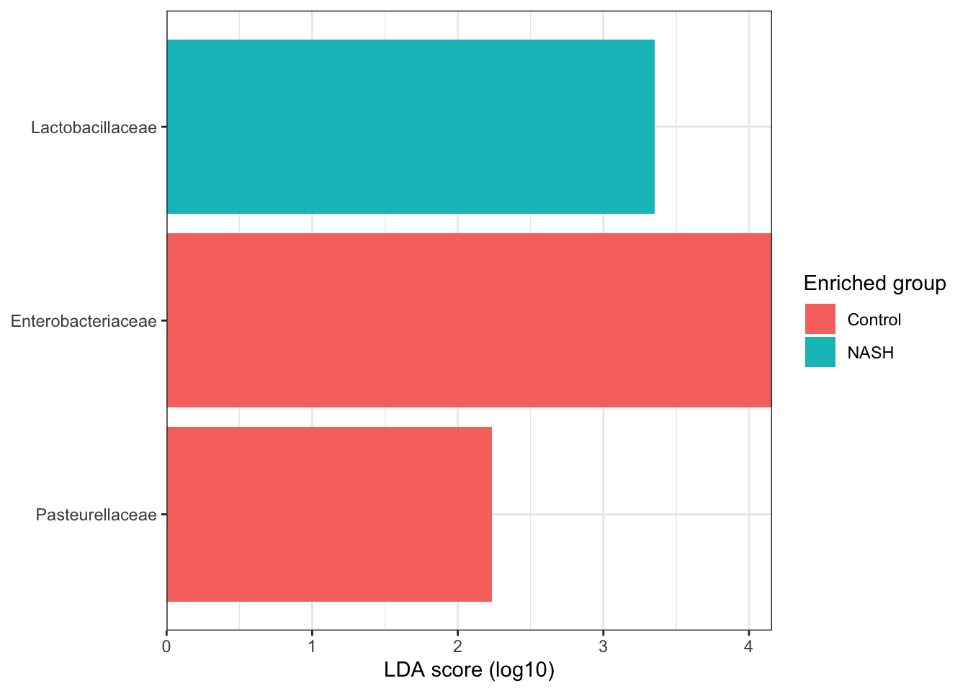
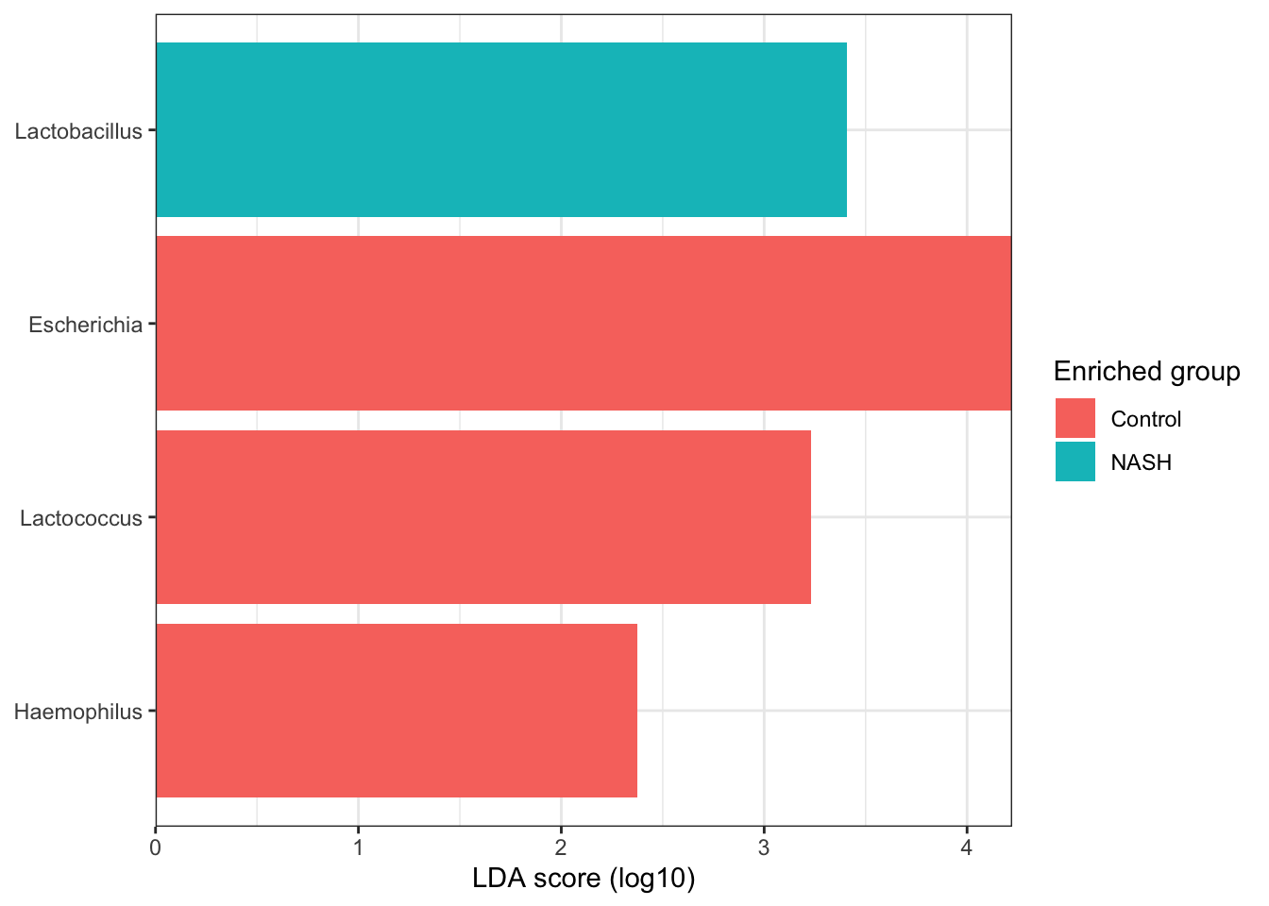
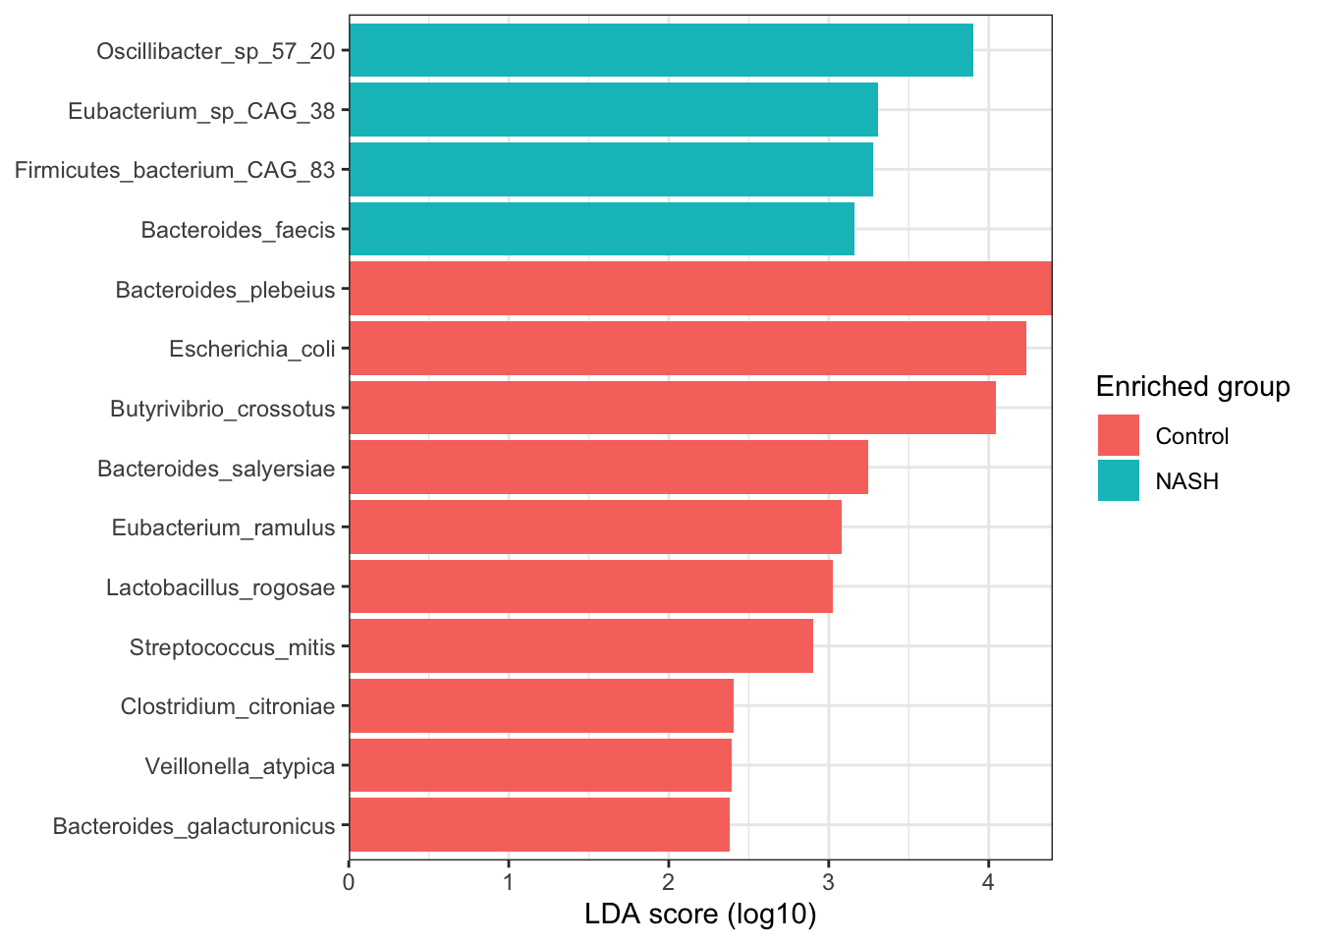
NASH vs Control considerando todas las muestras

Slide 7
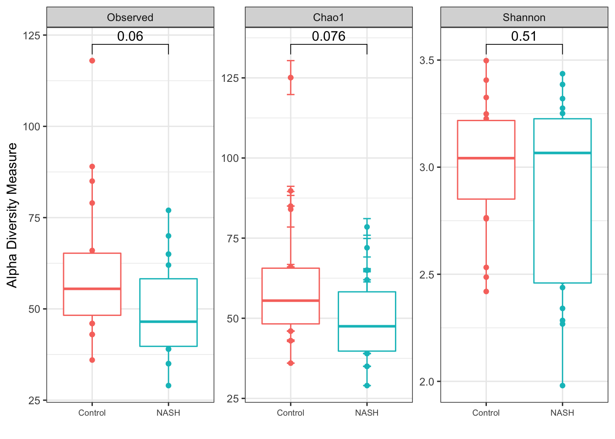
NASH vs Control considerando todas las muestras

Slide 8
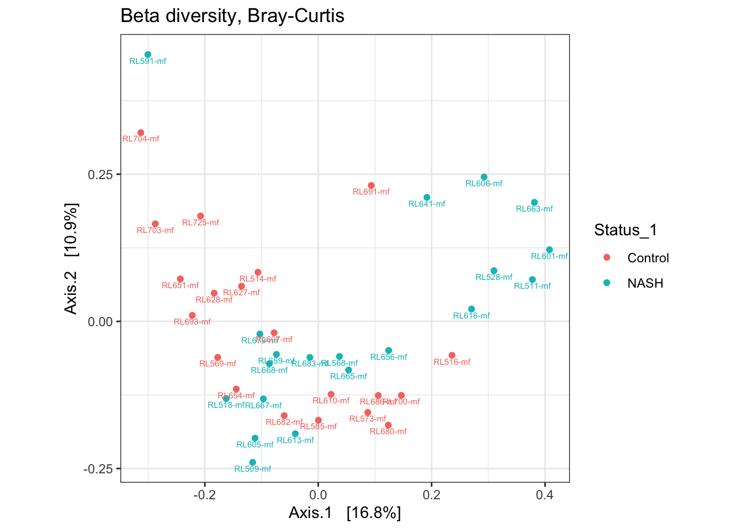
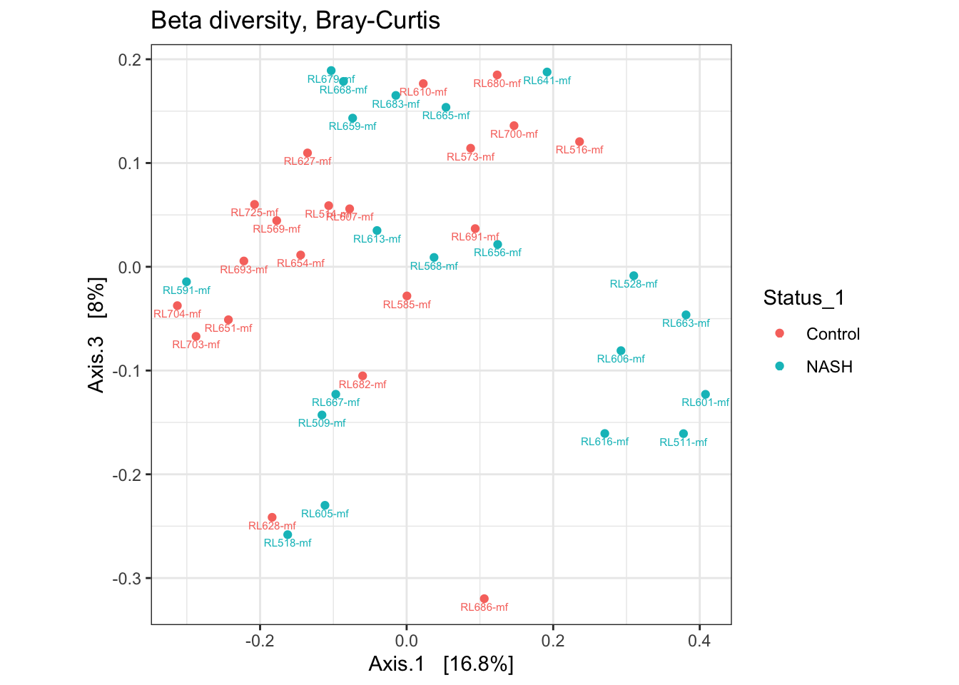
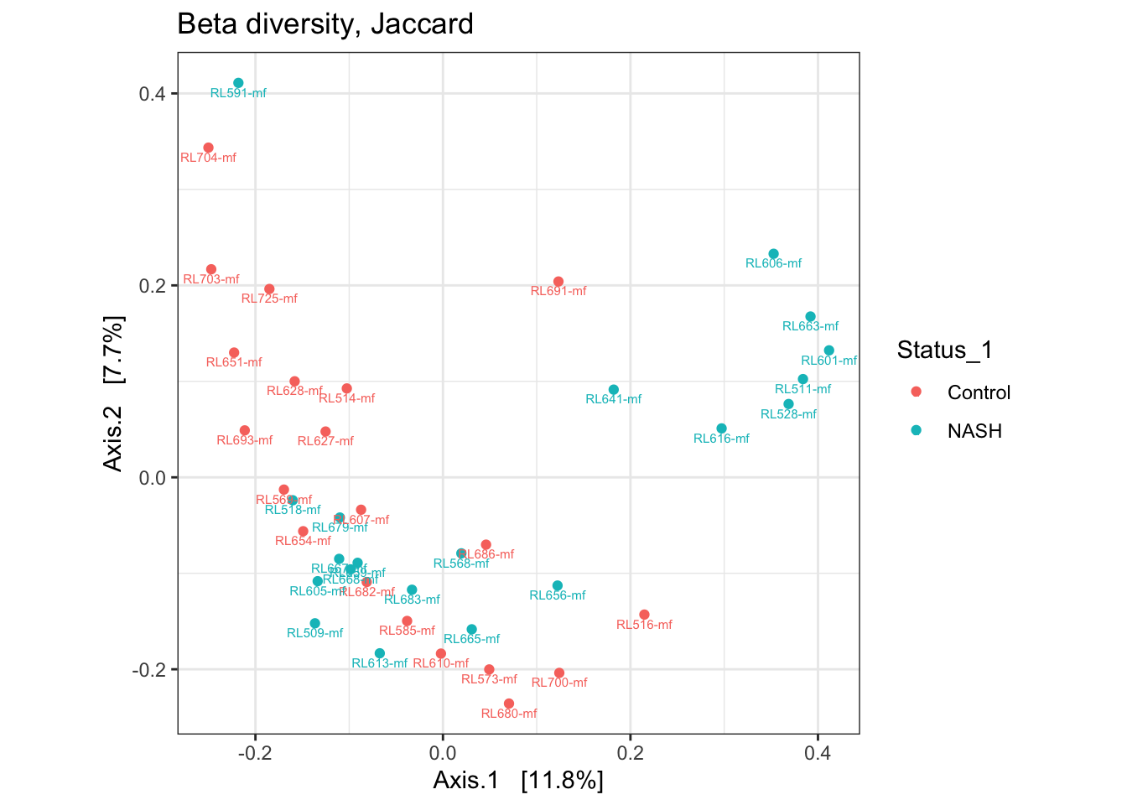
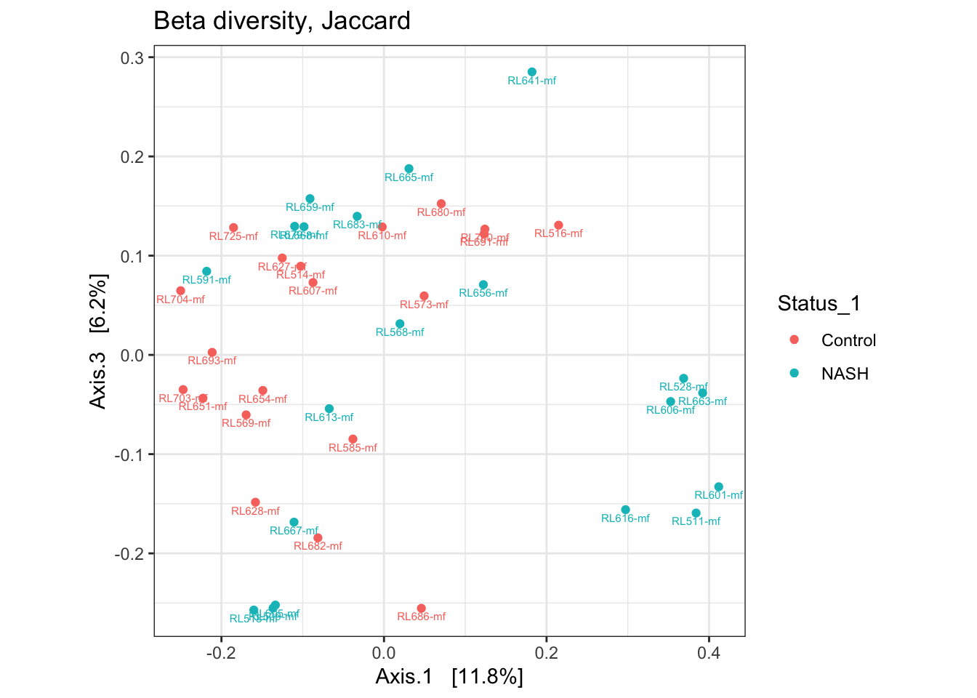
NASH vs Control considerando todas las muestras

Slide 10
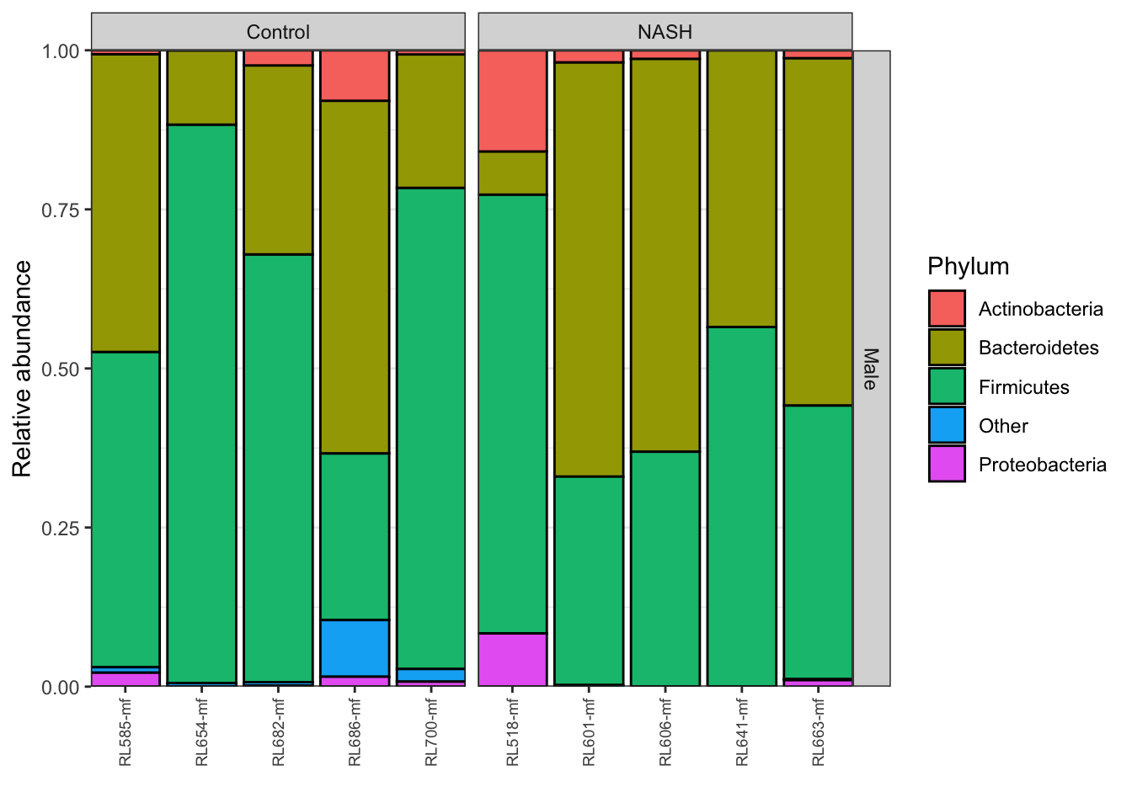
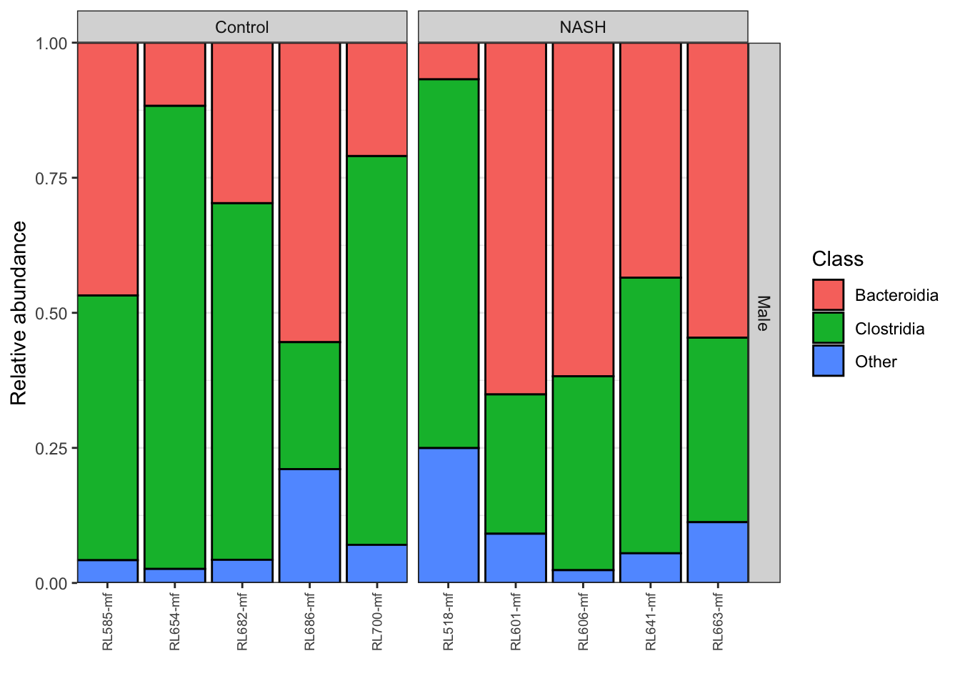
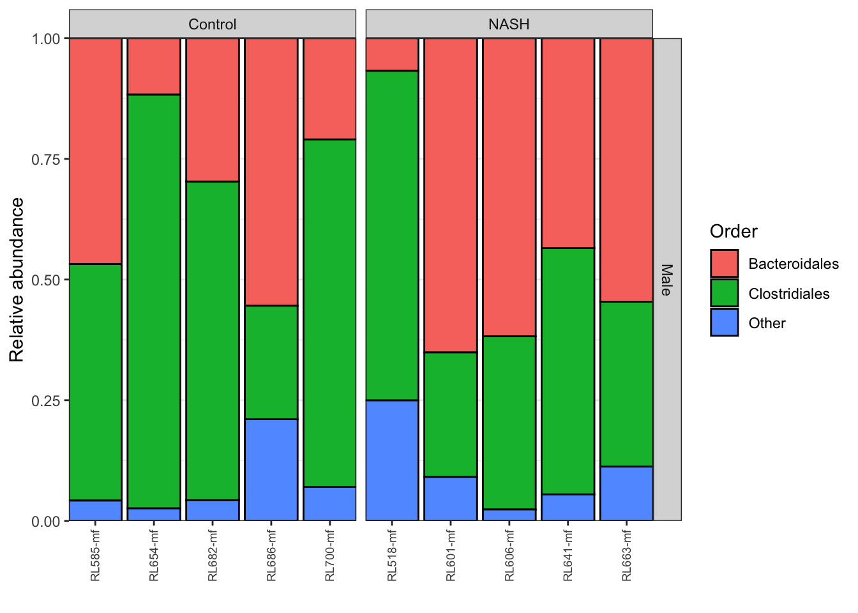
NASH vs Control estratificando por género (Male)

Slide 11
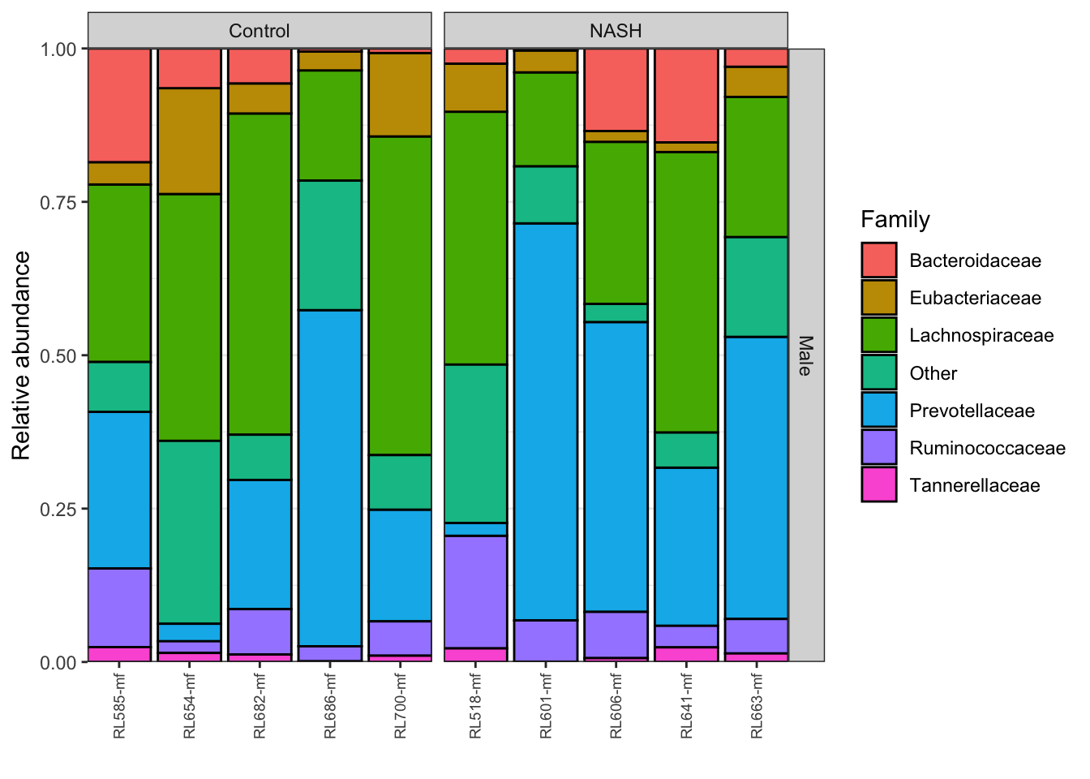
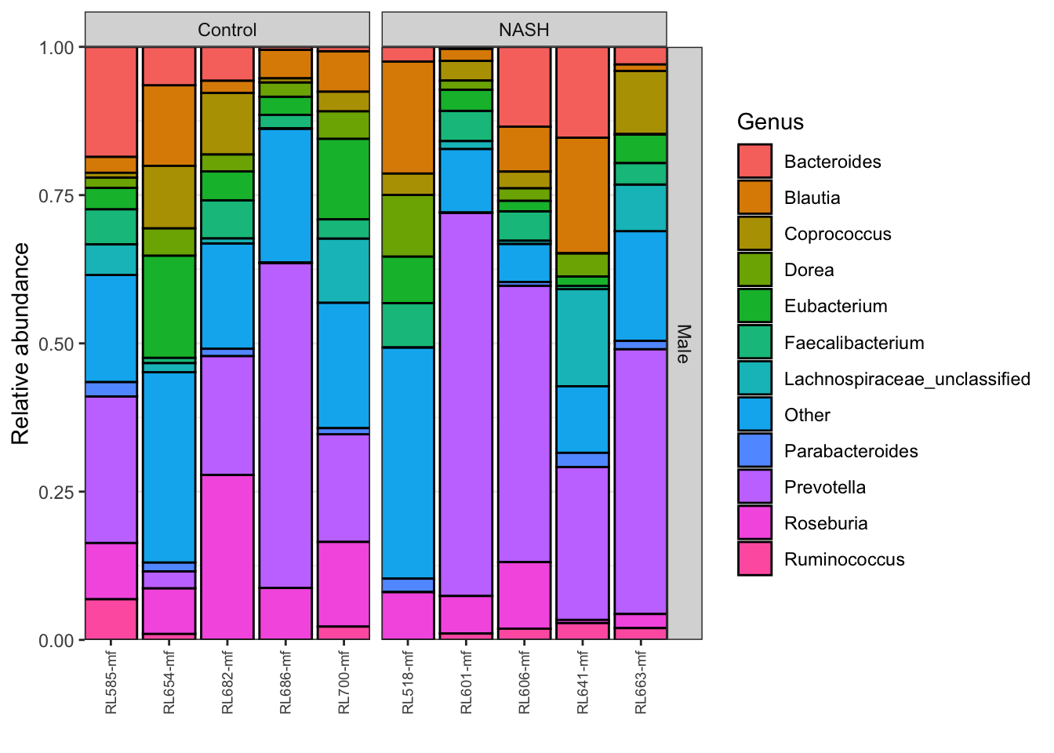
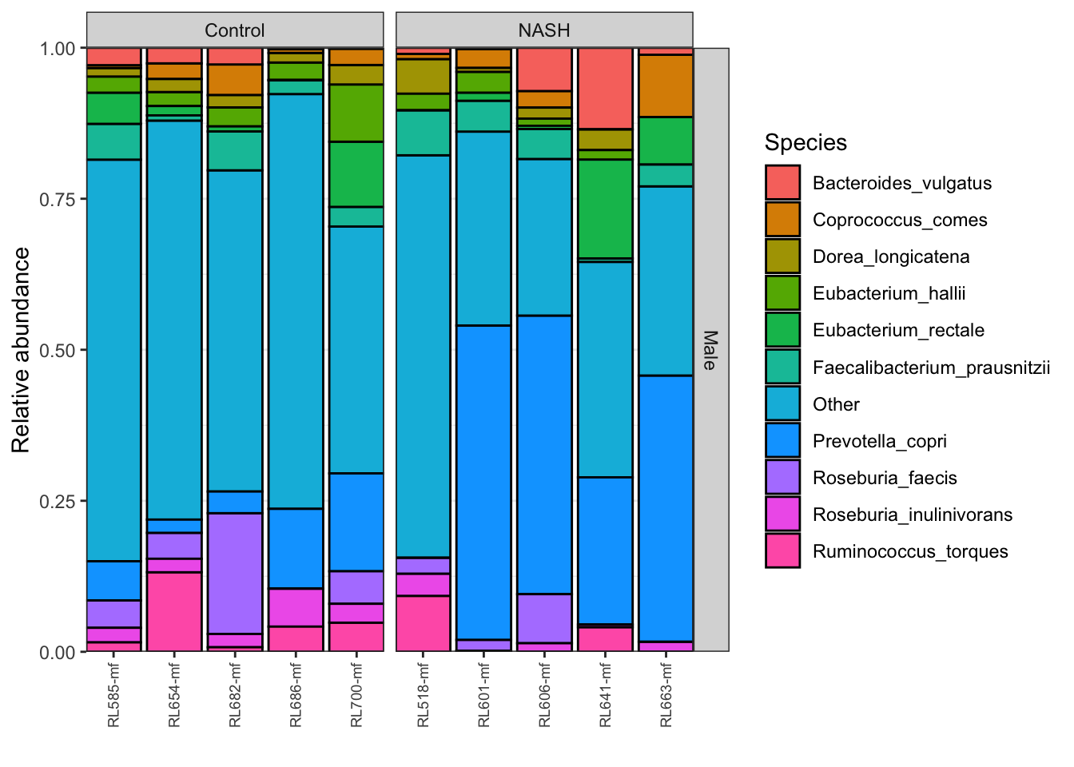
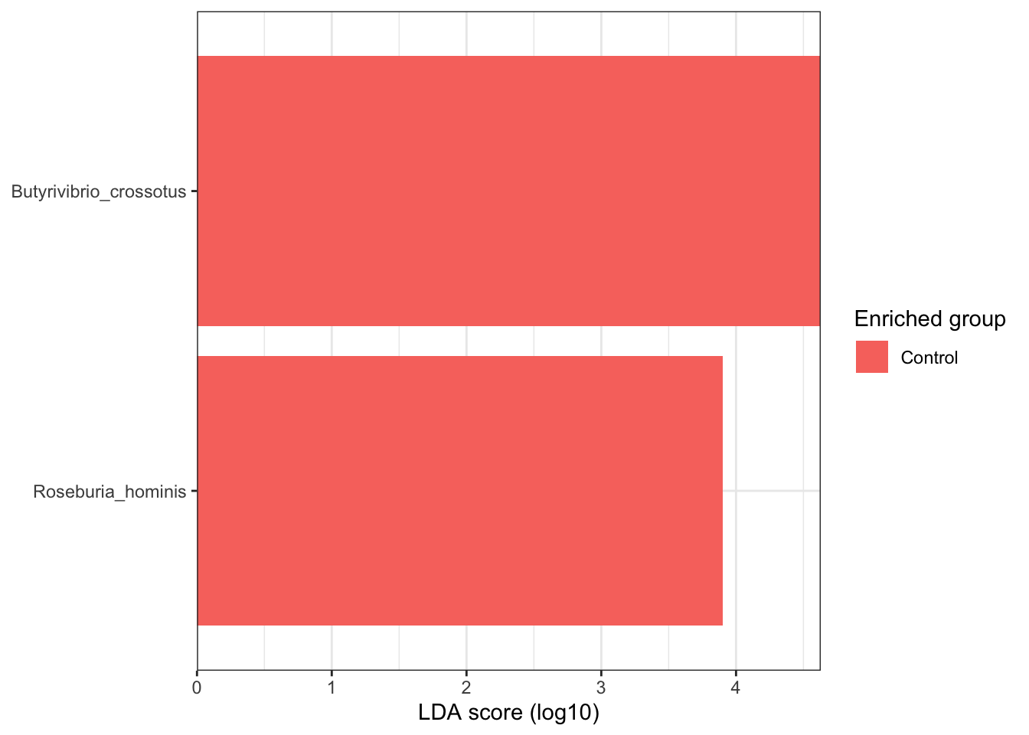
NASH vs Control estratificando por género (Male)

Slide 12
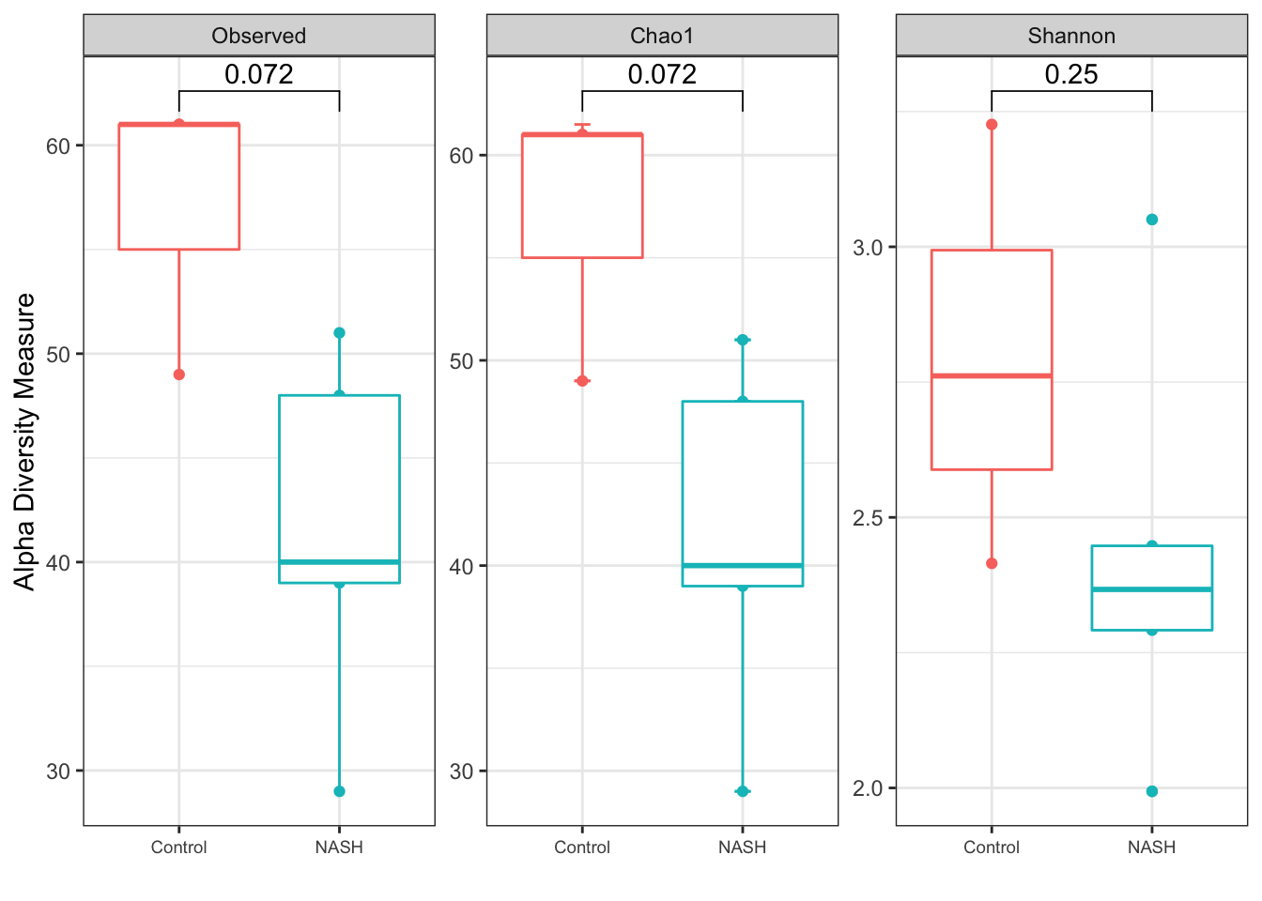
NASH vs Control estratificando por género (Male)

Slide 13
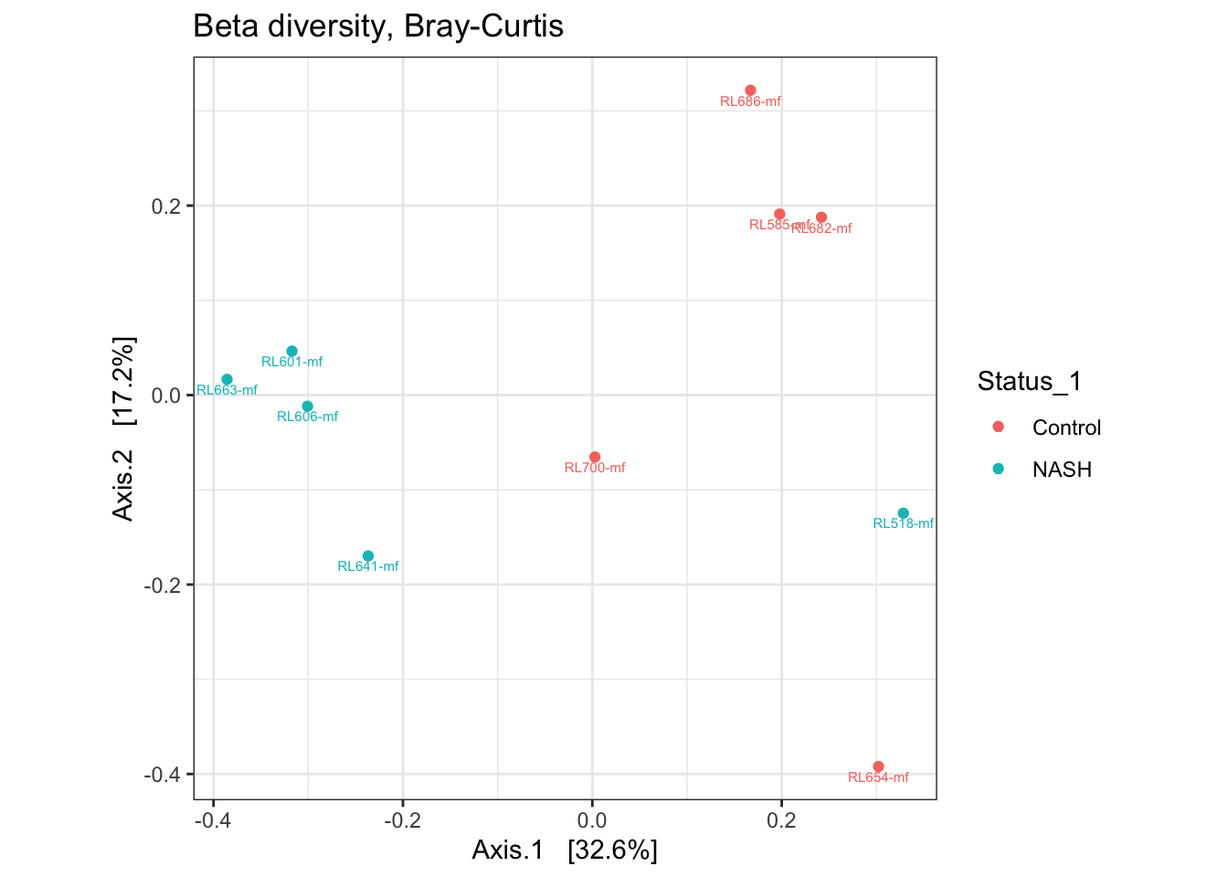
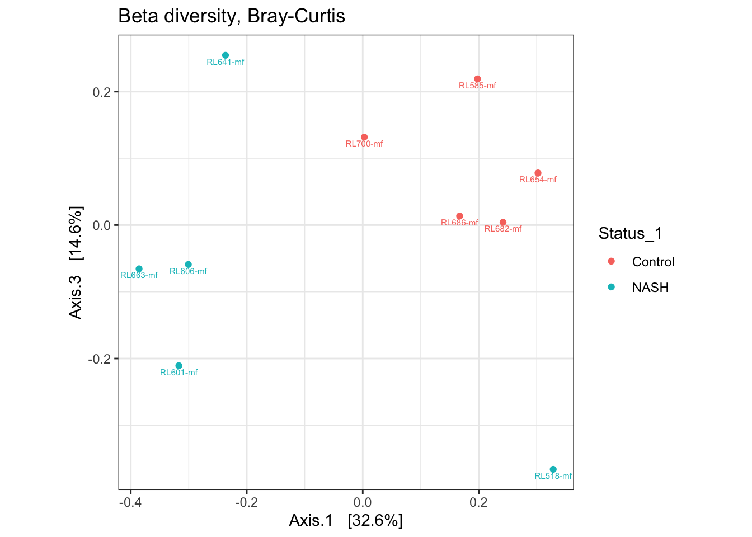
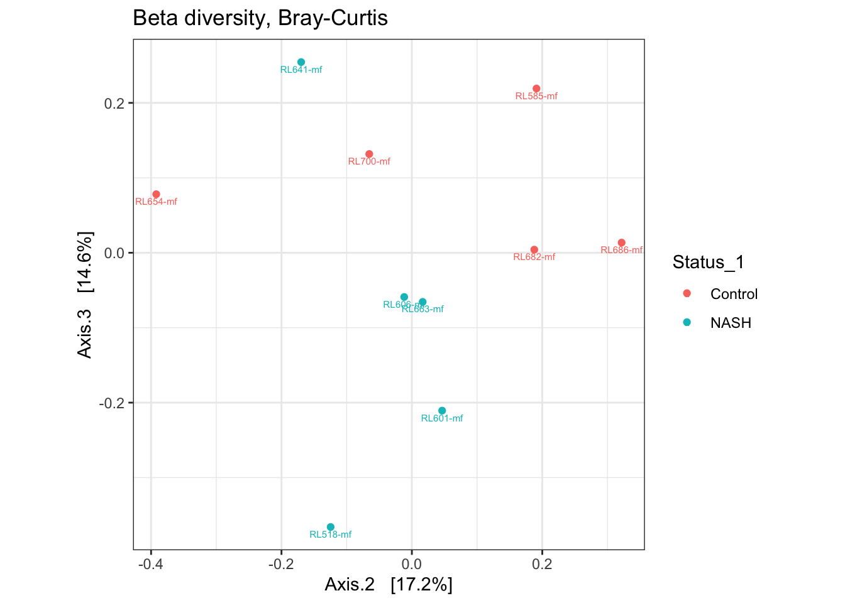
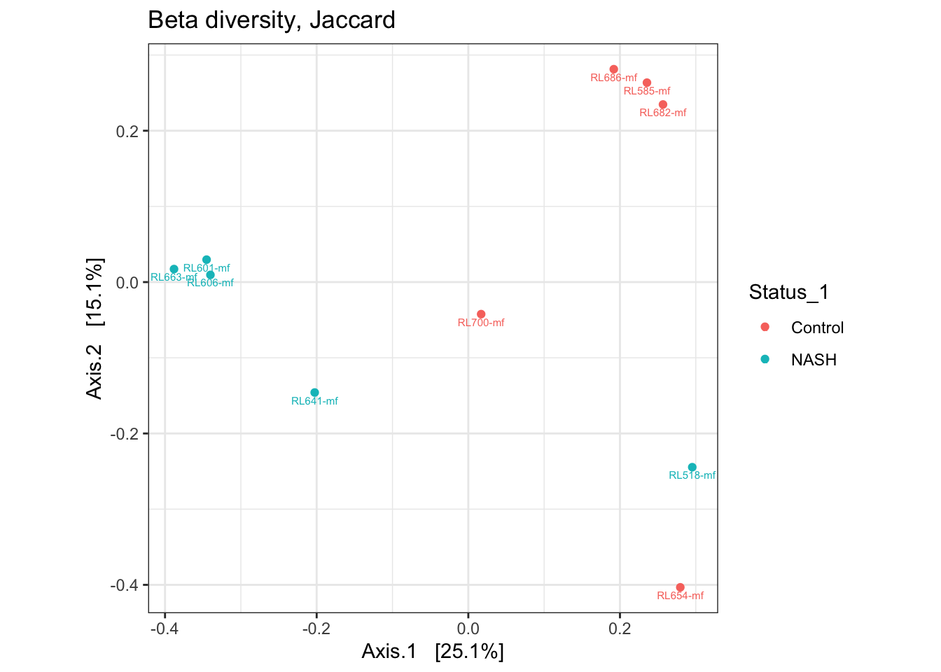
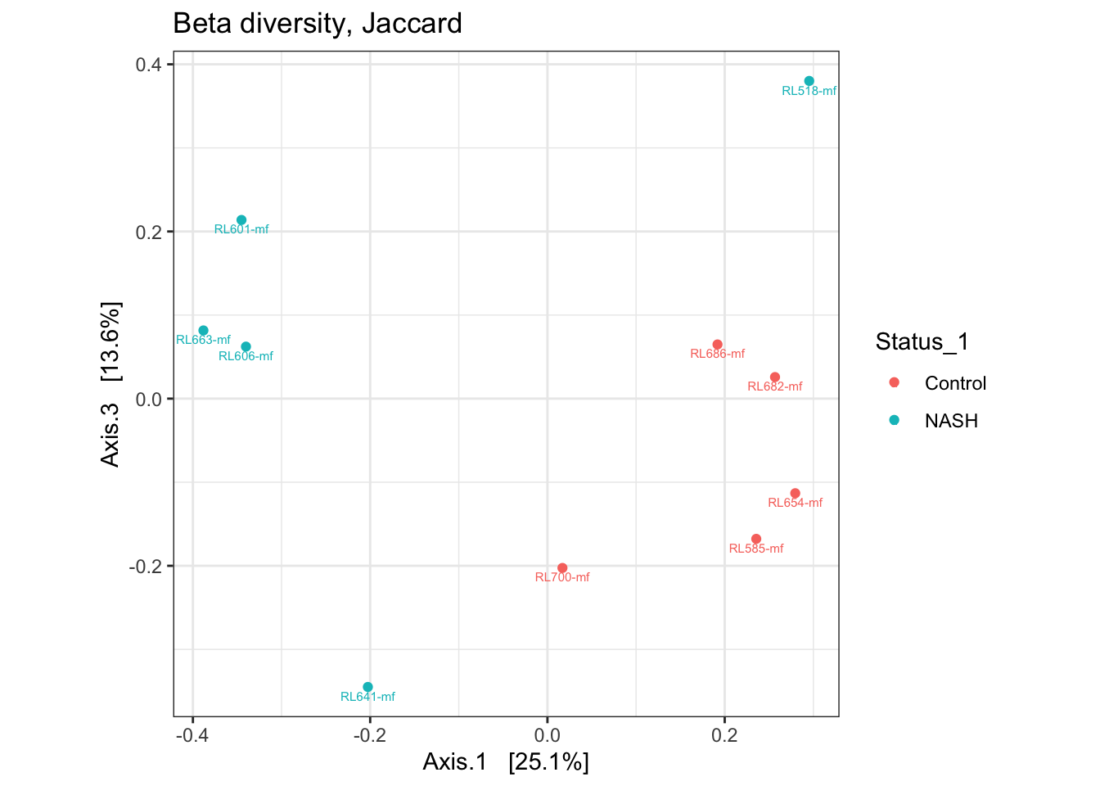
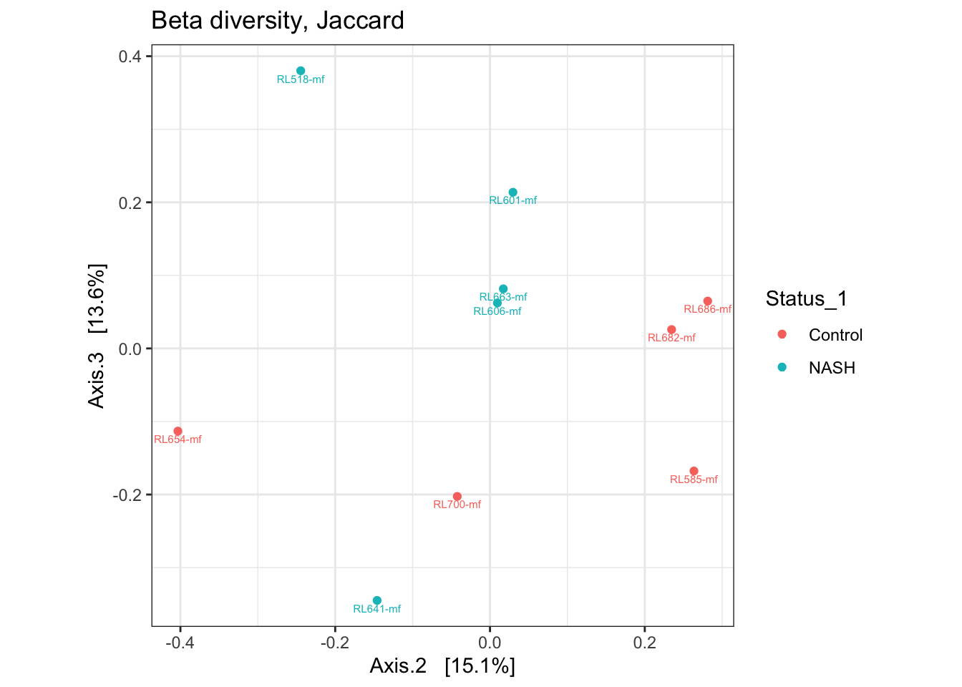
NASH vs Control estratificando por género (Male)

Slide 15
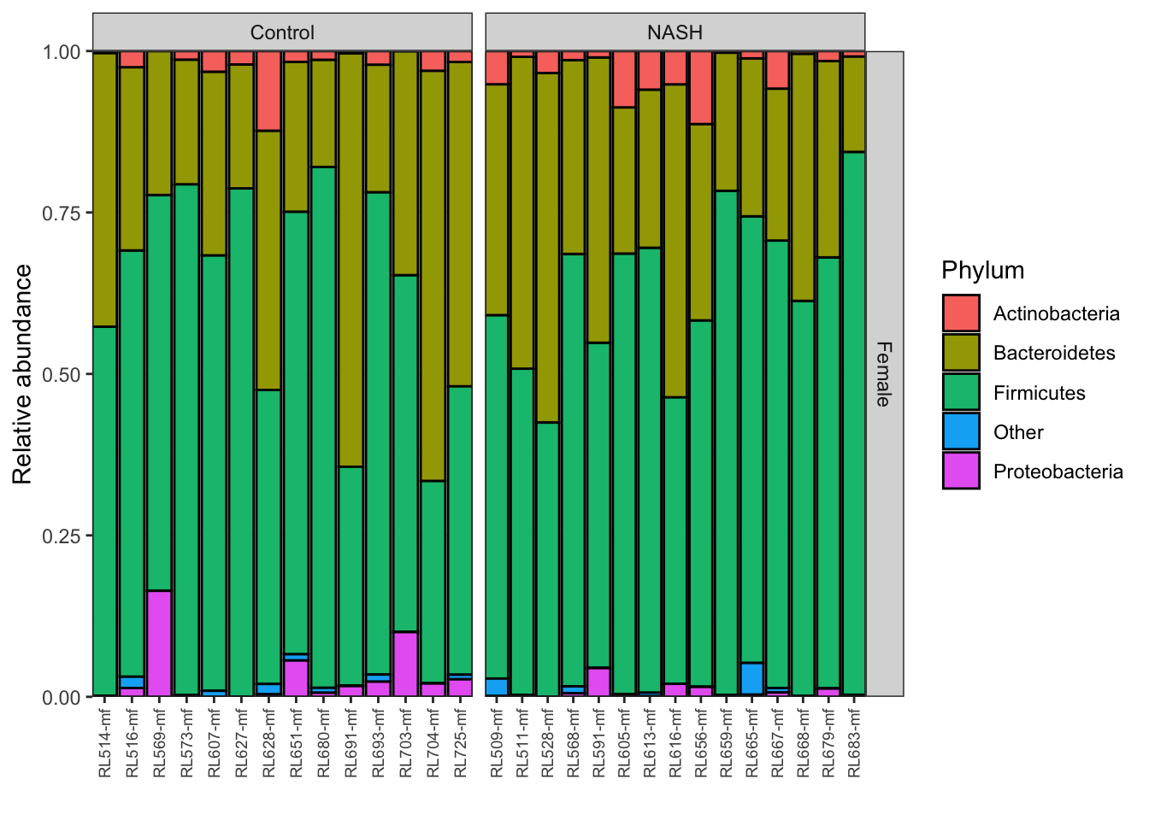

NASH vs Control estratificando por género (Female)

Slide 16
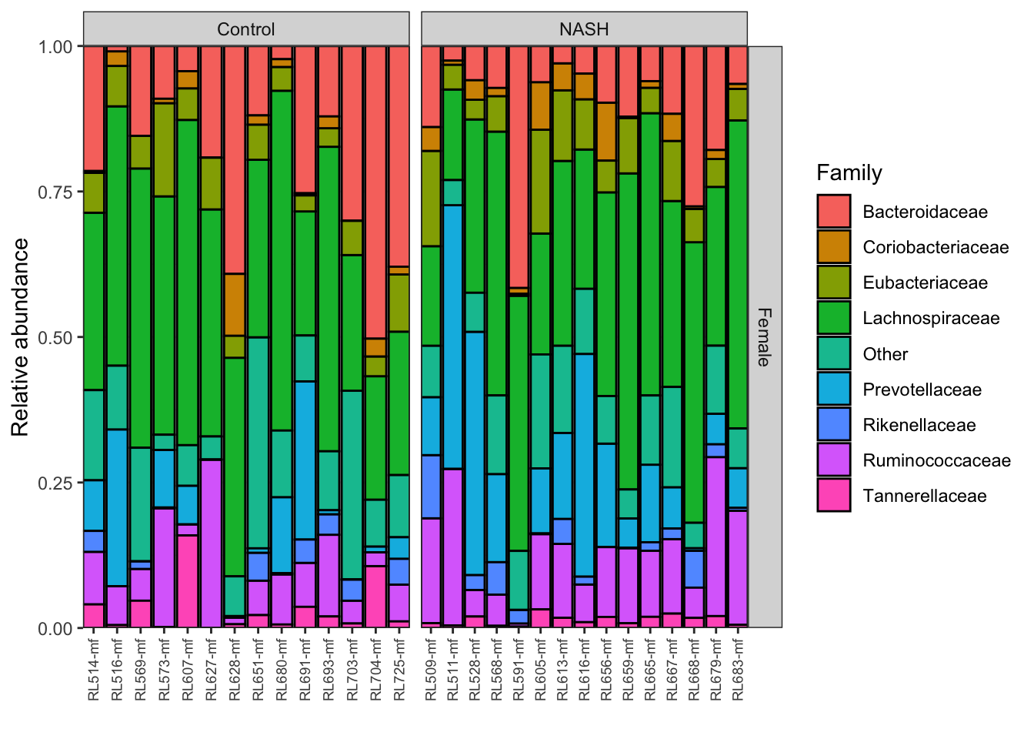
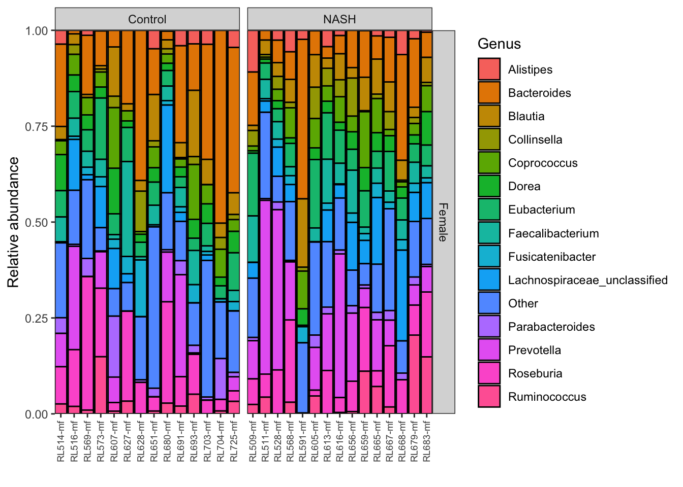
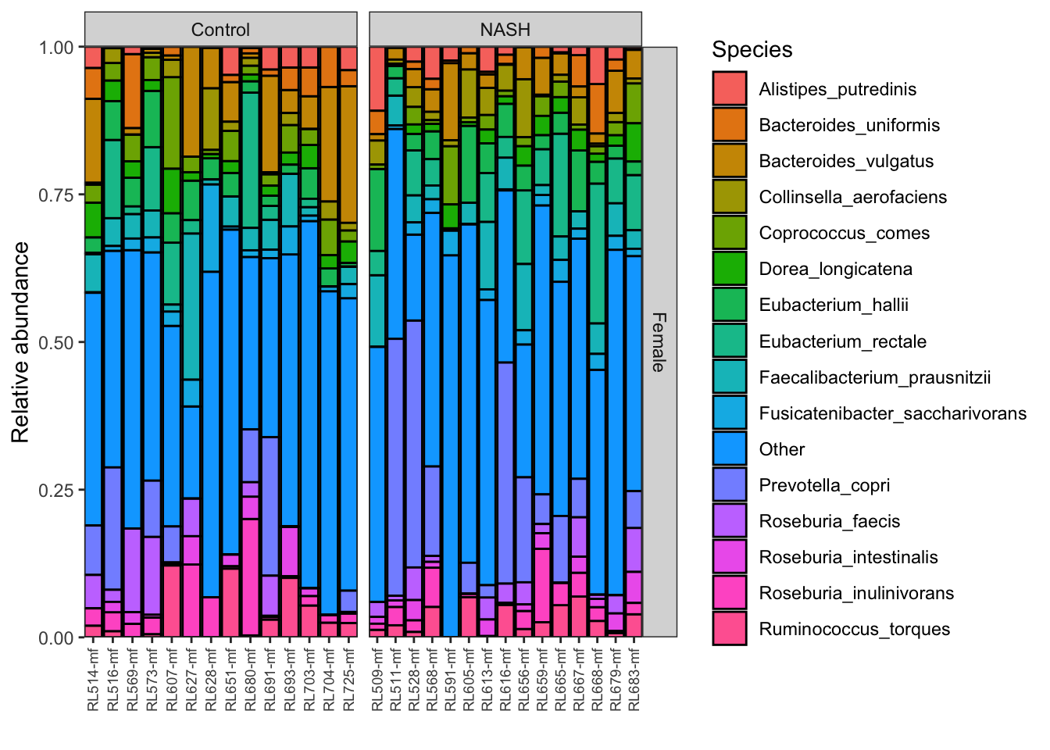
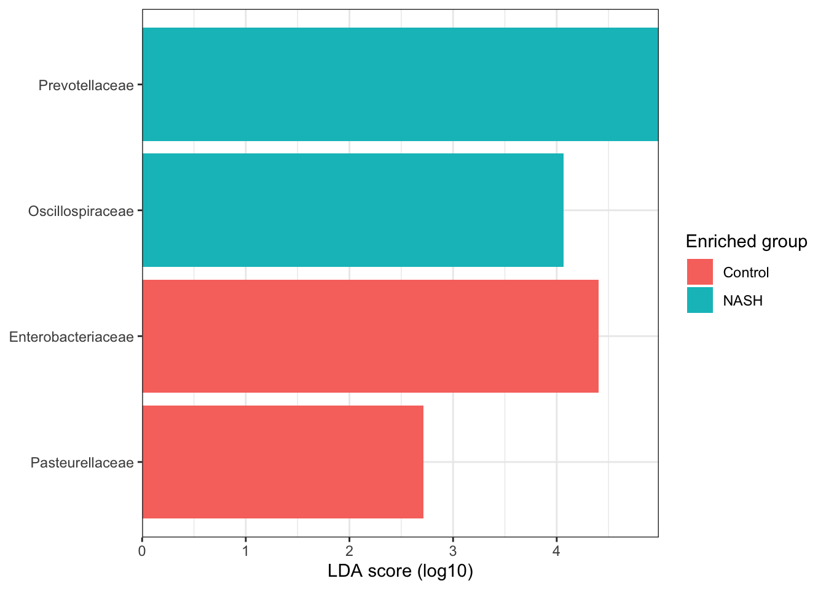
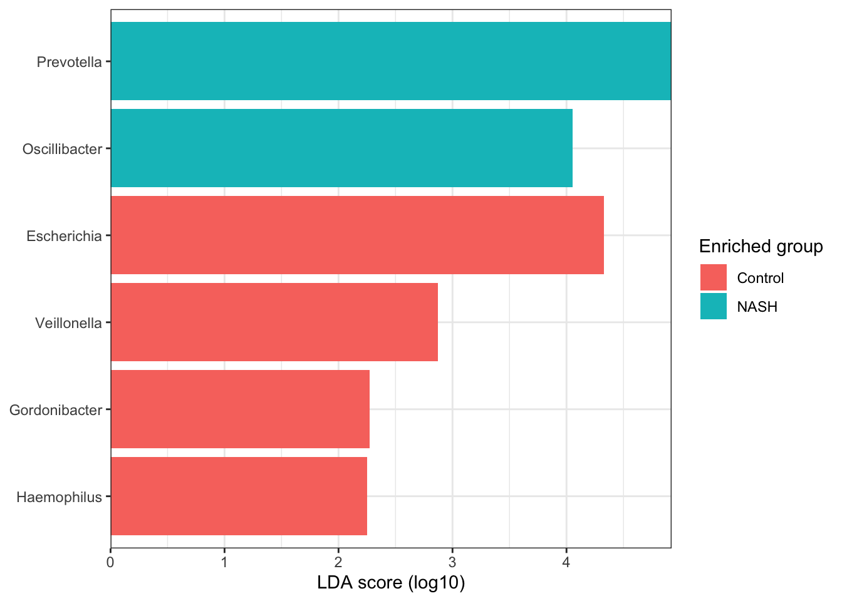
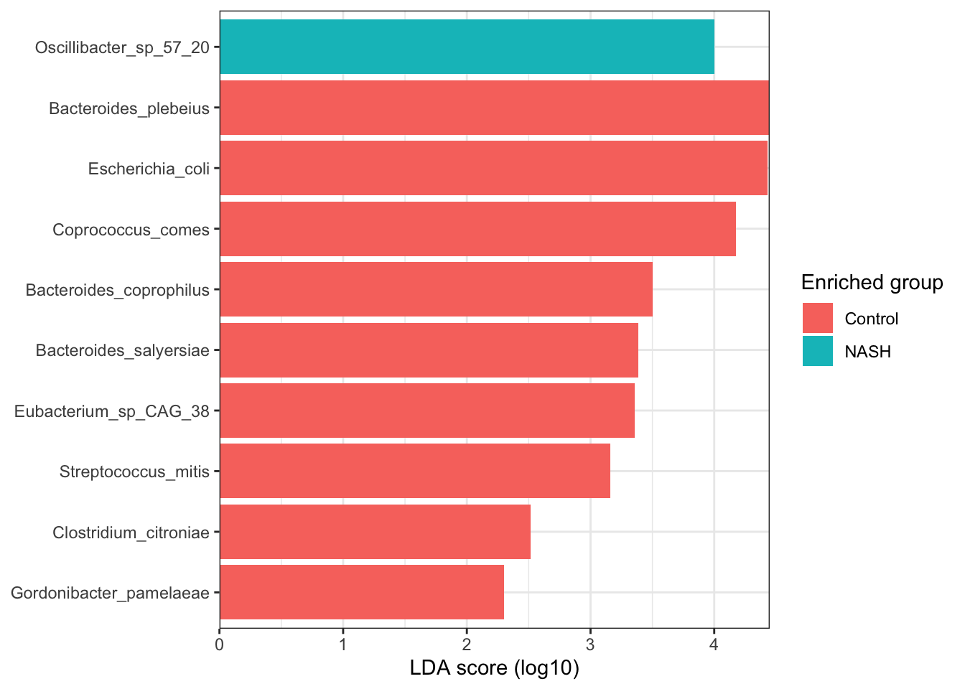
NASH vs Control estratificando por género (Female)

Slide 17
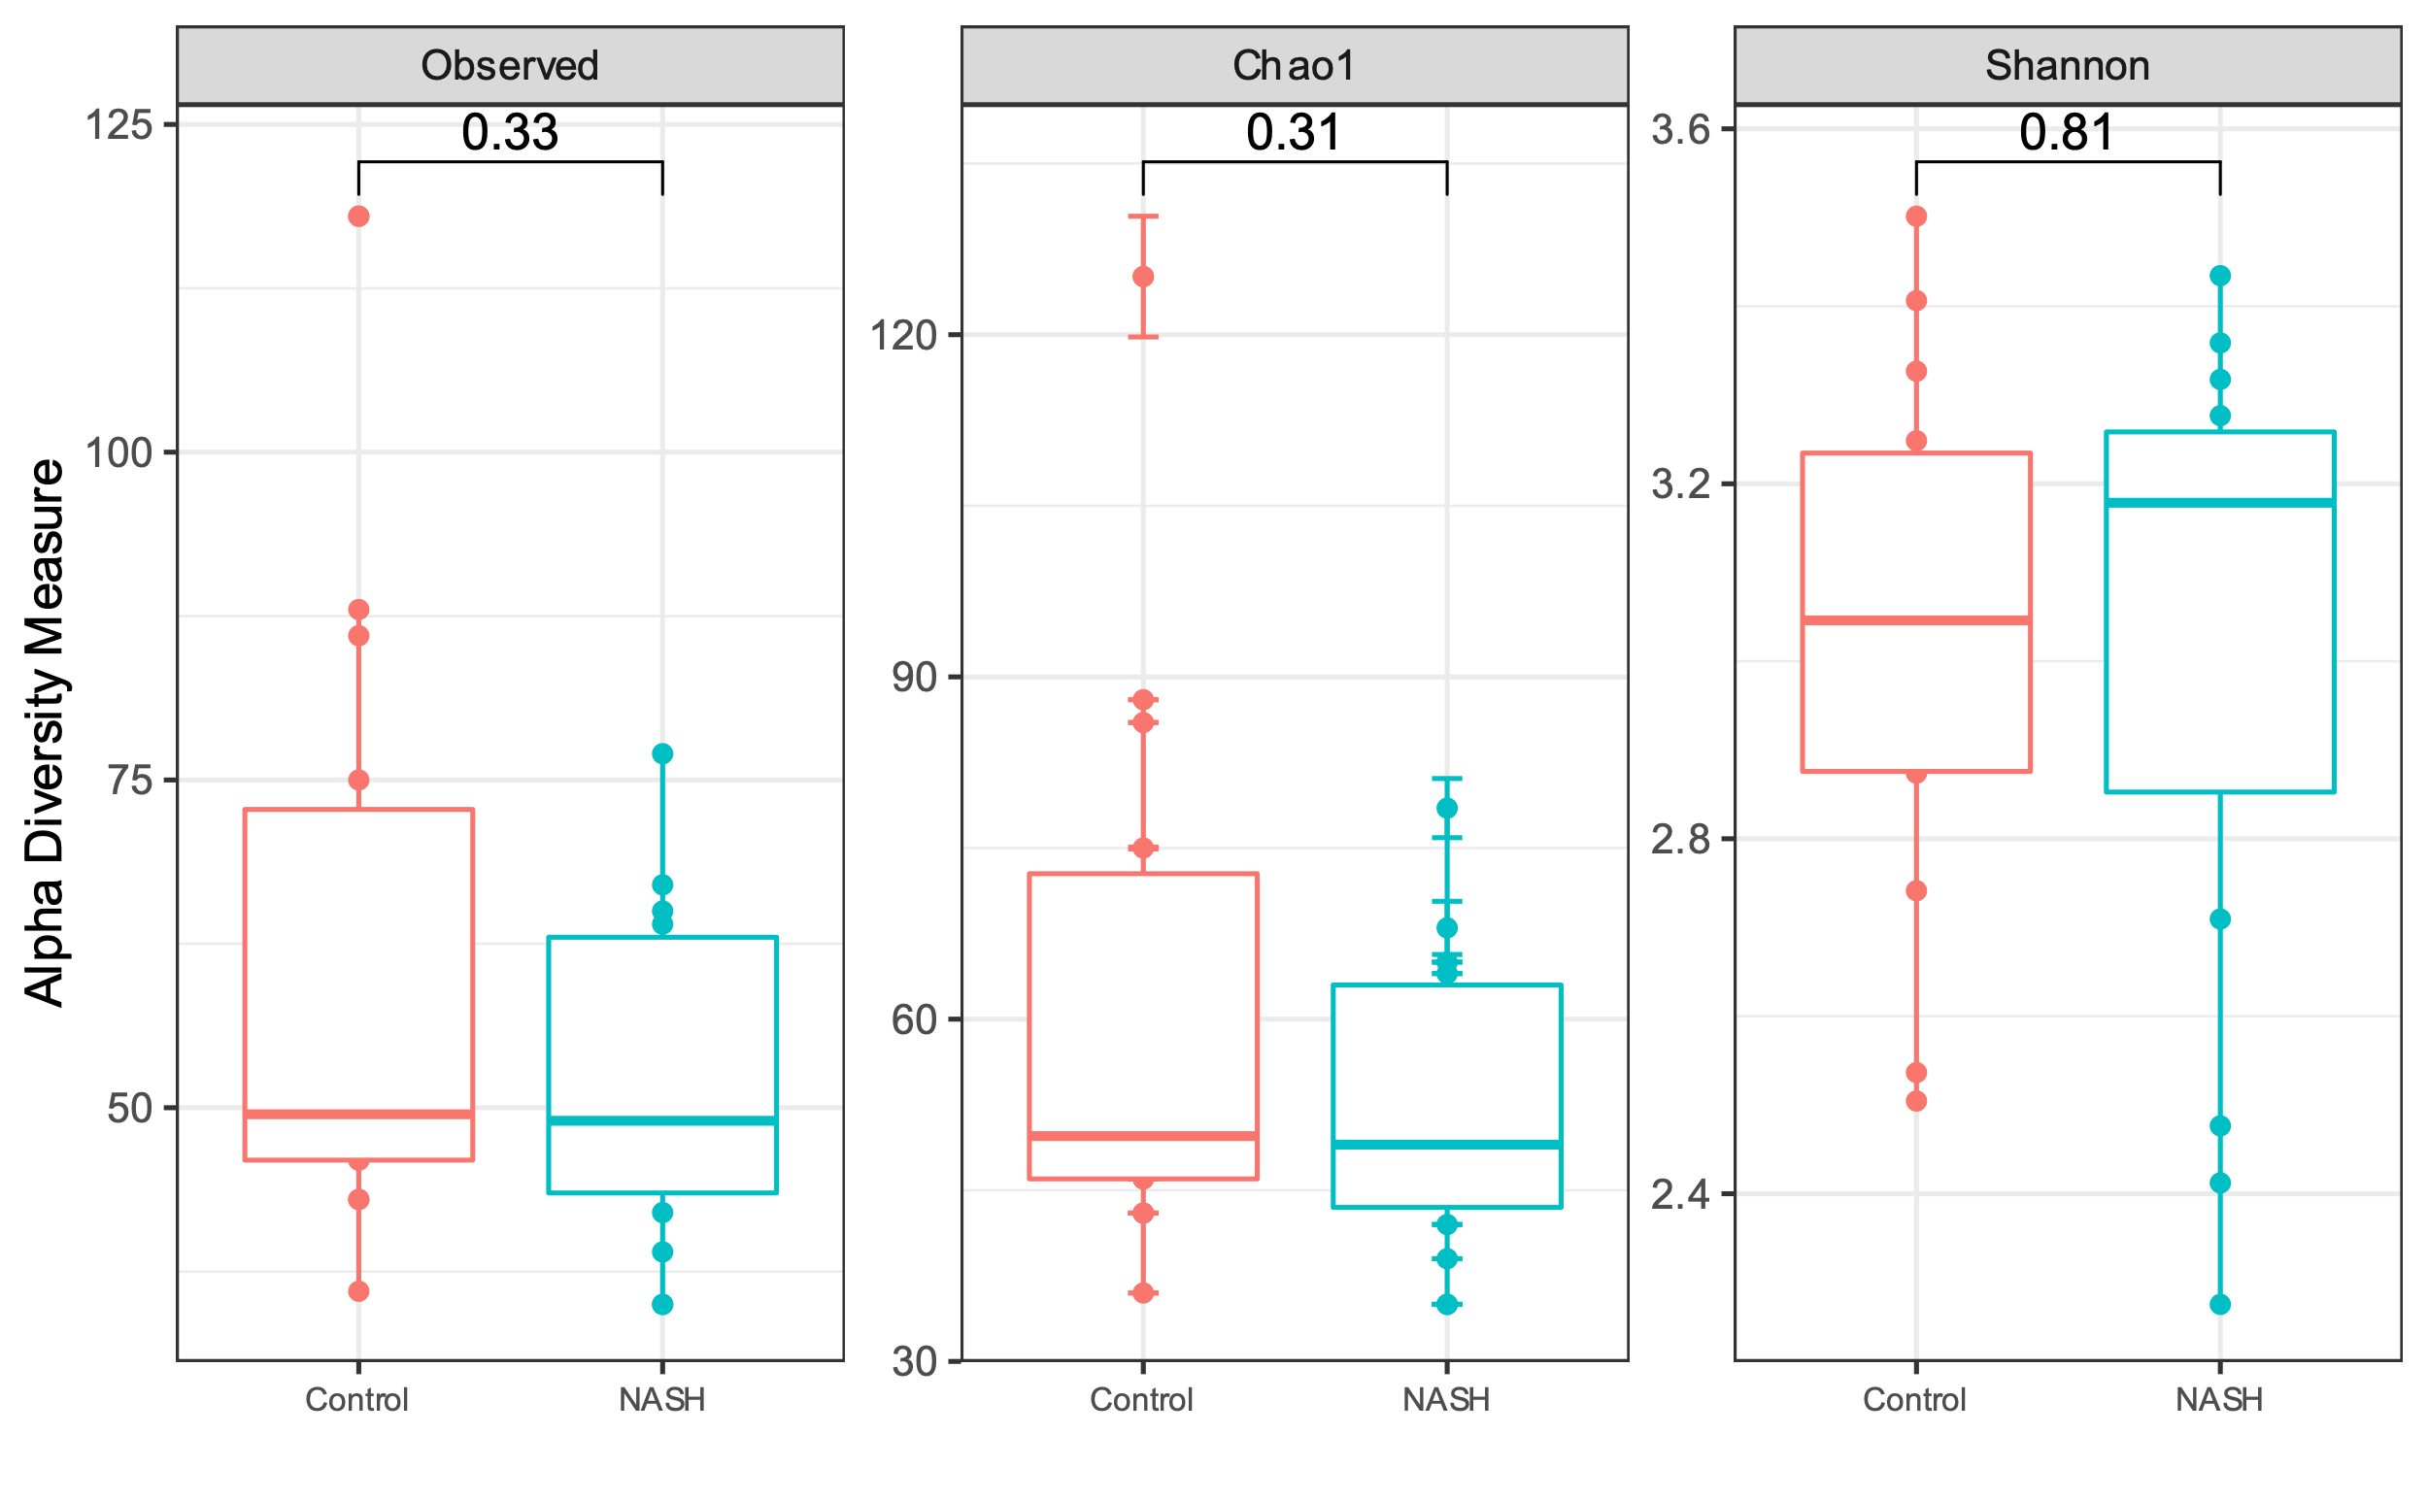
NASH vs Control estratificando por género (Female)

Slide 18
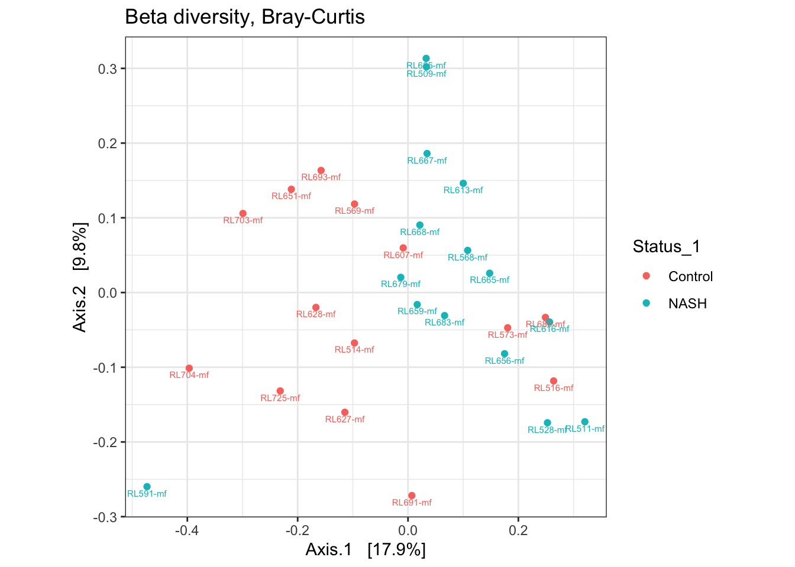
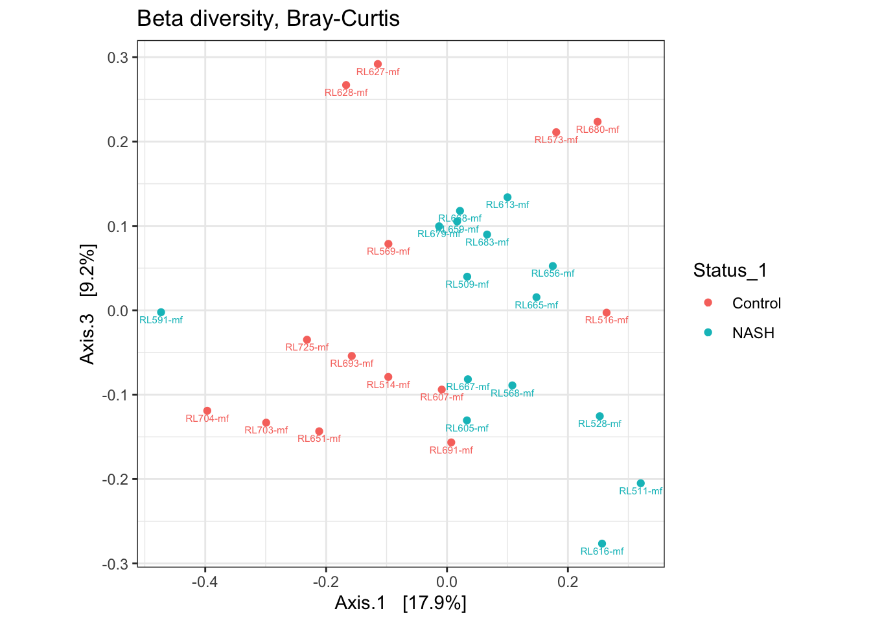
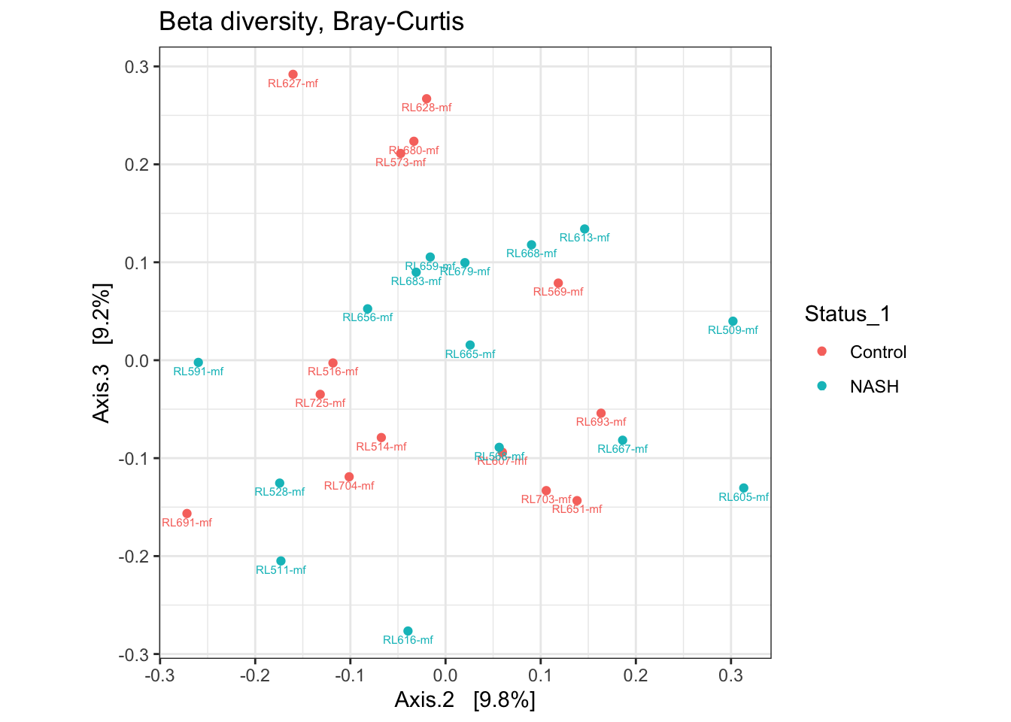
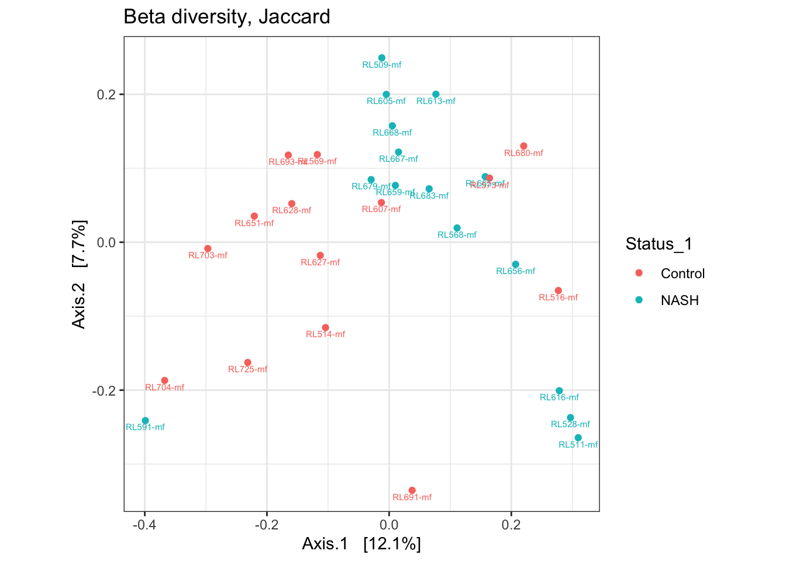
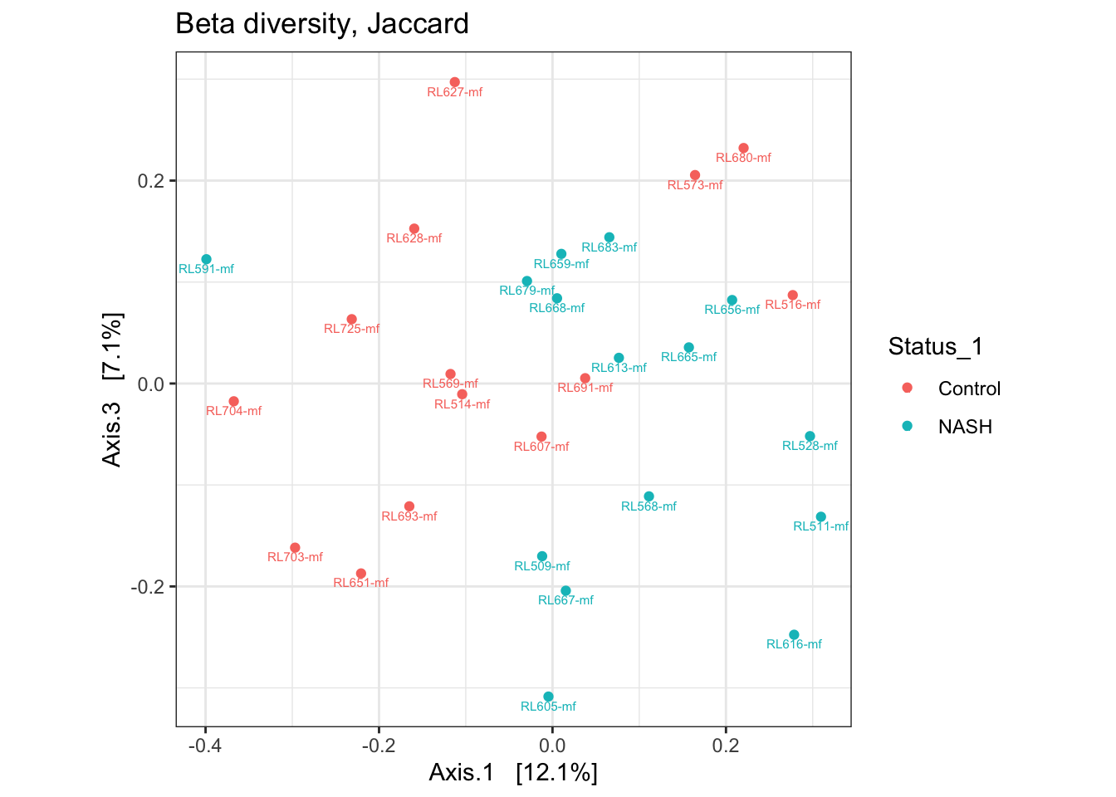
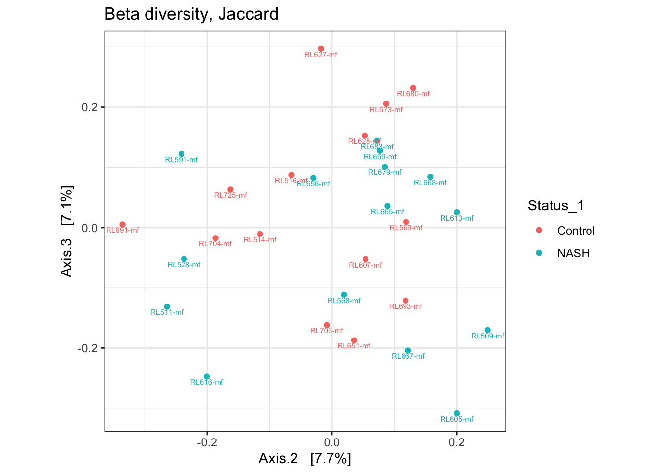
NASH vs Control estratificando por género (Female)

