Slide 1


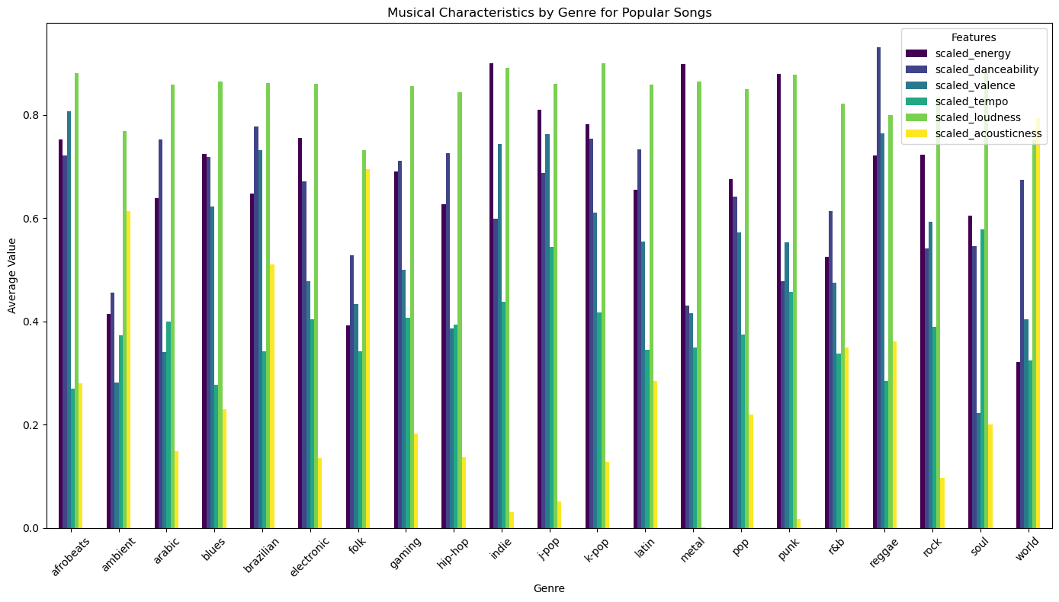
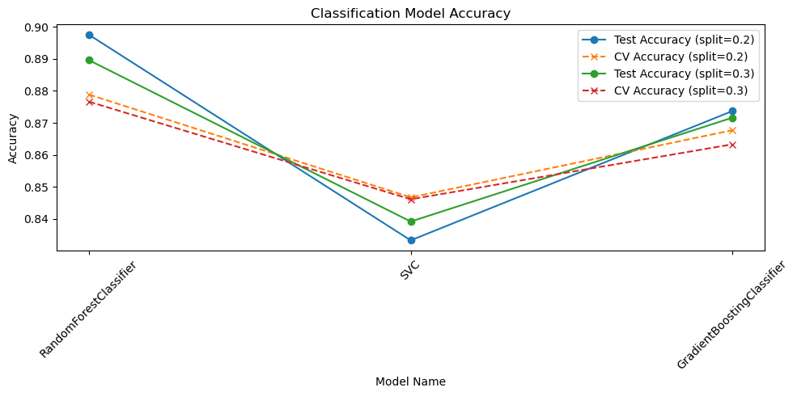
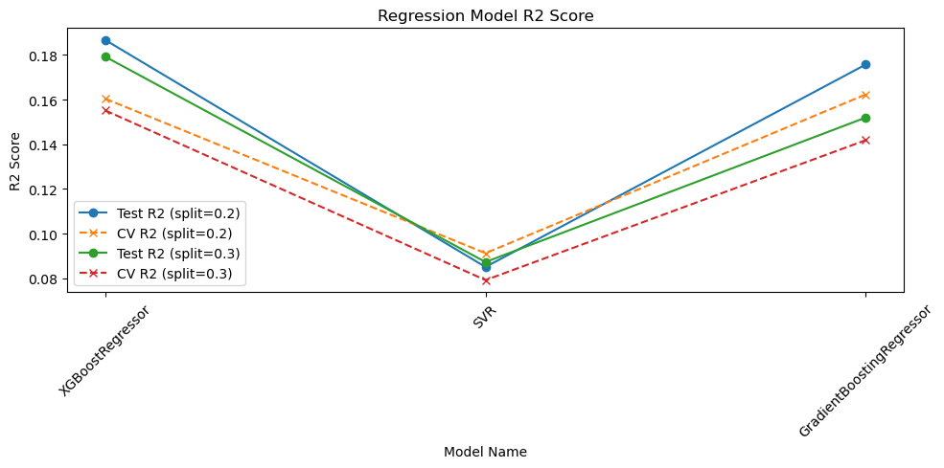
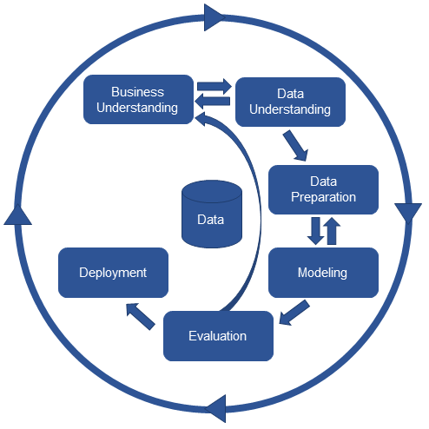
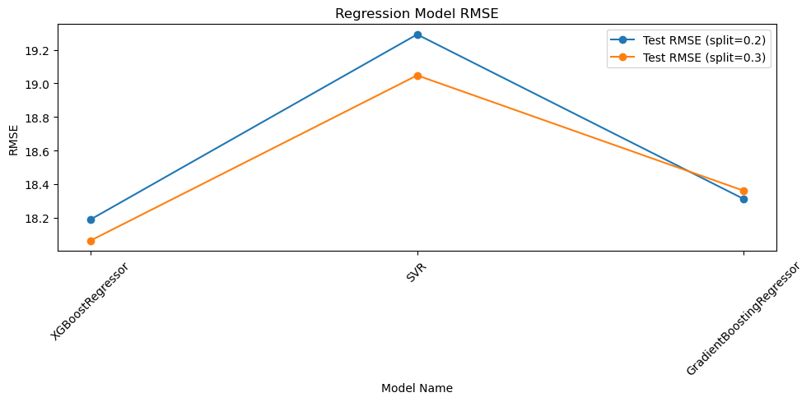
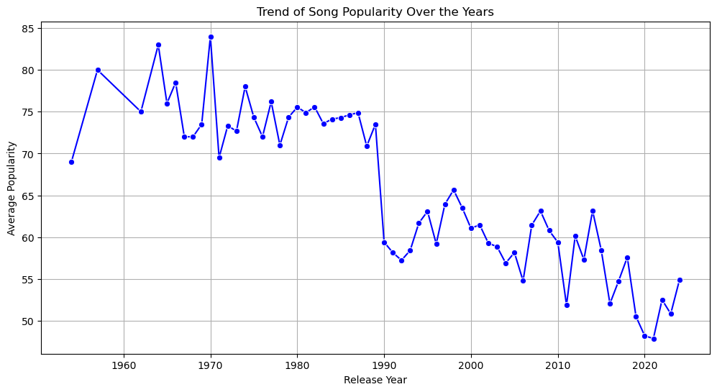


Unlocking the Charts: The Hidden Secrets From Hits
01
INTRODUCTION
DATA UNDERSTANDING
Modeling & Evaluation
1. Audio Features (Quantitative)
Spotify-generated numerical descriptors of musical content:​​
Danceability (0-1), Energy (0-1), Loudness (dB)​, Valence (0-1), Tempo (BPM): Duration_ms (milliseconds), Speechiness (0-1), Acousticness (0-1), Instrumentalness (0-1) and Liveness (0-1)
2. Metadata Features (Categorical & Temporal)​​
Key: Musical key (C, C#, D, etc.)​​
Mode: Major or Minor tonality​​
Time Signature: Beats per measure​​
Track_album_release_date: Release timestamp​​
Artist, Album, Track Name: Identifiers (removed for modeling)
All models were trained using an [80/20 and 70/30] split and tuned with GridSearchCV (3-fold) to optimize hyperparameters. FrancescaLazzeri (2022).
Approach 1: Binary Classification (Predicts "Hit" vs. "Not Hit")
Task:
Predict a binary target: Popular (1) or Not Popular (0).
Algorithms:
Random Forest Classifier (RFC),
Gradient Boosting Classifier (GBC),
Support Vector Classifier (SVC).
Key Metrics:
Test Accuracy, Mean Cross-Validation (CV) Score.
Approach 2: Regression (Predicts Exact Score)
Task:
Predict the exact track_popularity score (0-100).
Algorithms:
XGBoost Regressor (XGBR),
Gradient Boosting Regressor (GBR),
Support Vector Regressor (SVR).
Key Metrics:
R-squared (R²) Score,
Root Mean Squared Error (RMSE).
Overview of Spotify’s Digital Marketplace
Thousands new tracks uploaded daily.
Intense competition among artists.
Challenge: Music Discovery and Artist Visibility
Difficulty for artists to stand out.
Importance of effective discovery strategies.
Shift from Creativity to Data-Driven Strategy
Creativity still matters, but data analysis offers an edge.
Understanding what makes tracks successful.
Goal and Insight
Identify audio and metadata features that define hit songs.
Move from intuition to evidence-based production decisions.
Author:
02
OBJECTIVES
Luis Martins - 2025053
Project Description
Identify statistical relationships between audio features (danceability, energy, loudness, valence) and song popularity classification
Analyze structural elements including tempo, duration, key, mode, and release timing for correlation with success
Develop accurate ML models to predict high popularity songs based on intrinsic features
Compare and choose the best of three machine learning models
Extract actionable insights and strategic recommendations for artists and producers to increase competitive advantage
Machine learning analysis of Spotify data to identify audio features predicting song popularity, providing data-driven insights for artists and producers in the competitive digital music landscape.
Research Questions
Question 1:
Can intrinsic audio features (danceability, energy, loudness, tempo) and metadata (release year, key, mode) predict whether a song achieves high popularity on Spotify?
Question 2:
Do structural elements like duration, tempo, and key show a significant correlation with popularity?
Question 3:
Can a machine learning model be developed to accurately predict whether a song will achieve high popularity?
The bar chart shows the average "fingerprint" of various music genres using scaled features like energy, danceability, valence (positivity), tempo, loudness, and acousticness.
Each genre displays a unique audio profile:
J-Pop and K-Pop have high energy, danceability, and loudness.
Ambient and Folk show high acousticness and low energy.
This visual confirms that different genres have distinct sonic characteristics.
03
METHODOLOGY
CRISP-DM Methodology:
DATA PREPARATION
1. Data Consolidation
Imported two CSV files: high_popularity_spotify_data.csv and low_popularity_spotify_data.csv​​
Created binary target variable: popularity (1 = high, 0 = low)​​
2. Data Cleaning
Missing values: Removed all rows containing NaN values​​
Duplicates: Identified and eliminated duplicate records​​
Irrelevant features: Dropped non-predictive columns (track_id, track_href, analysis_url)​​
3. Feature Engineering
Temporal extraction: Parsed track_album_release_date to create:
Categorical conversion: Transformed key and mode from numeric to categorical types​​
4. Data Transformation & Scaling
MinMaxScaler normalization: Applied to numeric audio features (danceability, energy, loudness, tempo) to scale to range​​
Rationale: Prevents magnitude-sensitive algorithms (e.g., SVM) from feature dominance​​
5. Outlier Detection
IQR method: Applied to each numeric feature individually Kateri, A. and Kateri, M. (2024). ​​
6. Class Balance Check
Verified target variable distribution to assess imbalance​​ Kateri, A. and Kateri, M. (2024). ​​
7. Final Dataset
Records: 4,829 songs​
Features: 20 predictive variables (after cleaning)​
Target: Binary classification (popular vs. less popular)
04
CONCLUSION
Question 1:
Can intrinsic audio features and metadata predict popularity?
A: Yes. Our model confirms that intrinsic features are strong predictors. scaled_loudness, scaled_danceability, scaled_energy, and release_year were all identified as highly influential factors in determining a song's success.
Question 2:
Do structural elements show a significant correlation with popularity?
A: Yes. Structural elements are key. scaled_duration_ms was one of the top 6 most important features, indicating that song length is a significant factor in the model's predictions.
Question 3:
Can a machine learning model accurately predict high popularity?
A: Yes. We successfully developed a Random Forest Classifier that achieved 89.75% accuracy at predicting whether a song would be "Popular" (1) or "Not Popular" (0).
This line graph illustrates the “average popularity” of one score per “release year,” illustrating the historical pattern.
This chart is very clear: Average popularity was high during the years from 1960-1980, fell rapidly after 1990
It has slowly declined with some irregularities since then. This is a good example of how release_year is an important variable that reflects a dominant trend in the data.
BUSINESS UNDERSTANDING
Digital marketplace​​
Problem: Music discovery challenge in saturated
Goal: Identify data-driven characteristics of successful songs​​
Requirements:
Technologies: Jupyter Notebook, Python.
Data: Dataset from Kaggle:
The dataset has the amount of records relatively for the analysis.
Extracted directed by Spotify API.
References
FrancescaLazzeri (2022). Deep Learning vs. Machine Learning - Azure Machine Learning.​
Kateri, A. and Kateri, M. (2024). Foundations of Statistics for Data Scientists. CRC Press.​

