Slide 1
Untitled 3D Platformer
By Luis Bryan

Slide 2
NEEDED FEATURES | IMPLEMENTED FEATURES
Can be correctly deployed using Node.js and Live Server. | Can be correctly deployed using Node.js and Live Server.
All Web pages function as written in HTML and the style CSS. | All Web pages function as written in HTML and the style CSS.
All required web pages are implemented (Introduction page, Login page, New user register page, 404-page, game loading page and game pages). | All required web pages are implemented (Introduction page, Login page, New user register page, 404-page, game loading page and game pages).
Website has basic correct hyperlink to all pages | Website has basic correct hyperlink to all pages
404 page is deployed correctly, if incorrect link is entered. | 404 page is deployed correctly, if incorrect link is entered.
Responsive design: the web pages are rendered according to the window size. | Responsive design: the web pages are rendered according to the window size.
fully working with correct login & register web interface. | Mock-Up nonfunctioning correct login & register web interface.
music is working and can be heard on the website. | music is working and can be heard on the website.
Website and apps is working on the latest Google Chrome and Microsoft Edge web browsers for both PC and mobile devices (including game UI interaction). | Website and apps is working on the latest Google Chrome and Microsoft Edge web browsers for both PC and mobile devices (including game UI interaction).
Has “Readme” documentation (Can be formatted in .txt or .doc), clearly describe the website's project folder structure (database design if any) and the key points you have achieved. | Has “Readme” documentation (Can be formatted in .txt or .doc), clearly describe the website's project folder structure (database design if any) and the key points you have achieved.

Slide 3
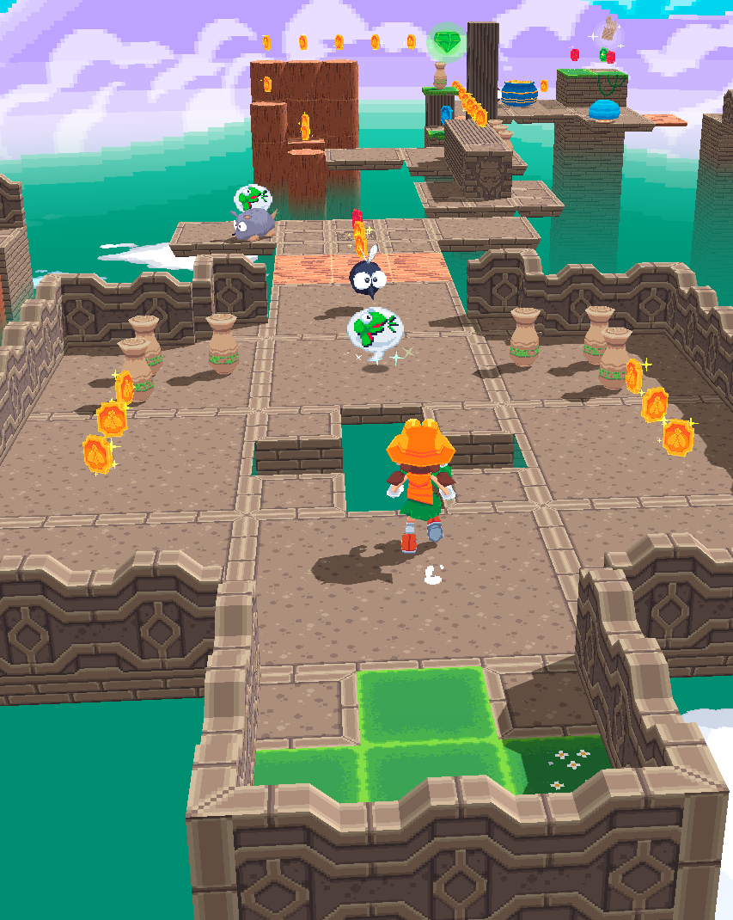
Game Plan:
3D Platformer game
Theme: Adventure Game
Goal:
To reach of level
To keep player engaged
Encourage replay ability
To challenge player's skills.
Design Pillars:
Movement,
Puzzles,
Exploration and
Environments

Slide 4
NEEDED FEATURES | IMPLEMENTED FEATURES
Game assets: for example, character, landscape/environment and enemy design (if applicable). | Basic placeholder assets: primitive meshes 3D Model loader Implemented
Game material design: light, texture, material for the game assets | Basic Lights and Materials + textured skybox + Shadows for player and terran
Game animation: animation of game assets | Basic rotation animation of models
Game interaction: user interaction with the game object | Fully controllable character with gravity and jump via keyboard Interaction with elements from HTML Document (buttons, stats)
Game UI: UI overlay on the web game for scores and life state etc. | Basic UI and Pause menu
Game mechanism: Fully functioning user interface displaying player statistics (i.e. lives or health), scores and rewards / penalties. | Non-Functional Health and Score UI
Responsive design: the web page and game are rendered according to the window size. | The web page and game are rendered according to the window size.
Game level design: game level or difficulty increase as the user score increases. | Test Level and WIP first level implemented, more planned
Game audio: audio (music and sound) is working and can be used in the game. | Placeholder Music implemented
Game is working on the latest Google Chrome web browser for both PC and mobile devices (including game UI interaction). | Working on the latest Google Chrome and Microsoft Edge web browser for PC (Mobile not yet tested)
Has “Readme” documentation (Can be formatted in .txt or .doc), clearly describe how to play the game, the game project folder structure (database design if any) and the key points you have achieved. | Yes, with full credits and explanations of project file structure

Slide 5
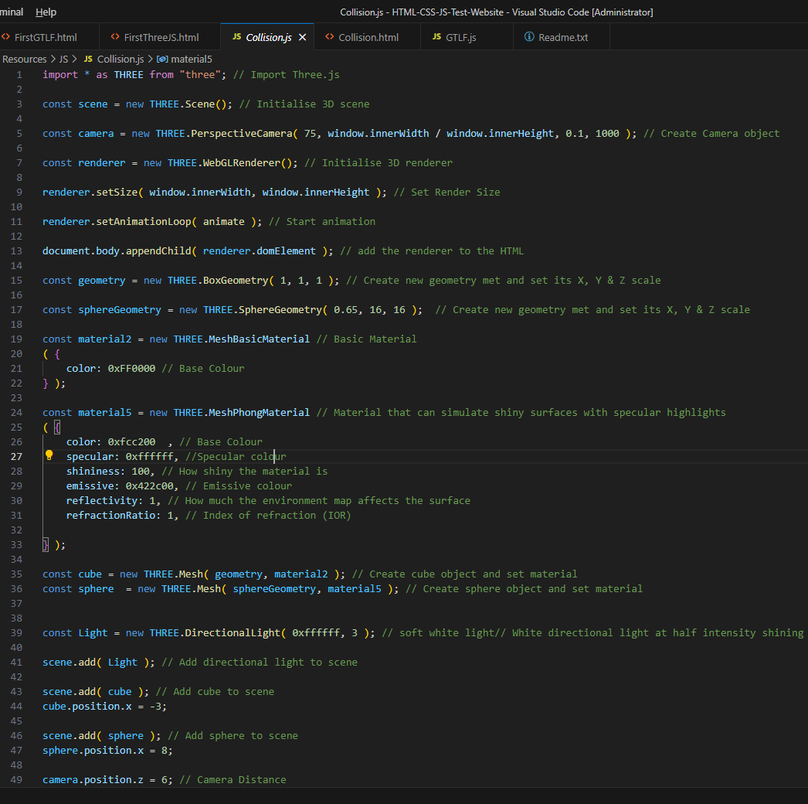
Engine / Programming Language:
This project was made using:
HTML (Hypertext Markup Language)
CSS (Cascading Style Sheets)
JavaScript
Three.JS: 3d game and graphics library for JavaScript
I used HTML to make the website that acts as the host for the game itself with CSS to stylize the website to make it look nice, attractive and professional.
JavaScript enabled more low-level functionality via scripting for reading from files and functions.
Three.JS was the library responsible for making the actual game itself, making it easy to create 3D scenes and objects as foundations to build a game from.

Slide 6
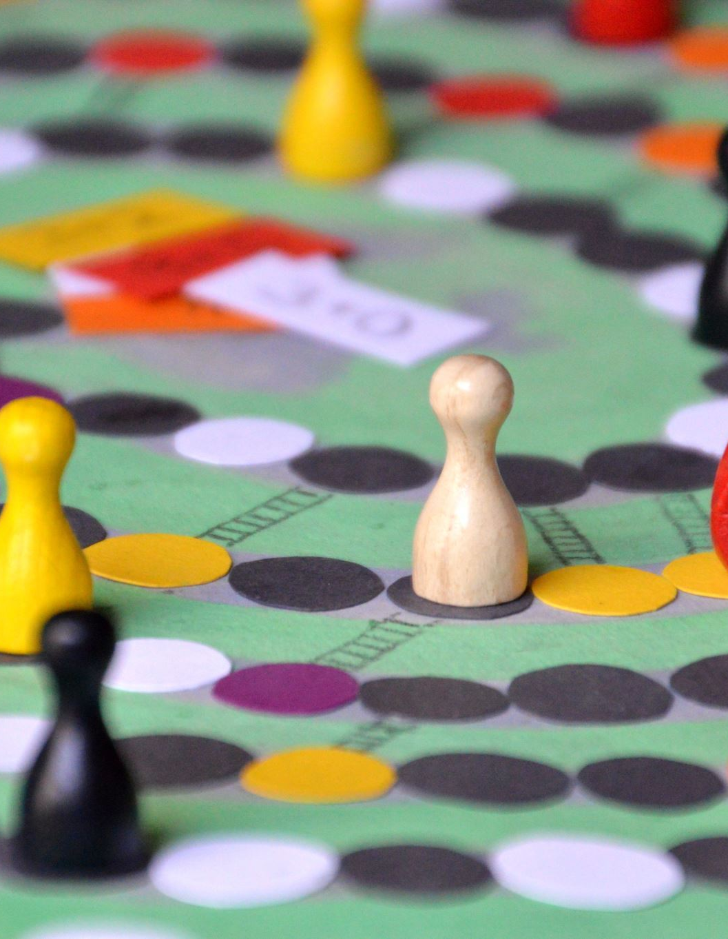
Target Audience:
The main intended target audience for this game is for people of all ages, including both children and adults to enjoy
To achieve this to the best amount, the game should meet these characteristics to best attract these audience groups:
Fun and Colourful visuals
Chill and Non-Intense atmosphere
Enticing puzzles with balanced challenge level
Awarding sense of achievement throughout game
Simple and intuitive controls

Slide 7
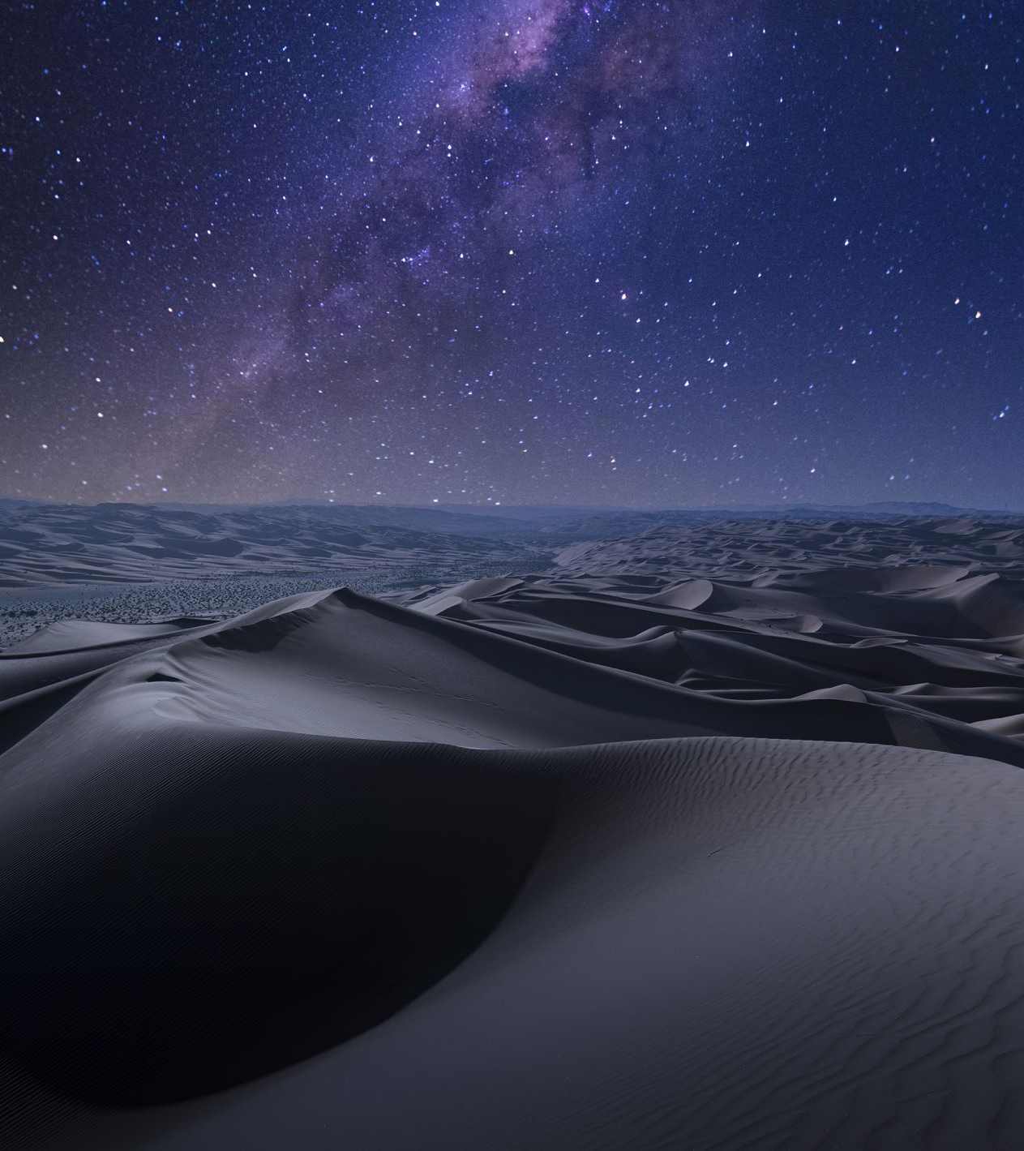
Environments:
For the game to visually enticing for all audiences, It would need to include a good amount of aesthetically attractive environments that player would want to explore.
Current ideas include:
Forest
Desert
Beach/Seaside
Sky (day or night)
Space

