Slide 1
ECON057 Final Presentation
The Influence of Net Migration, Unemployment, and Inflation on Economic Growth
Rumeysa Yilmaz & Luis Heredia Vasquez

Slide 2
Motivation
Globalization & increasing movement of people
Research gap
Policy implications

Slide 3
Introduction
3 Explanatory Variables (Independent)
Net migration
Unemployment
Inflation
y_{i} = β₀ + β₁x₁ + β₂x₂ + β₃x₃ + ε_{i}
Research Question: How do patterns of net migration, alongside unemployment rates and inflation, impact economic growth?
Hypothesis: We hypothesize that an increase in net migration to the United States will positively impact the economy, helping to mitigate the effects of unemployment and inflation, and ultimately contributing to a balanced growth equilibrium in the long run.

Slide 4
Methods
𝚫Real GDP ​= β0 + β1​ Net Migration ​+ β2​ Unemployment Rate ​+ β3​​ Inflation + 𝜖
β0: Intercept
β1 (Net Migration): The slope (β1) is expected to be positive, as higher net migration is associated with an overall increase in GDP growth .
β2 (Unemployment Rate): The slope (β2) is expected to be negative, indicating an inverse relationship between unemployment and GDP growth.
β3 (Inflation): The slope (β3) is expected to be negative, as higher inflation (measured by CPI changes) tends to correspond to lower GDP growth over the observed period.
𝜖 (Residual Error): Represents the unexplained variation in GDP growth

Slide 5
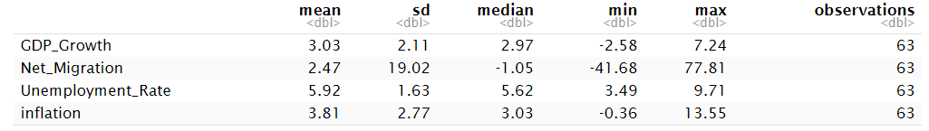
Data
Time series data spanning 63 years
1961 to 2023
World Bank & Federal Reserve Bank of St. Louis

Slide 6
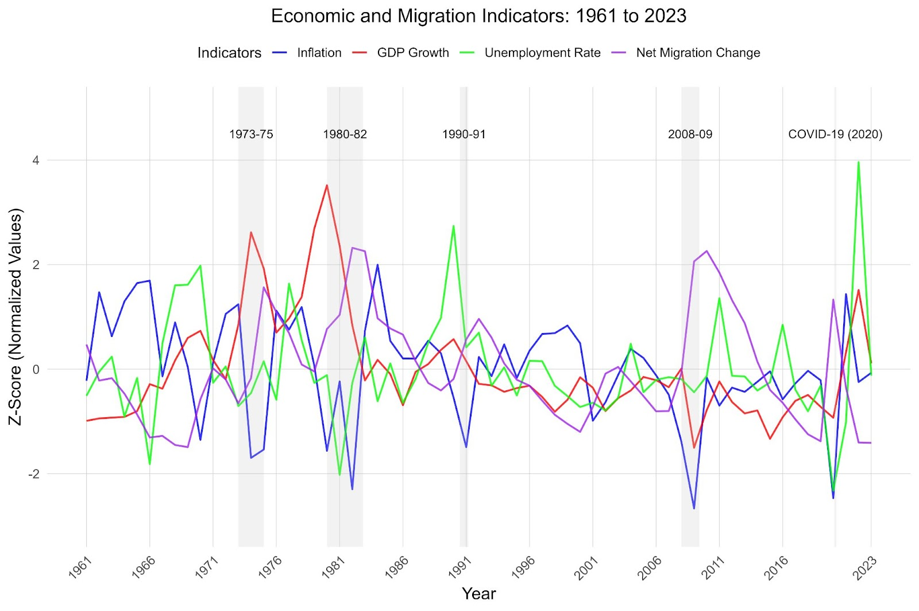
Data

Slide 7
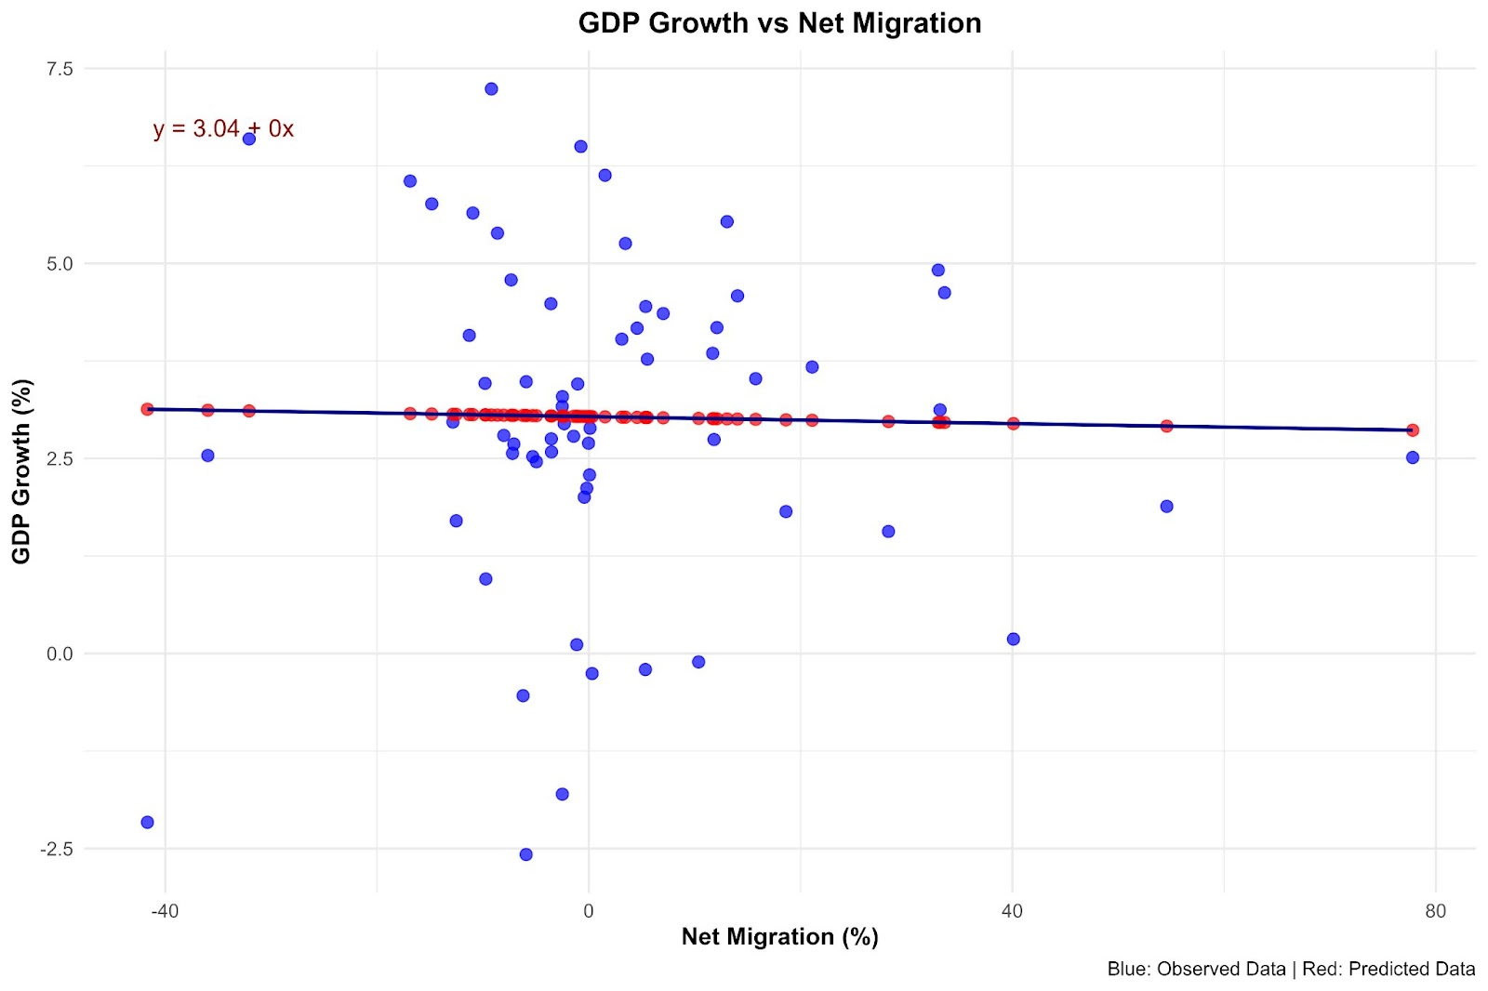
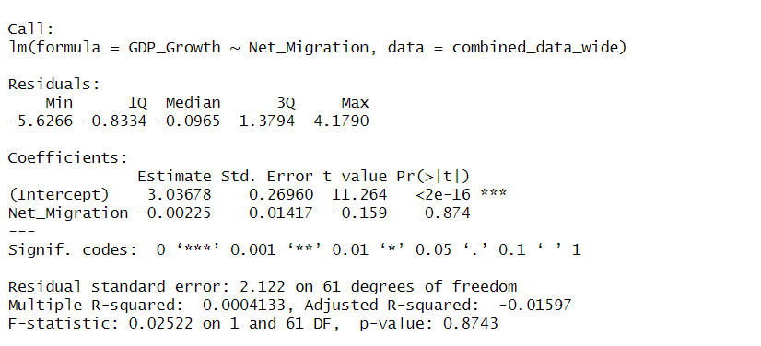




Analysis of Results
a)Null Hypothesis:. H0:β1=0
b) Alternative Hypothesis: There is a relationship between Net Migration and GDP growth. H0:β1≠ 0

Slide 8
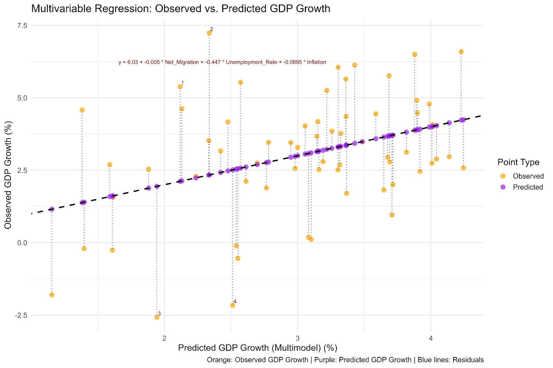
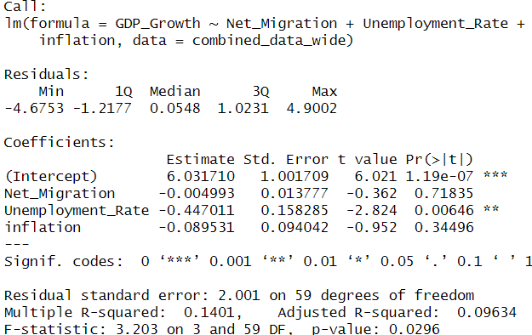






a)Null Hypothesis: H0:β1,β2, β3=0 .b) Alternative Hypothesis: H0:β1,β2, β3≠ 0

Slide 9
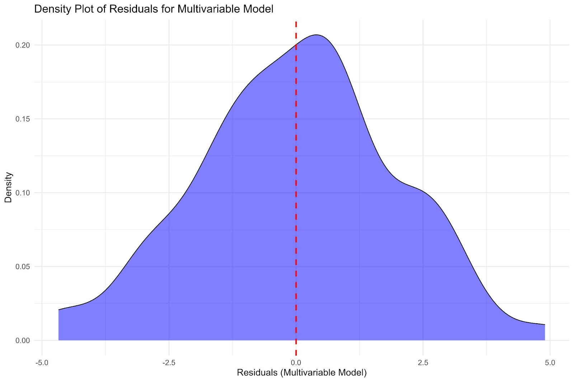
Analysis of Results

Slide 10
Conclusion & Takeaways
Unemployment rate has the most significant negative impact on GDP growth. Net migration and inflation don't show statistical significance.
Recommendations:
Use alternative regression models:
rlm() , glm(), optim() for better model fit.
Analyze variable correlations using cor().
Reverse the model: Net Migration as the response variable for additional insights.

