Slide 1

Predicting Customer Churn using K-Nearest Neighbors (KNN) Algorithm
Luis Anton P. Imperial BCS32

Slide 2
Case Study: Predicting Customer Churn Using K-Nearest Neighbors (KNN) Algorithm
Customer churn, or the rate at which customers stop doing business with a company, is a critical concern for many businesses. Understanding which customers are likely to leave can help organizations implement retention strategies. In this case study, we will use the K-Nearest Neighbors (KNN) algorithm to predict customer churn based on a dataset from a telecommunications company.

Slide 3

Objective of Case Study
The goal of this case study is to use the KNN algorithm to predict whether a customer will churn based on their attributes, such as age, account length, service usage, and payment method.

Slide 4

Dataset
We will use a fictional dataset with the following features:
CustomerID: Unique identifier for each customer
Age: Age of the customer
AccountLength: Duration (in months) the customer has been with the company
ServiceUsage: Average monthly usage (in minutes)
PaymentMethod: Type of payment (e.g., Credit Card, Bank Transfer)
Churn: Target variable indicating if the customer has churned (1) or not (0)

Slide 5
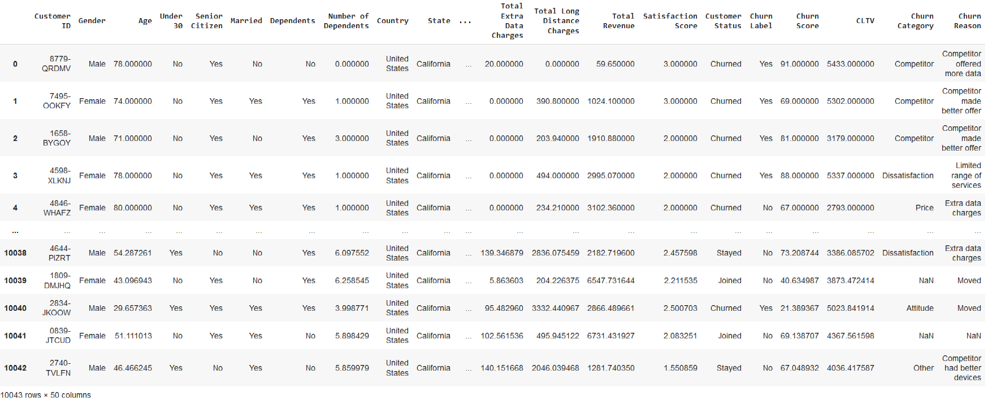
Dataset Sample

Slide 6
Steps
Data Preprocessing
Data Splitting
Choosing K Value
Model Training
Model Evaluation

Slide 7
Steps
Data Preprocessing
Data Splitting
Choosing K Value
Model Training
Model Evaluation

Slide 8
Data Preprocessing: Importing the dataset
We will assign to the `X` variable:
1. all rows (`:`), with
2. their corresponding values in:
- `Age`,
- `AccountLength`,
- `ServiceUsage`,
- `PaymentMethod`.
We will assign to the `y` variable:
1. all rows (`:`), with
2. the `Churn Label`,
- replaced first from `Yes` and `No` strings into 1s and 0s.

Slide 9
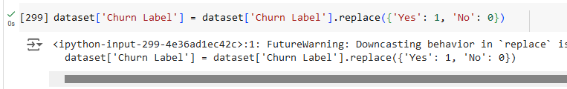
Data Preprocessing: Converting categorical values to numeric ones
Our training models cannot accept by themselves data passed on as strings, so we have to replace them with numerical equivalents.
#### Conversion of Churn Label values
Former Value | New Value
-----|-----
Yes | 1
No | 0

Slide 10
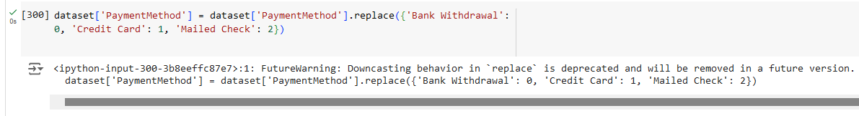
Data Preprocessing: Conversion of PaymentMethod values
Former Value | New Value
-----|-----
Bank Withdrawal | 0
Credit Card | 1
Mailed Check | 2

Slide 11
Data Preprocessing: Conversion of letters in Customer ID to numbers
def convert_alphanumeric_id(customer_id):
"""Converts alphanumeric ID to a numeric ID, handles purely numeric IDs, and removes hyphens.
"""
if not isinstance(customer_id, int):
customer_id = customer_id.replace('-', '') # Remove hyphens
if isinstance(customer_id, int):
return int(customer_id)
else:
numeric_id = ''
for char in customer_id:
if char.isalpha():
numeric_id += str(ord(char.upper()) - 64).zfill(2)
else:
numeric_id += char
return int(numeric_id)
# Apply the function to the 'Customer ID' column
dataset['Customer ID'] = dataset['Customer ID'].apply(convert_alphanumeric_id)

Slide 12
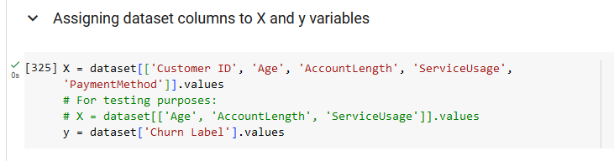
Data Preprocessing: Assigning dataset columns to X and y variables

Slide 13
Steps
Data Preprocessing
Data Splitting
Choosing K Value
Model Training
Model Evaluation

Slide 14
Data Splitting
Splitting the dataset into the training set and the test set is a core part of the process of creating a prediction machine.

Slide 15
Data Splitting
We will be importing the incredibly useful `train_test_split` function from the `model_selection` package of SciKit Learn.

Slide 16
Data Splitting
Assignment of Returned Elements from TTS
This function will output four elements, which we will respectively assign to `X_train`, `X_test`, `y_train` and `y_test`.

Slide 17
Data Splitting
Chosen Test Size
We chose 25% of the data set as our test size.

Slide 18
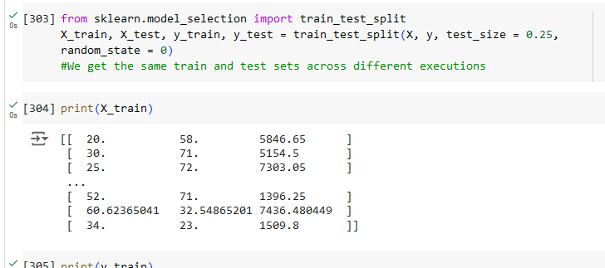
Data Splitting

Slide 19
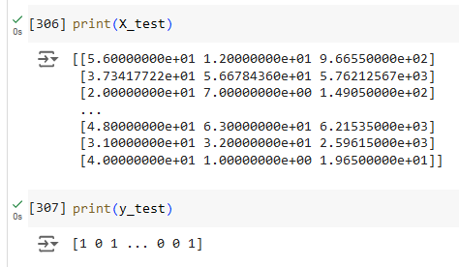
Data Splitting

Slide 20
Steps
Data Preprocessing
Data Splitting
Choosing K Value
Model Training
Model Evaluation

Slide 21
Choosing K Value
This is the third step in training a predictive model for customer churn.
We will initially choose the K-value of 40, a nice round number that can capture the complexity of the data set we have acquired regarding this telecommunications company.

Slide 22
Choosing a K-Value: Coming to Terms with our Chosen Value
According to a user on the Stack Overflow forum^{[1]}, "a general rule of thumb in choosing the value of k is k = sqrt(N)/2, where N stands for the number of samples in your training dataset."
^{[1]} Stack Overflow. Retrieved from https://stackoverflow.com/a/38965928.

Slide 23

Choosing a K-Value: How Not to Get K
There are 10,043 rows of customers in our data set, and typing `sqrt(7043)/2` into a calculator yields `50.1073846853`.
We can round this down by the tens place to simply `50`.
*But wait!*
There aren't 10,043 customers *in our training set*.

Slide 24

Choosing a K-Value: How We Got K
When we invoked the `train_test_split` function earlier, we configured the `test_size` to `0.25`, meaning only 75% of the dataset is for training purposes.
7,043 * 0.75 = 7532.25
sqrt(7532.25)/2 = 43.3942680547 = `40`

Slide 25

Our Chosen Value of K?
40

Slide 26
Steps
Data Preprocessing
Data Splitting
Choosing K Value
Model Training
Model Evaluation

Slide 27

Model Training: Feature Scaling
We will be importing the `StandardScaler` function from SciKit-Learn to transform and fit our `X_train` and `X_test` variables.

Slide 28
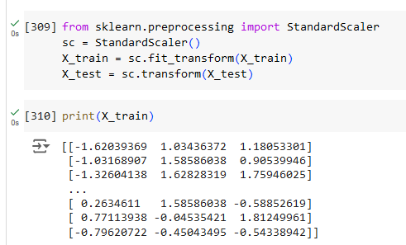
Model Training: Feature Scaling

Slide 29

Model Training: Shapes of Newly-Trained Data
As seen below, the dataset has:
2 dimensions, with each D consisting of:
7,532 elements, with
4 values within.
The latter is applicable only to the X set of variables, as we imported 4 columns worth of data onto them.

Slide 30

Model Training: Where Did That 7K Number Come From?
Remember from the *Data Splitting* heading that we used the `train_test_split` function to split our data into a training set and a testing set.
The `test_size` variable was set to `0.25`, meaning 25% of the data is for testing, while the remaining 75% remains as training data.
10,043 * 0.75 = 7,532.25
Therefore, the training data consists of 7,532 customers.

Slide 31
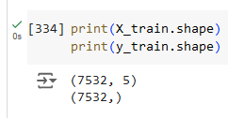
Model Training: Shapes of Newly-Trained Data

Slide 32
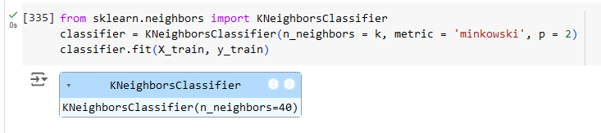
Model Training: Training the K-NN model on the Training Set
Using the declared K-value in the previous section, we will be importing the classifier function for the K Nearest Neighbors form of training.
Both training data will be fit with the classifier we have configured.

Slide 33
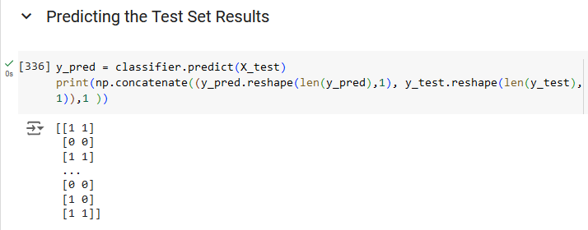
Model Training: Predicting the Test Set Results

Slide 34
Steps
Data Preprocessing
Data Splitting
Choosing K Value
Model Training
Model Evaluation

Slide 35

Results: Find the following results
Use accuracy, precision, recall, and F1 score to evaluate the model on the testing set.

Slide 36
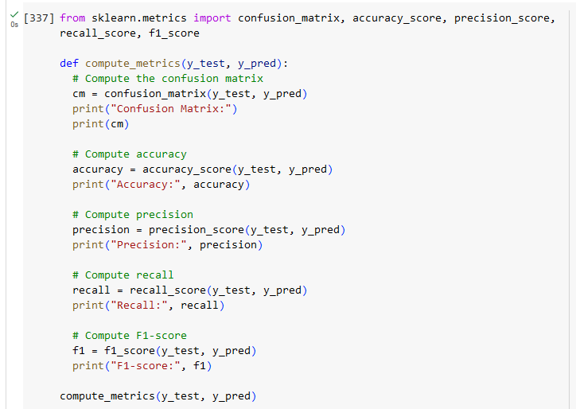
Model Evaluation: Accuracy, Recall, Precision, F-1

Slide 37
Model Evaluation: Accuracy, Recall, Precision, F-1
Confusion Matrix:
[[1432 32]
[ 24 1023]]
Accuracy: 0.9776981282357626
Precision: 0.9696682464454977
Recall: 0.9770773638968482
F1-score: 0.9733587059942912

Slide 38
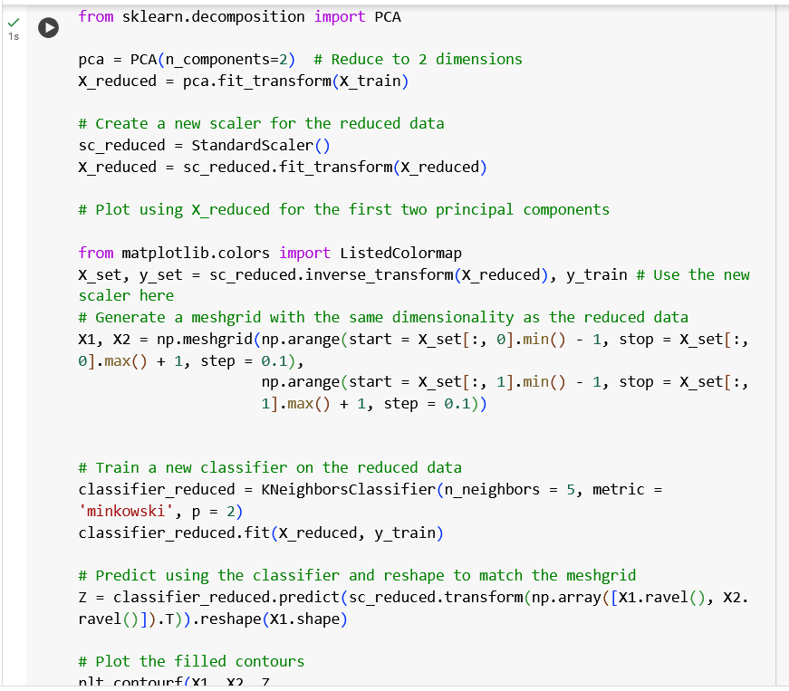
Visualization

Slide 39
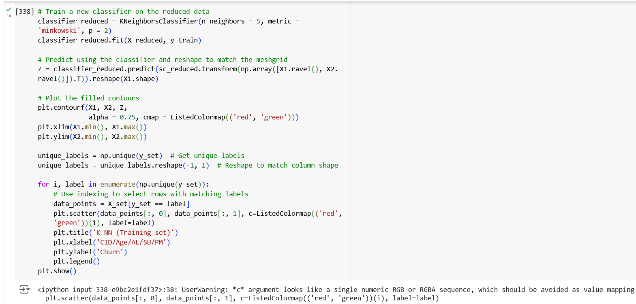
Visualization

Slide 40
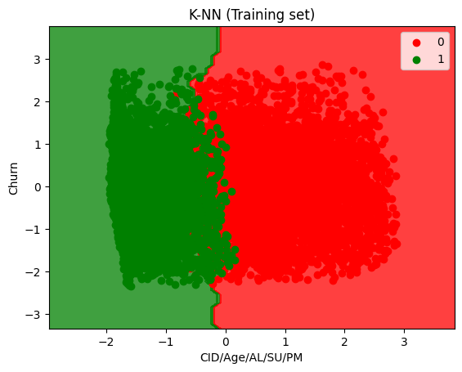
Visualization

Slide 41
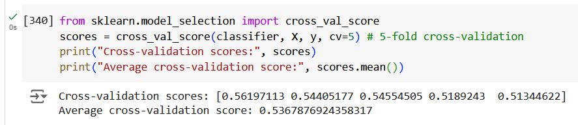
Visualization: Cross-Validation

Slide 42
Questions to Answer
What specific features from the customer data should be included in the training model to enhance prediction accuracy?
What preprocessing techniques, such as scaling or encoding, are essential before fitting the KNN model?
How can you use techniques like cross-validation to optimize the choice of K and prevent overfitting?
What metrics will you use to evaluate the model's performance, and how do these metrics relate to the business impact of customer churn predictions?

Slide 43
Questions to Answer: Features to Include in Training
What specific features from the customer data should be included in the training model to enhance prediction accuracy?
Satisfaction Score would be an important factor in determining whether the customer ultimately churned from the business model, for how long one is willing to pay for a service is directly connected to one’s satisfaction with it.
Another one is Avg Monthly GB Download, which indirectly measures both the reliability of the service and the importance of the said service to the customer.

Slide 44
Questions to Answer: Preprocessing Techniques
What preprocessing techniques, such as scaling or encoding, are essential before fitting the KNN model?
Encoding the data into appropriate formats can ease the use of the K-neighbor classifier tool, which relies on the use of numerical data for statistical purposes.

Slide 45
Questions to Answer: Cross-Validation
How can you use techniques like cross-validation to optimize the choice of K and prevent overfitting?
Cross-validation provides the researcher with appropriate K-values by splitting the dataset into multiple smaller ones and constantly retesting our classifier to check for generalizations or overfitting.

Slide 46
Questions to Answer: Metrics to Measure Model Performance
What metrics will you use to evaluate the model's performance, and how do these metrics relate to the business impact of customer churn predictions?
Accuracy checks how much of its declared values are correct overall. It is the most important out of all the metrics discussed by our professor.
Recall and precision check for the specific truthiness of its predicted positive and negative values for each test row.
Finally, F-1 scores were developed to simplify the use of recall and precision scores into a single metric.

