Slide 1
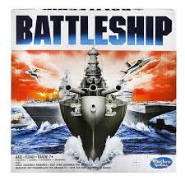
Battleship!
A game by
Daniel Cabe
Luis Umana
Dustin Goldman
Nathan Pearce

Slide 2
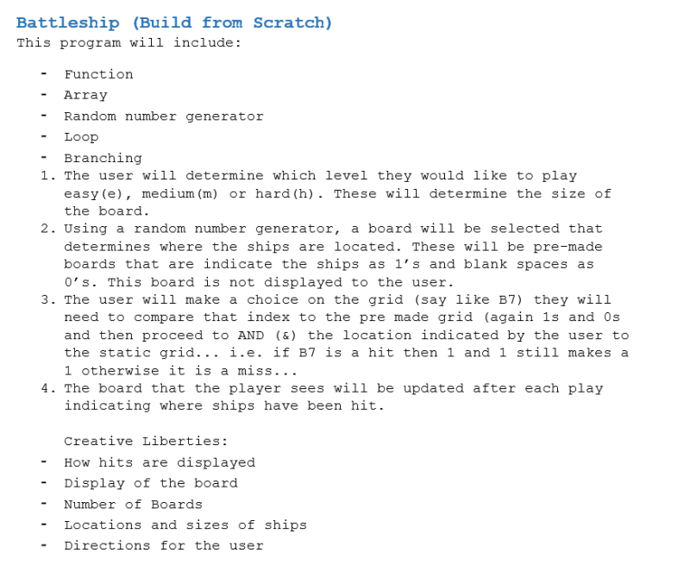
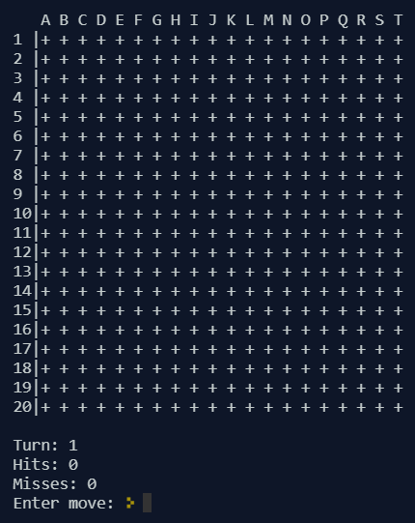
Battleship Overview, Rules, E.T.C.
One player
5 ships on the board(varying in size)
Three difficulties
Try to win in the least amount of turns possible.
Notes:
Dustin

Slide 3
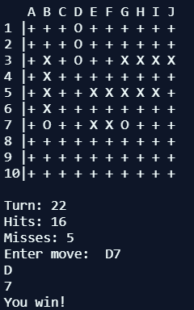
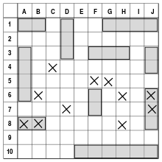
Challenges Our Team Had to Overcome
Meeting with the team.(Because of the way our team could meet, we could only meet a few times in person. Most of our coding and “team meetings” was done in Atom on a accessory package called Teletype)
Function to check if the ships were overlapping
Integrating each others code.
Notes:
louis

Slide 4
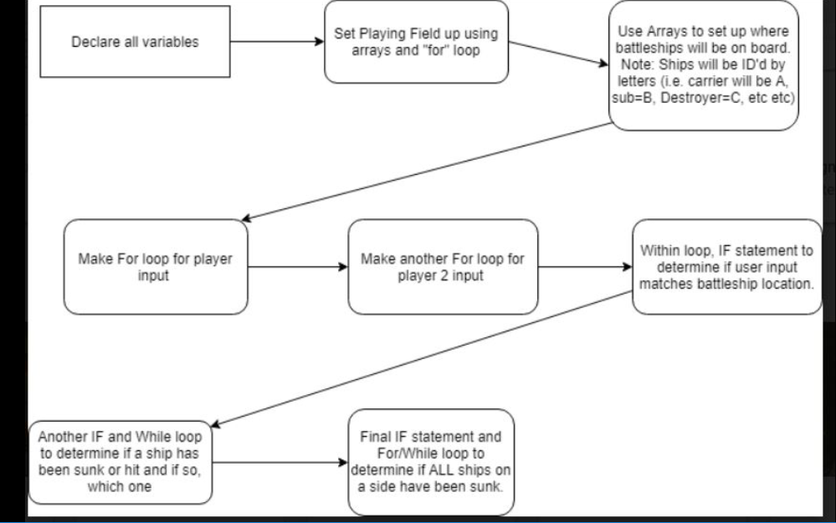
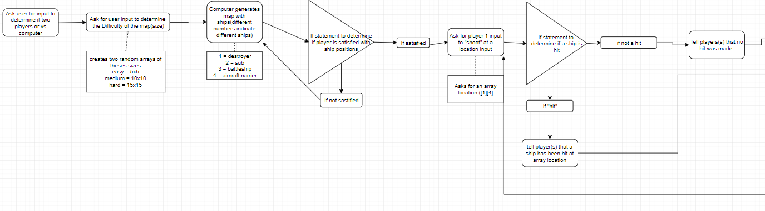
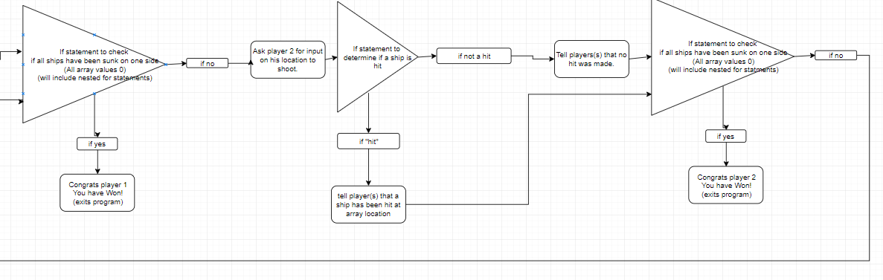
Flow Charts
Flow Chart #1
Our Flowcharts changed, Majorly.
Helped us outline what we would need for our project
Helped dictate what each person would do and when they would need to have it done by.
Flow Chart #2
Notes:
Nathan

Slide 5
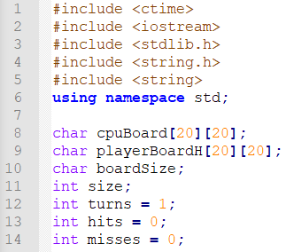
Global Variables and Libraries
Notes:
dUSTIN

Slide 6
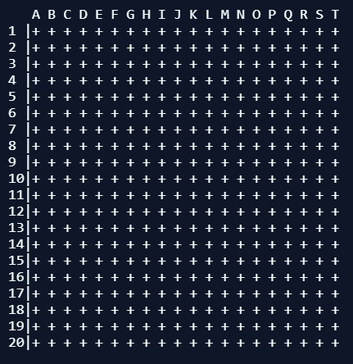
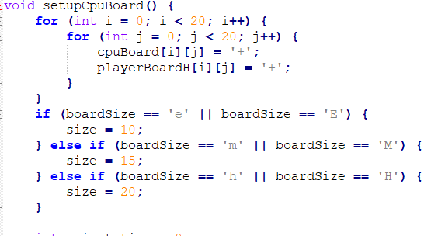
Board Function
The game runs through a for loop that initializes the board and gets the size from the user.
Notes:
Louis

Slide 7
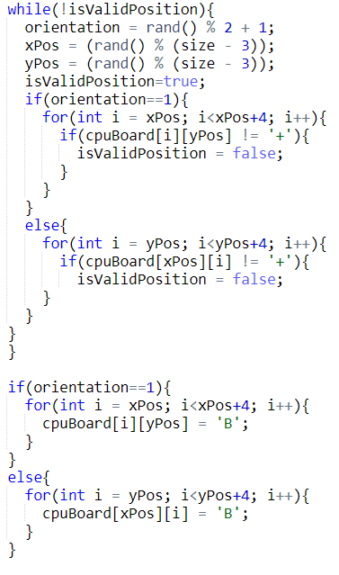
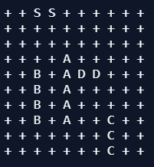
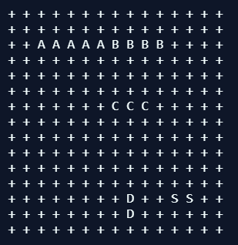
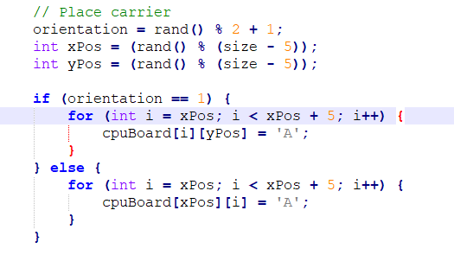
Ship Placement
Four while loops(one for each ship, except Aircraft Carrier) get a randomly generated location and orientation for each ship.
Notes:
Daniel

Slide 8
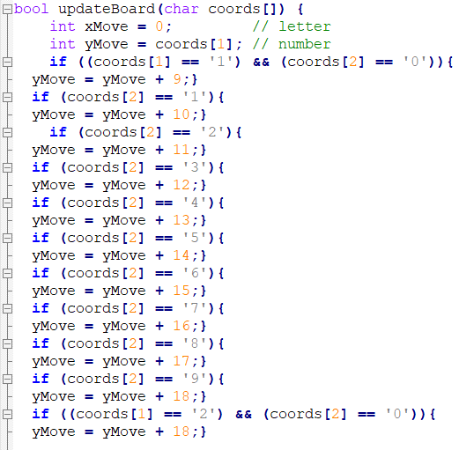
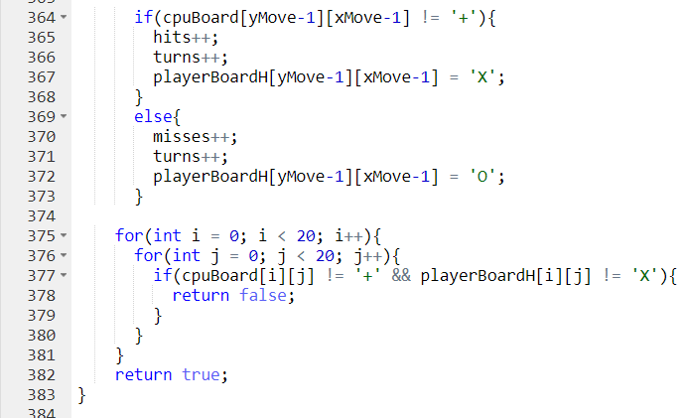
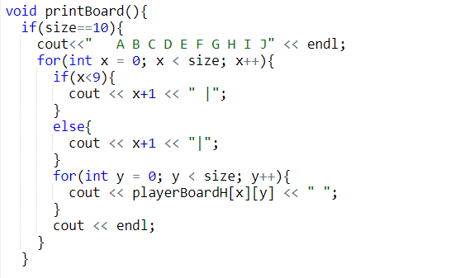
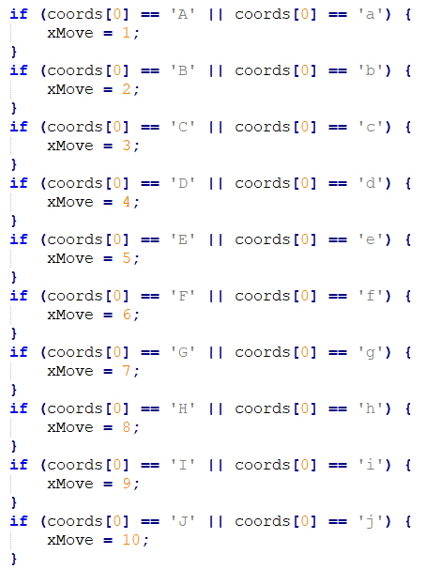
UserBoard Function
Another For loop that shows the board that the player will look at(the board with no ships shown).
A boolean function is then used to determine if the coordinates input by the are a “hit or miss”
Notes:
Daniel

Slide 9
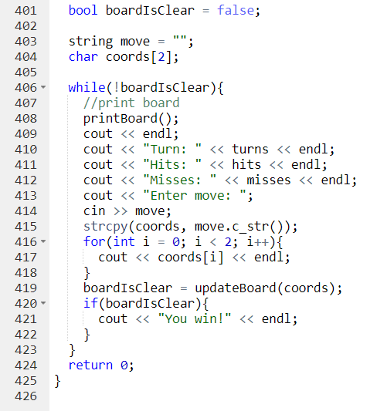
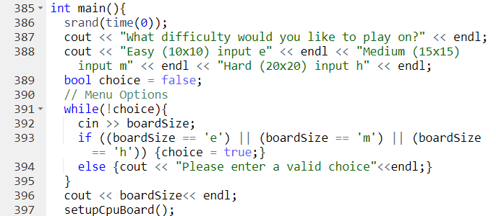
Main
Srand statement for random number generators.
Menu options
A while loop for the game, with the board and all necessary information being shown to the user and running until all spaces on the board are either “+”s, “x”’s or “o”’s
Notes:
Nathan

