Slide 1
Bayesian Meta-Learning

Slide 2
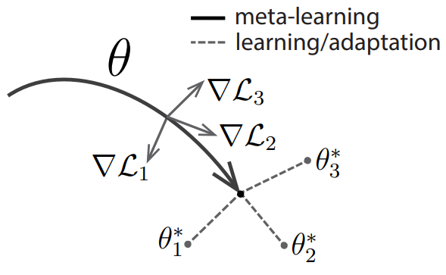
Meta Learning
TODO

Slide 3
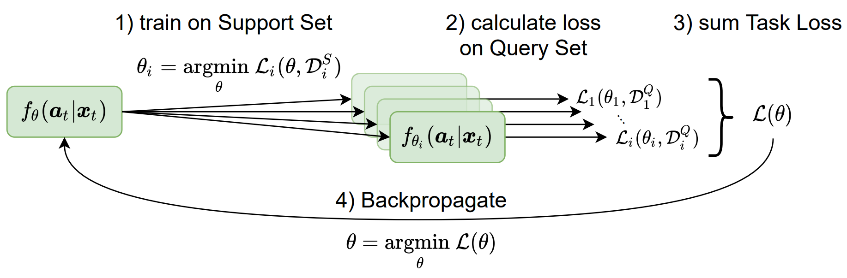
Model-Agnostic Meta Learning Overview
Small
only K samples
Fast
only ~5 steps

Slide 4
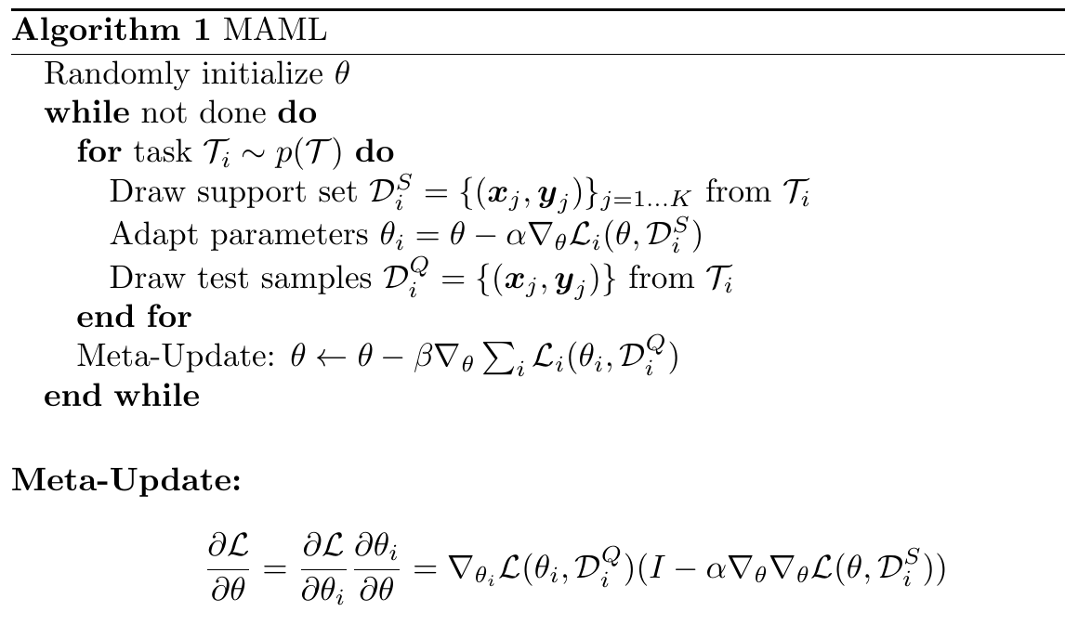
Hessian

Slide 5
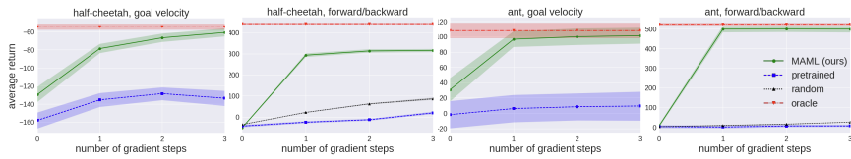
Advantages
No assumptions on the model-architecture
Does not expand the number of learned parameters
Can be applied to supervised and reinforcement learning
Good results:
BUT: we want an uncertainty measure
Model-Agnostic Meta-Learning for Fast Adaptation of Deep Networks, Chelsea Finn and Pieter Abbeel and Sergey Levine, 2017

Slide 6
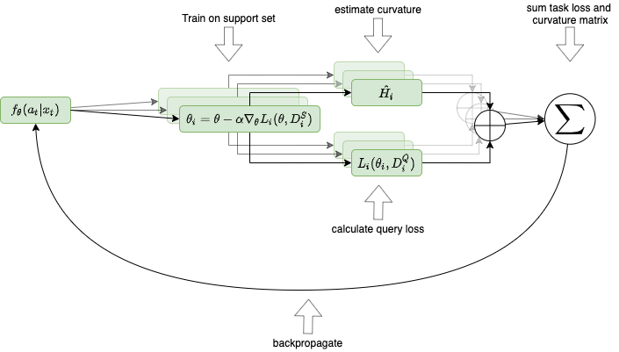
Lightweight Laplace Approximation for Meta-Adaption

Slide 7
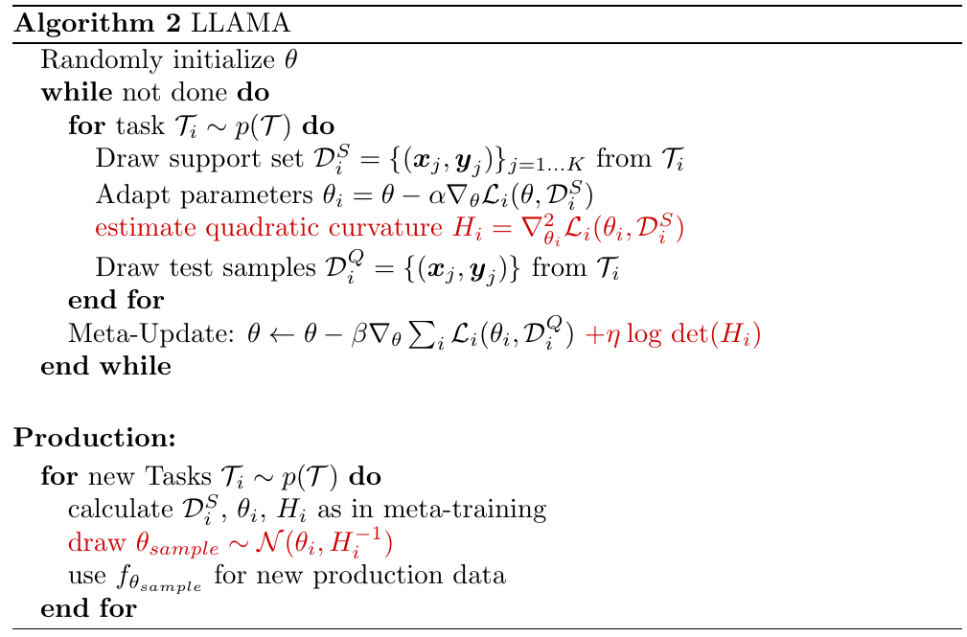

Slide 8
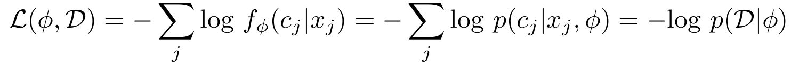



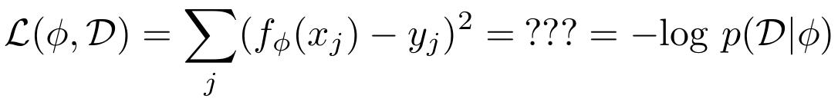


How to intepret log propability for regression?
For classification we have
for a model with a softmax layer at the end and a
dataset where f or C different classes.
What do we do for regression ? We estimate a mean and variance vector
for a model which which predicts targets

Slide 9
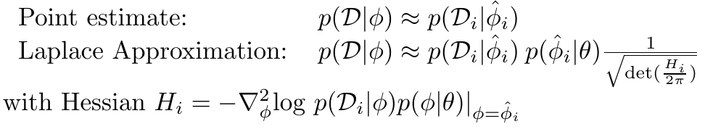
Laplace Approximation and Curvature Matrix
Instead of point estimate we can also use laplace approximation which is based on second order taylor approximation
Hessian for this part is too hard. Why? (The determinant is costly, not the hessian)
So they approximate it with the curvature matrix. How?
We approximate this part by a gaussian with constant variance.

Slide 10
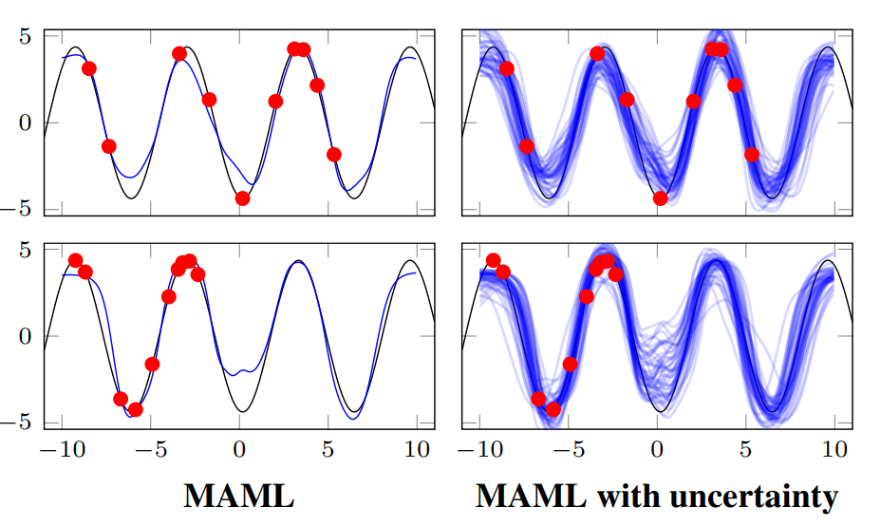
Key Accomplishment
Less data leads to increased variance

Slide 11


Probabilistic MAML
Goal:
-> Impossible to compute!
Approximate:
-> Gradient descent
Finding the prior:

Slide 12
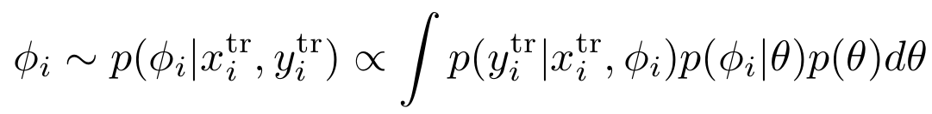

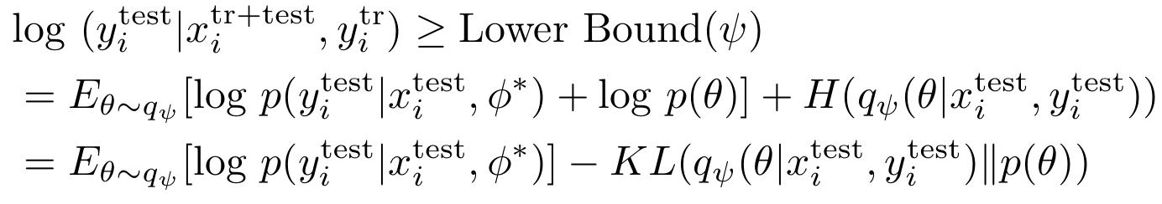


PLATIPUS Idea
Initial idea is untractable
Use point approximation
Maximize Variational Lower Bound
In the end approximates

Slide 13
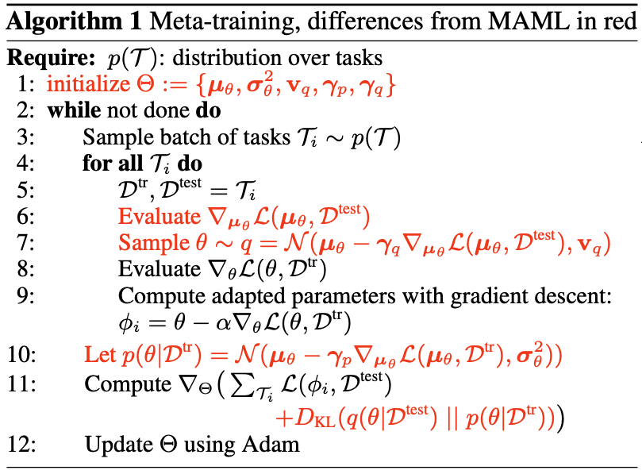
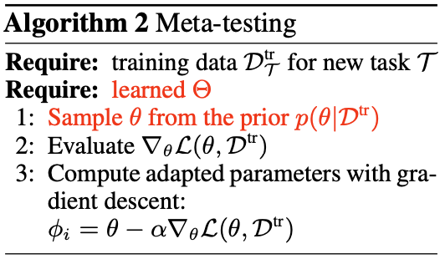
Probabilistic MAML

Slide 14
Probabilistic MAML
Shouldn‘t step 10 be inside the „for all T_i“ loop
Why is for q theta independent of D_train but for p we artificially create dependencies for theta from D_train ?
Graphical Model:
the MAML equation 4.2 correspond to the middle graphical model. From where does the left graphical model come in the first place?
Why is there no arrow from x_train to y_train in the 2nd and 3rd model?
How to calculate gradients through samples? (Reparametrization trick is mentioned)

Slide 15
Implementations
Learn2Learn or Torchmeta
few_shot_meta_learning
Well documented
Easy to use ?
Only MAML implemented
Implementations for all but LLAMA
Seems fairly well maintained
Less tested than L2L ?
More barebone interface
-> Integrate FSML into a L2L or TM fork
Implement LLAMA by hand ?

