Slide 1





Introducción a MongoDB
@luis_auz
@luisauz15

Slide 2

Before To Start
Database Course Introduction
Recommended
Javascript Basics
(Optional) JSON Basics

Slide 3

What is MongoDB?
Database Management System
powerful, flexible, general purpose db
open source
designed for web Applications and Internet Infraestructure
horizontally scalable primary across multiple machines, sharding
document oriented, not a relational
main reason is for scalability
developed by 10-gen in mid-2017, it start a software platform as a service
Nosql document store database
schemaless nature

Slide 4
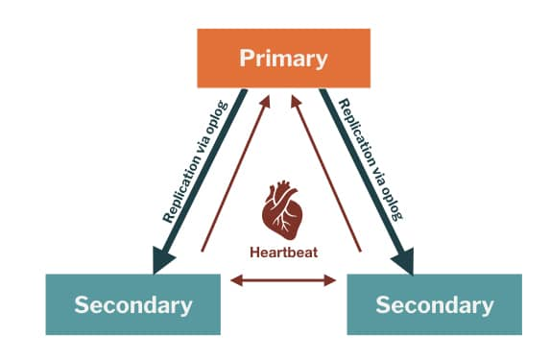
Why MongoDB?
Ease of use
intuitive data model
Easy Scaling
scaling out (partitioning data across more machines)

