Slide 1
Predicting the NHL season
Final ranking and coach changes from 100 years of hockey data
João Ferreira
1.0
Luís Bento
1.0
[3rd member]
1.0
Individual factor
Individual factor
Individual factor
Group G76 · Aprendizagem Computacional · M.EIC · FEUP · December 2026
Notes:
Apresentação do grupo G76. Fatores individuais: todos 1.0.

Slide 2
Domain: one NHL season, 30 teams
30
82
16
22
teams
games
playoff spots
tables
2 conferences, 6 divisions
regular season, 2 points per win
top 8 of each conference
1909–2009, players, goalies, coaches, awards
Ranking: teams are ordered by points% = Pts / (2·G); ties and overtime losses are worth one point.
Coaches: a team can have several coaches in one season (the Coaches.stint order); about 1 team in 3 changes coach each year.
Eras: expansions (6 → 30 teams), the 1979 WHA merger, the 2004 lockout and the 2005 salary cap change how comparable seasons are.
Notes:
Domínio: igual para todos os grupos, por isso curto. Realçar a estrutura conferência/divisão e o corte de playoffs (top 8 por conferência), que usamos nas métricas.

Slide 3
Business goals and data mining goals
Business goal (end users) | Data mining goal | Task | Main metric
How will the teams finish? (scouts, bettors, media) | Predict points% of season t, then sort (league, conference, division) | Regression → ranking | Spearman ρ
Will the team make the playoffs? | Top 8 per conference by predicted points% | Binary classification | Accuracy, ROC-AUC
Which teams will change coach? (management, media) | P(the coach who opens season t is gone by t+1) | Imbalanced binary classification | PR-AUC
CRISP-DM, iterated per task
1
Business
2
Data
3
Prepare
4
Model
5
Evaluate
6
Deploy
Constraint: only information available the day before the first game of season t may be used (no leakage).
Notes:
Business understanding: utilizadores finais e como usam a previsão. Cada objetivo de negócio traduzido num objetivo de DM com tipo de tarefa. Momento da previsão: o dia antes do 1.º jogo da época. Metodologia: CRISP-DM.

Slide 4
Last season explains most of this season
0.63
correlation of points% at t-1 and t (all seasons): the baseline to beat
0.95
goal differential vs points% at t-1: redundant features
0.79 → 0.57
predictability fell after the 1970s: more teams, salary cap, more parity
Notes:
EDA 1D/2D. Correlação de pontos% entre t-1 e t ≈ 0.63, mas caiu desde os anos 70 (mais equipas, salary cap). Justifica treinar só a partir de 1979. Diferença de golos é tão boa como pontos e muito redundante (0.95).

Slide 5
Bad teams change coach; luck does not repeat
Mann-Whitney p ≈ 1e-7 · χ² playoffs vs change p = 0.001 (Cramér's V 0.11)
Spearman(luck t-1, Δ points%) = −0.21, p ≈ 1e-10: two thirds of the luck is gone in one season
Notes:
Teste de hipóteses: Mann-Whitney (equipas que mudam treinador tinham pontos% piores, p≈1e-7), qui-quadrado playoffs vs mudança (p=0.001, V de Cramér 0.11 — efeito fraco). Sorte = pontos% - expetativa pitagórica; ~2/3 da sorte desaparece numa época.

Slide 6
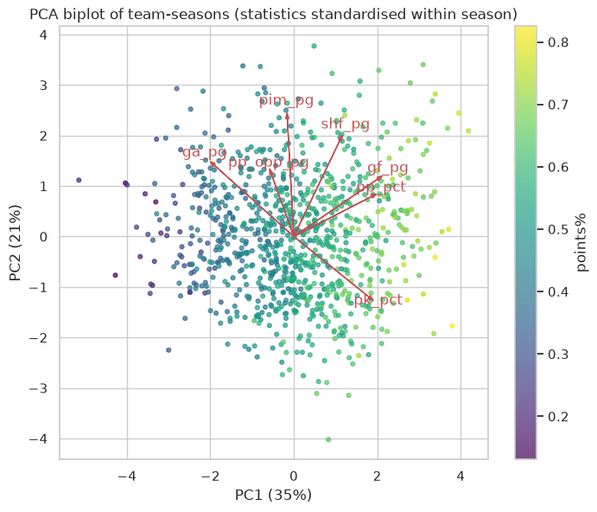
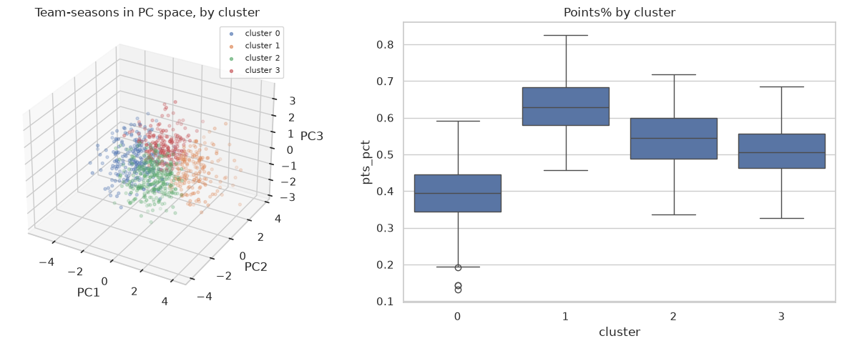
One quality axis, no sharp team profiles
PC1 (35%) = overall quality: correlates 0.88 with points%.
PC2 (21%) = open, penalised game: unrelated to success (ρ = −0.08).
k-means (k = 4): silhouette only 0.25, teams vary continuously; weak profile changes coach 37% vs 19% for elite (χ² p < 0.001).
Statistics standardised within each season to remove era effects
Notes:
Métodos 3+D: PCA com estatísticas normalizadas dentro de cada época (remove efeito de era). PC1 = qualidade (ρ=0.88 com pontos%), PC2 = jogo aberto/indisciplinado, sem relação com sucesso. k-means em 3 PCs: silhouette baixa (0.25), por isso perfis contínuos; mesmo assim o perfil 'fraco' muda de treinador 37% vs 19% no 'elite' (χ² p<0.001).

Slide 7
Problem definition
1
Unit
2
Inputs
One row per franchise-season (franchID survives relocations). 753 labelled rows, 1979–2009; 30 rows to predict (2010).
Only seasons t-1, t-2, … plus facts known pre-season: the coach who opens season t, the division.
3
Target (a)
4
Target (b)
points% of season t → sorted into league, conference and division rankings; top 8 per conference = playoffs.
coach_change_any: the coach who opens t is gone by the start of t+1 (31% positive in 2000–09). Two narrower variants are also built.
Sample: NHL only, 1979+ (WHA merger, 21–30 teams). Earlier seasons are only used to compute lag features.
Notes:
Unidade: uma linha por franquia-época (franchID segue a equipa quando muda de cidade). Features da época t só usam t-1, t-2... e factos conhecidos antes (treinador que abre a época). Três definições de mudança de treinador construídas; principal = 'any'. TEM DE SER CONFIRMADA COM O PROFESSOR.

Slide 8
Integration and data quality in SQL
Integration
Six quality dimensions checked
Entity matching: teams by franchID across relocations; coaches and players to Master, awards and HOF (100% match rate).
Format conversion: ties + OT losses merged, playoff round codes from 3 formats → ordinal depth 0–5, all counts per game (48- to 84-game seasons).
Tools: SQLite with window functions (LAG, ROW_NUMBER) for aggregation; Python for modelling.
Completeness
Accuracy
PP/PK before 1963, save% before 1982 missing
133 seasons: team GF ≠ Σ player goals (shootouts)
Consistency
Uniqueness
W+L+T+OTL = G; Pts = 2W+T+OTL; coach games
no duplicate team-seasons or people
Validity
Timeliness
no negative values or impossible ranks
data ends in 2009; short-lived tables dropped
Notes:
Integração em SQLite: conversão de formatos (T e OTL, códigos de playoff em escala ordinal, taxas por jogo) E matching de entidades (franchID, coachID↔Master, playerID↔Master, awards, HOF só antes de t). Qualidade: 6 dimensões verificadas em sql/data_quality.sql.

Slide 9
Data preparation inside one leak-free pipeline
KNN imputer
Winsorizer
Scaling
Balancing
Filter + wrapper
Model
k = 10; vs median, iterative
clip to 1–99% of train
only for distance / linear models
class weights or SMOTE
mutual info → RFE, k tuned
8 algorithms, grid search
Fitted on the training seasons only (also inside the inner tuning folds)
1
52 → 44 features
2
Missing values
3
Outliers
Team, roster, goalie and coach features; aggregations (3-season means, roster sums) and hockey concepts (Pythagorean %, luck, special teams, late form, tenure × badness). 8 removed by a systematic |ρ| > 0.9 rule on 1979–99 only.
Mostly structural (2–12%): expansion teams get a domain prior (mean first-season points% of earlier expansions) + flag; rookie coaches flagged; rest imputed by KNN.
IQR + Isolation Forest: 1994 lockout (48 games), first-year expansion teams, 1980s offences. Real, so kept: per-game rates, flags and winsorisation.
Notes:
Todas as transformações são passos do Pipeline (imblearn), ajustados só nas épocas de treino. Feature engineering: agregações (médias 3 épocas, plantel, guarda-redes) + conceitos de negócio (expetativa pitagórica, sorte, special teams, forma final, tenure x maus resultados). Redundância: |ρ|>0.9 removida de forma sistemática (8 features).

Slide 10
Experimental setup: walk-forward in time
test 2000
9 test seasons → 9 scores per model, so we can test significance.
Inner temporal tuning: grid search validated on each of the last 3 training seasons.
8 algorithms with different biases: linear (Ridge/Lasso, LogReg), kNN, SVM, Naive Bayes, tree, Random Forest, Gradient Boosting, MLP.
Baselines: (a) same as last season; (b) majority class and the rule "bad team changes coach".
Metrics: (a) Spearman ρ, rank MAE, points MAE, playoff accuracy; (b) PR-AUC (imbalanced), ROC-AUC, F1.
test 2001
test 2002
test 2003
test 2005
test 2006
test 2007
test 2008
test 2009
1979
2009
train (all earlier seasons)
test season
Notes:
Walk-forward com janela crescente: para testar a época T treina-se em todas as épocas < T. 9 épocas de teste (2000–2009 sem 2004) = 9 pontuações por modelo, permitindo testes de Friedman/Nemenyi e Wilcoxon. Tuning interno temporal (validar nas últimas 3 épocas de treino). Limiar de decisão escolhido na validação interna, nunca no teste.

Slide 11
Ranking: models match last season's order
ρ 0.55
Ridge = baseline "same as last season" (Wilcoxon p = 0.82)
0.059
points% MAE vs 0.067 for the baseline (better in 6 of 9 seasons, p = 0.055)
70%
playoff teams picked correctly (top 8 per conference); ROC-AUC 0.76
Notes:
Ridge com 8 features selecionadas é o melhor (ρ=0.548), mas igual ao baseline 'mesma ordem do ano passado' (Wilcoxon p=0.82). Friedman p=0.044: só a árvore e o gradient boosting são claramente piores (Nemenyi CD=4.5). Ganho real está no erro de pontos: 0.059 vs 0.067 (melhor em 6/9 épocas, Wilcoxon p=0.055) — o modelo aprendeu regressão para a média.

Slide 12
Coach change: a weak but real signal
+0.12
PR-AUC of LogReg over random (0.43 vs 0.315, Wilcoxon p = 0.004)
0.58
ROC-AUC: the risk ranking is only slightly better than chance
p = 0.055
vs the simple "bad team" rule: not significant at 5%
Notes:
PR-AUC: aleatório = taxa de positivos (0.315). LogReg 0.43 e MLP 0.45 batem claramente a maioria (Wilcoxon p=0.004 / 0.008) e têm o melhor rank médio (Friedman p=0.017), mas a diferença para a regra simples 'equipa má' (0.39) não é significativa (p=0.055). ROC-AUC só ~0.58: o problema é intrinsecamente difícil com dados pré-época.

Slide 13
Predictions for the 2010 season
(a) Predicted playoff teams, with predicted points
(b) Highest coach-change risk
# | East | Pts
1 | Washington | 105
2 | New Jersey | 97
3 | Pittsburgh | 97
4 | Boston | 91
5 | Buffalo | 91
6 | Ottawa | 91
7 | Philadelphia | 89
8 | NY Rangers | 88
# | West | Pts
1 | San Jose | 104
2 | Chicago | 103
3 | Detroit | 97
4 | Vancouver | 95
5 | Phoenix | 93
6 | Calgary | 92
7 | Los Angeles | 92
8 | St. Louis | 90
Team | P(change)
Edmonton Oilers | 0.62
New Jersey Devils | 0.58
Washington Capitals | 0.57
Montreal Canadiens | 0.56
Tampa Bay Lightning | 0.56
New York Rangers | 0.55
Detroit Red Wings | 0.55
Boston Bruins | 0.54
Points = predicted points% × 164. Risk scores are compressed (0.37–0.62): read them as a ranking, not as calibrated probabilities.
Notes:
Previsões finais: modelo re-treinado em 1979–2009. (a) top 8 previsto por conferência. (b) os 8 maiores riscos de mudança de treinador (LogReg). Nota: com o limiar escolhido por F1 a lista sim/não marcaria 21 de 30 equipas — usar como ranking de risco.

Slide 14
Conclusions, limitations and future work
1
Conclusions
2
Limitations
3
Future work
About 55% of the final order is predictable from last season; models equal that baseline and cut the points error (0.067 → 0.059).
Regression to the mean is the main thing learned: luck and extreme seasons revert.
Coach changes are driven by bad results and short patience; the signal is weak (PR-AUC 0.43 vs 0.32).
No in-season information: trades, injuries and the 2010 rosters are not in the data.
Only 9 test seasons: small samples for the statistical tests.
The definition of "coach change" still has to be confirmed; risk scores are not calibrated.
Use the new roster if allowed (ρ 0.55 → 0.57–0.60 in our tests).
Tune directly for Spearman; weight recent seasons more.
Calibrate probabilities and choose the threshold with the client's cost of false alarms; add task (c).
Notes:
Fechar com a mensagem principal: o sinal pré-época é limitado; os modelos não batem a persistência no ranking mas reduzem o erro de pontos; no treinador há sinal fraco mas real. Limitações honestas + próximos passos.

Slide 15
Thank you
Questions? Technical details follow in the annexes
Notes:
Obrigado. Seguem-se anexos com o detalhe técnico.

Slide 16
Data quality: checks and actions
Dimension | Check | Result | Action
Completeness | % missing per column and era | PP/PK missing before 1963, OTL only from 1999, save% before 1982 | Train on 1979+; structural vs real missing separated; impute in pipeline
Accuracy | Team GF vs Σ player goals | 133 seasons differ by > 2 goals, all from 2005 (shootout goal) | Use team-level GF
Consistency | W+L+T+OTL = G; Pts = 2W+T+OTL; coach games | 1 case: Detroit 1998 co-coaches (87 vs 82 games) | Mid-season change = MAX(stint) > 1
Uniqueness | Duplicate team-seasons / people | None; homonyms are different IDs | Keys: (franchID, year), playerID, coachID
Validity | Negative values, ranks, GA > SA | None in the modern era | None needed
Timeliness | Years covered per table | TeamsHalf, *SC, ScoringSup, shootout tables cover few seasons | Dropped; predict 2010

Slide 17
Feature engineering: 44 leak-free features
Group | Examples | How it is built | Hockey meaning
Team | pts_pct_lag1/lag2, pts_trend, gd_pg_ma3 | Lag 1–2 seasons, 3-season mean | Level and direction of the team
Business concepts | luck_lag1, pp_pct, pk_pct, late_form | pts% − GF²/(GF²+GA²); TeamSplits Jan–Apr | Luck reverts; special teams; finishing form
Roster | roster_pts_pg, top_scorer_pts, n_20goal, avg_age | Scoring ⨝ Master ⨝ AwardsPlayers, summed per franchise | Offensive talent, age, stars
Goalie | team_sv_pct, main_goalie_share | Goalies, goalie with most minutes | Goaltending quality
Coach | new_coach, coach_tenure, career win%, times replaced | All Coaches rows before t; HOF only if inducted before t | Grace period, track record
Franchise | franchise_coaches_5y | Distinct coaches in t-5 … t-1 | Impatient owners
Interaction | tenure_x_badness | tenure × (0.5 − pts% t-1) | Long-tenured coach of a bad team (from EDA)
Flags | is_new_team, coach_rookie | No history available | Missing-value indicators
Redundancy: 8 removed with |ρ| > 0.9 on 1979–99 (e.g. gd_pg ≈ pyth_pct, ρ = 0.996). Player HOF not used: induction happens after the career (leakage).

Slide 18
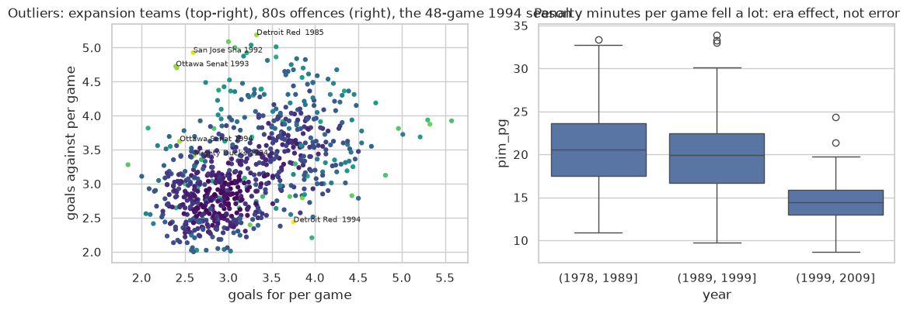
Outliers are real seasons, not errors
1994 lockout: 48 games instead of 84 → per-game rates.
Expansion teams (San Jose, Ottawa 1992: 0.14 points%) → is_new_team flag and expansion prior.
1980s extremes (Edmonton 1985: 5.3 goals per game) and falling penalty minutes are era effects.
Addressed with a Winsorizer (1–99% of training data) inside the pipeline; trees are robust by design.
Missing-value imputers compared (Ridge, all features, walk-forward): iterative ρ 0.521 · median 0.514 · KNN 0.511 — almost equal because most missing values are structural.

Slide 19
Algorithms, biases and tuned parameters
Algorithm | Language bias | Tuned (inner temporal grid search) | Imbalance (b)
Ridge / Lasso · LogReg | Linear; L2 shrinks, L1 selects | alpha · C | class weights
kNN | Average of similar past teams | k ∈ {10–75}, weights | SMOTE
SVR / SVM (RBF) | Max margin, kernel | C, ε, γ | class weights
Naive Bayes (categorical) | Independent features; 4 quantile bins | alpha (smoothing) | SMOTE
Decision tree | Axis-parallel rules | max_depth, min_samples_leaf | class weights
Random Forest | Bagging of decorrelated trees | depth, leaf size, max_features | class weights
Gradient Boosting | Trees fitted to residuals | learning rate, depth | class weights
MLP | Non-linear combinations | hidden layers, alpha | SMOTE
Feature selector | MI filter → RFE wrapper | k ∈ {8, 16, all} | —
SMOTE is a step of the imblearn Pipeline, so it only touches training folds. The yes/no threshold maximises F1 on the inner validation seasons.

Slide 20
Statistical tests: Friedman and Nemenyi
(a) Spearman ρ · Friedman χ² = 17.3, p = 0.044 · CD = 4.52
(b) PR-AUC · Friedman χ² = 21.7, p = 0.017 · CD = 5.03
Model | Avg rank
Ridge | 3.67
Lasso | 4.00
SVR | 4.78
Baseline: last season | 4.78
Random Forest | 4.89
MLP | 5.33
kNN | 5.56
Gradient Boosting | 6.89
Baseline: 3-season avg | 7.22
Tree | 7.89
Model | Avg rank
LogReg | 3.56
MLP | 3.89
kNN | 5.00
Baseline: bad team | 5.44
Random Forest | 5.44
Gradient Boosting | 5.78
Tree | 6.33
SVM | 6.56
Naive Bayes | 6.89
Baseline: missed playoffs | 8.28
Baseline: majority | 8.83
Ranks differing by less than the critical difference (CD) are not significantly different (α = 0.05). Wilcoxon, paired by season: Ridge vs last season p = 0.82 (ρ), 0.055 (MAE); LogReg vs majority p = 0.004, vs bad-team rule p = 0.055.

Slide 21
Overfitting: train vs test
kNN (train ρ 0.92, PR-AUC 1.00) and the tree ensembles memorise the training seasons; the linear models have the smallest gap and the best test scores.

Slide 22
White-box models: what drives the predictions
(a) Points% at t-1 dominates; once it is in, playoffs and save% get negative weights: regression to the mean. (b) A coach hired in the summer, an improving team and a coach with a winning record are safer; older coaches and teams with award winners (high expectations) are at risk.

Slide 23
Project management and tools
1
Methodology
2
Collaboration
CRISP-DM: one notebook per phase (01–02 understanding, 03 preparation, 04–05 modelling and evaluation); GUIDE.md maps each step to the rubric.
Git + GitHub (branches, pull requests), shared code in src/ and SQL in sql/, docs/ for business understanding and meeting notes.
3
Database
4
Analytics
SQLite: integration, aggregation with window functions and the data-quality checks are all SQL files.
Python: pandas, scikit-learn, imbalanced-learn, SciPy (tests), matplotlib/seaborn; Jupyter notebooks.
Reproduce: pip install -r requirements.txt → python src/load_db.py → run notebooks 01–05 in order.

Slide 24
Full predicted 2010 ranking
# | Eastern | Div | Pts | PO
1 | Washington Capitals | SE | 105 | yes
2 | New Jersey Devils | AT | 97 | yes
3 | Pittsburgh Penguins | AT | 97 | yes
4 | Boston Bruins | NE | 91 | yes
5 | Buffalo Sabres | NE | 91 | yes
6 | Ottawa Senators | NE | 91 | yes
7 | Philadelphia Flyers | AT | 89 | yes
8 | New York Rangers | AT | 88 | yes
9 | Montreal Canadiens | NE | 86 | no
10 | Carolina Hurricanes | SE | 83 | no
11 | Atlanta Thrashers | SE | 82 | no
12 | Florida Panthers | SE | 81 | no
13 | Toronto Maple Leafs | NE | 80 | no
14 | Tampa Bay Lightning | SE | 79 | no
15 | New York Islanders | AT | 76 | no
# | Western | Div | Pts | PO
1 | San Jose Sharks | PC | 104 | yes
2 | Chicago Blackhawks | CE | 103 | yes
3 | Detroit Red Wings | CE | 97 | yes
4 | Vancouver Canucks | NW | 95 | yes
5 | Phoenix Coyotes | PC | 93 | yes
6 | Calgary Flames | NW | 92 | yes
7 | Los Angeles Kings | PC | 92 | yes
8 | St. Louis Blues | CE | 90 | yes
9 | Nashville Predators | CE | 90 | no
10 | Anaheim Ducks | PC | 89 | no
11 | Minnesota Wild | NW | 88 | no
12 | Dallas Stars | PC | 86 | no
13 | Colorado Avalanche | NW | 86 | no
14 | Columbus Blue Jackets | CE | 82 | no
15 | Edmonton Oilers | NW | 75 | no

