Slide 1
Citation Retrieval
Goal: Find relevant papers given written context (multiple sentence – whole paragraphs)
Benchmark setup: Given the abstract of paper x, predict its references y_i
Baselines:
OpenAlex search APIs sometimes unresponsive
SemanticScholar search only work on keywords, not paragraphs
…
-> Build local vector database

Slide 2
Vector Database: Data Retrieval
Scraped references and metadata using multiple open-source APIs
OpenAlex
SemanticScholar
Crossref
Scraped data
Identifier (DOI, API-specific IDs)
Abstract
Various metadata (e.g. text type, topic, field)

Slide 3
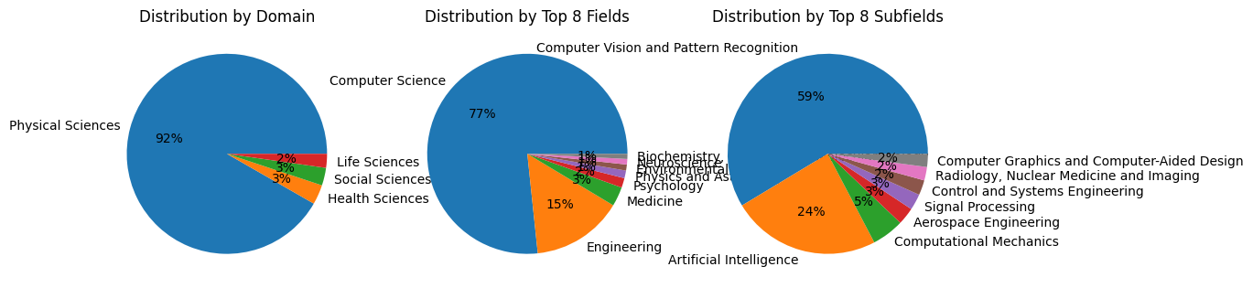
Vector Database: Data Overview
Core
1.1k CVPR papers (parsed via Docling)
References
60k referenced papers
30k unique papers with OpenAlex metadata available
25k unique papers with clean metadata

Slide 4
Vector Database: Local implementation
Stack
Embeddings created by HF models
FAISS index
Metadata stored in Parquet files

Slide 5
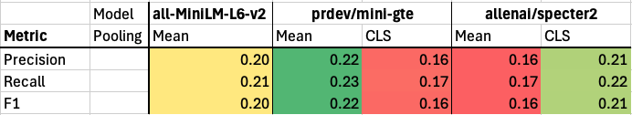
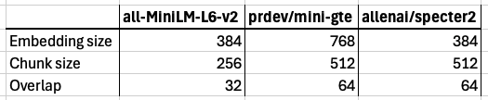
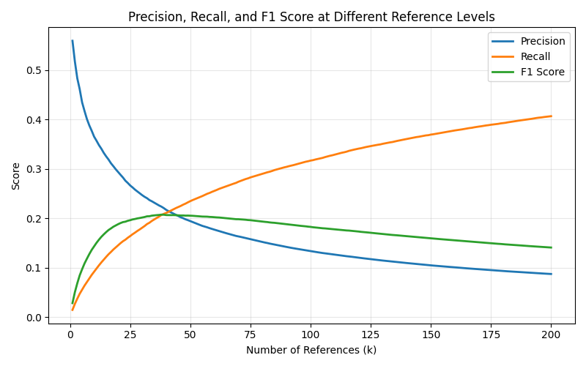
Embedding model benchmarking
Comparison of different embeddings
Best model in more detail
Notes:
Ideas for next steps:
- Use elastic/Milvus (defo include hybrid search incl keywords)
- Weight with citations
- Try SemSchol embeddings (using model to embed query and then query SemSchol using embedding vector)
- Incl error bars to mean F1/prec/recall papers
- Test scores on papers categorised by citation count

Slide 6
Vector Database: Next steps
Alternative RAG approach:
Use LLM to extract keywords from paragraph, then use APIs for search
Build local reranker
Extract relevant chunks from body of papers
Create on-demand embeddings for user-given papers

