Slide 1
Banking Customer Churn Prediction
Artificial Intelligence – Supervised Learning

Slide 2
Banking Customer Churn Prediction
Dataset
Bank customers and their churn status, which indicates whether they have exited the bank or not.
20,37 %
Machine learning problem
Factors influencing customer churn in banking institutions and build predictive models to identify customers at risk of churning.
Churn rate : 2037 / 10000

Slide 3
Tools and algorithms to use
Tools
Algorithms
Pandas
Numpy
MatPlot
Seaborn
Scikit-learn
TensorFlow
Imbalanced-learn
Decision Trees
Neural Networks
K-Nearest Neighbors (K-NN)
Support Vector Machines (SVM)
Naïve Bayes

Slide 4
Dataset features
A
B
C
D
E
F
G
H
I
J
K
L
M
N
A : | row number | H : | tenure
B : | customer id | I : | balance
C : | surname | J : | numOfProducts
D : | credit score | K : | hasCreditCard
E : | geography | L : | isActiveMember
F : | gender | M : | estimatedSalary
G : | age | N : | exited

Slide 5
Exited customers per country
Spain
16%
Churn rate : 413 / 2477
France
16%
Churn rate : 810 / 5014
Germany
32%
Churn rate : 814 / 2509

Slide 6
Exited customers per gender
16,46%
25,07%
Male
Female
Churn rate : 898 / 5457
Churn rate : 1139 / 4543

Slide 7
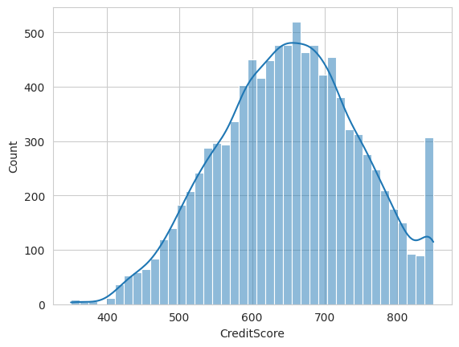
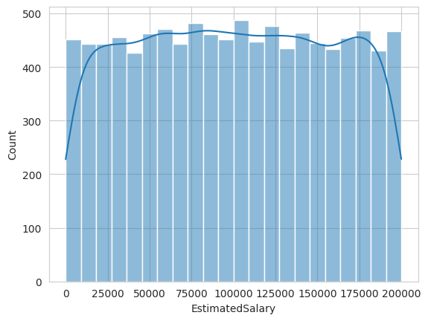
Credit score & estimated salary

Slide 8
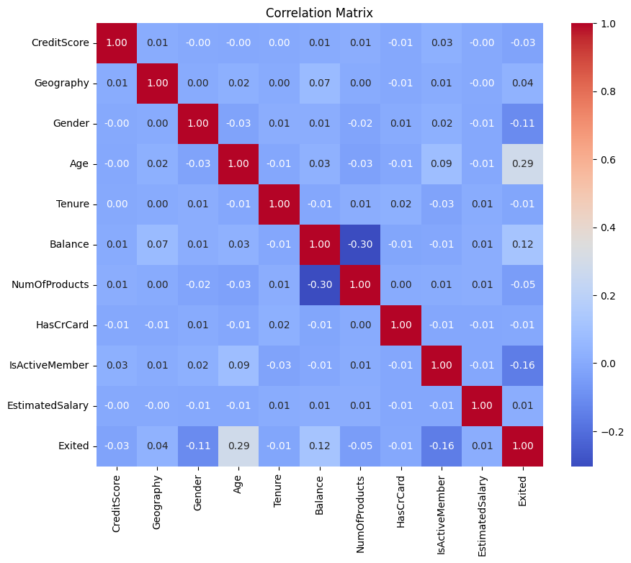

Slide 9
Data preprocessing

Slide 10
Dropping features
A
B
C
D
E
F
G
H
I
J
K
L
M
N
A : | row number | H : | tenure
B : | customer id | I : | balance
C : | surname | J : | numOfProducts
D : | credit score | K : | hasCreditCard
E : | geography | L : | isActiveMember
F : | gender | M : | estimatedSalary
G : | age | N : | exited

Slide 11
Dropping features
A
B
C
D
E
F
G
H
I
J
K
L
M
N
A : | row number | H : | tenure
B : | customer id | I : | balance
C : | surname | J : | numOfProducts
D : | credit score | K : | hasCreditCard
E : | geography | L : | isActiveMember
F : | gender | M : | estimatedSalary
G : | age | N : | exited

Slide 12
Dropping features
A
B
C
D
E
F
G
H
I
J
K
L
M
N
A : | row number | H : | tenure
B : | customer id | I : | balance
C : | surname | J : | numOfProducts
D : | credit score | K : | hasCreditCard
E : | geography | L : | isActiveMember
F : | gender | M : | estimatedSalary
G : | age | N : | exited
dataset.drop(['RowNumber', 'CustomerId', 'Surname’])

Slide 13
Dropping features
D
E
F
G
H
I
J
K
L
M
N
A : | row number | H : | tenure
B : | customer id | I : | balance
C : | surname | J : | numOfProducts
D : | credit score | K : | hasCreditCard
E : | geography | L : | isActiveMember
F : | gender | M : | estimatedSalary
G : | age | N : | exited

Slide 14
Converting input types
Gender
Gender
Geography
Geography
Male
1
Germany
2
Female
0
France
0
Female
0
Spain
1
Male
1
Germany
2
Male
0
Germany
2
Female
1
France
0

Slide 15
Normalizing salary
# Mapping the country to the minimum salary
country_salaries = {'France': 1540 * 12, 'Spain': 1050 * 12, 'Germany': 1580 * 12}
# Remove rows with 'EstimatedSalary' less than 1000
dataset = dataset[dataset['EstimatedSalary'] >= 1000]
# Multiply 'EstimatedSalary' by 12 if it's less than the corresponding country's salary
dataset.loc[dataset['EstimatedSalary'] < dataset['Geography'].map(country_salaries), 'EstimatedSalary'] *= 12

Slide 16
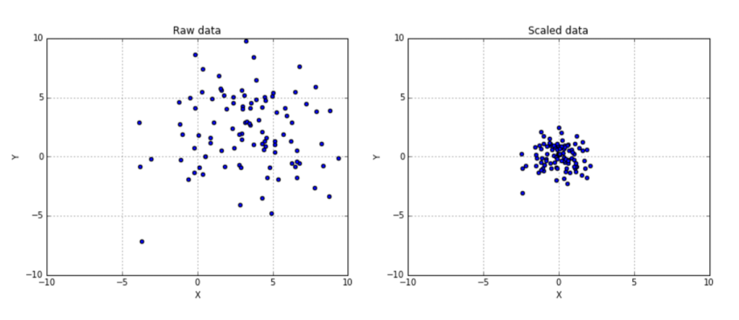
Feature scaling

Slide 17
Handle imbalanced data
Initial dataset
20%
Imbalanced - 2037 / 7963
smt = SMOTE(random_state=5)
Final dataset
50%
Balanced - 7963 / 7963

Slide 18
Model training

Slide 19
Results comparison
Classifier | F1-score | Accuracy | Recall | Auc
KNN | 85% | 85% | 85% | 92%
Decision Tree | 84% | 84% | 84% | 84%
MLP | 83% | 83% | 83% | 91%
SVC | 80% | 81% | 81% | 89%
Gaussian Naive Bayes | 73% | 73% | 73% | 81%

Slide 20
Hyperparameter
Tuning

Slide 21
Hyperparameter tuning
Training and test set sizes
K-fold cross validation
Balanced vs imbalanced datasets
Decision tree criterias
K-nearest neighbors proximity metric
SVM kernel function
Neural networks activation functions and optimizers

Slide 22
Results comparison
Classifier | F1 Score | Accuracy | Recall | AUC
KNNeighbors | 87% | 86% | 87% | 93%
Decision tree | 84% | 84% | 84% | 84%
Neural Network | 83% | 83% | 83% | 92%
SVC | 80% | 81% | 81% | 89%

Slide 23
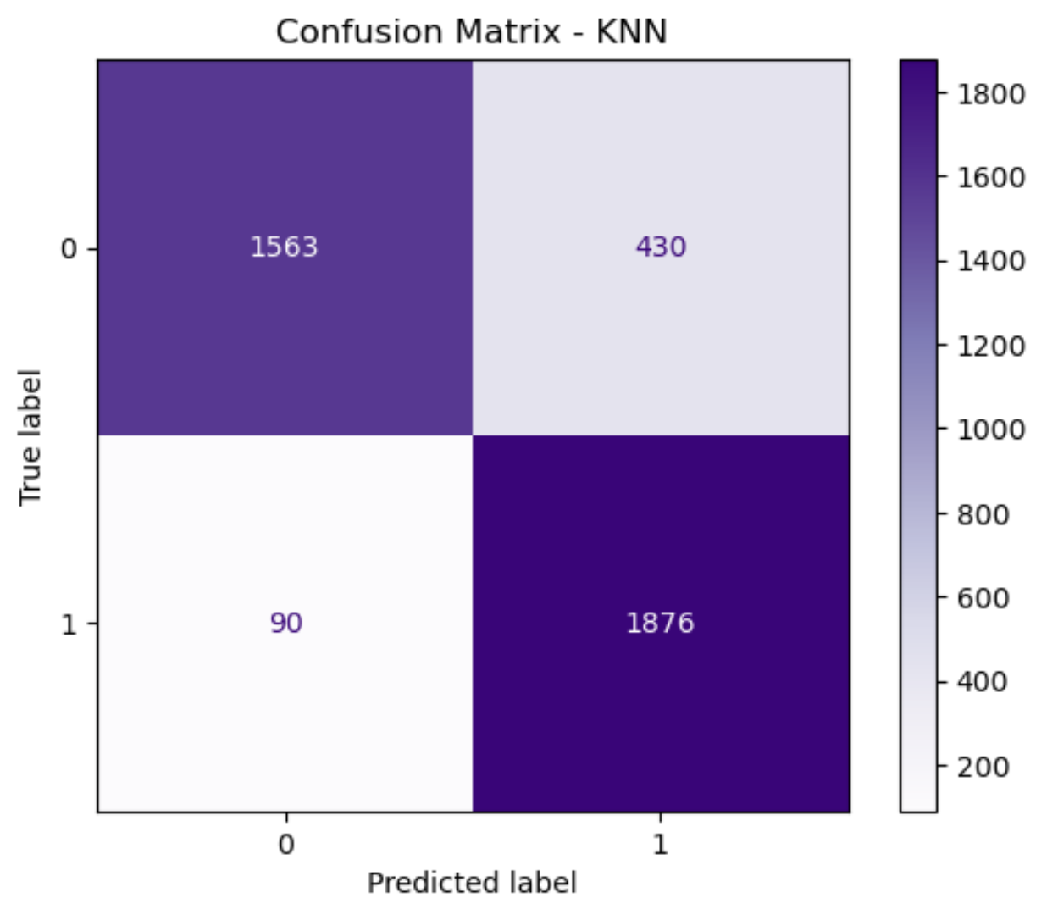
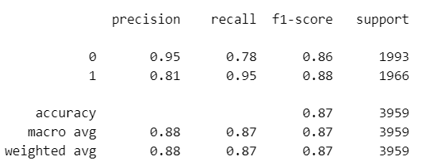
KNN-Neighbors

Slide 24
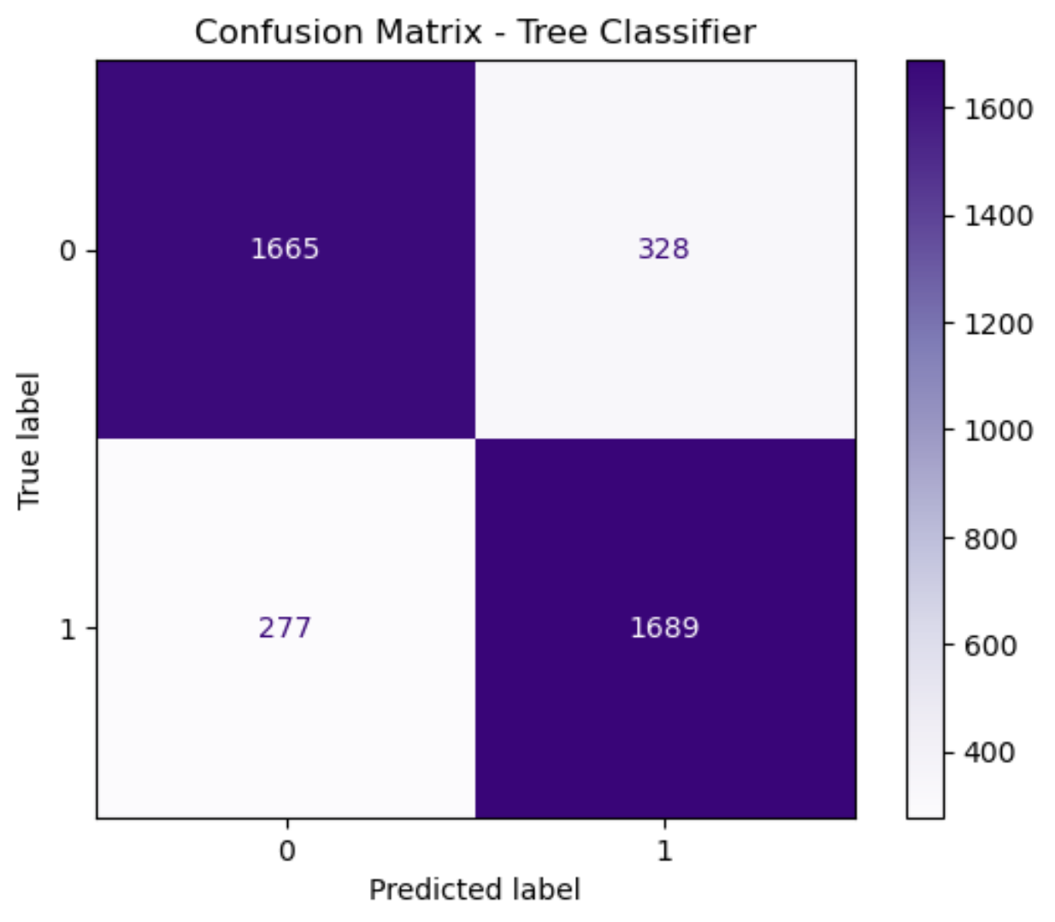
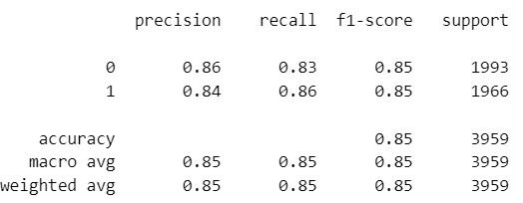
Decision tree

Slide 25
END!

