Slide 1
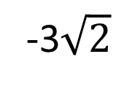
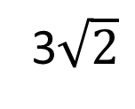
θ
3$\sqrt{2}$
r
-3$\sqrt{2}$

