Slide 1
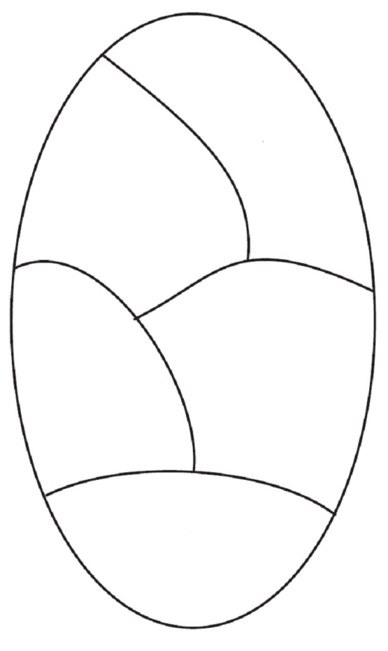
g₁K
g₁
f(g₁)
K
e'
e
f(g₂)
g₂K
g₂
Group H
Group G

