Slide 1






$$id$$
$$(AB)$$
$$(AC)$$
A
B
C
A
B
C
A
B
C
A
B
C
A
B
C
A
B
C
$$(BC)$$
$$(ABC)$$
$$(ACB)$$
A
B
C
A
B
C
A
B
C
A
B
C
A
B
C
A
B
C

Slide 2



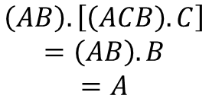




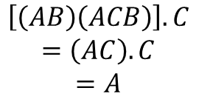






$$\left[\left(AB\right)\left(ACB\right)\right].C$$
$$=\left(AC\right).C$$
$$=A$$
$$\left(AB\right).\left[\left(ACB\right).C\right]$$
$$=\left(AB\right).B$$
$$=A$$
First, $\left(AB\right)\left(ACB\right)$:
First, $\left(ACB\right)$ acting on $C$.
$$(ACB)$$
$$(AB)$$
$$\left(ACB\right).C$$
A
B
C
A
B
C
A
B
C
A
B
C
A
B
C
Which results in:
$$\left(ACB\right).C=B$$
$$(AC)$$
Then, $\left(AB\right)$ acting on $B$:
A
B
C
A
B
C
$$\left(AB\right).B$$
A
B
C
A
B
C
Then, $\left(AC\right)$ acting on $C$:
$$\left(AC\right).C$$
$$\left(AB\right).B=A$$
A
B
C
A
B
C
The two mappings can be seen
happening one after the other
A
B
C
A
B
C
A
B
C
$$\left(AC\right).C=A$$

