Slide 1
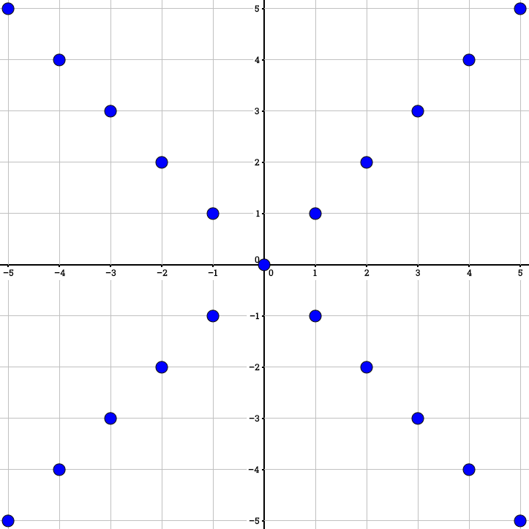
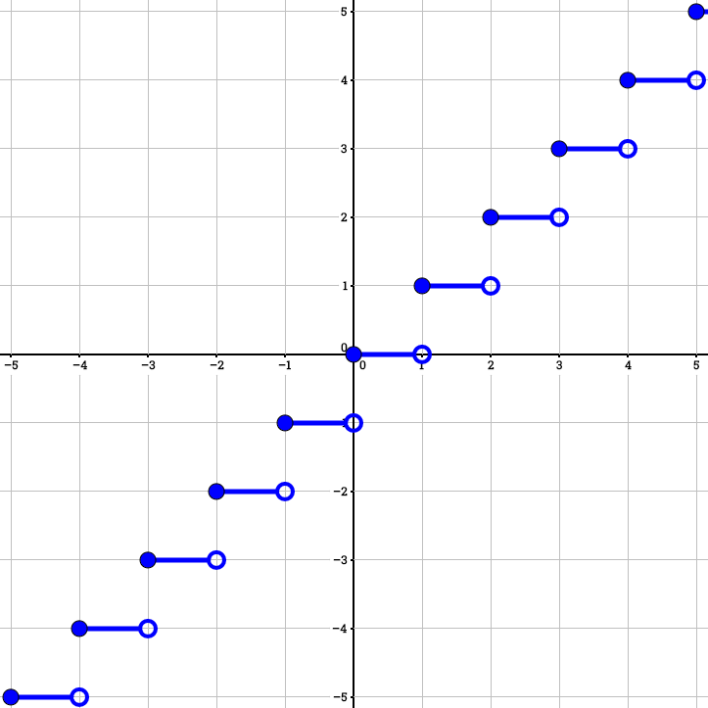
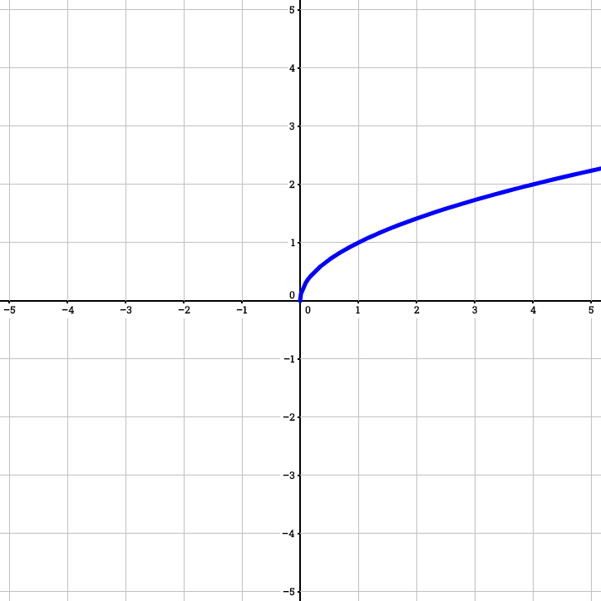





$$ℤ×ℤ$$
$$ℝ×ℤ$$
$$ℝ×ℝ$$
$$\left\{\left(x,y\right):\left|x\right|=\left|y\right| \text{and} x,y∈ℤ\right\}$$
$$y=\left\lfloor x\right\rfloor$$
$$y=\sqrt{x}$$

