Slide 1

Come As You Are
escuela de musica
Members:
Garrido Hernández Jorge
Luis Edgar Hernández Vargas
Victor Manuel Rosales Zayas
Jose Gilberto Schiaffini Corona

Slide 2

Name Of The Project
Escuela de Musica
‘Come As You Are’

Slide 3
Objective Of The Project
The main objective of the company is to have a quality learning when we talk about topics related to music and the courses we give, we are committed to teach everyone who is interested to play the musical instrument they have always wanted to play, turning That commitment in something real in the medium or long term.

Slide 4
Social Impact
The management of this project is intended for any type of population sector, without any distinction, since the courses are designed to serve any sector of the population without giving importance to the sector from which it comes.

Slide 5
Scope Of The Project
Assignment of responsibilities
Activity/Resource | Jorge | Edgar | Victor | Gilberto
Foundation | R | R | R | R
Sources | R | A | C | R
Investigation | R | CI | CI | A
Planning | C | C | R | A
Development | RA | C | C | R
Error checking | CI | R | CI | A
The scope of the present project is defined in roles assigned to the members through the use of a table of assignment of responsibilities, which will present these assigned roles in general aspects of the project.
R: Responsible / Responsable
A: Accountable / Persona a cargo
C: Consulted / Consultar
I: Informed / Informar

Slide 6
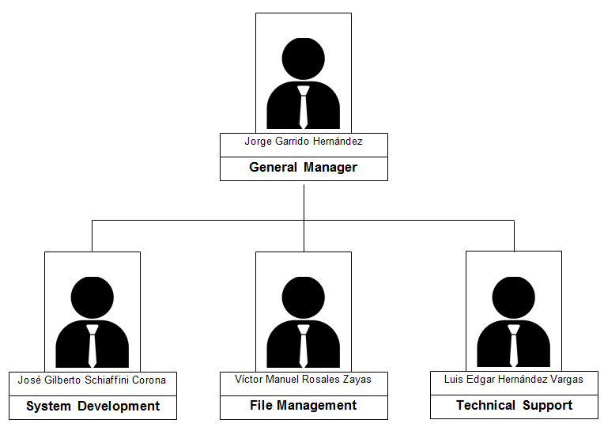
Layout
Business
Organization
Chart

Slide 7
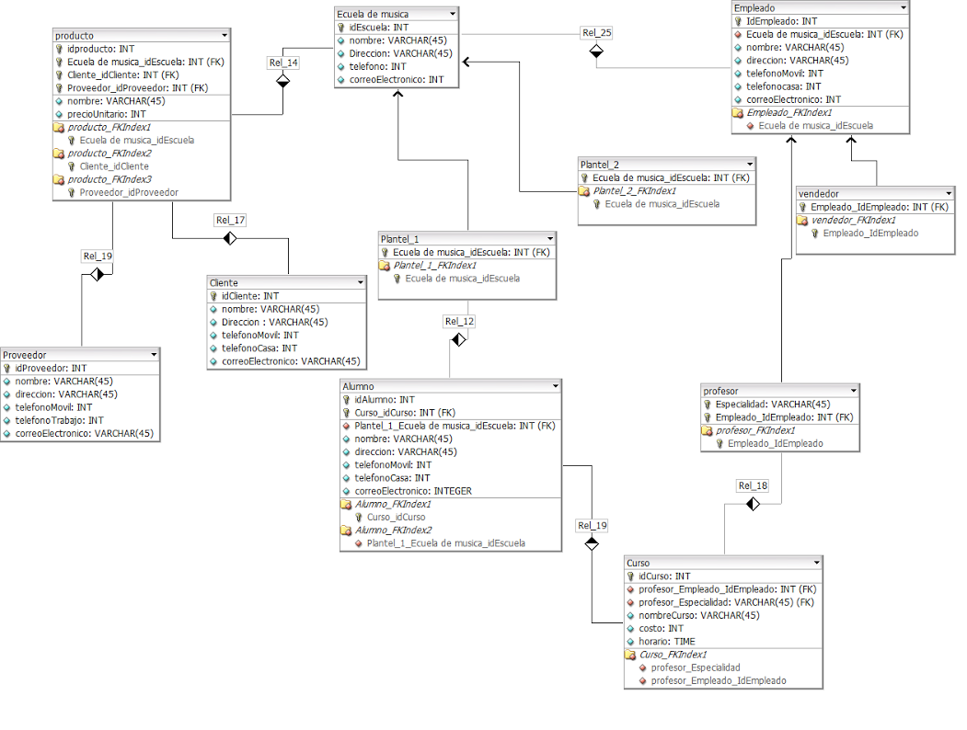
relational Model

