Slide 1
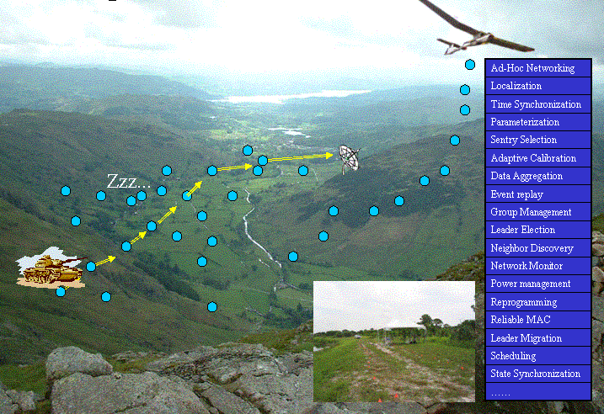
Target Detection and Tracking with Wireless Sensor Networks
Frank Rowe
John Gaetano
http://www.cs.virginia.edu/wsn/vigilnet/

Slide 2
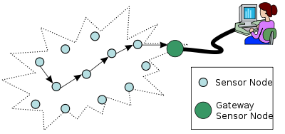

Applications
One of the most important applications involving Wireless Sensor Networks (WSNs) is target tracking.
Some applications that use WSNs for target tracking and detection are
  Battlefield Surveillance http://www.cs.virginia.edu/wsn/vigilnet/
  Disaster and Emergency Response
  Wildlife detection
  Traffic monitoring
  Border crossing detection
http://en.wikipedia.org/wiki/Sensor_network

Slide 3
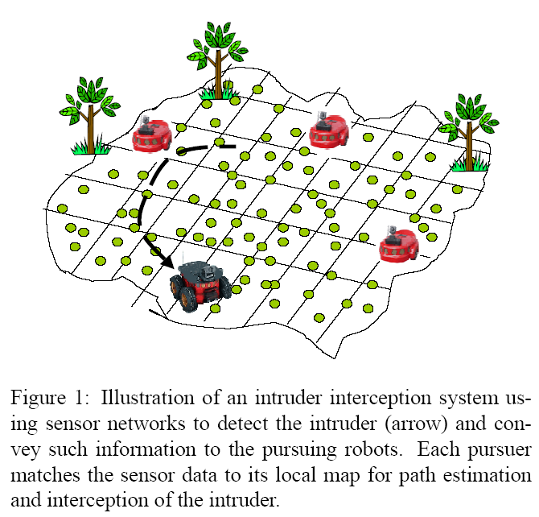
Main Goals
Real-time object tracking
Fast object detection and response
Target classification
Energy awareness

Slide 4

Impacting Factors
Number of objects to be tracked
Sampling frequency
Degree of data precision
Speed of object to be tracked
Energy available

Slide 5
Object Tracking Methods
The methods used to track objects are integral to the energy conservation of the system. An inefficient algorithm for tracking objects can cause a system to fail due to a excessive energy consumption.
Prediction Based
Tree Based

Slide 6

Schemes without Prediction
    Naïve implementation:
      All nodes active all the time
      Highest possible energy consumption
    Scheduled monitoring
      All nodes synchronized
      Report to base station at regular intervals
      Then sleep for as long as possible
      Wake up briefly to scan their surroundings
      Significant power savings over naïve model

Slide 7
Prediction Based
    Goal: save more energy!
    Increase the amount of time nodes spend sleeping
      Nodes not involved in tracking sleep until woken up
      Even nodes currently tracking spend as much time as they can sleeping
    Three components
      Prediction
      Wakeup
      Recovery
[1]

Slide 8
Prediction Models
Heuristics INSTANT
Heuristics AVERAGE
Heuristics EXP_AVG
[1]

Slide 9

Heuristic - INSTANT
Assumes object will stay at the same speed and direction.
Data from other nodes is not needed
Historical data is not needed
Energy efficient and simple
[1]

Slide 10
Heuristic - Average
Uses object's movement history to predict future speed and direction
Requires historical data from other nodes
Less energy efficient
Predictions are more accurate
[1]

Slide 11
Heuristic - EXP_AVG
More complex but superior version of AVERAGE
Assigns weights to different stages of history
Recent activity weighed higher
More energy efficient than AVERAGE
Predictions are even more accurate
5
2
1
[1]

Slide 12

Wake Up Mechanisms
Heuristics DESTINATION
  Wake up predicted destination node
  Most energy efficient, and most likely to lose the object
Heuristics ROUTE
  Additionally, wake up nodes along the direct route
  Assumes predicted direction is correct, but speed could change
Heuristics ALL_NBR
  Additionally, wake up all nodes surrounding the route
  Assumes inaccuracies in predicted speed and direction
[1]

Slide 13
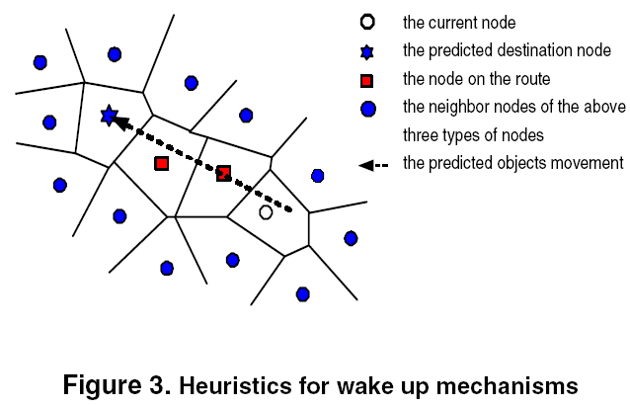
Wake Up Mechanisms
[1]

Slide 14
Recovery
  Prediction mechanisms cannot guarantee 0% miss rate
  A mechanism is needed to reacquire lost objects
  Step 1: ALL_NBR
    Wake up all nodes surrounding the predicted route
    If a node finds the object, notify the current node
    If not, use step 2
  Step 2: Flooding recovery
    Transmit recovery message to entire network
    Recovery message specifies an “activate time”
    All nodes wake up together at that time, find the object
[1]

Slide 15
Dual-Prediction
  dd
  dd
  ddd
    dd
    dd
    ddd
  dd
    dd
    dd
    d

Slide 16
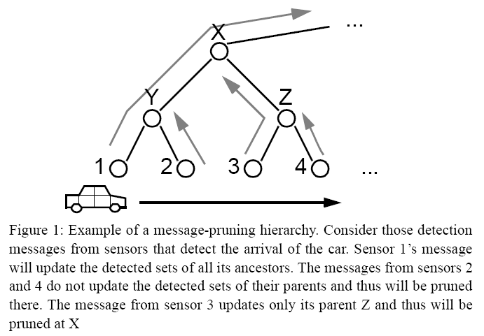

Tree Based
Large-scale movement patterns are not likely to be uniform because real-world environments usually have inherent structures that make this infeasible. [2]
STUN: Scalable Tracking Using Networked Sensors

Slide 17

Tree Based: STUN
Each leaf node is a sensor node
Each intermediate node has a detected set
Objects are registered in nodes along the path to root
As object moves, no updates are needed if the detected set remains unchanged

Slide 18
Target Classification

Slide 19
References
[1] Yingqi Xu; Winter, J.; Wang-Chien Lee, “Prediction-based strategies for energy saving in object tracking sensor networks,” Mobile Data Management, 2004. Proceedings. 2004 IEEE International Conference on Mobile Data Management (MDM’04), 2004.
[2] Kung, H.T.; Vlah, D, “Efficient location tracking using sensor networks,” Wireless Communications and Networking Conference (WCNC), 2003.
  [3] Yingqi Xu; Winter, J.; Wang-Chien Lee, “Dual prediction-based
  reporting for object tracking sensor networks,” The First Annual
  International Conference on Mobile and Ubiquitous Systems:
  Networking and Services, Aug. 22-26, 2004, pp. 154 – 163.

