Slide 1
Trabalho 2
Joice Marek e Luis Felipe de Castro

Slide 3
Ferramentas escolhidas
static analysis tool
cppcheck
Coverage
Gcov
Continuous Integration
Travis CI
Testing for performance
Gprof

Slide 4
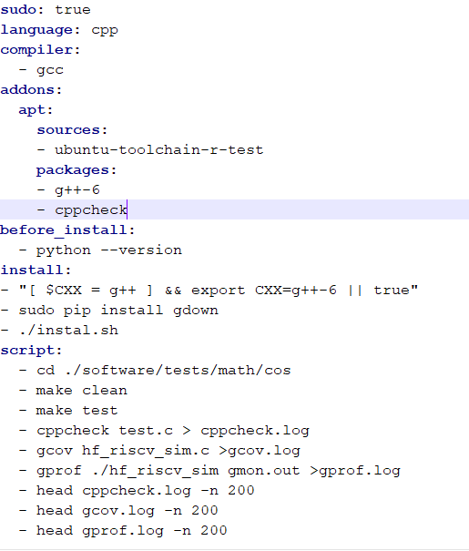
.travis.yml

Slide 5
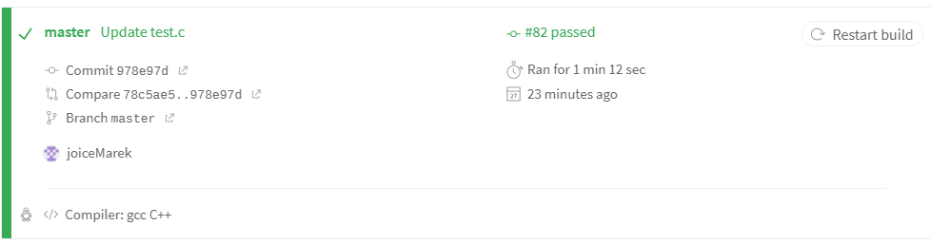
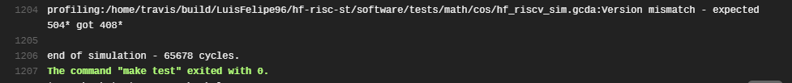
Travis - OK

Slide 6
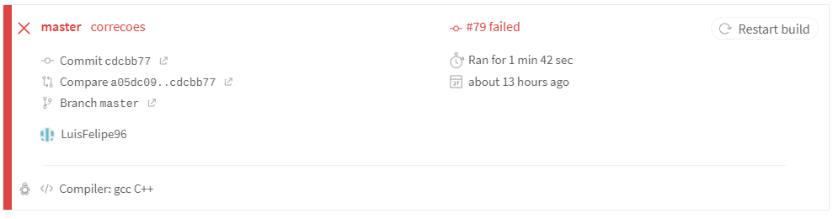
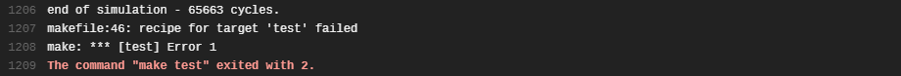
Travis - Erro

Slide 7
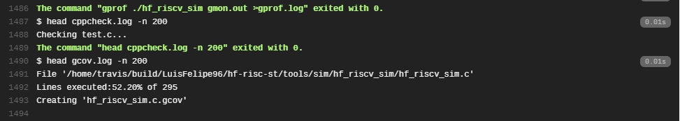
Cppcheck e Gcov

Slide 8
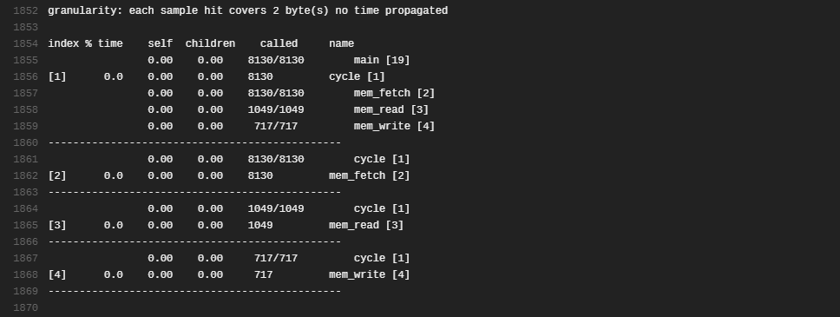
Gprof

