Slide 1
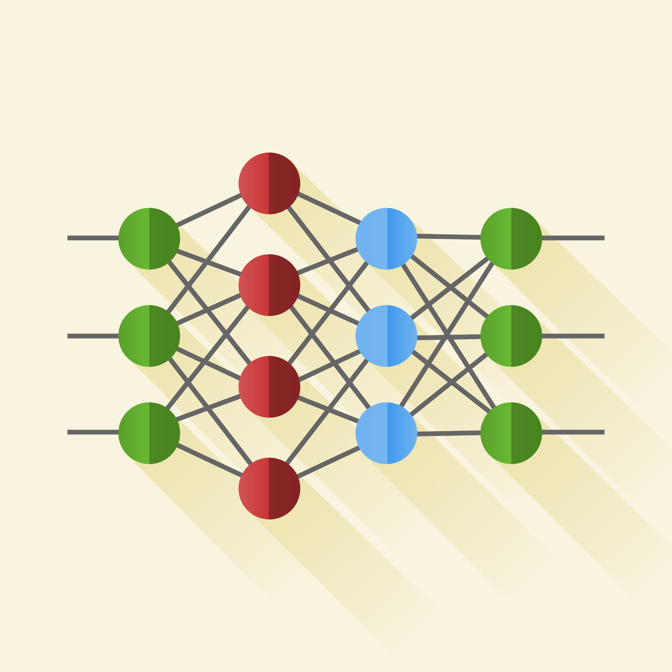
How Do Computers 'See'?
Exploring the Science Behind Image Recognition
linkedin.com/in/luis-felipe-jorge

Slide 2
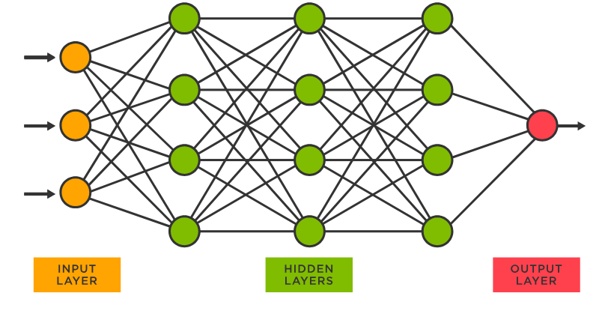
The diagram below is commonly used to represent the behavior of neural networks. Let's imagine as a thought exercise that our network aims to predict whether it will rain tomorrow
Input Layer
Hidden Layers
Output Layer
Where does the insertion of data related to the analyzed problem occur?
In our example:
temperature, humidity, presence of rain in previous days...
Intermediate layers, where the process of learning patterns from the data occurs.
A bit more math for the purpose of this post
Output layer, where the model provides a response to the problem.
In our case, whether it will rain or not
linkedin.com/in/luis-felipe-jorge

Slide 3
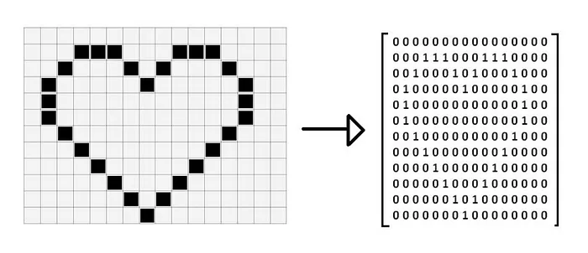
Although the previous representation serves educational purposes to describe the basic structure of a neural network, it is not sufficient to present more complex learning structures, such as those used in image processing, when the goal is, for example, to Classify / Recognize figures
Binary Pixel Art by The University of Utah
An image is typically represented as a matrix of pixels, which is a grid where each square contains the color information of the image. We could represent white as 0 and black as 1
linkedin.com/in/luis-felipe-jorge

Slide 4
6J7
0
0
0
1
1
0
0
0
0
1
1
1
0
The traditional structure of a neural network does not offer scalability. In it, each neuron is directly connected to neurons in the immediately preceding and following layers.
A common low-resolution representation is 32x32 pixels, meaning a single image would be an input of 1,024 values.
Each connection represents a new set of calculations, making the learning process more costly.
Now, extrapolate this to a database with thousands of modern images with much higher resolutions!
. . .
In summary, the matrix is a list of "0"s and "1"s
.
.
.
.
.
.
linkedin.com/in/luis-felipe-jorge

Slide 5
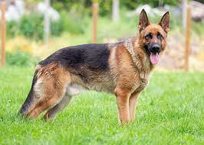
To make image processing feasible in neural networks, a technique called "convolution" was applied, which takes advantage of the correlation between pixels. That is, neighboring pixels in an image tend to have similar colors
linkedin.com/in/luis-felipe-jorge

Slide 6
Convolution is the application of a "filter," a matrix of smaller dimensions than the original image, which moves over regions of the image and performs mathematical operations on groups of pixels. Each group is summarized into a numerical value (max, average, etc.), a process called pooling. In other words, this technique allows for the reduction of an image's dimensions without losing relevant information, such as edges, textures, and other patterns, for the training process
Imagem Original
Nova matriz gerada após a convolução
Art by The WikiMedia
linkedin.com/in/luis-felipe-jorge

Slide 7
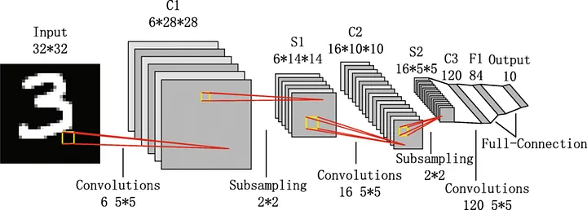
Here's an example of the structure of a real convolutional neural network (LeNet), where we can see successive sampling and convolution operations to reduce the dimensionality of the data and enable the problem to be tackled with the usual implementation of a neural network
Onde se implementa a estrutura “usual” das redes neurais
Art by The Medium
linkedin.com/in/luis-felipe-jorge

