Slide 1

Bioinformatics Algorithms Project proposal
Luís Fonseca 45125
Teacher:
Prof. Cátia vaz
24/03/2024

Slide 2
Index
Problem
Motivation
Techologies
EnteroBase
Example with python
Timeline
Future work

Slide 3
Problem
Giving a database(example: EnteroBase, PubMSLT) with a dataset provided, use different bioinformatics algorithms and compare results.
Tree algorithms,
Metrics algorithms.
Discover which one presents the best results, by doing analysis of each of the different algorithms.

Slide 4
Motivation
The desire to discover and learn more about the field of bioinformatics, its uses in different aspects
It is an area that is growing. However, from my knowledge, it is not often discussed or mentioned

Slide 5




Technologies
Pycharm
EnteroBase
Jupyter Notebook
Star UML

Slide 6
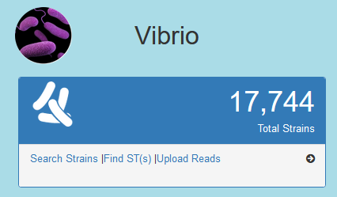
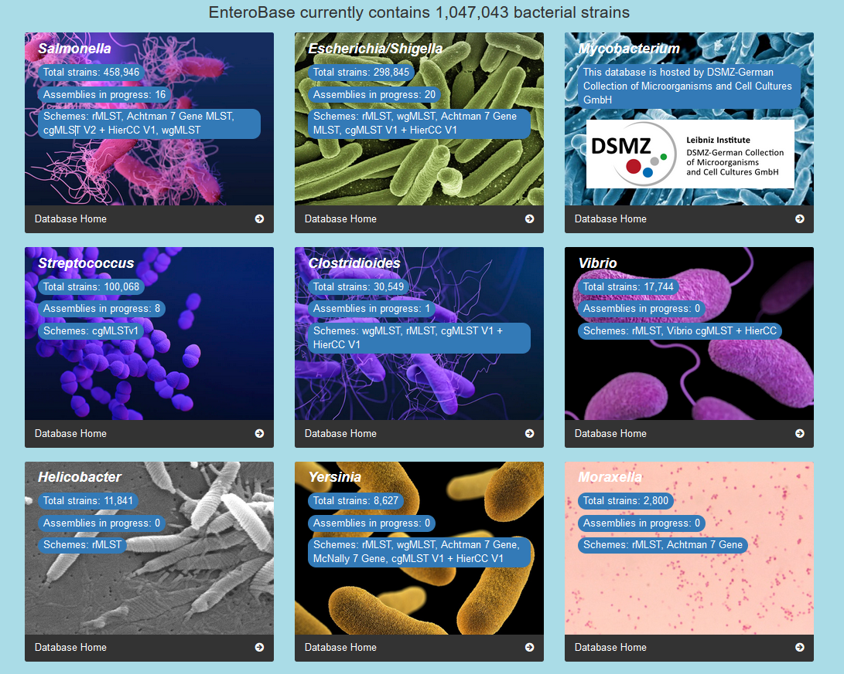
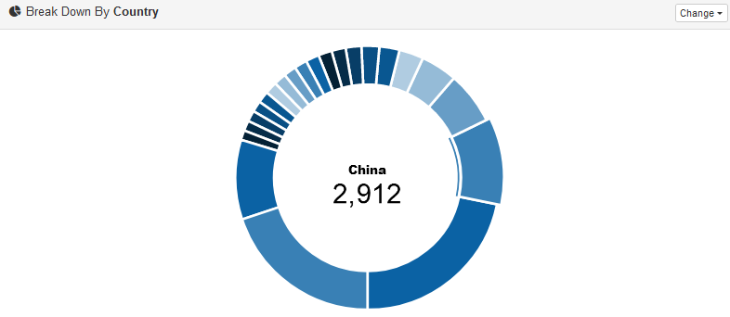
EnteroBase
Analyzing and visualizing genomic variation within enteric bacteria

Slide 7
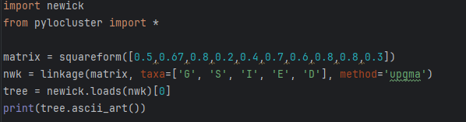
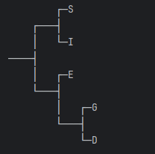
With python…
Using the Pylocluster library with the Newick package, we obtain the following example

Slide 8
Timeline

Slide 9
Future Work
Include More Detailed Analysis of Bioinformatics Algorithms
Sequence alignment (Smith-Waterman, Needleman-Wunsch),
Sequence assembly (Bruijn graphs, overlap-layout-consensus),
Phylogenetic analysis (maximum likelihood).
Comparative Genomics of Bacteria
Conduct a comparative genomics study to compare genetic variations among different bacterial strains.

Slide 10
Questions?

