Slide 1

Destroy
Luís Fonseca 45125
Teacher:
Prof. Cátia vaz
17/03/2024

Slide 2
Index

Slide 3
Motivation
We

Slide 4
Problems

Slide 5

Technologies
Star UML

Slide 6
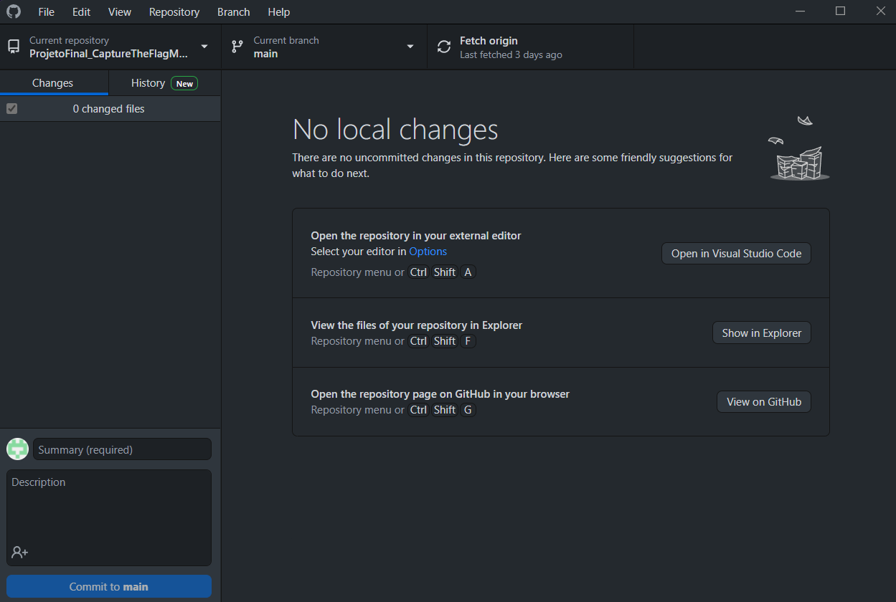
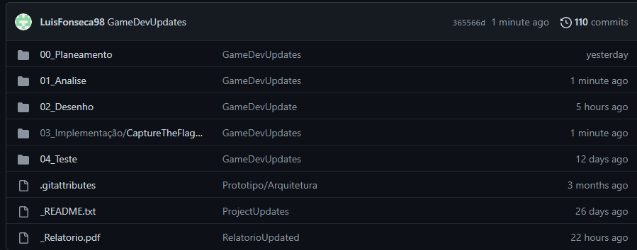
Version Control

Slide 7
Timeline

Slide 8
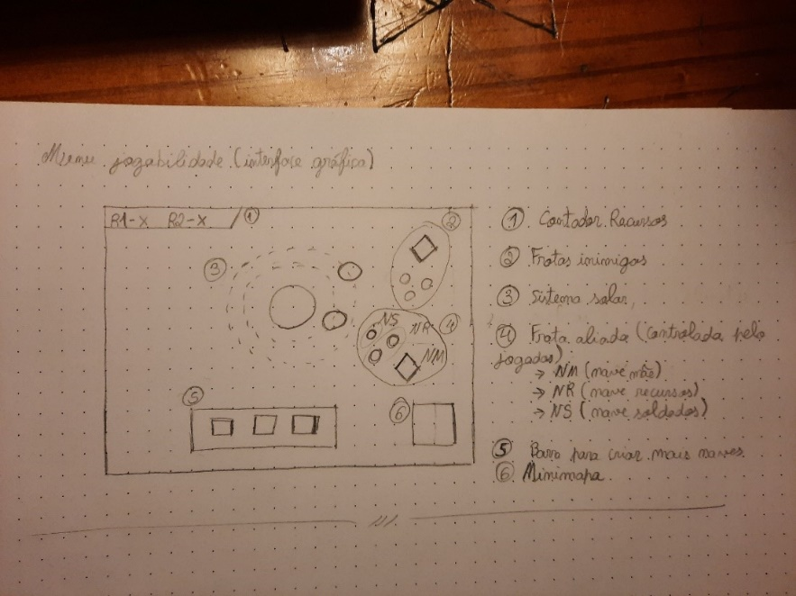
Future Work
Adding a second game mode (arcade mode)
Add more levels
Improve map design
Mock-Up

Slide 9
Questions?

