Slide 1

Capture the flag: Mastermind Galaxy Afar: A Journey to the Unknown
Paulo Jorge 45121
Luís Fonseca 45125
Advisors:
Prof. Diogo Lopes
Prof. Hélder Bastos
PRJ #08
06/04/2022

Slide 2
Motivation
We both enjoy playing video games and, as future developers, we also have to consider the rapid growth of the gaming market
What we learned in the subject AAV
Strategy games, specially when competitive, can be quite fun

Slide 3
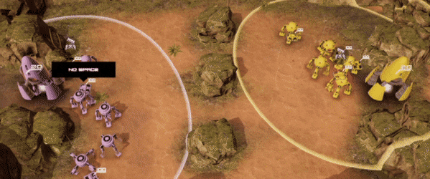
Rules
Each side starts with a mothership and a number of battleships (depending on the level)
There can be obstacles, like rocks or space debris
Every 60 seconds a portal will spawn a random ship (except for a mothership)
There are 3 types of battleships:
A Mothership
A Hunter ship
A Light ship
The battle ends when one of the motherships is destroyed or if the battle time reaches 6 minutes
If the player fails to destroy the enemy mothership within the 6 minutes, it counts as a loss
Imagina figurativa

Slide 4


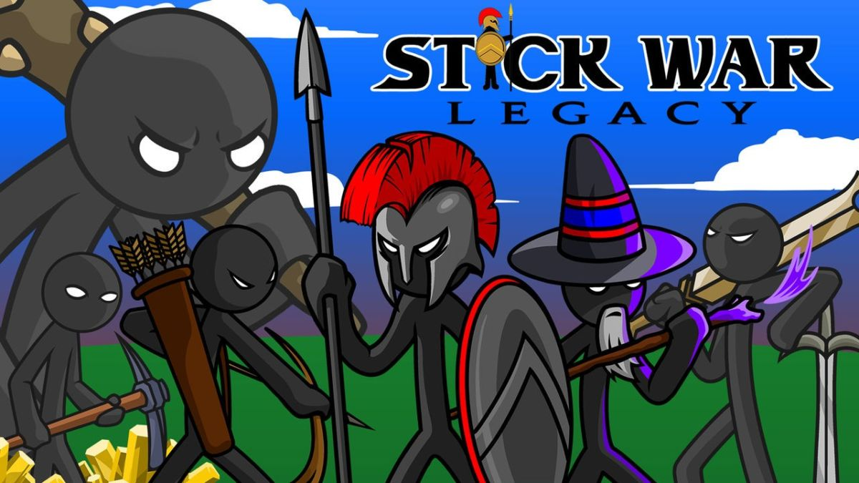
Inspiration
Command &Conquer Rivals
Stellaris
Stick War Legacy

Slide 5
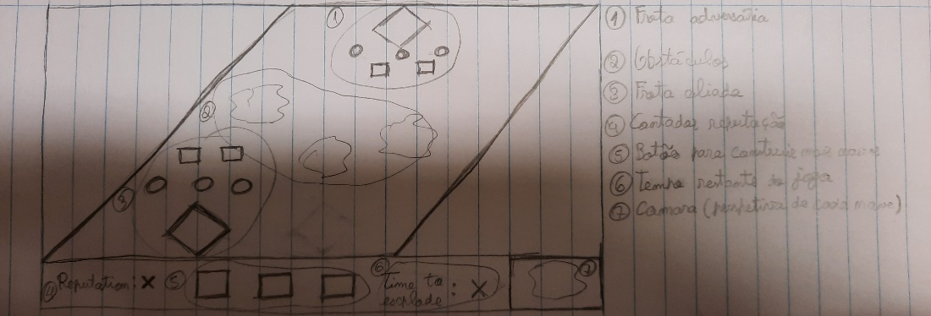
HUD (Heads Up Display)
Reputation counter
Button to build more battleships
Enemies' health bars
Allies' health bars
Window with the attributes from the selected ship
Circle below the selected battleship(s)
Battleships POV
HUD mock up

Slide 6
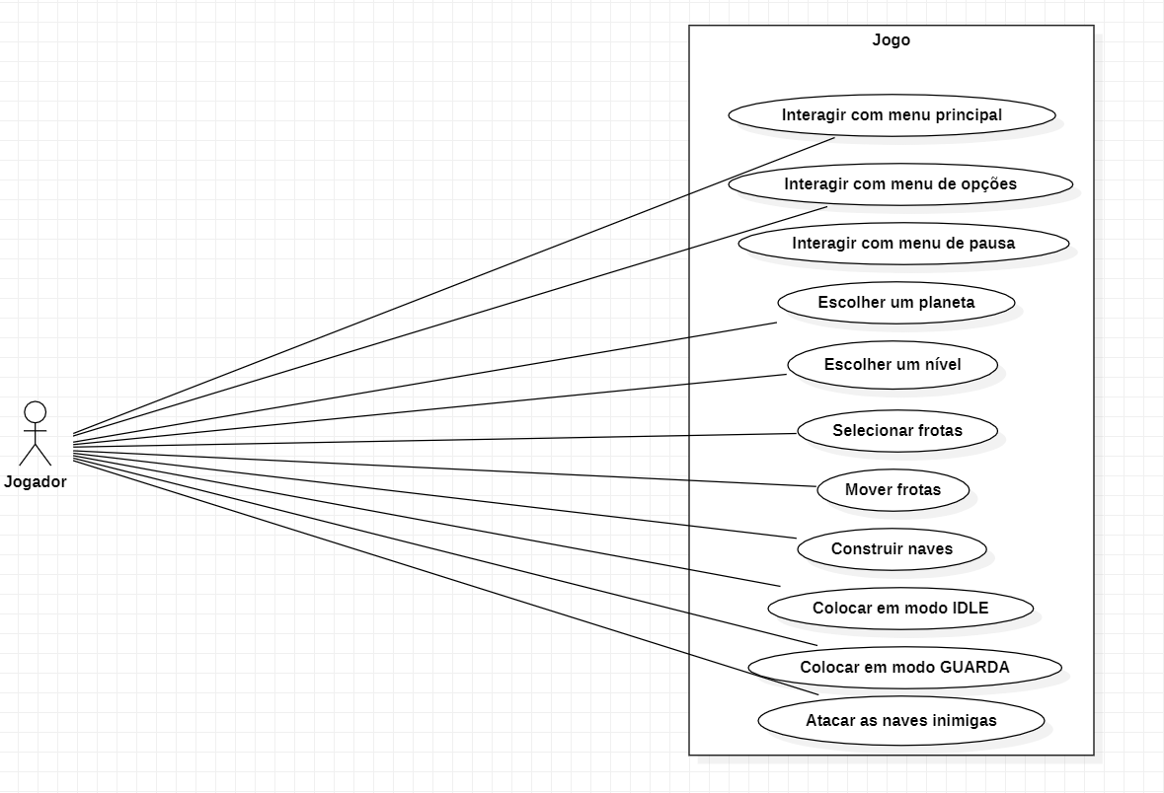
Use Cases

Slide 7


Technologies Employed
Unity
Adobe Photoshop

Slide 8
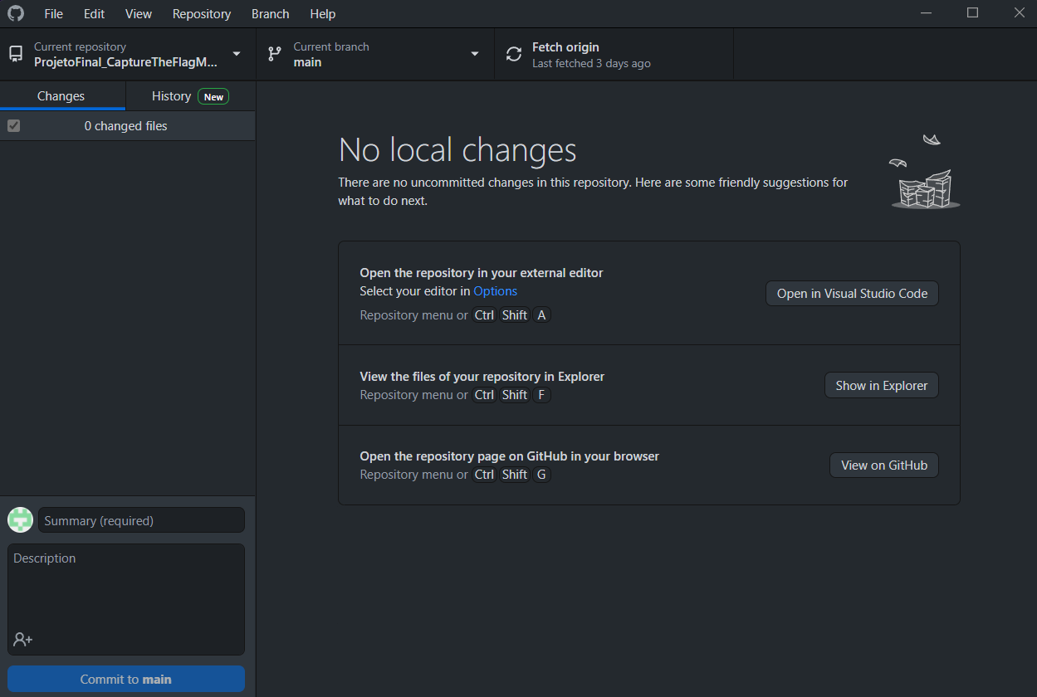
Version Control
To do the version control we used GitHub
We had to install the extension Git LFS (Large File Storage), since Unity files are very heavy
In order to ignore the files that don't have to be committed we also used Git Ignore

Slide 9
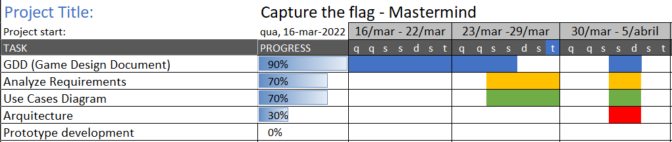
Timeline

Slide 10
Questions?

