Slide 1

Senior Data Analyst ClearCover
Data analysis demo

Slide 2
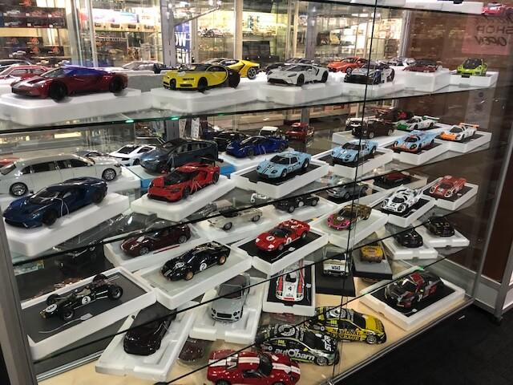


Architecture for this demo:
Scale collectible cars store

Slide 3

Ideal architecture:
ETL / ELT
Scale collectible cars store

Slide 4
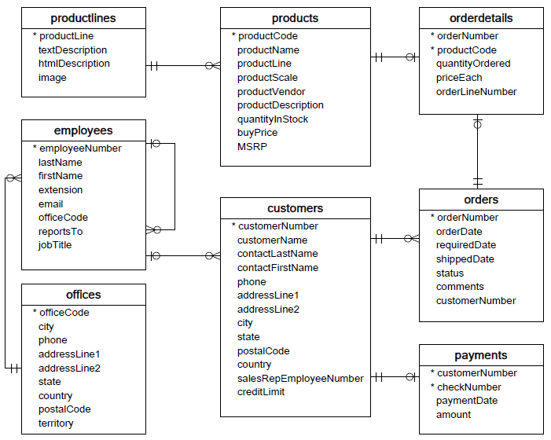
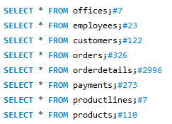
1. Research phase

Slide 5
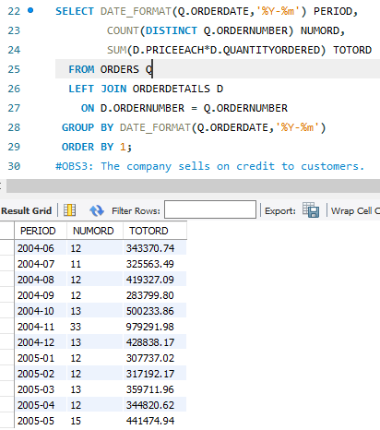
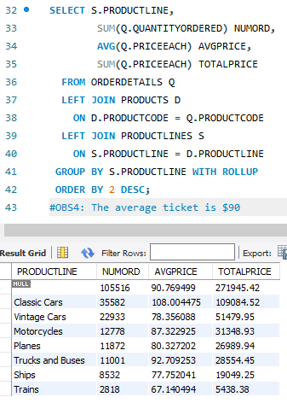
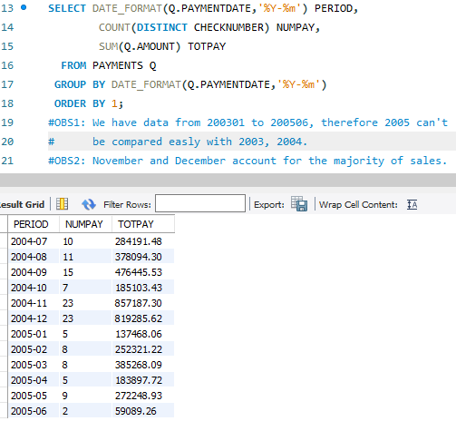
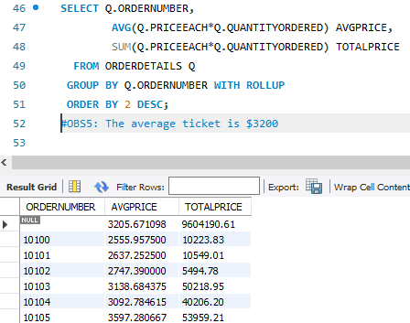
1. Research phase

Slide 6
1. Research phase
Data Scope: We have data from 200301 to 200506, therefore 2005 can't be compared easily with 2003, 2004.
Payment Behaviour: November and December account for the majority of payments.
Sells modality: The company sells on credit to customers.
KPIs:
Average ticket is 3200$. (Order)
Average item price is 90$. (Item)

Slide 7
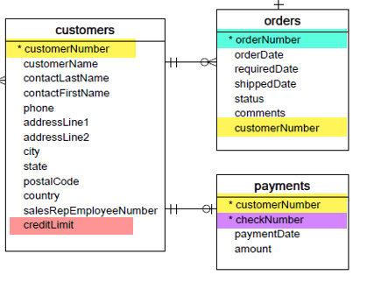
2. Quality Phase
Data clean: Not required.
Data consistency / coherence: We have no relation between orders and payments, this will limit the analysis.

Slide 8
3. DashBoards in PowerBI
Overview of principals KPIs.
Payments.
Orders.
Orders.
State.
Evolution.
Top Seller.

Slide 9
Go to Dash Board

Slide 10
Thanks
https://github.com/LuisGarcia206/PoC3

