Slide 1

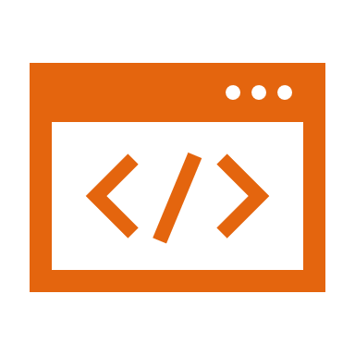
Software development Life cycle
Luis Gerardo Camara Salinas

Slide 2

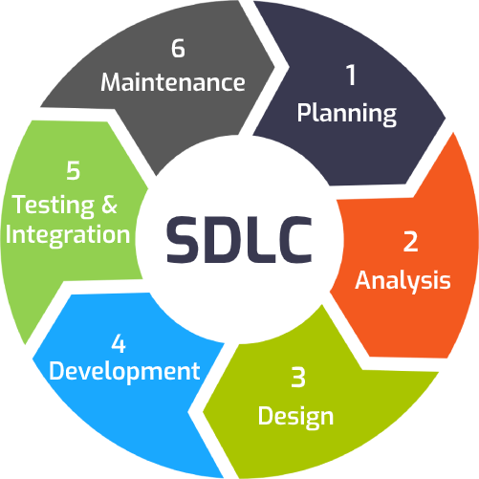
Software development Life cycle
Objective: Provide a predictable framework of procedures designed to identify all requirements about functionality, cost, reliability, and delivery schedule and ensure that each are met in the final solution.

Slide 3



Software development Life cycle
Planning
Determine whether information involved in the project requires protection,
Any information that is handled by the application needs a value assigned by its owner
Define the scope
Determine solutions
Cost
Time

Slide 4
Software development Life cycle
Analysis
Requirements could be derived from a variety of sources such as evaluating competitor products for a commercial product to surveying the needs of users for an internal solution. In some cases these requirements could come from a direct request from a current customer.
Information is collected from the customer
Software Requirement Specification document (SRS)
Purpose of the product.
Meetings

Slide 5
Software development Life cycle
Design
In this process question like how the software will satisfy all functional and security goals.
internal behavior and operations
Software to specific requirements
Hardware

Slide 6
Software development Life cycle
Development
Implementation/Coding starts once the developer gets the Design document. The Software design is translated into source code. All the components of the software are implemented in this phase. The Develop phase involves writing the code or instructions that make the software work.
Research and Study
Tickets
Start of production / Coding

Slide 7
Software development Life cycle
Testing & Integration/Deployment
In the Test/Validate phase, several types of testing should occur, including ways to identify both functional errors and security issues. Once the product is tested, it is deployed in the production environment
Software is tested thoroughly and any defects found are assigned to developers to get them fixed.kets
Retesting, regression testing is done until the point at which the software is as per the customer’s expectation.

Slide 8
Software development Life cycle
Maintenance
After the deployment of a product on the production environment, maintenance of the product i.e. if any issue comes up and needs to be fixed or any enhancement is to be done is taken care by the developers.

Slide 9

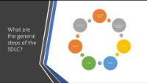
videos

Slide 10
References
https://www.innovativearchitects.com/KnowledgeCenter/basic-IT-systems/system-development-life-cycle.aspx
https://www.softwaretestinghelp.com/software-development-life-cycle-sdlc/
Chapter 8. Software Development Security
Chapter 10. The Software Life Cycle

Slide 11
Software development models PART I
Luis Gerardo Camara Salinas

Slide 12
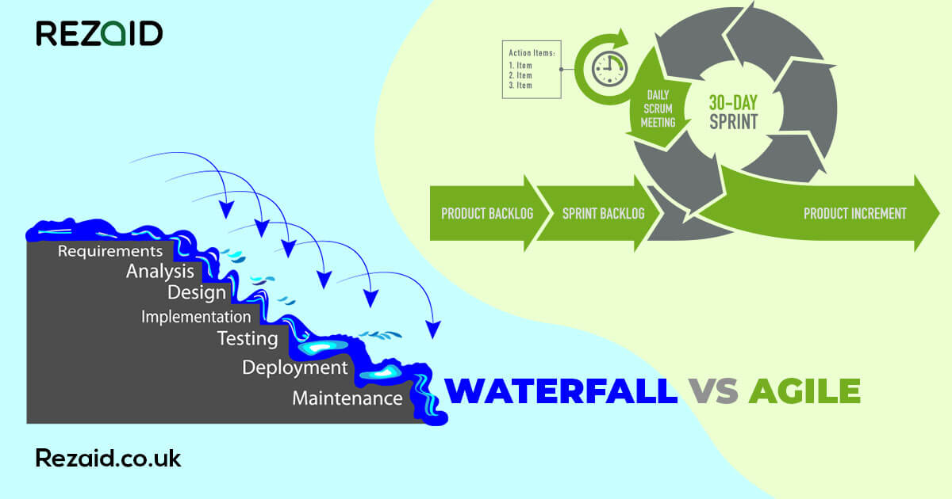
Software development models PART I
In every project, you need requirements, design, testing, deployment, and maintenance.
Exactly how you handle those tasks can vary depending on the scope of the project.
Luis Gerardo Camara Salinas

Slide 13
Software development models PART I
Agile methods allow a project’s goals to change over time to track changing customer needs
Test-driven development forces programmers to write tests for their code.
Each model has its own philosophy, set of rules, and lists of important principles.
.
Luis Gerardo Camara Salinas

Slide 14
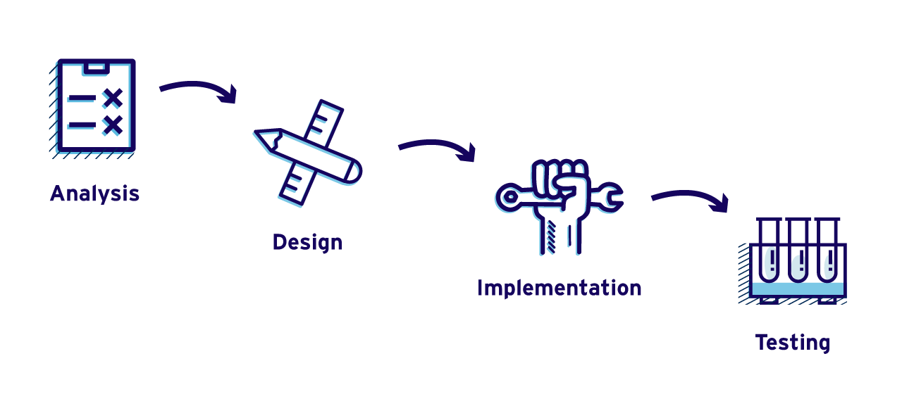
Software development models PART I
Objetive: “what actually matters is whether you produce high-quality software reasonably close to on time and within your budget. A lot of development models use clever techniques.”
.
Luis Gerardo Camara Salinas

Slide 15
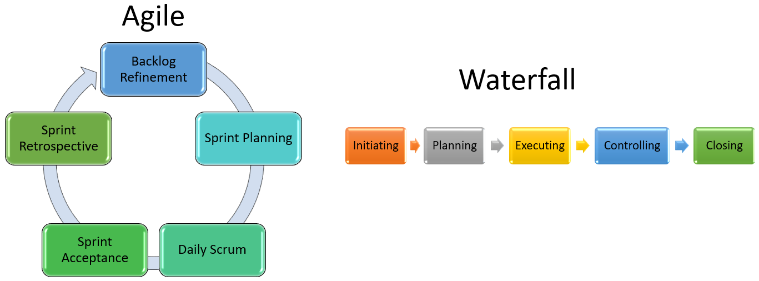
Software development models PART I
KIND OF DEVELOPMENT MODELS
Predictive.
Adaptive.
You use the requirements to design the system, and you use the design as a blueprint to write the code.
Luis Gerardo Camara Salinas

Slide 16

Software development models
Predictive Model
You test the code, have customers sign off saying it really does what the specification says it should, and then pop the champagne.
Experience
Predict
Luis Gerardo Camara Salinas

Slide 17

Software development models
Adactive Model
Adaptive development model enables you to change the project’s goals if necessary, during development.
An adaptive model lets you periodically reevaluate and decide whether you need to change direction.
The adaptive model just gives you chances to fine-tune the project if necessary.
Luis Gerardo Camara Salinas

Slide 18

Software development models
Adactive Model analogy example
TV detective show
Your goal is to find the killer.
interview witnesses, check cell phone records
you don’t know exactly where the case will lead.
You follow the first clue, and it leads to a second…
Each time you find a new clue, you update the direction of the investigation
Luis Gerardo Camara Salinas

Slide 19
Software development models
Predictive Model Success Indicators
User involvement
Clear vision: If the customers and developers have the same clear vision about the project’s goals, development will stay on track.
Limited size: A small size helps the customers and team members see the whole picture all at once. Requirements won’t have time to change.
Luis Gerardo Camara Salinas

Slide 20

Software development models
Predictive Model Success Indicators
Experienced team
Realistic
Established technology
Luis Gerardo Camara Salinas

Slide 21
Software development models
Advantages and Disadvantages to predictive models.
Better documentation
Stability
Fix bugs early
Inflexible
Later initial release
Big Design Up Front: You need to define everything up front. You can’t start development until you know everything you’re going to need to do.
Luis Gerardo Camara Salinas

Slide 22
Software development models
Consideration in order to use a predictive models.
The most “pure” predictive models assume that each stage of development is finished completely and correctly before the next stage begins.
One of the biggest ideas of BDUF projects is that the time spent on design up-front saves you time later in the project.
Luis Gerardo Camara Salinas

Slide 23
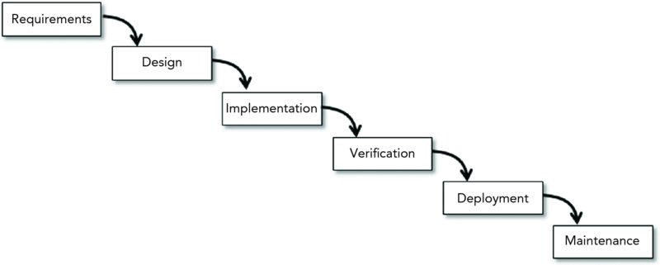
Software development models
WATERFALL MODEL.
Waterfall is the plain vanilla of the predictive model world. It assumes that you finish each step completely and thoroughly before you move on to the next step.
Luis Gerardo Camara Salinas

Slide 24
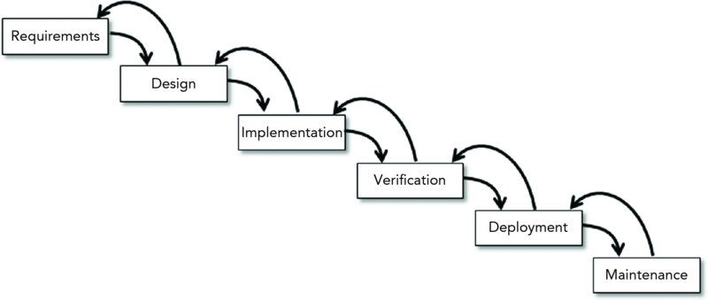
Software development models
WATERFALL WITH FEEDBACK.
The waterfall with feedback variation enables you to move backward from one step to the previous step..
Luis Gerardo Camara Salinas

Slide 25
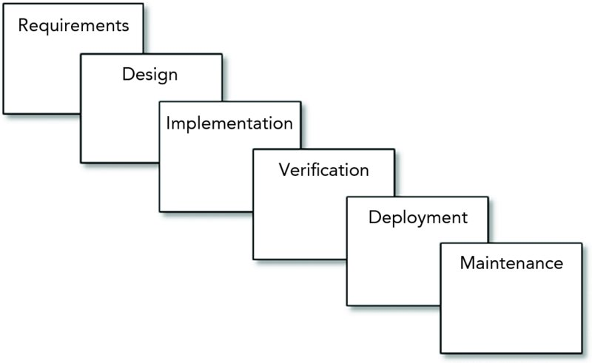
Software development models
SASHIMI MODEL
Sashimi (also called sashimi waterfall and waterfall with overlapping phases) is similar to the waterfall model except the steps are allowed to overlap.
Luis Gerardo Camara Salinas

Slide 26
Software development models
SASHIMI MODEL
In a project’s first phase, some requirements will be defined while you’re still working on others.
You could have people working on requirements, design, implementation, and testing all at the same time.
Luis Gerardo Camara Salinas

Slide 27
Software development models
SASHIMI Advantages
People with different skills can focus on their specialties without waiting for others.
It lets you perform a spike or deep dive into a particular topic to learn more about it.
You can refine the requirements.
If you discover during design that the requirements are impossible or need alterations, you can make the necessary changes.
Luis Gerardo Camara Salinas

Slide 28
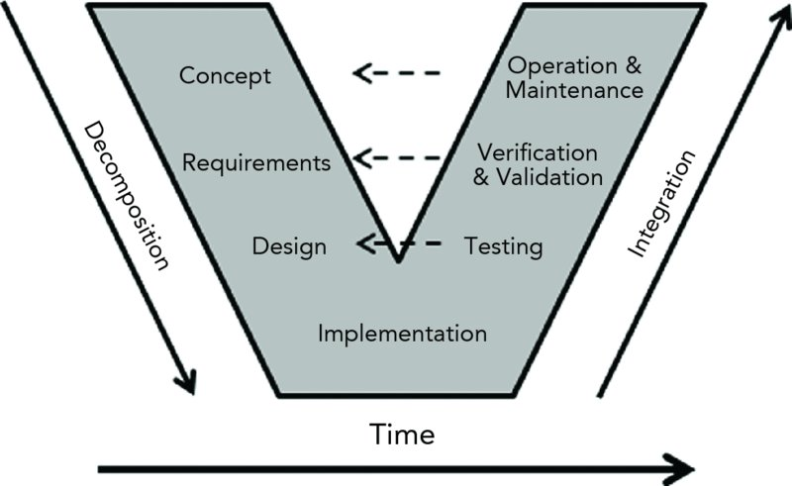
Software development models
V-MODEL
V-model is basically a waterfall that’s been bent into a V shape
Each of the tasks on the left corresponds to a task on the right with a similar level of abstraction.
Luis Gerardo Camara Salinas

Slide 29
Software development models
Iterative models
Predictive software development has some big advantages. It’s predictable, encourages a lot of up-front design (hence the nickname big design up front or BDUF)
Luis Gerardo Camara Salinas

Slide 30
Software development models
Iterative models
Iterative models address those problems by building the application incrementally. They start by building the smallest program that is reasonably useful. Then they use a series of increments to add more features to the program until it’s finished (if it is ever finished).
Luis Gerardo Camara Salinas

Slide 31
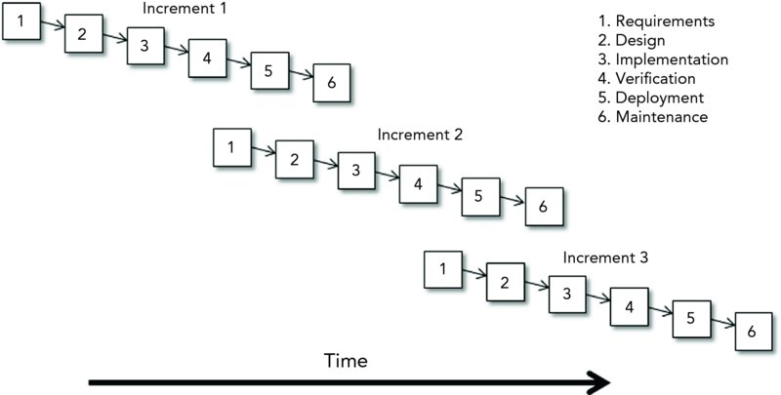
Software development models
Iterative models
Luis Gerardo Camara Salinas

Slide 32
Software development models
Iterative models
Iterative models address those problems by building the application incrementally. They start by building the smallest program that is reasonably useful. Then they use a series of increments to add more features to the program until it’s finished (if it is ever finished).
Each increment has a relatively small duration (compared to a predictive project)
Iterative models also handle fuzzy requirements reasonably well. If you’re unsure of some of the application’s requirements, you can start building the parts you do understand and figure out the rest later.
Luis Gerardo Camara Salinas

Slide 33
Software development models
Iterative models
Luis Gerardo Camara Salinas

Slide 34
Software development models
Iterative models (Prototypes)
Throwaway prototype: You use the prototype to study some aspect of the system and then you throw it away and write code from scratch.
Evolutionary prototype: the prototype demonstrates some of the application’s features. As the project progresses, you refine those features and add new ones until the prototype morphs into the finished application.
Incremental prototyping: You build a collection of prototypes of that separately demonstrate the finished application’s features and joint it. (you need to use good programming techniques for all the prototypes.)
Luis Gerardo Camara Salinas

Slide 35
Software development models
Iterative models (Prototypes)
Improved requirements: allow customers to see the app and them feedback.
Common vision: Custumers and Dev.
Better design
Luis Gerardo Camara Salinas

Slide 36
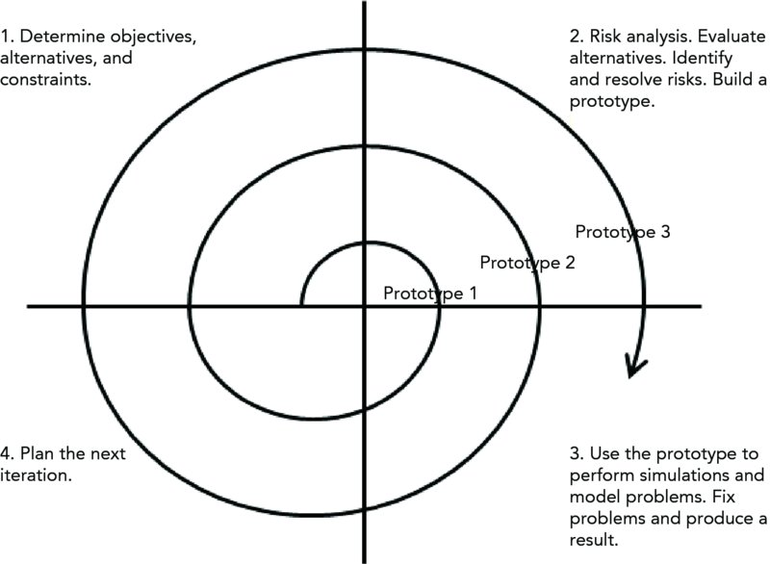
Software development models
Iterative models (SPIRAL)
If you don’t understand all the requirements, then you might use an iterative approach for developing them.
Luis Gerardo Camara Salinas

Slide 37
Software development models
Iterative models (SPIRAL)
Phases in Spiral Model
1-. Planning Phase
2-. Risk analysis phase.
3-. Engineering phase.
4-. Evaluation phase.
Luis Gerardo Camara Salinas

Slide 38
Programming session 1
Variables
Variables are used to store data in JavaScript, such as numbers and text values. The name of a variable is called an identifier, and it must conform to certain naming rules. A variable can be declared using the var, let or const keyword.
Global variables exist outside any function while local variables are defined inside a particular function.
Variable hoisting allows accessing a variable before it is declared in code, but a hoisted variable returns the value of undefined.
Luis Gerardo Camara Salinas

Slide 39
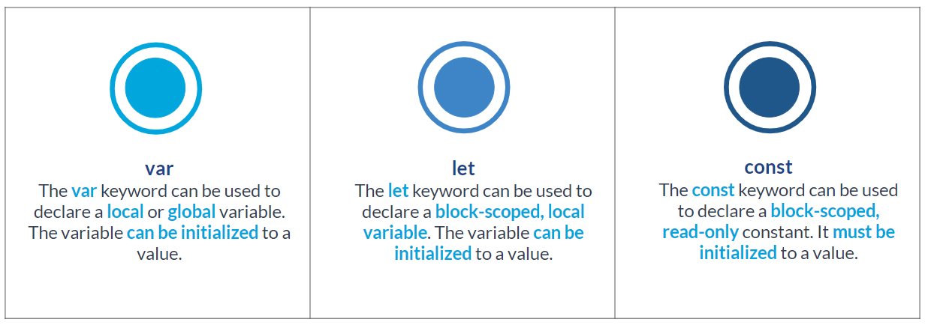
Programming session 1
Variables
Luis Gerardo Camara Salinas

Slide 40
Programming session 1
Coding…
Luis Gerardo Camara Salinas

Slide 41
Programming session 1
Data Types
A variable can be declared and initialized using one of the eight data types.
Number: Number is a primitive data type allows storing an integer or floating point number.
String: String is a primitive data type that allows storing a sequence of characters that represent a text value.
BigInt: BigInt is a primitive data type allows storing an integer with arbitrary precision format.
Object: The Object data type can be used to store keyed collections of data items and complex entities.
Symbol: Symbol is a primitive data type that can be used to define unique and immutable values.
Undefined: The undefined keyword represents a primitive value that is not defined. It is auto-assigned to a variable that has been declared but not initialized.
Null: The null keyword represents any null value. It is a case-sensitive and primitive value.
Boolean: Boolean is a primitive data type that allows storing the value of true or false.
Luis Gerardo Camara Salinas

Slide 42
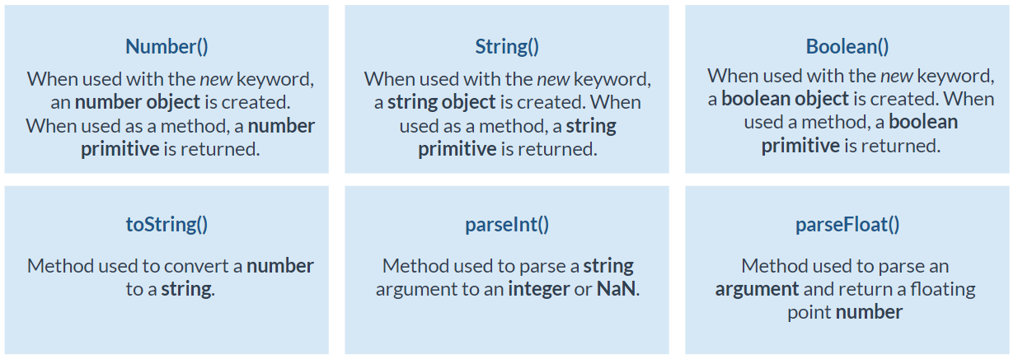
Programming session 1
Typecasting
variable of one data type can be explicitly converted to another data type which is called typecasting. The following methods can be used.
Luis Gerardo Camara Salinas

Slide 43
Programming session 1
Coding…
Luis Gerardo Camara Salinas

