Slide 1
Luis Krötz
Formado em Sistemas para Internet
Front End Developer (transainc)
Performance na Web

Slide 2



Alguns projetos em que trabalho
Melissa
https://www.melissa.com.br/
Coza
https://www.coza.com.br
Universo do Couro http://www.cicb.org.br/cicb
Forum CICB Sustentabilidade: http://forumcicb.cicb.org.br/
Muda
http://transainc.com/muda
SageWeb
http://177.37.54.153
Visionários da cidade http://visionariosdacidade.com.br

Slide 3
O que é performance ?

Slide 4
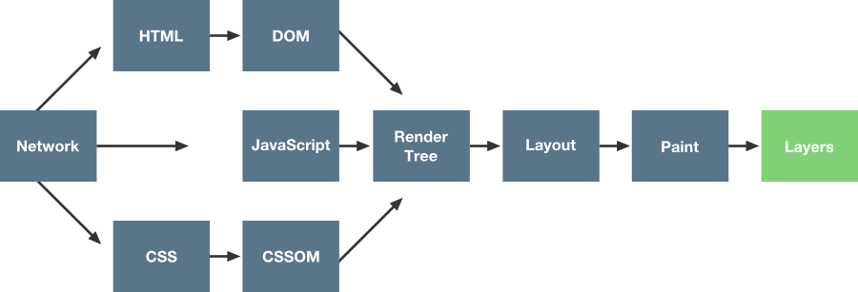
Network/Render

Slide 5
Como melhorar a performance?

Slide 6
Que
tal praticar ?
https://github.com/LuisKrotz/performance-presentation

Slide 7
Muito Obrigado :)
https://github.com/LuisKrotz
https://www.linkedin.com/in/luis-krotz-9a712482

Slide 8
Links Uteis
https://www.google.com/chrome/browser/features.html?brand=CHBD&gclid=CjwKCAjwj8bPBRBiEiwASlFLFcRY-yLmzn0HeRCNV2iBoj3_Y5W-EGFlcsIdVQS8vAgQbSrwIbZO-RoCLzkQAvD_BwE&dclid=COiL5baAj9cCFUOFkQody24OYg
https://nodejs.org/en/download/package-manager/
https://code.visualstudio.com/download
https://www.npmjs.com/package/lighthouse
https://chrome.google.com/webstore/detail/lighthouse/blipmdconlkpinefehnmjammfjpmpbjk?hl=en
https://www.google.com.br/url?sa=t&rct=j&q=&esrc=s&source=web&cd=13&cad=rja&uact=8&ved=0ahUKEwiT3oXSuI_XAhXBvZAKHQgEDSIQFghfMAw&url=https%3A%2F%2Fdevelopers.google.com%2Fsearch%2Fdocs%2Fguides%2Fintro-structured-data&usg=AOvVaw1TFhCJLo0P-BmaUrSxFQfn

Slide 9
Para pesquisar.
Udacity (cursos gratuitos)
Minificação de Arquivos
Gulp
Git
REPAINT/REFLOW
FOUT
Lazyload
Service Workers
Offline First
Acessar MDN
NODE/NPM (task managers)
HTML + CSS (Render three)
Elementos CSS que não causam reflow
Velocity.js (animação em JS)
Cache (AWS, Digital Ocean, S3, CloudFront)

Slide 10
Comandos Uteis
sudo apt-get install git git-extras apache2 php7.0 nodejs

