Slide 1



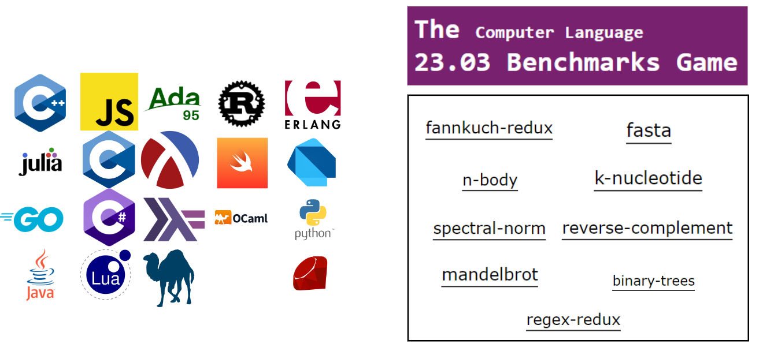






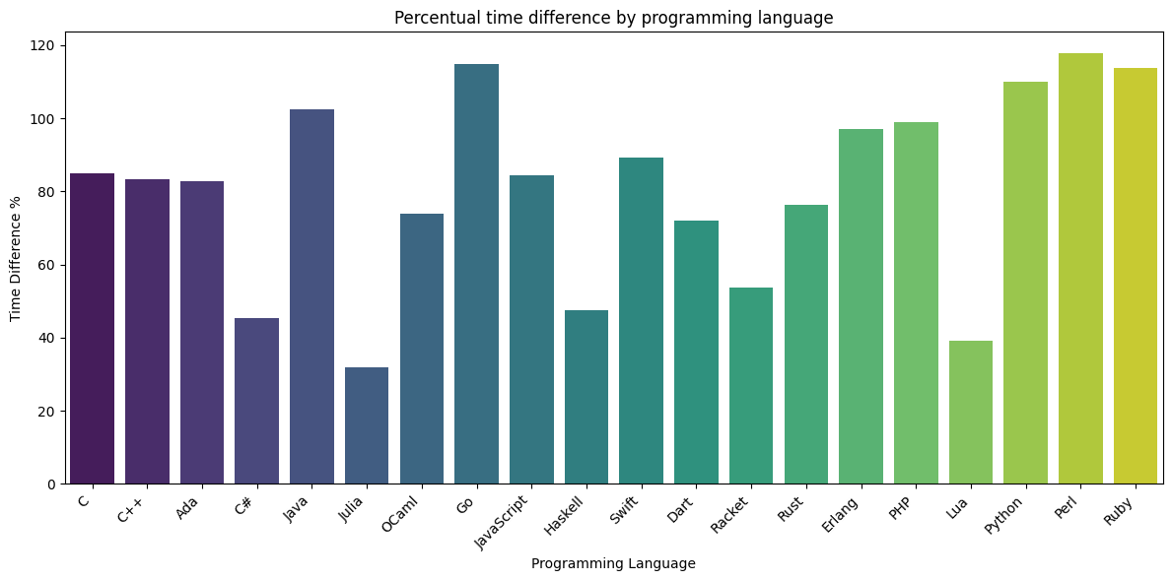
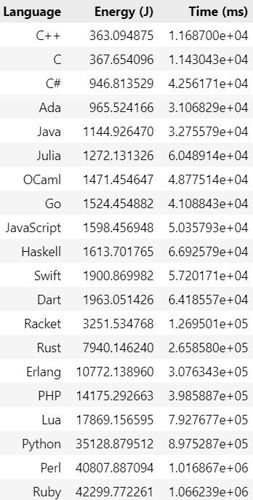
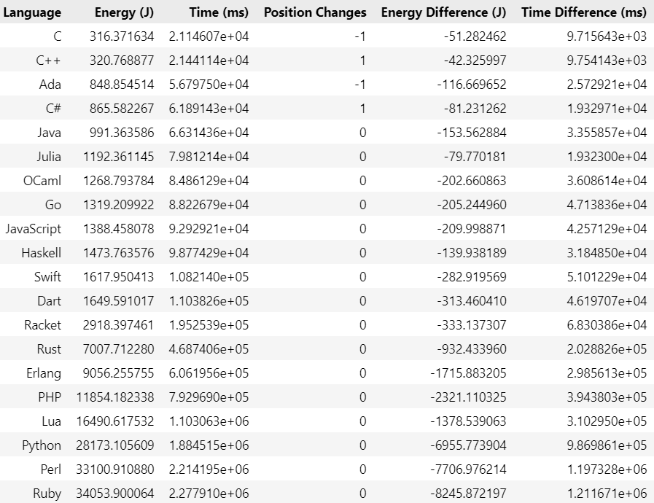
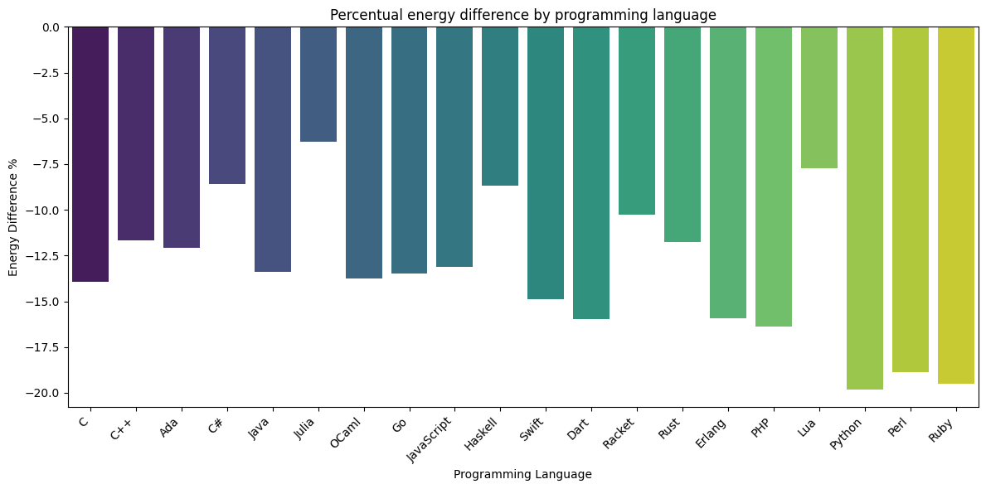
How Sustainable Is Your Programming language? Analyzing the impact of Power Cap on Energy Efficiency of Programming Languages
Simão Cunha | Luís Silva | João Saraiva
a93262@alunos.uminho.pt | pg50564@alunos.uminho.pt | saraiva@di.uminho.pt
University of Minho, Portugal | University of Minho, Portugal | University of Minho, Portugal
Abstract
This paper presents the outcomes of an extensive investigation centered on the assessment of the energy efficiency inherent in diverse computational algorithms implemented across twenty distinct programming languages from “The Computer Language
23.03 Benchmarks Game”. The study delves into the comprehensive analysis of the aggregate energy utilization of each computational program across varied programming languages, while scrutinizing the repercussions of CPU power constraints on language-specific performance. The discerned findings reveal that C and C++ manifest heightened efficacy concerning execution time and energy consumption, particularly when subjected to the imposition of power constraints. In contrast, Ruby and Perl exhibit suboptimal performance with regard to energy consumption, even under the constraints of PowerCap. Regarding the ramifications of employing power caps, all investigated programming languages derive benefits in terms of energy efficiency, with Python showcasing a noteworthy conservation of nearly 20% in overall energy consumption across the considered programs. In summation, this study imparts substantive insights into the energy efficiency of diverse computational problems across a spectrum of programming languages, while elucidating the consequential impact of power limitations on their respective performances.
Analysis of programming languages' performance when running various CLBG problems.
Temperature sensors
PowerCap
Reads CPU temperature
Guarantee that all programs execute at the same (CPU) temperature
Limits CPU power
Consumes less energy
Longer execution time
Results
Without PowerCap
With PowerCap
C and C++ are the faster and greener programming languages.
Ruby and Perl are the slowest and least greener programming languages.
PowerCap reduces energy consumption, while increasing runtime.
Python reduces 19.80% its energy consumption by limiting the power of the CPU.

