Slide 1



How Sustainable Is Your Programming Language? Analyzing the Impact of Power Cap on Energy Efficiency of Programming Languages
Simão Cunha
simaopscunha@outlook.pt
University of Minho, Portugal
Luís Silva
luis.m.peixoto@gmail.com
University of Minho, Portugal
João Saraiva
saraiva@di.uminho.pt
University of Minho, Portugal

Slide 2

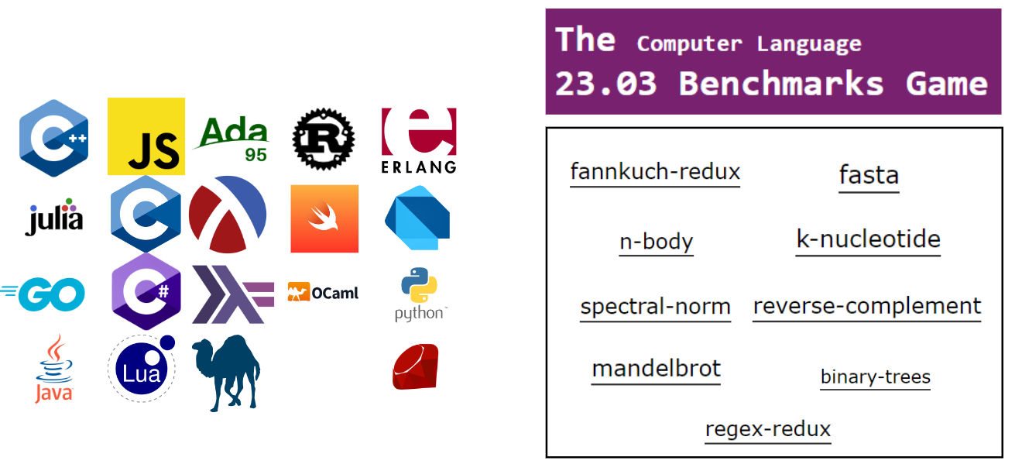

Analysis of programming languages' performance when running various CLBG problems.

Slide 3
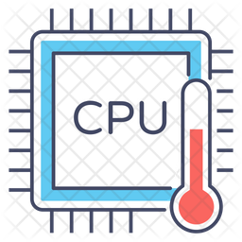



Temperature sensors & PowerCap
Guarantee that all programs execute at the same (CPU) temperature
Reads CPU temperature
lm - sensors
Limits CPU power
Consumes less energy
Longer execution time
raplcap/powercap

Slide 4
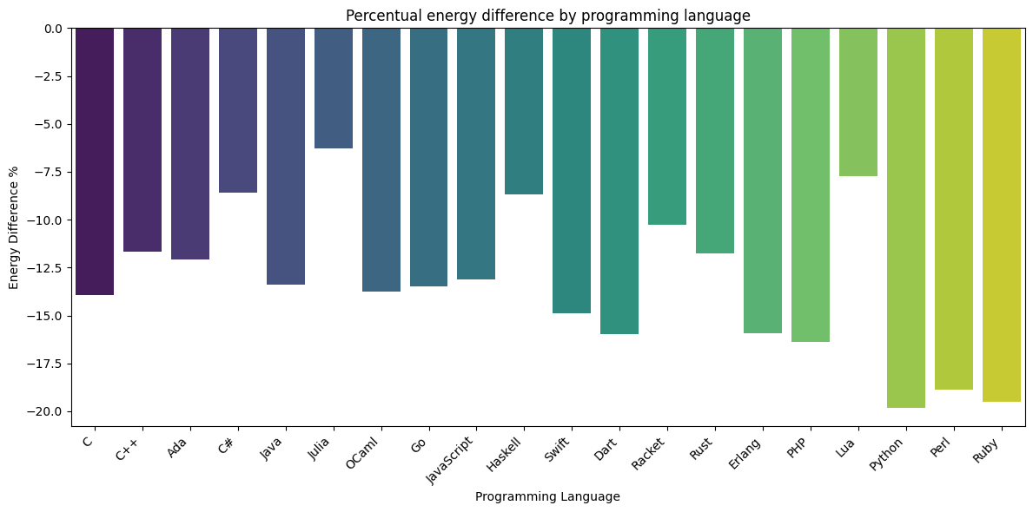
Results – Energy consumption

Slide 5
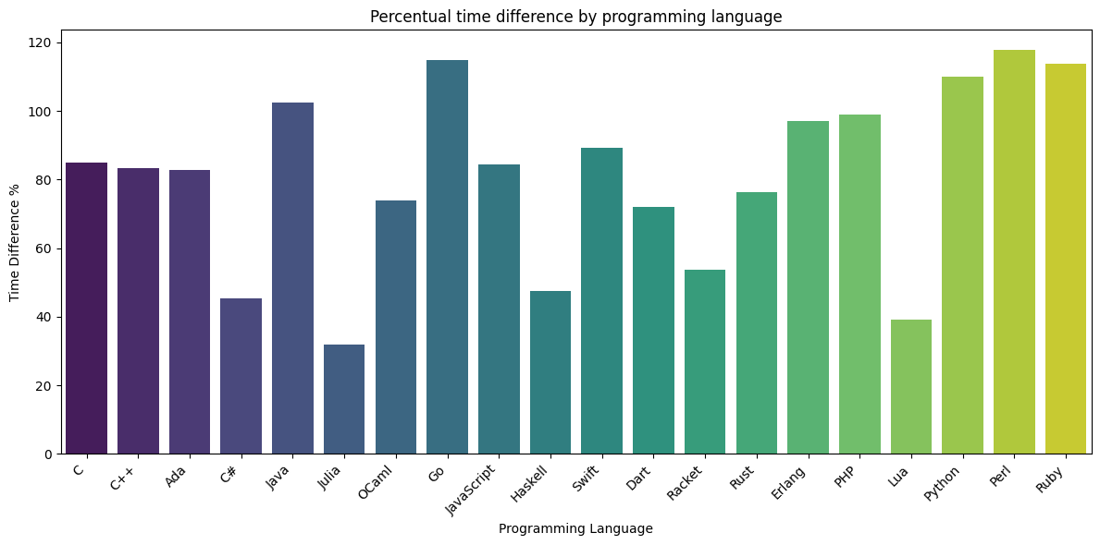
Results – Execution time

Slide 6
Conclusions
C and C++ are the faster and greener programming languages.
Ruby and Perl are the slowest and least greener programming languages.
PowerCap reduces energy consumption, while increasing runtime in all the programming languages.
Python reduces 19.80% its energy consumption by limiting the power of the CPU but is one of the most energy inefficient languages.

Slide 7
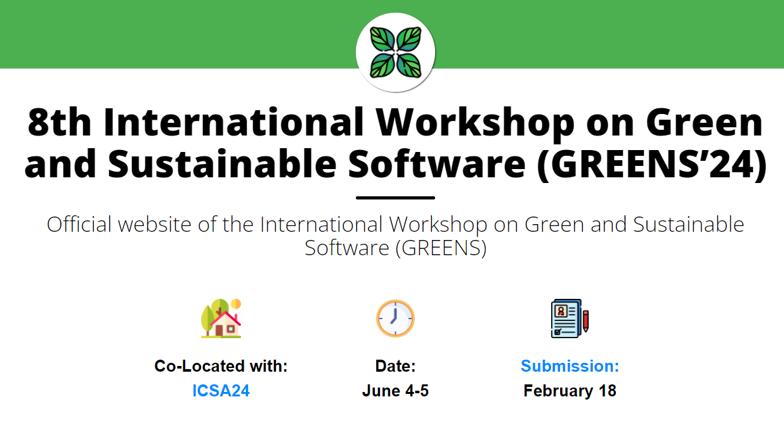
Next steps

