Slide 1
LLM-Guided Semantic Trust Gate
for Text-Attributed Graph Neural Networks
Problem
Standard GNNs aggregate all neighbours equally — ignoring whether a neighbour is semantically relevant for the current node's prediction.
Approach
Use a frozen LLM to assess per-edge semantic reliability and gate the self vs. neighbour aggregation path accordingly.
Contribution
First formal study of 4 trust-gate signals under 2 stress conditions (injection attacks + structural heterophily) benchmarked against 6 baselines.
Benchmarked on: Cora · Texas WebKB · 6 baselines (GraphSAGE, GNNGuard, H2GCN, GPR-GNN, TAPE, STEM-GNN)

Slide 2
Research Problem — Formal Formulation
When is a GNN neighbour semantically trustworthy?
Setup
Our Formulation
G = (V, E, T)
Goal: learn per-node trust gate β_v ∈ [0, 1]
V: nodes, E: edges, T = {t_v}: text attributes
h_v = β_v · W_self(e_v)
φ : t_v → e_v ∈ ℝ^768
+ (1−β_v) · W_neigh( MEAN({e_u : u∈N(v)}) )
frozen LLM encoder (SentenceTransformer)
where β_v is driven by LLM semantic assessment:
Standard GNN aggregation:
Q: 'Is neighbour u relevant for v's class label?'
h_v = σ( W · MEAN({h_u : u ∈ N(v) ∪ {v}}) )
treats all neighbours equally
4 gate signals studied:
A cos( h_v, mean(h_u) ) [GNN hidden states]
Problem: noisy/wrong-class neighbours corrupt h_v
B 1 − max softmax(logits) [model confidence]
— more so when edges are structurally forced (hetero-
C MLP(e_v ‖ mean(e_u)) [learned gate]
phily) or adversarially injected (text-similar, wrong class).
D cos( e_v, mean(e_u) ) [LLM text cosine]
Proposed: replace D with LLM label-support score
so β_v uses semantic reasoning, not just cosine.

Slide 3
Survey — 6 Related Methods
Prior work across robustness, heterophily, and text-attributed graphs
Method (venue)
Text use
Structure
Agg. weight
Core idea
GraphSAGE NeurIPS '17
None
Mean agg
Equal
Inductive GNN with mean/max/LSTM aggregation over sampled neighbours.
GNNGuard NeurIPS '20
None
Cosine prune
Edge-level
Computes cosine similarity between adjacent node features; drops or down-weights dissimilar edges before aggregation.
H2GCN NeurIPS '20
None
Ego-sep
Node-level
Separates ego (self) and neighbour channels; combines multi-hop neighbourhoods explicitly for heterophilic graphs.
GPR-GNN ICLR '21
None
PageRank
Layer-level
Learnable generalized PageRank coefficients per propagation step; adapts how much each hop contributes to the final representation.
TAPE ICLR '24
LLM feat
Standard
Equal
Uses LLM-generated text explanations as node features; plugs into any GNN backbone with equal-weight aggregation.
STEM-GNN KDD '26
VQ tokens
MoE route
Expert
MoE encoder + VQ codebook + Lipschitz regularisation; routes per node to specialised experts for OOD robustness.

Slide 4
Limitations — Where Existing Methods Fall Short
No single prior method handles both injection attacks and structural heterophily with text semantics
Method
Injection↓
Heterophily↑
Text↑
Key limitation
GraphSAGE
✗
✗
✗
Equal-weight mean agg; no mechanism to down-weight misleading neighbours under injection or heterophily.
GNNGuard
~
✗
✗
Cosine prune helps under feature noise but fails when injected edges are deliberately text-similar to the victim — exactly our attack.
H2GCN
✗
✓
✗
Strong on heterophily by ego-separation, but no robustness mechanism; injection degrades performance as severely as SAGE.
GPR-GNN
✗
✓
✗
Learnable hop weights adapt globally, not per node. Cannot identify which specific neighbours are unreliable.
TAPE
✗
✗
~
Rich text features but equal-weight aggregation: LLM knowledge is in the features, not in the routing — still vulnerable to both.
STEM-GNN
~
~
~
Router uses post-aggregation z_v (already corrupted by noisy neighbours). No upstream semantic neighbour assessment.
Ours (goal)
✓
✓
✓
LLM judges per-edge semantic relevance BEFORE aggregation. Gate β_v adapts to injection and heterophily via text reasoning.

Slide 5
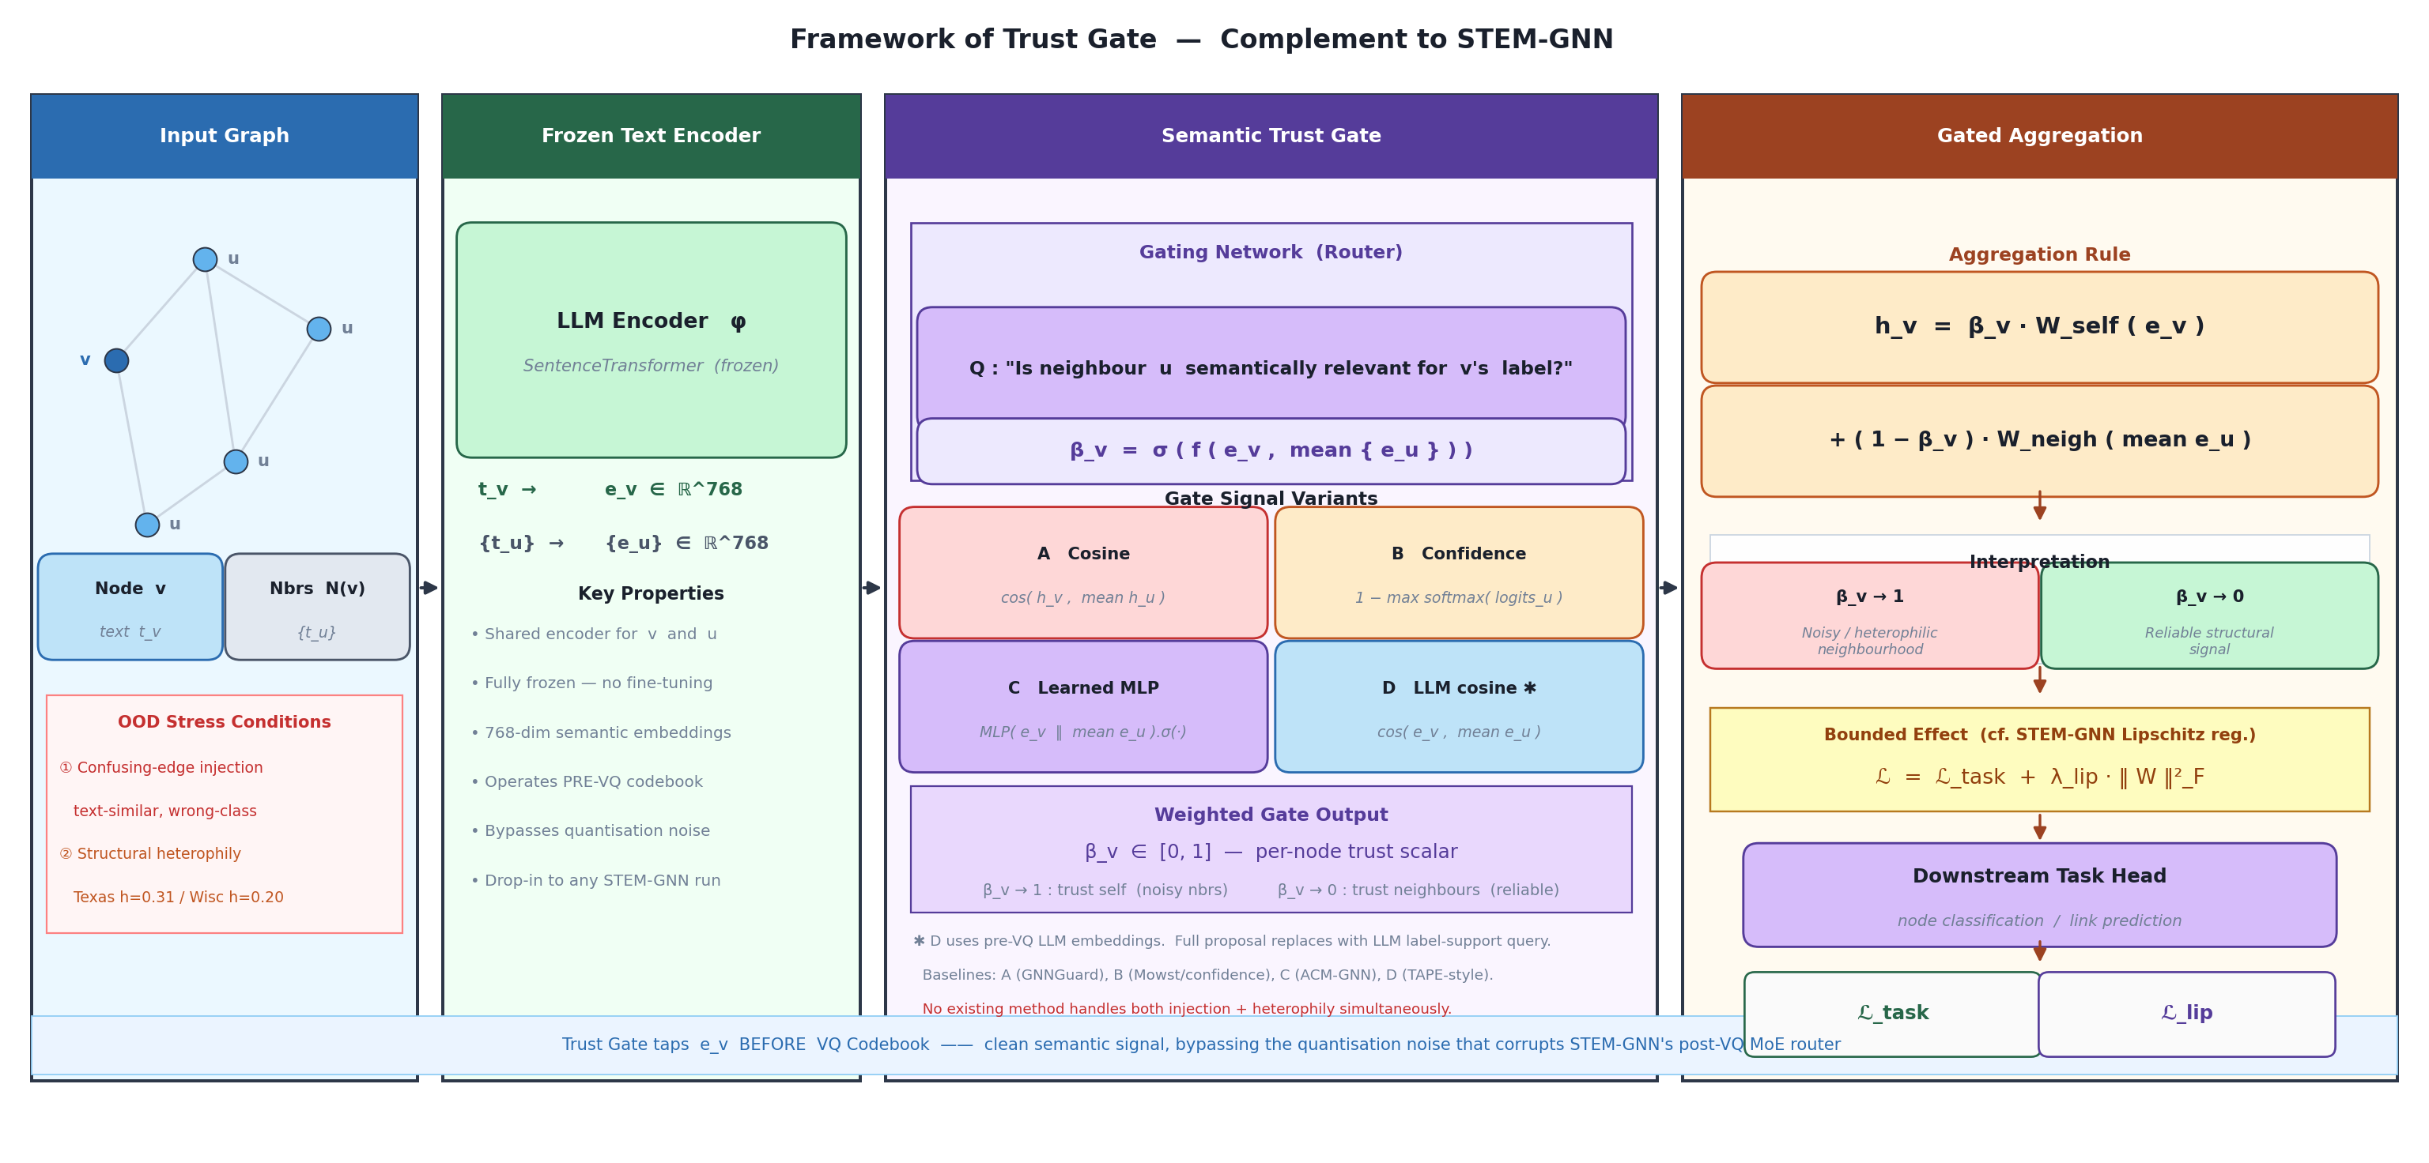
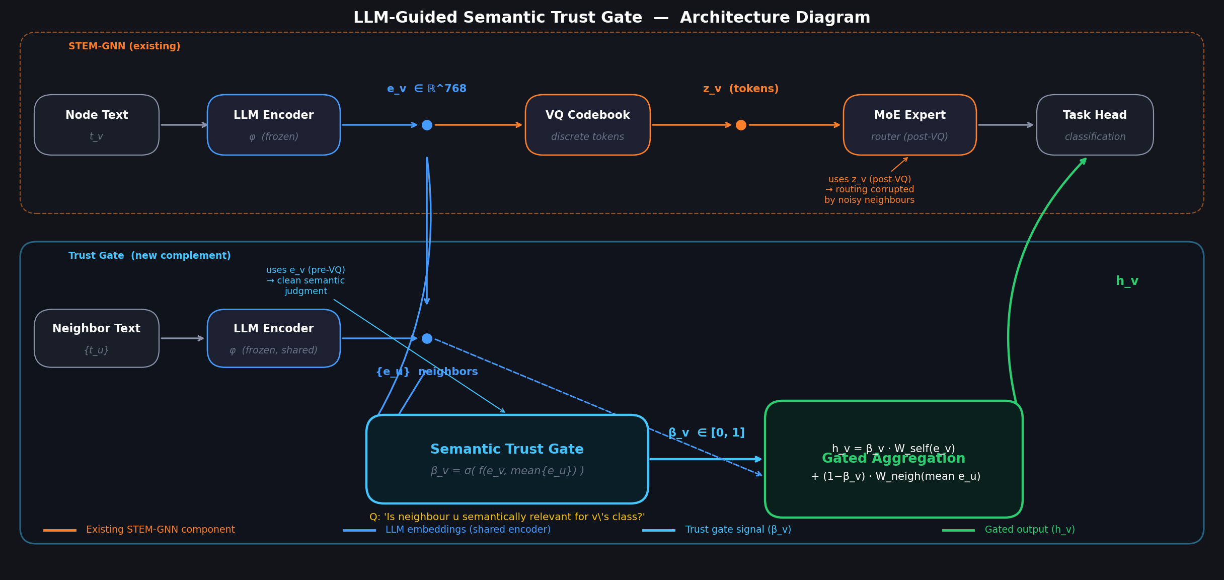
Proposed Method — Trust-Gated Architecture
Trust gate taps e_v BEFORE VQ quantization — cleaner semantic signal than STEM-GNN's post-VQ router
h_v = β_v · W_self(e_v) + (1 − β_v) · W_neigh( MEAN{ e_u : u ∈ N(v) } )
A Cosine
B Confidence
C Learned
D LLM cosine
Proposed
1 − σ(cos(h_v, mean h_u))
1 − mean[max softmax(logits_u)]
MLP(e_v ‖ mean e_u).sigmoid()
1 − σ(cos(e_v, mean e_u))
LLM('is u relevant for v?') → β_v

Slide 6
Experiment Design — Tri-Objective Framework
Following STEM-GNN's evaluation protocol: ID performance · OOD robustness · Cross-dataset transfer
Objective 1 ID Performance
Objective 2 OOD Robustness
Objective 3 Transfer / Scale
Standard train/val/test splits. Measure clean test accuracy on Cora, PubMed, ArXiv (OFA format), Texas, Wisconsin. Primary baseline: STEM-GNN published numbers.
Stress test 1 — Confusing-edge injection: Add k% edges connecting text-similar, wrong-class node pairs. Ratios: 0%, 10%, 20%, 30%, 40%, 50%. Stress test 2 — Structural heterophily: Texas (h=0.31), Wisconsin (h=0.20) WebKB datasets. Metric: accuracy × 3 splits.
Pretrain trust gate on Cora; zero-shot evaluate on PubMed & ArXiv. Measure how well learned gate β_v transfers across domains without retraining the gate signal.
Datasets & Splits
Cora
Texas
Wisconsin
PubMed
STEM-GNN baselines
2708 nodes · 5429 edges · 7 classes 3 seeds · OFA splits
183 nodes · 295 edges · 5 classes 10 official splits
251 nodes · 466 edges · 5 classes 10 official splits
19717 nodes · 44324 edges · 3 classes OFA format · 3 seeds
Clean avg 80.79% OOD-low Cora 82.73% OOD-worst 78.45%

Slide 7
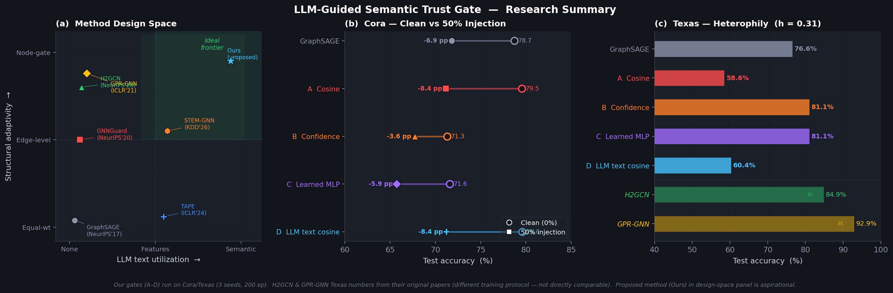
Results — Trust Gate vs. 6 Baselines
Cora injection sweep (3 seeds, 200 ep) · Texas WebKB heterophily (3 splits, 200 ep)
▶
B_confidence most injection-robust — −3.6 pp drop at 50% injection (vs −8.4 pp for cosine gates A and D).
▶
D_llm = A_cosine under injection — Both drop −8.4 pp — text cosine trusts wrong-class text-similar injected edges.
▶
B and C dominate on heterophily — 81.1% on Texas vs 76.6% for SAGE; cosine gates A (58.6%) and D (60.4%) hurt.
▶
Gap motivates full proposal — No single gate wins both. LLM label-support reasoning expected to handle both.

Slide 8
Conclusion & Open Questions
What the experiments confirm and what remains to build
What this work shows
Open Questions / Next Steps
• No single existing gate signal handles both stress conditions.
Q1
Can an LLM generate reliable per-edge trust scores at scale without fine-tuning?
• Cosine-based gates (A, D) are vulnerable to injection by design — injected edges are chosen to be text-similar, so cosine trusts them.
Q2
How to handle the label leakage risk when LLM uses class-label text in the trust query?
• Confidence and learned gates (B, C) are more injection-robust but lack direct text understanding for heterophilic settings.
Q3
Does the gate β_v transfer zero-shot to PubMed / ArXiv without retraining?
• Text cosine (D) ≠ semantic label-support — a node can be text-similar but irrelevant or misleading for the classification task.
Q4
Can the gate be distilled into a lightweight MLP for inference-time efficiency?
• The full LLM label-support gate is the natural next step: robust to injection (semantic judgment) and heterophily (class-aware).
Q5
How does the trust gate interact with STEM-GNN's VQ codebook? Can they be jointly trained?
• Experiment design follows STEM-GNN's tri-objective framework, enabling direct comparison to KDD '26 results.
Q6
Wisconsin results pending (HTTP download error). Will heterophily trend hold at h=0.20?

