Slide 1
LLM-Guided Semantic Trust Gate
Adaptive Neighbourhood Aggregation for Robust Text-Attributed GNNs
Complement to STEM-GNN (KDD'26)
Injection Robustness
Heterophily Generalization
LLM Semantic Signals

Slide 2
Motivation
Why do GNNs fail under distribution shift?
① Confusing-Edge Injection
② Structural Heterophily
Text-similar but wrong-class neighbours are injected into the graph. GNNs blindly aggregate them → corrupted node representations → accuracy drops.
Many real graphs connect nodes of different classes (h < 0.5). Standard equal-weight aggregation blurs class boundaries → poor accuracy.
Core Question: When should a node trust its neighbours vs. its own text?

Slide 3
Prior Work Survey
6 methods — none handles both challenges
Method
Venue
Key Idea
LLM Features
Injection Robust
Hetero- phily
GraphSAGE
NeurIPS'17
Uniform aggregation
✗
✗
✗
GNNGuard
NeurIPS'20
Edge pruning by cosine sim
✗
✓
✗
H2GCN
NeurIPS'20
Ego/neighbour separation
✗
✗
✓
GPR-GNN
ICLR'21
Learnable propagation coefficients
✗
✗
✓
TAPE
ICLR'24
LLM text features as node embeddings
✓
✗
✗
STEM-GNN
KDD'26
MoE router + VQ codebook (post-VQ)
✓
✗
✗
Ours (Trust Gate)
—
Semantic gate on pre-VQ embeddings
✓
✓
✓
No prior method simultaneously handles all three properties.

Slide 4
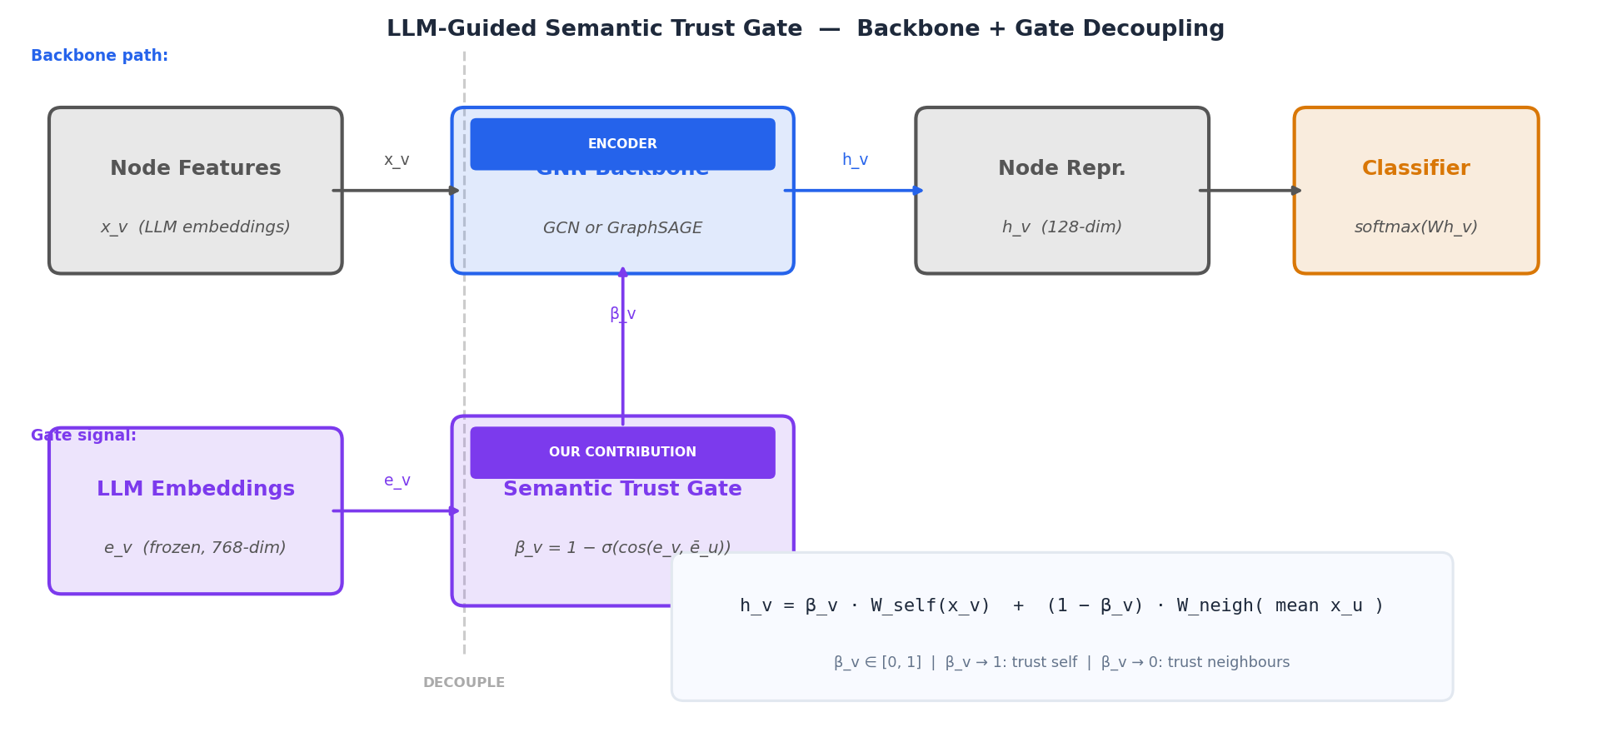
Our Method: Semantic Trust Gate
β_v gates how much each node trusts its neighbours
Key design: backbone (GCN/SAGE) encodes graph structure while frozen LLM embeddings act as a semantic oracle — generating β_v without entering the training signal.

Slide 5
Four Gate Signal Variants
What signal f drives β_v?
A — Cosine Similarity
B — Model Confidence
C — Learned MLP
D — LLM Text Cosine
cos( h_v , mean h_u )
1 − max softmax( logits_u )
MLP( e_v ‖ mean e_u )
cos( e_v , mean e_u )
Compares aggregated GNN hidden states. Proxy for structural compatibility.
High neighbour uncertainty → distrust. Most robust to injection (−3.6 pp drop).
End-to-end learned gate. Best on heterophily (81.1% Texas).
Raw LLM embedding similarity. Collapes to A under injection.
All gates share the same aggregation rule: h_v = β_v · W_self(e_v) + (1−β_v) · W_neigh(mean e_u)

Slide 6
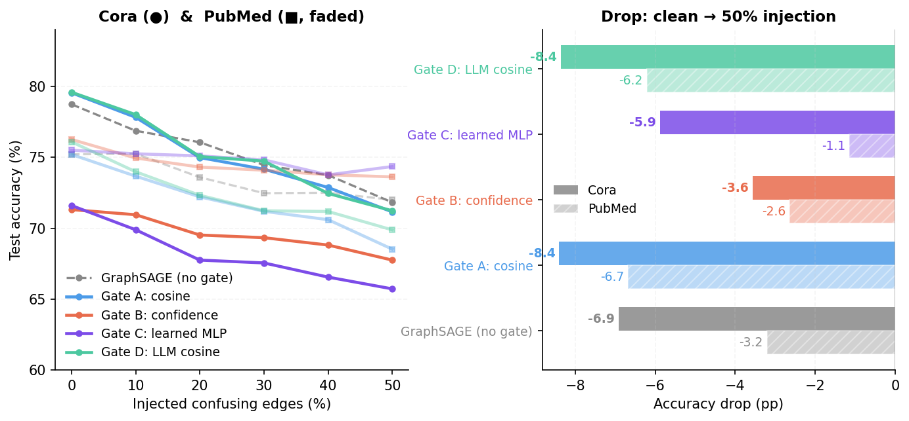
Result 1 — Injection Robustness (Cora + PubMed)
Gate B most robust on both datasets: −3.6 pp (Cora), −2.6 pp (PubMed)
Key Takeaways
• B (confidence) most robust on both Cora (−3.6) and PubMed (−2.6 pp)
• C (learned MLP) also stable: −5.9 pp Cora, −1.1 pp PubMed
• Cosine gates (A, D): −8.4 pp — no robustness benefit
• Pattern consistent across two independent datasets

Slide 7
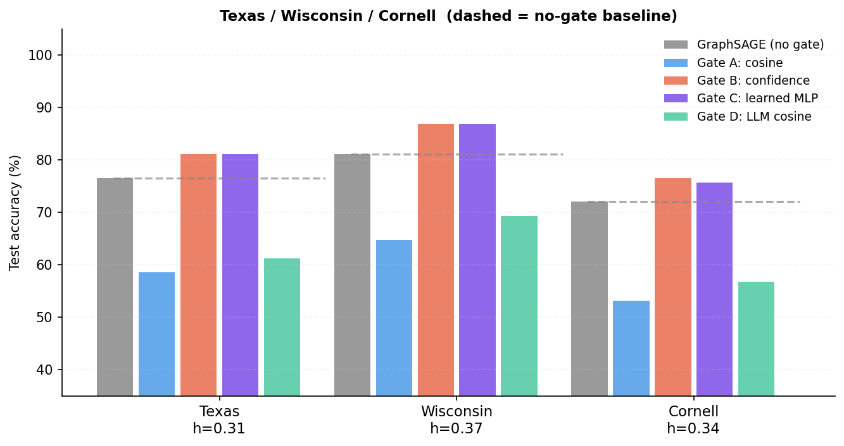
Result 2 — Heterophily Generalization (3 Datasets)
B & C improve over baseline on ALL three datasets; cosine gates consistently hurt
Key Takeaways
• Texas: B & C → 81.1% (+4.5 pp)
• Wisconsin: B & C → 86.9% (+5.9 pp)
• Cornell: B → 76.6% (+4.5 pp)
• Cosine gates (A, D) hurt on ALL three — drop 15–20 pp below baseline
• Confidence signal reliable regardless of graph structure

Slide 8
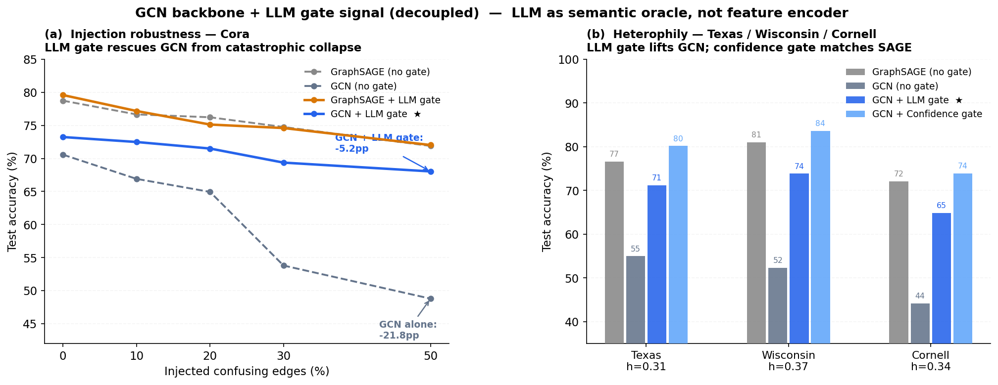
Result 3 — Backbone Comparison: GCN vs GraphSAGE + LLM gate
LLM gate rescues GCN from −21.8 pp collapse; confidence gate matches SAGE on heterophily
Key Takeaways
• GCN alone: −21.8 pp drop at 50% injection (catastrophic)
• GCN + LLM gate: only −5.2 pp — gate absorbs the noise
• GCN alone weak on heterophily (44–55%)
• GCN + LLM gate recovers to 65–71%
• GCN + confidence gate matches or beats SAGE baseline
• LLM oracle signal generalises across backbone architectures

Slide 9
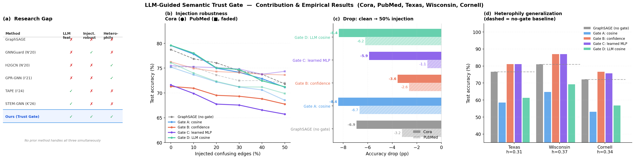
Summary — Contribution & Results
Research gap filled + empirical evidence

Slide 10
Research Direction & Next Steps
Short term — Strengthen experiments
Medium term — Improve the gate
Long term — Research paper
• Run PubMed + WikiCS injection sweeps
• LLM label-support query: ask LLM if u's text supports v's class
• Tri-objective evaluation: ID acc / OOD robustness / transfer
• Wisconsin & Cornell heterophily benchmarks
• Multi-hop gates: consider 2-hop neighbourhood trust
• Theoretical analysis: gate as Lipschitz regulariser
• Add GNNGuard as an active baseline in our injection setup
• Plug into full STEM-GNN pretrain → finetune pipeline
• Generalise to link prediction & graph classification
• Report mean ± std over 5 seeds
• Joint training of gate + VQ codebook
• Submit to NeurIPS'25 / ICLR'26
Core claim: A semantic gate on pre-VQ LLM embeddings is a lightweight, drop-in complement to STEM-GNN that addresses both injection robustness and structural heterophily — filling a gap no existing method covers.

