Slide 1
Quantum Hashing Function Solution to Super-Quantum Challenge
Liam Azar, Pranay Kumar, Luis Mendez, & Chidubem Ugenyi

Slide 2
Description of the Algorithm
Our circuit uses all 20 qubits to ensure that the hash function may take inputs of arbitrary lengths. The bottom 4 qubits are "coins" that determine the evolution of the quantum walk. The remaining 16 qubits act as registers to record the current position of the pointer.
The input bitvector is padded as needed with zeros. The input is then chunked into slices of length 2. We then use Hadamard gates controlled by the classical bits in each chunk and then entangle these with the position qubits with CNOT gates.

Slide 3
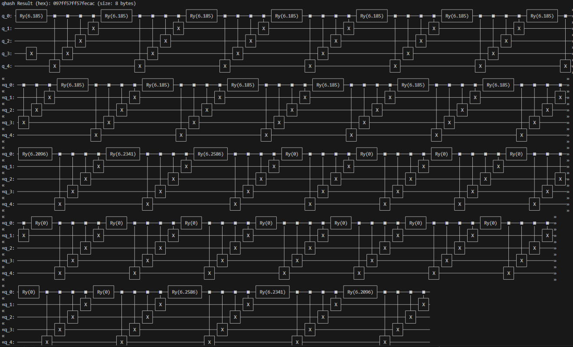
The Circuit

Slide 4
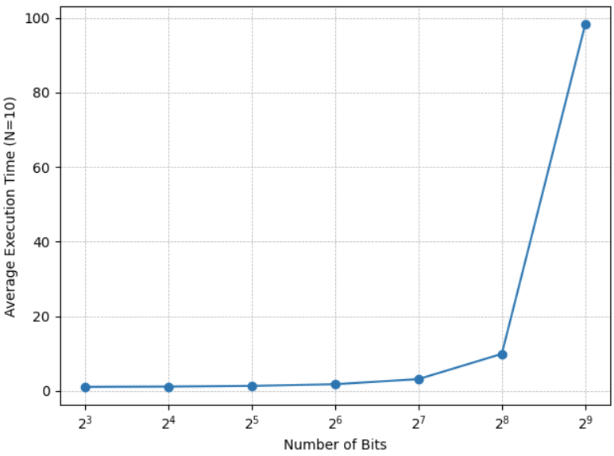
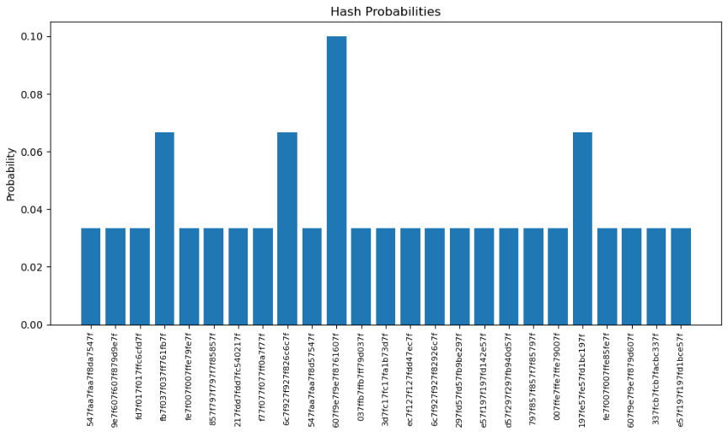
Numerical Analysis
Double-exponential running time → conveys computational difficulty.
Indicates that this algorithm would be a bad fit for classical computers.
Entropy is roughly how uniform the output of a hash function is.
Roughly uniform probabilities of getting a specific output = preserved entropy.
Notes:
To analyze the entropy of our hash function, we tested it on random subsets of the possible domain.

Slide 5


Mathematical Basis
Hashing via a quantum walk falls under a class of hash functions where the output is of the form
Holevo's theorem can be used to prove the irreversibility of our hash function.
N qubits can only be used to extract at most n classical bits, and since our domain is so much larger than the co-domain, we can be certain that finding the pre-image of a hash is impossible in general.
The special case where S is a subset of a cyclic group of order 2^n corresponds exactly to the case where the hash function looks like rotating by random angles. The quantity below, which intuitively measures collision resistance, thus has a set S that bounds it by a small epsilon.

Slide 6

Thank You!

