Slide 1
Weather Data Visualization presentation
Presented by Luis Mercado
Notes:
Hi, my name is Luis Mercado, and in this presentation, I’ll be walking you through a project I worked on that focuses on visualizing and analyzing weather data.

Slide 2

Introduction
Dataset: Full financial year (July-June) weather history
11 columns of data including:
Daily temperatures (actual and historical)
Rainfall measurements
Historical averages and extremes
Goal: Extract meaningful insights through creative visualization
Notes:
The dataset I used covers an entire year—365 days of detailed weather records, including daily temperatures and rainfall. I also compared this data to historical averages and extreme weather records to see how this year measured up.
Let’s take a look at the visualization now .

Slide 3
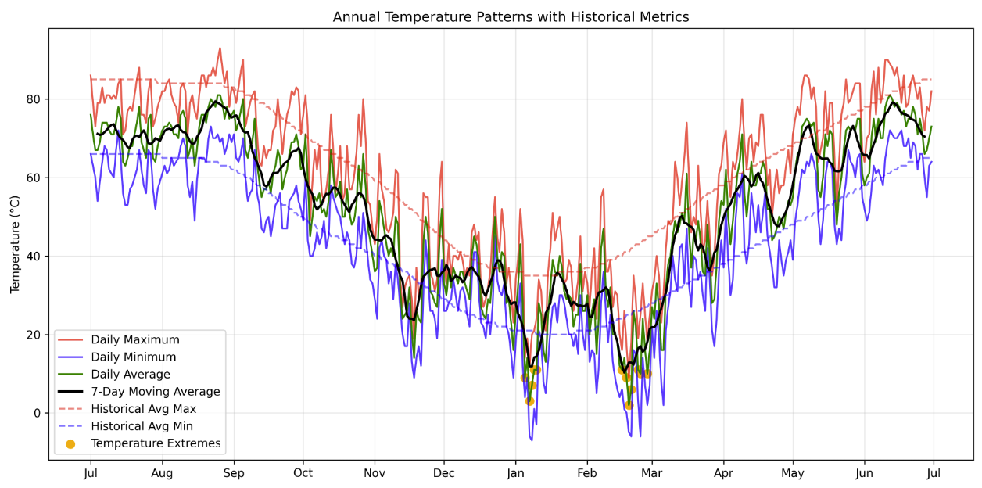
Temperature Patterns Overview
Notes:
First, I made a temperature chart that shows daily minimum, maximum, and average temperatures throughout the year.
To make the trends easier to spot, I included a 7-day moving average line that vary along the time. I also added historical average temperatures for comparison, and flagged days where the temperature was much higher or lower than usual—those are the extreme days marked with a yellow circle.

Slide 4
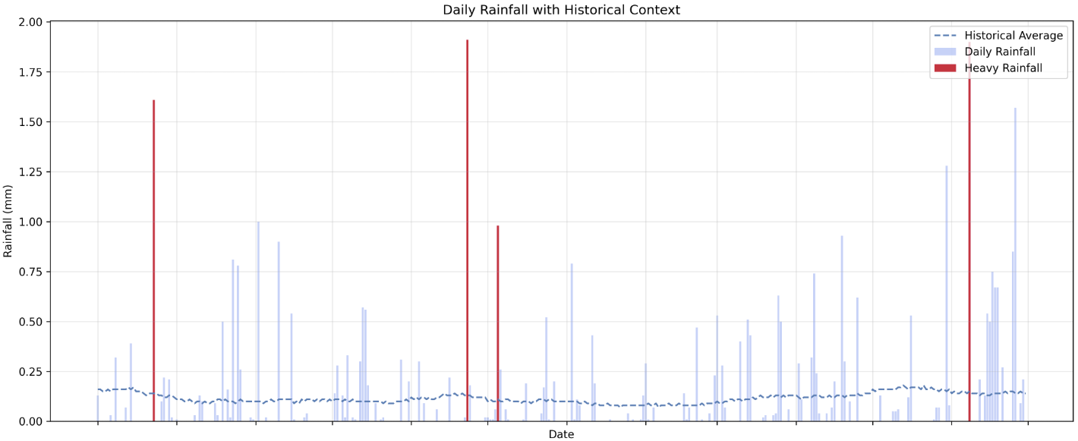
Quote
Rainfall Analysis
Notes:
This figure combines two perspectives. The first subplot shows daily rainfall and how it compares to historical averages, highlighting unusually heavy rainy days.

Slide 5
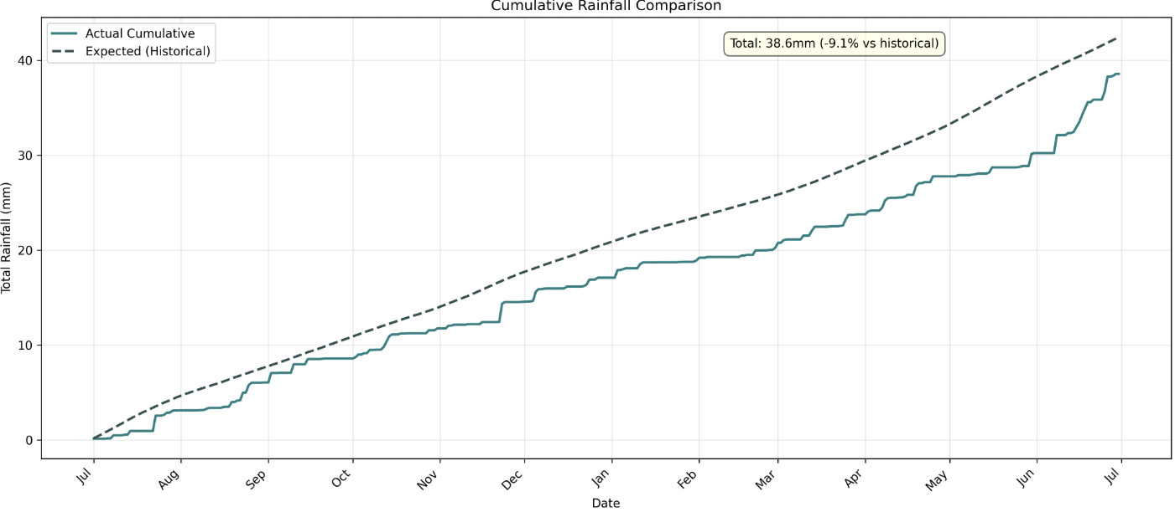
Quote
Rainfall Analysis
Notes:
he second chart tracks how rainfall added up over the year, and compares that to the expected trend. this view helps us understand both individual heavy rain days and the bigger picture—was the whole year wetter or drier than usual? I also added labels to the cumulative chart to show the percentage difference from the normal total.

Slide 6
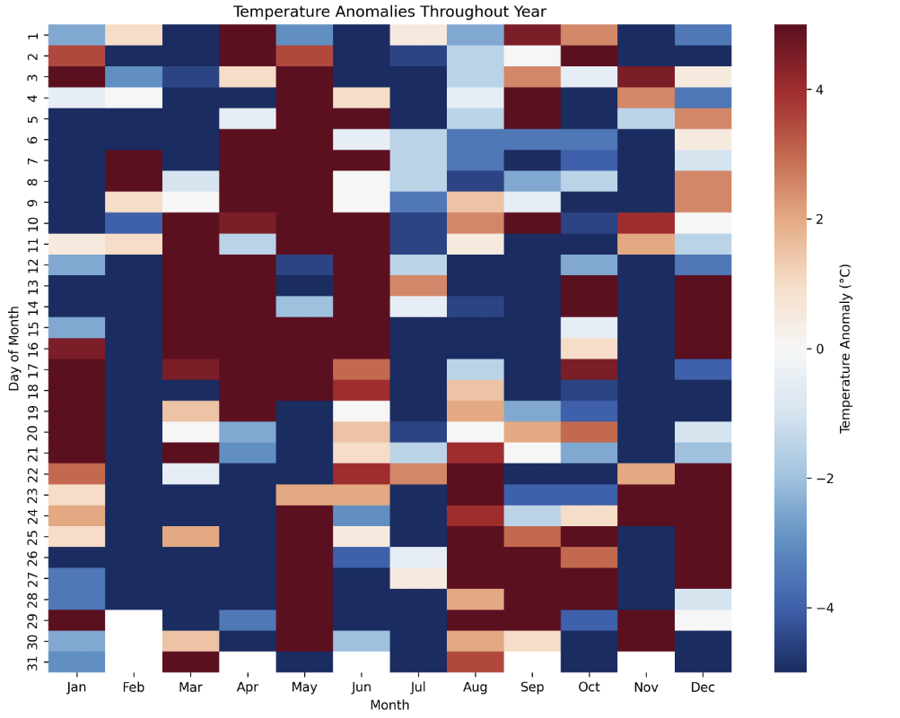
Quote
Temperature Anomalies Analysis
Notes:
a heatmap to show how each day’s average temperature compared to the historical norm.
This looks like a calendar, with each square representing a day. Red means warmer than usual, and blue means cooler. This makes it easy to spot unusually hot or cold days and spot patterns, like a heatwave or a cold spell.
I used this design because it packs a lot of information into a small space, and helps reveal patterns that would be hard to notice with a regular line graph.

Slide 7
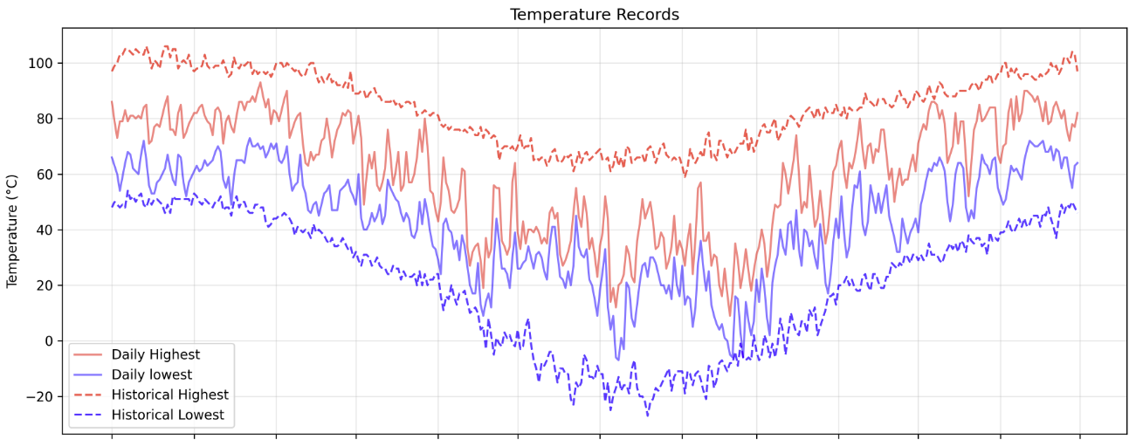
Quote
Temperature Extremes Analysis
Notes:
Finally, I looked at extreme weather days—when temperatures or rainfall broke past historical records.

Slide 8
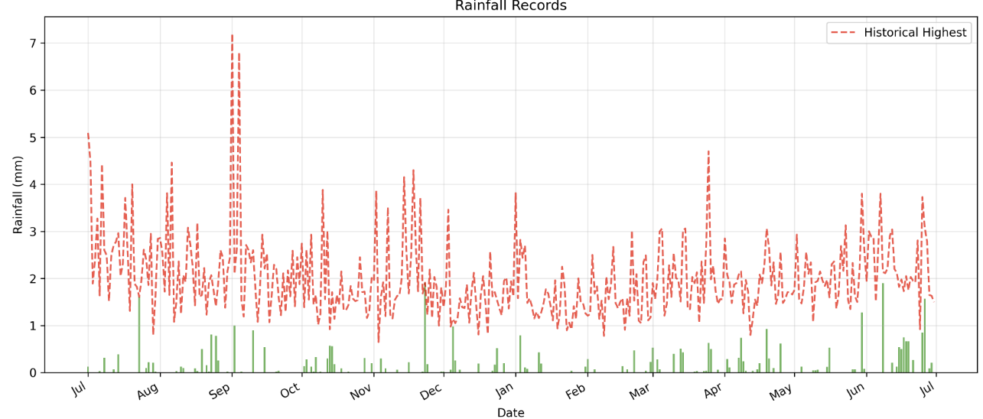
Quote
Rainfall Extremes Analysis
Notes:
I used scatter plots and color-coded bars to make these stand out. These events are important because they might be signs of a changing climate or increasing weather instability.

