Slide 1


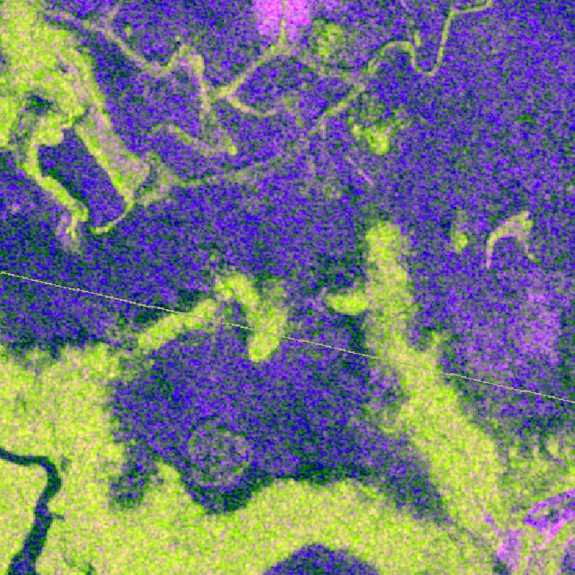

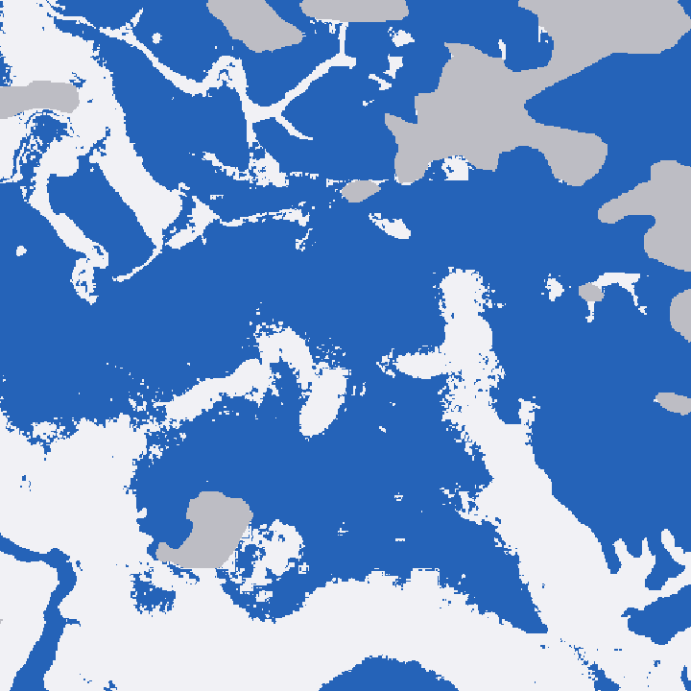
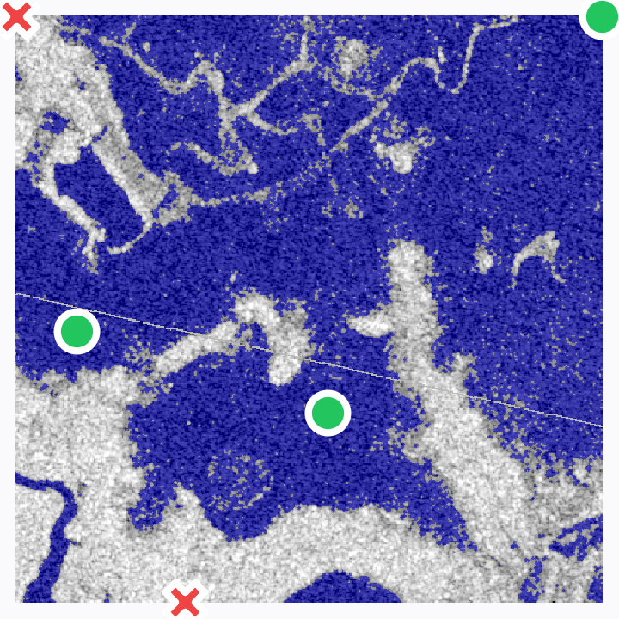
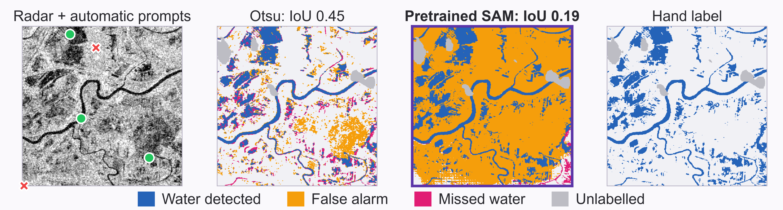
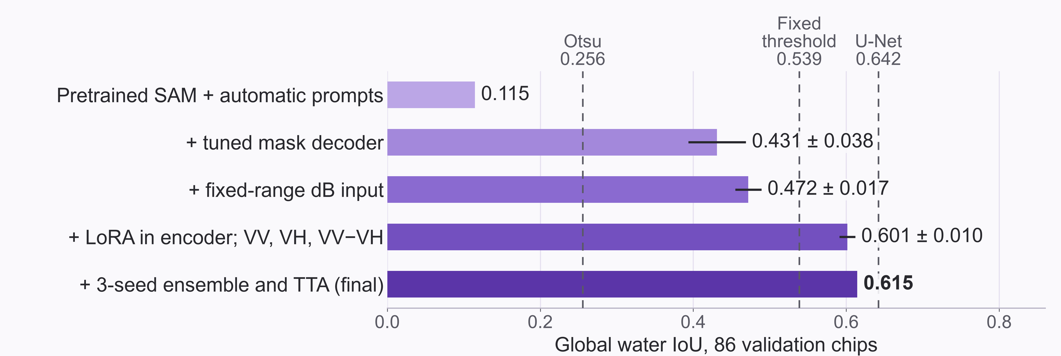
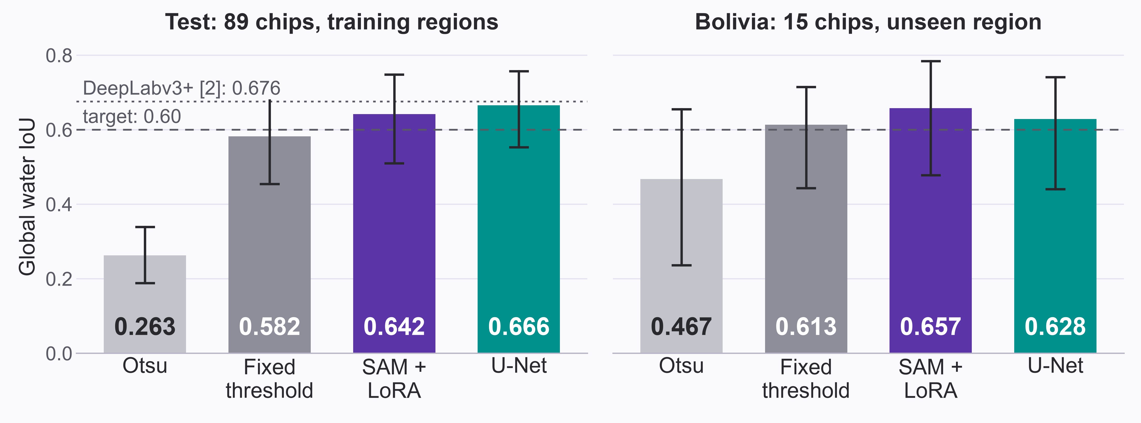
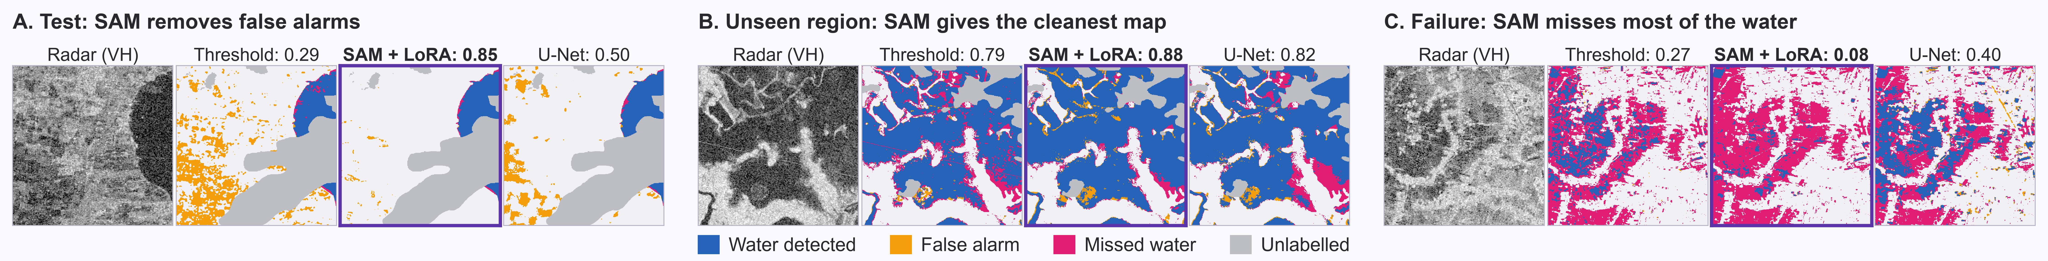
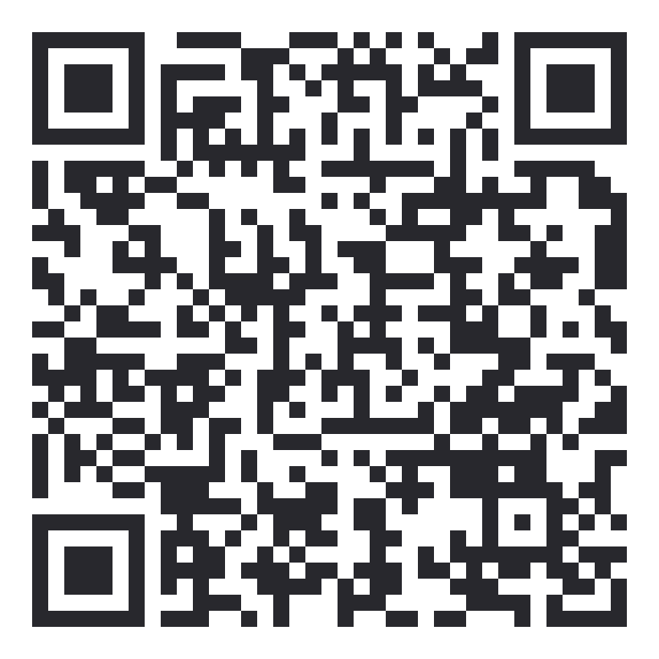
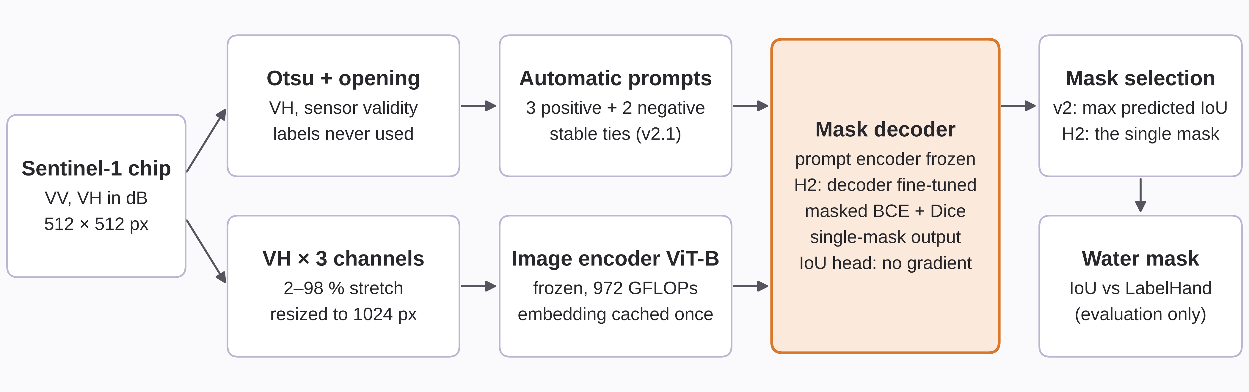
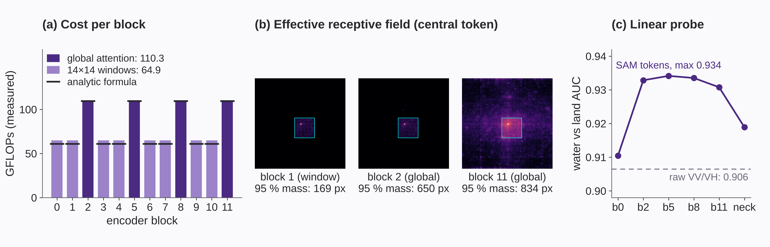
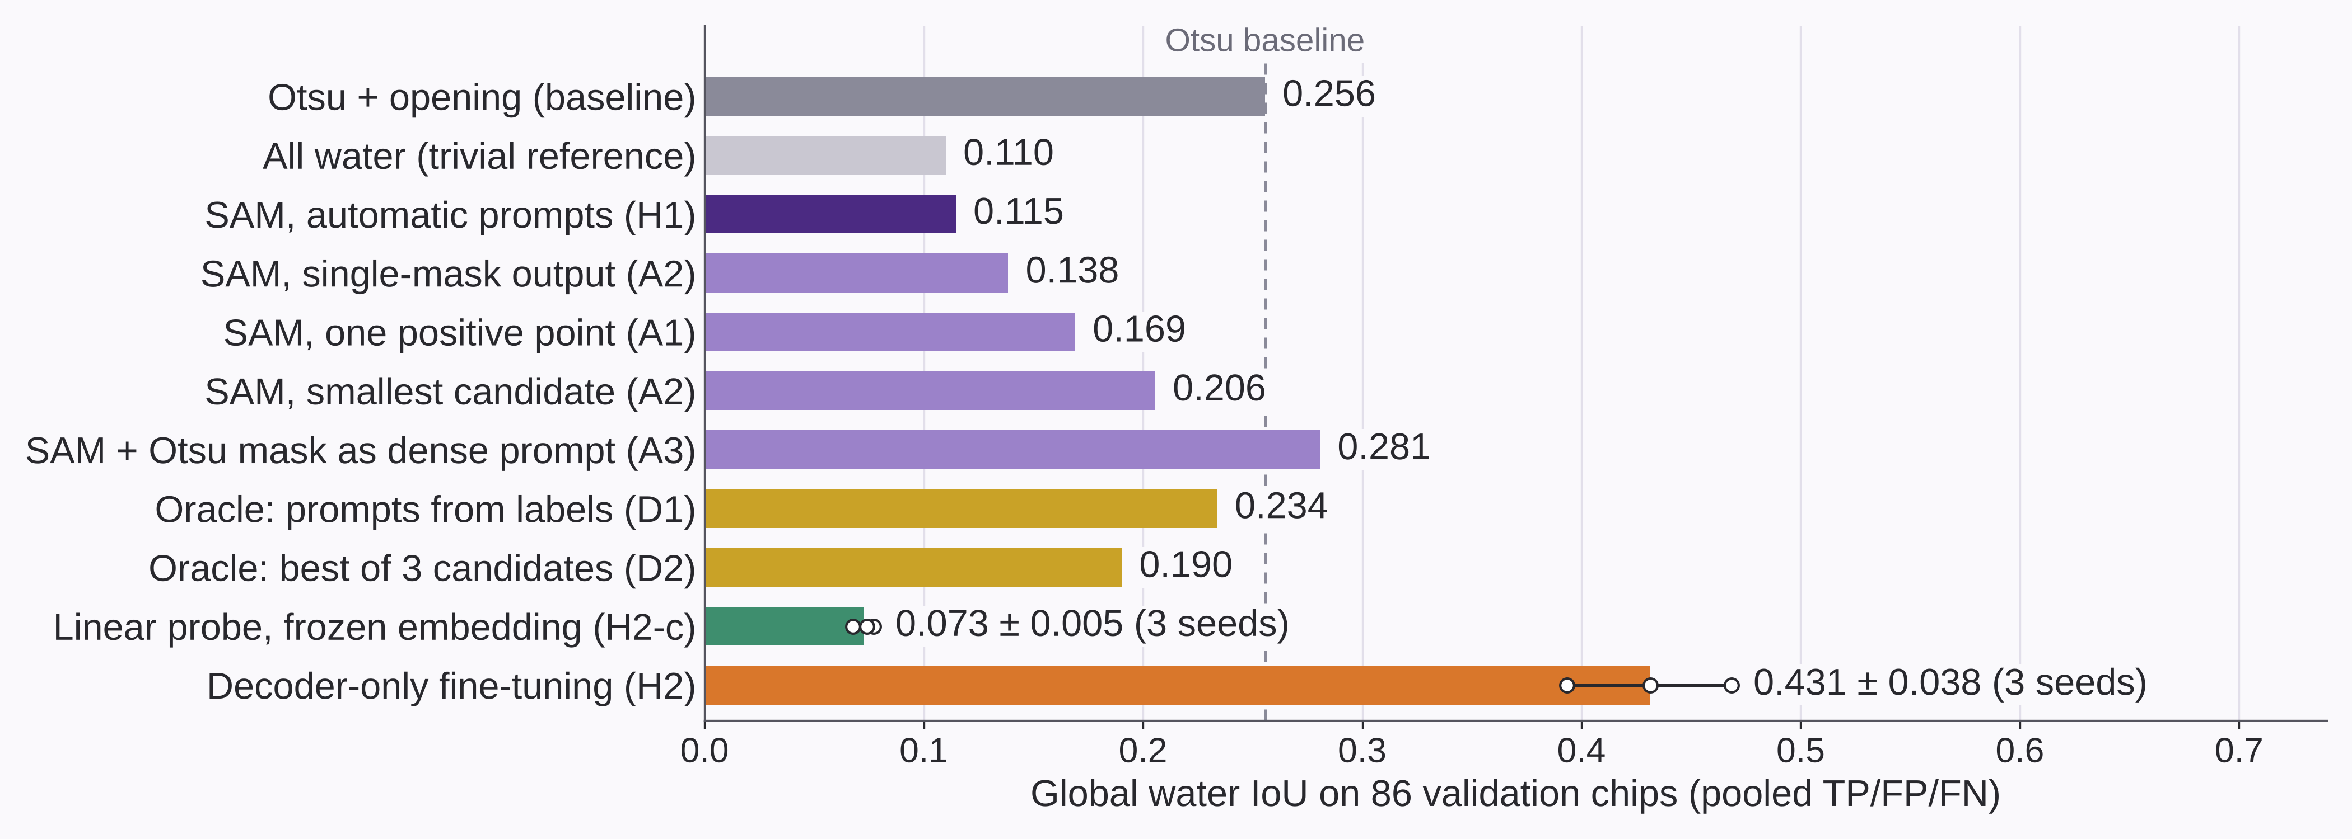
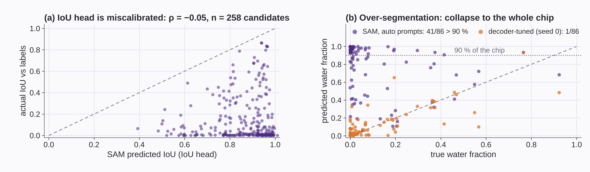
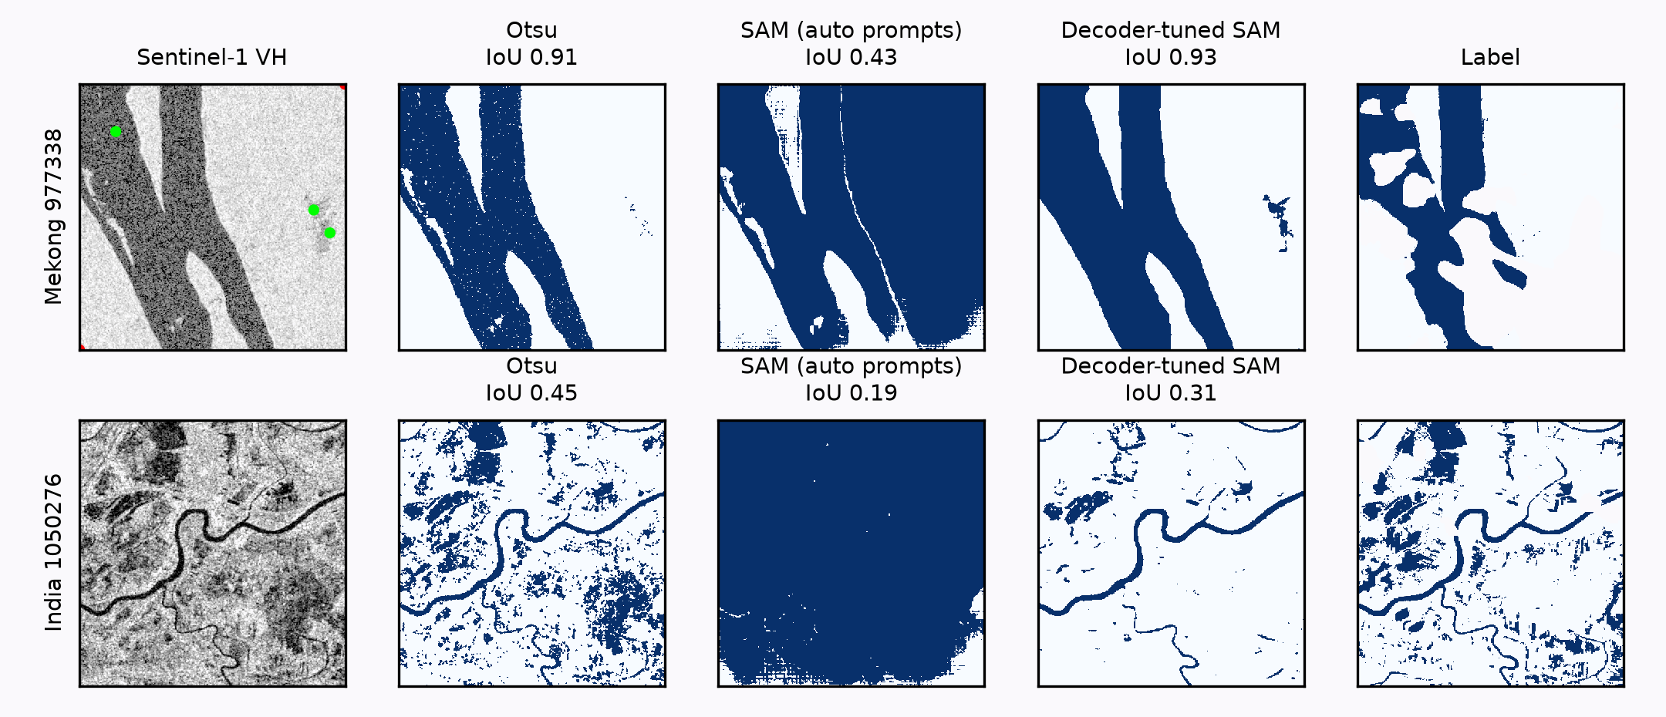
Workshop on Artificial Intelligence and Machine Learning Applications
Adapting Segment Anything for Sentinel-1 Water Mapping with Automatic Prompts
John Manuel Arzapalo Arana¹ • Luis Alberto Miranda Mallqui¹ • Juan Diego Zavala Viscardo¹
¹Graduate School, Pontificia Universidad Católica del Perú, Lima, Peru
MOTIVATION & RESEARCH PROBLEM
OBJECTIVES
Sentinel-1 radar sees surface water through the clouds of extreme rainfall, as in the 2017 coastal El Niño floods in Piura, Peru.
State of the art on Sen1Floods11 [1] with radar and hand labels: global IoU 0.68 [2]. Reaching 0.72 takes an optical teacher [2] or auxiliary data and extra weak labels [3].
SAM [4] was pretrained on natural images, far from SAR [5]. LoRA [6] helps on other SAR data [7], but we found no published SAM result on these chips with radar only.
Research question: can SAM map water from radar with automatic prompts, and what must be adapted?
General objective
To evaluate whether an adapted SAM can map surface water on Sentinel-1 imagery using only automatic prompts.
Specific objectives
To identify which SAM component limits performance on SAR.
To adapt input, encoder and decoder to reach a global IoU of 0.60.
To compare the adapted model with threshold and U-Net baselines on held-out data and an unseen region.
METHODOLOGY
Sentinel-1 chip
SAM image encoder
ViT-B frozen + LoRA rank 8 trained
Water mask
Hand label
Table 1. Experimental setup
Data | Sen1Floods11 v1.1 [1], hand labels, 512 × 512 px: 250 train, 86 valid, 89 test, 15 Bolivia
Prompts | Otsu [8] on VH; no labels
Model | SAM ViT-B [4]; LoRA on 12 encoder blocks [9] + mask decoder (4.35 M trainable)
Training | 15 epochs, AdamW, lr 1e-4, BCE + Dice, D4 flips and rotations; no hyperparameter search
Baselines | Otsu; fixed VH threshold −23.3 dB + 5×5 median [11]†; U-Net from scratch [10], 7.76 M
Metrics | Global IoU (pooled TP, FP, FN); mean per-chip IoU; paired bootstrap 95 % CI; Wilcoxon
Protocol | Pre-registered steps; test and Bolivia evaluated once
Otsu mask + points
Mask decoder
trained
vs
VV, VH, VV−VH
fixed dB range
Prompt encoder
frozen
3 seeds + TTA
threshold 0.5
evaluation only
IoU 0.88 on this chip
3 positive, 2 negative
Fig. 1. Final pipeline on a Bolivia chip. Prompts come from Otsu, so inference needs no labels. Only LoRA and the mask decoder are trained.
RESULTS & DISCUSSION
R1. Pretrained SAM fails on radar; better prompts do not fix it
R2. Adapting input, encoder and decoder lifts validation IoU to 0.615
0.115
SAM IoU (Otsu: 0.256)
41 of 86
masks cover > 90 % of the chip
ρ = −0.05
predicted vs true IoU
0.234
with prompts taken from labels
Fig. 2. Validation chip with 19 % water: pretrained SAM marks 95 % as water.
Fig. 3. Each bar adds one change (± SD over 3 seeds). Validation guided these choices, so values are optimistic.
R3. On held-out data, SAM + LoRA exceeds the 0.60 target
R4. U-Net wins on test, SAM on the unseen region, by small margins
Table 2. Final results | Test (89 chips) |  |  |  | Bolivia (15 chips)
Method | IoU | Mean | Prec. | Recall | IoU | Mean | Prec. | Recall
Otsu | 0.263 | 0.235 | 0.300 | 0.676 | 0.467 | 0.427 | 0.513 | 0.840
Fixed threshold† | 0.582 | 0.314 | 0.812 | 0.673 | 0.613 | 0.371 | 0.914 | 0.651
SAM + LoRA (ours) | 0.642 | 0.405 | 0.836 | 0.734 | 0.657 | 0.438 | 0.834 | 0.757
U-Net | 0.666 | 0.421 | 0.814 | 0.785 | 0.628 | 0.397 | 0.849 | 0.708
Table 3. Paired differences in global IoU | Test [95 % CI] | Bolivia [95 % CI]
SAM − threshold | +0.059 [+0.026, +0.101] | +0.044 [−0.005, +0.092]
U-Net − threshold | +0.083 [+0.053, +0.120] | +0.015 [−0.025, +0.057]
U-Net − SAM | +0.024 [−0.007, +0.061] | −0.029 [−0.069, +0.021]
Mean: mean per-chip IoU. It is lower because near-dry chips (< 1 % water) are 31 % of test chips but 3 % of the pixels, with IoU 0.15.
†Chosen on train; added after test was opened. Wilcoxon, U-Net vs SAM: test p = 0.011, Bolivia p = 0.046. One test chip has no radar data and stays empty for every method.
Fig. 4. Global IoU, evaluated once; whiskers show the 95 % chip-bootstrap CI. DeepLabv3+ [2] was measured at 16 m.
R5. Where it works and where it fails
Fig. 5. Number after each method: IoU on that chip. Chips come from a fixed rule (largest gaps between models, most water), so they are extreme cases, not typical ones.
CONCLUSIONS
KEY REFERENCES
Prompts alone do not make pretrained SAM useful on radar (0.115 vs 0.256 for Otsu).
Adapting input, encoder and decoder reaches 0.642 on test and 0.657 on an unseen region, with radar only and 250 training chips.
A U-Net from scratch beats it in the training regions and is more stable; on the unseen region, a fixed threshold comes close.
Limits: 15 chips from a single unseen region, wide intervals, no Peru data yet.
Future work: Piura 2017 test against Copernicus EMS maps; optical data during training; SAR-pretrained models.
[1] D. Bonafilia et al., “Sen1Floods11,” CVPR Workshops, 2020.
[2] S. Garg et al., “Cross modal distillation for flood extent mapping,” arXiv:2302.08180, 2023.
[3] N. K. Sharma and M. Saharia, “DeepSARFlood,” Sci. Remote Sens., vol. 11, 2025.
[4] A. Kirillov et al., “Segment Anything,” ICCV, 2023.
[5] S. Ren et al., “Segment anything, from space?,” WACV, 2024.
[6] E. J. Hu et al., “LoRA: Low-rank adaptation of large language models,” ICLR, 2022.
[7] Z. Wang et al., “Parameter-efficient fine-tuning of the Segment Anything Model for remote sensing SAR flood mapping,” preprint, SSRN 5373217.
[8] N. Otsu, “A threshold selection method from gray-level histograms,” IEEE Trans. SMC, 1979.
[9] K. Zhang and D. Liu, “Customized Segment Anything Model for medical image segmentation,” arXiv:2304.13785, 2023.
[10] O. Ronneberger et al., “U-Net,” MICCAI, 2015.
[11] sar-flood-unet, github.com/Ronnelpabalan/sar-flood-unet.
ACKNOWLEDGMENTS / FUNDING
CONTINUE THE CONVERSATION
INF659 course project, PUCP. Model: Meta SAM ViT-B (Apache-2.0). Data: Sen1Floods11 (Cloud to Street) and Copernicus Sentinel-1. Compute: one desktop GPU (RTX 3070). No external funding. AI coding and writing assistants were used; each use is logged in the project's decision log.
Code, results and decision log:
github.com/LuisMirandaMallqui/INF659_TareaAcademica_SAM
Contact: luis.mirandam@pucp.edu.pe
Ask us: would you adapt SAM or just train a U-Net?
BRING YOUR RESEARCH. SHARE YOUR IDEAS. JOIN THE CONVERSATION.
WAIMLAp 2026 • November 18–20, 2026 • Lima, Peru • waimlap.org

