Slide 1
Taller 6 de python
Importing libraries, custom made functions and loops(practice
)

Slide 2
Quick review of previous Workshops
Review on menu using while loop
Dividing a genome string in codons
Given a strand of DNA, find its RNA (just change Thyamine with Uracil)
Given a strand of DNA, find its complementary strand

Slide 3
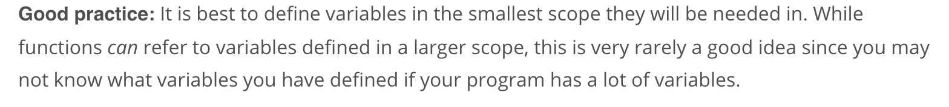
Variable scope
Several example of what can be done and what can’t be done
In general, “Variables are defined from a greater scope to a lower scope.”
What this means is that variables defined

Slide 4
Libraries in Python
Def: A library is a set previously defined functions in Python that require the “import” command to be used.
Import command’s syntax #1: import library_name as library_temporary_name
Import command’s syntax #2: from some_library import library_name as library_temporary_name
In order to be able to use a function from a library, this command must be written before the function in the library is to be used
Let us practice several examples now.

Slide 5
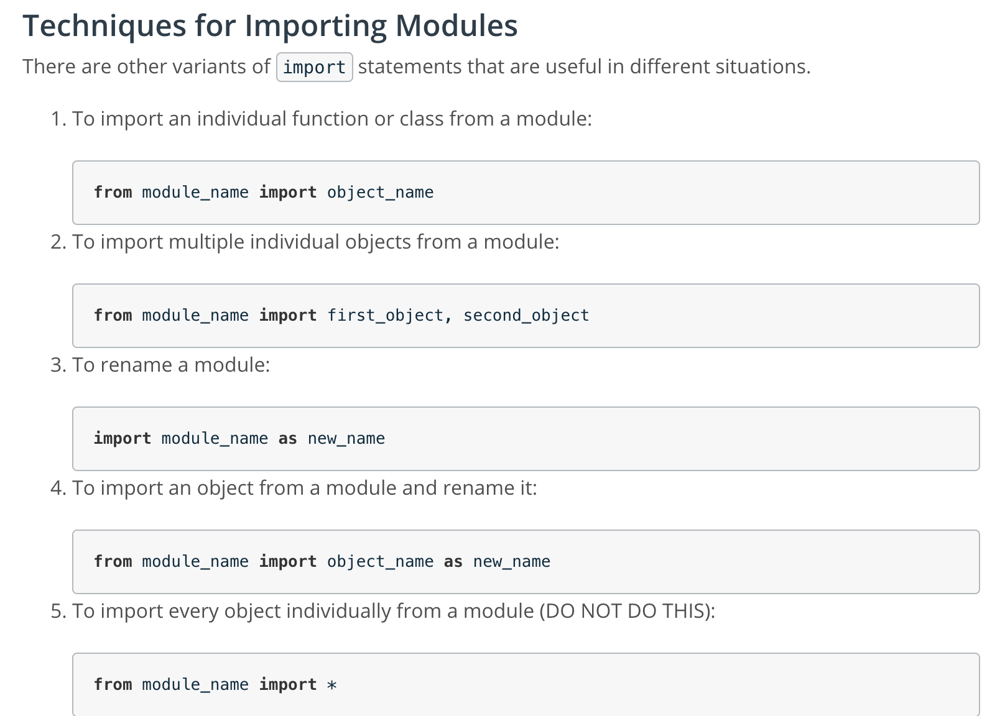

Slide 6
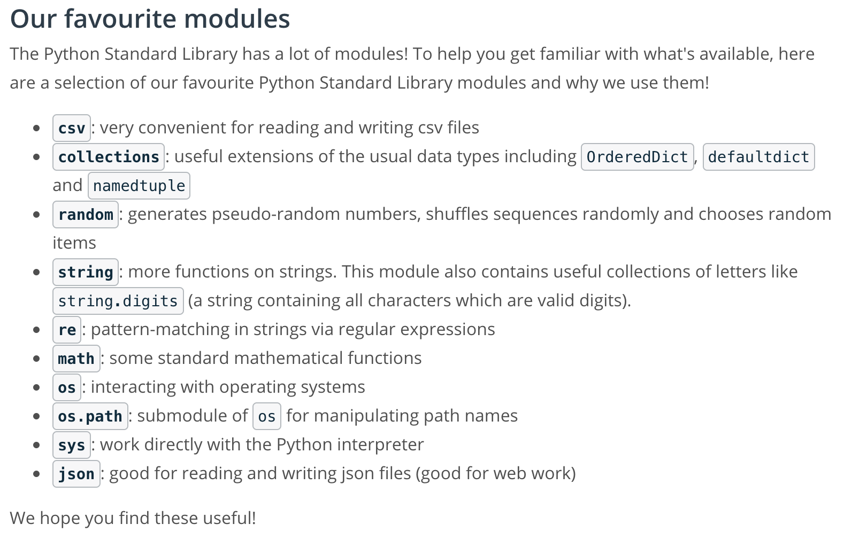
Most useful libraries

Slide 7
Becoming independent in python
Learning about good documentation.
Using Docstrings
Accessing docsrtrings in terminal using import library_name, dir(), and help(library_name.object)

Slide 8
Exercises for home
Practice problem: N factorial with while loops (to do in workshop). Practice doing it also with for loops.
N! as a recursive function (to discuss in workshop)
Study the Menu implemented before using while loop(s)

