Slide 1
Federal Assistance and Municipal Borrowing: Unpacking the effects of the CARES Act on Government Liquidity Management
O’Neill School of Public and Environmental Affairs
Luis Navarro
Presentation for the
Municipal Finance Conference
INDIANA UNIVERSITY BLOOMINGTON

Slide 2
Introduction
This paper examines the effect of federal aid on local government borrowing during macroeconomic crises.
While federal aid alleviates liquidity pressures, it could also signal the market the recipient government is more prone to experience larger economic dislocations. Empirical question!
Empirical Analysis: The Coronavirus Relief Fund (CRF) creates a quasi-experimental setting in which some governments received direct assistance from the Treasury.
This paper: county governments on the primary and secondary market (Apr20-Dec21). Outcomes: borrowing costs (bond spreads) and per-capita debt issuance/traded.
Notes:
At first sight, the relationship between these variables is not straightforward.
If the government is helping you, is because you might need it.

Slide 3


Findings Preview
Main Results
Primary Market Bond Spreads: ≈ ⬇️ 7−9 bps, 0.12-0.17x SD
Primary Market Debt Issuance: ⬆️ $1.7- $5.0, 0.13-0.39x SD
Secondary Market: results mixed and inconclusive.
Mechanisms and Liquidity Management
Credit risk: in the margin, lower rated governments observed larger spread reductions).
Maturity: substitution of longer-term debt towards shorter-term instruments.
Notes:
At first sight, the relationship between these variables is not straightforward.
If the government is helping you, is because you might need it.

Slide 4
Policy Description: Coronavirus Relief Fund (CRF)
CRF: $150 billion for state and local governments. Allocations across states proportional to population with no state receiving less than $1.25 billion.
Key: Counties and cities with population > 500K ➡️ Direct aid from the Treasury (subtracted from state’s allocation).
Coverage: 154 local governments received direct assistance. 118 counties from 32 states.
Payments to counties ➡️ Mean: $159 per capita; SD: $63 per capita.
Fungibility: CRF could cover: i) necessary expenses incurred due to the health emergency, ii) expenses not accounted for on local budgets (as of March 27, 2020), iii) and expenses incurred between Mar20-Dec21 (Extended to Dec22 on Dec21).
Enactment: March 27, 2020.

Slide 5
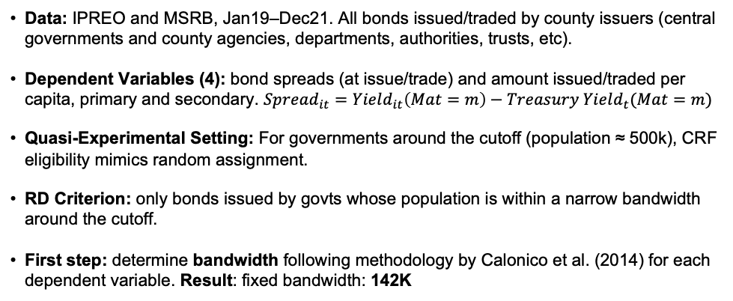
Empirical Analysis
Data: IPREO and MSRB, Jan19–Dec21. All bonds issued/traded by county issuers (central governments and county agencies, departments, authorities, trusts, etc).
Dependent Variables (4): bond spreads (at issue/trade) and amount issued/traded per capita, primary and secondary. $Spread_{it}=Yield_{it}\left(Mat=m\right)−Treasury Yield_{t}(Mat=m)$
Quasi-Experimental Setting: For governments around the cutoff (population ≈ 500k), CRF eligibility mimics random assignment.
RD Criterion: only bonds issued by govts whose population is within a narrow bandwidth around the cutoff.
First step: determine bandwidth following methodology by Calonico et al. (2014) for each dependent variable. Result: fixed bandwidth: 142K
Notes:
I study the quasi-experimental setting created by the CRF using the intuition behind a Regression Discontinuity Design.

Slide 6


Treatment and Control Groups
Treatment Group: Population 500K-642K | Control Group: Population 358K-499K
Primary Market 27 counties (44 issuers) [1,440 bonds] Secondary Market 32 counties (76 issuers) [82,082 bond trades] | Primary Market 50 counties (60 issuers) [1,619 bonds] Secondary Market 50 counties (124 issuers) [115,698 bond trades]
Notes:
I study the quasi-experimental setting created by the CRF using the intuition behind a Regression Discontinuity Design.

Slide 7
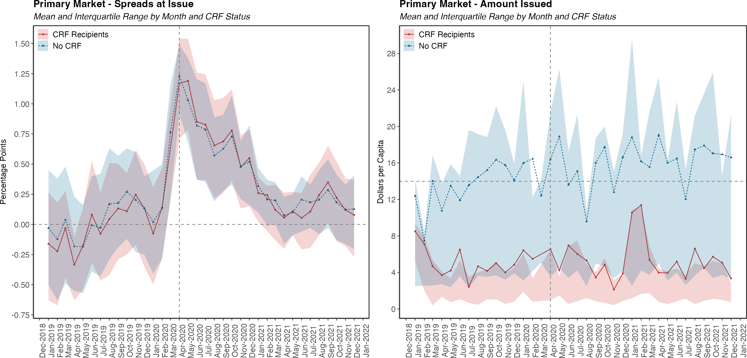
At the onset of the pandemic spreads spiked and returned to pre-pandemic levels until 2Q-2021.
No visual differences on primary market spreads.
Larger per-capita issuance from issuers on the control group.
Secondary market graphs show similar trends, with narrower differences across groups.
Notes: This graph shows the distribution of each dependent variable for each month between Jan-2019 and Dec-2021. The lines show the average for both treatment and control groups. The shaded areas show the inter-quartile range (i.e. distribution between the 25th and the 75th percentiles). Vertical dashed lines show the intervention month and separate the pre-intervention period from the post-intervention one. Horizontal gray dashed lines depict baseline comparisons. For the panel on the left (spreads) comparison is around zero (i.e. risk free rate), while for panel on the right (par issued/traded) the reference is the average of each dependent variable during the pre-treatment period.

Slide 8
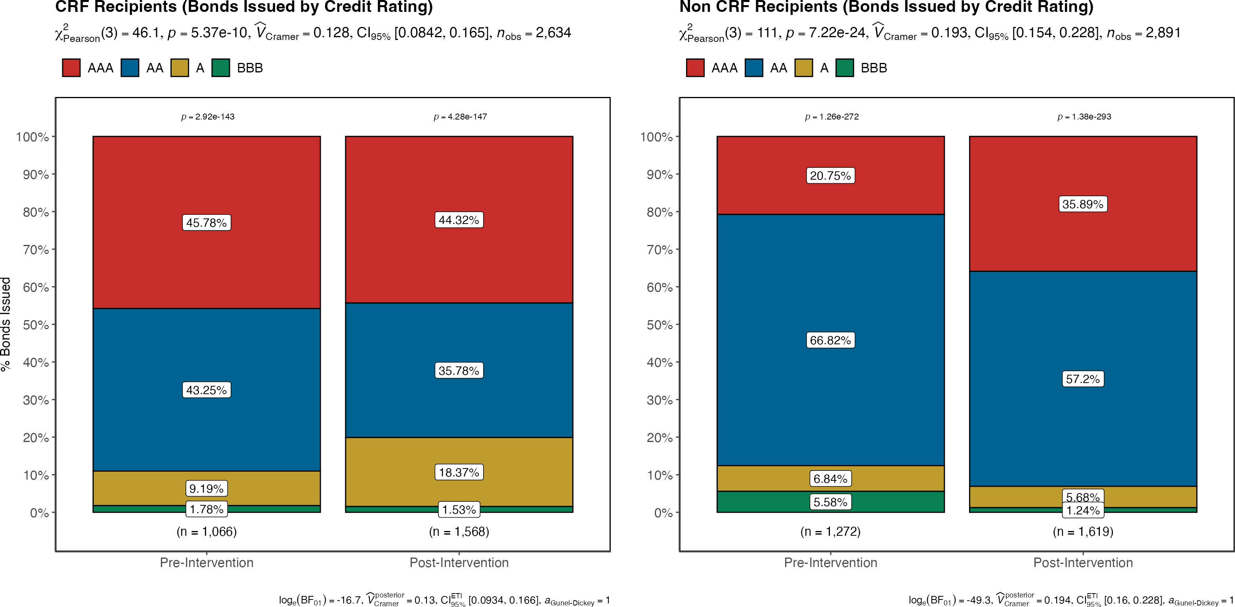
During the post-intervention period (Apr20:Dec21), there was a deterioration of the overall creditworthiness of CRF-recipient counties.
Figure: Primary Market Spreads by Treatment Status and Credit Rating
After the intervention:
Treatment Group: ⬇️ AA bonds with ⬆️ A bonds.
Control group: ⬆️ AAA bonds with ⬇️ AA bonds.
Possible interpretations:
Heightened credit risk for lower rated populated areas.
Higher rated governments observed improved access to the market.
Notes: These panels compare the distribution of bonds issued by credit rating before and after the intervention. Pearson statistic and corresponding p-value correspond to a Chi-squared association test where the null hypothesis is that the distribution by credit rating before the intervention is independent to the distribution after the intervention.

Slide 9
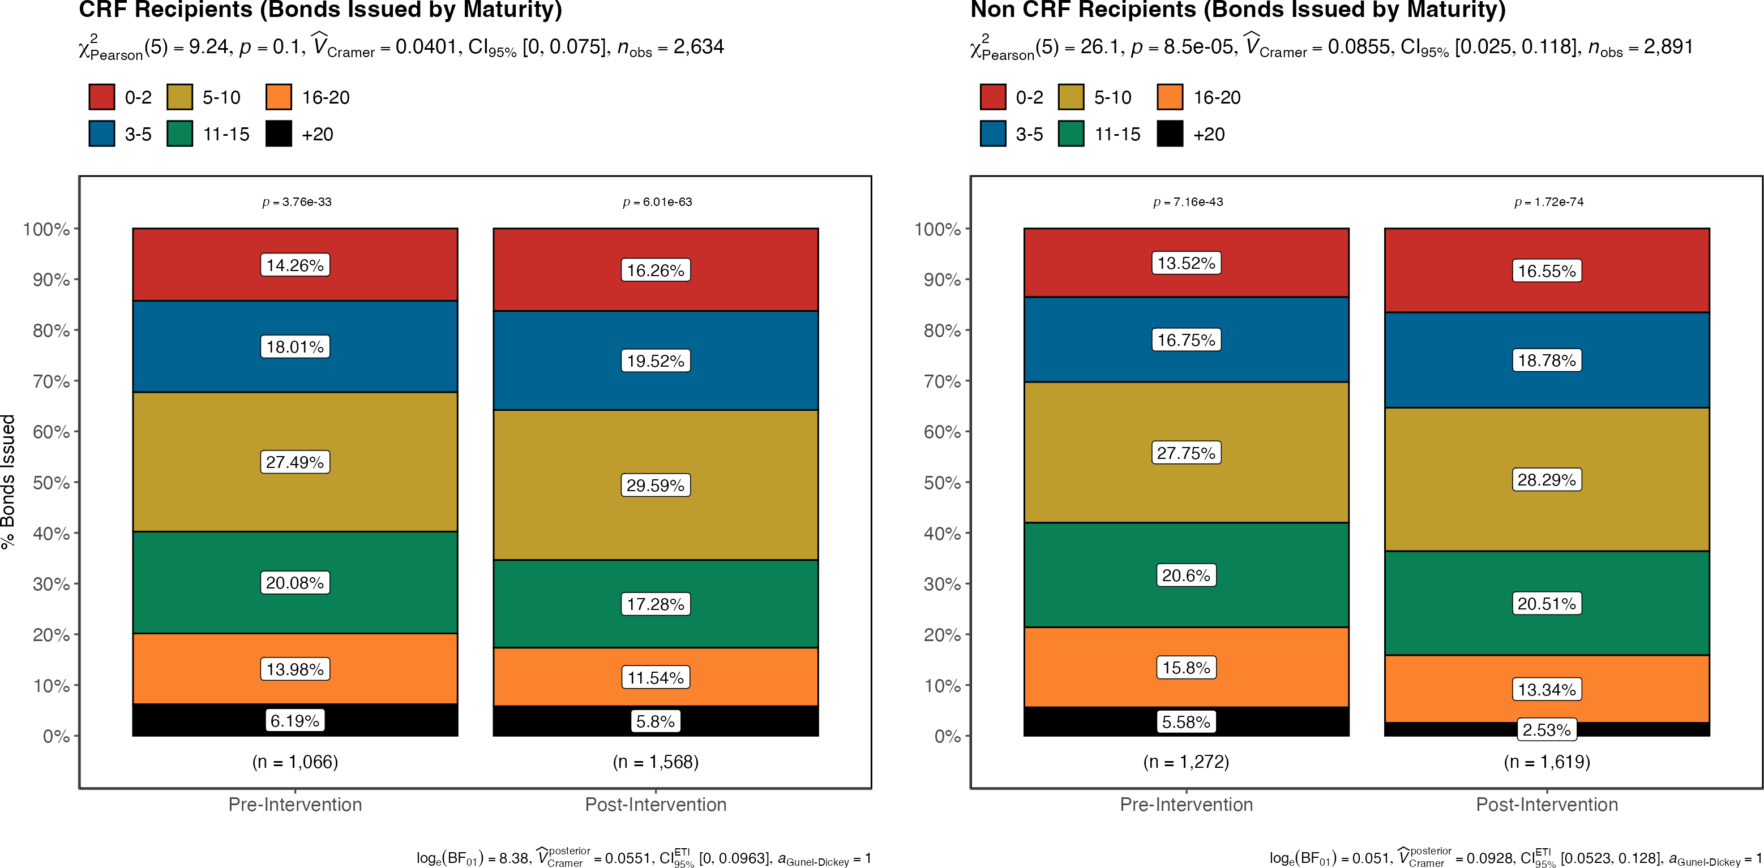
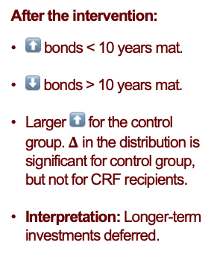
During the post-intervention period (Apr20:Dec21), issuers in both arms substituted longer-term debt towards shorter-term instruments.
Figure: Primary Market Spreads by Treatment Status and Years to Maturity
After the intervention:
⬆️ bonds < 10 years mat.
⬇️ bonds > 10 years mat.
Larger ⬆️ for the control group.$Δ$ in the distribution is significant for control group, but not for CRF recipients.
Interpretation: Longer-term investments deferred.
Notes: These panels compare the distribution of bonds issued by maturity before and after the intervention. Pearson statistic and corresponding p-value correspond to a Chi-squared association test where the null hypothesis is that the distribution by maturity before the intervention is independent to the distribution after the intervention.

Slide 10
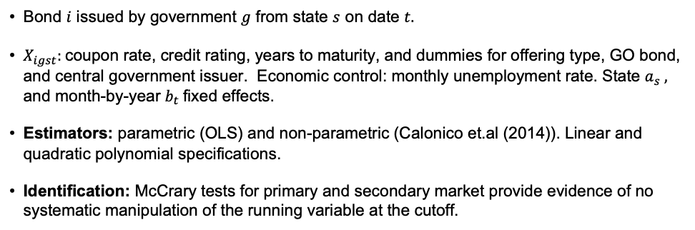
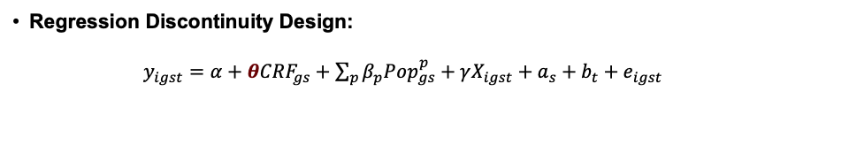
Econometric Analysis
Regression Discontinuity Design:
$y_{igst}=α+θCRF_{gs}+\sum_{p}{β_{p}Pop_{gs}^{p}+γX_{igst}+a_{s}+b_{t}+e_{igst}}$
Bond $i$ issued by government $g$ from state $s$ on date $t.$
$X_{igst}:$ coupon rate, credit rating, years to maturity, and dummies for offering type, GO bond, and central government issuer. Economic control: monthly unemployment rate. State $a_{s} ,$ and month-by-year $b_{t}$fixed effects.
Estimators: parametric (OLS) and non-parametric (Calonico et.al (2014)). Linear and quadratic polynomial specifications.
Identification: McCrary tests for primary and secondary market provide evidence of no systematic manipulation of the running variable at the cutoff.

Slide 11
Main Results
Table: LATE Estimates of the CRF on the Municipal Bond Market
Model | Spread Issue | Amount Issued | Spread Trade | Amount Traded
Panel A: Non-Parametric
Linear | -0.066* | 1.751* | 0.085*** | 0.0141
 | (0.0297) | (0.7711) | (0.0106) | (0.0108)
Quadratic | -0.4711* | -10.0827 | -2.6152*** | -0.316***
 | (0.1887) | (7.0314) | (0.0723) | (0.0716)
Panel B: Parametric
Linear | -0.0913 | 5.0732* | -0.4154 | 0.0744
 | (0.0553) | (2.0702) | (0.3178) | (0.043)
Quadratic | -0.0907 | 4.8842* | -0.4084 | 0.0742
 | (0.0579) | (2.0338) | (0.3122) | (0.043)
Mean Dep Var | 0.3772 | 6.7051 | 0.5438 | 0.2543
SD Dep Var | 0.5295 | 12.9271 | 0.9406 | 0.7897
Obs (Left Cutoff) | 1619 | 1619 | 115698 | 115698
Obs (Right Cutoff) | 1440 | 1440 | 82082 | 82082
Summary of LATE for CRF Recipients:
Primary Spreads: ≈ ⬇️ 7−9 bps, 0.12-0.17x SD. Upper bound: 47 bps (0.9xSD).
Primary Debt Iss: ⬆️ $1.7-5.0, 0.13-0.39x SD.
Secondary market: results are mixed and inconclusive, yet provide suggestive evidence toward:
⬇️ spreads at trade and ⬆️ trading volumes for bonds issued by CRF recipients.
Note: This table shows the coefficient estimates of the Local Average Treatment Effect for the dependent variables of interest. Each column shows the estimations from the non-parametric and parametric estimations, for both linear and quadratic polynomial specifications on the data during the post-intervention period. For the non-parametric estimation, bias corrected estimates with robust standard errors are reported. Parametric estimation reports standard errors clustered at the county level. All econometric specifications include control variables, state and month-by-year fixed effects. Spreads at issue and trade are expressed in percentage points and amount issued and traded are expressed in dollars per capita. *** p < 0.001 , ** p < 0.01, * p < 0.05.

Slide 12
Robustness Checks: Baseline Model
Bandwidth 90K: stronger ⬇️ in bond spreads (12-23 bps, 0.22-0.43x SD) and larger increase in debt issuance ($2.0-$8.7 per capita).
Bandwidth 221K: results within the magnitude and precision of the baseline model.
Only county central governments: stronger ⬇️ in primary spreads: 23-25 bps. Precise estimates for secondary spreads: ⬇️ 23-58 bps. Mixed evidence on amount issued/traded.

Slide 13
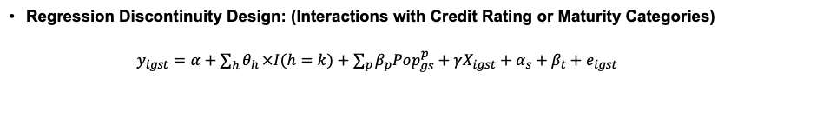
LATE Heterogeneity by Credit Rating and Time to Maturity
Regression Discontinuity Design: (Interactions with Credit Rating or Maturity Categories)
$y_{igst}=α+\sum_{h}{θ_{h}}×I(h=k)+\sum_{p}{β_{p}Pop_{gs}^{p}+γX_{igst}+α_{s}+β_{t}+e_{igst}}$
Summary of Results
While not precisely estimated, results confirm descriptive evidence and suggest a substitution of longer-term instruments towards shorter-term ones.
Large and significant ⬇️ in primary bond spreads for bonds A-rated and above. In the margin, lower rated instruments observed larger spread reductions.
Results for the secondary market show suggestive evidence of fly-to-safety behavior: ⬇️ trading shorter-term bonds and ⬆️ trading of longer-term bonds.

Slide 14
Conclusions
Broadly, the findings indicate that recipient governments observed mild reductions in their borrowing costs and increased their debt issuance on the primary market, with no significant spillovers to the secondary market.
This indicates that federal aid produced crowd-in effects for local governments that enabled the provision of local services.
This analysis provides some suggestive evidence on the liquidity management undertaken by local governments. It documents an increase in the issuance of short-term debt, at the expense of reductions on the issuance of longer-term bonds.

Slide 15

Thanks for your attention!
Scan to learn more about this project.
I am in the Job Market!
Contact: Luis Navarro lunavarr@iu.edu

Slide 16
Appendix

Slide 17
Coming to the pandemic, treated governments observed lower bond spreads, and less debt issued and traded…
Table: Balance Table: Municipal Debt Outcomes (Primary and Secondary Markets)
Pre-Intervention Period (Jan19 – Mar20) Post-Intervention Period (Apr20-Dec21)
Post-Intervention Period:
Larger increase in bond spreads and amount of debt issued/traded for treated units.
Unconditional differences on primary bond spreads not significant.
Variable | Control | Treatment | Mean Diff | Control | Treatment | Mean Diff
Panel A: Dependent Variables
Spread at Issue | 0.0820 | -0.0497 | -0.1317*** | 0.3817 | 0.3726 | -0.0091
 | (0.5572) | (0.4727) | (0.0213) | (0.5241) | (0.5351) | (0.0188)
Amount Issued Per Capita | 7.1220 | 4.6512 | -2.4708*** | 7.4964 | 5.8880 | -1.6085***
 | (14.3861) | (9.5284) | (0.4979) | (13.0134) | (12.7902) | (0.4571)
Spread at Trade | 0.2950 | 0.2103 | -0.0847*** | 0.6402 | 0.4226 | -0.2176***
 | (0.8971) | (0.8782) | (0.0044) | (1.0243) | (0.8071) | (0.0040)
Amount Traded Per Capita | 0.2892 | 0.2303 | -0.0588*** | 0.2662 | 0.2394 | -0.0268***
 | (0.8308) | (0.7299) | (0.0038) | (0.8008) | (0.7753) | (0.0035)
Note: This table shows the balance table across the treatment and control groups, for both the pre-intervention and post-intervention period. Columns Control and Treatment show the mean of each variable, with the standard deviation reported in parenthesis. The column Mean Diff shows the result of a t-test with the standard error reported in parenthesis.

Slide 18
Table: Descriptive Statistics
Variable | Mean | SD | Min | P25 | P50 | P75 | Max | N
Panel A: Primary Market
Spread at Issue | 0.2269 | 0.5558 | -0.93 | -0.18 | 0.14 | 0.58 | 2.27 | 5525
Amount Issued Per Capita | 6.4048 | 12.7385 | 0.0722 | 1.3529 | 3.2381 | 6.7978 | 195.2708 | 5525
Coupon | 3.602 | 1.3746 | 0 | 2.471 | 4 | 5 | 5 | 5525
Credit Rating | 2.8822 | 1.958 | 1 | 1 | 3 | 4 | 10 | 5525
Years to Maturity | 9.3189 | 6.5066 | 0 | 4 | 8 | 14 | 39 | 5525
Offering Type | 0.5006 | 0.5 | 0 | 0 | 1 | 1 | 1 | 5525
GO Bond | 0.5694 | 0.4952 | 0 | 0 | 1 | 1 | 1 | 5525
Central Government | 0.6626 | 0.4729 | 0 | 0 | 1 | 1 | 1 | 5525
Unemployment Rate | 4.9132 | 2.5674 | 1.8 | 3.1 | 4.4 | 5.8 | 17.4 | 5525
Panel B: Secondary Market
Spread at Trade | 0.4172 | 0.9293 | -2.708 | -0.21 | 0.236 | 0.808 | 4.414 | 373144
Amount Traded Per Capita | 0.2585 | 0.7894 | 0.008 | 0.0271 | 0.0564 | 0.138 | 10.1146 | 373144
Note: This table shows the descriptive statistics of the samples used for the primary and secondary market analysis. Spreads, coupon rate, and the unemployment rate are expressed in percentage points and amounts (issued an traded) in dollars per capita. Offering Type, GO Bond and Central Government are dummy variables that equal to one if the bond sale was competitive, the bond is a general obligation bond, and was issued by the central county government, respectively.

Slide 19
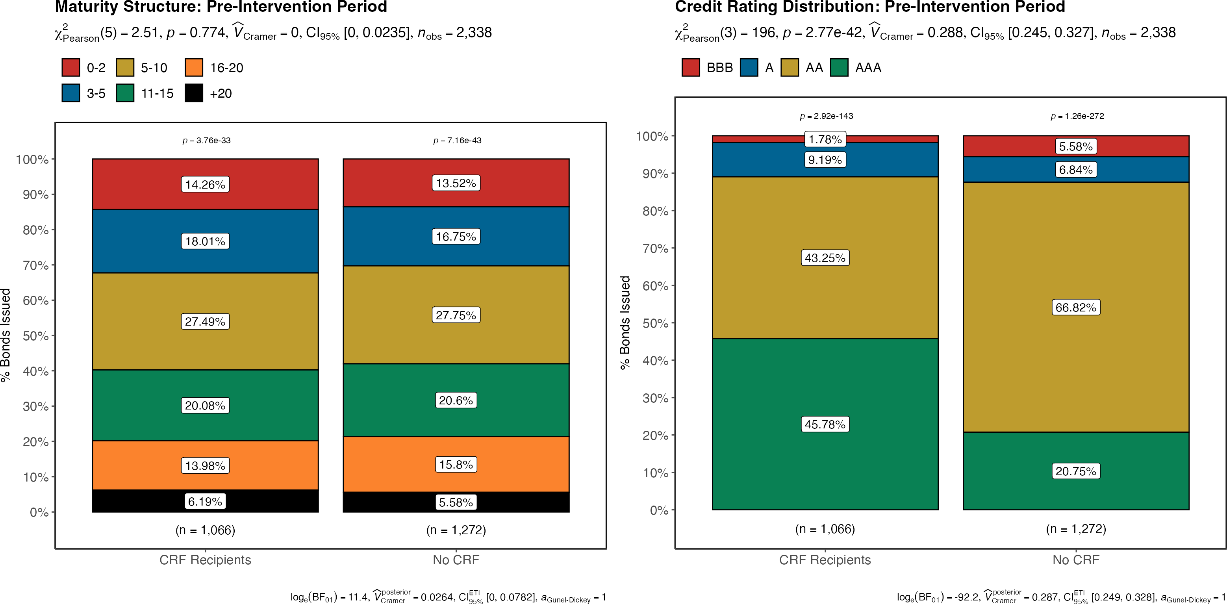
Comparing the distribution of bonds issued between groups during the pre-intervention period reveals:
No significant differences by maturity structure across groups.
Non-CRF recipients observed a slightly riskier credit profile (lower % of AAA bonds and higher % of AA bonds).
Notes: These panels compare bond issues by governments on the treat and control groups during the pre-treatment period. The bar-plots compare the distribution of bonds issued by maturity and credit rating between the treatment and control groups. Pearson statistic and corresponding p-value correspond to a Chi-squared association test where the null hypothesis is that the distribution by maturity (and credit rating) of the control group is independent to the distribution of the treatment group.

Slide 20
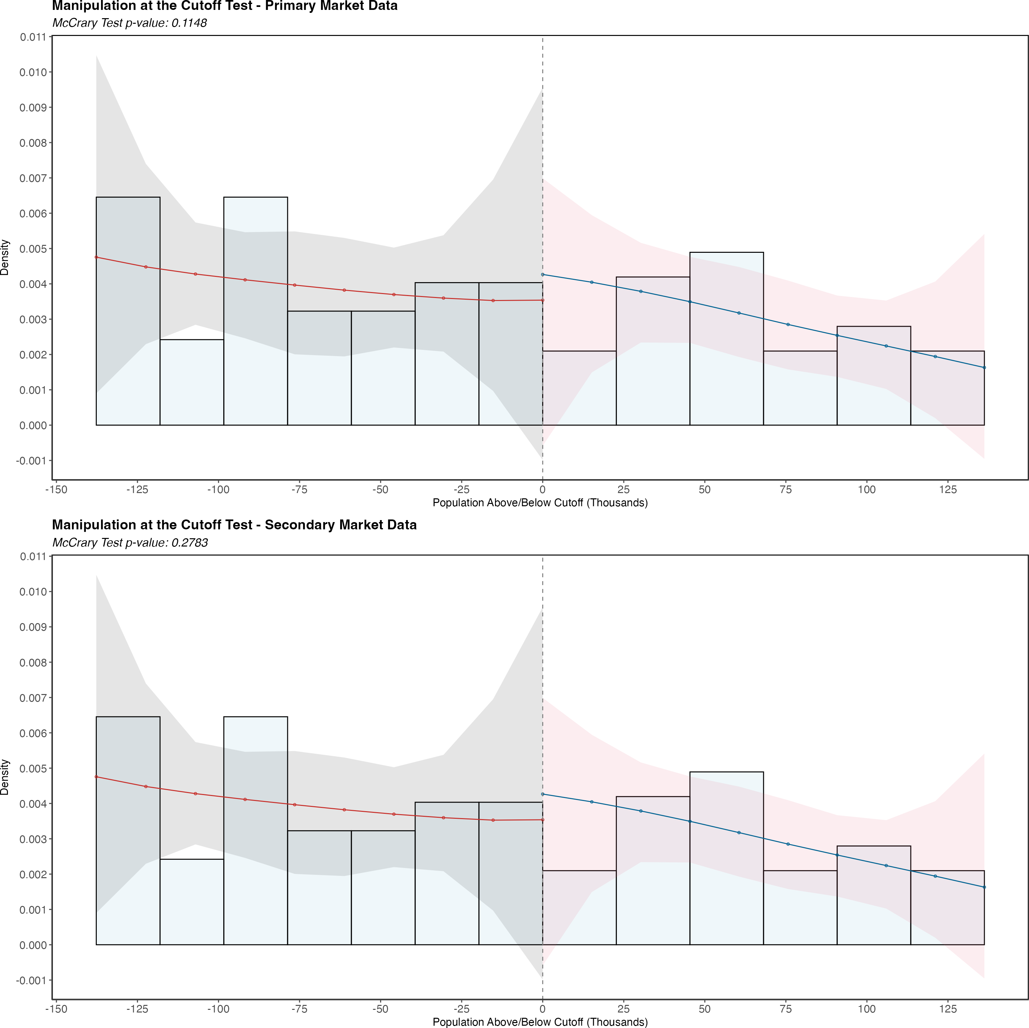
Figure: Manipulation at the Cutoff Test
Note: This figure shows the histogram of the running variable (i.e. population) and shows the estimated polynomial for each side of the cutoff, along with its confidence intervals at the 95% of significance. These intervals are represented as the shaded areas on the graph. Units on the vertical axis represent the density of the running variable. Observations in red correspond to governments in the control group, while observations in blue to units from the treatment group.

Slide 21
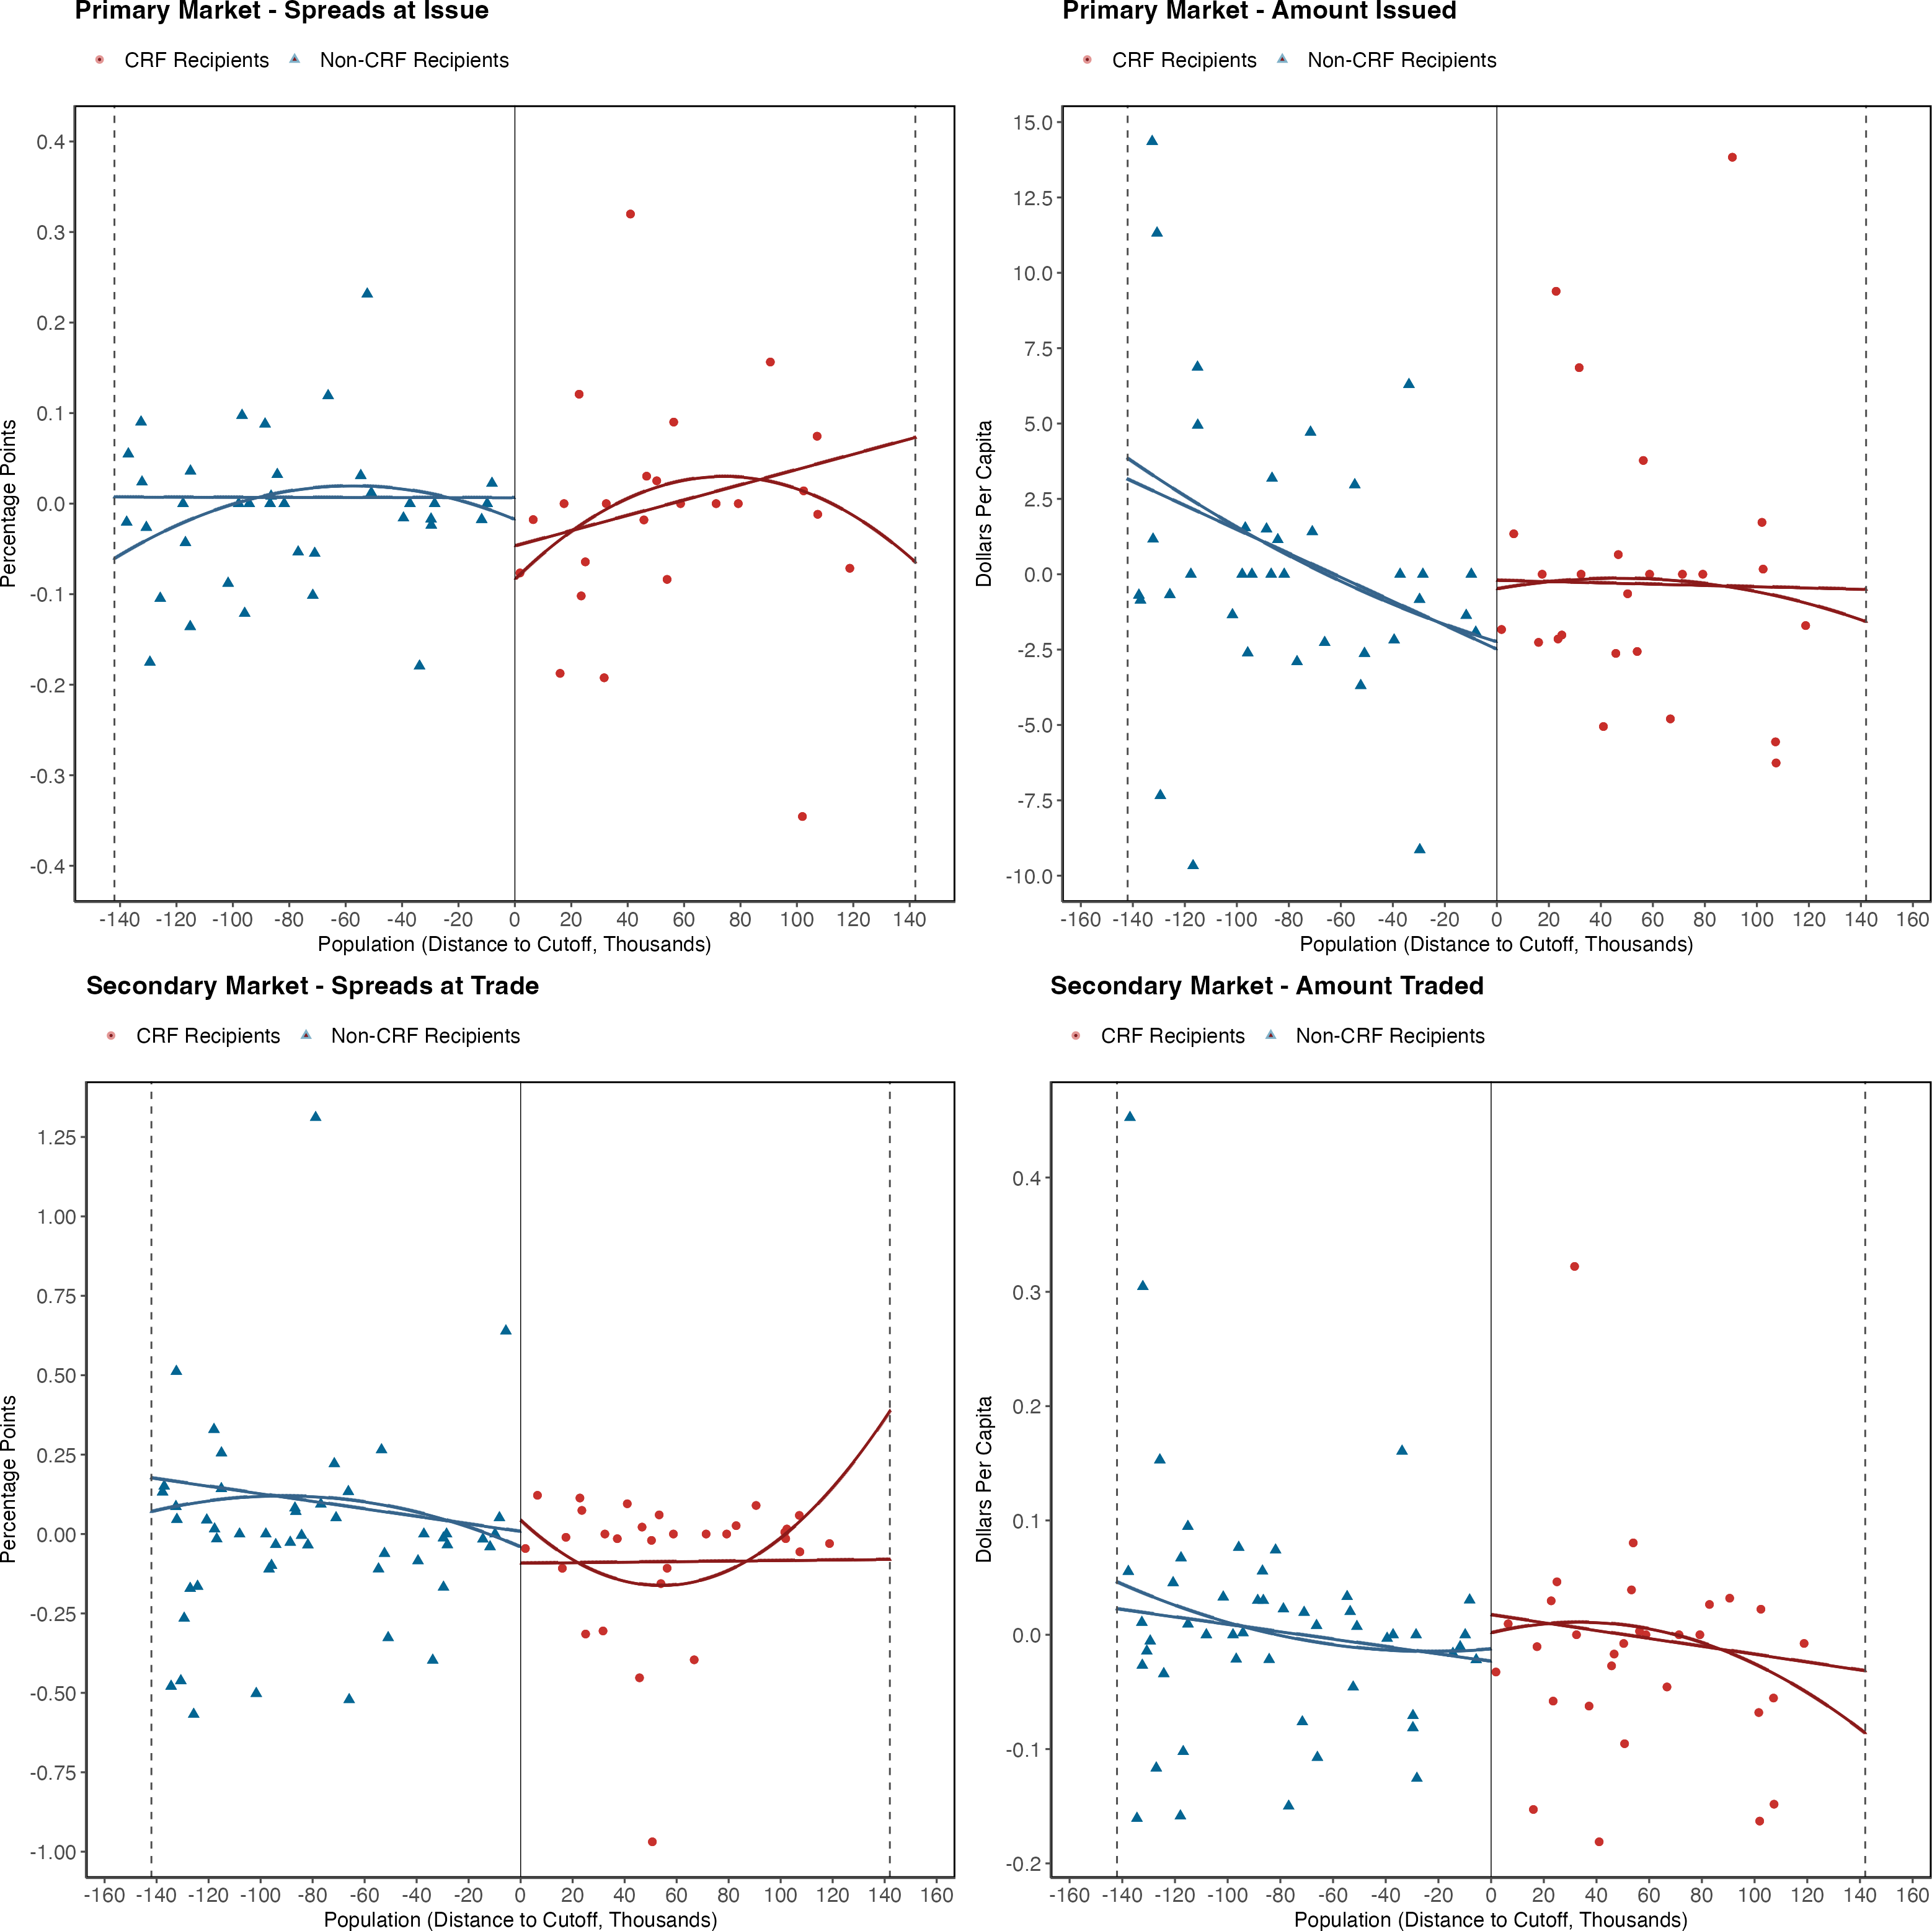
Figure: Regression Discontinuity Plots - Non Parametric Estimation
Note: These figures display the scatter binned plots of the dependent variables around the cutoff for treatment assignment, as well as the results from the non-parametric estimation of the statistical model at Equation 1. The gray dashed lines show the optimal bandwidth used for the estimation of the Local Average Treatment Effect. Both linear and quadratic estimations are reported. The top-left scatter-plot (spreads at issue) restricts the vertical axis to exclude an outlier observation that obscures the visualization results.

Slide 22
Table: LATE Estimates of the CRF on the Municipal Bond Market (Bandwidth = 90K)
Model | Spread Issue | Amount Issued | Spread Trade | Amount Traded
Panel A: Non-Parametric
Linear | -0.122*** | 2.0563* | -0.1936*** | -0.0073
 | (0.0348) | (0.8468) | (0.013) | (0.0132)
Quadratic | -1.4567*** | -23.5114 | 1.8227*** | -0.5106***
 | (0.4362) | (16.662) | (0.1221) | (0.1073)
Panel B: Parametric
Linear | -0.1858 | 8.763* | 0.1468 | 0.0783
 | (0.1026) | (3.8046) | (0.2258) | (0.0547)
Quadratic | -0.2326* | 7.1787** | 0.1369 | 0.0799
 | (0.1019) | (2.6133) | (0.2274) | (0.0563)
Mean Dep Var | 0.4367 | 6.6966 | 0.5943 | 0.252
SD Dep Var | 0.5402 | 12.4442 | 0.9836 | 0.7779
Obs (Left Cutoff) | 1117 | 1117 | 76170 | 76170
Obs (Right Cutoff) | 1012 | 1012 | 57652 | 57652
Note: This table shows the coefficient estimates of the Local Average Treatment Effect for the dependent variables of interest, on the sample of bonds of all issuers with a population within 90 thousand people from the cutoff. Each column shows the estimations from the non-parametric and parametric estimations, for both linear and quadratic polynomial specifications on the data during the post-intervention period. For the non-parametric estimation, bias corrected estimates with robust standard errors are reported. Parametric estimation reports standard errors clustered at the county level. All econometric specifications include control variables, state and month-by-year fixed effects. Spreads at issue and trade are expressed in percentage points and amount issued and traded are expressed in dollars per capita. *** p < 0.001 , ** p < 0.01, * p < 0.05.

Slide 23
Table: LATE Estimates of the CRF on the Municipal Bond Market (Bandwidth = 221K)
Model | Spread Issue | Amount Issued | Spread Trade | Amount Traded
Panel A: Non-Parametric
Linear | -0.0727* | 0.9516 | 0.0778*** | 0.0093
 | (0.029) | (0.7716) | (0.0105) | (0.0108)
Quadratic | -0.4514* | -7.5199 | -3.1384*** | -0.2907***
 | (0.1849) | (7.0466) | (0.0712) | (0.0696)
Panel B: Parametric
Linear | -0.0913 | 5.0732* | -0.4154 | 0.0744
 | (0.0553) | (2.0702) | (0.3178) | (0.043)
Quadratic | -0.0907 | 4.8842* | -0.4084 | 0.0742
 | (0.0579) | (2.0338) | (0.3122) | (0.043)
Mean Dep Var | 0.3958 | 6.5797 | 0.5445 | 0.2582
SD Dep Var | 0.533 | 12.4497 | 0.9353 | 0.7978
Obs (Left Cutoff) | 3130 | 3130 | 123691 | 123691
Obs (Right Cutoff) | 1736 | 1736 | 88717 | 88717
Note: This table shows the coefficient estimates of the Local Average Treatment Effect for the dependent variables of interest, on the sample of bonds of all issuers with a population within 221 thousand people from the cutoff. Each column shows the estimations from the non-parametric and parametric estimations, for both linear and quadratic polynomial specifications on the data during the post-intervention period. For the non-parametric estimation, bias corrected estimates with robust standard errors are reported. Parametric estimation reports standard errors clustered at the county level. All econometric specifications include control variables, state and month-by-year fixed effects. Spreads at issue and trade are expressed in percentage points and amount issued and traded are expressed in dollars per capita. *** p < 0.001 , ** p < 0.01, * p < 0.05.

Slide 24
Table: LATE Estimates of the CRF on the Municipal Bond Market - Only Central County Governments
Model | Spread Issue | Amount Issued | Spread Trade | Amount Traded
Panel A: Non-Parametric
Linear | -0.0305 | -1.0945 | -0.2301*** | -0.0466*
 | (0.0378) | (1.0154) | (0.0127) | (0.0181)
Quadratic | -0.3976 | -4.316 | -2.0331*** | -0.433***
 | (0.2672) | (8.7396) | (0.0891) | (0.1053)
Panel B: Parametric
Linear | -0.2346* | 3.2395 | -0.5842 | 0.0939
 | (0.1112) | (4.6124) | (0.3139) | (0.0663)
Quadratic | -0.2584* | 2.4895 | -0.5355* | 0.0878
 | (0.0966) | (4.6091) | (0.2678) | (0.0693)
Mean Dep Var | 0.3368 | 7.2556 | 0.4833 | 0.267
SD Dep Var | 0.4975 | 12.5913 | 0.8759 | 0.8204
Obs (Left Cutoff) | 1058 | 1058 | 76896 | 76896
Obs (Right Cutoff) | 876 | 876 | 49474 | 49474
Note: This table shows the coefficient estimates of the Local Average Treatment Effect for the dependent variables of interest on the sample of bonds considering only central county government issuers. Each column shows the estimations from the
non-parametric and parametric estimations, for both linear and quadratic polynomial specifications on the data during the
post-intervention period. For the non-parametric estimation, bias corrected estimates with robust standard errors are reported. Parametric estimation reports standard errors clustered at the county level. All econometric specifications include control variables, state and month-by-year fixed effects. Spreads at issue and trade are expressed in percentage points and amount issued and traded are expressed in dollars per capita. *** p < 0.001 , ** p < 0.01, * p < 0.05.

Slide 25
Table: Robustness Checks: Placebo Estimates on the LATE
Model | Spread Issue | Amount Issued | Spread Trade | Amount Traded
Panel A: Non-Parametric
Linear | -0.029 | 1.4842 | 0.1307*** | 0.0286*
 | (0.0324) | (0.9819) | (0.0129) | (0.0115)
Quadratic | -0.2298 | 10.7008 | -0.5077*** | -0.3324***
 | (0.1992) | (7.6214) | (0.0793) | (0.0796)
Panel B: Parametric
Linear | -0.0949 | 4.9162* | 0.0121 | 0.0583
 | (0.0859) | (2.4537) | (0.0923) | (0.0525)
Quadratic | -0.0935 | 5.0143 | 0.0174 | 0.0536
 | (0.0836) | (2.5278) | (0.0896) | (0.051)
Mean Dep Var | 0.0219 | 5.9954 | 0.2582 | 0.2636
SD Dep Var | 0.5244 | 12.4678 | 0.8899 | 0.789
Obs (Left Cutoff) | 1272 | 1272 | 93529 | 93529
Obs (Right Cutoff) | 998 | 998 | 63630 | 63630
Note: This table shows the coefficient estimates of the Local Average Treatment Effect for the dependent variables of interest. Each column shows the estimations from the non-parametric and parametric estimations, for both linear and quadratic polynomial specifications on the data during the post-intervention period. For the non-parametric estimation, bias corrected estimates with robust standard errors are reported. Parametric estimation reports standard errors clustered at the county level. All econometric specifications include control variables, state and month-by-year fixed effects. Spreads at issue and trade are expressed in percentage points and amount issued and traded are expressed in dollars per capita. *** p < 0.001 , ** p < 0.01, * p < 0.05.

Slide 26
Federal Assistance and Municipal Borrowing: Unpacking the effects of the CARES Act on Government Liquidity Management
O’Neill School of Public and Environmental Affairs
Luis Navarro
Presentation for the
Municipal Finance Conference
INDIANA UNIVERSITY BLOOMINGTON

