Slide 1
SPEA-V-202
Contemporary Economic Issues in Public Affairs
Healthcare and Insurance
Luis Navarro

Slide 2


Outline for Today
Economic Theory of Insurance
Diminishing Marginal Utility
Consumption Smoothing
Information Asymmetries
Market for Lemons and Insurance
Equilibrium with perfect and imperfect information
Risk Aversion

Slide 3













Quick Recap of Demand Theory
Remember this diagram? It shows the marginal benefit of consuming an additional unit of some good, at p=2.
The marginal benefit of the 1st unit is 6. The marginal benefit for the 2nd unit is 4, and so and so forth. This is a consequence of having negatively sloped demand curves.
This is called diminishing marginal utility or diminishing marginal benefit.
The incremental benefit of consuming another unit of the good is decreasing: each additional bite of the cake provides lower benefits (pleasure).
$$P$$
$$P\left(Q\right)=10 −2Q$$
$$MB\left(1\right)=6$$
$$8$$
$$MB\left(2\right)=4$$
$$6$$
$$MB\left(3\right)=2$$
$$4$$
$$MB\left(4\right)=0$$
$$Q$$
$$1$$
$$2$$
$$3$$
$$4$$

Slide 4
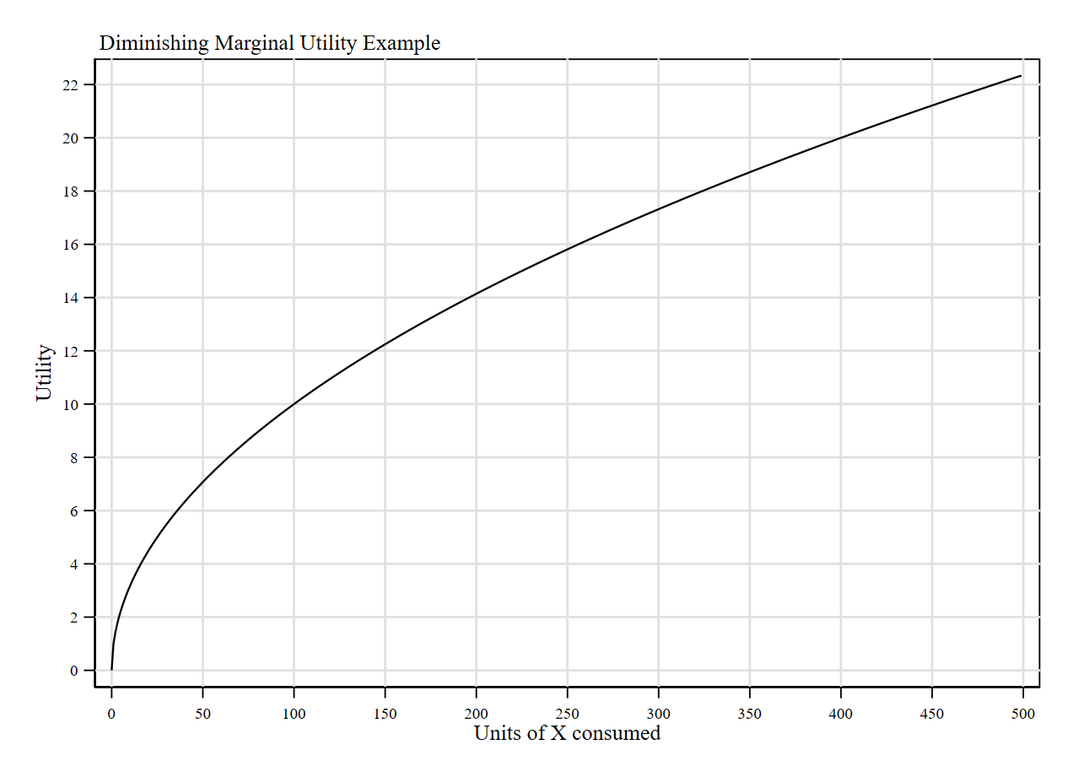
Diminishing Marginal Utility
Perhaps another representation might be helpful. The following diagram represents in the y-axis the total benefits you derive from consuming a good. Economists often use utility functions for this.
Intuition: the utility function is just a representation of your preferences for consumption. In general, it satisfies one property: is increasing at decreasing rates.
Increasing: each additional unit consumed leads to higher benefits (utility).
Decreasing rates: the size of each increment in utility gets smaller with additional unit consumed.

Slide 5


Diminishing Marginal Utility
Analytical framework: suppose there are two states of the world: today and the future. Let x be a bundle of all the things you buy.
Today your income is enough to buy up to 400 units of x. In the future, however, you won’t be able to work the same number of hours so your income can only buy 50 units.
Note this: giving up 50 units of x today (i.e. moving from 400 to 350), derives in losing ≈ 1.29 units of utility (“utils”). At the same time, increasing your future consumption from 50 units to 100 leads to a rise of ≈ 2.92. utils.
Takeaway: you will be better off if your present self can send some units to your future self.
Intuition: theoretical motivation for savings.

Slide 6
Consumption Smoothing
The previous example highlights the basic intuition behind insurance (and financial) markets: consumption smoothing.
Consumption smoothing: translation of consumption from periods when consumption is high (low marginal utility) to periods when consumption is low (high marginal utility).
This is the same motivation behind retirement savings. You will be better off if you can transfer some units of consumption from the present to the future. How do you do that?
Saving money!
How does this relate to insurance markets and healthcare?

Slide 7
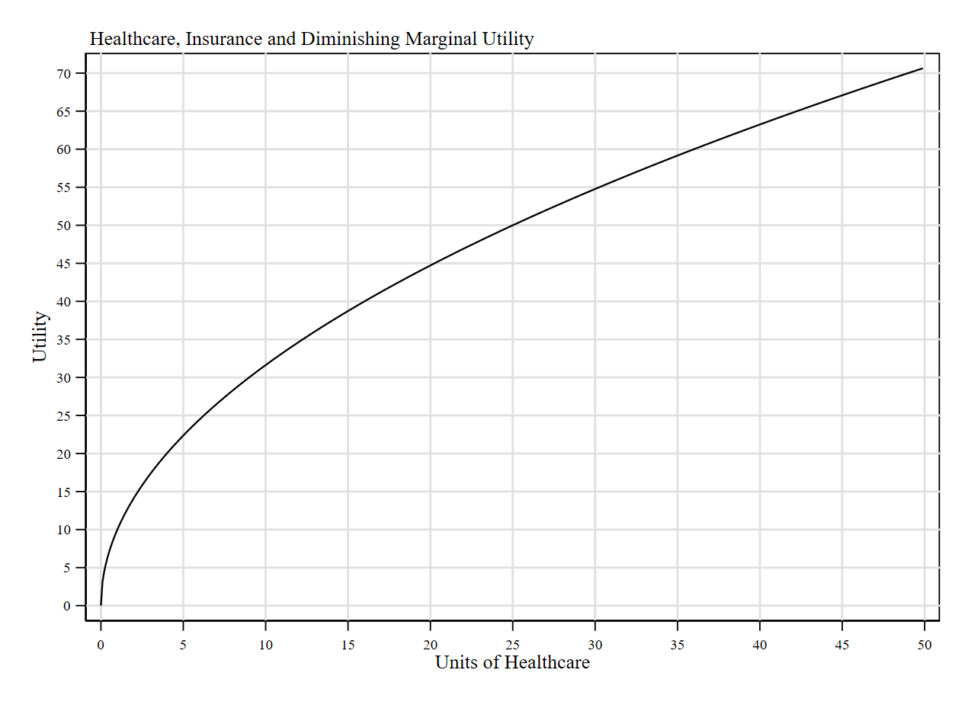


Consumption Smoothing
Example: suppose there are two states of the world: healthy and sick. Let x be units of healthcare.
If you are healthy: low healthcare consumption (high marginal utility).
If you are sick, however, you might require some medical care: high healthcare consumption (low marginal utility).
Consumption smoothing transferring some healthcare units from the state of the world where you are healthy to the one where you are sick.
What is the version of “saving” here?
Getting insurance!!

Slide 8
Insurance Markets
Insurance markets provide a solution to transfer healthcare consumption across states of the world.
Insurance could be thought of as a special way of saving money.
How does it work for consumers? Each period you will pay a premium (save some money), and if/when you observe the bad state of the world (get sick) you will have money to face that situation.
How does it work for providers? With everyone’s premiums, a pool of resources is formed. Whenever an insured individual faces the bad state of the world (gets sick), she can tap into the pool and pay her medical bills.
If the market operates properly, then premiums (prices) in equilibrium should provide enough money to cover the expected healthcare costs of the economy (pool of insured people).
Key question: how premiums are determined in equilibrium? In other words, how much are you willing to pay to hedge yourself against the bad state of the world? It depends on the probability of getting sick and the expected costs associated with being sick.

Slide 9

Insurance Vocabulary
Definition: an insurance contract provides (some) coverage when you are in the bad state of the world, in exchange for some premiums.
In general, insurance contracts (especially health insurance) have 3 types of payments:
Deductibles: individuals face the full cost of their care but only up to some limit. For example, a $100 deductible means you pay the first $100 of your medical costs of the year, and the insurance company pays some or all the costs thereafter.
Copayment: individuals make some fixed payment when they get a medical good or service. For example: a $20 copayment for a doctor’s office visit or a new prescription.
Coinsurance: the patient pays a percentage (coinsurance rate) of each medical bill, rather than a flat dollar amount (copayment).

Slide 10
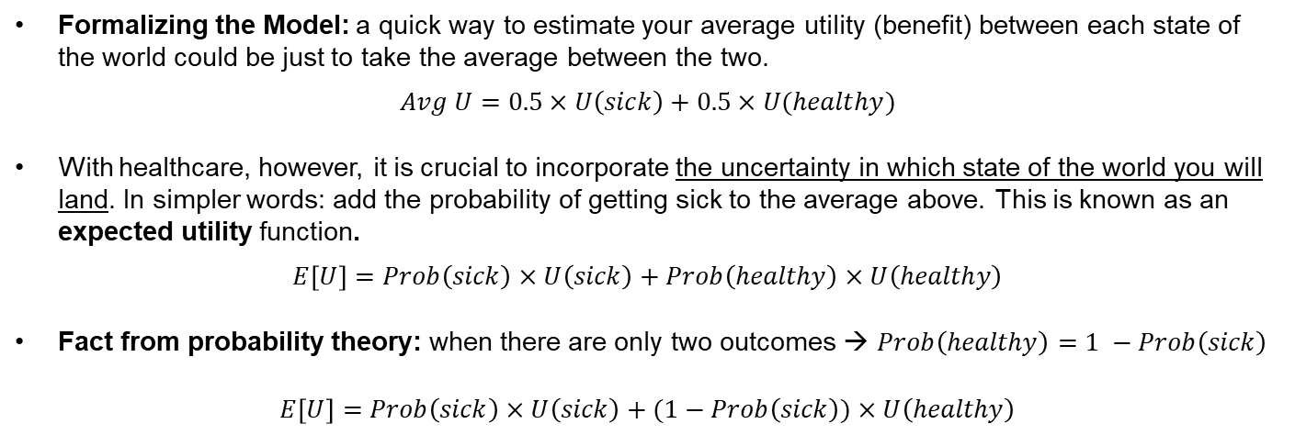
Economics of Insurance: Demand Side
Formalizing the Model: a quick way to estimate your average utility (benefit) between each state of the world could be just to take the average between the two.
$$Avg U=0.5×U\left(sick\right)+0.5×U(healthy)$$
With healthcare, however, it is crucial to incorporate the uncertainty in which state of the world you will land. In simpler words: add the probability of getting sick to the average above. This is known as an expected utility function.
$$E\left[U\right]=Prob\left(sick\right)×U\left(sick\right)+Prob\left(healthy\right)×U\left(healthy\right)$$
Fact from probability theory: when there are only two outcomes → $Prob\left(healthy\right)=1 −Prob\left(sick\right)$
$E\left[U\right]=Prob\left(sick\right)×U\left(sick\right)+(1−Prob\left(sick\right))×U\left(healthy\right)$

Slide 11
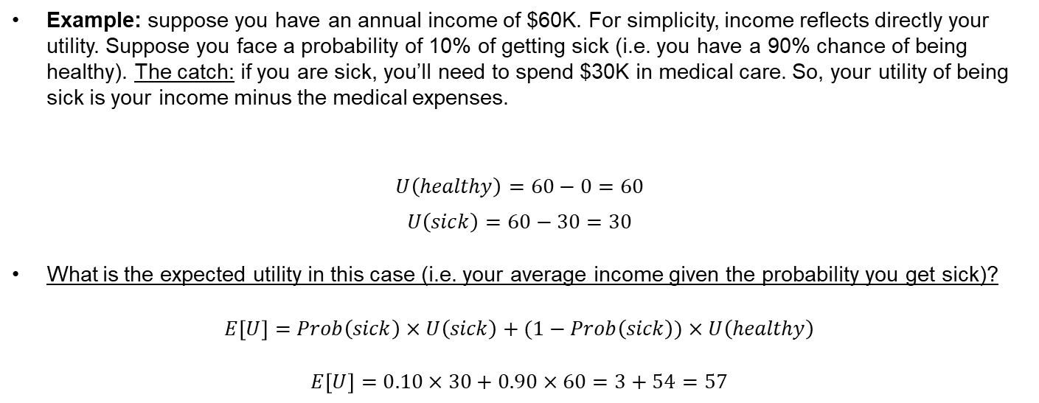
Expected Utility
Example: suppose you have an annual income of $60K. For simplicity, income reflects directly your utility. Suppose you face a probability of 10% of getting sick (i.e. you have a 90% chance of being healthy). The catch: if you are sick, you’ll need to spend $30K in medical care. So, your utility of being sick is your income minus the medical expenses.
$$U\left(healthy\right)=60−0=60$$
$$U\left(sick\right)=60−30=30$$
What is the expected utility in this case (i.e. your average income given the probability you get sick)?
$E\left[U\right]=Prob\left(sick\right)×U\left(sick\right)+(1−Prob\left(sick\right))×U\left(healthy\right)$
$E\left[U\right]=0.10×30+0.90×60=3+54=57$

Slide 12
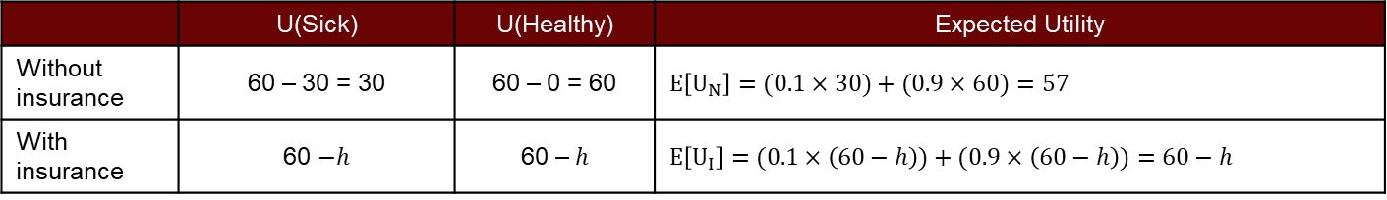
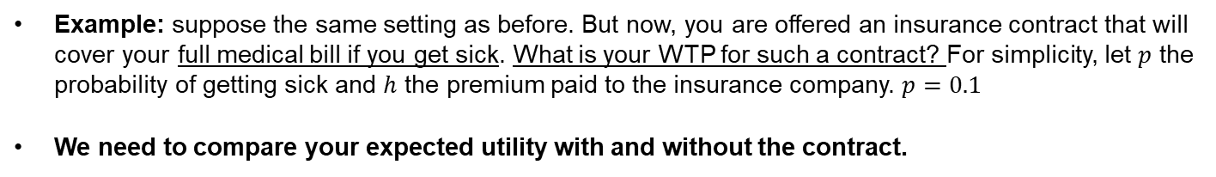


Insurance Premiums
Example: suppose the same setting as before. But now, you are offered an insurance contract that will cover your full medical bill if you get sick. What is your WTP for such a contract? For simplicity, let $p$ the probability of getting sick and $h$ the premium paid to the insurance company. $p=0.1$
We need to compare your expected utility with and without the contract.
 | U(Sick) | U(Healthy) | Expected Utility
Without insurance | 60 – 30 = 30 | 60 – 0 = 60 | $$E\left[U_{N}\right]=(0.1×30)+(0.9×60)=57$$
With insurance | 60 $−h$ | 60 – $h$ | $$E\left[U_{I}\right]=(0.1×\left(60−h\right))+(0.9×\left(60−h\right))=60−h$$
WTP is determined by the insurance premium $h$ that makes you indifferent (same expected utility) with and without the insurance contract. In this case is obtained by solving:
$$E\left[U_{N}\right]=E\left[U_{I}\right]→57=60−h$$
$$h^{′}=3$$

Slide 13

Economics of Insurance
 | U(Sick) | U(Healthy) | Expected Utility
Without insurance | 60 – 30 = 30 | 60 – 0 = 60 | $$E\left[U_{N}\right]=(0.1×30)+(0.9×60)=57$$
With insurance | 60 $−h$ | 60 – $h$ | $$E\left[U_{I}\right]=(0.1×\left(60−h\right))+(0.9×\left(60−h\right))=60−h$$
WTP for insurance: $3K a year. This is also known as the actuarially fair premium. The one that equals your expected payoff with and without insurance.
What about the supply? Think about it from the insurer’s standpoint: the probability of getting sick = 10% means that (on average) 1 out of 10 people will require $30K to cover medical bills.
If there are 10 people in the pool of insured people, then charging $3K each will provide enough money to cover the average healthcare costs of the pool.
We say it is fair because it is proportional to the likelihood of getting sick. In practice, we need to incorporate administrative costs and the profit margin of insurance companies, yet intuition prevails.

Slide 14
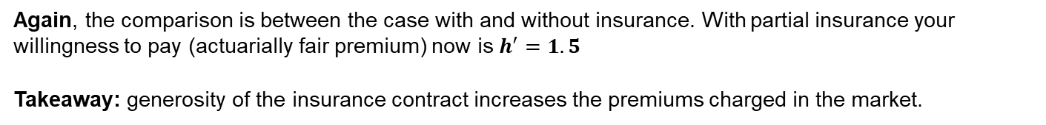
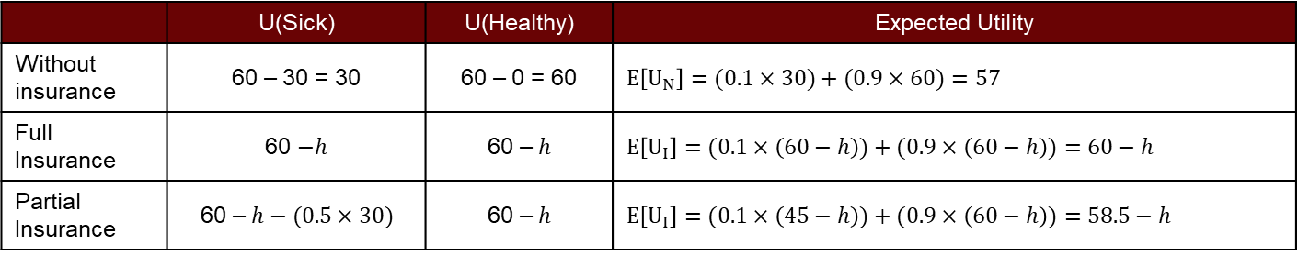
Economics of Insurance: Partial Insurance
Example: suppose the same setting as before. But now, you are offered an insurance contract with a coinsurance rate of 50%. In other words, the insurance company will cover half of your medical expenses. What is your maximum willingness to pay for such a contract?
 | U(Sick) | U(Healthy) | Expected Utility
Without insurance | 60 – 30 = 30 | 60 – 0 = 60 | $$E\left[U_{N}\right]=(0.1×30)+(0.9×60)=57$$
Full Insurance | 60 $−h$ | 60 – $h$ | $$E\left[U_{I}\right]=(0.1×\left(60−h\right))+(0.9×\left(60−h\right))=60−h$$
Partial Insurance | 60 – $h−(0.5×30)$ | 60 – $h$ | $$E\left[U_{I}\right]=(0.1×\left(45−h\right))+(0.9×\left(60−h\right))=58.5−h$$
Again, the comparison is between the case with and without insurance. With partial insurance your willingness to pay (actuarially fair premium) now is $h^{′}=1.5$
Takeaway: generosity of the insurance contract increases the premiums charged in the market.

Slide 15
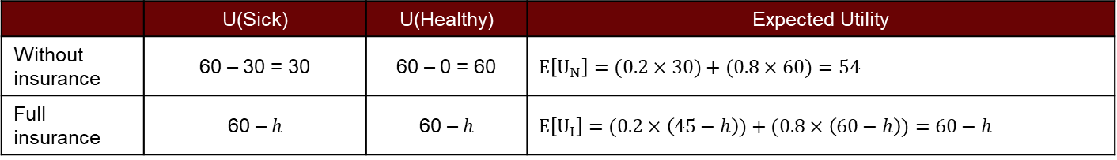
Economics of Insurance
Some remarks. If the probability of getting sick increases, then the premium also rises. Suppose p=0.20. With full insurance, the actuarially fair premium increases from $3K to $6K.
 | U(Sick) | U(Healthy) | Expected Utility
Without insurance | 60 – 30 = 30 | 60 – 0 = 60 | $$E\left[U_{N}\right]=(0.2×30)+(0.8×60)=54$$
Full insurance | 60 – $h$ | 60 – $h$ | $$E\left[U_{I}\right]=(0.2×\left(45−h\right))+(0.8×\left(60−h\right))=60−h$$
Why? Now it is more likely that people will require healthcare.
Hence, the pool of money needs to be larger.

Slide 16
Market for Lemons
Imperfect information is one of the main market failures in the insurance market. Information asymmetry: the difference in the information that is available to sellers and buyers in the market.
The intuition of information asymmetry as a market failure comes from the example of the market for used cars illustrated by George Akerlof in 1970. He won the Nobel prize for this.
The story: suppose you enter a lot where people are selling their cars (all cars are used). Incentives are as usual: sellers want to sell at the highest price possible and buyers at the lowest. We reach equilibrium when WTP = WTS.
The catch: Sellers have more information on the quality of the car than buyers. They might be selling the car because it has serious defects, and buyers have few tools (if any) to distinguish the car’s quality.
Sellers have incentives to set a price above the real quality of the car. Hence, creating a DWL in the economy. The DWL stems from dumping lemons (low-quality cars) to unsuspected buyers. The car might need additional repairs after being purchased. The price paid does not reflect the quality of the good.

Slide 17
Market for Lemons
If buyers realize sellers have these incentives, they might not trust sellers and will avoid the market for used cars if possible. Hence, lowering the demand for used cars.
The problem: suppose you are one of the guys trying to sell your car in the lot. Even if you are being honest and disclosing all the information, buyers can’t be sure of this. So, they will try to buy your car for a lower amount than your offer (because they assume if you are lying, the price is overestimated).
The consequence: sellers with good cars will exit (crowd-out) the market. The price at which consumers are willing to buy might be larger than the seller’s reservation price. This “thins” the market, leaving only the low-quality cars in the lot.

Slide 18
Lemons on the Insurance Market
What is the version of Akerlof’s market for lemons on the insurance market?
Here the information asymmetry is reversed. Consumers know more about the quality of the assets (in this case patient’s health) than the sellers (i.e. insurance companies).
Instead of good and bad cars, we have patients with high and low-risk of getting sick.
Patients have incentives to underreport their health (say they are healthier than they really are).
Insurance companies (aware of this) will charge a higher premium (i.e. they require a larger pool of money if people are less healthy than they report).
High prices crowd-out low-risk (healthy) patients.
Key Takeaway: Who is more likely to pay for insurance? High-risk patients! Moreover, insurance for these patients is more expensive (e.g. likelihood of getting sick/treatment cost is higher).

Slide 19
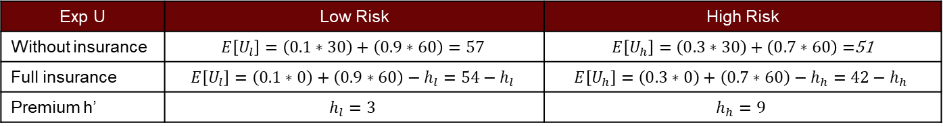
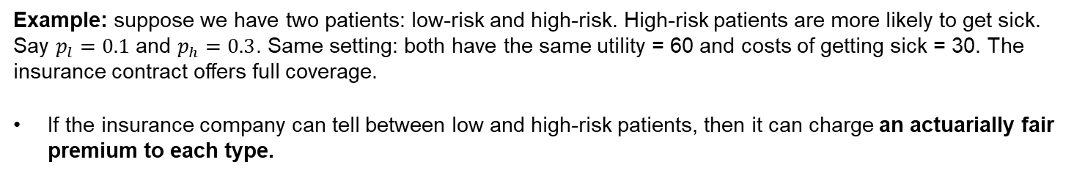
Insurance Markets with Perfect Information
Example: suppose we have two patients: low-risk and high-risk. High-risk patients are more likely to get sick. Say $p_{l}=0.1$ and $p_{h}=0.3$. Same setting: both have the same utility = 60 and costs of getting sick = 30. The insurance contract offers full coverage.
If the insurance company can tell between low and high-risk patients, then it can charge an actuarially fair premium to each type.
Exp U | Low Risk | High Risk
Without insurance | $$E\left[U_{l}\right]=\left(0.1∗30\right)+\left(0.9∗60\right)=57$$ | $E\left[U_{h}\right]=\left(0.3∗30\right)+\left(0.7∗60\right)=$51
Full insurance | $$E\left[U_{l}\right]=\left(0.1∗0\right)+\left(0.9∗60\right)−h_{l}=54−h_{l}$$ | $$E\left[U_{h}\right]=\left(0.3∗0\right)+\left(0.7∗60\right)−h_{h}=42−h_{h}$$
Premium h’ | $$h_{l}=3$$ | $$h_{h}=9$$
Note this is an efficient outcome! both patients are fully insured. High-risk patients pay a higher premium.

Slide 20
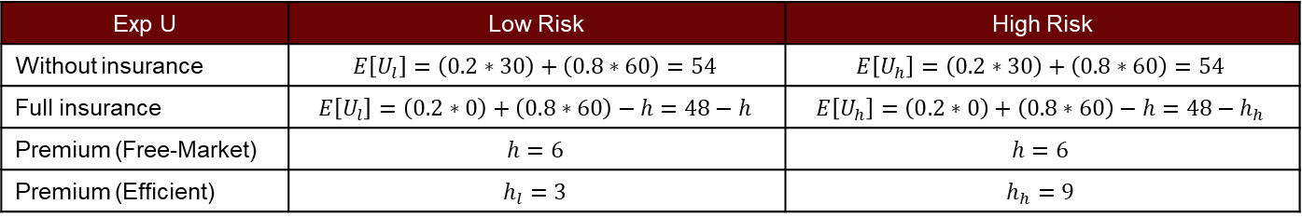
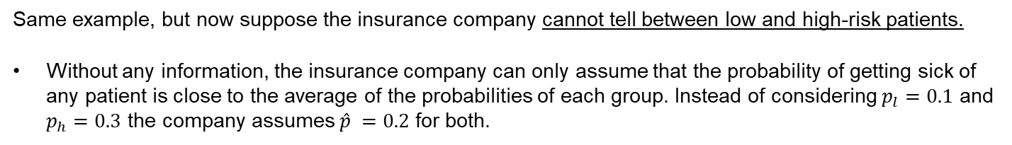
Insurance Markets with Imperfect Information
Same example, but now suppose the insurance company cannot tell between low and high-risk patients.
Without any information, the insurance company can only assume that the probability of getting sick of any patient is close to the average of the probabilities of each group. Instead of considering $p_{l}=0.1$ and $p_{h}=0.3$ the company assumes $\hat{p} =0.2$ for both.
Exp U | Low Risk | High Risk
Without insurance | $$E\left[U_{l}\right]=\left(0.2∗30\right)+\left(0.8∗60\right)=54$$ | $$E\left[U_{h}\right]=\left(0.2∗30\right)+\left(0.8∗60\right)=54$$
Full insurance | $$E\left[U_{l}\right]=\left(0.2∗0\right)+\left(0.8∗60\right)−h=48−h$$ | $$E\left[U_{h}\right]=\left(0.2∗0\right)+\left(0.8∗60\right)−h=48−h_{h}$$
Premium (Free-Market) | $$h=6$$ | $$h=6$$
Premium (Efficient) | $$h_{l}=3$$ | $$h_{h}=9$$
With imperfect information, free-market exchange leads to a scenario where low-risk patients are paying more than the efficient insurance premium. Hence, they have incentives to exit the market, leaving high-risk patients only on the market. This is what economists call adverse selection
Adverse selection: high-risk individuals are more likely to select insurance. If insurers cannot tell their true type, they will lose money if they offer insurance.

Slide 21
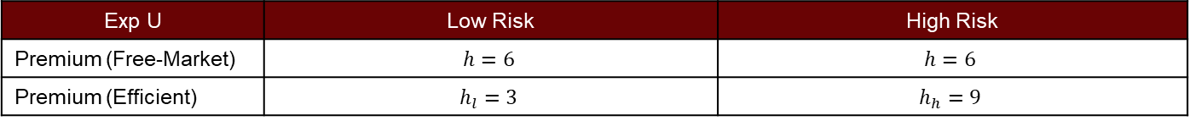
Risk Aversion and Risk Premiums
Note: in general, we do not observe all low-risk patients exiting the market. People are risk-averse.
Risk-aversion reflects your tolerance to bear risks. Alternatively, your WTP to avoid them.
Risk-averse individuals have high WTP to avoid risks.
Risk premium is the amount above the actuarily fair price that individuals pay in order to get insurance.
So long risk premium is below individual’s max WTP for insurance, they will not exit the market.
In our example: if low-risk patient’s max WTP for insurance is above 6, then they will remain in the market (although paying a higher price).
Exp U | Low Risk | High Risk
Premium (Free-Market) | $$h=6$$ | $$h=6$$
Premium (Efficient) | $$h_{l}=3$$ | $$h_{h}=9$$

Slide 22
Final Remarks
The previous model explains several forms of insurance, not only health insurance.
Car Insurance: two states of the world, one where you have a car accident and the other where you don’t. The premiums form the pool of money that covers the average cost of car repairs.
Social Insurance: two states of the world, one where you are low-income and the other where you are high-income. This is the motivation for welfare programs seen as an insurance contract.
Instead of premiums, you pay contributions/taxes.
The more generous the program (e.g. expansion of SNAP) the higher the premiums (taxes).
Probability of getting sick here is the probability of being poor (i.e. the poverty rate).
We can use this same framework to study the optimal generosity of welfare programs by calculating the premiums/taxes that make you indifferent between having (or not) a safety net.

Slide 23
For Next Class
Next class: Health Care
Readings: Mankiw Ch 20. Stiglitz & Rosengard Ch 15. Gruber Ch 12 and 17.

Slide 24
SPEA-V-202
Contemporary Economic Issues in Public Affairs
Healthcare and Insurance
Luis Navarro

Slide 25
Why do we need health insurance?
Getting sick is expensive!
The costs of some medical procedures are way larger than the annual income per capita in the US ($35K).
So, if you require any of these procedures your yearly income might not be large enough to afford them.
More importantly, most of these medical procedures are not chosen by individuals! No one chooses their propensity for some conditions (e.g. diabetes, heart problems).
Knowing that getting sick is expensive, what is the simplest thing you could do to hedge (cover yourself) against the scenario where you require one of these surgeries?
Save some money in case you need it!
Source: https://www.talktomira.com/post/how-much-does-surgery-cost-without-insurance

