Slide 1
SPEA-V-202
Contemporary Economic Issues in Public Affairs
Health Care and Insurance II
Luis Navarro

Slide 2


Outline for Today
Risk Aversion and Moral Hazard
Imperfect information and moral hazard
Moral Hazard and overconsumption of health care
Health care in the US
Medicaid
Medicare
International Comparison

Slide 3
Summary of Main Concepts
Imperfect Information: the difference in information available to sellers and buyers in the market.
Adverse Selection: insured individuals know more about their risk level than the insurer. Hence, those more likely to experience adverse outcomes (less healthy) are more prone to buy insurance.
Moral Hazard: when you insure individuals against adverse events, you can encourage adverse behavior.
Behavior induced/encouraged by insuring against an adverse event.
Example: if individuals have health insurance, they may be less likely to take precautions against getting ill.
Risk Aversion: the degree to which consumers are willing to bear risks.

Slide 4
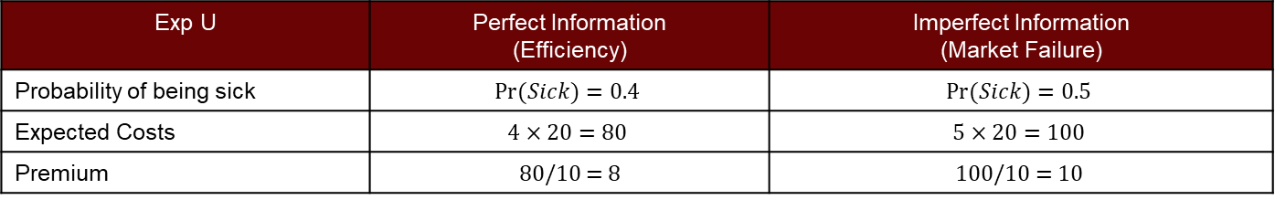
More on Imperfect Information
Example: suppose we have a pool of 10 individuals: 4 sick and 6 healthy (hence $Pr⁡(Sick)=0.4).$ Medical costs in case of an adverse event are estimated in $20. Since insurers cannot tell who is healthy and who is not, so they assume it is like a coin toss. $Pr⁡(Sick)=0.5.$
Exp U | Perfect Information (Efficiency) | Imperfect Information (Market Failure)
Probability of being sick | $$Pr⁡(Sick)=0.4$$ | $$Pr⁡(Sick)=0.5$$
Expected Costs | $$4×20=80$$ | $$5×20=100$$
Premium | 80/10 = 8 | $$\text{100/10 = 10}$$
Takeaway: under the presence of asymmetric information, insurance companies might assign a wrong probability to the adverse events, increasing the prices faced by everyone (both low-risk and high-risk individuals).

Slide 5
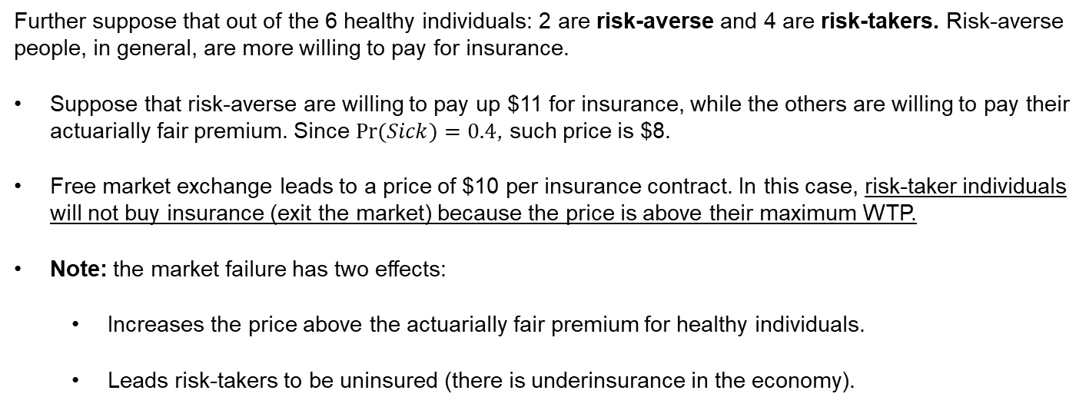
More on Imperfect Information: Risk Aversion
Further suppose that out of the 6 healthy individuals: 2 are risk-averse and 4 are risk-takers. Risk-averse people, in general, are more willing to pay for insurance.
Suppose that risk-averse are willing to pay up $11 for insurance, while the others are willing to pay their actuarially fair premium. Since $Pr(Sick)=0.4$, such price is $8.
Free market exchange leads to a price of $10 per insurance contract. In this case, risk-taker individuals will not buy insurance (exit the market) because the price is above their maximum WTP.
Note: the market failure has two effects:
Increases the price above the actuarially fair premium for healthy individuals.
Leads risk-takers to be uninsured (there is underinsurance in the economy).

Slide 6
Death Spiral of Insurance Companies
Same setting: pool of 10 individuals: 4 sick and 6 healthy. Medical costs = $20. Since insurers cannot tell who is healthy and who is not, they assume p=0.5, which leads to a price of $10 per contract. Of the 6 healthy individuals: 2 are risk-averse (max WTP=$11) and 4 are risk-takers (max WTP=$4).
Year 1: If the company sells insurance at premiums of $10, only 6 people will get insurance. So, the pool of money raised to cover medical expenses is $60. However, if all 4 sick people cash their contract, total medical expenses are $80. So, the insurance company loses $20.
Year 2: Considering last period it was $20 short, the insurer thinks he underestimated the riskiness of the pool (i.e. number of high-risk patients). In response, he increases the price of insurance by $2 (from $10 to $12). However, at $12, only 4 people get insurance, so the pool of money raised is $36. If all 4 sick people cash their contract, total medical expenses are $80, and the insurance company loses $54.
Takeaway: so long the insurer is not able to distinguish between patients, it has incentives to increase prices. But that crowds-out the healthy population! increasing the risk of the pool along with expected health care costs. Supplying insurance leads to losing money, so in response the insurer keeps increasing prices, amplifying the crowding-out effect on the market.

Slide 7
Solutions to this problem
Problem: free-market exchange leads to underprovision of insurance and could potentially lead to the collapse of the market.
Government intervention: fill the gaps in private provision.
Publicly provided healthcare/health insurance (Medicaid, Medicare)
Subsidy to companies providing private insurance.

Slide 8
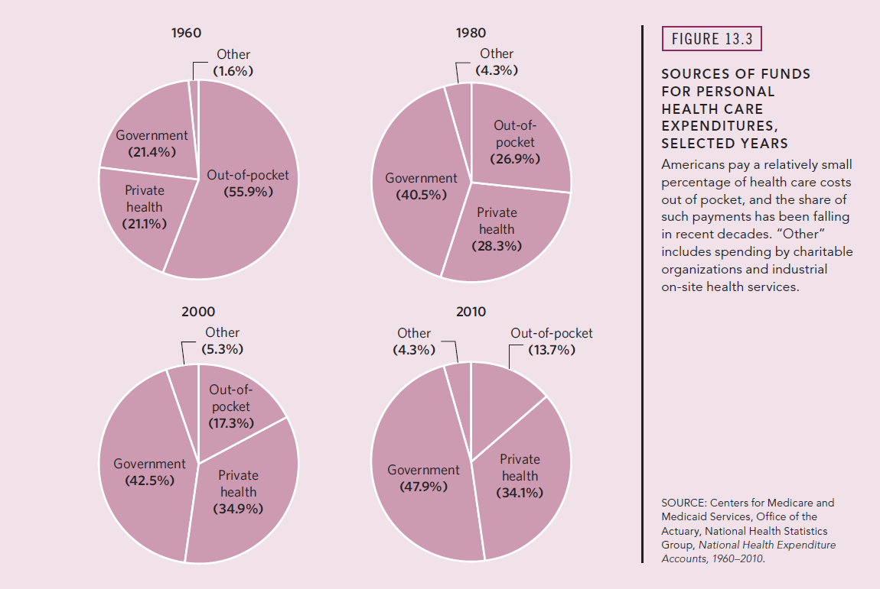
Health Care in the United States
The U.S. health care system is a mix of public, private, and non-profit providers.
Public Provision (Government)
Medicaid
Medicare
Private Provision
Employer Provided Insurance
Self-purchased Insurance
Uninsured Population
Source: Stiglitz and Rosengard Ch 13

Slide 9
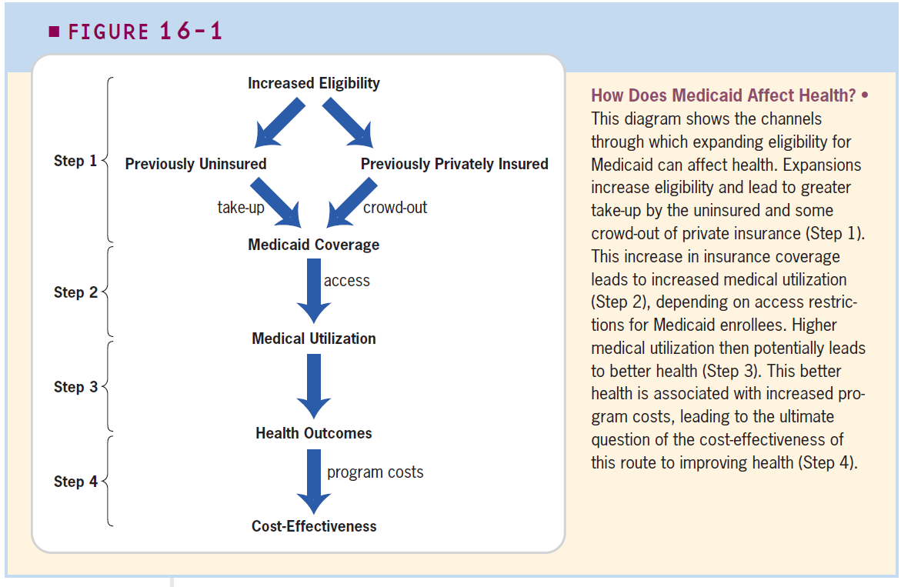
Government Intervention in health care markets
Increasing insurance coverage aims to improve health outcomes in the population.
Thinking like an economist: insurance coverage should be expanded so long the marginal benefits (improved health) outweigh the marginal costs (health care costs).
Source: Gruber Ch 16

Slide 10
Medicaid
Major public health expenditure program which provides health care for people experiencing poverty, targeting several specific groups:
People that qualify for cash welfare programs (e.g. single mothers and their children).
Most low-income pregnant women and children.
Elderly and disabled population.
Financed by the federal and state governments. Federal spending is progressive in this policy: low-income states observe higher participation of federal funds financing the program.
For providers, Medicaid works like private insurance: reimbursement for the services provided to enrollees. However, reimbursement rules differ across states.

Slide 11
Medicare
Major public health expenditure program which provides health care for all people over age 65 and disabled persons under age 65.
Every citizen who has worked for 10 years or more in Medicare-covered employment is eligible for Medicare at age 65.
Medicare has three components: hospital insurance (part A), supplementary medical insurance (part B) and prescription drugs (part D). It is financed by a 2.9% payroll tax.
Eligibility and benefits differ across states. Hence, states bear some of the costs of the program.

Slide 12
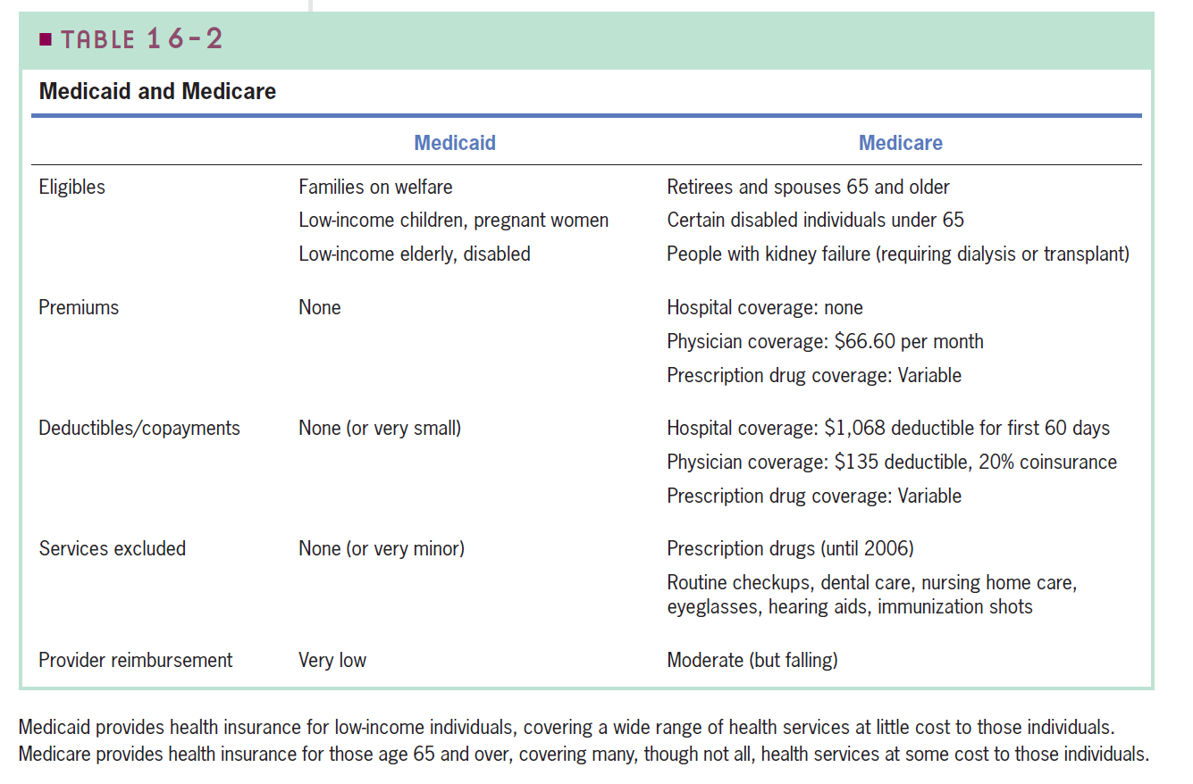
Medicaid and Medicare
Source: Gruber Ch 16

Slide 13
Health care costs and insurance
Getting sick is expensive!
The costs of some medical procedures are way larger than the annual income per capita in the US ($35K).
So, if you require any of these procedures your yearly income might not be large enough to afford them.
More importantly, most of these medical procedures are not chosen by individuals! No one chooses their propensity for some conditions (e.g. diabetes, heart problems).
Insurance alleviates the financial burden of medical events. However, by doing so creates a distortion on individual's behavior.
Source: https://www.talktomira.com/post/how-much-does-surgery-cost-without-insurance

Slide 14
Uninsured population and the “job lock”
Some individuals might be afraid of moving to another job where they could be more productive if they risk losing health insurance coverage.
Think about risk-takers and risk-averse individuals, and the intuition behind the “benefit-cliff”.
If the opportunity cost of switching jobs is too high, then individuals might be unwilling to move. In this case, the opportunity cost is determined by the costs of healthcare. This leads to the job lock.
Job lock: the unwillingness to move to a better job for fear of losing health insurance.
This leads to a DWL because resources in the economy are not efficiently allocated (e.g. some people could be earning more by providing goods and services in a more productive way).

Slide 15
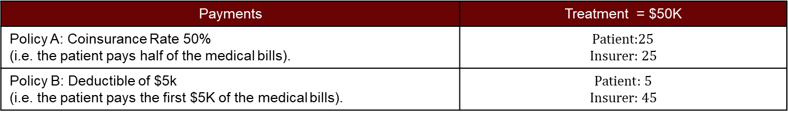
Moral Hazard: Patient’s Side
Example: suppose there are 2 patients with the same demand for healthcare, but different insurance policies. Both patients require medical treatment. A new experimental drug was developed that seems to be more effective but costs $50K. Suppose both patients chose this new treatment. How does this reflect on the costs borne by the insurer and the patients?
Payments | Treatment = $50K
Policy A: Coinsurance Rate 50% (i.e. the patient pays half of the medical bills). | $$\text{Patient}\text{:}25$$ $$\text{Insurer}\text{: 25}$$
Policy B: Deductible of $5k (i.e. the patient pays the first $5K of the medical bills). | $$\text{Patient}\text{: 5}$$ $$\text{Insurer}\text{: 45}$$
Policy B caps the payment made by the patient. Hence, for costs above his deductible ($5K) he is no longer price responsive (e.g. perfectly inelastic demand). Everything else constant, he will consume the best treatment, regardless of the cost. Moreover, under Policy B the insurer pays $20 more relative to Policy A.
Main Takeaway: When individuals buy insurance, they no longer pay the full costs of health care, hence incentivizing them to consume more than they would if they faced the full costs.

Slide 16
Moral Hazard: Patient’s Side
Moral hazard: individuals are more willing to take risks if they know they are insured.
Key Idea: When individuals buy insurance, they no longer pay the full costs of health care.
Recall our externalities framework. Under the presence of an externality, social marginal benefits/costs differ from private marginal benefits/costs. Thus, leading to over/underconsumption of some good.
Imperfect information has a similar on the demand/supply curves: they no longer reflect accurately society’s WTP/WTS.
We can use the same framework to analyze this problem.

Slide 17
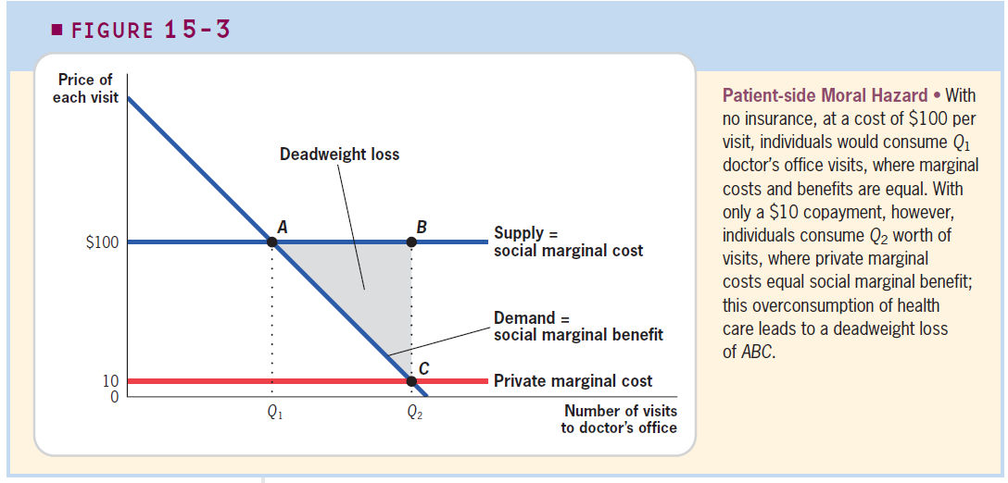
Moral Hazard: Patient’s Side
Source: Gruber Ch 15

Slide 18
Moral Hazard: Patient’s Side
The previous example highlights how moral hazard leads to increased healthcare costs.
Moral Hazard: with insurance, individuals spend too much on healthcare.
The issue is not so much the increase in costs, but that at the margin the costs might outweigh the benefits. There is a concern that excessive insurance (due to government policies) explains the large healthcare costs in the US.
The key question, however, remains to be whether incremental healthcare expenditures derive on marginal benefits at health outcomes (Gruber’s Figure 16-1, Step 4).
In summary: information asymmetries have two main effects in health care markets:
Underprovision of insurance (adverse selection).
Overconsumption of health care (moral hazard).

Slide 19
Healthcare in the US: International Comparison
The United States is one of the countries that spend the most on healthcare.
However, health outcomes in the United States are poorer than those in other advanced economies that spend a fraction of the amount spent in the US.
Potential causal mechanisms: lifestyle decisions (U.S. also leads in obesity incidence) and income inequality (there is still population without healthcare due to insufficient income).
Takeaway: there is room for improvement in the efficiency and effectiveness of US’s healthcare sector.

Slide 20
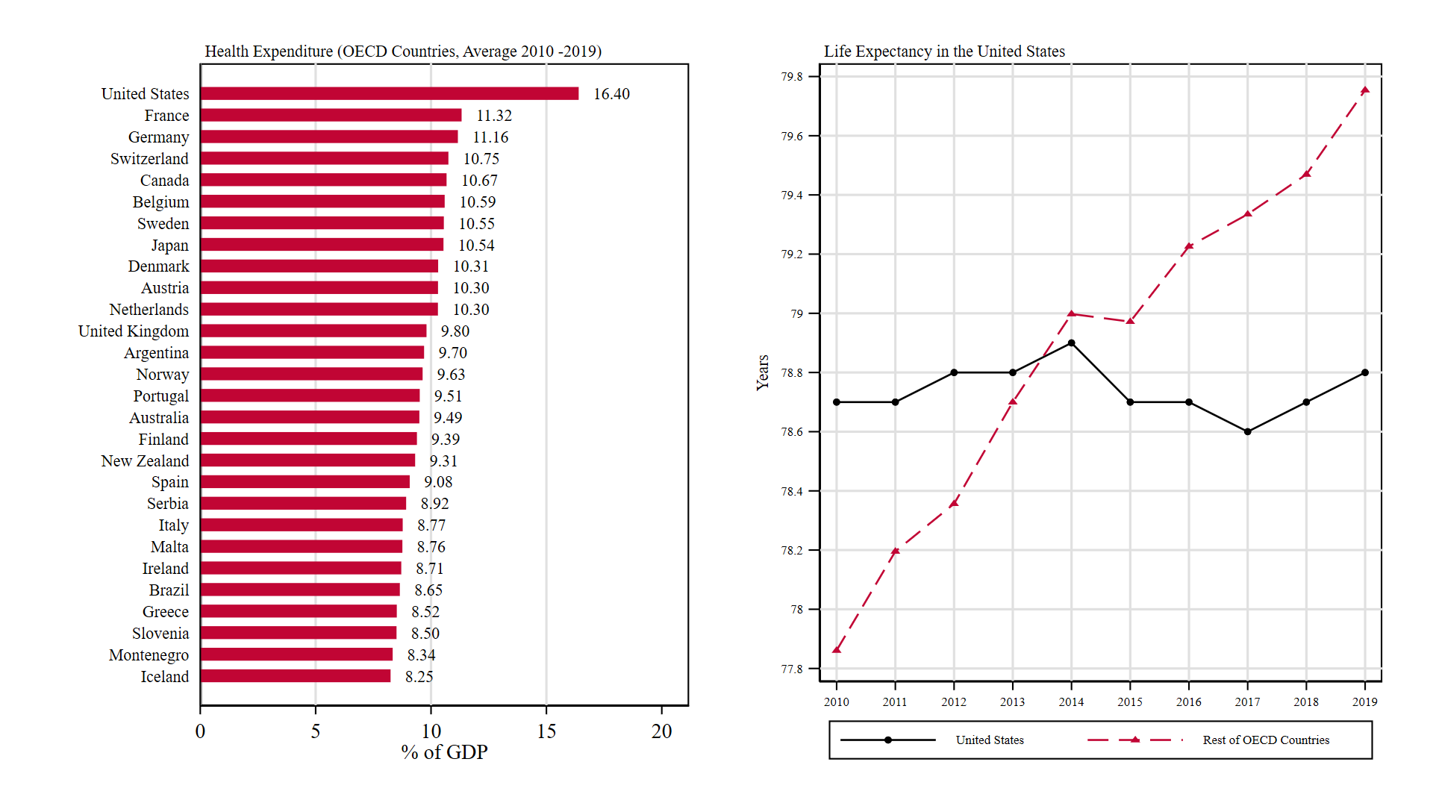
Healthcare and Life Expectancy in the United States
https://stats.oecd.org/Index.aspx?ThemeTreeId=9

Slide 21
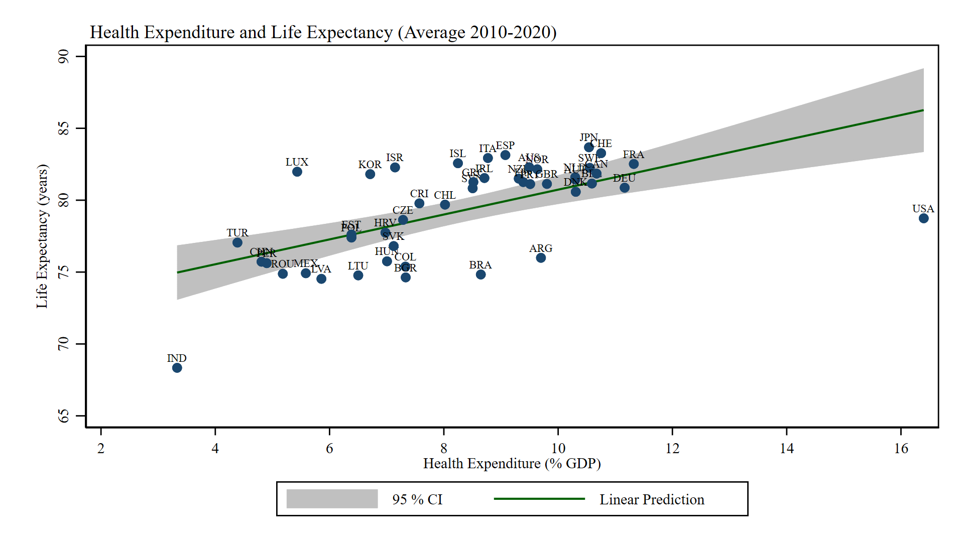
Healthcare and Life Expectancy in the United States
https://stats.oecd.org/Index.aspx?ThemeTreeId=9

Slide 22
For Next Class
Next class: Monopoly and Anti-trust Regulation
Readings: Mankiw Ch 15.

Slide 23
SPEA-V-202
Contemporary Economic Issues in Public Affairs
Healthcare and Insurance II
Luis Navarro

