Slide 1
SPEA-V-202
Contemporary Economic Issues in Public Affairs
Monopoly and Antitrust Regulation
Luis Navarro

Slide 2


Outline for Today
Market Structure
Market structure
Perfect competition vs monopolistic behavior
Price-taking vs price-setting behavior
Market Equilibrium with Monopoly
Market Equilibrium
Monopoly’s Markup
Welfare Effects of Monopolistic Competition

Slide 3
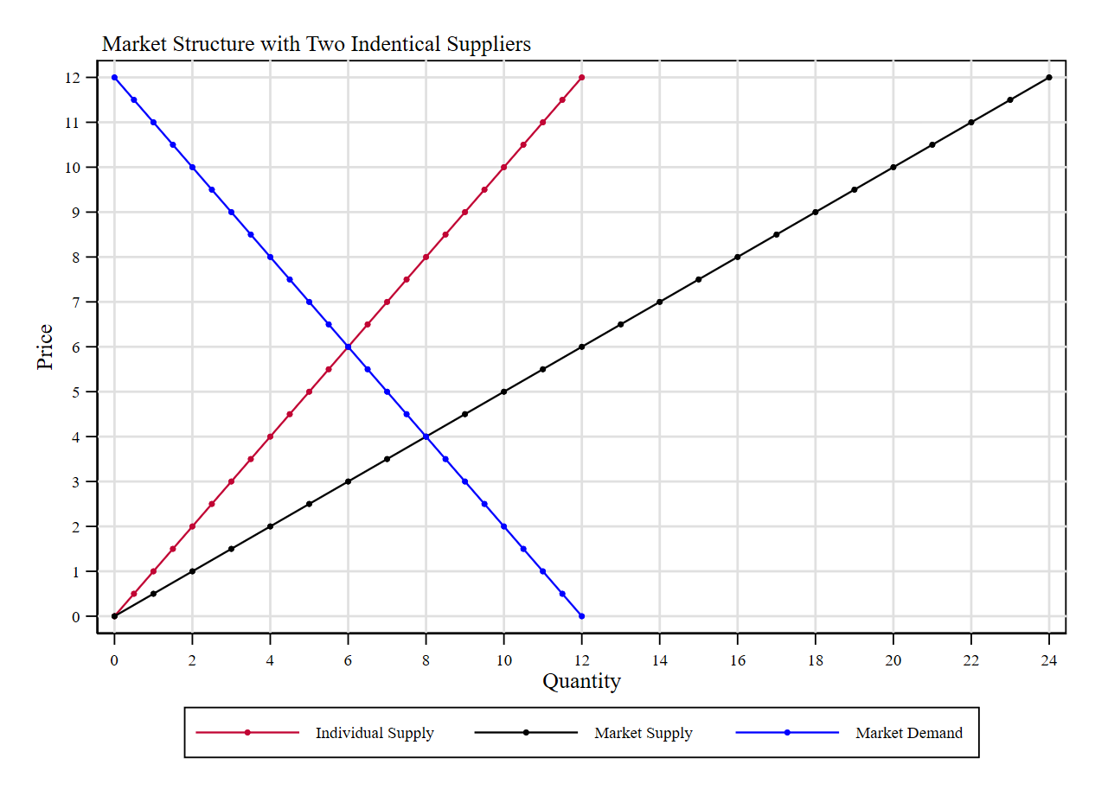
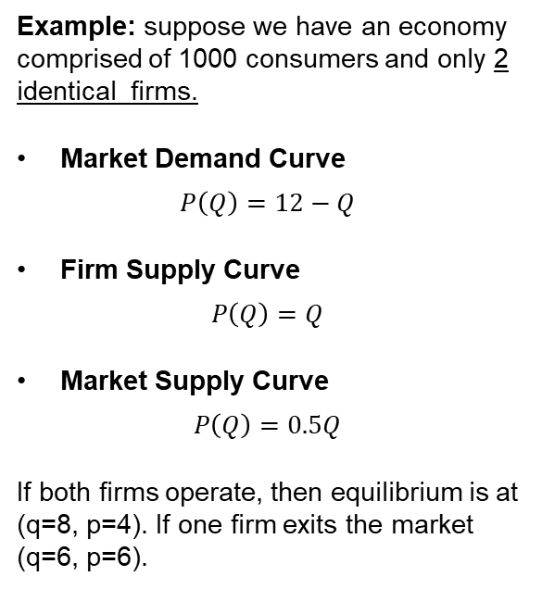
Market Structure
Example: suppose we have an economy comprised of 1000 consumers and only 2 identical firms.
Market Demand Curve
$$P\left(Q\right)=12−Q$$
Firm Supply Curve
$$P\left(Q\right)=Q$$
Market Supply Curve
$$P\left(Q\right)=0.5Q$$
If both firms operate, then equilibrium is at (q=8, p=4). If one firm exits the market (q=6, p=6).

Slide 4
Market Structure
Market Structure refers generally to the number of suppliers and consumers in the economy.
The previous example reflects how the number of firms influences the outcome (prices) observed by consumers.
If both firms operate, then market supply is larger (at the same price, quantity supplied is higher) so equilibrium leads to a larger quantity exchanged. Consumer surplus is larger.
If one firm exits the market, then the quantity supplied decreases and the price in equilibrium increases.
Market Power refers to the influence a market agent has to change the equilibrium price and quantity in the market with her behavior.

Slide 5
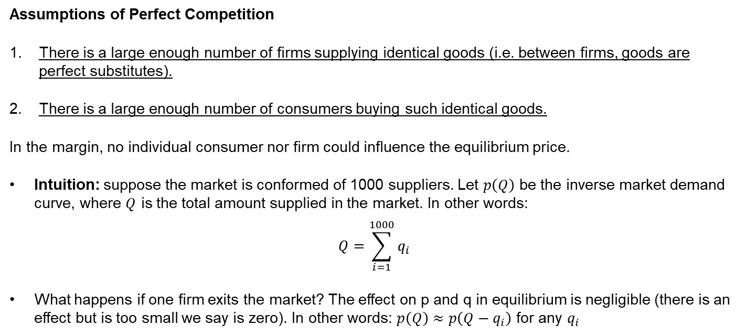
Quick Recap of Perfect Competition
Assumptions of Perfect Competition
There is a large enough number of firms supplying identical goods (i.e. between firms, goods are perfect substitutes).
There is a large enough number of consumers buying such identical goods.
In the margin, no individual consumer nor firm could influence the equilibrium price.
Intuition: suppose the market is conformed of 1000 suppliers. Let $p\left(Q\right)$ be the inverse market demand curve, where $Q$ is the total amount supplied in the market. In other words:
$$Q=\sum_{i=1}^{1000}{q_{i}}$$
What happens if one firm exits the market? The effect on p and q in equilibrium is negligible (there is an effect but is too small we say is zero). In other words: $p\left(Q\right)≈p\left(Q−q_{i}\right)$ for any $q_{i}$

Slide 6
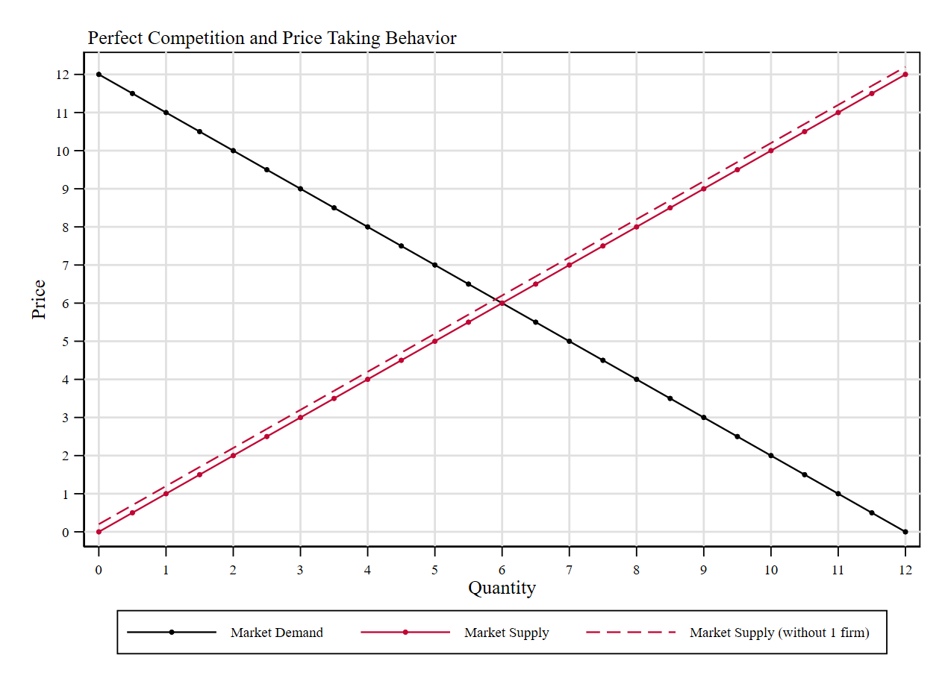
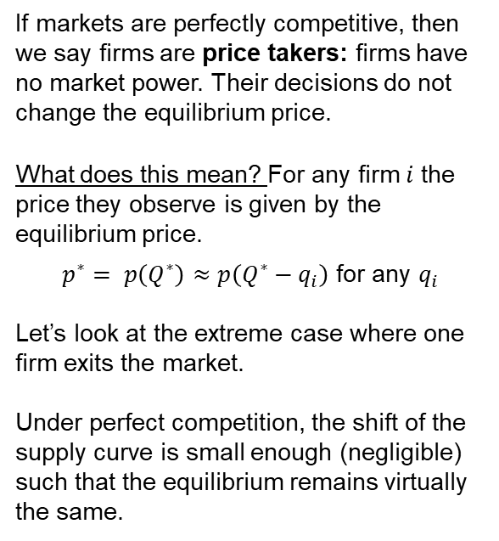
Perfect Competition and Price-Taking Behavior
If markets are perfectly competitive, then we say firms are price takers: firms have no market power. Their decisions do not change the equilibrium price.
What does this mean? For any firm $i$ the price they observe is given by the equilibrium price.
$p^{∗}= p\left(Q^{∗}\right)≈p\left(Q^{∗}−q_{i}\right)$ for any $q_{i}$
Let’s look at the extreme case where one firm exits the market.
Under perfect competition, the shift of the supply curve is small enough (negligible) such that the equilibrium remains virtually the same.

Slide 7
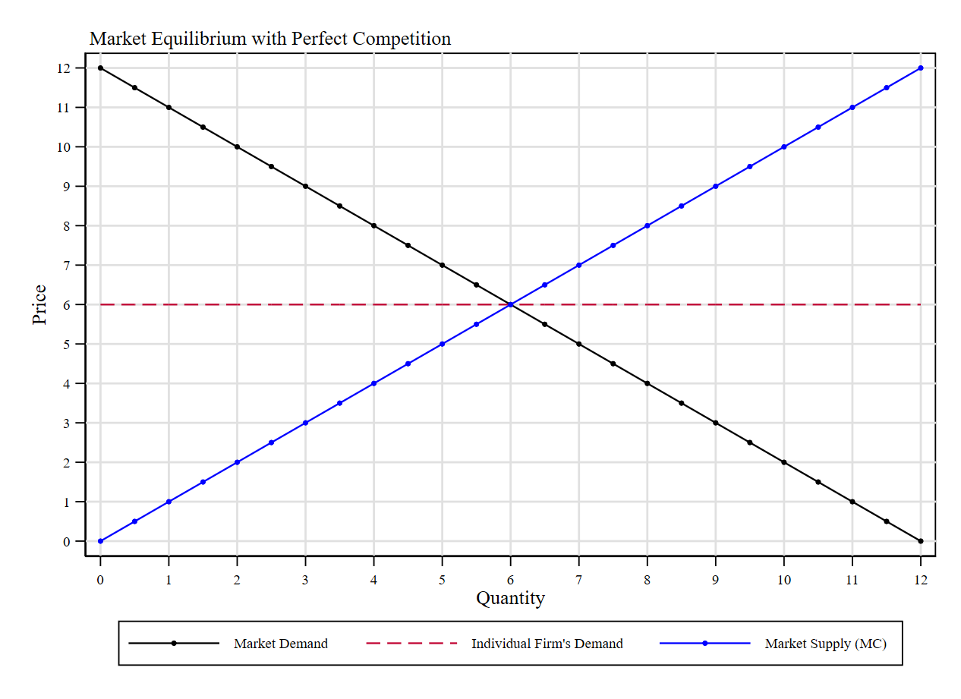
Perfect Competition and Price-Taking Behavior
Graphic Intuition: Price-taking firms face perfectly elastic demand curves!
Suppose one firm increases the price above the equilibrium level. Since goods are perfect substitutes, then consumers will stop buying at such firm and go to another that is cheaper. In this case, the firm makes zero profits and closes.
Suppose one firm decreases the price below the equilibrium level. Since goods are perfect substitutes, then all consumers will go to that store. However, that store is too small to satisfy all demand. So, without expanding its capacity it can only sell the same amount as before. It can capture some additional revenue in the margin, but profits remain virtually the same.

Slide 8
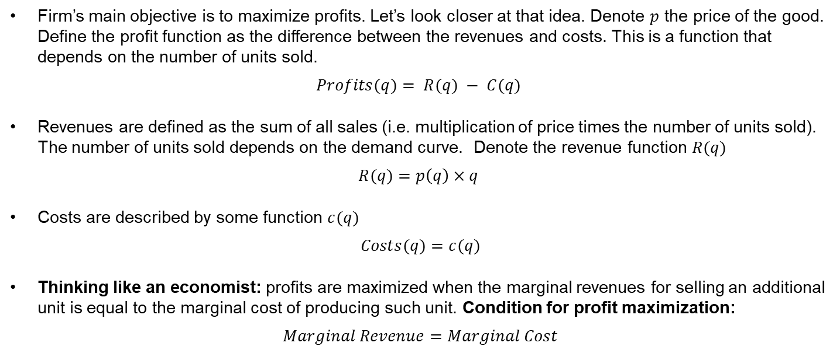
Quick Review of Profit Maximization
Firm’s main objective is to maximize profits. Let’s look closer at that idea. Denote $p$ the price of the good. Define the profit function as the difference between the revenues and costs. This is a function that depends on the number of units sold.
$$Profits(q)= R(q) − C(q)$$
Revenues are defined as the sum of all sales (i.e. multiplication of price times the number of units sold). The number of units sold depends on the demand curve. Denote the revenue function $R(q)$
$$R(q)=p\left(q\right)×q$$
Costs are described by some function $c(q)$
$$Costs(q)=c(q)$$
Thinking like an economist: profits are maximized when the marginal revenues for selling an additional unit is equal to the marginal cost of producing such unit. Condition for profit maximization:
$$Marginal Revenue=Marginal Cost$$

Slide 9
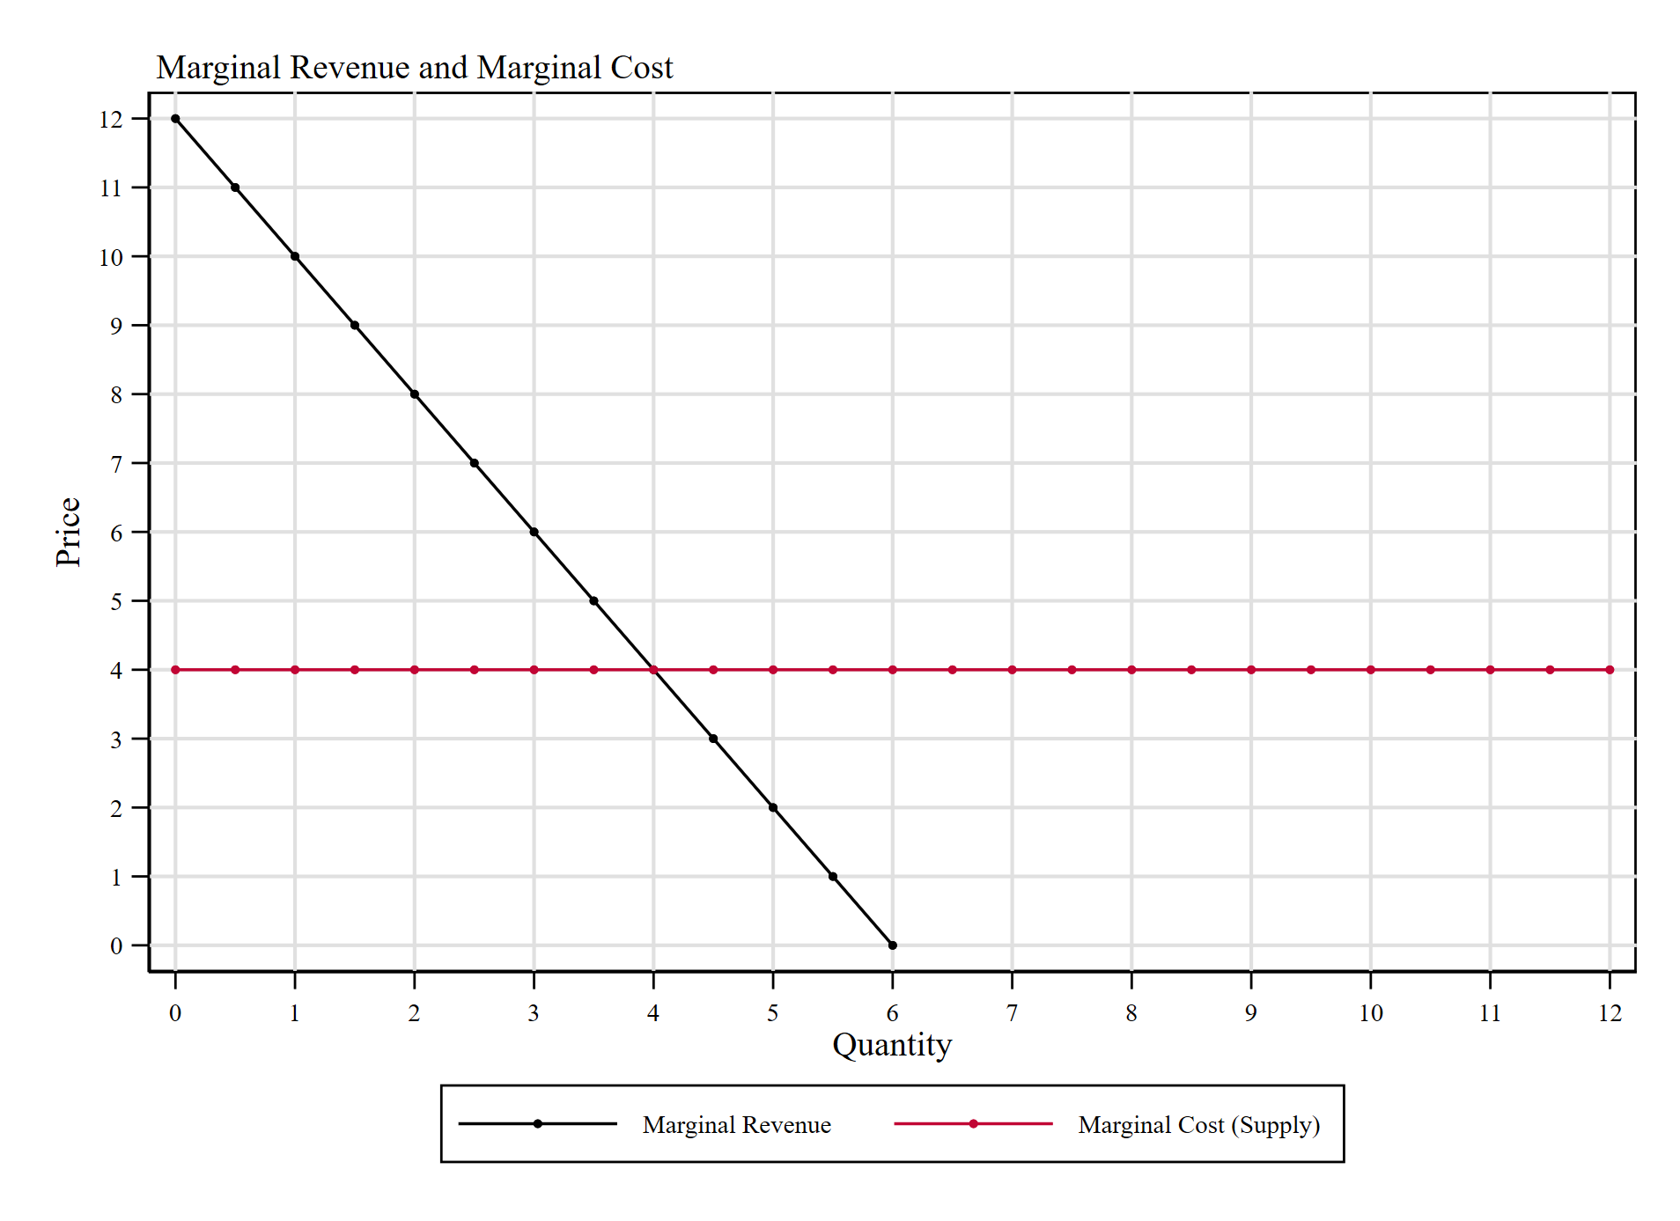

Intuition of Profit Maximization
In this example, MR=MC at q=4.
Key for Intuition: for q<4, MR > MC and for q>4, MR < MC.
Suppose we are at some q<4. Increasing one unit of production increases total revenue by A+B and only costs B. Marginal profit >0, so keep producing is a good idea.
Suppose we are at some q>4. Increasing one unit of production increases total revenue by D and costs C+D. Marginal profit <0 and we are losing money by increasing production.
A
Profit Maximizing Quantity
$$q^{∗} :MR\left(q^{∗}\right)=MC\left(q^{∗}\right)$$
B
C
D
Source: https://2012books.lardbucket.org/books/theory-and-applications-of-microeconomics/s10-04-markup-pricing-combining-margi.html

Slide 10
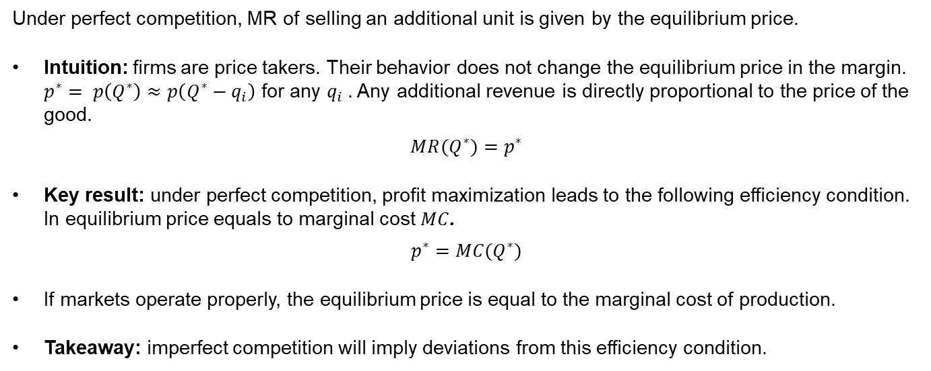
Perfect Competition and Marginal Revenue
Under perfect competition, MR of selling an additional unit is given by the equilibrium price.
Intuition: firms are price takers. Their behavior does not change the equilibrium price in the margin. $p^{∗}= p\left(Q^{∗}\right)≈p\left(Q^{∗}−q_{i}\right)$ for any $q_{i}$. Any additional revenue is directly proportional to the price of the good.
$$MR(Q^{∗})=p^{∗}$$
Key result: under perfect competition, profit maximization leads to the following efficiency condition. In equilibrium price equals to marginal cost $MC$.
$$p^{∗}=MC(Q^{∗})$$
If markets operate properly, the equilibrium price is equal to the marginal cost of production.
Takeaway: imperfect competition will imply deviations from this efficiency condition.

Slide 11
Imperfect Competition and Monopoly
Perfect Competition is required for free-market exchange to derive in economic efficiency.
We say the market observes imperfect competition when some agent has market power (can influence the equilibrium market with her individual behavior).
The extreme case of imperfect competition is monopolistic behavior. In other words, when there is only one firm in the market supplying the good.
Monopoly: a firm that is the sole seller of a product without any close substitutes.
Example: Duke Energy in Bloomington.
Example: Microsoft in the 90s.

Slide 12
Market Equilibrium with Monopoly
When there is only one firm supplying, then we say is a price setter: the monopoly has market power to change the price and quantity exchanged in equilibrium.
What happens when the monopoly tries to change the price at which it is selling?
Unlike firms under perfect competition, if the monopoly increases the price above the equilibrium level it leads to a lower quantity exchanged (excess supply), but it remains operating (still makes profits).
What does this mean? Monopoly faces the traditional downward-sloping market demand curve.
See Mankiw Ch 15, Fig 2.

Slide 13
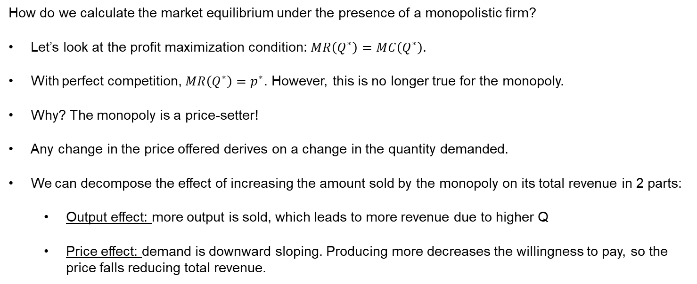
Market Equilibrium with Monopoly
How do we calculate the market equilibrium under the presence of a monopolistic firm?
Let’s look at the profit maximization condition: $MR\left(Q^{∗}\right)=MC\left(Q^{∗}\right)$.
With perfect competition, $MR\left(Q^{∗}\right)=p^{∗}$. However, this is no longer true for the monopoly.
Why? The monopoly is a price-setter!
Any change in the price offered derives on a change in the quantity demanded.
We can decompose the effect of increasing the amount sold by the monopoly on its total revenue in 2 parts:
Output effect: more output is sold, which leads to more revenue due to higher Q
Price effect: demand is downward sloping. Producing more decreases the willingness to pay, so the price falls reducing total revenue.

Slide 14
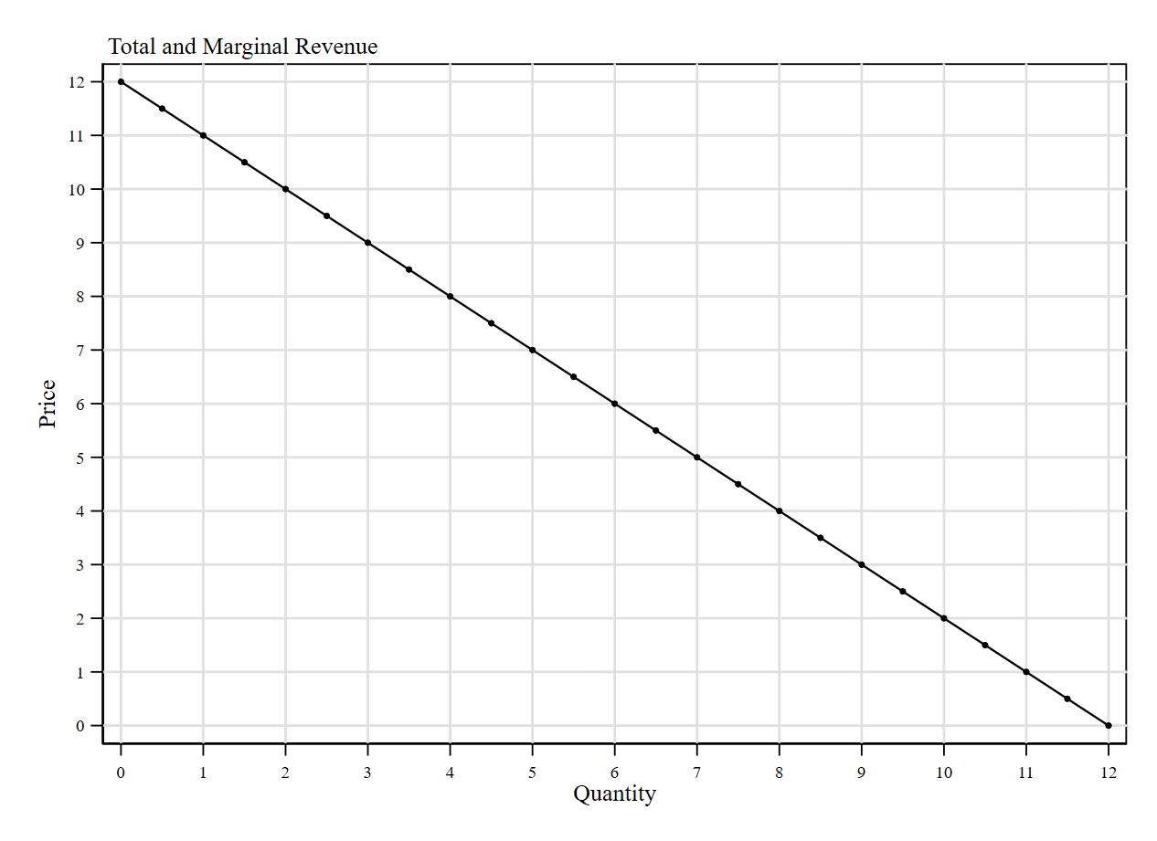
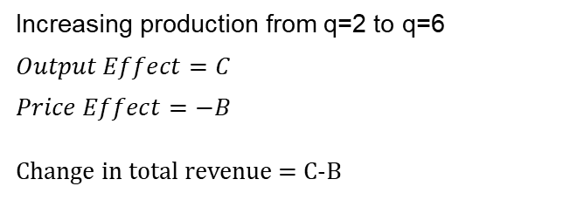
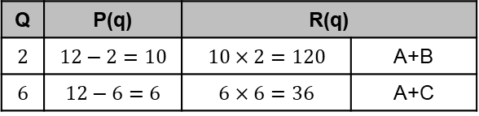
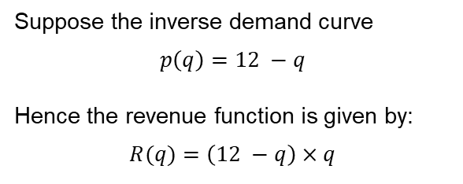
Marginal Revenue
Let’s look closer at the revenue function. $R(q)=p\left(q\right)×q$. How does it look in a graph?
Suppose the inverse demand curve
$$p\left(q\right)=12 −q$$
Hence the revenue function is given by:
$$R(q)=\left(12 −q\right)×q$$
B
Q | P(q) | R(q)
$$2$$ | $$12−2=10$$ | $$10×2=120$$ | A+B
$$6$$ | $$12−6=6$$ | $$6×6=36$$ | A+C
A
C
Increasing production from q=2 to q=6
$$Output Effect=C$$
$$Price Effect=−B$$
Change in total revenue = C-B

Slide 15
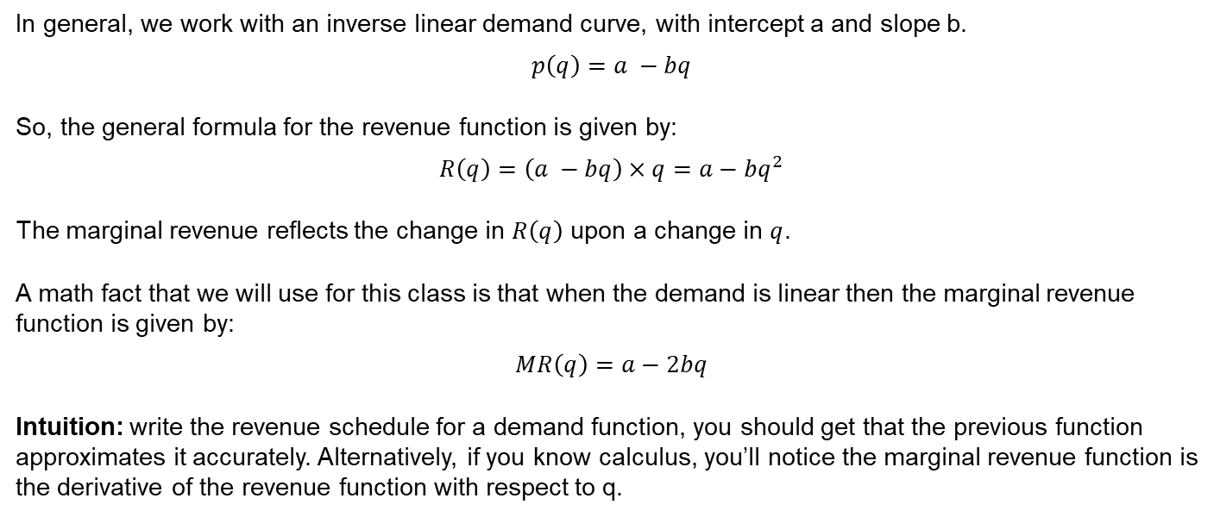
Marginal Revenue for Monopolistic Firms
In general, we work with an inverse linear demand curve, with intercept a and slope b.
$$p\left(q\right)=a −bq$$
So, the general formula for the revenue function is given by:
$$R\left(q\right)=\left(a −bq\right)×q=a−bq^{2}$$
The marginal revenue reflects the change in $R\left(q\right)$ upon a change in $q$.
A math fact that we will use for this class is that when the demand is linear then the marginal revenue function is given by:
$$MR\left(q\right)=a−2bq$$
Intuition: write the revenue schedule for a demand function, you should get that the previous function approximates it accurately. Alternatively, if you know calculus, you’ll notice the marginal revenue function is the derivative of the revenue function with respect to q.

Slide 16
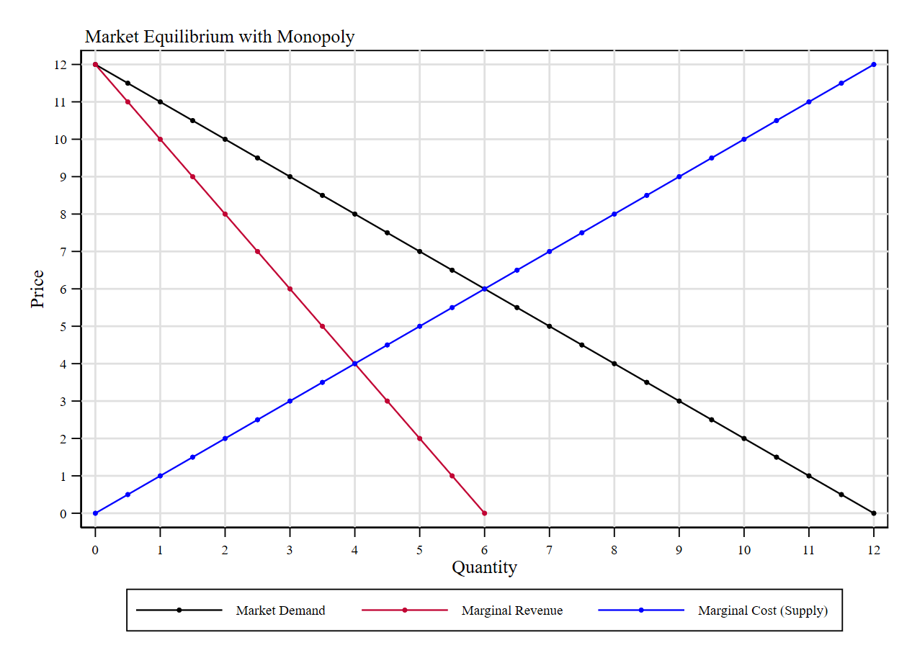
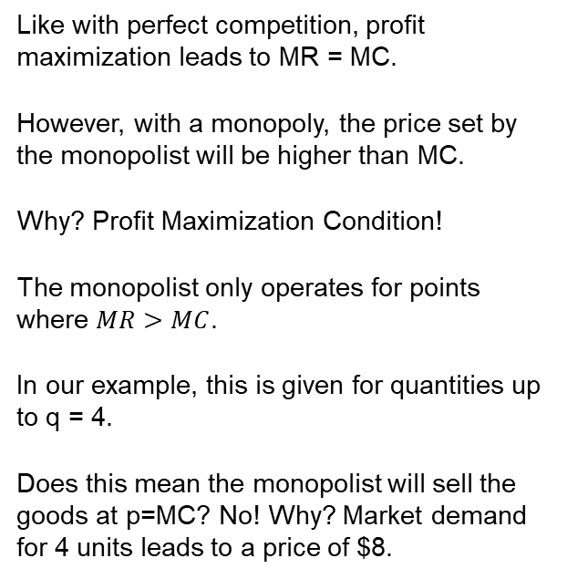
Market Equilibrium with Monopoly
Like with perfect competition, profit maximization leads to MR = MC.
However, with a monopoly, the price set by the monopolist will be higher than MC.
Why? Profit Maximization Condition!
The monopolist only operates for points where $MR>MC$.
In our example, this is given for quantities up to q = 4.
Does this mean the monopolist will sell the goods at p=MC? No! Why? Market demand for 4 units leads to a price of $8.

Slide 17
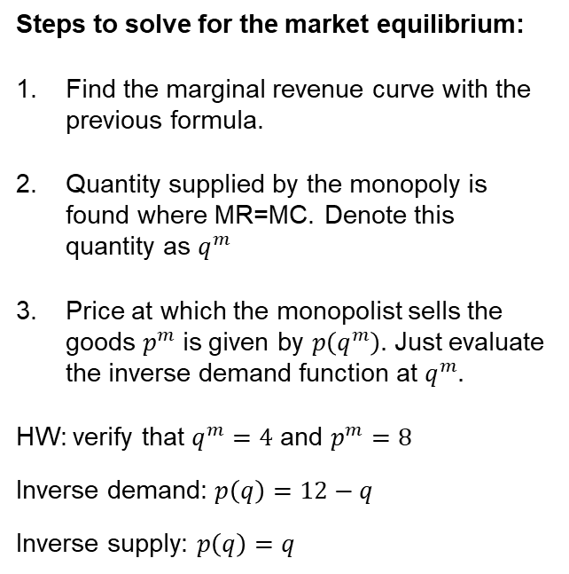
Market Equilibrium with Monopoly
Steps to solve for the market equilibrium:
Find the marginal revenue curve with the previous formula.
Quantity supplied by the monopoly is found where MR=MC. Denote this quantity as $q^{m}$
Price at which the monopolist sells the goods $p^{m}$is given by $p\left(q^{m}\right).$ Just evaluate the inverse demand function at $q^{m}.$
HW: verify that $q^{m}=4$ and $p^{m}=8$
Inverse demand: $p\left(q\right)=12−q$
Inverse supply: $p\left(q\right)=q$

Slide 18
Welfare Effects of Monopolistic Behavior
A
Under perfect competition
CS = A + B + C
PS = E + D + F
DWL = 0
With the Monopoly, there is DWL>0
CS = A
PS = B + E + F
DWL = C + D
B
C
E
D
F

Slide 19




Perfect Competition vs Monopolistic Behavior
Relative to perfect competition, monopolistic behavior leads to two main results:
Quantity supplied by the monopolist is lower than the one supplied at perfectly competitive markets.
Price at which the goods are sold by the monopolist is higher than the price at perfectly competitive markets.
The difference between the monopoly price and the one observed under perfect competition is called the monopolist markup.
$$p^{m}=8$$
$$p^{∗}=6$$
$$q^{m}=4$$
$$q^{∗}=6$$

Slide 20
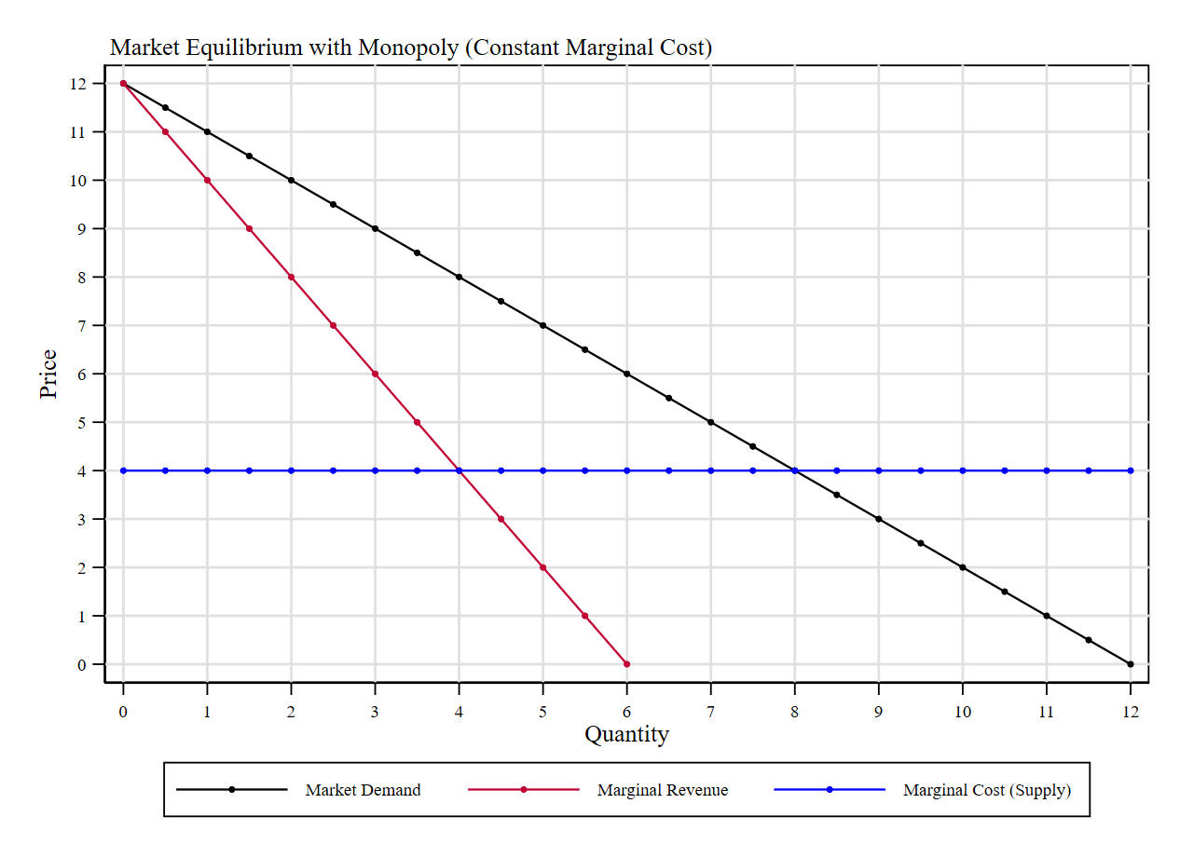

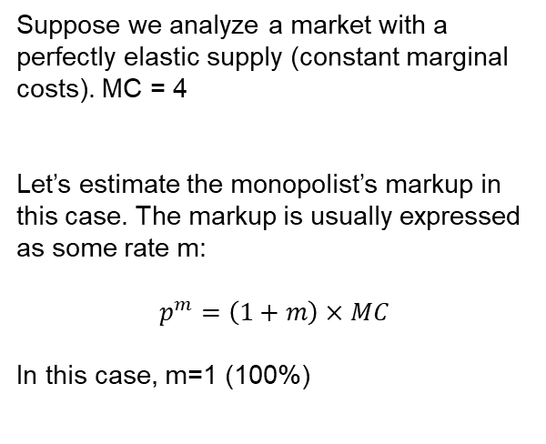



Monopolist Markup – Example
Suppose we analyze a market with a perfectly elastic supply (constant marginal costs). MC = 4
Let’s estimate the monopolist’s markup in this case. The markup is usually expressed as some rate m:
$$p^{m}=\left(1+m\right)×MC$$
In this case, m=1 (100%)
$$p^{m}=8$$
$$p^{∗}=4$$
$$q^{m}=4$$
$$q^{∗}=8$$

Slide 21
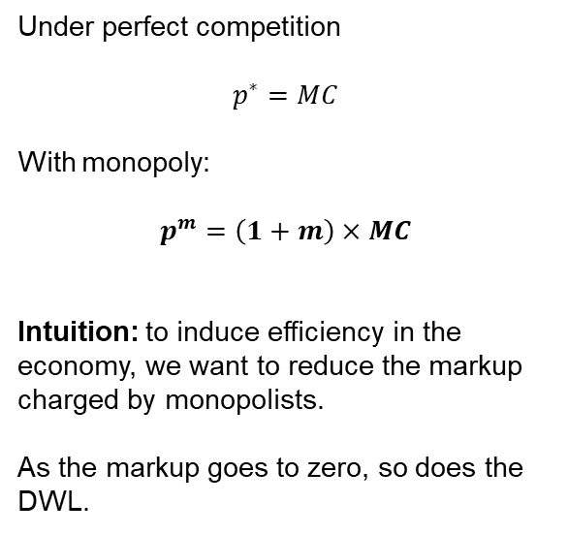

Monopolist Markup and Efficiency
Monopolist’s markup provides a direct way to measure the efficiency losses due to lack of competition
Under perfect competition
$$p^{∗}=MC$$
With monopoly:
$$p^{m}=\left(1+m\right)×MC$$
Intuition: to induce efficiency in the economy, we want to reduce the markup charged by monopolists.
As the markup goes to zero, so does the DWL.
$$p^{m}=8$$
$$markup$$
$$p^{∗}=4$$
$$q^{m}=4$$
$$q^{∗}=8$$

Slide 22
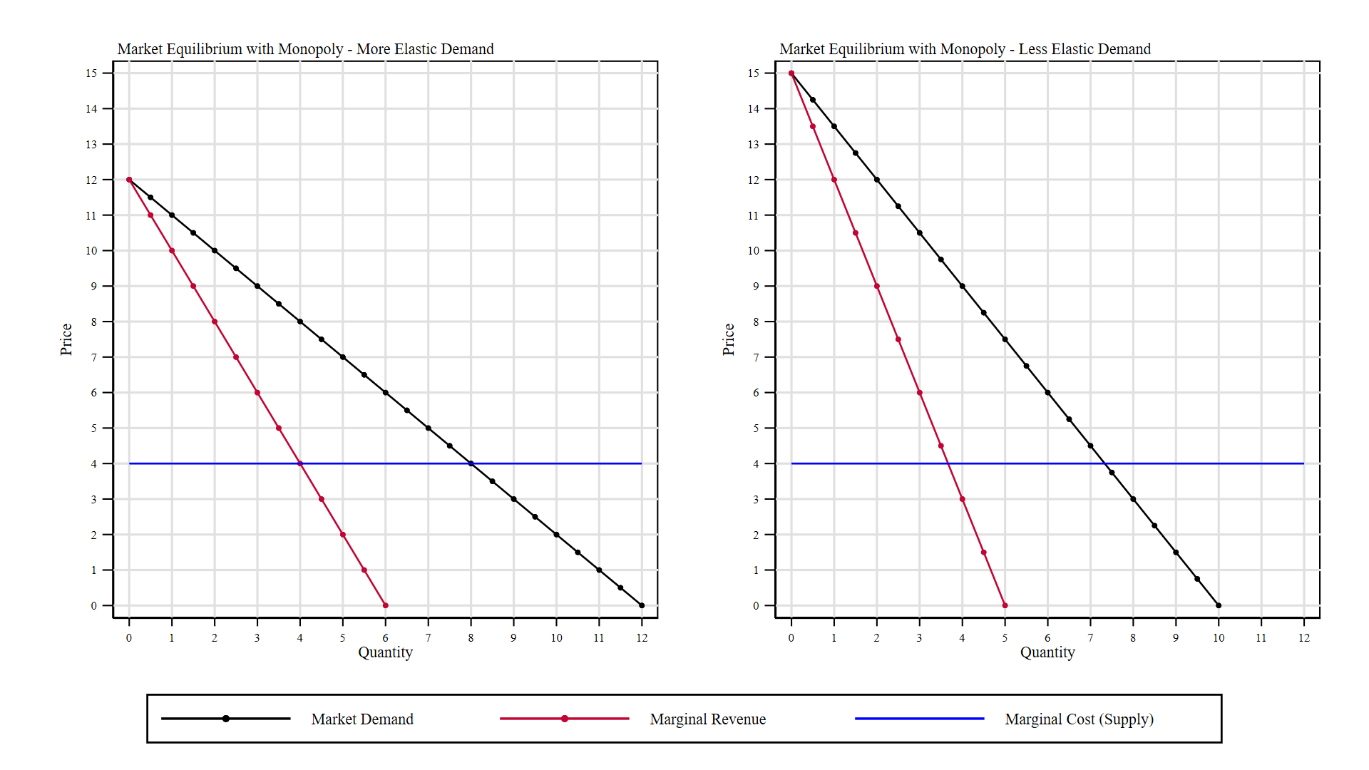


Monopolist Markup and Elasticity of Demand
More elastic demand observe lower markups.
More inelastic demand observe higher markups.
$$m_{i}$$
$$m_{e}$$

Slide 23
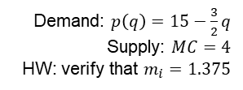

Monopolist Markup and Elasticity of Demand
Demand: $p\left(q\right)=12−q$
Supply: $MC=4$
HW: verify that $m_{e}=1$
Demand: $p\left(q\right)=15−\frac{3}{2}q$
Supply: $MC=4$
HW: verify that $m_{i}=1.375$
$$m_{i}$$
$$m_{e}$$

Slide 24
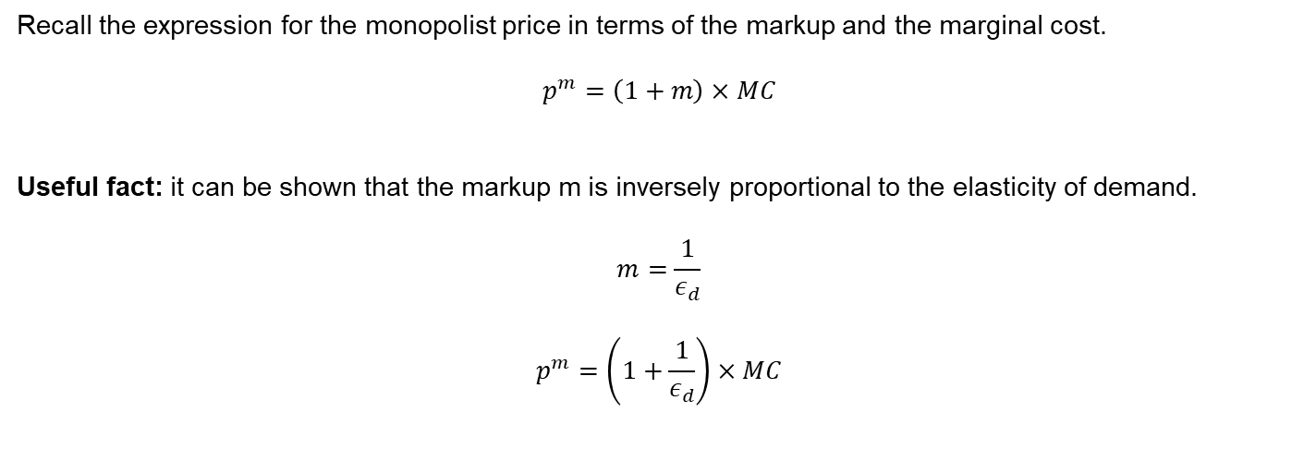
Monopolist Markup and Elasticity of Demand
Recall the expression for the monopolist price in terms of the markup and the marginal cost.
$$p^{m}=\left(1+m\right)×MC$$
Useful fact: it can be shown that the markup m is inversely proportional to the elasticity of demand.
$$m=\frac{1}{ε_{d}}$$
$$p^{m}=\left(1+\frac{1}{ε_{d}}\right)×MC$$

Slide 25
For Next Class
Next class: Monopoly and Antitrust Regulation
Readings: Mankiw Ch 20.

Slide 26
SPEA-V-202
Contemporary Economic Issues in Public Affairs
Monopoly and Antitrust Regulation
Luis Navarro

