Slide 1
SPEA-V-202
Contemporary Economic Issues in Public Affairs
Macroeconomic and Monetary Policy
Luis Navarro

Slide 2


General Outline
Credit and Money Markets
Market of Loanable Funds
Market of Money: supply and demand
Equilibrium in the Money and Credit Markets
Monetary Policy Tools
Quantity Theory of Money
Macroeconomics
Basics of Macro: national accounting
Price dynamics and inflation
Nominal and real variables
Indexing

Slide 3
Intuition behind the financial system: loans 101
How do loans/credit (borrowing money) work in practice? What are the elements of a loan?
Length/maturity (when do you have to pay); interest rate (price of the loan); principal (amount borrowed).
Example: suppose you borrow $10,000 at an interest rate of 10% annually. The maturity of the loan is 2 years and each year you pay $5,000 to reduce the principal, plus the corresponding interest.
Year | Amount Outstanding (Beginning of Period) | Principal Payment | Interest Payment (Interest rate x Amount Outstanding) | Total Payment (Principal + Interest) | Amount Outstanding (End of Period)
Total |  | 10,000 | 1,500 | 11,500
1 | 10,000 | 5,000 | 1,000 | 6,000 | 5,000
2 | 5,000 | 5,000 | 500 | 5,500 | 0
Sum of principal payments = Amount borrowed.
Interest payments are the cost of getting money from the future. Why?
With the loan, your available resources today increased by $10,000. But will decrease by $6,000 in t+1 and by $5,500 in t+2.

Slide 4
Intuition behind the financial system
Remarks from the previous example:
Note that you borrowed $10,000 but end up paying $11,500. $1,500 of interest payments.
Saving/borrowing money is just moving consumption units across time.
Example: saving for retirement → moving consumption units from the present to the future.
Example: student loans → moving consumption units from the future to the present.
The interest rate captures the price of moving money (consumption units) across time.
It represents the opportunity cost of substituting present consumption for future consumption. The price of using the “time machine” of the economy.

Slide 5
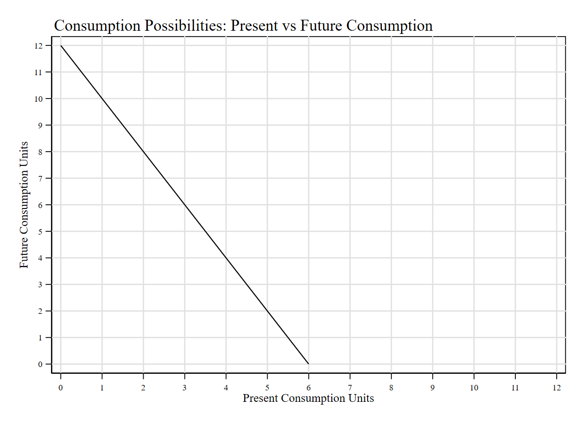
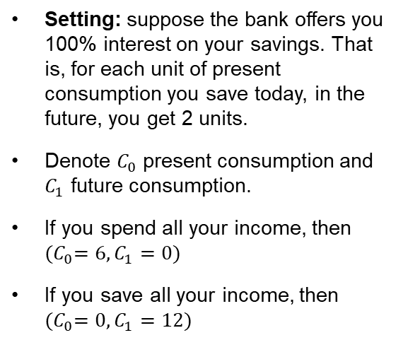

Intuition behind the financial system
Suppose you want to choose between present and future consumption. Future consumption is determined by how many units you save in the bank. Let’s draw your consumption possibilities frontier.
Setting: suppose the bank offers you 100% interest on your savings. That is, for each unit of present consumption you save today, in the future, you get 2 units.
Denote $C_{0}$ present consumption and $C_{1}$ future consumption.
If you spend all your income, then ${(C}_{0}=6,C_{1}=0)$
If you save all your income, then ${(C}_{0}=0,C_{1}=12)$
Opportunity cost is given by the slope
To increase future consumption by 2 units you need to give up 1 unit of present consumption.
$Slope=−\frac{1}{1+r}$
In this case: $slope=−\frac{1}{1+1}=−\frac{1}{2}$

Slide 6
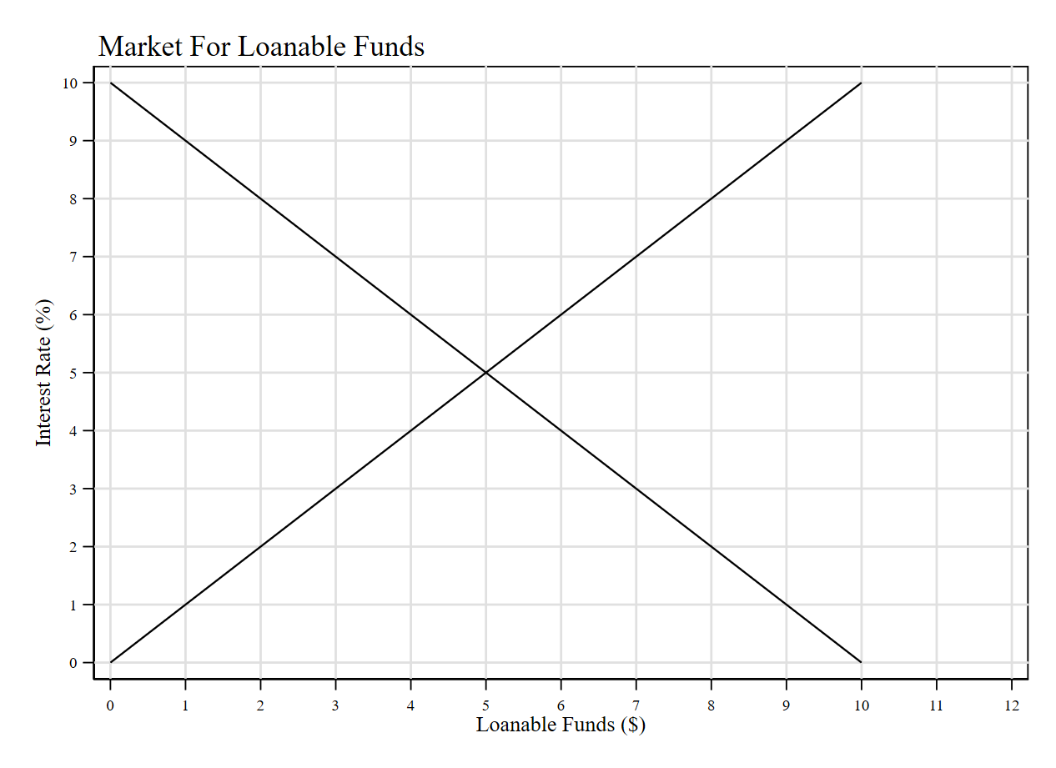
Market for Loanable Funds
Suppose we have an economy conformed of 2 people: borrowers and lenders.
Supply: all the people willing to lend (substitute present consumption for future consumption).
Demand: all the people willing to borrow (substitute future consumption for present consumption).
Loanable funds: refers to all income that people chose to save and lend out, rather than use for their own consumption, and to the amount that investors have chosen to borrow to fund new investment projects.
Interest rate: the price of a loan/credit.
High-interest rate makes borrowing more expensive (downward-sloping demand curve) and saving more attractive (upward-sloping supply curve).

Slide 7
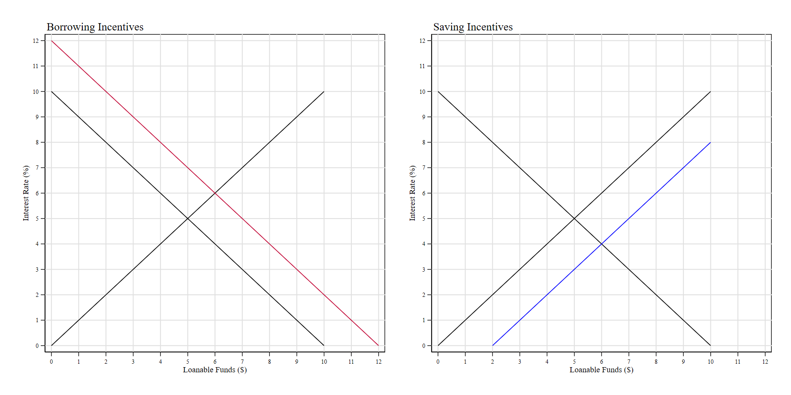










Market for Loanable Funds
Borrowing incentives: increase in the demand for loans. The interest rate in equilibrium increases.
Saving incentives: increase in the supply of loans. The interest rate in equilibrium decreases.
$$S_{0}$$
$$S_{0}$$
$$S_{1}$$
$$r^{∗}$$
$$r^{∗}$$
$$D_{1}$$
$$c^{∗}$$
$$c^{∗}$$
$$D_{0}$$
$$D_{0}$$

Slide 8
Financial System in Practice
Financial system: the group of institutions in the economy that helps to match one person’s saving with another person’s investment.
Basically, it connects savers to borrowers enabling the economy to transfer resources across time.
Financial institutions can be categorized in 2 groups:
Financial Markets/Financial instruments: the market for bonds, loans (debt instruments) and stock (equity instruments).
Bond: a certificate of indebtedness (an IOU). Stock: share in the ownership of a company.
Financial Intermediaries: institutions selling financial instruments.
Banks: take deposits from people that wants to save and use these deposits to make loans to people that wants to borrow.
Mutual funds: sells shares to the public and use the proceeds to buy bonds and stocks.

Slide 9
An Introduction to Money
Money: the set of assets in an economy that people regularly use to buy goods and services from other people.
Functions of Money: medium of exchange (allow market transactions), unit of account (unit to record debts), store of value (an item to transfer present to future consumption), liquidity (ease with which an asset can be converted into the economy’s medium of exchange).
Fiat Money: money established by the government through decree.
Example: why can’t you use Monopoly (the game) dollars to pay at Kroger?
Since the government is the only allowed to create money. Hence, how does the money supply work?
Currency: bills and coins. Physical money.
Bank Deposits: balances in bank accounts that are as good as cash. Virtual money.

Slide 10
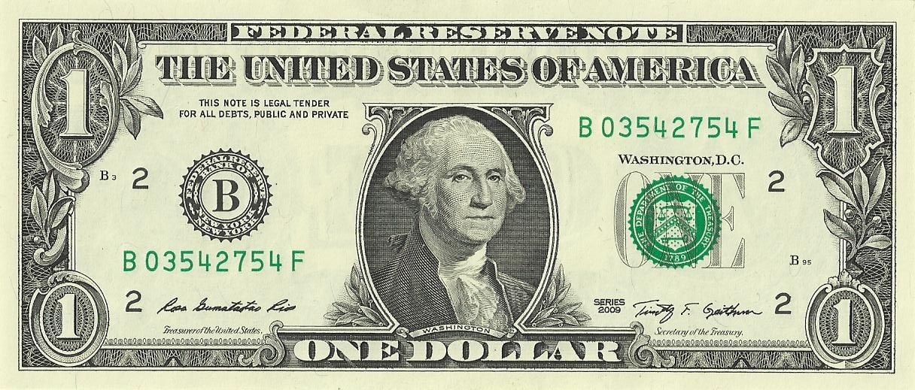
An Introduction to Money
The central bank is the monetary authority of the economy. An institution designed to oversee the banking system and regulate the quantity of money in the economy.
The Federal Reserve is the US central bank.
Money Supply: the quantity of money available in the economy.
Dollars are federal reserve notes.
Legal tender for all debts, public and private.

Slide 11
Federal Reserve and Money Supply
The central bank is often called “the bank of banks”. Why? Because all banks hold reserve accounts with the central bank. A way to track how much money circulates in the economy through the financial system.
The Federal Reserve has two main jobs.
Regulate banks and ensure the health of the banking system (the network of all banks operating in the US).
The Fed monitors each bank’s financial condition and facilitates transactions by clearing checks.
Example: daily operations of the financial system entail clearing deposit/retirement transactions across banks.
Control the money supply.
Often referred as the “money printer”. In practice is more subtle. Most of the money is virtual.
Money supply is controlled indirectly via the number of loanable funds in the market.

Slide 12
Equilibrium in the Money Market
What determines the value of money? As always: supply and demand forces.
Value of money is determined by what you can buy with it.
Money supply: perfectly inelastic (fixed) and determined by the Federal Reserve.
Money demand: downward sloping. Determined by individual’s preferences for present consumption.
Intuition: the average price level determines the value of money. If the price of milk increases, then with your same $20 bill you can buy less units of milk.

Slide 13
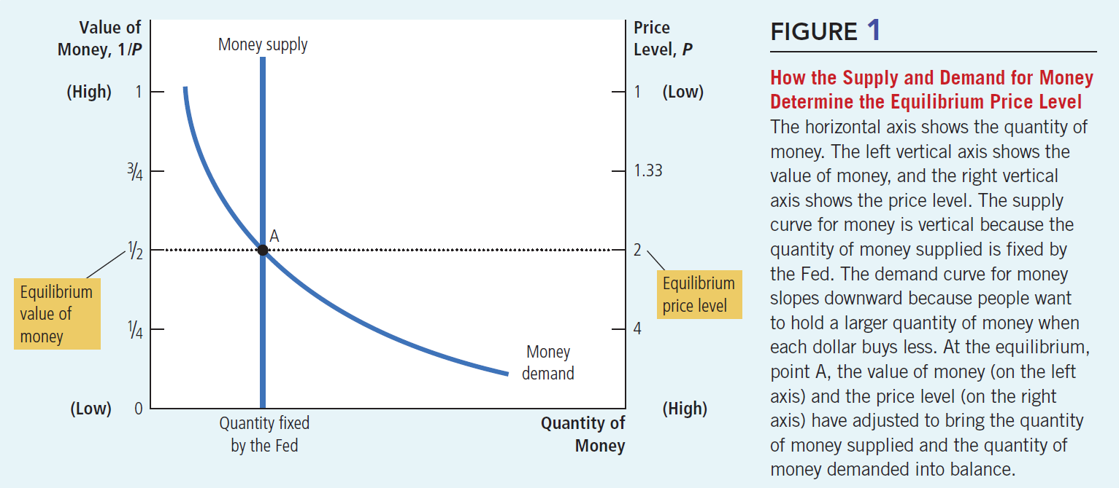
Equilibrium in the Money Market
Source: Mankiw Chapter 30.

Slide 14
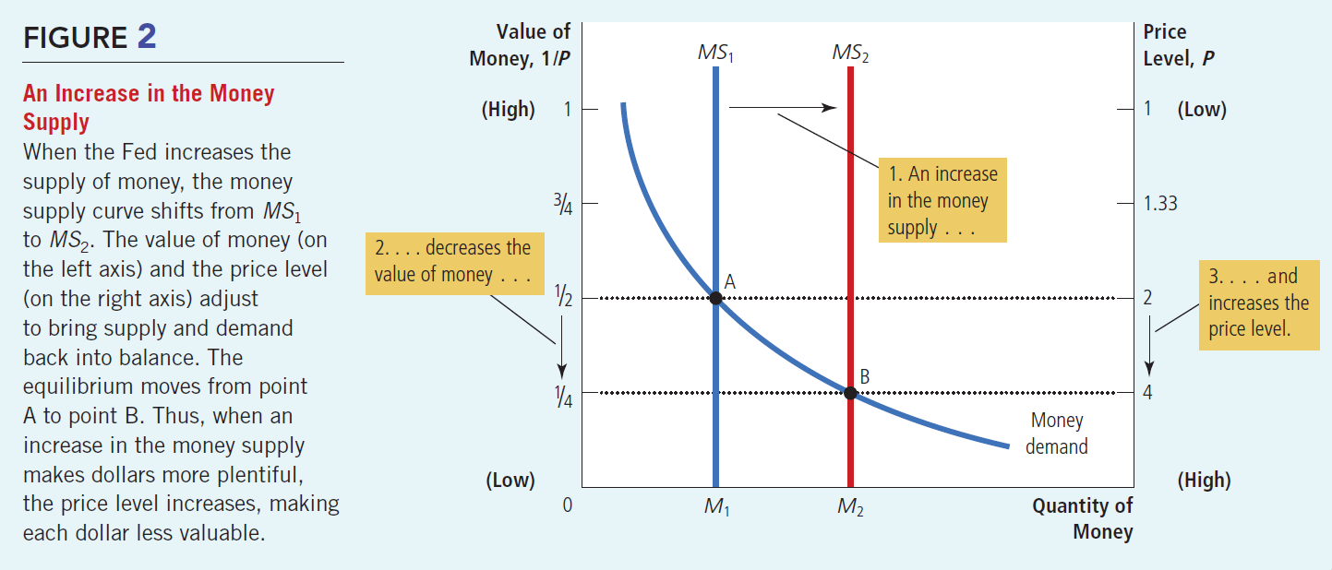
Equilibrium in the Money Market
Source: Mankiw Chapter 30.

Slide 15
Equilibrium in the Money Market
Remark: when the Fed increases the money supply, it is reducing the relative scarcity of money in the economy. More dollars for the same number of goods.
If there is more money in the economy, households can buy more units of present consumption (they have more cash). But what happens when the demand for present consumption increases?
Law of Demand: it increases the price of present consumption.
Intuition: draw a supply and demand diagram for present consumption. In this case, more money implies the demand shifts to the right. Both price and quantity increase in equilibrium.
If prices increase it means, we observe inflation.
Takeaway: when the Fed aims to reduce the money supply it is implicitly looking to reduce the inflation observed in the economy.

Slide 16
Equilibrium in the Money and Loans Market
Recall the basic intuition behind financial markets is moving resources across time. Present consumption vs future consumption.
Example: Suppose you have 10 apples, which you want to allocate between present and future consumption. In other words, you want to choose how many apples you’ll eat today and how many you’ll save for tomorrow.
Suppose you are hungry, so you decided to eat 7 apples today, and save 3 for tomorrow. How can we translate this into the terms of the money and loans markets?
Present consumption → demand for money.
Future consumption → demand for savings.
Intuition: present and future consumption are substitutes. If you increase present consumption (equilibrium in the money market), demand for future consumption decreases (equilibrium in the loans market). The equilibrium of both markets is determined simultaneously by just one price: the equilibrium interest rate.

Slide 17
The Theory of Liquidity Preference
John Maynard Keynes in his seminal work The General Theory of Employment, Interest and Money proposed the theory of liquidity preference to explain how the equilibrium interest rate is determined.
Basic idea: equilibrium in the money market determines the equilibrium in the market for loanable funds.
Liquidity: the ease with which an asset can be converted into the economy’s medium of exchange (i.e. money). Money is the most liquid asset in the economy.
Money demand: demand is driven by preferences for liquidity. Same story as before. People will demand money proportional to their demand for present consumption (goods and services).
Interest rate: represents the opportunity cost of holding money. Why? Recall the consumption possibility frontier (present vs future consumption).
Equilibrium interest rate: the interest rate that makes the supply = demand in the market for money.

Slide 18
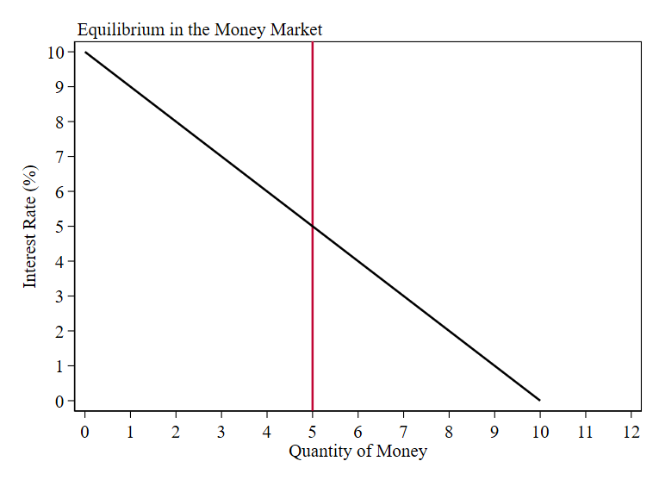





The Theory of Liquidity Preference
This market reaches equilibrium when the interest rate = 5%.
Ex1: Suppose the interest rate is above its equilibrium level. Say 7%. At this rate, people want to hold less money than the quantity supplied by the FED (i.e. excess supply = 2).
Ex2: Suppose the interest rate is below its equilibrium level. Say 3%. At this rate, people want to hold more money than the quantity supplied by the FED (i.e. excess demand = 2).
$r$=7%
$r^{∗}$=5%
$r$=3%
$$ES$$
$$ED$$

Slide 19
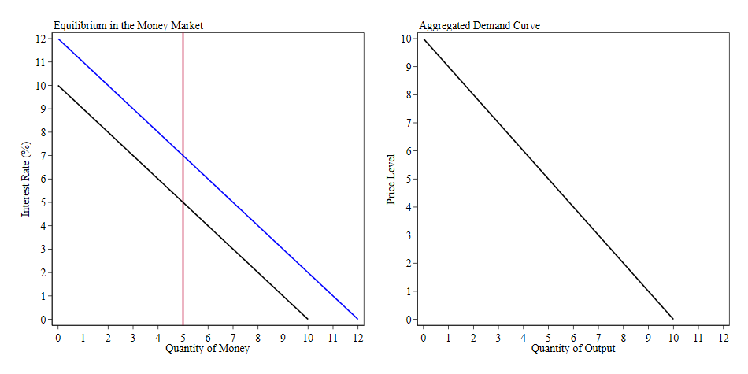







The Theory of Liquidity Preference
Suppose there is a price increase in the economy. From $p_{1}$ to $p_{2}$.
This increases the interest rate from $r_{1}$ to $r_{2}$.
The interest rate reduces the incentives to borrow. Hence, people want to save.
This leads to a reduction of total output (present consumption) from $y_{1}$ to $y_{2}$
$p_{2}$=7
$r_{2}$=7%
$r_{1}$=5%
$p_{1}$=4
$$ΔY=y_{2}−y_{1}$$

Slide 20
Monetary Policy Tools

Slide 21



Monetary Policy Tools
The Federal Reserve controls the money supply through several monetary policy tools.
Lending reserves to banks
(Discount Rate)
Reserve requirements
Open-market operations
(Federal Funds Rate)

Slide 22
Monetary Policy in Practice: Intro to Banking
Example: suppose a bank has $1,000 in deposits from the public. How does the bank make a profit out of this?
It lends out the money! The role of banks is to connect borrowers with lenders/savers.
For savers/lenders: the bank pays an interest rate for holding their money.
Intuitively, the depositor is lending money to the bank.
For borrowers: the bank charges an interest rate for lending the money.
Borrowers pay interest to the bank.
The difference between the rate at which the bank lends and borrows money, determines the bank’s profits.
This is often called the net interest margin .

Slide 23
Monetary Policy in Practice: Intro to Banking
Example: suppose a bank has $1,000 in deposits from the public. How does the bank make a profit out of this?
Why can’t the bank lend all the money it holds in deposits?
Intuition: The bank does not know when people will withdraw their money. In order to operate properly, it needs to have a cash/capital reserve proportional to the average withdrawal in the economy.
In practice, banks need to hold liquid reserves (cash) proportional to the number of deposits they have. This reserve/capital requirement is set by the Federal Reserve.
Suppose the bank has a reserve requirement of 10% of its deposits. This means it can lend up to $900. It always needs to have $100 in case people want to withdraw their money.
In a nutshell, reserves are cash buffers for banks. How can a bank increase its reserves? By selling financial instruments (future consumption) in exchange of cash (present consumption).
In practice, these reserves are sold either by the Federal Reserve itself or other banks/financial institutions.

Slide 24
Monetary Policy in Practice: Reserve Requirements
Reserve Lending: the Fed can lend money to banks and increase their reserves. This extra money allows banks to increase lending (credit) to the public.
This loan works as any other loan and pays an interest rate. This rate is called the discount rate: the rate at which banks obtain loans from the central bank.
Increasing the discount rate leads to a decrease in the money supply. Why? If the rate at which banks borrow increases, then their incentives to borrow decrease. Hence, it reduces the amount of reserves in the economy (i.e. cash held by banks). In other words: it lowers the money supply.
Reserve Requirements: the proportion of cash to liabilities that banks need to hold at any moment.
Intuition: banks need to have enough cash to face average withdrawals. Lowering reserve requirements allows the bank to increase lending, with the same level of cash reserves.

Slide 25
Monetary Policy in Practice: OMC
Open Market Operations: the purchase and sale of U.S. government bonds by the Federal Reserve.
Let’s look at the nature of this transaction: Recall the market for loanable funds. For simplicity, assume U.S. government bonds are the only financial instrument in the economy. Hence, bonds are the only “time machine” of the economy (i.e. the way to convert present consumption into future consumption).
Savers/Lenders: demand government bonds. They want to exchange present consumption (i.e. sell dollars) for future consumption (i.e. buy bonds).
Borrowers: demand money. They want to exchange future consumption (i.e. sell bonds) for present consumption (i.e. buy dollars).
Example: the Fed purchases U.S. government bonds from the public. In that transaction, the Fed acquires debt certificates in exchange of money (cash) given to the holders of such bonds. Hence:
Increase of money supply and contraction of bonds supply.

Slide 26
Monetary Policy in Practice: Federal funds rate
Federal funds rate: the interest rate at which banks make overnight loans to one another.
If a bank wants to buy reserves (cash) it can borrow them from another bank. In other works, through an inter-bank loan. Such loans are temporary (typically overnight). The price of such loans is the federal funds rate.
“Borrowing reserves from another bank in the federal funds market is an alternative to borrowing reserves from the Fed, and a bank short of reserves will typically do whichever is cheaper (Mankiw, 29-4D)”
Intuition: banks can either borrow reserves from one another or directly from the central bank. These two goods are substitutes. Hence, actions to increase cash reserves in the economy influence the price of credit (i.e. the equilibrium interest rate).
In practice, the discount rate and the federal funds rate move closely together. Result from no-arbitrage between the two markets. Both instruments are virtually risk-free.

Slide 27
Monetary Policy in Practice: FOMC
How does it work in practice?
Federal Open Market Committee (FOMC): meets approximately every 6 weeks to decide the target goal of the federal funds rate. Policy actions are to increase, decrease or keep constant the target.
This target rate influences the market for reserves (recall Fed’s reserves are substitutes to cash from other banks). Hence, this target signals the actions the Fed will undertake to reach its objective.
When the Fed announces a change in the federal funds rate, it is committing itself to the open-market operations necessary to make that change happen, and these open-market operations will alter the supply of money.
Decisions by the FOMC to change the target for the federal funds rate are also decisions to change the money supply.
Example: suppose the Fed wants to increase the money supply. How? Injecting reserves to the financial system by buying US Treasury bonds from the public. That transaction decreases the number of debt held by the public and increases the amount of cash. From our diagram, this leads to higher inflation.

Slide 28
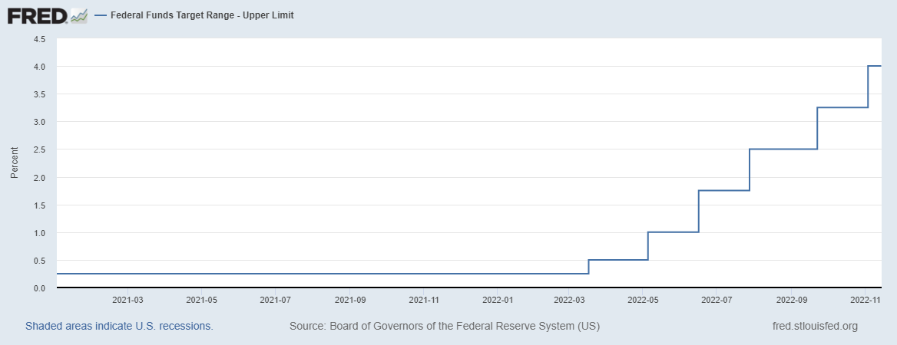
Monetary Policy in Practice: FOMC
How does it work in practice?
The FOMC meets to review and discuss the updated economic outlook (economic growth, unemployment, inflation, financial markets stability).
Members of the FOMC vote to either increase, decrease, or keep constant the target interval for the federal funds rate.
Example: at the last FOMC meeting decided to raise the target for the federal funds rate to 3.75%-4.0%. The main concern is to return inflation to low levels.
Causal mechanism: increasing the target rate signals to the market that the Fed is going to decrease the money supply. How? Increasing the rate makes saving more attractive, so people will substitute cash for bonds (increase of money supply). From our diagram, we know this leads to lower prices (reduces inflation).

Slide 29
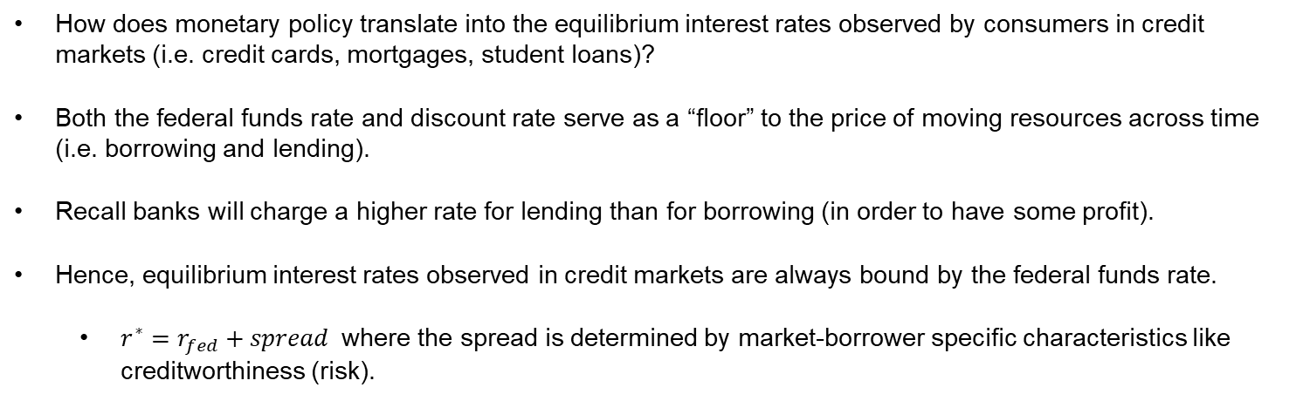
Monetary Policy in Practice
How does monetary policy translate into the equilibrium interest rates observed by consumers in credit markets (i.e. credit cards, mortgages, student loans)?
Both the federal funds rate and discount rate serve as a “floor” to the price of moving resources across time (i.e. borrowing and lending).
Recall banks will charge a higher rate for lending than for borrowing (in order to have some profit).
Hence, equilibrium interest rates observed in credit markets are always bound by the federal funds rate.
$r^{∗}=r_{fed}+spread$ where the spread is determined by market-borrower specific characteristics like creditworthiness (risk).

Slide 30
Monetary Policy in Summary
Policy Tools | Increase Money Supply | Decrease Money Supply
Open Market Operations (Target Federal Funds Rate) | Purchase of government bonds from the public. (Decrease the target) | Selling government bonds to the public (Increase the target)
Reserve Lending (Discount Rate) | Increase lending to banks (Decrease the discount rate) | Decrease lending to banks (Increase the discount rate)
Reserve Requirements | Lower reserve requirements | Raise reserve requirements

Slide 31
Quantity Theory of Money

Slide 32
Classical Theory of Inflation
Money supply: fixed by the Fed
Money demand: preferences for liquid wealth (i.e. demand of present consumption).
Equilibrium leads to an implicit value of money, that depends on the price level.
An increase in the money supply leads to a decrease in the value of money. Why?
More dollars are chasing the same amount of goods. Hence, prices increase.
Source: Mankiw Chapter 30.

Slide 33
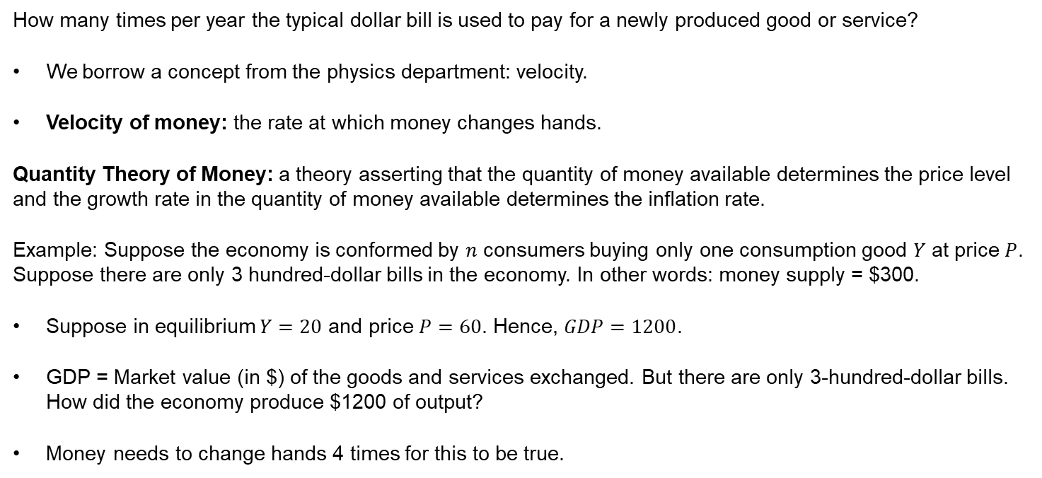
Quantity Theory of Money
How many times per year the typical dollar bill is used to pay for a newly produced good or service?
We borrow a concept from the physics department: velocity.
Velocity of money: the rate at which money changes hands.
Quantity Theory of Money: a theory asserting that the quantity of money available determines the price level and the growth rate in the quantity of money available determines the inflation rate.
Example: Suppose the economy is conformed by $n$ consumers buying only one consumption good $Y$ at price $P$. Suppose there are only 3 hundred-dollar bills in the economy. In other words: money supply = $300.
Suppose in equilibrium $Y=20$ and price $P=60$. Hence, $GDP=1200$.
GDP = Market value (in $) of the goods and services exchanged. But there are only 3-hundred-dollar bills. How did the economy produce $1200 of output?
Money needs to change hands 4 times for this to be true.

Slide 34
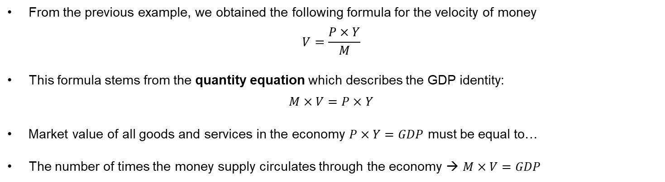
Quantity Theory of Money
From the previous example, we obtained the following formula for the velocity of money
$$V=\frac{P×Y}{M}$$
This formula stems from the quantity equation which describes the GDP identity:
$$M×V=P×Y$$
Market value of all goods and services in the economy $P×Y=GDP$ must be equal to…
The number of times the money supply circulates through the economy → $M×V=GDP$

Slide 35
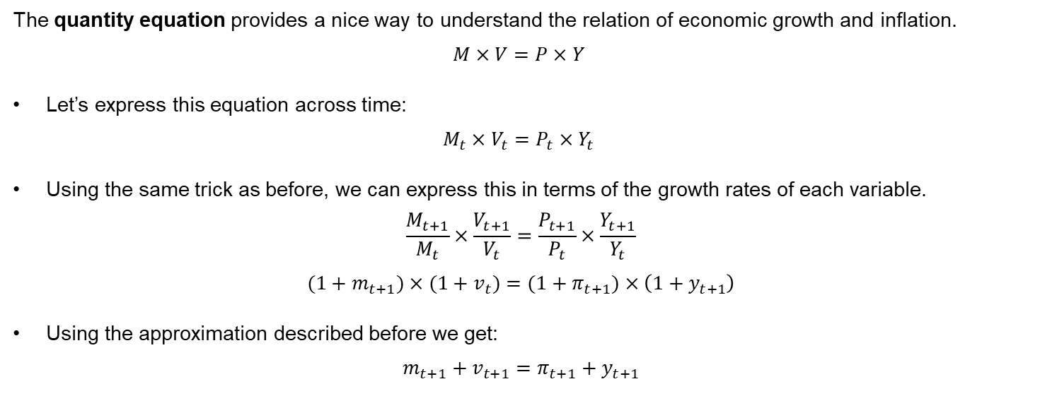
Quantity Theory of Money
The quantity equation provides a nice way to understand the relation of economic growth and inflation.
$$M×V=P×Y$$
Let’s express this equation across time:
$$M_{t}×V_{t}=P_{t}×Y_{t}$$
Using the same trick as before, we can express this in terms of the growth rates of each variable.
$$\frac{M_{t+1}}{M_{t}}×\frac{V_{t+1}}{V_{t}}=\frac{P_{t+1}}{P_{t}}×\frac{Y_{t+1}}{Y_{t}}$$
$${(1+m}_{t+1})×{(1+v}_{t})={(1+π}_{t+1})×\left(1+y_{t+1}\right)$$
Using the approximation described before we get:
$$m_{t+1}+v_{t+1}=π_{t+1}+y_{t+1}$$

Slide 36
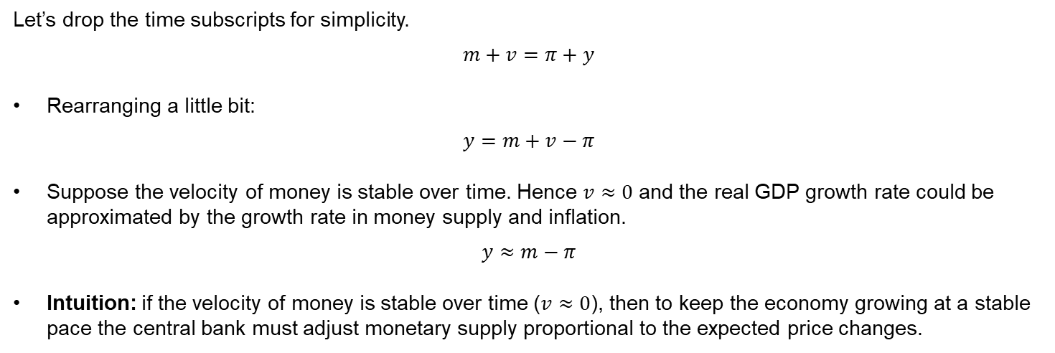
Quantity Theory of Money
Let’s drop the time subscripts for simplicity.
$$m+v=π+y$$
Rearranging a little bit:
$$y=m+v−π$$
Suppose the velocity of money is stable over time. Hence $v≈0$ and the real GDP growth rate could be approximated by the growth rate in money supply and inflation.
$$y≈m−π$$
Intuition: if the velocity of money is stable over time ($v≈0$), then to keep the economy growing at a stable pace the central bank must adjust monetary supply proportional to the expected price changes.

Slide 37
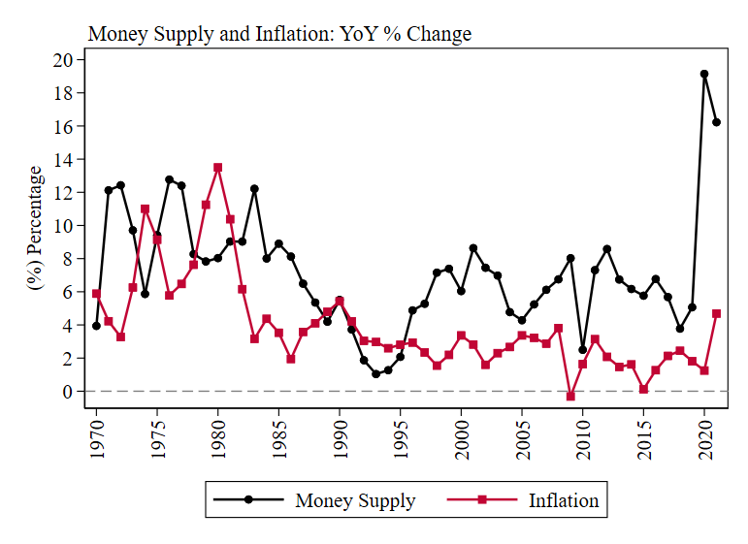
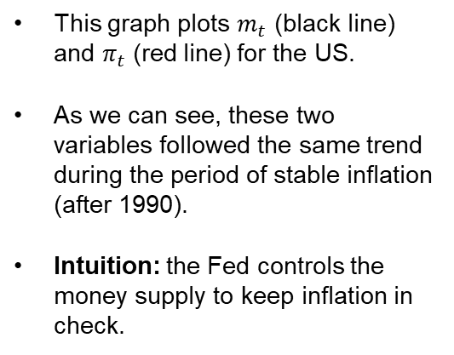
Money Supply and Inflation for the United States
This graph plots $m_{t}$ (black line) and $π_{t}$ (red line) for the US.
As we can see, these two variables followed the same trend during the period of stable inflation (after 1990).
Intuition: the Fed controls the money supply to keep inflation in check.
Source: FRED

Slide 38
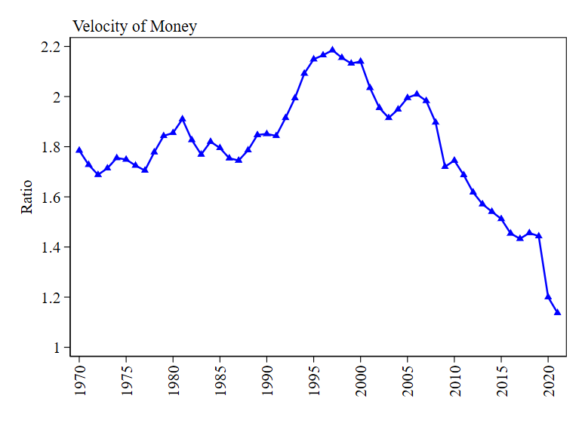
Velocity of Money
In most cases (several countries), the velocity of money is indeed stable over time. For the US, however, it has been decreasing for the past 2 decades.
In theory, money velocity decrease when there are fewer transactions being made.
Why has the velocity of money slowed down in the last years?
This post from the St. Louis Federal Reserve Bank suggests the answer lies behind the monetary policy measures undertaken in the aftermath of the Great Recession.
Source: FRED

Slide 39
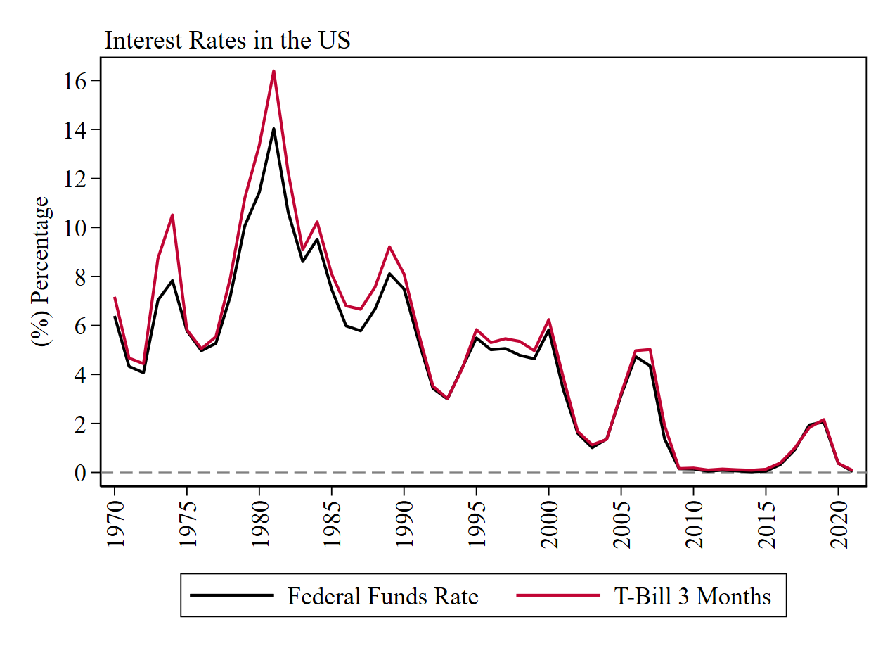
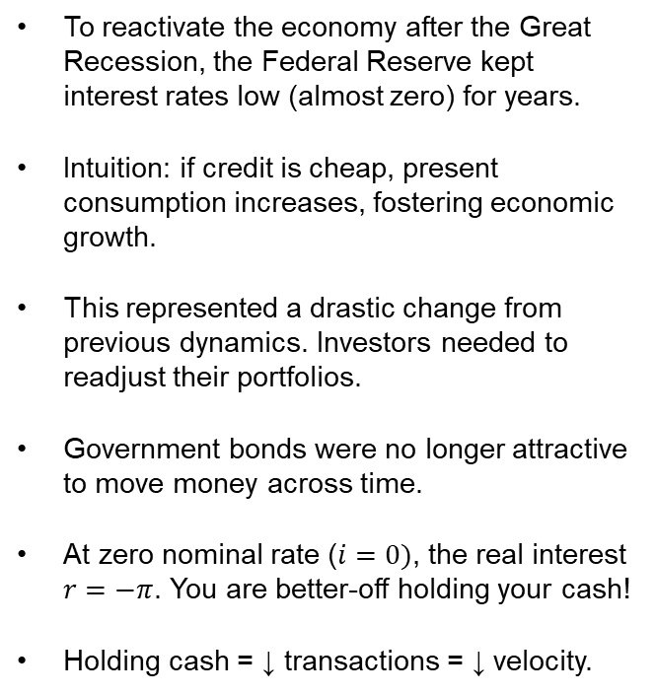
Interest Rates in the US
To reactivate the economy after the Great Recession, the Federal Reserve kept interest rates low (almost zero) for years.
Intuition: if credit is cheap, present consumption increases, fostering economic growth.
This represented a drastic change from previous dynamics. Investors needed to readjust their portfolios.
Government bonds were no longer attractive to move money across time.
At zero nominal rate ($i=0)$, the real interest $r=−π$. You are better-off holding your cash!
Holding cash = ↓ transactions = ↓ velocity.
Source: FRED

Slide 40
Monetary Neutrality
We have discussed how the money supply influences prices (i.e. inflation).
Since the causal mechanism is through the value of money, some economists posit that changes in nominal variables (e.g. money supply, nominal interest rate) do not influence real variables (output, employment, real interest rate). This concept is called monetary neutrality.
Intuition: more dollars chasing the same amount of goods. If the central bank doubles the money supply of the economy, then the value of each dollar decreases by half, but the output (physical units) remains unchanged.
Is this a realistic example? Not necessarily. Economic theory (and evidence) suggest that money is neutral in the long-run but has effects on real variables in the short-run.
Takeaway: monetary policy cannot determine the growth path of the economy but can boost/decrease economic activity in the short-run.

Slide 41
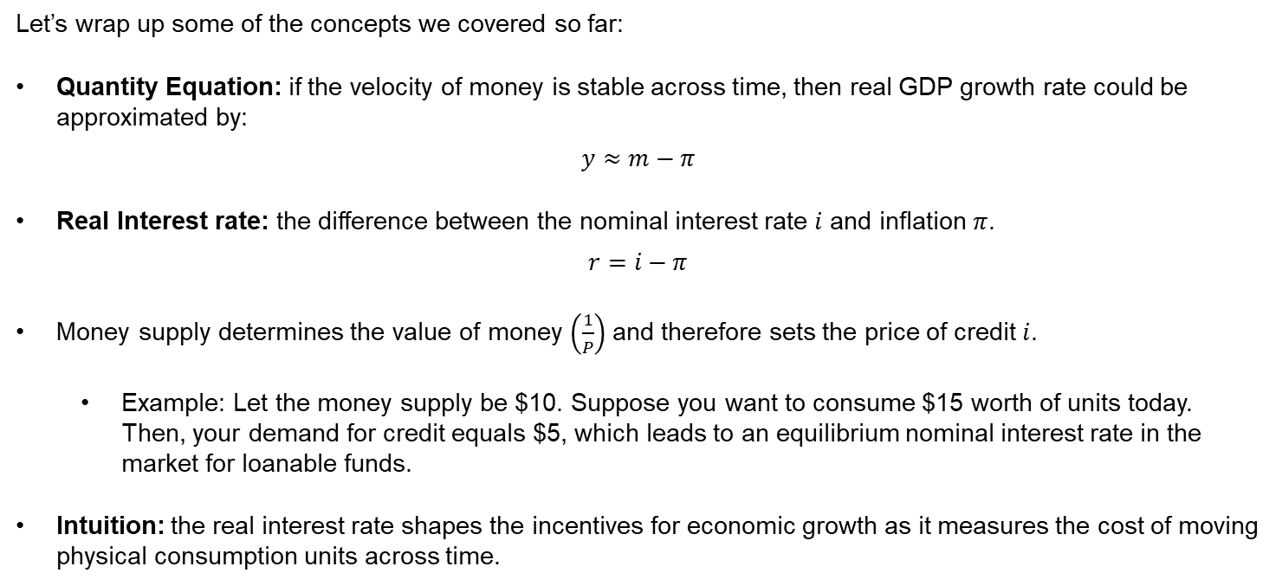
Summary
Let’s wrap up some of the concepts we covered so far:
Quantity Equation: if the velocity of money is stable across time, then real GDP growth rate could be approximated by:
$$y≈m−π$$
Real Interest rate: the difference between the nominal interest rate $i$ and inflation $π$.
$$r=i−π$$
Money supply determines the value of money $\left(\frac{1}{P}\right)$and therefore sets the price of credit $i$.
Example: Let the money supply be $10. Suppose you want to consume $15 worth of units today. Then, your demand for credit equals $5, which leads to an equilibrium nominal interest rate in the market for loanable funds.
Intuition: the real interest rate shapes the incentives for economic growth as it measures the cost of moving physical consumption units across time.

Slide 42
Macroeconomics

Slide 43
Economics
Economics is divided into two branches:
Microeconomics: the study of how households and firms make decisions and how they interact in markets.
Explain how individual households and firms interact with each other in specific markets.
Example: market for burgers, labor market, insurance market.
Macroeconomics: the study of economy-wide phenomena, including inflation, unemployment and economic growth.
Explain the economic changes that affect households, firms and markets simultaneously.
Study of the economy as an aggregated unit: all markets at the same time.

Slide 44
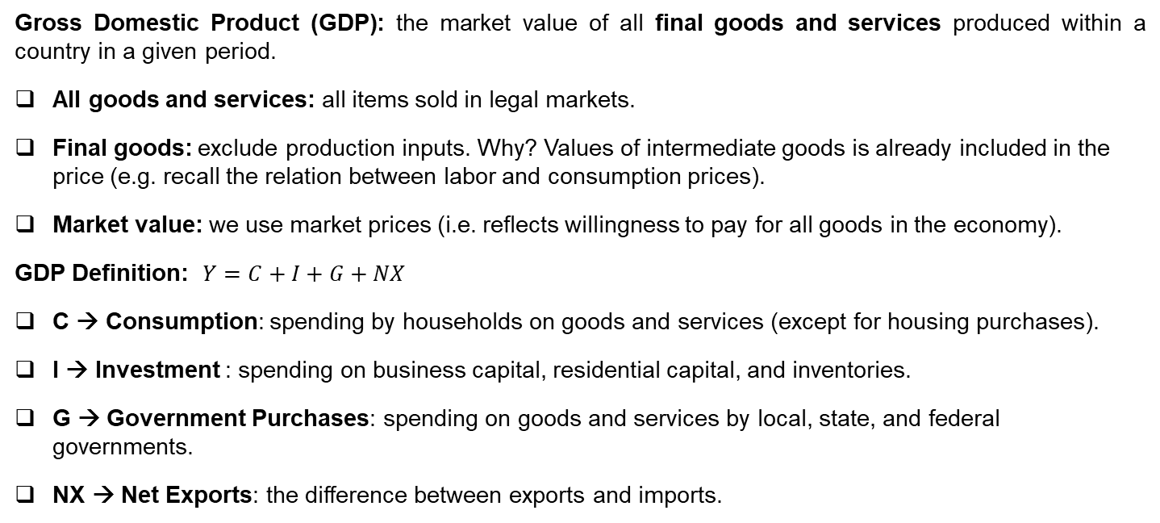
GDP Definition
Gross Domestic Product (GDP): the market value of all final goods and services produced within a country in a given period.
All goods and services: all items sold in legal markets.
Final goods: exclude production inputs. Why? Values of intermediate goods is already included in the price (e.g. recall the relation between labor and consumption prices).
Market value: we use market prices (i.e. reflects willingness to pay for all goods in the economy).
GDP Definition: $Y=C+I+G+NX$
C → Consumption: spending by households on goods and services (except for housing purchases).
I → Investment : spending on business capital, residential capital, and inventories.
G → Government Purchases: spending on goods and services by local, state, and federal governments.
NX → Net Exports: the difference between exports and imports.

Slide 45
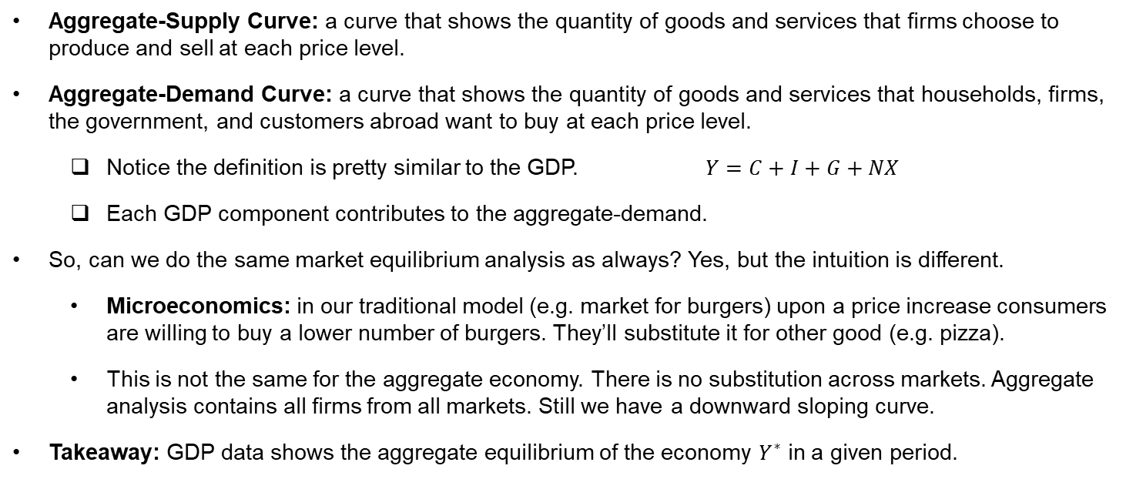
Aggregate-Demand and Supply
Aggregate-Supply Curve: a curve that shows the quantity of goods and services that firms choose to produce and sell at each price level.
Aggregate-Demand Curve: a curve that shows the quantity of goods and services that households, firms, the government, and customers abroad want to buy at each price level.
Notice the definition is pretty similar to the GDP. $Y=C+I+G+NX$
Each GDP component contributes to the aggregate-demand.
So, can we do the same market equilibrium analysis as always? Yes, but the intuition is different.
Microeconomics: in our traditional model (e.g. market for burgers) upon a price increase consumers are willing to buy a lower number of burgers. They’ll substitute it for other good (e.g. pizza).
This is not the same for the aggregate economy. There is no substitution across markets. Aggregate analysis contains all firms from all markets. Still we have a downward sloping curve.
Takeaway: GDP data shows the aggregate equilibrium of the economy $Y^{∗}$ in a given period.

Slide 46
GDP and Aggregated Demand
$$Y=C+I+G+NX$$
US GDP 2021 | Billions of Dollars | % of Total
GDP | 23,315 | 100.00%
Consumption | 15,903 | 68.21%
Investment | 4,114 | 17.64%
Government Consumption | 4,161 | 17.85%
Net Exports | -862 | -3.70%
Export | 2,540 | 10.89%
Imports | 3,401 | 14.59%
Source: https://www.bea.gov/data/gdp/gdp-industry

Slide 47
Economic Growth
In practice, we care most about the growth rate of the economy rather than the actual value of the GDP.
Growth rate: percentage increase/decrease relative to an initial value.
Annual growth rate: compares the annual GDP (average observed during the year) vs its observation from the previous year. YoY %.
Benefit: accounts for seasonality. Example: consumption is usually higher in the last quarter of the year due to Christmas shopping. Annual comparison directly addresses this.
Business cycle: Economy’s growth usually follows a cyclical behavior around a trend.
Periods of expansion are followed by periods of contraction.
Takeaway: following the business cycle allows to track the general outlook of the economy.

Slide 48
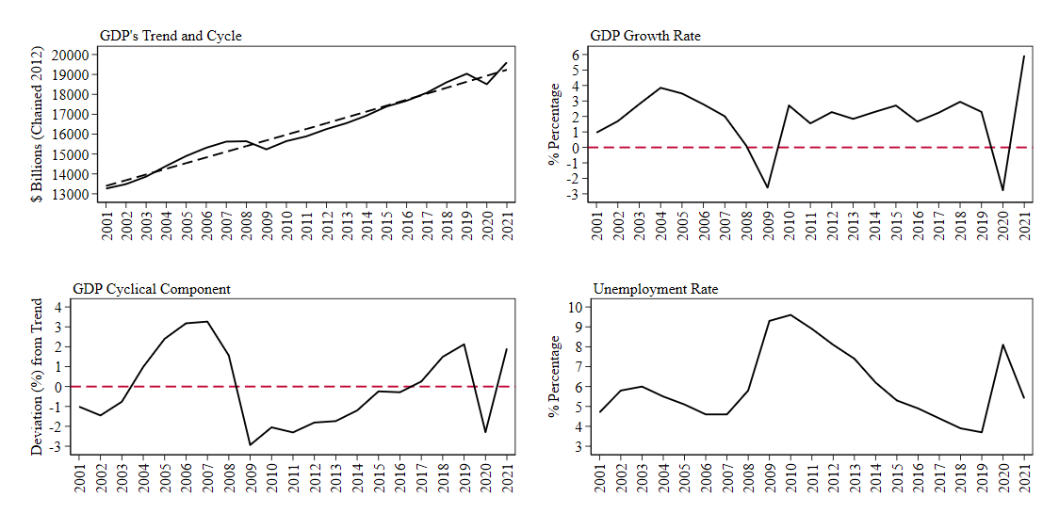
Economic Growth and Business Cycles
Source: FRED

Slide 49
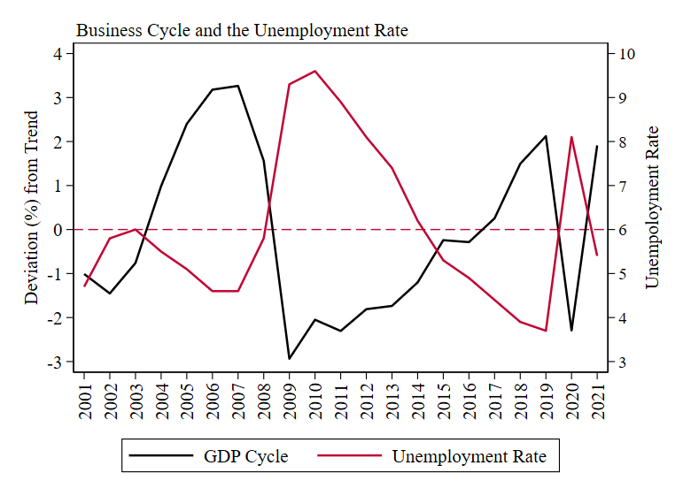
Economic Growth and Business Cycles
In practice, the unemployment rate is a good indicator to track the economy's general health.
Unemployment is inversely related to economic growth. Intuition is straightforward if you recall that labor is one of the main production inputs.
If unemployment rises, then an economic contraction will be observed. COVID-19 is a recent example.
Source: FRED

Slide 50
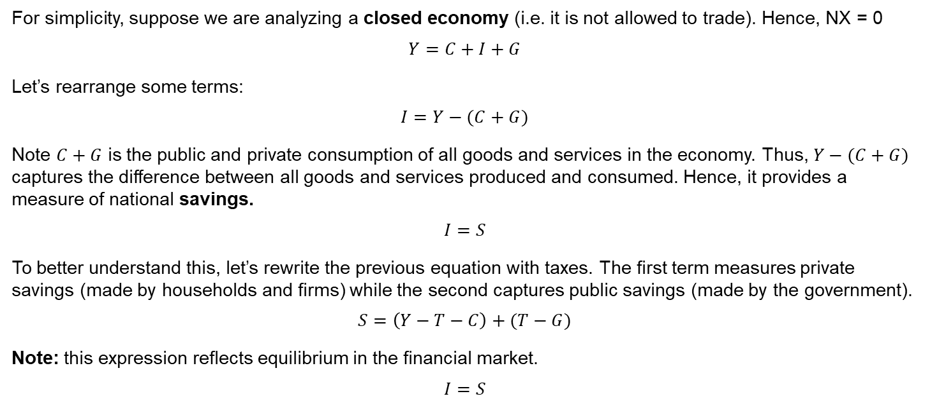
Some useful identities from the GDP equation
For simplicity, suppose we are analyzing a closed economy (i.e. it is not allowed to trade). Hence, NX = 0
$$Y=C+I+G$$
Let’s rearrange some terms:
$$I=Y−(C+G)$$
Note $C+G$ is the public and private consumption of all goods and services in the economy. Thus, $Y−(C+G)$ captures the difference between all goods and services produced and consumed. Hence, it provides a measure of national savings.
$$I=S$$
To better understand this, let’s rewrite the previous equation with taxes. The first term measures private savings (made by households and firms) while the second captures public savings (made by the government).
$$S=\left(Y−T−C\right)+(T−G)$$
Note: this expression reflects equilibrium in the financial market.
$$I=S$$

Slide 51
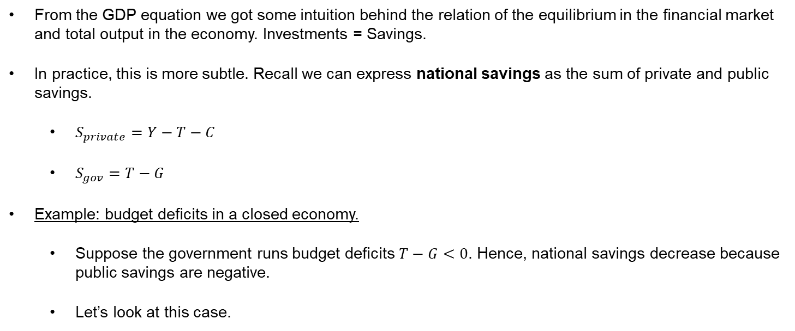
Government Borrowing and the Interest Rate
From the GDP equation we got some intuition behind the relation of the equilibrium in the financial market and total output in the economy. Investments = Savings.
In practice, this is more subtle. Recall we can express national savings as the sum of private and public savings.
$S_{private}=Y−T−C$
$S_{gov}=T−G$
Example: budget deficits in a closed economy.
Suppose the government runs budget deficits $T−G<0$. Hence, national savings decrease because public savings are negative.
Let’s look at this case.

Slide 52
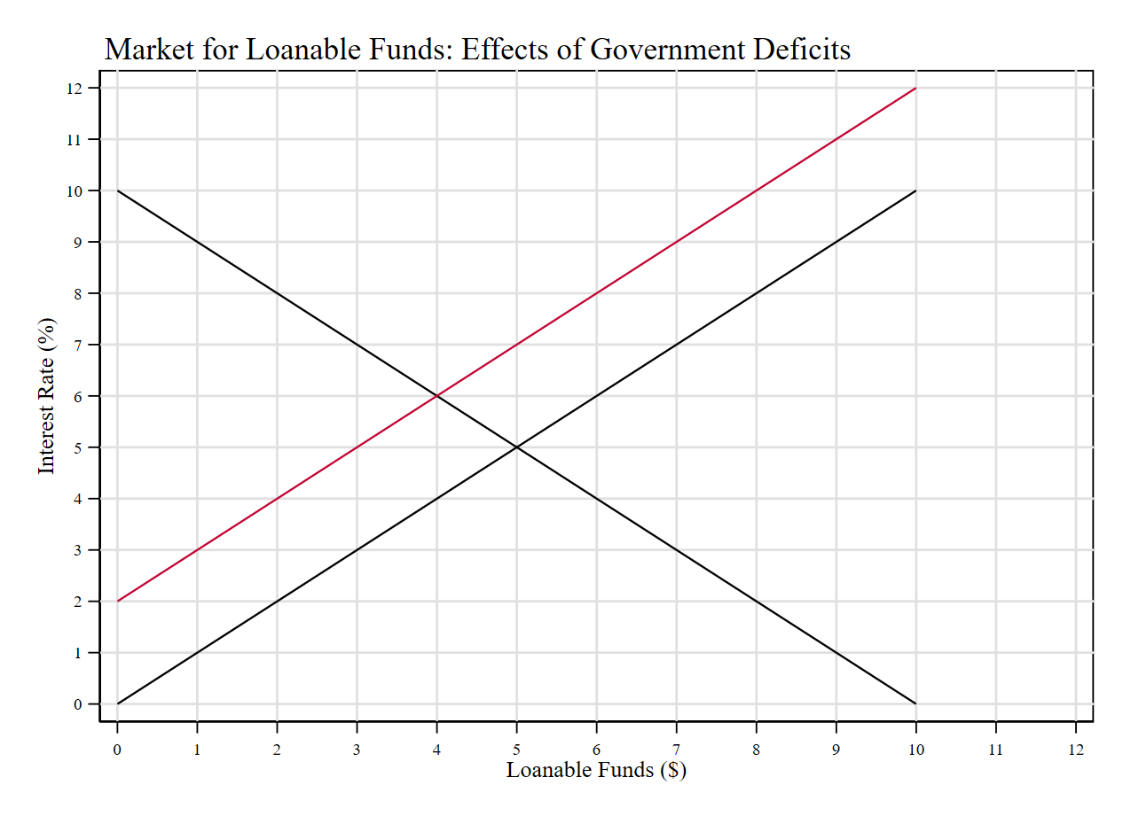





Government Borrowing and the Interest Rate
$$S_{1}$$
Intuition: running a deficit means the government is borrowing money. Number of bonds increased.
In a closed economy, who is lending the money?
Households and firms through their deposits held in the financial system!
Crowding out effect: a decrease in investment (loans to private investors) due to government borrowing.
Increase in the equilibrium interest rate.
$$S_{0}$$
$$r^{∗}$$
$$c^{∗}$$
$$D_{0}$$

Slide 53
Open-Economy Macroeconomics
Recall the value of money is given by you can buy with it. Suppose you want to buy goods from Mexico. What do you need to do?
Buy some Mexican pesos! Exchange rate: how many pesos you can buy with one dollar.
Suppose the demand for Mexican goods in the US increases. What is the effect on the exchange rate?
It will decrease/depreciate. Why? More demand for Mexican goods implies the equilibrium price of such goods increases. Hence, the purchasing value of $1 decreases. Now you need more pesos to buy the same amount of goods.
Takeaway: currency markets are markets for money. Exchange rates are determined by the relative demand for goods and services of one economy with another.

Slide 54
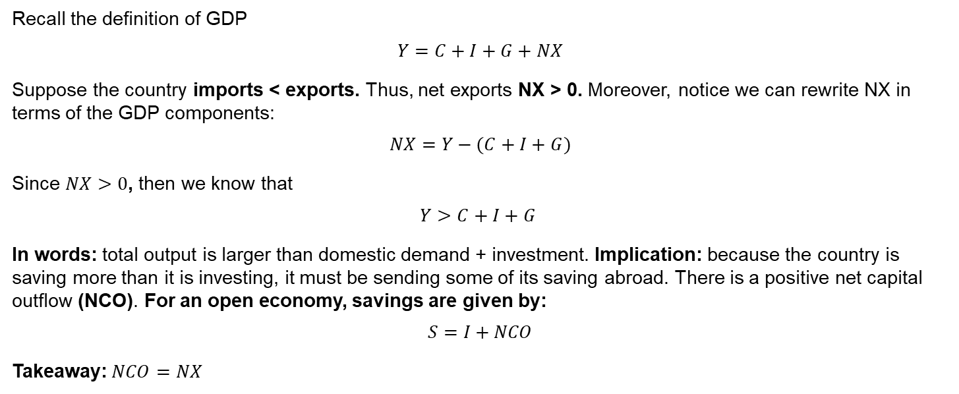
Open-Economy Macroeconomics
Recall the definition of GDP
$$Y=C+I+G+NX$$
Suppose the country imports < exports. Thus, net exports NX > 0. Moreover, notice we can rewrite NX in terms of the GDP components:
$$NX=Y−(C+I+G)$$
Since $NX>0$, then we know that
$$Y>C+I+G$$
In words: total output is larger than domestic demand + investment. Implication: because the country is saving more than it is investing, it must be sending some of its saving abroad. There is a positive net capital outflow (NCO). For an open economy, savings are given by:
$$S=I+NCO$$
Takeaway:$NCO=NX$

Slide 55
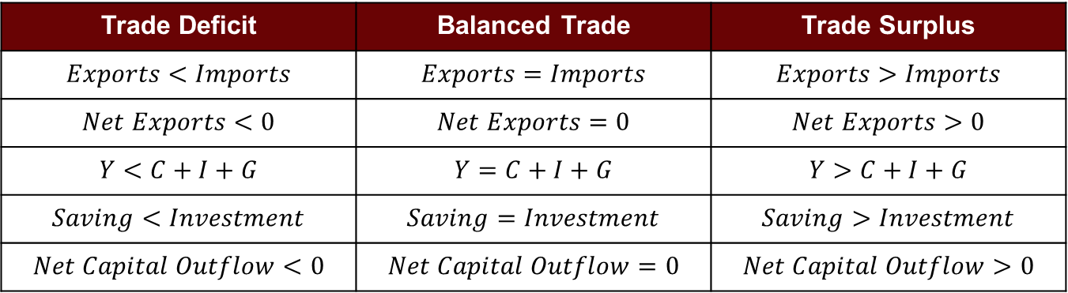
Open-Economy Macroeconomics
International Flows of Goods and Capital: Summary
Trade Deficit | Balanced Trade | Trade Surplus
$$Exports<Imports$$ | $$Exports=Imports$$ | $$Exports>Imports$$
$$Net Exports<0$$ | $$Net Exports=0$$ | $$Net Exports>0$$
$$Y<C+I+G$$ | $$Y=C+I+G$$ | $$Y>C+I+G$$
$$Saving<Investment$$ | $$Saving=Investment$$ | $$Saving>Investment$$
$$Net Capital Outflow<0$$ | $$Net Capital Outflow=0$$ | $$Net Capital Outflow>0$$

Slide 56
Price Dynamics and Inflation

Slide 57
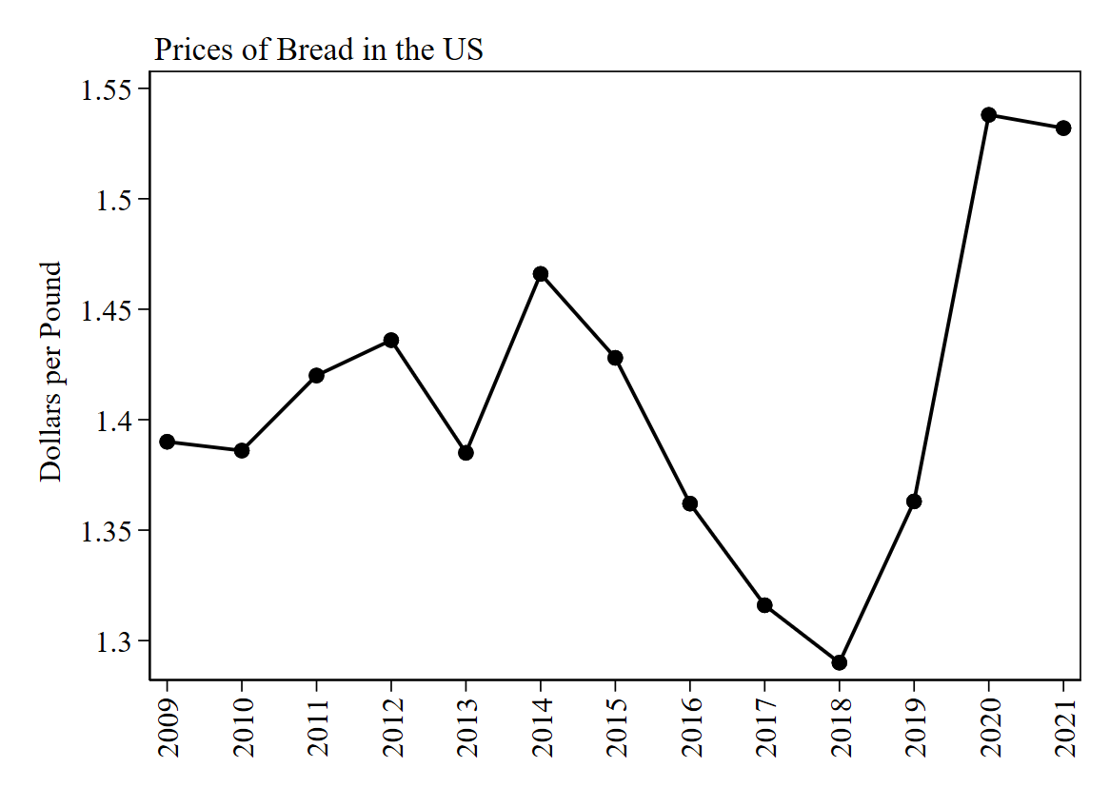
Introduction
We have talked a lot about inflation. Let’s formalize some concepts.
In our microeconomics models we studied markets individually and obtained equilibrium prices for each market.
For instance, the following graph the average price of a pound of bread in the United States.
Using our standard supply and demand model, what could explain an increase in prices observed after 2018?

Slide 58
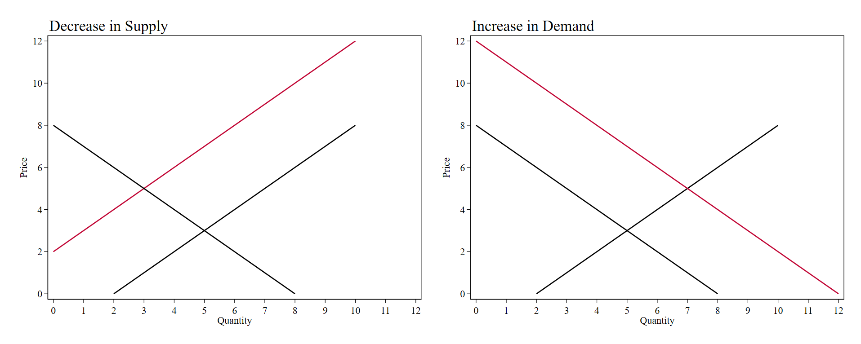








Introduction
Using our standard supply and demand model, what could explain an increase in prices? It could be a contraction in supply, or an increase in demand (or a combination of both).
$$S_{1}$$
$$S_{0}$$
$$S_{0}$$
$$p^{∗}$$
$$p^{∗}$$
$$D_{1}$$
$$D_{0}$$
$$D_{0}$$

Slide 59
Evolution of Prices
Markets are dynamic. Prices are constantly updating to the forces of supply and demand.
Prices reflect the current stance of the market as they measure the relative scarcity of goods and services exchanged. Recall the previous example. Suppose we observe an increase in the price of bread. This could be either by a decrease in supply, an increase in demand, or a combination of both.
Note in both cases, excess demand is created in the short-run.
Excess demand = quantity demanded > quantity supplied at given prices.
Relative scarcity of bread increases.

Slide 60




Introduction
The new equilibrium is point B. While markets transition from equilibrium A to B, there is excess demand, which slowly decreases as we reach the new equilibrium.
$$S_{1}$$
$$S_{0}$$
$$S_{0}$$
$$B$$
$$B$$
$$A$$
$$A$$
$$D_{1}$$
$$D_{0}$$
$$D_{0}$$

Slide 61
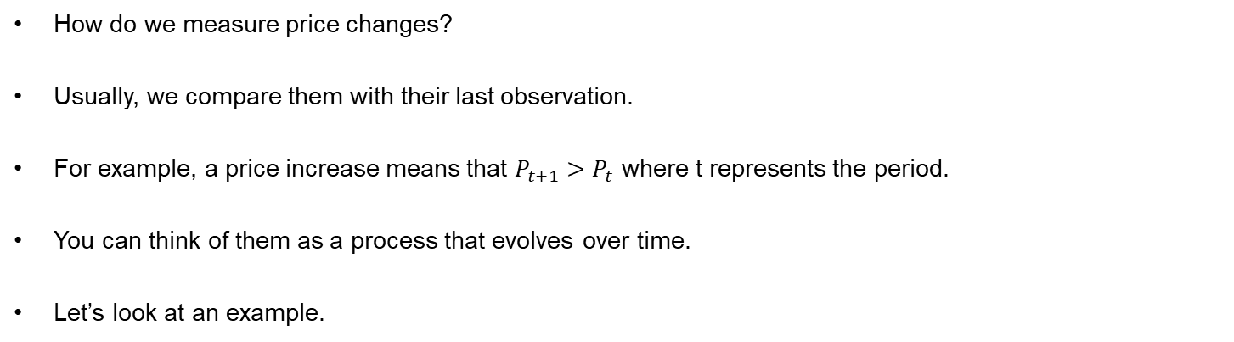
Evolution of Prices
How do we measure price changes?
Usually, we compare them with their last observation.
For example, a price increase means that $P_{t+1}>P_{t}$ where t represents the period.
You can think of them as a process that evolves over time.
Let’s look at an example.

Slide 62
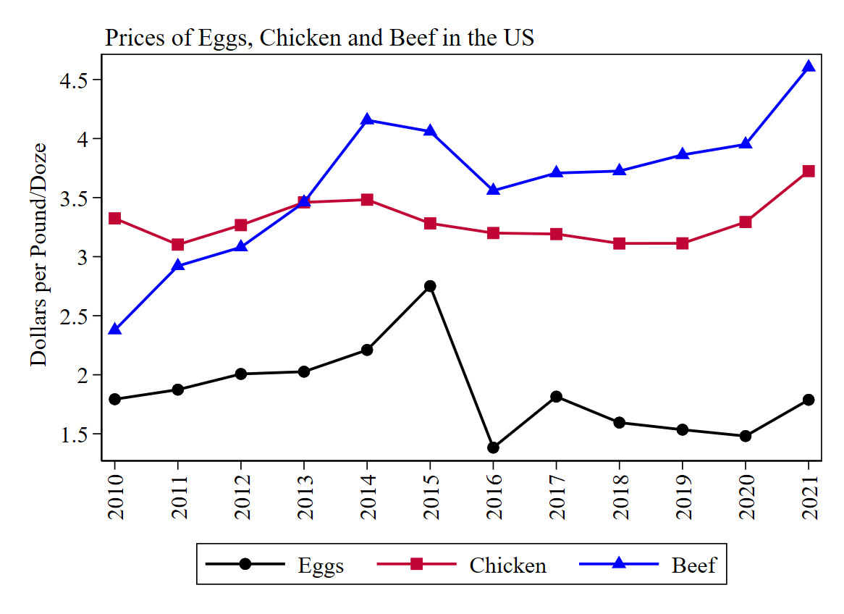
Evolution of Prices
What can we infer from this graph?
Price of chicken has been higher than the price of eggs in the past 10 years.
Price of chicken is relatively stable over time.
In 2014, beef became more expensive than chicken.
In 2015 there was a significant change in the price of eggs.
Does it tell which good observed higher price increases?
Source: FRED

Slide 63
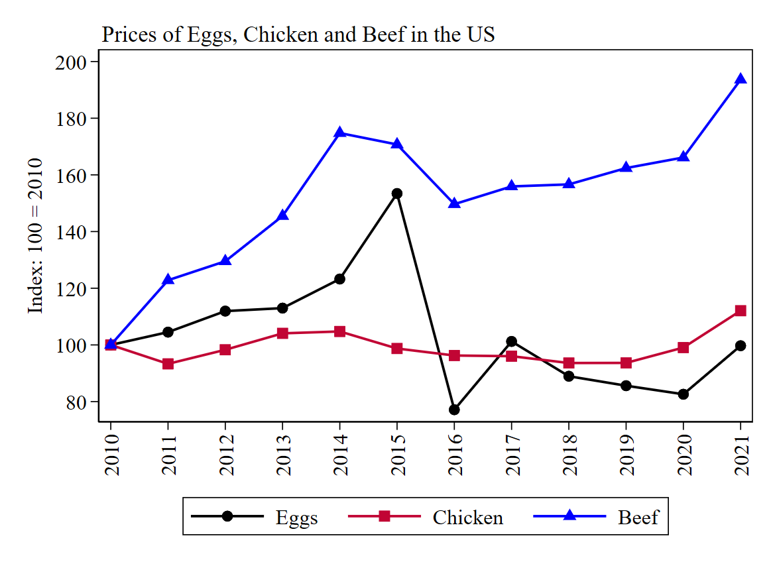
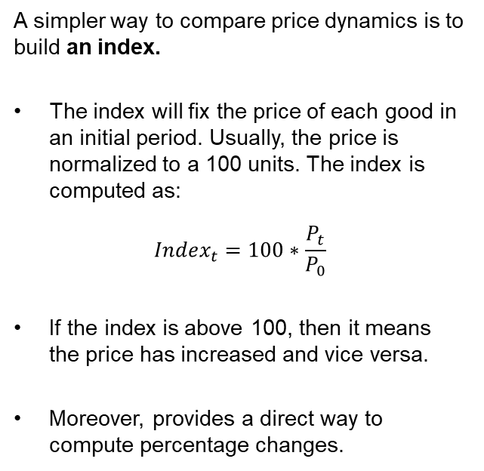
Evolution of Prices: Price Indices
A simpler way to compare price dynamics is to build an index.
The index will fix the price of each good in an initial period. Usually, the price is normalized to a 100 units. The index is computed as:
$$Index_{t}=100∗\frac{P_{t}}{P_{0}}$$
If the index is above 100, then it means the price has increased and vice versa.
Moreover, provides a direct way to compute percentage changes.

Slide 64
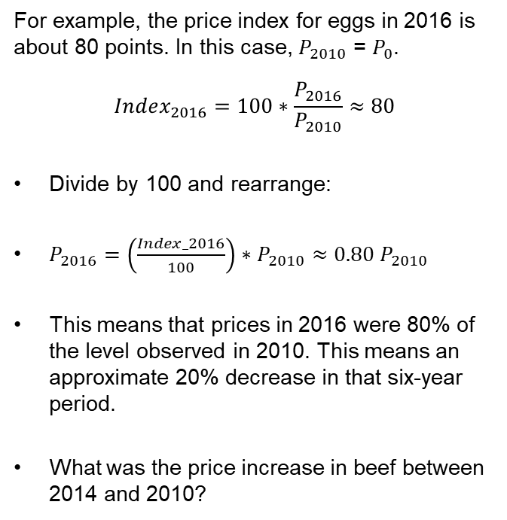
Evolution of Prices: Price Indices
For example, the price index for eggs in 2016 is about 80 points. In this case, $P_{2010}$ = $P_{0}$.
$$Index_{2016}=100∗\frac{P_{2016}}{P_{2010}}≈80$$
Divide by 100 and rearrange:
$P_{2016}=\left(\frac{Index_2016}{100}\right)∗P_{2010}≈0.80 P_{2010}$
This means that prices in 2016 were 80% of the level observed in 2010. This means an approximate 20% decrease in that six-year period.
What was the price increase in beef between 2014 and 2010?
Source: FRED

Slide 65
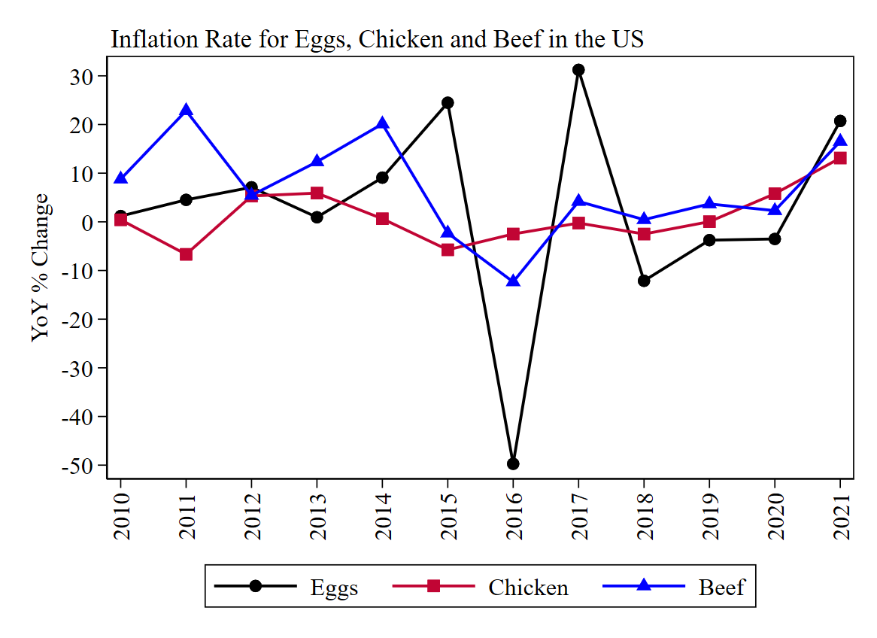
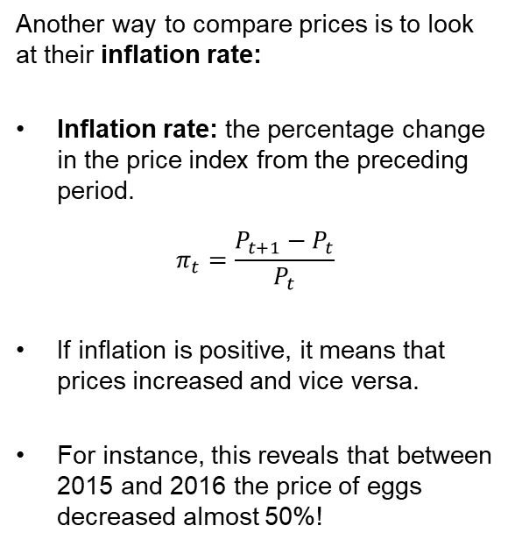
Evolution of Prices: Inflation Rate
Another way to compare prices is to look at their inflation rate:
Inflation rate: the percentage change in the price index from the preceding period.
$$π_{t}=\frac{P_{t+1}−P_{t}}{P_{t}}$$
If inflation is positive, it means that prices increased and vice versa.
For instance, this reveals that between 2015 and 2016 the price of eggs decreased almost 50%!
Source: FRED

Slide 66


Evolution of Prices: Summary
The following table shows the average price of a dozen of eggs in the United States, along with the variables that show the price dynamics.
Year | Price | Index 2010 = 100 | Annual Inflation Rate (%YoY change)
2010 | 1.79 | 100.00
2011 | 1.87 | 104.52 | 4.52%
2012 | 2.01 | 111.94 | 7.10%
2013 | 2.03 | 112.99 | 0.95%
2014 | 2.21 | 123.26 | 9.08%
2015 | 2.75 | 153.43 | 24.48%
2016 | 1.38 | 77.13 | -49.73%
2017 | 1.82 | 101.23 | 31.24%
2018 | 1.60 | 88.96 | -12.12%
2019 | 1.54 | 85.61 | -3.76%
2020 | 1.48 | 82.60 | -3.52%
2021 | 1.79 | 99.72 | 20.73%
Note the Index provides a measure of cumulative change of prices, while the annual inflation rate provides a period-specific measure.
$$Index_{t}=100∗\frac{P_{t}}{P_{0}}$$
$$π_{t}=\frac{P_{t+1}−P_{t}}{P_{t}}$$
Homework: verify these numbers using a spreadsheet.
Source: FRED

Slide 67
More on Prices: the CPI

Slide 68
Evolution of Prices: Consumer Price Index
The previous example showed the price dynamics of 3 goods. However, there are several other goods consumed in the economy. The Consumer Price Index provides a generalization of the previous example.
Consumer Price Index: a measure of the overall cost of the goods and services bought by a typical consumer.
Every month, the Bureau of Labor Statistics (BLS) computes and reports the CPI. Why is this important? The Consumer Price Index is the main variable used to track inflation in the economy. How is it computed?
Fix a basket: list of goods and services typically bought by the average consumer.
Find the prices: for each good or service in the basket, find the market prices across time.
Compute the basket cost: calculate the cost of the basket (holding constant the number of items in the basket) across time.
Choose the base year and compute the index: apply the index formula described previously.

Slide 69
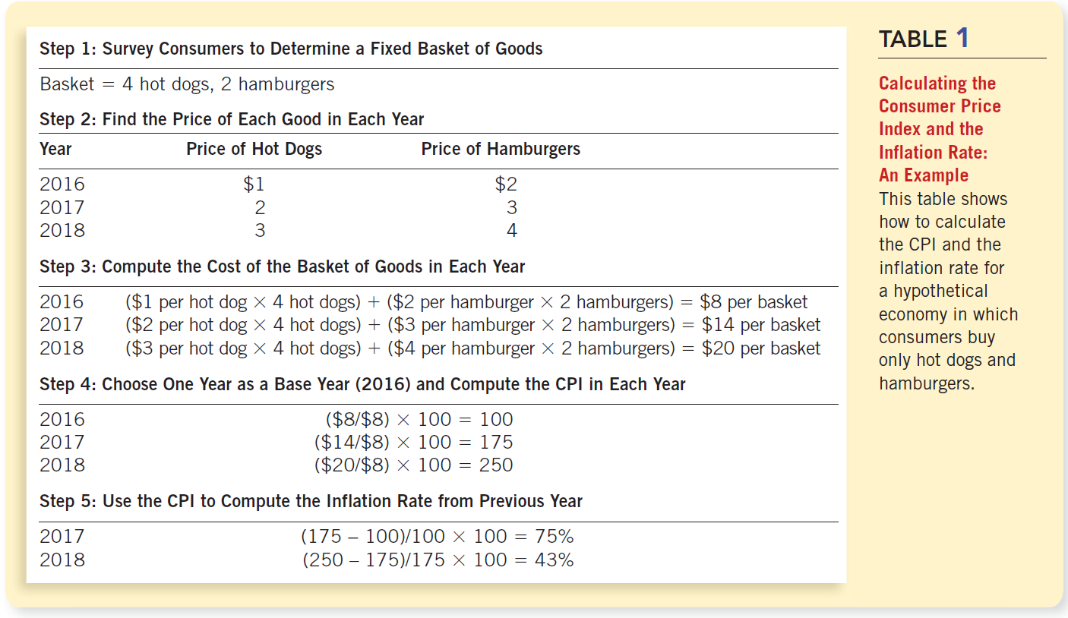
Evolution of Prices: Consumer Price Index
Source: Mankiw Chapter 24

Slide 70
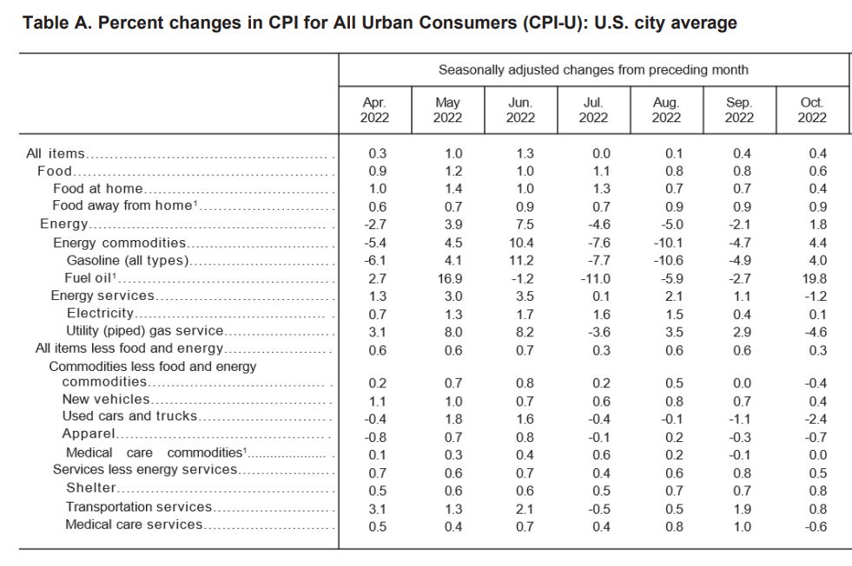
Evolution of Prices: Consumer Price Index
Let’s look at the latest inflation report by the BLS
The basket used by the BLS categorizes goods between food and energy. Why?
Energy prices are more volatile.
Food prices often follow agricultural cycles.
Core CPI: all goods and services excluding food and energy.
The table shows MoM %change.

Slide 71
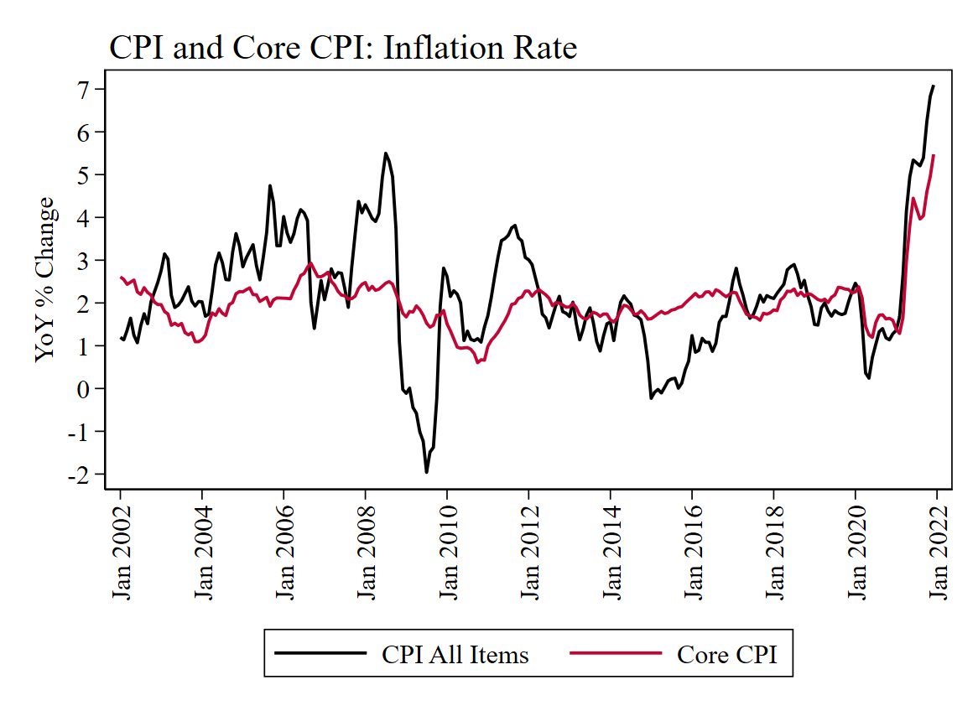
Evolution of Prices: Consumer Price Index
Notice the inflation rate for the Core CPI is more stable over time.
The measurement of the CPI that includes food and energy observes more volatility.
Volatility: larger and more frequent jumps (in statistics, higher standard deviation).
Source: FRED

Slide 72
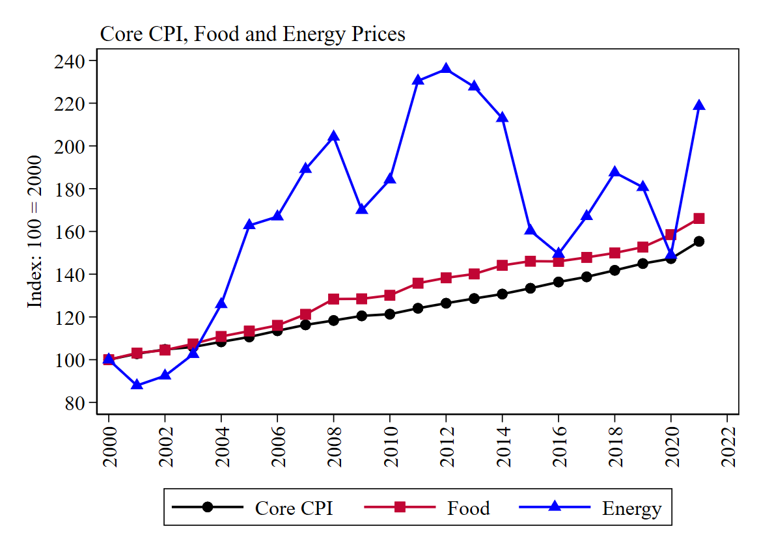
Evolution of Prices: Consumer Price Index
W hen we separate the components of the CPI, it is clear energy prices observe larger jumps.
Food items have also observed higher fluctuations, relative to the components of the core CPI.
Source: FRED

Slide 73
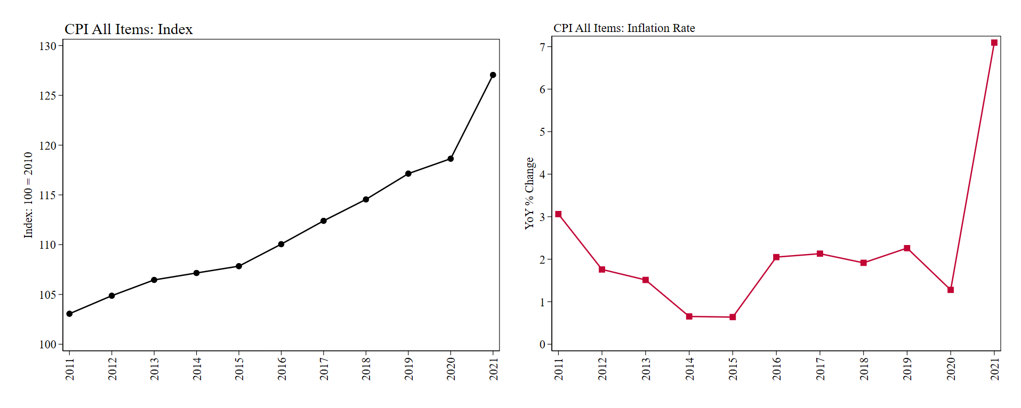
Evolution of Prices: Consumer Price Index
The inflation rate shows the speed at which the CPI evolves over time. When inflation decreases (but is still positive) it means the CPI is growing at a slower rate.
Source: FRED

Slide 74
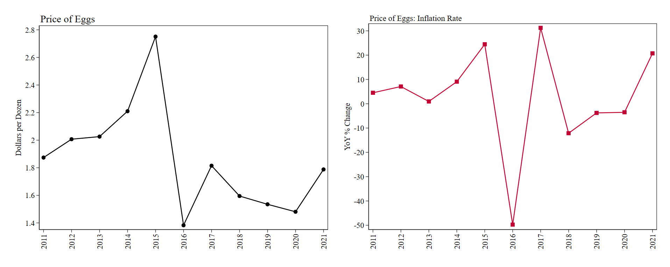
Evolution of Prices: Inflationary Shock
Notice that an inflation shock leaves a long-lasting effect on prices. In 2016 there was a huge contraction in the price of eggs. The inflation rate was -50%, but then reverted to the trend. Yet, prices remained lower.
Source: FRED

Slide 75
Nominal and Real Variables

Slide 76
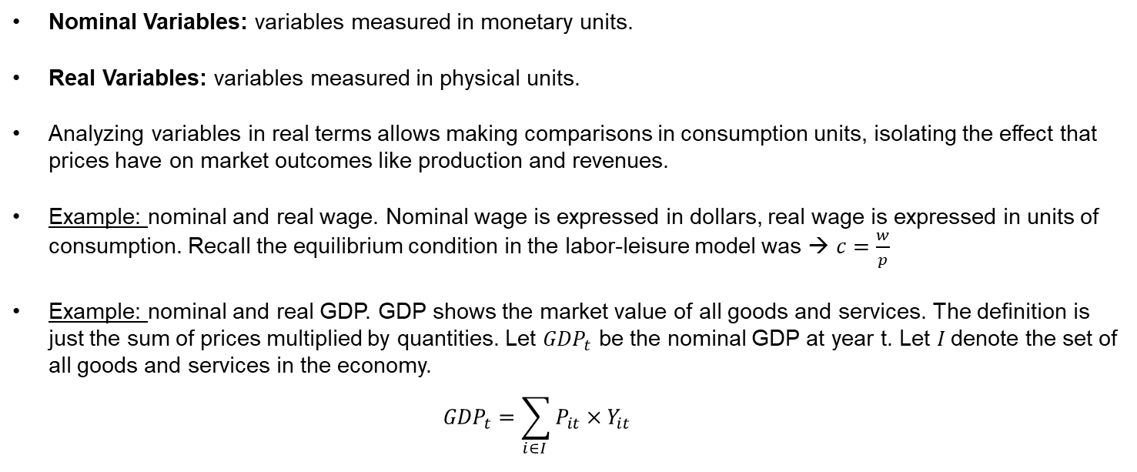
Nominal and Real Variables
Nominal Variables: variables measured in monetary units.
Real Variables: variables measured in physical units.
Analyzing variables in real terms allows making comparisons in consumption units, isolating the effect that prices have on market outcomes like production and revenues.
Example: nominal and real wage. Nominal wage is expressed in dollars, real wage is expressed in units of consumption. Recall the equilibrium condition in the labor-leisure model was → $c=\frac{w}{p}$
Example: nominal and real GDP. GDP shows the market value of all goods and services. The definition is just the sum of prices multiplied by quantities. Let ${GDP}_{t}$ be the nominal GDP at year t. Let $I$denote the set of all goods and services in the economy.
$${GDP}_{t}=\sum_{i∈I }{P_{it}×Y_{it}}$$

Slide 77
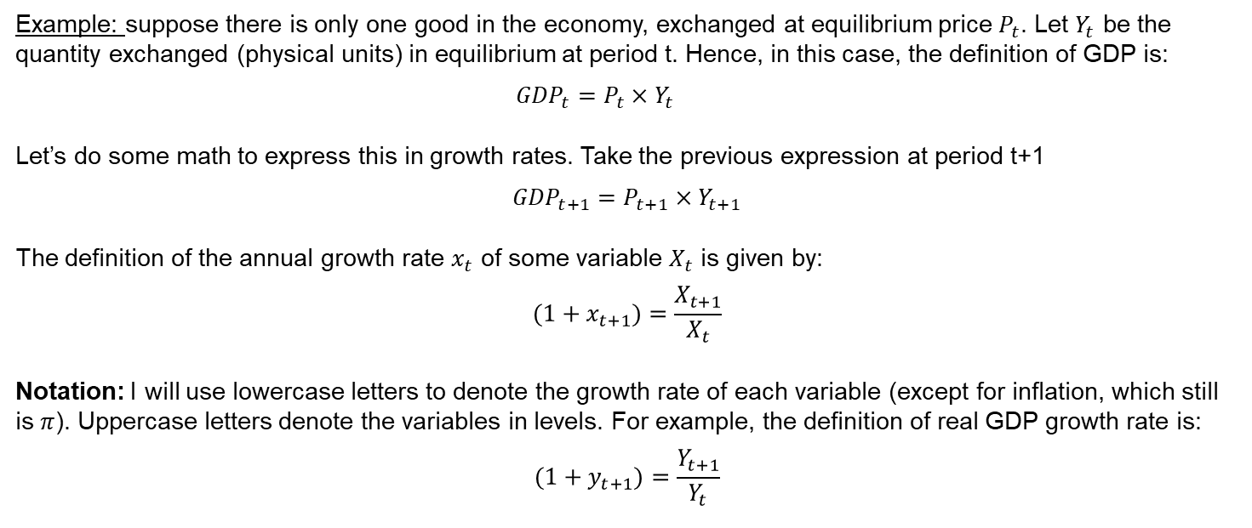
Nominal and Real GDP
Example: suppose there is only one good in the economy, exchanged at equilibrium price $P_{t}$. Let $Y_{t}$ be the quantity exchanged (physical units) in equilibrium at period t. Hence, in this case, the definition of GDP is:
$${GDP}_{t}=P_{t}×Y_{t}$$
Let’s do some math to express this in growth rates. Take the previous expression at period t+1
$${GDP}_{t+1}=P_{t+1}×Y_{t+1}$$
The definition of the annual growth rate $x_{t}$ of some variable $X_{t}$ is given by:
$$(1+x_{t+1})=\frac{X_{t+1}}{X_{t}}$$
Notation: I will use lowercase letters to denote the growth rate of each variable (except for inflation, which still is $π$). Uppercase letters denote the variables in levels. For example, the definition of real GDP growth rate is:
$$(1+y_{t+1})=\frac{Y_{t+1}}{Y_{t}}$$

Slide 78

Nominal and Real GDP
If we divide Equation 2 by Equation 1:
$$\frac{{GDP}_{t+1}}{{GDP}_{t}}=\frac{P_{t+1}}{P_{t}}×\frac{Y_{t+1}}{Y_{t}}$$
Using the definition of the annual growth rate we can rewrite the previous expression as:
$$(1+gdp_{t+1})=\left(1+π_{t+1}\right)×(1+y_{t+1})$$
Where $y_{t}$ is the real GDP growth rate. From this equation we get a formula for the real GDP growth rate as a function of the nominal growth rate and the inflation rate.
$$(1+y_{t})=\frac{(1+gdp_{t})}{(1+π_{t})}$$
Using the same trick as before we can approximate this as the difference between the nominal growth rate and the inflation rate.
$$y_{t}≈gdp_{t}−π_{t}$$

Slide 79


Nominal and Real GDP
Some takeaways from this expression:
$$(1+gdp_{t+1})=\left(1+π_{t+1}\right)×(1+y_{t+1})$$
Nominal economic growth could be driven by increases in real output (i.e. more apples are being produced) or increases in prices (i.e. higher apple prices). High nominal growth rates do not imply more real output.
For example, suppose the economy is producing 10 apples in both periods $t$ and $t+1$. Prices are $p_{t}=10$ and $p_{t+1}=11.$ So, the inflation rate is 10%. Since $Y_{t}=Y_{t+1}=10$. Then $y_{t+1}=0$, and
$$(1+gdp_{t+1})=\left(1+π_{t+1}\right)$$
Concept | Variable | t | t+1 | Growth rate
Prices | $$P$$ | $$P_{t}=10$$ | $$P_{t+1}=11$$ | $$p_{t+1}=\frac{11}{10}−1=10\%$$
Quantity | $$Y$$ | $$Y_{t}=10$$ | $$Y_{t+1}=10$$ | $$y_{t+1}=\frac{10}{10}−1=0\%$$
GDP | $$GDP=P×Y$$ | $${GDP}_{t}=100$$ | $${GDP}_{t+1}=110$$ | $${gdp}_{t+1}=\frac{110}{100}−1=10\%$$

Slide 80

Expressing Variables in Real Terms
Suppose you have nominal GDP data. How can you express this in real terms (constant dollars)?
First, recall the intuition behind the CPI: an index that keeps the basket of goods constant over time. Hence, all the observed variation in the CPI stems from changes in prices. In practice, $P_{t}=CPI_{t}$and the definition of the inflation rate is:
$$(1+π_{t+1})=\frac{CPI_{t+1}}{CPI_{t}}$$
Let’s define nominal GDP using the notation from the quantity theory of money:
$$GDP_{t}=P_{t}×Y_{t}$$
Rearranging this expression, we get real GDP (i.e. expressed in consumption units) as:
$$Y_{t}=\frac{GDP_{t}}{P_{t}}$$

Slide 81

Expressing Variables in Real Terms
Suppose you have nominal GDP data. How can you express this in real terms (constant dollars)?
Choose the base year: let the base year be 2012. Hence, $Y_{t}$ will be expressed in consumption units valued in 2012. That is why we say it is in “chained dollars”. The value of dollars is fixed at the prices observed in 2012.
Build the price index using the base year:
$Index_{t}=\frac{CPI_{t}}{CPI_{base}}$= $\frac{CPI_{t}}{CPI_{2012}}$
Express the variables in real terms using the index you built and the nominal variables. Note the implicit definition of GDP in this case is:
$$GDP_{t}={CPI}_{t}×Y_{t}$$

Slide 82

Expressing Variables in Real Terms
Express the variables in real terms using the index you built and the nominal variables.
Write the inverse of the Index.
$$\frac{1}{Index_{t}}=\frac{CPI_{base}}{CPI_{t}}$$
Multiply it by the definition of nominal GDP (or any variable you want to express in chained dollars):
$$\frac{1}{Index_{t}}×GDP_{t}={\frac{CPI_{base}}{CPI_{t}}×CPI}_{t}×Y_{t}$$
CPI terms cancel each other
$$\frac{1}{Index_{t}}×GDP_{t}={CPI}_{base}×Y_{t}$$
$Y_{t}$ is expressed in physical units, hence ${(CPI}_{base}×Y_{t}$) measures the market value of units produced in year t in terms of the value of money observed in the base year.

Slide 83
Expressing Variables in Real Terms
Example: Nominal and Real GDP
Year | CPI | Nominal GDP ($ Billions) | CPI (Index Base 2012) | Real GDP ($ Billions, Chained 2012)
2010 | 218 | 15,049 | 0.95 | 15,843
2011 | 225 | 15,600 | 0.98 | 15,923
2012 | 230 | 16,254 | 1.00 | 16,254
2013 | 233 | 16,843 | 1.01 | 16,600
2014 | 237 | 17,551 | 1.03 | 17,022
2015 | 237 | 18,206 | 1.03 | 17,636
2016 | 240 | 18,695 | 1.05 | 17,884
2017 | 245 | 19,477 | 1.07 | 18,243
2018 | 251 | 20,533 | 1.09 | 18,774
2019 | 256 | 21,381 | 1.11 | 19,201
2020 | 259 | 21,060 | 1.13 | 18,680
Source: FRED

Slide 84

Nominal and Real GDP for the United States
Source: FRED

Slide 85
Expressing Variables in Real Terms
Why should we care about making comparisons in real terms? Value of money is not constant across time. Money is worth whatever you can buy with it.
Example: budgetary allocations. Suppose you observe the following data on the budgetary allocations made to some welfare program.
A congressman suggests that the program should always receive an annual increase of 1%. Is this good?
No! Inflation is higher. This means that the real size of this program is decreasing over time.
Year | CPI | Assigned Budget ($ dollars) | CPI (Base 2012) | Real Budget ($ dollars, constant 2012)
2012 | 230 | 10,000 | 1.00 | 10,000
2013 | 233 | 10,100 | 1.01 | 9,954
2014 | 237 | 10,201 | 1.03 | 9,894
2015 | 237 | 10,303 | 1.03 | 9,981
2016 | 240 | 10,406 | 1.05 | 9,954
2017 | 245 | 10,510 | 1.07 | 9,844
2018 | 251 | 10,615 | 1.09 | 9,706
2019 | 256 | 10,721 | 1.11 | 9,628
2020 | 259 | 10,829 | 1.13 | 9,605
The proposal is slowly shrinking the program, despite including a provision for annual increases.

Slide 86
Inflation and the interest rate
The inflation rate captures the price of most goods and services in the economy. However, not all of them. We have discussed some of the ones not included when we looked at the difference between a real and a nominal variable.
Example: real wage. The number of consumption units you can buy given the observed prices and your current wage.
If the price of consumption increases, but wages remain constant, then you can purchase fewer units of consumption. There is a decrease in the real wage.
Example: real interest rate. The number of consumption units you can move across time, given the observed prices in the market.
If the price of consumption increases, then the money you saved today can buy less tomorrow.
Recall the mortgage example covered in the video.

Slide 87

Real Interest Rate
Example: suppose you can lend/invest $1000 in a bond that pays a nominal interest rate of 15% in a year. We normalize the price of one consumption unit to $1 (i.e. we use an index). The expected inflation rate is equal to 10%.
With those $1000, today you can buy up to 1000 units of consumption. If you decide to not invest and store the money under your mattress, how many consumption units you can buy in a year?
In a year, the price of one consumption unit will be $1.1. Hence, you can only buy $1000/$1.1 $≈$909 units.
If you decide to invest, then you receive $1000 + $150 in one year. Hence, you have $1150 and can buy $1150/$1.1 $≈$1045 units. Since you can buy +45 units it means the real return (interest rate) is positive.
 | Nominal | Real
Return | $1150 | 1045 units
Interest Rate (Return) | 15% | 4.5%

Slide 88

Real Interest Rate
In general, the formula to express a variable in real terms stems from Fisher’s equation.
Let $i$ be the nominal interest rate. Denote $r$ the real interest rate and $π$ the inflation rate.
$$1+r_{t}=\frac{1+i_{t}}{1+π_{t}}$$
When $i$ and $π$ are relatively small, then we can approximate the previous expression as:
$$r_{t}=i_{t}−π_{t}$$
It is now clear the negative effect that inflation has on the real interest rate.
If consumption becomes more expensive, then number of consumption units you can buy with the money you moved across time decreased.

Slide 89

Real Interest Rate
Source: Mankiw Chapter 24

Slide 90
Real Variables and Indexation
Expressing variables in real terms allows to control for the effects of price changes and allows to contrast to which extent the number of consumption units you can purchase changed over time.
In practice, we observe several examples of indexation: automatic correction by law or contract of a dollar amount for the effects of inflation.
Wages
Lease agreements
Social security benefits
Brackets of the federal income tax.

Slide 91
For Next Class
Next class: review questions and wrap up.
Readings: review all chapters at Canvas.

Slide 92
SPEA-V-202
Contemporary Economic Issues in Public Affairs
Macroeconomic and Monetary Policy
Luis Navarro

